Slide 1





The course notes are partly based on the Machine learning course presented by Andrew Ng at Stanford University and the original can be found at https://www.coursera.org/course/ml b
e.
All materials without annotations or marks are copyrighted by their copyright owner.
All the codes and modified slides are available at Github & OSChina
The project homepage:
https://github.com/sunzuolei/ml
https://git.oschina.net/samuel/ml
The Git repository:
https://github.com/sunzuolei/ml.git
https://git.oschina.net/samuel/ml.git

Slide 2

The problem of overfitting
Regularization
Machine Learning

Slide 3
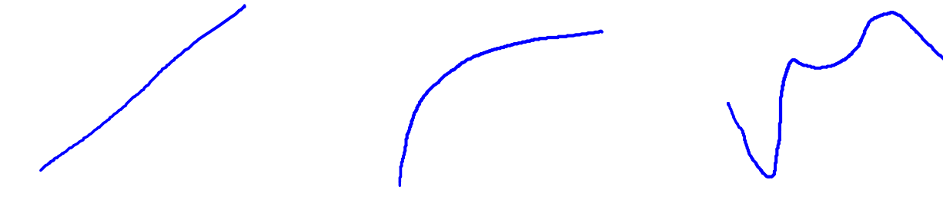
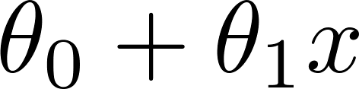
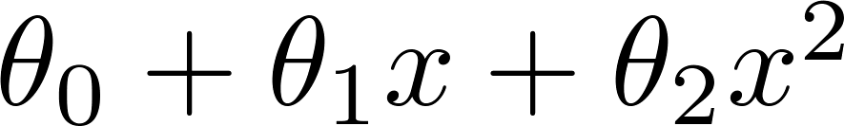
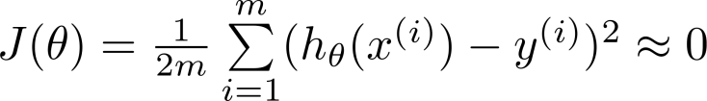
Example: Linear regression (housing prices)
Price
Price
Price
Size
Size
Size
Under fit
JUST RIGHT
Over fit
High bias
High variance
Overfitting: If we have too many features, the learned hypothesis may fit the training set very well ( ), but fail to generalize to new examples (predict prices on new examples).

Slide 4
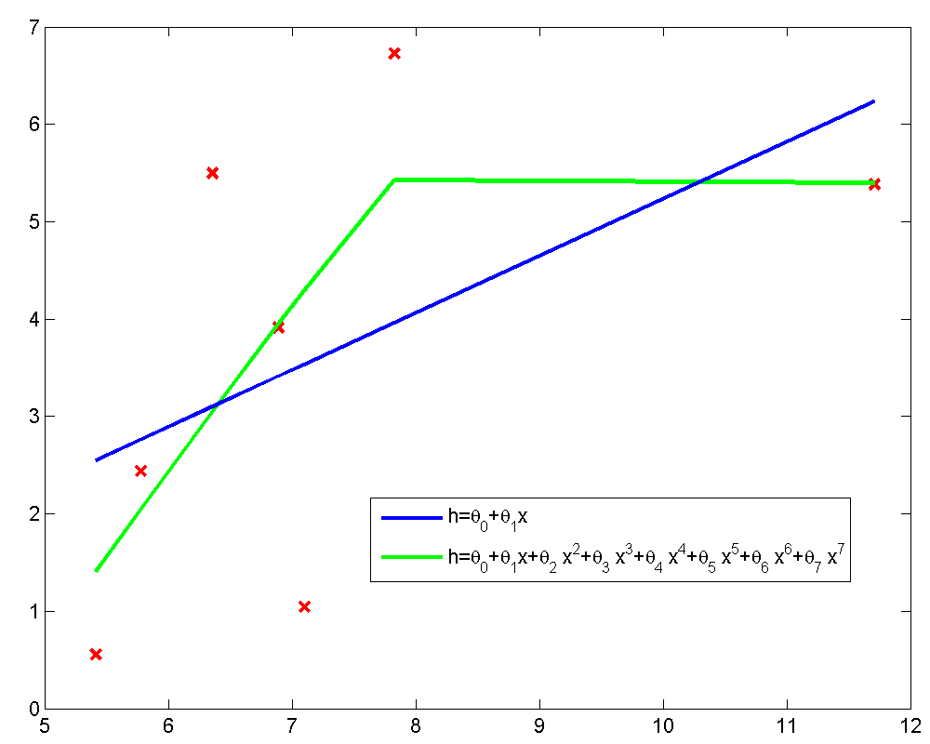
P23

Slide 5
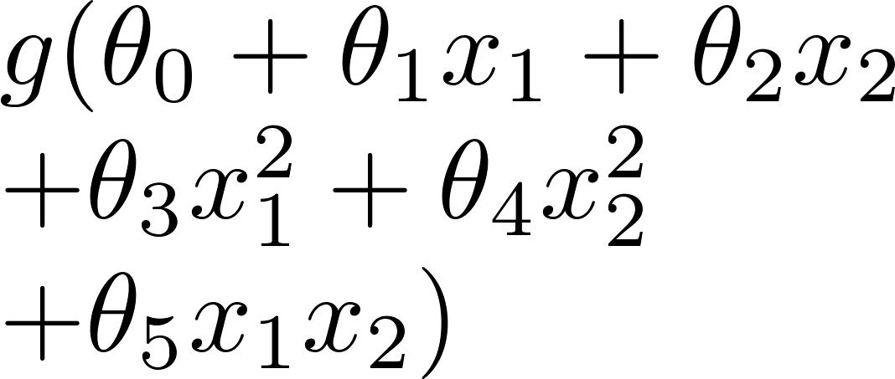
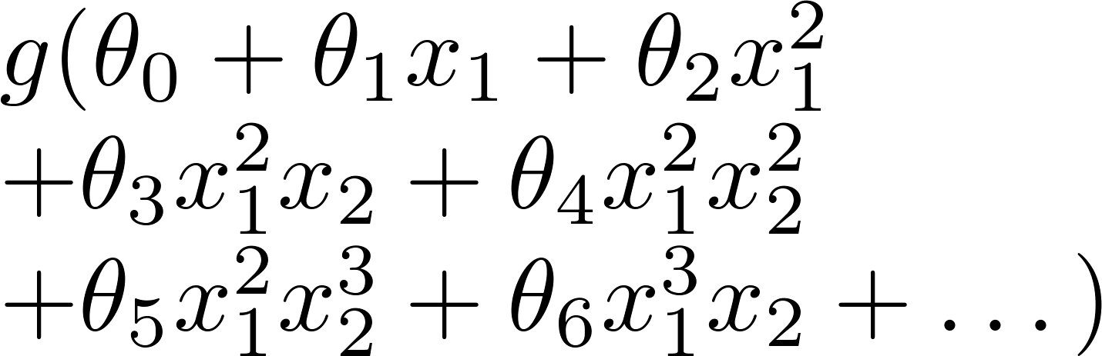
Example: Logistic regression
x₂
x₂
x₂
x₁
x₁
x₁
( = sigmoid function)

Slide 6






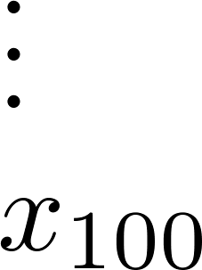
Addressing overfitting:
size of house
no. of bedrooms
Price
no. of floors
age of house
average income in neighborhood
Size
kitchen size
Too many features, but too less training examples

Slide 7


Addressing overfitting:
Options:
Reduce number of features.
Manually select which features to keep.
Model selection algorithm (later in course).
Regularization.
Keep all the features, but reduce magnitude/values of parameters .
Works well when we have a lot of features, each of which contributes a bit to predicting .

Slide 8
Cost function
Regularization
Machine Learning

Slide 9



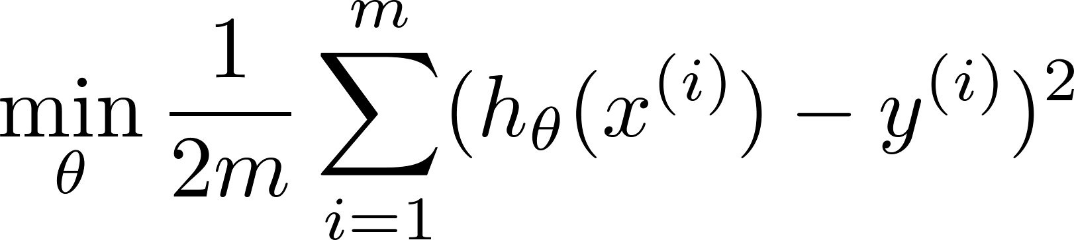
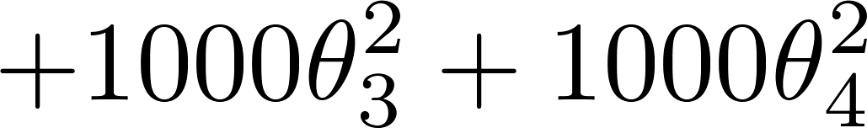
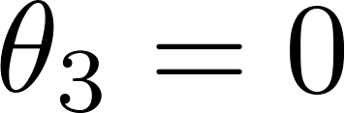
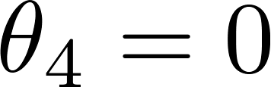
Intuition
Price
Price
Size of house
Size of house
Suppose we penalize and make , really small.

Slide 10
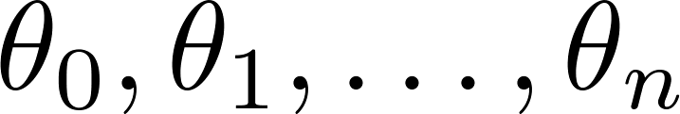
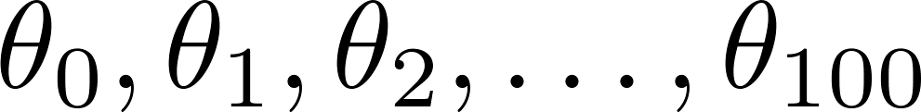
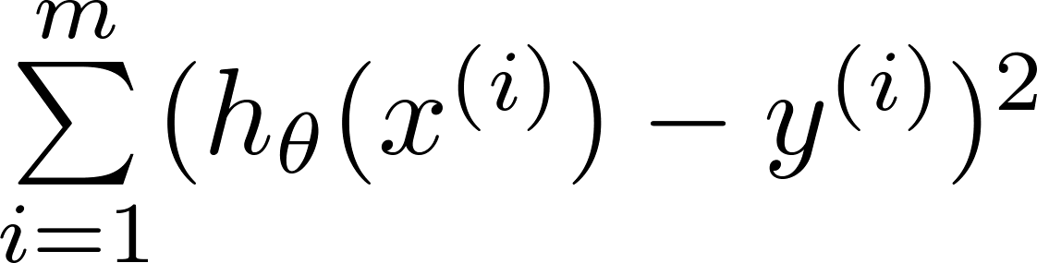
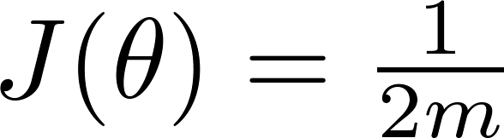
Regularization.
Small values for parameters
“Simpler” hypothesis
Less prone to overfitting
Housing:
Features:
Parameters:

Slide 11
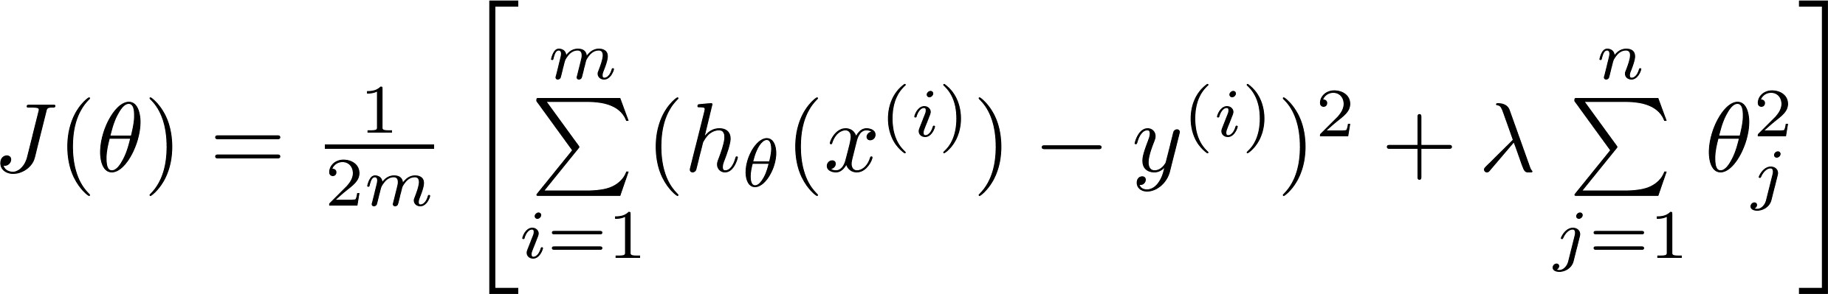
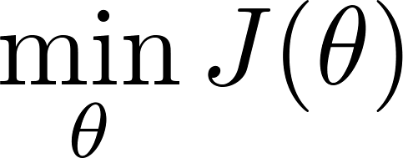
Regularization.
Regularization parameter
Price
Size of house

Slide 12


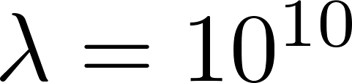
In regularized linear regression, we choose to minimize
What if is set to an extremely large value (perhaps for too large for our problem, say )?
Price
Size of house

Slide 13
In regularized linear regression, we choose to minimize
What if is set to an extremely large value (perhaps for too large for our problem, say )?
Algorithm works fine; setting to be very large can’t hurt it
Algorithm fails to eliminate overfitting.
Algorithm results in underfitting. (Fails to fit even training data well).
Gradient descent will fail to converge.

Slide 14
Regularized linear regression
Regularization
Machine Learning

Slide 15
Regularized linear regression
function J = computeCostReg(X, y, Theta, lambda)
m = length(y);
J = ((X * Theta - y)' * (X * Theta - y) + ...
lambda * (Theta' * Theta) ) / (2 * m);

Slide 16

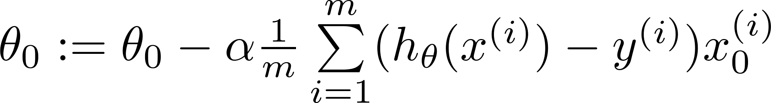
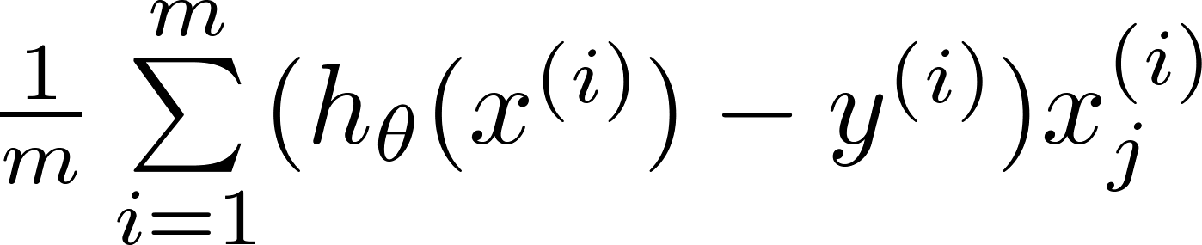
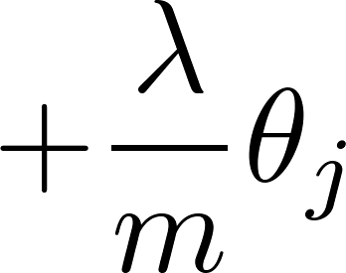
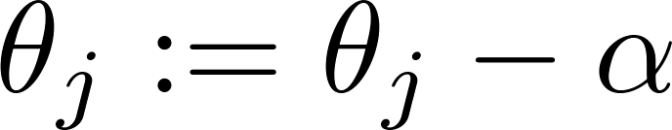


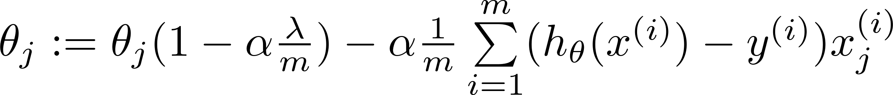

Gradient descent
Repeat
(
)

Slide 17
thetaSeq(1, i) = thetaSeq(1, i-1) - alpha / m * (X(:, 1)' * (X * thetaSeq(:, i-1) - y));
(
)
thetaSeq(2:end, i) = thetaSeq(2:end, i-1) * (1 - alpha * lambda / m) -alpha / m * (X(:, 2:end)' * (X * thetaSeq(:, i-1) - y));

Slide 18
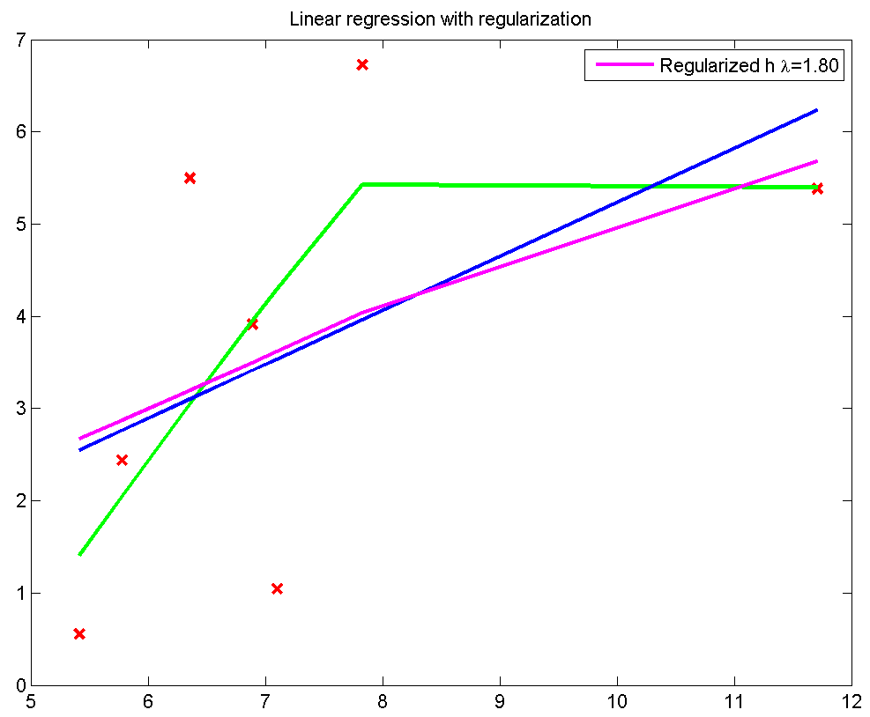
P23

Slide 19
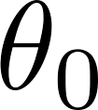
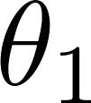
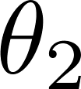
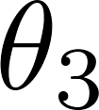
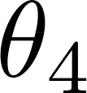
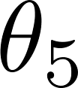
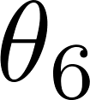
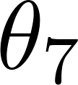
 | Over Fitting | Regularized
 | 3.65280 | 3.65280
 | 2.78289 | 0.68800
 | 1.53874 | 0.42981
 | 0.54920 | 0.21871
 | -0.21487 | 0.05621
 | -0.79653 | -0.06382
 | -1.23695 | -0.15009
 | -1.56965 | -0.21101
P23

Slide 20
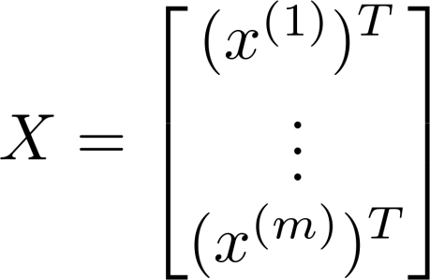
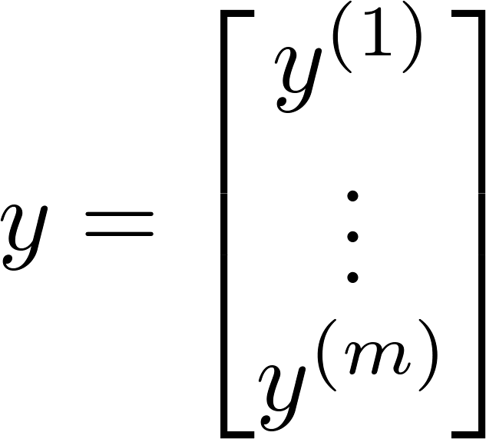
Normal equation

Slide 21
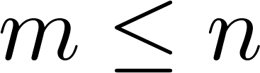
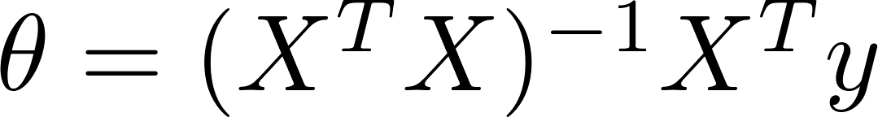

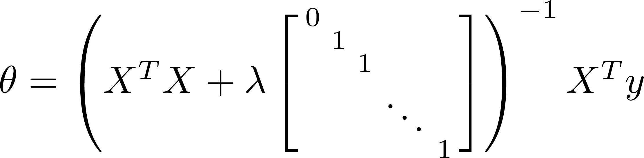
Non-invertibility (optional/advanced).
Suppose ,
(#examples) (#features)
If ,

Slide 22
Regularized logistic regression
Regularization
Machine Learning

Slide 23
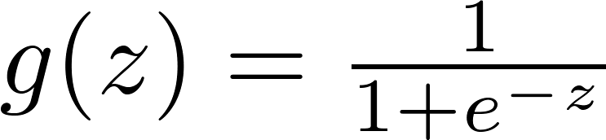
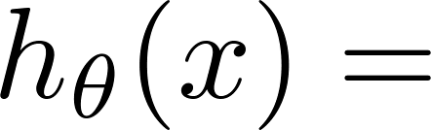
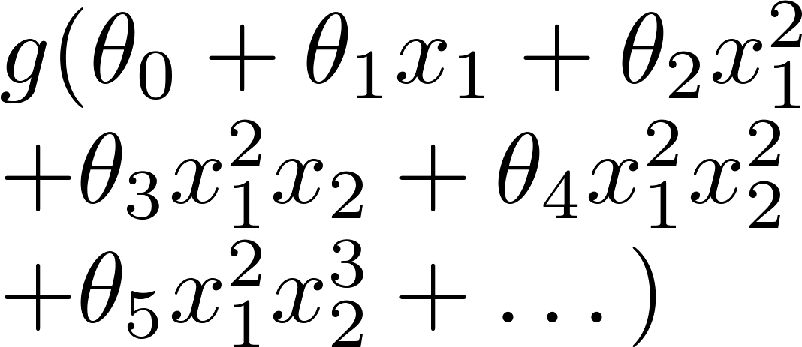
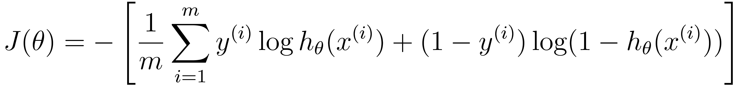
Regularized logistic regression.
x₂
x₁
Cost function:

Slide 24
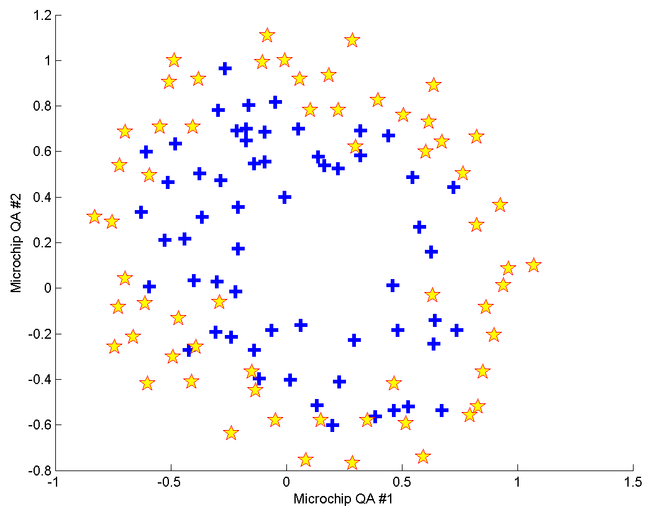

P14

Slide 25
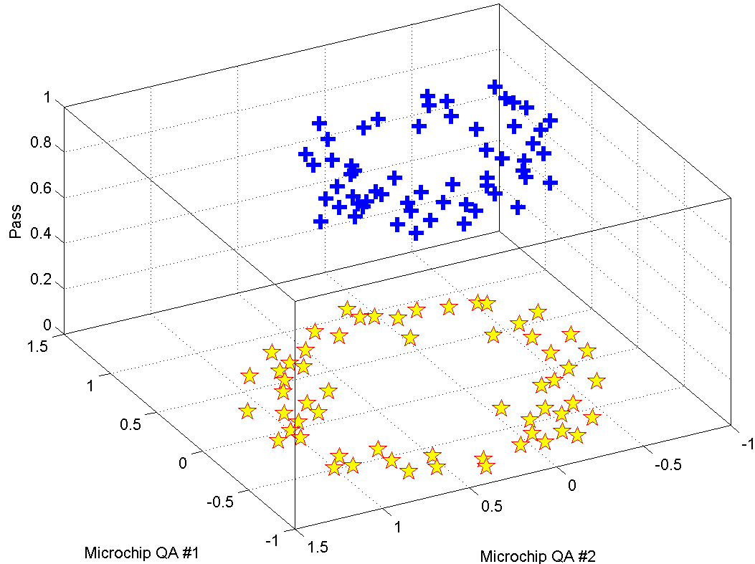
P14

Slide 26
==== i=1 ===
x1
x2
==== i=2 ===
2
x1
x1 x2
2
x2
==== i=3 ===
3
x1
2
x1 x2
2
x1 x2
3
x2
==== i=4 ===
4
x1
3
x1 x2
2 2
x1 x2
3
x1 x2
4
x2
==== i=5 ===
5
x1
4
x1 x2
3 2
x1 x2
2 3
x1 x2
4
x1 x2
5
x2
==== i=6 ===
6
x1
5
x1 x2
4 2
x1 x2
3 3
x1 x2
2 4
x1 x2
5
x1 x2
6
x2
P24
Re-generate the features

Slide 27

==== i=1 ===
x1
x2
==== i=2 ===
2
x1
x1 x2
2
x2
==== i=3 ===
3
x1
2
x1 x2
2
x1 x2
3
x2
==== i=4 ===
4
x1
3
x1 x2
2 2
x1 x2
3
x1 x2
4
x2
==== i=5 ===
5
x1
4
x1 x2
3 2
x1 x2
2 3
x1 x2
4
x1 x2
5
x2
==== i=6 ===
6
x1
5
x1 x2
4 2
x1 x2
3 3
x1 x2
2 4
x1 x2
5
x1 x2
6
x2
2
3
4
1
5
6
7
How to calculate the number of \theta?

Slide 28
==== i=1 ===
x1
x2
==== i=2 ===
2
x1
x1 x2
2
x2
==== i=3 ===
3
x1
2
x1 x2
2
x1 x2
3
x2
==== i=4 ===
4
x1
3
x1 x2
2 2
x1 x2
3
x1 x2
4
x2
==== i=5 ===
5
x1
4
x1 x2
3 2
x1 x2
2 3
x1 x2
4
x1 x2
5
x2
==== i=6 ===
6
x1
5
x1 x2
4 2
x1 x2
3 3
x1 x2
2 4
x1 x2
5
x1 x2
6
x2
2
3
4
1
5
6
7
numFeat=sum(1:(degree + 1));
numSamp=length(x1);
feats =ones(numSamp, numFeat);
%%
c = 2;
for i = 1 : degree
for j = 0 : i
feats(:, c) = ( x1.^(i-j) ) .* ( x2.^j );
c = c + 1;
end
end

Slide 29

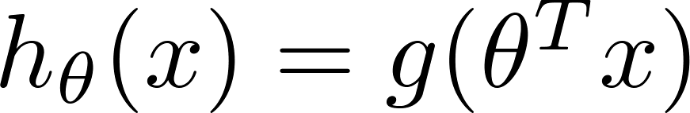

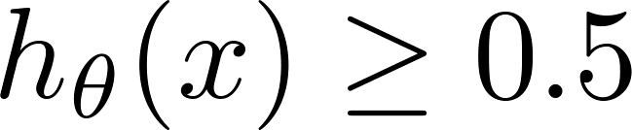

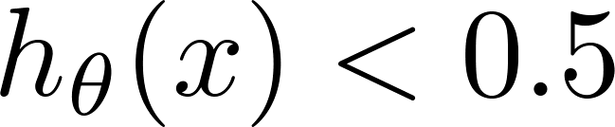
Logistic regression
1
z
Suppose predict “ “ if
predict “ “ if

Slide 30
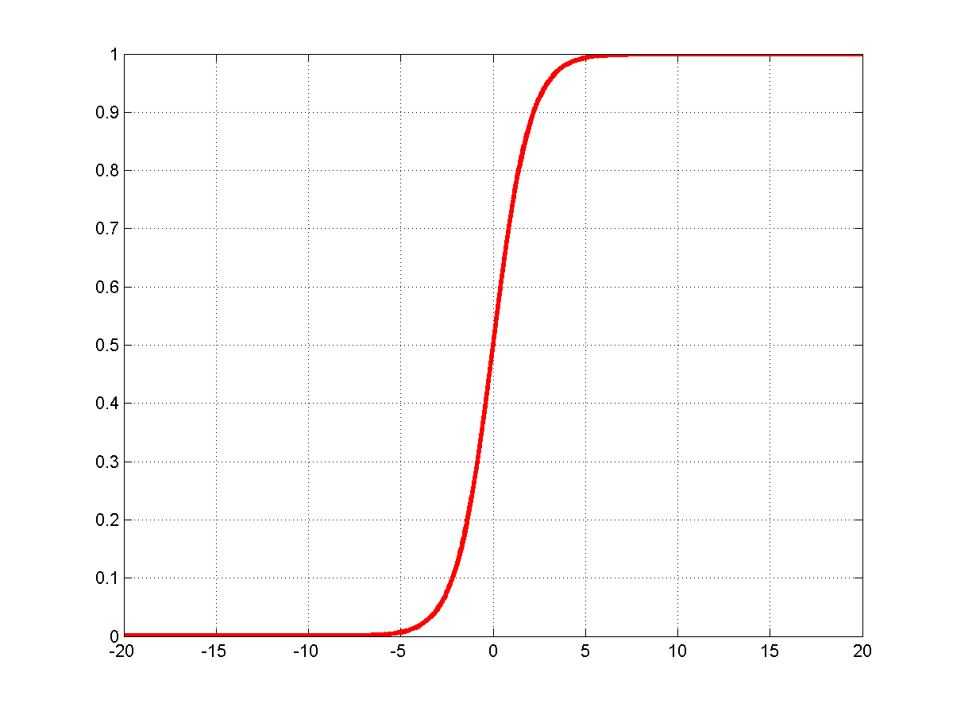
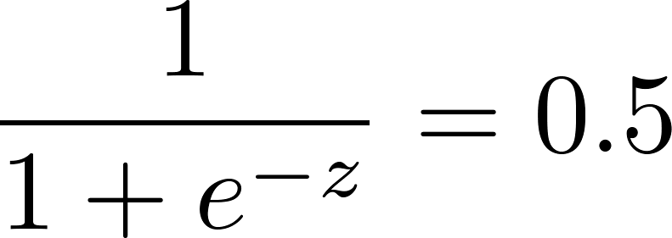


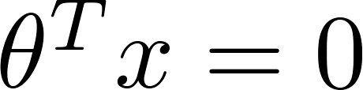
How to plot the decision boundary?
1
0.5
Contour

Slide 31

P25
Vectorized

Slide 32


Slide 33


Slide 34
P26
Classify the QA status without regularization

Slide 35

P26
Over fitting!

Slide 36
Gradient descent
Repeat

Slide 37








Advanced optimization
function [jVal, gradient] = costFunction(theta)
code to compute
jVal = [ ];
code to compute
gradient(1) = [ ];
code to compute
gradient(2) = [ ];
+
code to compute
gradient(3) = [ ];
+
code to compute
gradient(n+1) = [ ];

Slide 38
P27
Classify the QA status with regularization

Slide 39

P27

Slide 40

P27
Under fitting!

Slide 41



3.02391
-1.25490
1.71460
-15.03121
-9.61134
3.00983
0.72627
20.45605
35.51947
6.12234
57.43873
17.80647
12.94114
-0.85655
-26.12140
18.30078
-10.36969
-22.54489
-22.80018
-22.53768
12.19995
-93.55721
-52.53922
-20.24529
35.39649
-90.70366
-52.48432
-6.12112
1.02504
0.44349
0.91210
-1.61164
-0.65410
-1.04934
0.07086
-0.26973
-0.27969
-0.16170
-1.18495
-0.04713
-0.49600
-0.18714
-0.97436
-0.21339
-0.17119
-0.05241
-0.21895
-0.21948
-0.41277
-0.86313
0.01708
-0.24966
0.01006
-0.26689
-0.09026
-0.78549
0.03824
-0.13920
0.06450
-0.30357
-0.03183
-0.18522
-0.07943
0.00455
-0.00235
-0.10519
-0.22633
0.03980
-0.03246
0.03345
-0.21326
-0.08762
0.02558
0.03229
0.01551
0.02413
-0.16229
-0.16665
0.04783
0.01216
0.05248
0.00578
0.04562
-0.22062
86.44%
83.05%
61.86%
Over
fitting
Just
Right
Under
fitting

Slide 42
Recognize
handwritten
digits
P31
It is a subset of the MNIST handwritten digit dataset (http://yann.lecun.com/exdb/mnist/)
Yann LeCun,
Courant Institute, NYU
Corinna Cortes,
Google Labs, New York
Christopher J.C. Burges,
Microsoft Research, Redmond

Slide 43


Without regularization
Elapsed time is 9.709350 seconds.
Train Accuracy (based on training data): 96.37%
Train Accuracy (based on test data): 91.00%
94.29%
91.00%
93.39%
90.00%
rng(666)
Elapsed time is 8.974104 seconds.
Train Accuracy (based on training data): 96.63%
Train Accuracy (based on test data): 88.00%
94.27%
90.00%
93.59%
90.00%
rng(531)
rng(742)
Elapsed time is 8.843744 seconds.
Train Accuracy (based on training data): 96.43%
Train Accuracy (based on test data): 86.00%
94.51%
90.00%
93.67%
90.00%
Elapsed time is 10.552962 seconds.
Train Accuracy (based on training data): 96.47%
Train Accuracy (based on test data): 89.00%
rng(38)
94.37%
92.00%
93.53%
93.00%

Slide 44

I live here in Silicon Valley, there are a lot of engineers that are frankly, making a ton of money for their companies using machine learning algorithms. if you understand linear regression, the advanced optimization algorithms and regularization, by now, you probably know quite a lot more machine learning than many of the Silicon Valley engineers having very successful careers, making tons of money for the companies,or building products using machine learning.
---- Andrew NG

Slide 45


Congratulations!
You've actually come a long way.

