Slide 1

Re-implement 1# Ass. with the built-in optimization function
Assignment 2#

Slide 2
Data
The data you will use is included in a1.mat. After loading it, you should find two data matrix, samples and newData.

Slide 3
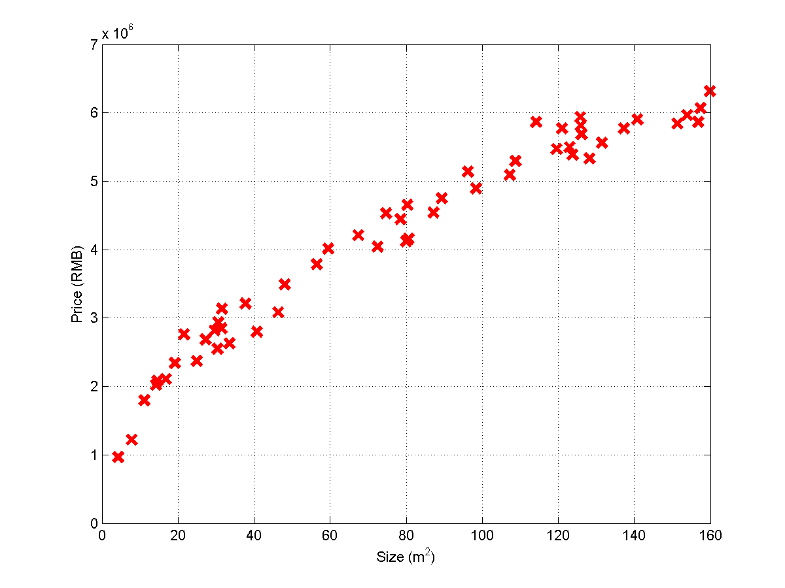

Slide 4
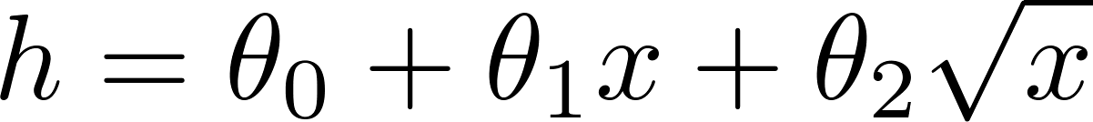
Hypothesis Model

Slide 5
Algorithm
The algorithm that you shall use is well implemented by the built-in optimization function.
fminunc

Slide 6
Coding issues
Either Matlab or Octave can be used in programming.
Higher grade will be given, if Python or C++ or C or Java or C# is used.
The codes introduced in the classroom lectures could be freely reused in your application.
Any modification on programming style, algorithm routine is preferred.

Slide 7
Documentation
Your understanding of the algorithm, the framework/flow of your result should be involved in your document.
It makes NO sense and ZERO is scored if only codes but without document is submitted.
The file format could be doc, docx, or Tex-based pdf.
No limitation on the document length.

Slide 8

Submission
Package your codes and document in a single compressed file titled as:
ML_ASS2#_your name_your ID, for example:
ML_ASS2#_马伊俐_19970188
Send it as attachment to
assignments.shmtu@gmail.com
The subject of the email should be the same as the title of your attachment.
Any email with mismatched formats will be identified as SPAM.

Slide 9
About Plagiary
NO Tolerance on any plagiary. ZERO score will be given.
DON’T share your source code with others, otherwise ZERO score will be given.
Some criterions on determining plagiary:
With the exactly same codes or documents
If two copies are same, the one sent later is considered as plagiarizer. Here, ‘later’ is judged based on the coming time of its email.
Student will be assigned randomly to present his (her) codes on class.

Slide 10
Deadline
Submitting your assignment later than the following data makes no sense:
18:00 PM
2014/04/29

