Slide 1

Onboarding Powerhouse
Sale Agent Code & Reporting Hierarchy
Sales visibility and case attribution for the Bank Portal
Product demo · SMBP V3 Bank Portal · Story AMP-2548 (approved 06/09/2026)
Appro Onboarding Solutions FZ-LLC
07 September 2026
Notes:
Demo of the approved feature: every Sale user carries a Sale Agent Code; applications are tagged to it; enquiry visibility follows the reporting hierarchy; every other department keeps full visibility.

Slide 2

1 · Business Workflow
From user setup to reporting, in five steps

Slide 3
APPRO – INTERNAL & APPROVED DOMAINS | Controlled Distribution
Business Workflow · from setup to reporting
1
BANK ADMIN
2
CUSTOMER JOURNEY
3
SYSTEM · SUBMISSION
4
SALES STAFF & MANAGERS
5
OPERATIONS & OTHERS
Set up the Sale user
Capture the code
Tag the case
See your own book
Run the bank as today
Create the user with Department = Sale, a Sale Agent Code and one or more Reporting Managers. Maker/Checker approves.
›
The code travels with the application: the UTM link (sale_agent_code) or the Referral Code pop-up the customer fills in.
›
The latest captured code that matches an active Sale user wins. No match: sales round-robin where a pool exists, otherwise untagged.
›
Staff see the cases tagged to them. Managers see their whole reporting subtree, at any depth, in real time.
›
Every department outside Sale keeps full visibility, untagged cases included. Reports and exports follow the same scope.
The rule behind it: Department = Sale switches everything on. Sale users get a Sale Agent Code and Reporting Manager; every other department keeps full visibility through the permissions it already has. No new permission, no migration grant.
Maker/Checker on every change
Tag set once, audited
Same scope everywhere
Sale Agent Code and Reporting Manager follow the standard flow; uniqueness and cycle checks re-run at Checker approval.
Attribution is fixed at submission and never reassigned. Raw value, resolved code and source are stored with each application.
Application Enquiry, Report Enquiry and exports apply the same pre-filter before every other filter.
This document is classified as INTERNAL & WHITELISTED | Sharing allowed only with approved external domains
3
Notes:
Walk the five steps left to right. The yellow banner is the design principle the CPO asked for: department-driven, no new permission.

Slide 4
APPRO – INTERNAL & APPROVED DOMAINS | Controlled Distribution
Who Sees What · visibility by role
Role | Department | Application Enquiry & Report Enquiry | What changes for them
Sales staff | Sale | Own tagged applications only | Own book of business; IM005 "No results found" until the first tagged case
Sales manager | Sale | Own cases plus every user in the reporting subtree, unlimited depth | Several managers per user are allowed; each manager sees the user's cases; updates in real time
Operations, Credit, Admin, others | Any other | All applications, including untagged ones | Nothing: the existing View permission applies, no new permission, no migration grant
Reporting hierarchy, unlimited depth
Jane Smith · Manager
John Doe · Manager
Alice Rahman · Staff
Khalid · Credit Ops
Alice reports to Jane (solid) and to John (dashed): both see her cases. Khalid is in Credit Operations, has no code and sees everything.
Visibility scope (Department, Sale Agent Code, reporting subtree) is evaluated server-side from the user record on every request. A manager change or a department change takes effect on the next request, never on the next login.
Sale staff and managers
Everyone else
Pre-filter applied before channel, product, status and search filters, on every enquiry screen.
Unfiltered, exactly as today. Untagged cases are visible here and only here.
This document is classified as INTERNAL & WHITELISTED | Sharing allowed only with approved external domains
4
Notes:
Three audiences, one rule. Emphasise that operations lose nothing.

Slide 5
APPRO – INTERNAL & APPROVED DOMAINS | Controlled Distribution
How a Case Gets Tagged · three capture points, one rule
1
UTM link
2
Referral Code pop-up
3
Sales round-robin
The bank shares its link with sale_agent_code=STF-042. The Distribution Portal captures it and passes it to the Bank Portal.
The customer types the code the salesperson gave them. Validated live against active Sale codes; an unknown code can be skipped.
No matching code? The Sale user with the lowest count, A to Z tiebreak, per channel and product, where a pool is configured.
Precedence: the latest captured value that matches an active Sale Agent Code wins (canonical key, case- and separator-insensitive). Still no match: the case stays untagged, visible to non-Sale users, and ops receive an alert (ET51 pattern).
Immutable after submission
Every capture audited
Optional by design
No reassignment function. The tag survives deactivation and department changes, so history always resolves.
Raw value, resolved code, source (UTM / Pop-up / Round-robin / Backfill) and timestamp are stored with the application.
Both codes are optional, so not every application carries a code. Untagged cases are normal, not errors.
Go-live: historical applications whose stored referral code matches an active Sale Agent Code are tagged once (source = Backfill, audited). Nothing else is touched.
This document is classified as INTERNAL & WHITELISTED | Sharing allowed only with approved external domains
5
Notes:
Three capture points feed one attribution rule. Stress "latest matching value wins" and that untagged cases are a normal outcome.

Slide 6
2 · Screens & Features
Portal-faithful wireframes of the approved story

Slide 7
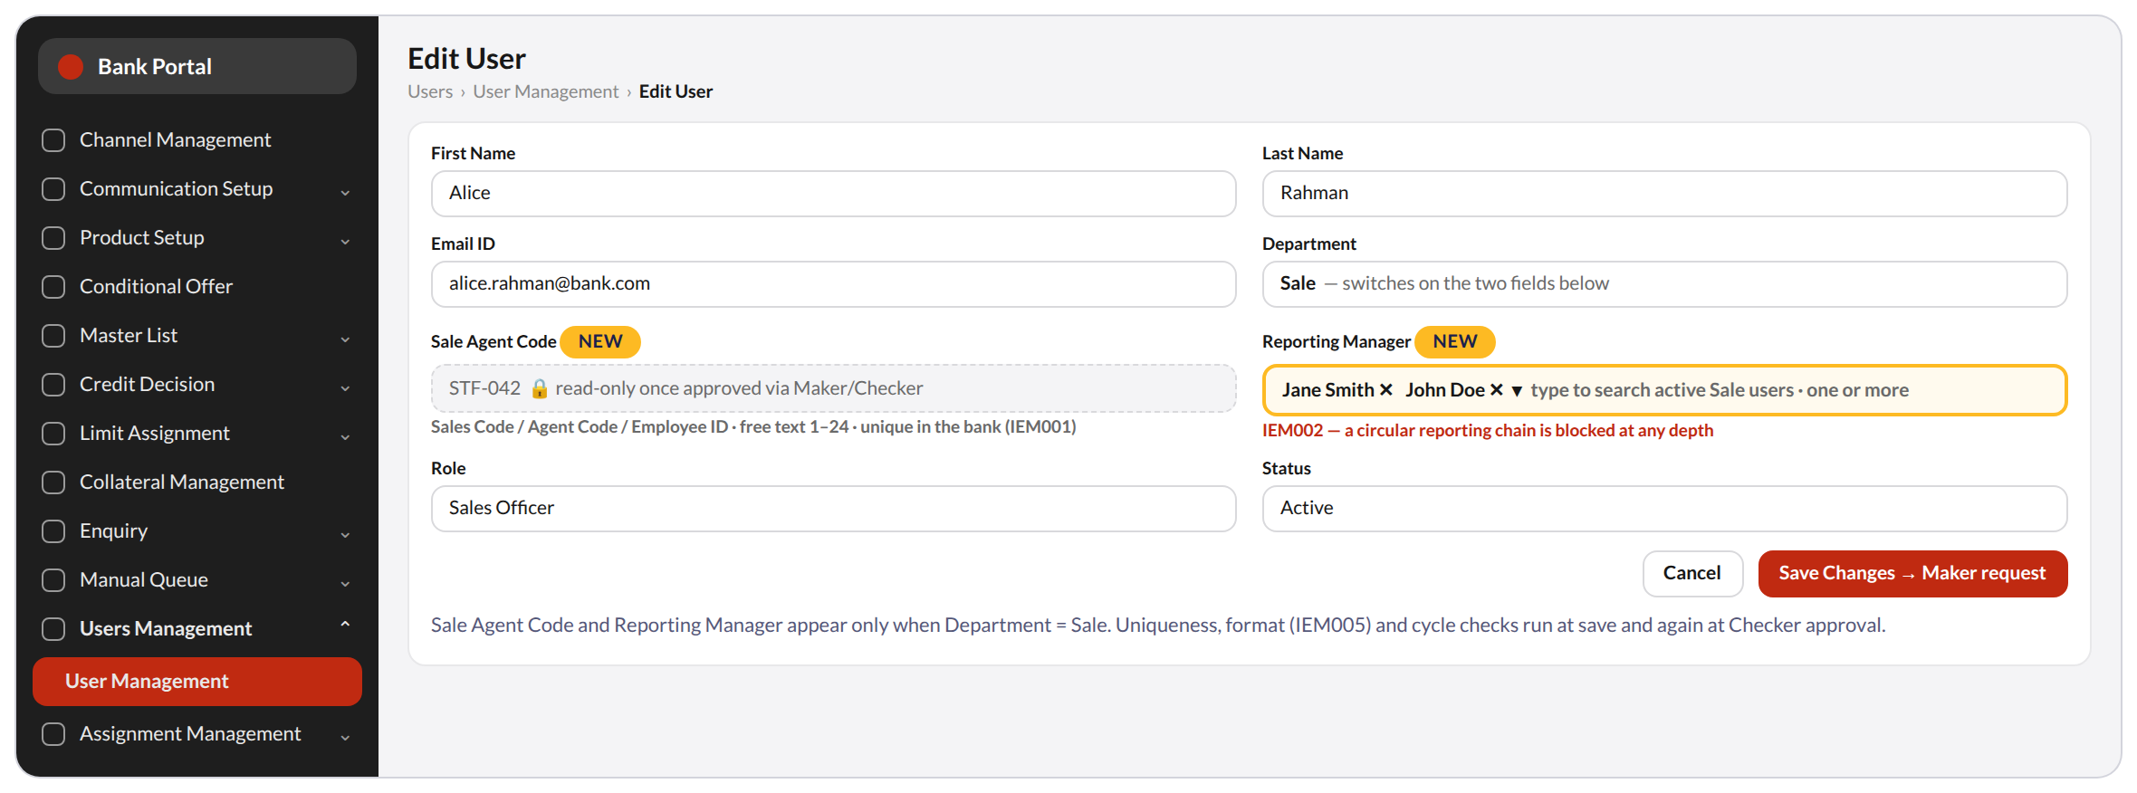
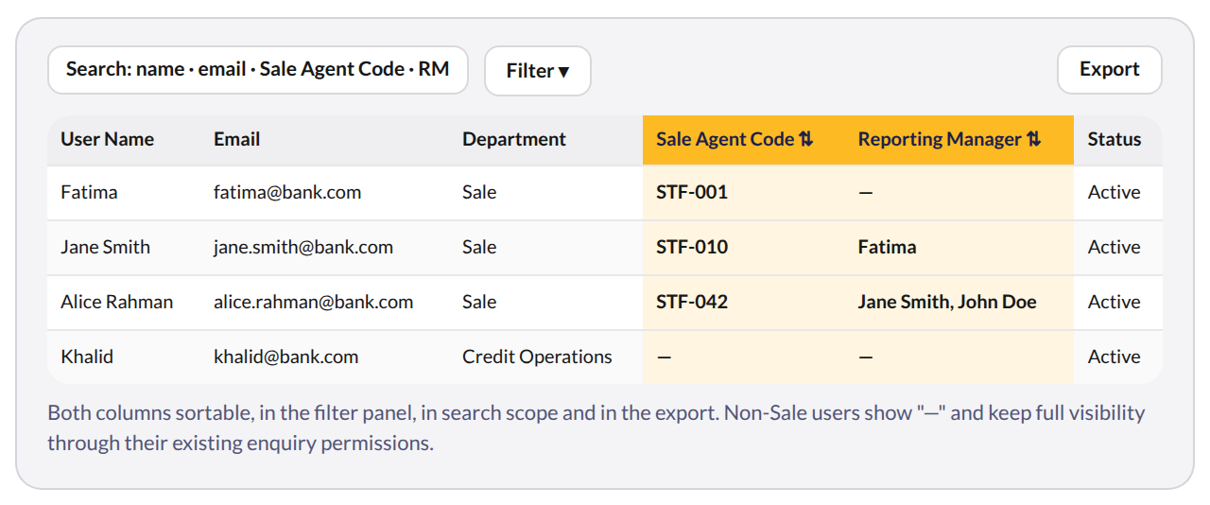
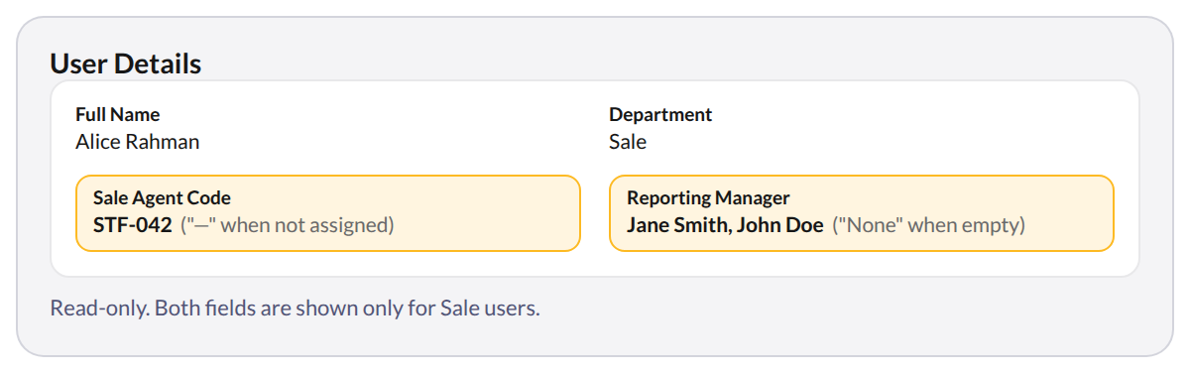
APPRO – INTERNAL & APPROVED DOMAINS | Controlled Distribution
User Management · Sale-only fields, list and details
1
Shown only when Department = Sale
Any other department never sees the two fields and keeps full visibility.
2
Sale Agent Code
The bank's own Sales Code / Agent Code / Employee ID. Free text, unique, read-only once approved (IEM001).
3
Reporting Manager, one or more
Multi-select of active Sale users; a circular chain is blocked at any depth (IEM002).
List of Users — new columns
User Details — read-only
4
Two new columns
Sale Agent Code and Reporting Manager after Department: sortable, filterable, searchable, exported.
5
Read-only details, full control
View Details shows the code and the manager list; "None" when empty. Every change is Maker/Checker.
Both fields appear only for Department = Sale. Sale Agent Code is free text, 1–24 characters, unique in the bank; Reporting Manager takes one or more active Sale users. Non-Sale users show "—" and keep full visibility.
This document is classified as INTERNAL & WHITELISTED | Sharing allowed only with approved external domains
7
Notes:
One slide for the whole User Management module: Add / Edit User on top, then the list and the read-only detail view. Point out the lock on the code and the multi-select manager field.

Slide 8
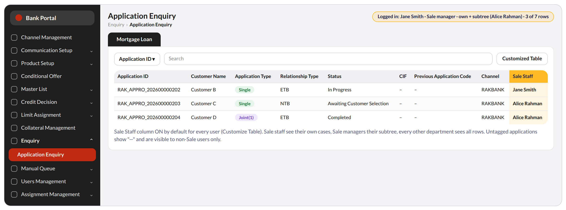
APPRO – INTERNAL & APPROVED DOMAINS | Controlled Distribution
Application Enquiry · the manager view
1
Pre-filter first
The visibility rule runs before channel, product, status and search filters. Default filters are identical for everyone.
2
Sale Staff column
ON by default for every user through Customize Table; the code itself is available as a column too.
3
Manager sees the subtree
Jane Smith sees her own cases and Alice Rahman's: 3 of 7 rows. Unlimited depth, real time.
Screen | Sales staff | Sales manager | Other departments
Application Enquiry (ACP-226/227) | Own tagged cases | Own + subtree, unlimited depth | All rows, untagged included
Report Enquiry + exports (ACP-230, 265/266/268) | Own tagged cases | Own + subtree | All rows, unfiltered
Sale Staff column and detail field | ON by default | ON by default | ON by default; "—" for untagged
4
Untagged shows "—"
Visible to non-Sale users only. Report Enquiry and exports follow the same scope.
This document is classified as INTERNAL & WHITELISTED | Sharing allowed only with approved external domains
8
Notes:
The scope pill at the top of the wireframe explains what the logged-in manager sees.

Slide 9
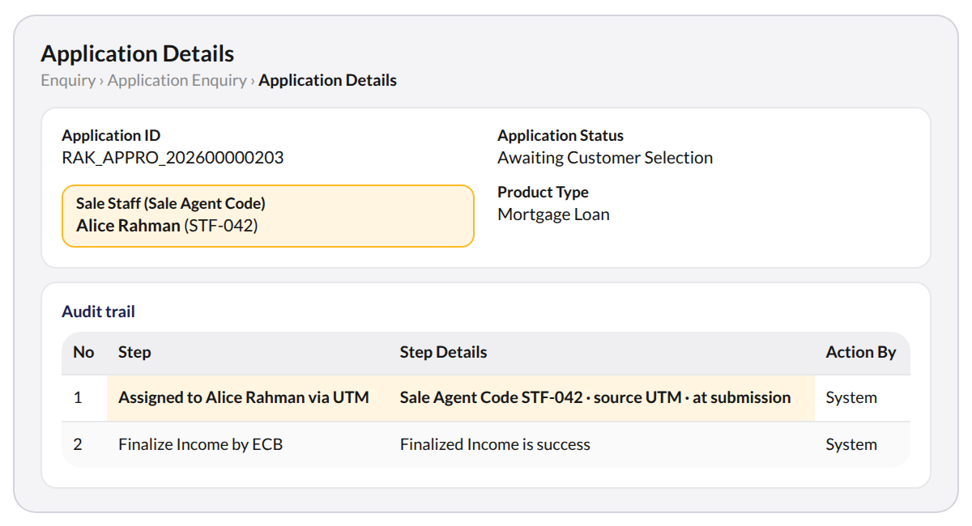
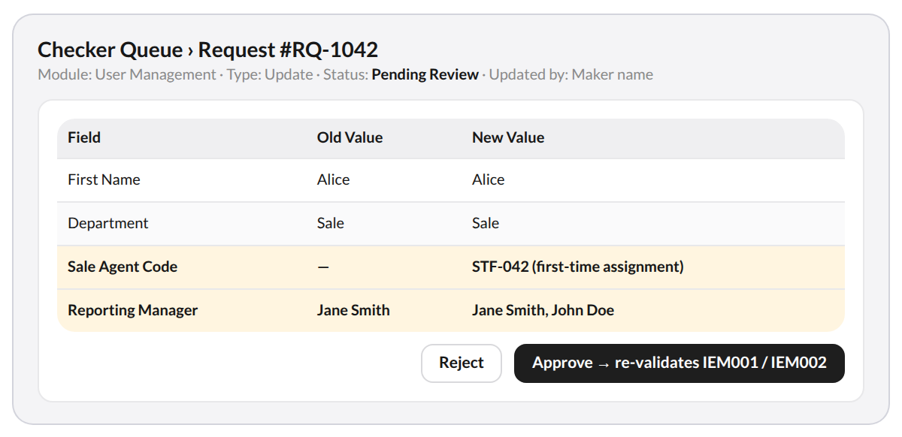
APPRO – INTERNAL & APPROVED DOMAINS | Controlled Distribution
Details & Checker · audit and approval
1
Sale Staff on the case
Full name and code on Application Details; the first audit-trail entry records who was assigned, how, and when.
2
Source you can trust
UTM, Pop-up, Round-robin or Backfill is stored next to the raw value received.
First audit-trail entry, written at submission: "Assigned to [Staff Name] via [UTM / Pop-up / Round-robin / Backfill]" with the Sale Agent Code and the time.
3
Old / new comparison
Checker Detail shows the code and the manager list before and after, first-time assignments included.
Raw value received
Resolved Sale Agent Code
Source and timestamp
4
Approve re-validates
IEM001 and IEM002 run again at approval, so two concurrent requests cannot land a duplicate or a cycle.
Exactly as typed in the pop-up or carried in the link.
Matched on the canonical key against active Sale users.
UTM, Pop-up, Round-robin or Backfill, and when it was captured.
This document is classified as INTERNAL & WHITELISTED | Sharing allowed only with approved external domains
9
Notes:
Left: what a sales manager or ops user sees on the case. Right: what the Checker approves.

Slide 10
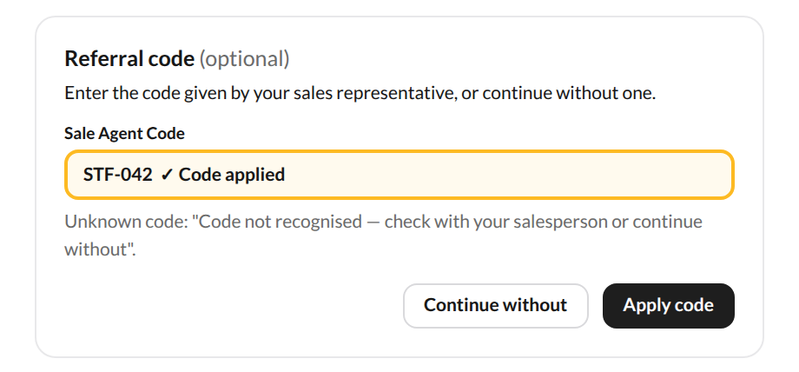
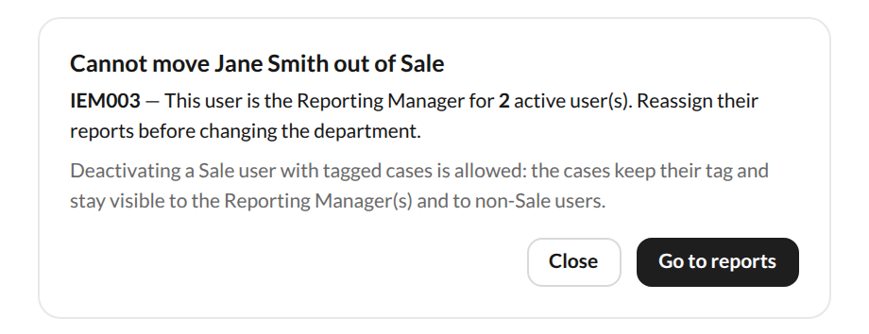
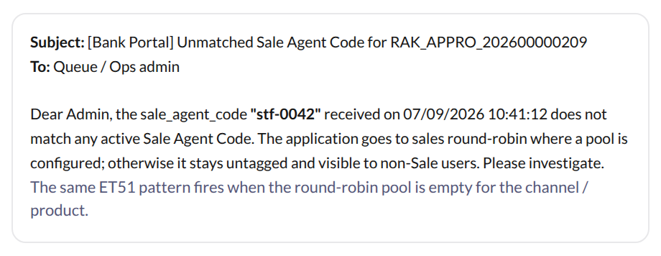
APPRO – INTERNAL & APPROVED DOMAINS | Controlled Distribution
Customer Pop-up & Guardrails
1
Referral Code pop-up
2
Lifecycle guardrails
3
Ops alert on unmatched codes
The customer enters the code the salesperson gave them. Validated live; an unknown code can be skipped. The latest matching code wins at submission.
A manager cannot leave Sale or be deactivated while active Sale users report to them (IEM003). Deactivating staff is allowed; their cases keep the tag.
A typo or a leaver's code never fails silently: ops receive the code, the application reference and the timestamp (ET51 pattern).
Every edge is audited: pop-up captures carry source and timestamp, lifecycle changes go through Maker/Checker, and alerts name the code, the application reference and the time received.
This document is classified as INTERNAL & WHITELISTED | Sharing allowed only with approved external domains
10
Notes:
Customer side, admin side, operations side: the three edges of the feature.

Slide 11
3 · Why It Sells
Six things a bank gets on day one

Slide 12
APPRO – INTERNAL & APPROVED DOMAINS | Controlled Distribution
Best Selling Points · what a bank gets
Six things a bank gets on day one. Every proof line below comes straight from the approved acceptance criteria of AMP-2548.
1
One code, end to end
2
Switch it on by department
3
Hierarchy without limits
The bank's own Sale Agent Code on the user record, in the UTM link, in the customer pop-up and on the application. No mapping tables, no second identifier.
Department = Sale drives the fields, the filters and the round-robin pool. No new permission, no role rework, no migration grant.
Unlimited depth, several managers per user, real time when the org chart changes. A regional head sees every level below.
4
Attribution you can audit
5
Operations never lose sight
6
Bank-grade control
Every capture is logged with its source and timestamp; the tag is immutable once submitted, so sales credit never moves silently.
Every other department keeps full visibility, untagged cases included, and a typo'd link raises an alert instead of a lost lead.
Maker/Checker on every change, uniqueness and cycle checks re-run at approval, scope evaluated server-side on every request.
This document is classified as INTERNAL & WHITELISTED | Sharing allowed only with approved external domains
12
Notes:
Lead with the benefit on each card; the proof line underneath comes straight from the approved acceptance criteria.

Slide 13
APPRO – INTERNAL & APPROVED DOMAINS | Controlled Distribution
Go-Live Readiness · data, dependencies, next steps
Day-one data
Dependencies to close
Existing Sale users
Distribution Portal parameter
Get their Sale Agent Code through Edit User (Maker/Checker) at go-live; until then they see no applications (IM005).
sale_agent_code added to the Super Admin-configurable UTM parameter list: one name, case-sensitive, across every channel and product.
Historical applications
Notification audit
One-off backfill: cases whose stored referral code matches an active Sale Agent Code are tagged (source = Backfill, audited). No round-robin backfill.
Review every template that mails the assigned staff member and decide where the Reporting Manager is copied (separate ticket).
Everything else
Mockup and messages
Stays visible to non-Sale users exactly as today. Reports, exports and queues are untouched.
Mockup labels move to "Sale Agent Code"; IEM001 to IEM003 and IEM005 confirmed unused in the message registry.
This document is classified as INTERNAL & WHITELISTED | Sharing allowed only with approved external domains
13
Notes:
Two tickets to raise before development starts; the rest is configuration.

Slide 14
Thank you
You Choose It, We Approve It.
This is not a legally binding document. Highly confidential — not to be shared without written consent.

