Slide 1

Onboarding Powerhouse
AI Enablement in the Super Portal
Feature proposal — four AI use cases for credit decisioning
Appro Onboarding Solutions FZ-LLC
Product Owner · 21 October 2026
Notes:
Proposal of the four AI use cases agreed in the 20 Oct 'AI enablement on products' session, grounded on the current SMBP portal and verified market practice.

Slide 2

APPRO – INTERNAL & APPROVED DOMAINS | Controlled Distribution
The Mandate — Four AI Use Cases
Agreed 20 Oct — AI embeds into existing SMBP modules, not a separate AI product. Each use case needs exactly one narrow LLM task; everything else stays deterministic.
1 · Policy Copilot
2 · AI Reports
PROMPT → RULE
PROMPT → SQL
Credit Decision › Rule Engine (Strategies)
Enquiry › Report Enquiry
• Describe a policy change in plain language; pick product + time range.
• System re-runs past applications (or specific IDs) and shows how many would pass under the new policy.
• Lands as a Maker request with an AI-generated checklist; shadow mode before production.
• Ask for a report in plain language; the system queries the database.
• Result shows the generated SQL plus a chart or diagram.
• Cathal: expose the same capability to banks through MCP.
3 · AI Document Validation
4 · FEEL Assist
DOC COMPARISON
PROMPT → FEEL
Document Management › Document Set Up
Limit Assignment › Calculated Variables · RE variables
• Validate documents in the new Document setup module.
• Security cheques, source-of-income proofs, clearance letters checked against application data before ops review.
• Write FEEL formulas from a prompt — configuration is too difficult for users today (Anto).
• Also covers use case 5: creating new Rule Engine variables with FEEL expressions.
Technical direction (Antofelix, 20 Oct): one offline, lightweight model from the Foundry catalog, specialised for these tasks, hosted in the UAE — plan and dates tracked per activity.
This document is classified as INTERNAL & WHITELISTED | Sharing allowed only with approved external domains
1
Notes:
Minutes by Kha, 20 Oct. Antofelix follow-up: all four depend on one LLM; direction = offline lightweight Foundry model, UAE-hosted. Use case 5 (FEEL variables in RE) folds into FEEL Assist.

Slide 3
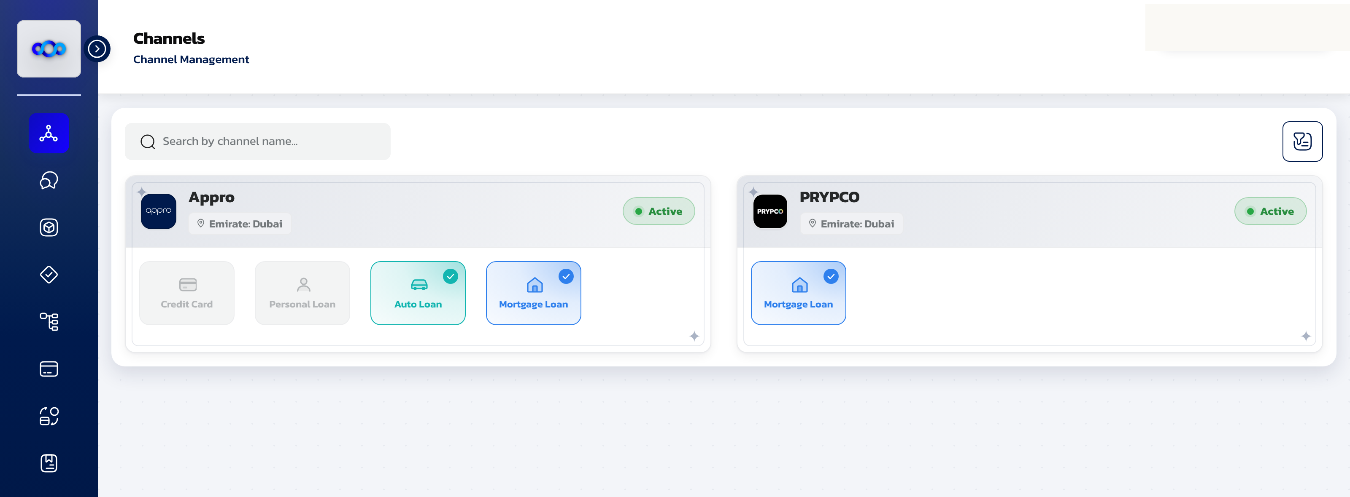
APPRO – INTERNAL & APPROVED DOMAINS | Controlled Distribution
Design Principle — AI Drafts, Maker-Checker Decides
Every use case follows one pattern — AI drafts, the platform validates, Maker-Checker approves. No AI output reaches production unreviewed.
Why it passes review — CBUAE
Guidance Note, Feb 2026: responsible AI/ML for licensed financial institutions — human oversight on high-impact decisions, validation before deployment, drift monitoring and periodic bias testing.
Maker-checker meets this by construction — AI never holds the pen on a production decision.
Why SMBP is ready
SMBP Super Portal — Channel Management (mirror build, demo data). All four features land inside existing modules.
Controls already live: maker-checker on every configuration change, ~97-attribute Rule Engine catalog, formula builder and per-product document profiles.
AI plugs into controls we already run — no new governance framework to invent.
The pattern — every use case, same controls
Prompt → AI draft → Validation → Maker request → Checker approval → Publish
The model proposes; parsers, replays and field-matching verify; people approve.
Sources: CBUAE Guidance Note on AI/ML (Feb 2026) · SMBP portal mirror (Appro build)
This document is classified as INTERNAL & WHITELISTED | Sharing allowed only with approved external domains
2
Notes:
Governance-first frame: every AI output is a draft into the existing maker-checker flow. CBUAE Guidance Note Feb 2026 expects human oversight on high-impact decisions.

Slide 4
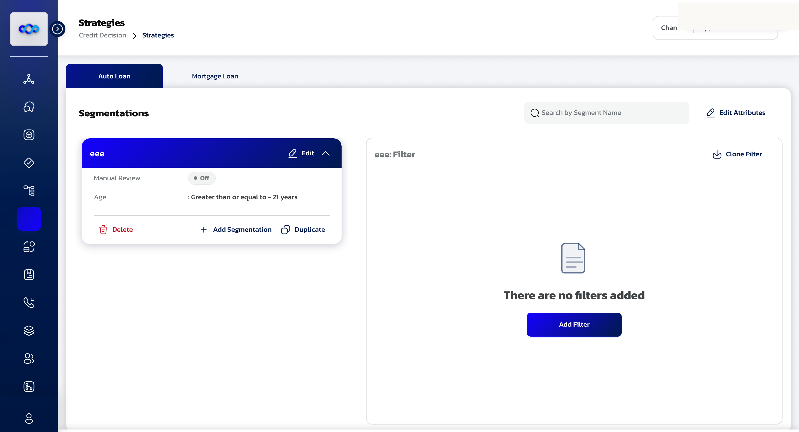
APPRO – INTERNAL & APPROVED DOMAINS | Controlled Distribution
Policy Copilot — Write Policy, Prove It On Our Own Book
Write policy in plain language — and prove it on our own book before it touches production.
Requirement · prompt → rule (20 Oct)
Back-test: prompt + product + time range → re-run past applications; show how many would pass under the new policy. Runs on specific application IDs too.
Governed: output is a Maker request with an AI checklist; shadow mode before production.
Market base
Taktile: AI copilot writes & debugs decision logic (Monzo, Allianz, Rakuten Bank; $110M Series C, 2026).
Experian Assistant: vendor-claimed model build cut from months to days.
Back-test + shadow: standard champion-challenger discipline in decisioning platforms.
Feasibility & gate
Narrow LLM task: prompt → rule JSON against our attribute catalog. Impact numbers come from deterministic replay — never from the model.
Gate: generated rules match analyst intent on a pre-agreed prompt set, then shadow pilot on one product.
Credit Decision › Strategies (Rule Engine) — segmentations and filters: the surface Policy Copilot writes to.
Sources: Taktile (company; Business Wire 2026) · Experian (vendor claim) · Forrester AI Decisioning Wave Q2 2025 (FICO Leader)
This document is classified as INTERNAL & WHITELISTED | Sharing allowed only with approved external domains
3
Notes:
LLM writes the rule; the impact numbers come from deterministic replay of past applications — no AI in the math. Shadow mode + maker request per the minutes.

Slide 5
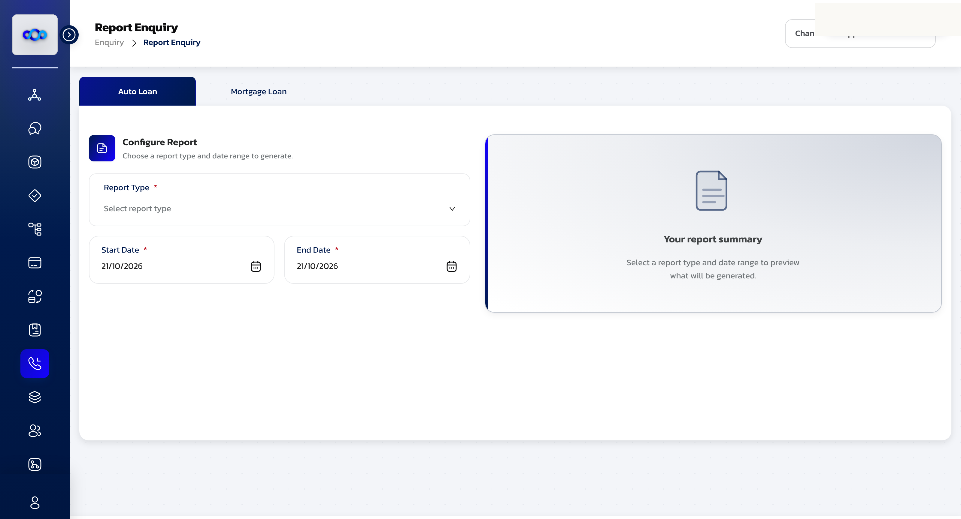
APPRO – INTERNAL & APPROVED DOMAINS | Controlled Distribution
AI Reports — Governed Semantic Layer, Not Raw NL-to-SQL
Prompt-to-report is feasible — if we constrain it to a governed semantic layer. Raw NL-to-SQL fails on enterprise schemas.
Requirement · prompt → SQL (20 Oct)
Ask in plain language; the system queries the database and returns the generated SQL with a visualization.
MCP: Cathal — expose the capability to the bank through MCP.
Market reality check
≈80% on academic leaderboards (BIRD) — but on real enterprise warehouses:
10.8% execution accuracy (BEAVER, GPT-5.2 agents)
21.3% on Spider 2.0 vs 91.2% on Spider 1.0. The schema is the bottleneck, not the model.
Hypothesis & gate
Constrain: curated reporting views + the report types already in Report Enquiry; SQL always visible; read-only replica.
Gate: top report intents validated against analyst-written SQL before free-form prompts unlock. MCP serves the same governed layer — never raw tables.
Enquiry › Report Enquiry — today: pick a report type and date range. Target: ask in plain language, see SQL + chart.
Sources: BEAVER (arXiv 2409.02038) · Spider 2.0 (ICLR 2025) · BIRD leaderboard (Gemini-SQL2 80.04%)
This document is classified as INTERNAL & WHITELISTED | Sharing allowed only with approved external domains
4
Notes:
Honest feasibility: enterprise text-to-SQL accuracy collapses on raw schemas (BEAVER 10.8%, Spider 2.0 21.3%). Constrain to curated views + always show SQL. MCP exposes the same governed layer.

Slide 6
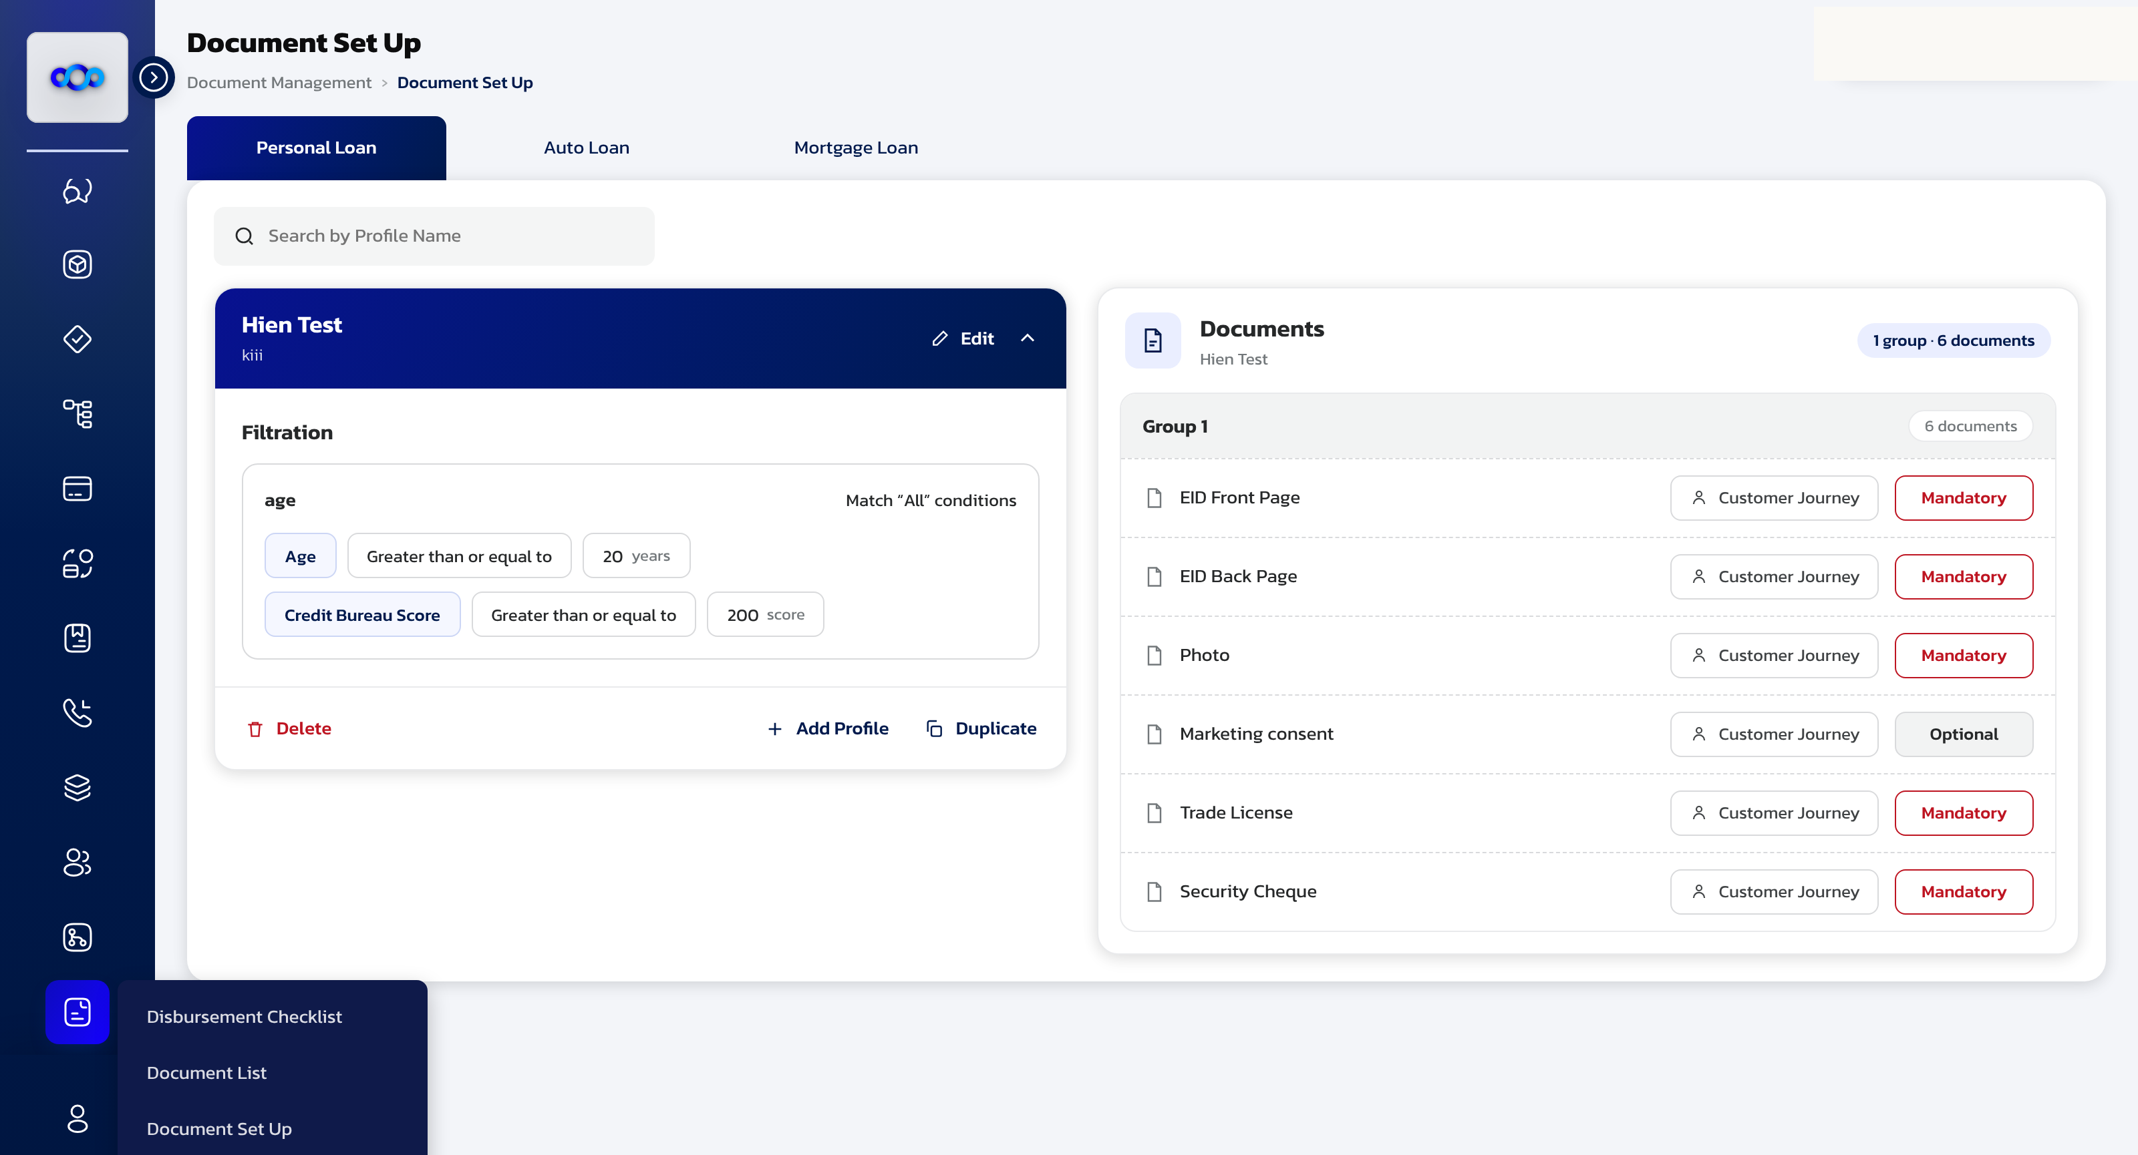
APPRO – INTERNAL & APPROVED DOMAINS | Controlled Distribution
Document Validation — Checkers Review Exceptions, Not Everything
AI pre-checks every document so checkers spend their time on exceptions — not on 100% review.
Requirement · doc comparison (20 Oct)
Validate documents in the new Document setup module — security cheques, source-of-income proofs, clearance letters — against application data before ops review.
Market base
Ocrolus: classifies & analyses 1,150+ financial document types with fraud-signal detection (vendor).
Informed.IQ: automated stip verification; works with 7 of the top-10 US auto lenders (company-reported).
Feasibility & gate
Task: extract fields, compare to the application (amount, names, IBAN, dates), flag missing or inconsistent items into the ops Maker queue.
Dependency: labelled document samples — the largest data gap. Gate: model agrees with checker verdicts on a labelled pilot set.
Document Management › Document Set Up — mandatory documents are already modelled per product and journey.
Sources: Ocrolus (vendor) · Informed.IQ (company-reported)
This document is classified as INTERNAL & WHITELISTED | Sharing allowed only with approved external domains
5
Notes:
Extraction + comparison vs application data. Main dependency is labelled samples — the largest data gap (slide 10).

Slide 7
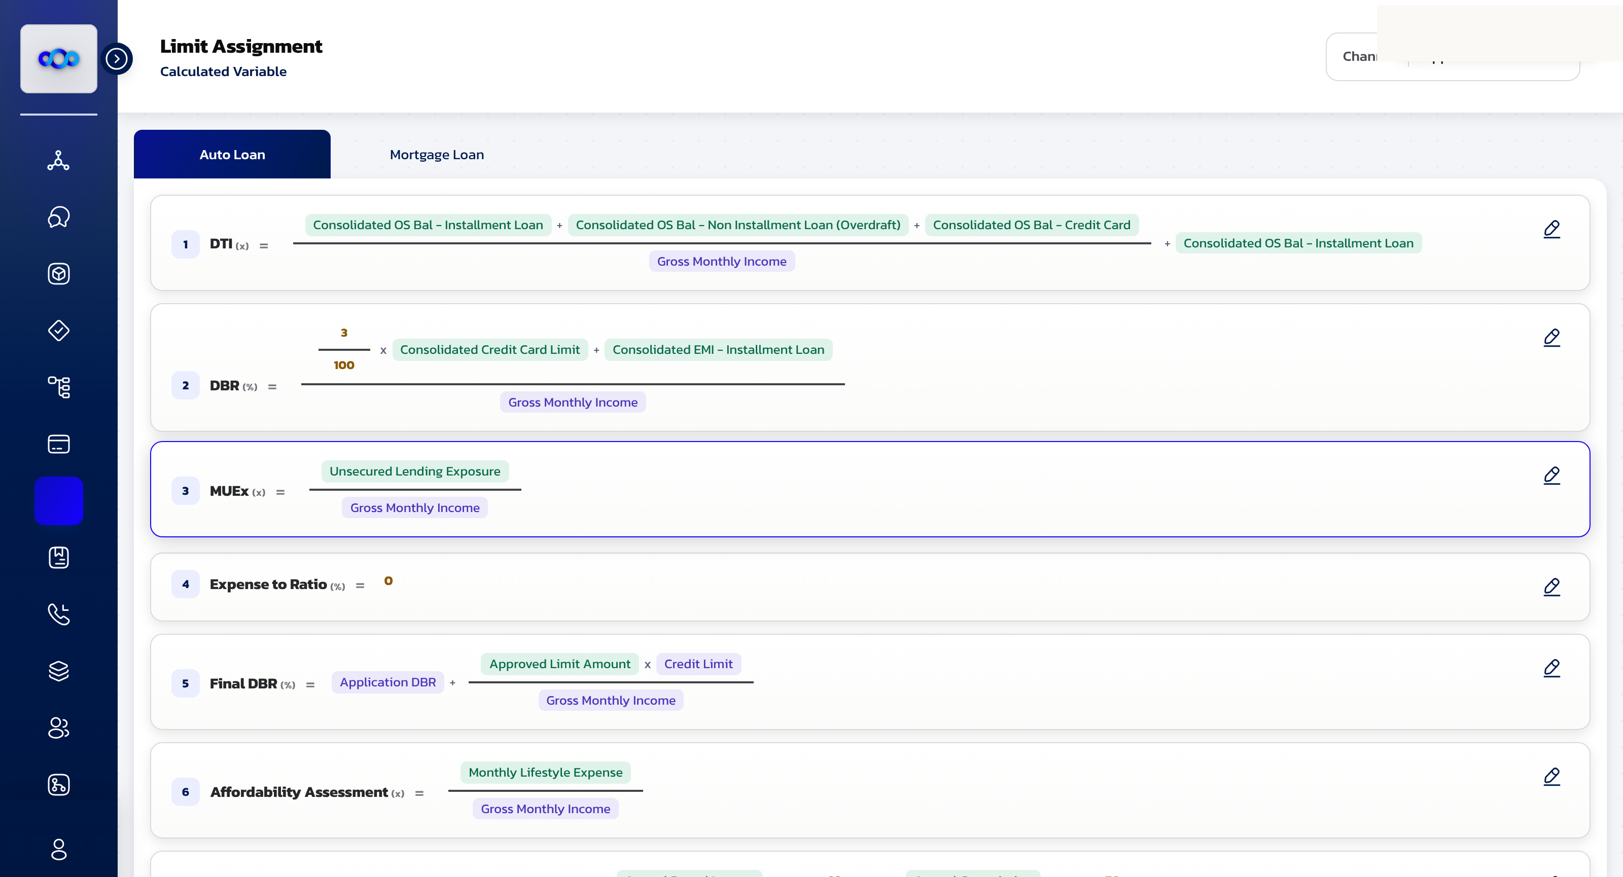
APPRO – INTERNAL & APPROVED DOMAINS | Controlled Distribution
FEEL Assist — The Fastest Win On The List
The fastest win: FEEL has a formal grammar, a built-in validator — and users who struggle with it today.
Requirement · prompt → FEEL (20 Oct)
Write FEEL formulas from a prompt in Limit Assignment › Calculated Variables — configuring them is too difficult for users today (Anto).
Use case 5 folds in: create new Rule Engine variables with FEEL expressions.
Technical base
FEEL is the DMN-standard expression language — a small formal grammar.
Constrained code generation with instant parser validation is the most mature LLM pattern in production copilots.
Feasibility & gate
Flow: generate → parse → preview on sample values → save as Maker request.
Zero customer data to start: ground on the existing formula library. Gate: BA panel signs off a replay of the current formulas from plain-language descriptions. Recommended v1.
Limit Assignment › Calculated Variable — DBR, MUEx, Max Eligibility: the formulas users build by hand today.
Sources: OMG DMN / FEEL specification · SMBP portal mirror (Appro build)
This document is classified as INTERNAL & WHITELISTED | Sharing allowed only with approved external domains
6
Notes:
FEEL is a formal DMN grammar: generate → parse → preview → maker request. Zero customer data needed to start. Recommended v1.

Slide 8
APPRO – INTERNAL & APPROVED DOMAINS | Controlled Distribution
Solution Direction — One Model, Four Adapters
One offline small language model behind all four use cases — the adapters differ, the controls stay the same.
Prompt
→
Guardrails
→
SLM
→
Task adapter
→
Validator
→
Maker-Checker
in-module UI
scope + PII filter
offline · UAE-hosted
rule · SQL · doc · FEEL
parser · replay · match
approve & publish
Model direction — Foundry SLM
Grounding vs fine-tuning
Reusable if we swap models
Shortlist from the Foundry small-model catalog — e.g. the Phi-4 family: reported MIT-licensed and self-hostable (Foundry, Hugging Face, Ollama).
Verify licence and commercials on the model card — Cathal's session output.
One base model, per-task adapters — not four separate models.
Start with RAG + few-shot on our own artefacts: attribute catalog, schema dictionary, formula library, document profiles.
Fine-tune only where evals prove a gap — most likely prompt→rule and prompt→FEEL.
Each use case keeps its own eval set — the go/no-go instrument per phase.
Model-agnostic: prompts, task schemas, eval sets, guardrails, validators, UI.
Model-bound: fine-tuned weights only.
Swap the model tomorrow and the training assets survive — the platform investment is protected.
Sources: Azure AI Foundry / Phi model documentation (licence to be confirmed on model card)
This document is classified as INTERNAL & WHITELISTED | Sharing allowed only with approved external domains
7
Notes:
Answers agenda §3–5: one base SLM + per-task adapters; RAG first, fine-tune where evals prove gaps; prompts/schemas/evals/guardrails stay model-agnostic.

Slide 9
APPRO – INTERNAL & APPROVED DOMAINS | Controlled Distribution
Governance — Designed To Pass Review
The CBUAE's Feb-2026 AI guidance maps directly onto maker-checker controls the portal already runs.
CBUAE expectations (Feb 2026)
Our answer, by design
Guidance Note on responsible AI/ML for licensed financial institutions: human oversight on high-impact decisions, validation before deployment, monitoring for model drift, periodic bias testing. Not legally binding — but the supervisory direction.
AI stops at draft. Credit decisions stay deterministic in the Rule Engine; every AI-assisted change is a Maker request with checker approval; new policies run in shadow mode before production.
Auditability
Data protection
Log per change: prompt, model version, draft, validation result, approver.
Same maker-checker trail banks already audit — no new audit framework to invent.
Offline UAE hosting keeps bank data in-country.
Training data anonymised before any use — owned by the data-readiness workstream (slide 10).
Sources: CBUAE Guidance Note on AI/ML (Feb 2026) — verify specifics against the original text before external use
This document is classified as INTERNAL & WHITELISTED | Sharing allowed only with approved external domains
8
Notes:
CBUAE Feb 2026 guidance mapped to design choices. AI stops at draft; decisions stay deterministic.

Slide 10
APPRO – INTERNAL & APPROVED DOMAINS | Controlled Distribution
Data Readiness — What We Have vs What Training Needs
Per Antofelix: Gurkirat + Hailey own data readiness — what we can ground on today, what training needs, and the gaps.
Use case | Grounding — in the platform today | Training / evaluation — needed | Gap → action
Policy Copilot | Rule Engine attribute catalog (~97 filtration attributes), segmentation & strategy configs | Historical applications + decision outcomes for replay; analyst prompt→rule pairs | Anonymised extract of decisioned applications
AI Reports | Report types + schemas behind Report Enquiry | Schema dictionary with business terms; analyst SQL for the top report intents | Build the semantic layer; collect a query corpus
Doc Validation | Document List & Set Up profiles — document types per product and journey | Labelled samples: security cheques, SOI proofs, clearance letters (accepted + rejected) | Largest gap — start collection through ops queues
FEEL Assist | Live formula library (calculated variables per product) | Prompt→FEEL pairs from BA / analyst sessions | Smallest gap — compile from existing configs
This document is classified as INTERNAL & WHITELISTED | Sharing allowed only with approved external domains
9
Notes:
Hailey + Gurkirat action from Antofelix's mail: tables/datasets for training & grounding, and the gaps.

Slide 11
APPRO – INTERNAL & APPROVED DOMAINS | Controlled Distribution
Proof Plan — Hypothesis, Experiment, Gate Per Use Case
No feature ships on belief — each one carries a hypothesis, an experiment on our own data, and a pass gate agreed up front.
FEEL Assist
AI Reports
Hypothesis — prompt → FEEL is valid and correct for the formulas our users actually build.
Experiment — replay the existing formula library from plain-language descriptions; score with parser + value preview.
Gate — BA panel signs off accuracy on the replay set.
Hypothesis — on a curated semantic layer, prompt → SQL matches analyst SQL for the top report intents.
Experiment — blind comparison of model vs analyst SQL on the agreed intent list; score result-set equality.
Gate — the agreed intent list passes before free-form prompts unlock.
Policy Copilot
Document Validation
Hypothesis — prompts reproduce intended policy changes without manual rule editing.
Experiment — re-create past policy CRs from their business descriptions; diff against shipped rules; replay the back-test.
Gate — diff-clean on the CR set, then a shadow pilot on one product.
Hypothesis — the model matches checker verdicts on real document sets.
Experiment — run the labelled pilot corpus through extraction + comparison; confusion matrix vs ops decisions.
Gate — checker-agreement threshold set with ops before any rollout.
This document is classified as INTERNAL & WHITELISTED | Sharing allowed only with approved external domains
10
Notes:
Research-method structure: each feature ships only after its experiment passes its gate. Gates are agreed with BAs/ops, not invented.

Slide 12
APPRO – INTERNAL & APPROVED DOMAINS | Controlled Distribution
Delivery Sequence — Ordered By Data Readiness
Sequence by data readiness, not by appeal — each phase ships a working feature and unblocks the next.
PHASE 0
PHASE 1
PHASE 2
PHASE 3
PHASE 4
Foundations
→
FEEL Assist
→
AI Reports
→
Policy Copilot
→
Doc Validation
model shortlist · UAE hosting · guardrails
smallest data gap — proves the pattern
needs the semantic layer
needs replay + shadow infra
needs the labelled corpus
Cathal — solution & model
Gurkirat + Hailey — data readiness
Antofelix — objective & tracking
Leads agenda §3–6: recommended direction, Foundry model shortlist, hosting & running cost, licence and procurement answers.
Dataset inventory and gap list per slide 10: which tables and datasets exist for training and grounding, anonymisation approach, collection plan for the gaps.
Objective and use-case recap; the session output is a sequenced activity plan — owner and target date per activity, tracked.
Dates: the technical session puts an owner and a target date on every activity — the sequence and dependencies above are what we lock today.
This document is classified as INTERNAL & WHITELISTED | Sharing allowed only with approved external domains
11
Notes:
Sequence by data readiness, not appeal. Dates land in Cathal's technical session; sequence and dependencies fixed here.

Slide 13
APPRO – INTERNAL & APPROVED DOMAINS | Controlled Distribution
Decision & Next Steps
Asking today: approve the four-feature scope and the delivery sequence — dates follow the technical session.
1
Approve scope & sequence
2
Run the technical session
Four AI features, phased by data readiness (slide 12). Use case 5 delivered inside FEEL Assist.
Cathal returns the model shortlist, hosting, cost and licence answers — dates then land on the plan.
3
Start the data-readiness audit
4
Spec v1 — FEEL Assist
Gurkirat + Hailey deliver the dataset inventory and gap list (slide 10) as a tracked workstream.
UX spec for the prompt experience in Limit Assignment › Calculated Variables; the same pattern then reuses across all four modules.
On approval: a clickable walkthrough of the four features inside the portal will be shared as a link.
This document is classified as INTERNAL & WHITELISTED | Sharing allowed only with approved external domains
12
Notes:
Ask: approve scope + sequence today; dates follow the technical session. After approval: clickable walkthrough link.

Slide 14
Thank you
This is not a legally binding document. Highly confidential — not to be shared without written consent.

