Slide 1

Onboarding Powerhouse
Salary Transfer —
Credit Card & Personal Loan
Design update: one toggle, four customer cases,
the account created along the way
Appro Onboarding Solutions FZ-LLC
V1.0 · 04 November 2026

Slide 2

APPRO – INTERNAL & APPROVED DOMAINS | Controlled Distribution
Business Context & Client Cases
Salary-transfer pricing needs the salary at Reem Bank. Today the journey knows only NSTL — detected salaries, future transfers and clients without an account all fall out. The backend now classifies every applicant before the screen renders and asks only what it cannot derive.
C1 — New to bank
C2 — Salary already credits to Reem (detected)
Toggle ON → FSTL · asks the 1st salary credit date.
Fulfilment: CIF + account + IBAN created, then the loan or card.
Toggle stays visible, relabelled · asks nothing — date, account and IBAN are already with the bank.
Releases at creation — no letter, no hold.
C3 — Has an account, salary elsewhere
C4 — Reem client without an account
Toggle ON → FSTL · asks the 1st salary credit date.
Existing account reused — the letter carries its IBAN.
Toggle ON → FSTL · asks the 1st salary credit date.
Account created along the way at fulfilment — previously a dead end.
Design anchor
A parallel application invalidates the one in progress — so the customer is never sent out of the journey to open an account first. NSTL (toggle OFF) keeps today’s flow untouched: salaried IBAN, direct debit, immediate disbursal.
Asked on the journey: expected 1st salary credit date (FSTL only) · salaried IBAN + disbursement account (NSTL only) · everything else is detected or derived.
This document is classified as INTERNAL & WHITELISTED | Sharing allowed only with approved external domains
2

Slide 3
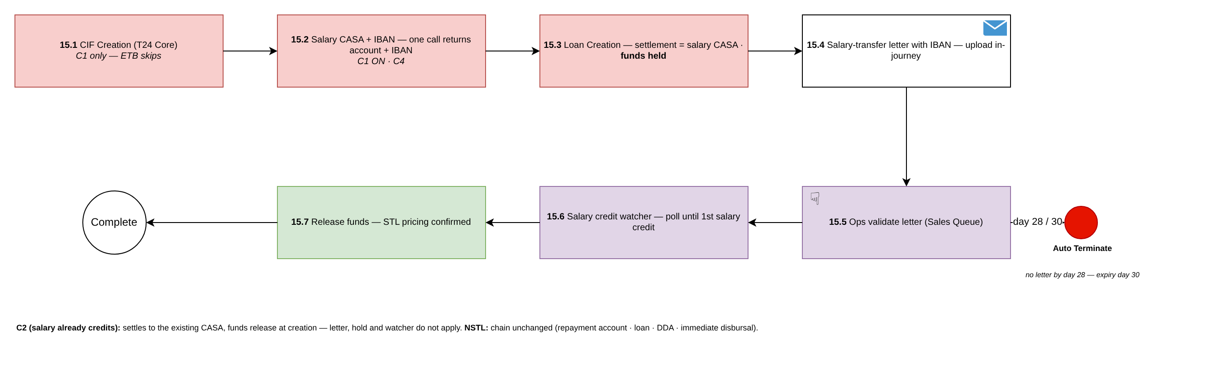
APPRO – INTERNAL & APPROVED DOMAINS | Controlled Distribution
Workflow & Backend Updates
Personal Loan — workflow v2.0
BACKEND LOGIC UPDATES
Salary-type fork after acceptance → FSTL chain 15.1–15.7:
CIF → account + IBAN (one call) → loan booked with funds held → letter → Ops validate → salary watcher → release. NSTL/DDA chain unchanged.
Decision & data rules
Classification before render: own-account salary credit in T / T-1 (primary), bureau IBAN match (confirmatory), products list for has-account.
No IBAN question on FSTL/STL — the salaried IBAN and the disbursement choice belong to NSTL only.
Grace is derived from the salary date and adjusted once, on the offer, within pricing-matrix bounds.
Credit Card — workflow v1.7
Fork after Account Creation (NI) → chain 17.1–17.6:
account + IBAN → card created INACTIVE → letter → validate → watcher → activate with STL pricing & limit.
Fulfilment rules
Order rule: the account and IBAN exist before the loan or card — the settlement fields and the letter need them; one core call returns both.
Release condition: letter validated AND the first salary credit detected by the account-transactions watcher — never one alone.
Repayment: STL/FSTL by standing instruction from the Reem account — no DDA; NSTL keeps the DDA.
New portal statuses — letter reminders D7 · 10 · 13 · 26, cut-off D28, offer expiry D30
This document is classified as INTERNAL & WHITELISTED | Sharing allowed only with approved external domains
3

Slide 4
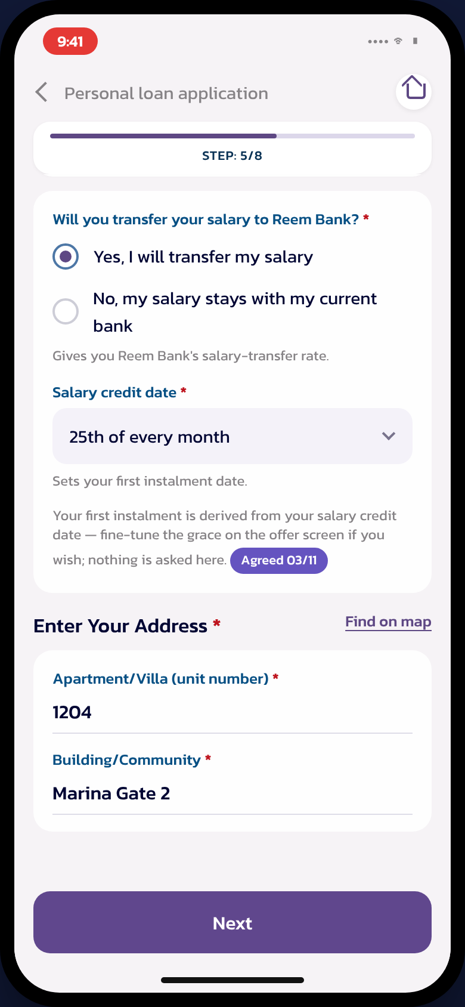
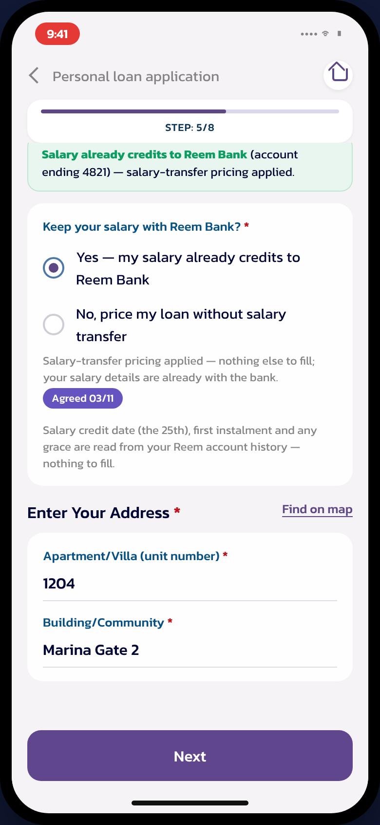
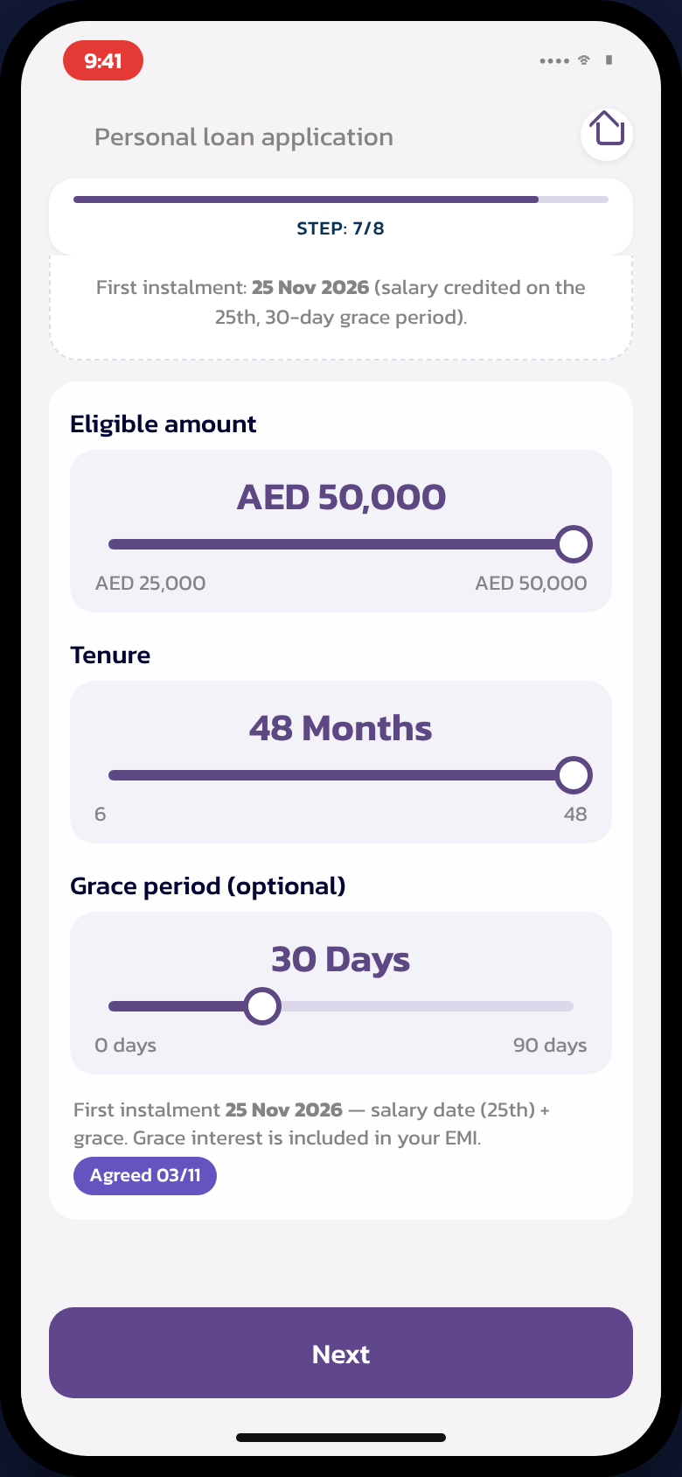
APPRO – INTERNAL & APPROVED DOMAINS | Controlled Distribution
Customer Journey & Open Questions
OPEN QUESTIONS FOR REEM BANK
Appro proposal sits in BRD §10 — confirming it is enough to proceed
1. Funds hold / release mechanism at booking — CORE
2. Debit card for the account created along the way — CARDS
3. Standing instruction for STL repayment — CORE
4. Confirm: no security cheque, any variant — CREDIT POLICY
5. Arabic copy: toggle, letter, five client emails — BUSINESS
6. Letter validation SLA in the 28-day window — OPERATIONS
7. C2 with toggle OFF — repayment account — BUSINESS
Toggle + salary date
(FSTL — C1/C3/C4)
C2 detected —
nothing asked
Grace on the offer,
salary-aligned default
Super Portal
Application Details adds: Salary Type · Case C1–C4 · Grace Days · 1st Instalment Date · Letter status.
One structured audit entry per salary-transfer event.
Letter validated in the Sales/Ops queue; release by Disbursement Maker–Checker.
Where everything lives
Workflows v2.0 / v1.7 (draw.io masters + renders) · clickable prototype v6 · BRD_Salary_Transfer_CC_PL_V1.0 (Word + PDF + screens pack) · one-page summary slide.
This document is classified as INTERNAL & WHITELISTED | Sharing allowed only with approved external domains
4

