Slide 3

Visualization of operations on tree datastructures
Mini project – Group 5
Tran Quang Hung – 20226045
Nguyen Huu Hoang – 20225972
Nguyen Dinh Son - 20225997
Pham Phuong Huy - 20225977

Slide 4
1. Aims of project
We l design a program to display and explain some basic operations four types of tree : Generic, Binary, Balance, Balance Binary.
Try to create GUI and function as same as reference from visualgo.net.
Try to integrate AI into our project.

Slide 5
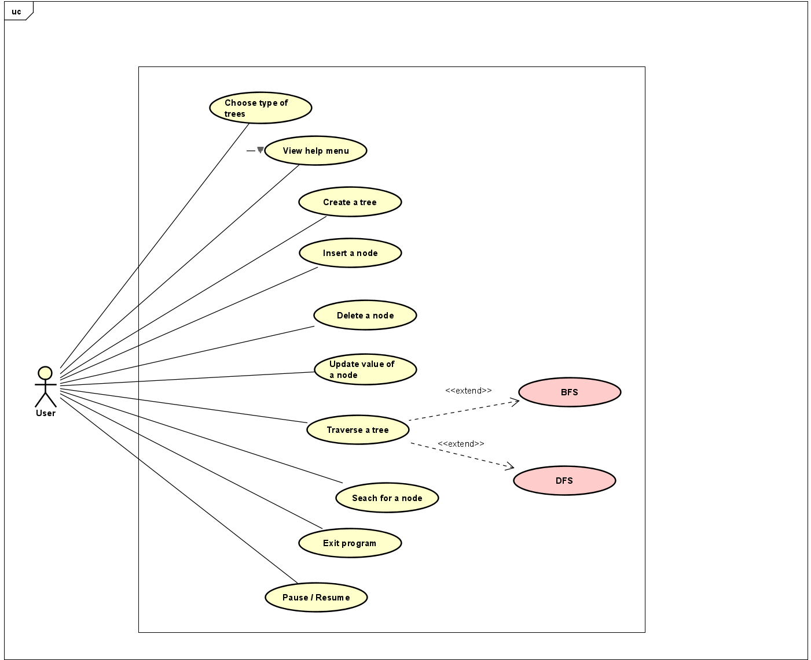
2. UML Class Diagrams

Slide 6
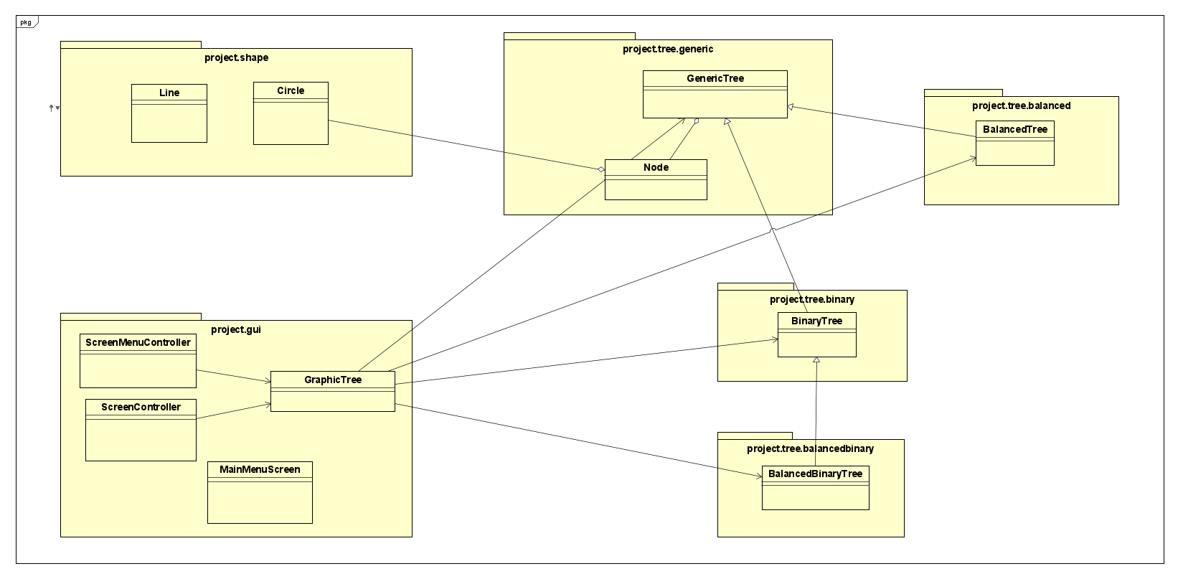
2 UML Class Diagrams
General Class Diagrams

Slide 7
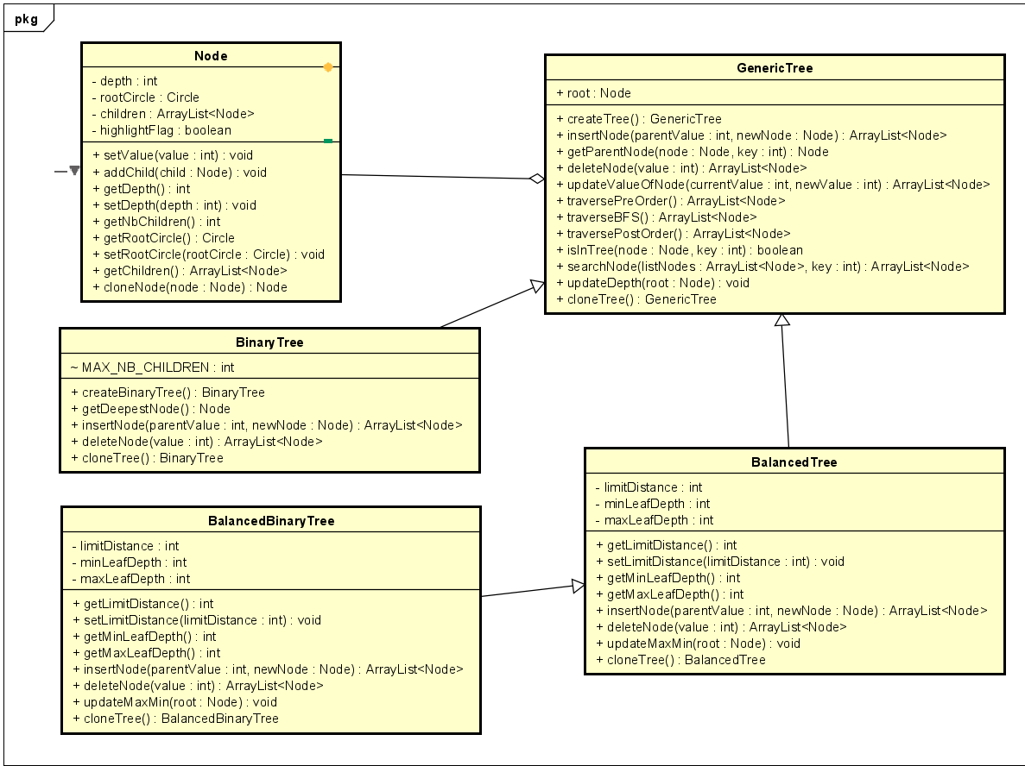
2 UML Class Diagrams
Tree Class Diagrams

Slide 8
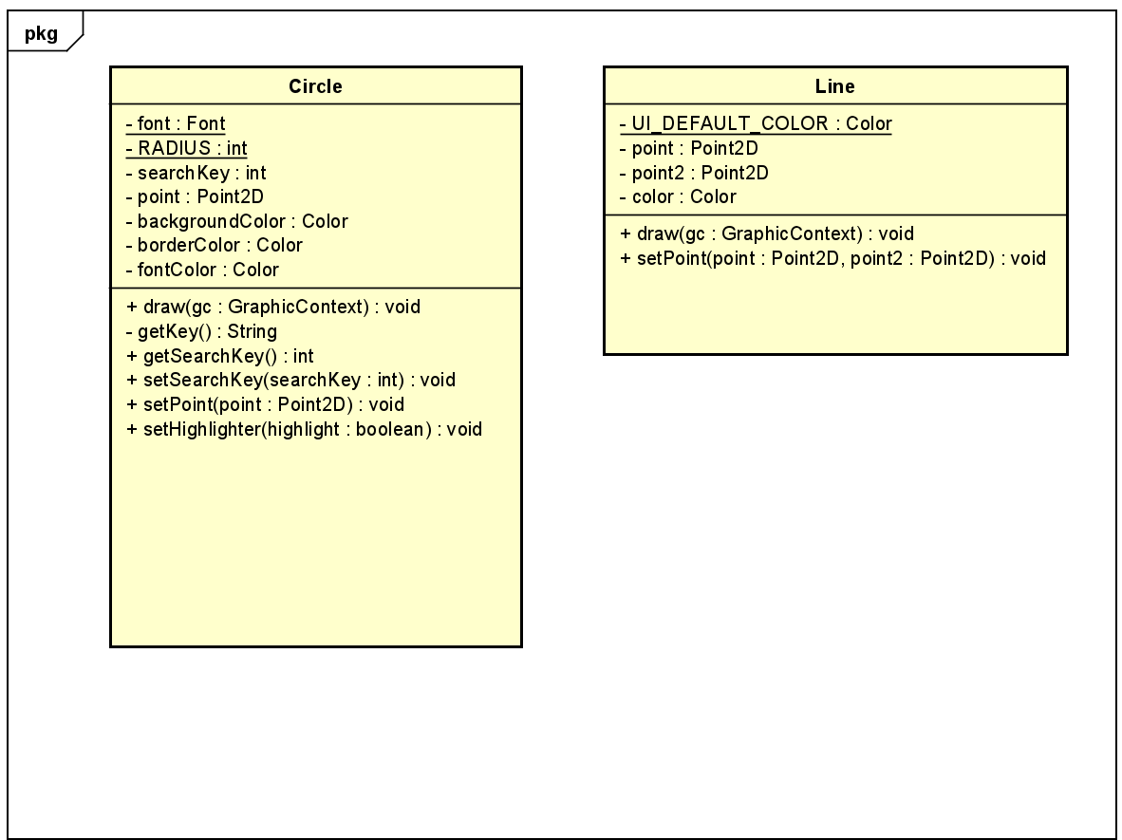
2 UML Class Diagrams
Shape Class Diagrams

Slide 9
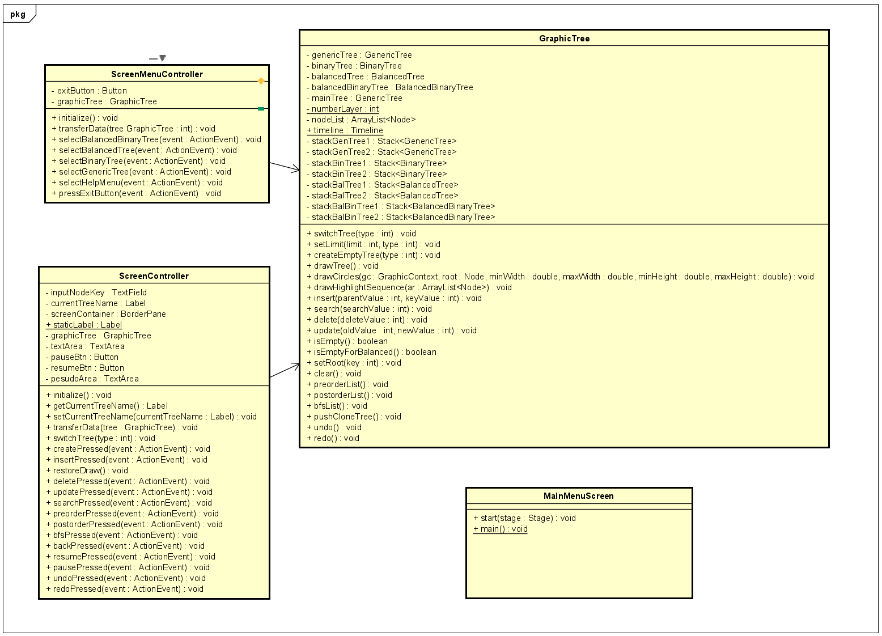
2 UML Class Diagram
GUI Class Diagram

Slide 10
3. Our solution
We applied properties of Object Oriented in building our Trees. Firstly, we used Inheritance property to make Generic Tree the parent of the other three trees.
To build a tree, we created a Node class, followed Aggregation properties. A tree is built from nodes. Here, we designed a root node for each tree. One node can have multiple children so the attribute contains an ArrayList of Node.
We also used Override technique to reuse some methods from Generic Tree when we applied for Binary, Balanced and Balanced Binary Tree.

Slide 11
3. Our solution
ScreenMenuController controls MainMenuScreen class and ScreenController controls GraphicTree.
Those two controller classes use GraphicTree class, so Association is used here.
We also designed a class named Graphic Tree to determine which elements need to visualize a tree, and also some methods to help us illustrate operations on each tree data structures. We also applied Polymorphism in Graphic Tree by upcasting the other four trees to the main tree. Then almost all the operations were used in the main tree.

Slide 12
4. Demo
Link to video demo:
https://youtu.be/Fjot6pCteK0
Link GitHub:
https://github.com/AppuruP41/OOP_LT_20232

Slide 13
5.Teamwork
Tran Quang Hung: UI , UML design
Nguyen Huu Hoang: Algorithm
Nguyen Dinh Son: Algorithm
Pham Phuong Huy: Algorithm

Slide 14
THANK YOU !

