Slide 1

Patterns in Independent Medical Reviews (IMRs)
By Chinmay Purav
* Picture from https://precisionmedicalbilling.com/

Slide 2
Project Overview
The dataset was collected from HealthData.gov
28,048 cases of declined medical claim
14 columns
ReferenceID, Report Year, Diagnosis Category, Determination, Age Range
Goal:
Identifying patterns in the outcomes of the IMRs
Motivation:
In my personal experience, I have observed the importance of having a medical claim. But what happens when it is rejected?

Slide 3

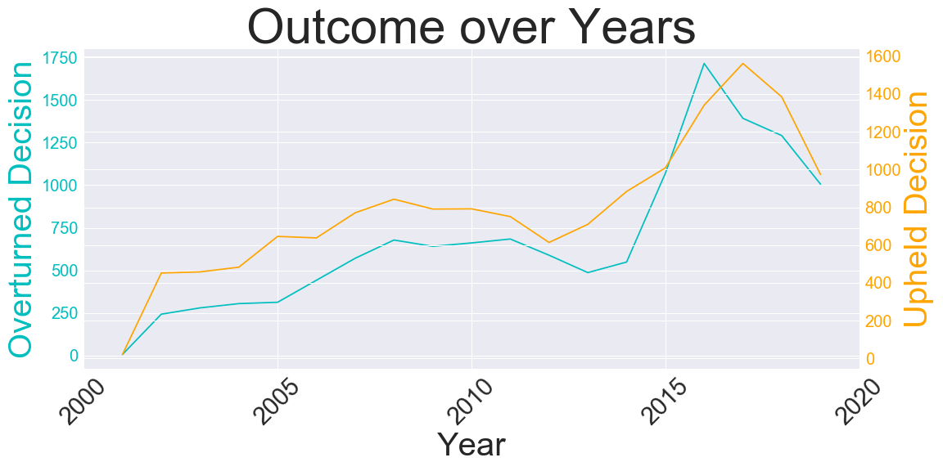
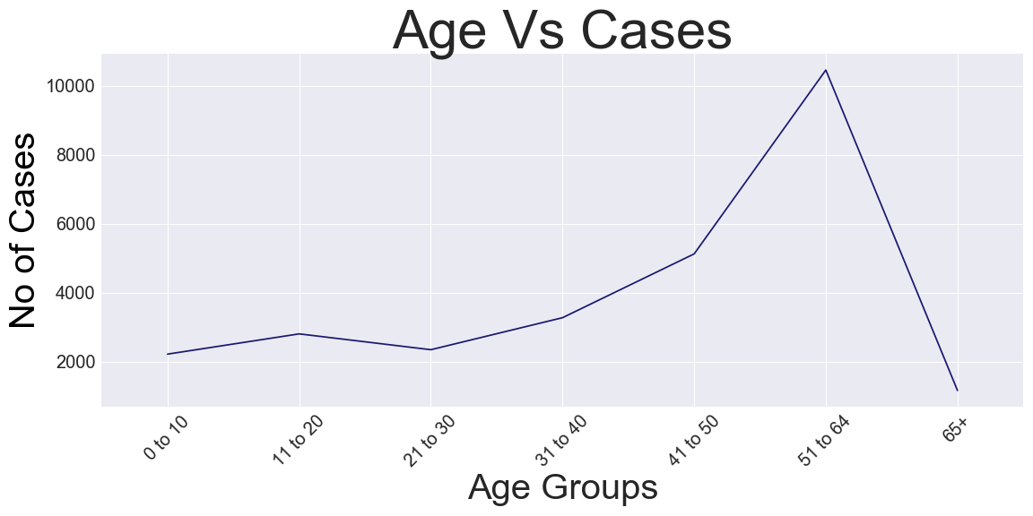
Exploratory Data Analysis

Slide 4
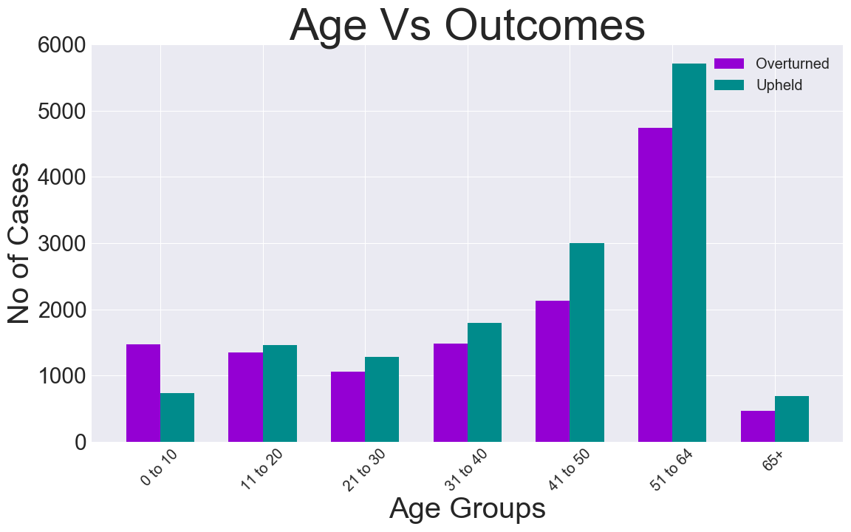
Exploratory Data Analysis

Slide 5
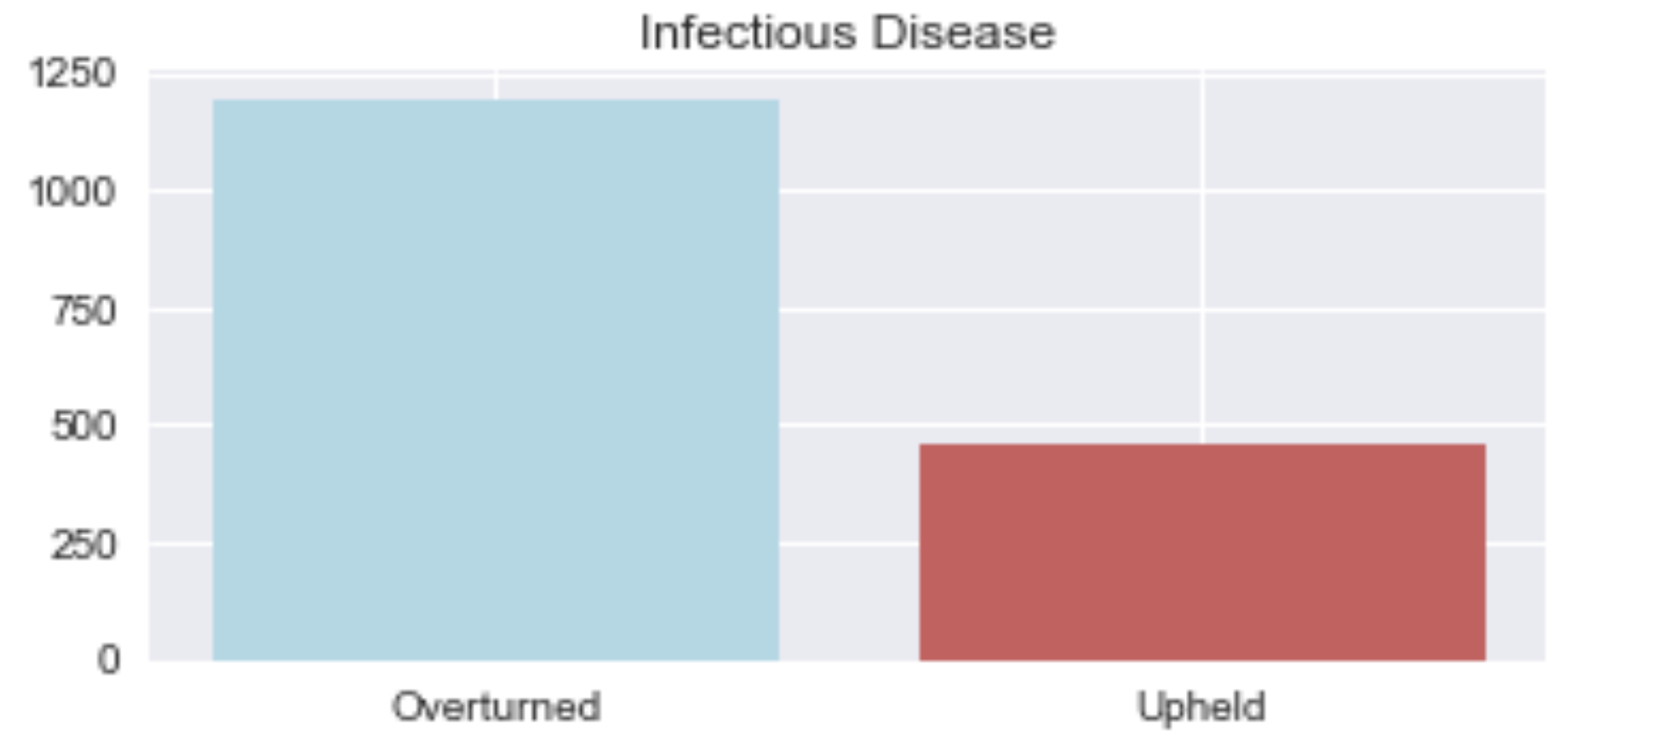
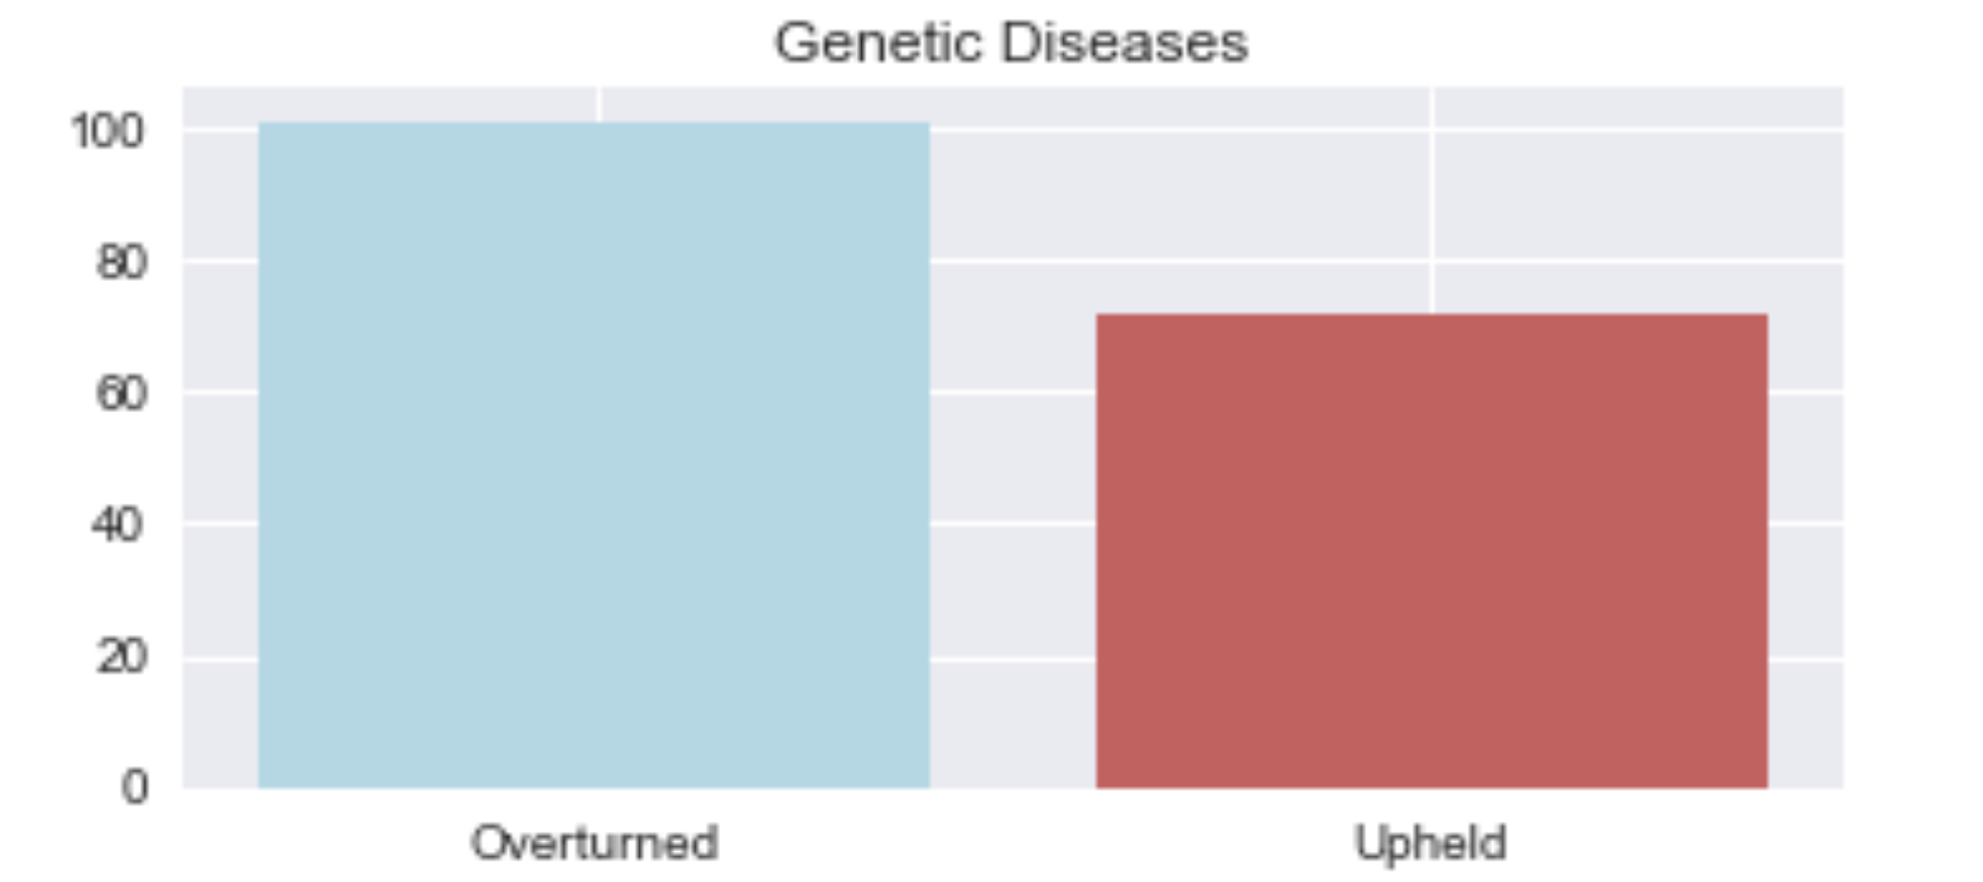

Exploratory Data Analysis

Slide 6
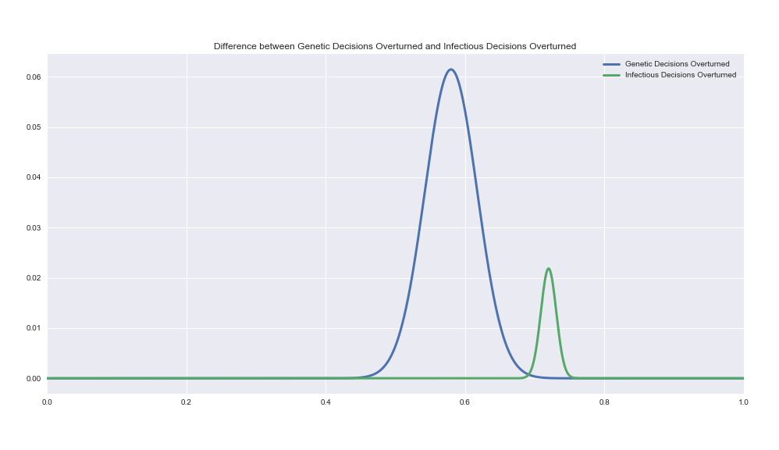
Hypothesis Tests
H0: pID <= pGD
HA: pID > pGD
Resulting p-value: 0.00
Conclusion: Reject the null hypothesis

Slide 7
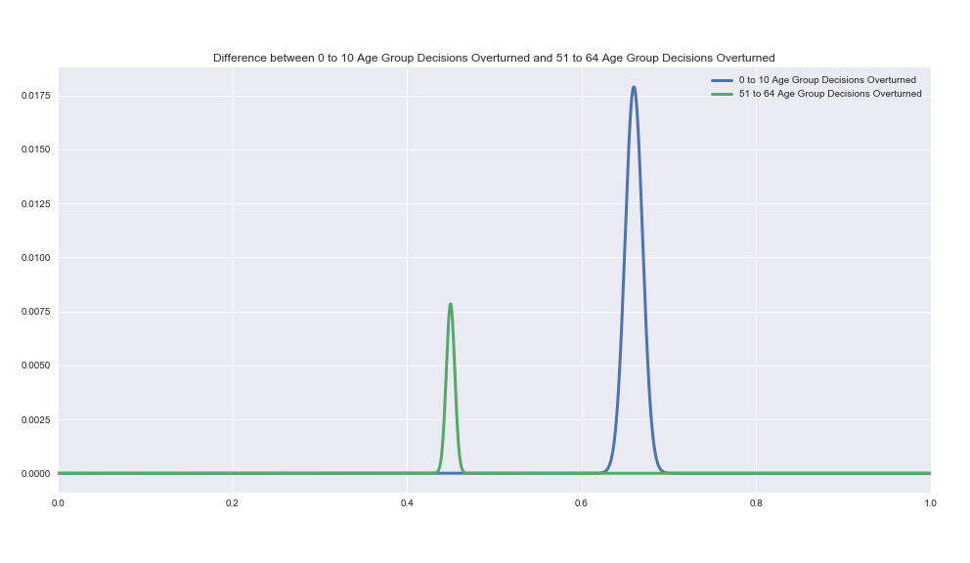
Hypothesis Test
H0: p(0-10) <= p(51-64)
HA: p(0-10)> p(51-64)
Resulting p-value: 0.00
Conclusion: Reject the null hypothesis

Slide 8
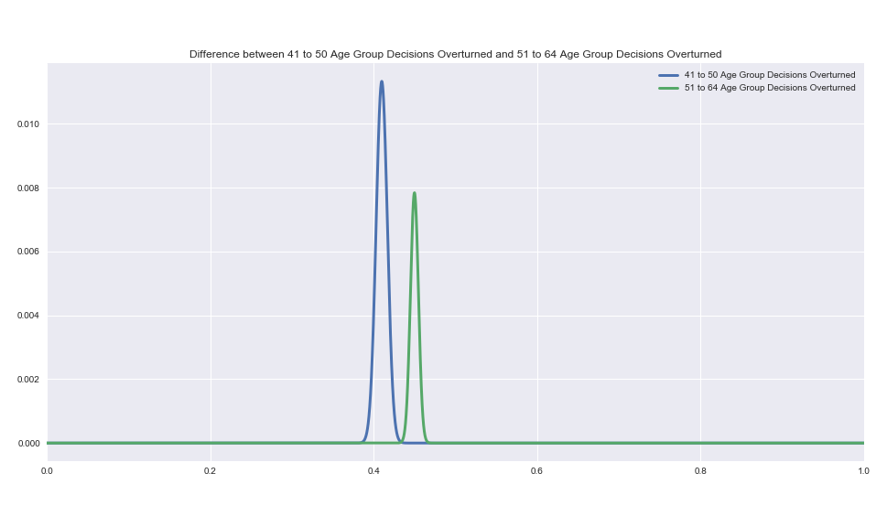
Hypothesis Test
H0: p(41-50) = p(51-64)
HA: p(41-50) != p(51-64)
Resulting p-value: 0.00
Conclusion: Reject the null hypothesis

Slide 9
Conclusion and Next Steps
Took the data and performed EDA.
Two of the different routes that could be taken – Comparing different Diseases against each other, and different Age Groups against each other.
In this project, hypothesis tests were conducted on one of each routes.
The next steps would be to conduct each Age group and Diseases against each other to gain a deeper insight into the data.

Slide 10
Questions?

