Slide 1

Are you noisy enough?
By Chinmay Purav

Slide 2
Agenda
Overview of Data
Feature Extraction
EDA
Machine Learning Modeling
Correlation Check
Conclusion and Future Work

Slide 3
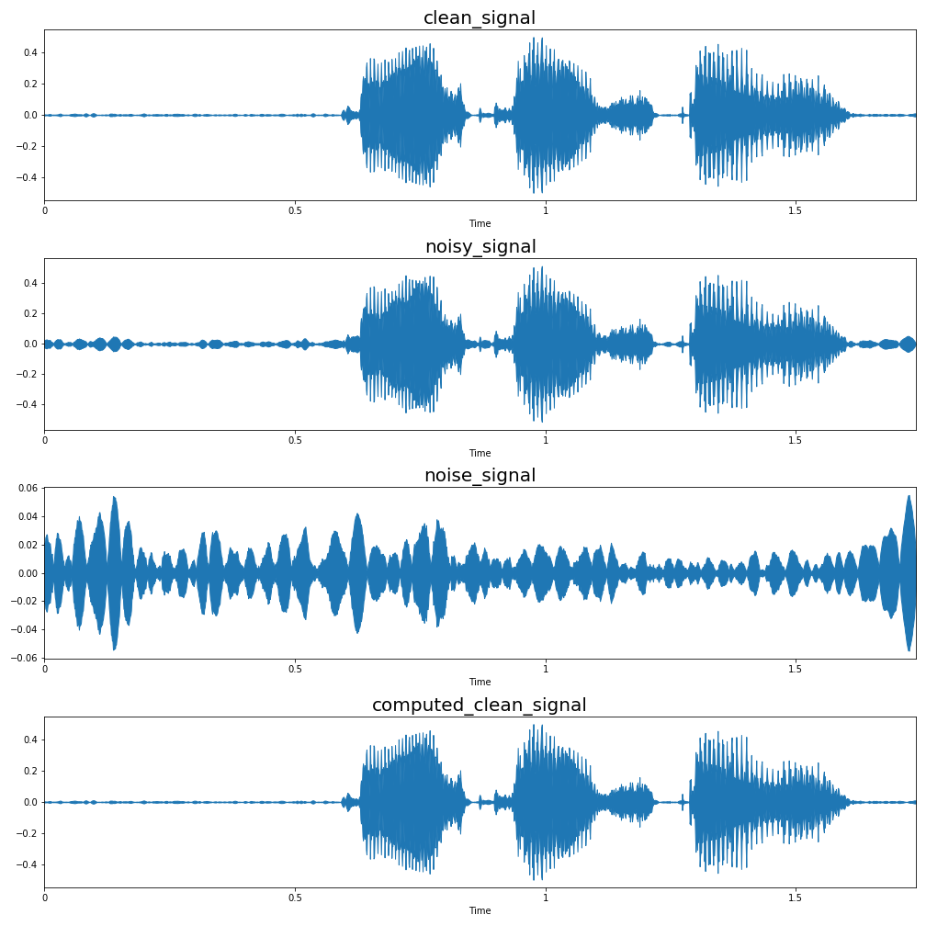
Overview of Data
Published by The University of Edinburgh, UK
The data consist of 825 clean audio files and 825 noisy audio files
The clean and noisy audio files correspond to each other as they have same speech with and without background noise.
Total of 26 features were extracted from each of these files.

Slide 4
Feature Selection
Zero Crossing Rate
Spectral Centroid
Spectral Rolloff
Chroma Frequencies
Mel-frequency cepstral coefficients

Slide 5
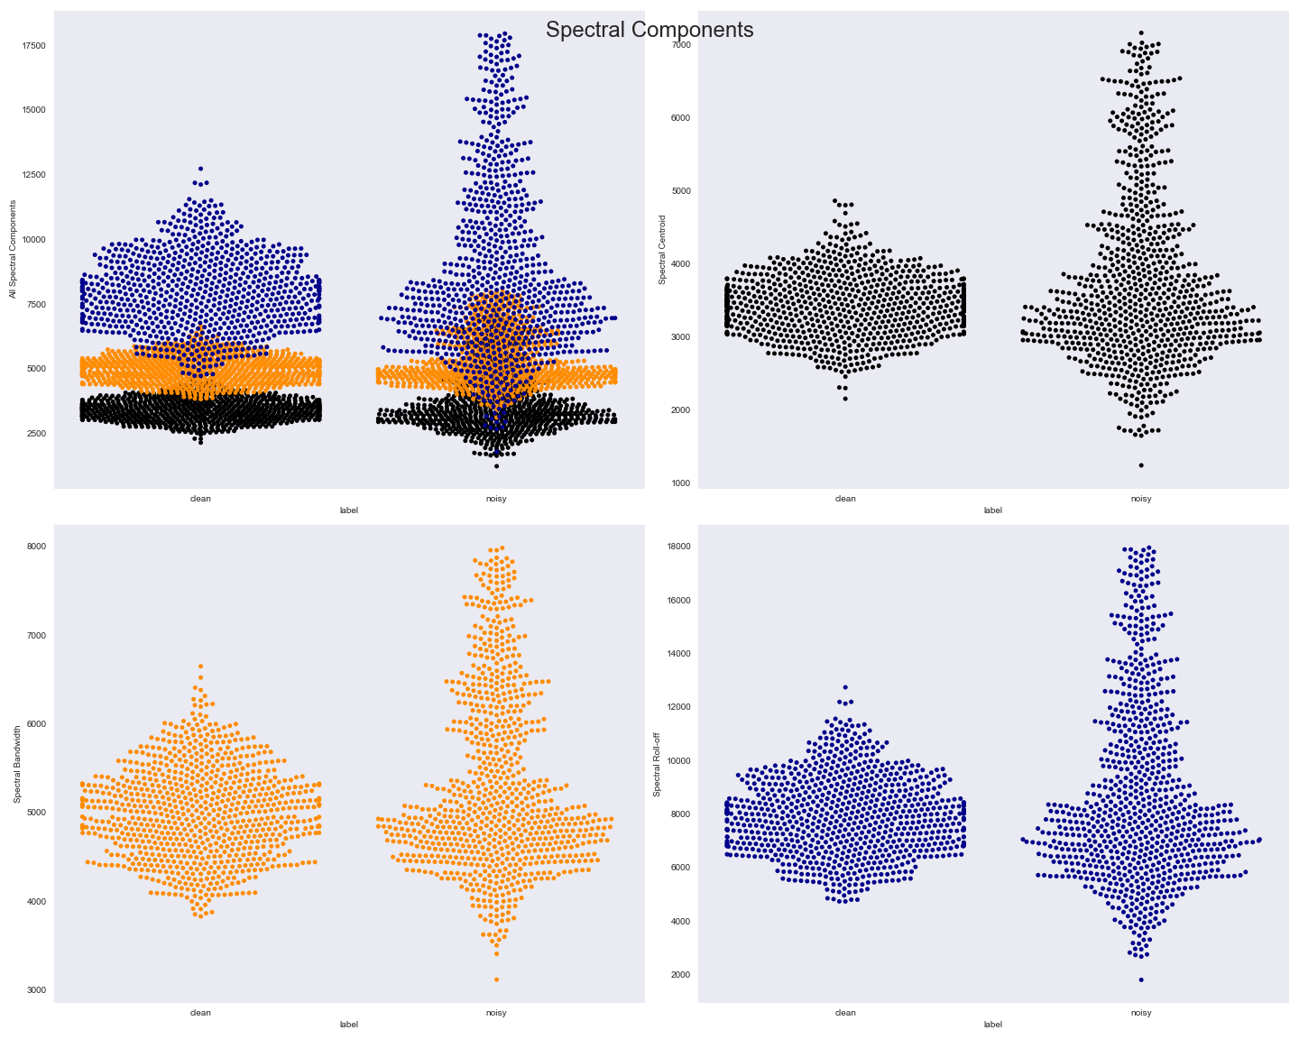
Exploratory Data Analysis
All the three components of the spectral features that were considered showed few differences in clean and noisy audio
But the difference observed visually wasn’t significant enough

Slide 6
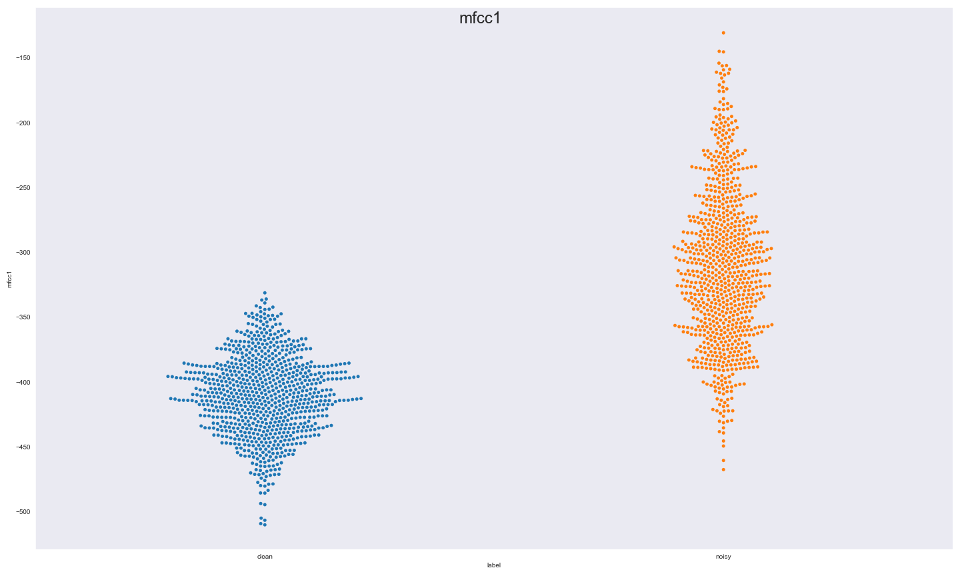
Exploratory Data Analysis
MFCC1 is the first coefficient of the Mel-frequency Cepstrum.
It can be observed visually the differences of MFCC1 in clean and noisy audio
Hence, suggesting that MFCC1 would be a good predictor of the classification

Slide 7
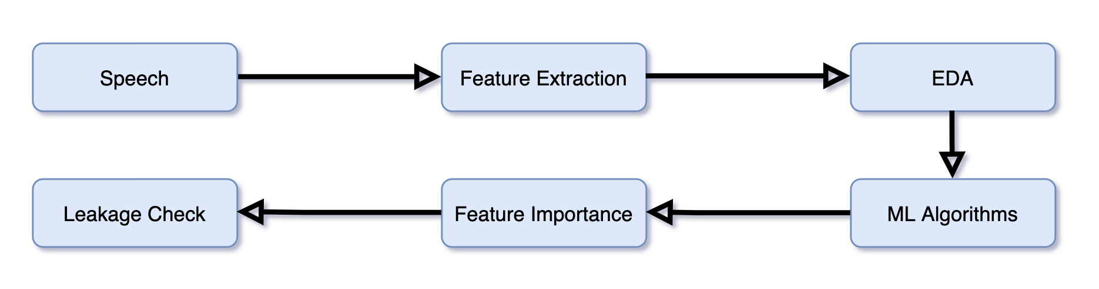
Pipeline

Slide 8
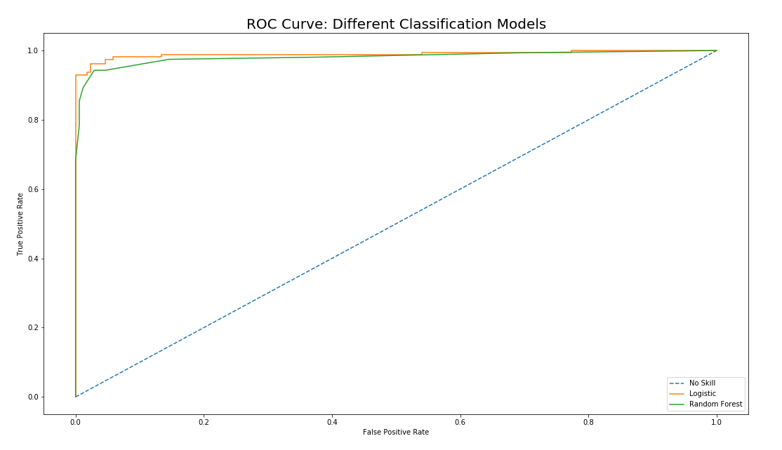
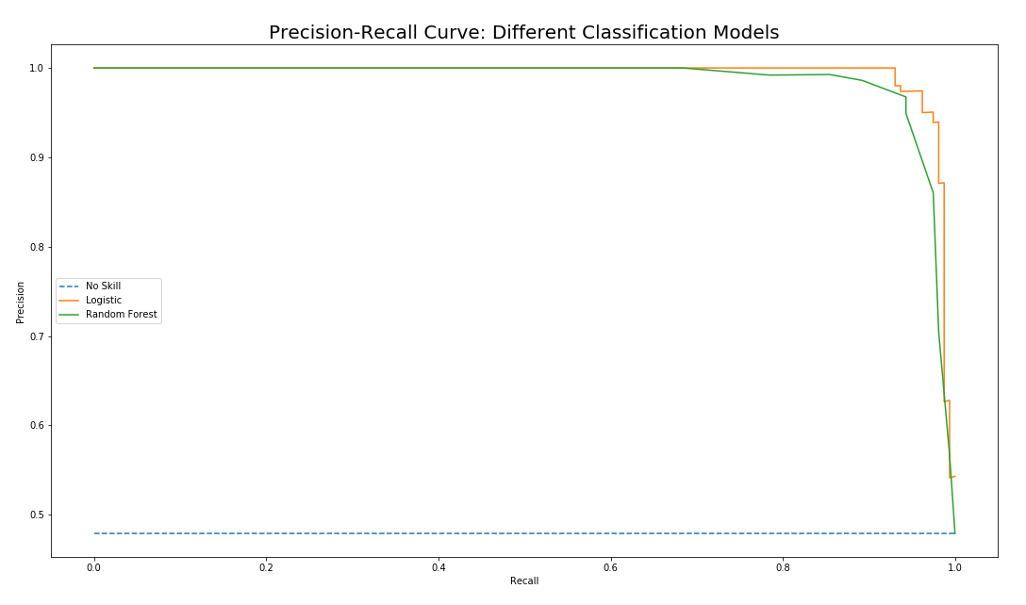
Machine Learning Modeling
Logistic Regression Accuracy: 0.95
Random Forest Accuracy: 0.94

Slide 9
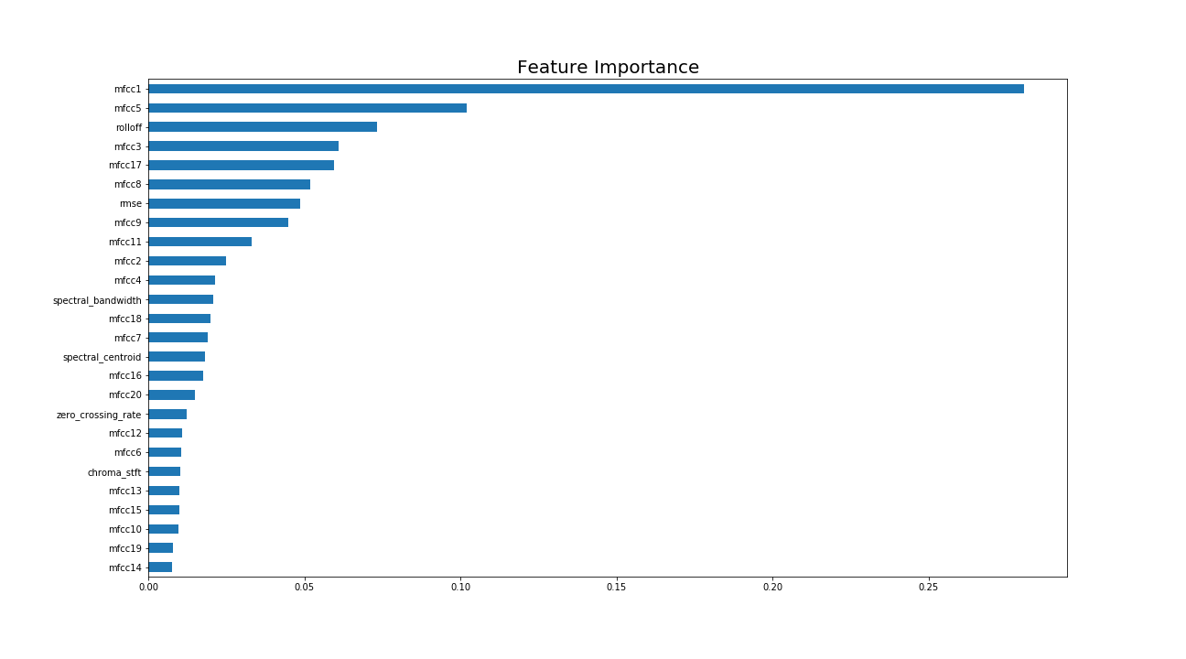
Machine Learning Modeling
Feature importance were found using Random Forest Classifier
Feature importance was iterated 7 times to find the top 7 features that repeated most in those iterations

Slide 10
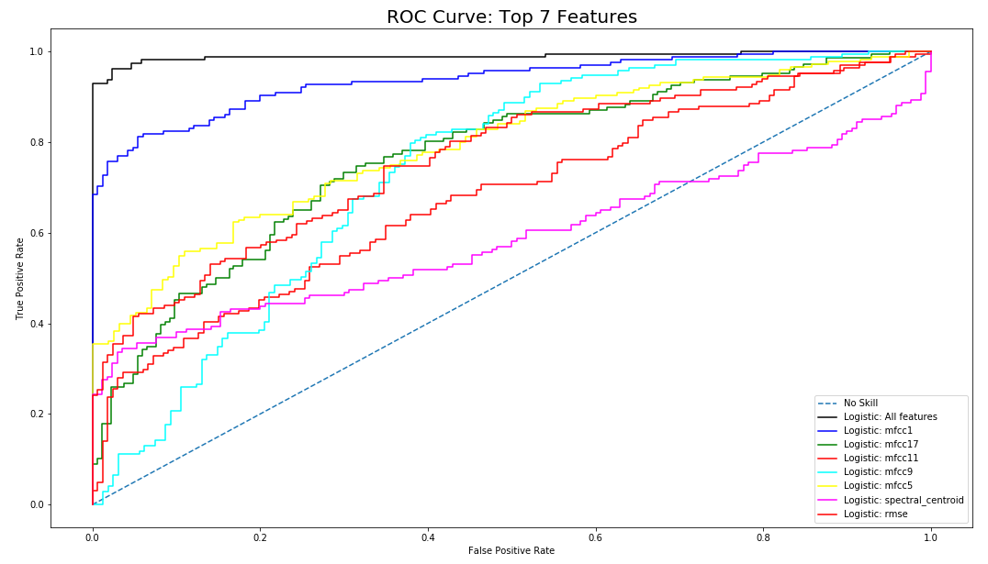
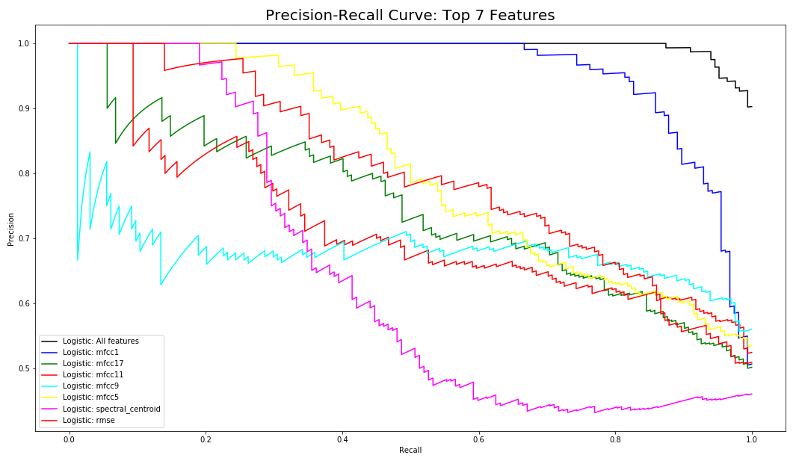
Correlation Check

Slide 11
Conclusion and Future Work
Even though there is strong correlation between mfcc1 and the classification, it is not strong enough to call it a leakage.
It can be concluded that there was leakage between the two classes in the downloaded data files.
I would recommend not using the same files for future work. Hence, I have found new, and larger sound files for training in the future work.
Those new files would be used to do speech enhancement with RNN.

Slide 12
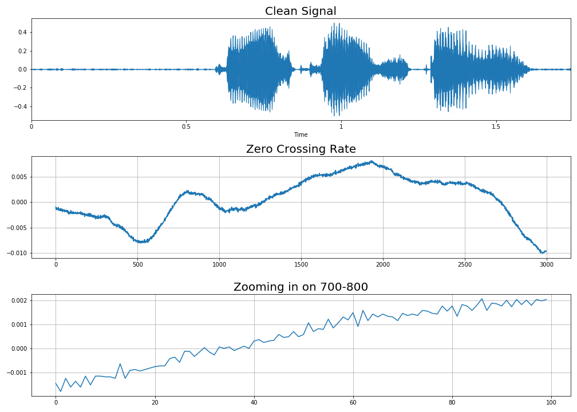
Zero Crossing Rate
ZRC is the rate at which a signal changes the sign
In essence, ZRC measures the dominant frequency of the signal

Slide 13
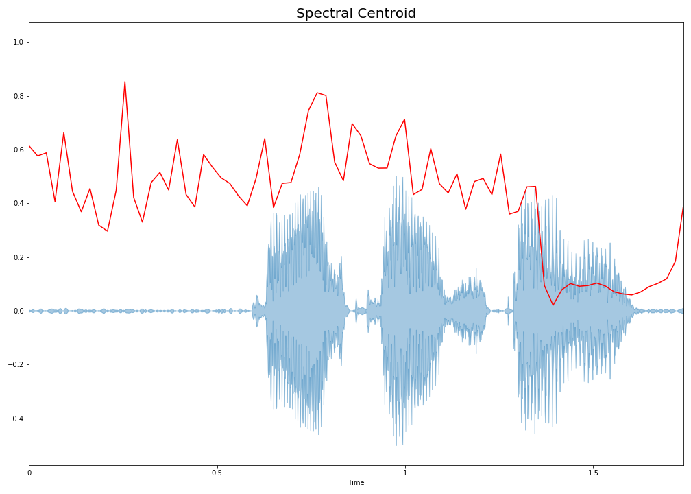
Spectral Centroid
Spectral Centroid indicates the balancing point of the spectral power distribution.
In essence, Spectral Centroid measures the perceived sound quality.

Slide 14
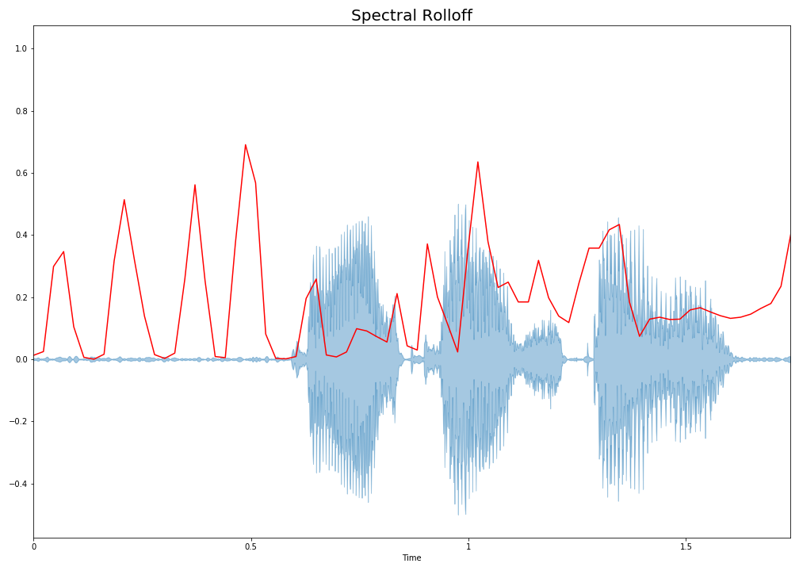
Spectral Rolloff
Spectral Rolloff is the frequency below which a specified percentage of the total spectral energy lies.
The rolloff frequency can be used to distinguish between harmonic (below rolloff) and noisy sounds (above rolloff)
In this project, the rolloff frequency was found at 85% of the total energy spectrum

Slide 15
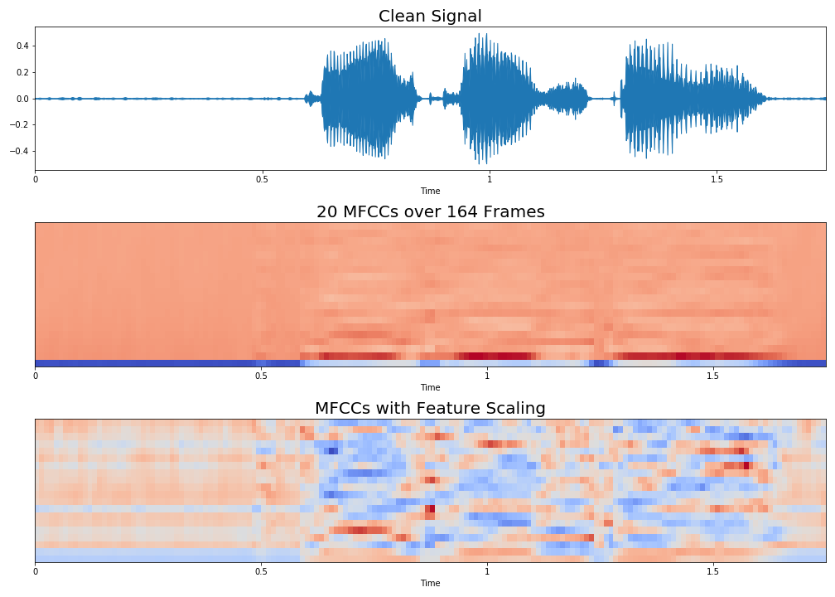
Mel-frequency Cepstrum
Mel-frequency cepstral coefficients (MFCCs) are are coefficients that make up the MFC. A MFC is the short term power spectrum of sound. MFCCs are commonly used in speech recognition.
As MFCCs are sensitive to noise, it is common to normalize them to reduce the influence of noise.
In essence, MFCCs describe the overall shape of the spectral envelope.

Slide 16
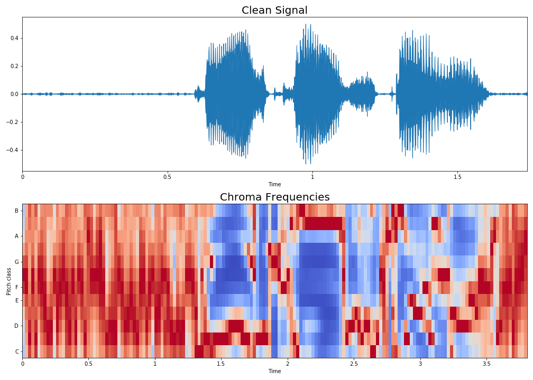
Chroma Frequencies
Chroma features is projecting the entire spectrum into the 12 distinct semitones of the musical octave.

