Slide 1

Are you noisy enough?
By Chinmay Purav
Notes:
Good Morning everyone, my name is Chinmay. I am here to present my project, “Are you noisy enough?”
Decades of research has been done in the field of signal processing. This performance saturation has been stirred by the recent advances in Machine Learning and AI, where data-driven methods are being explored. This is a two-step project, first audio files classification, second denoising the noisy audio files. Today, we will be talking about part one and the progress in the second part to conclude.

Slide 2
Agenda
Overview of Data
Feature Selection
EDA
Modeling
Features in Details
Conclusion and Future Work
Notes:
The Agenda is to talk about the overview of the data, the features that were selected, the EDA looking at what the sound files look like.
From there we will dive into the models that have been used for classification. Along with concluding, we will talk about the future work which will then include how these classified audio files will be used.

Slide 3
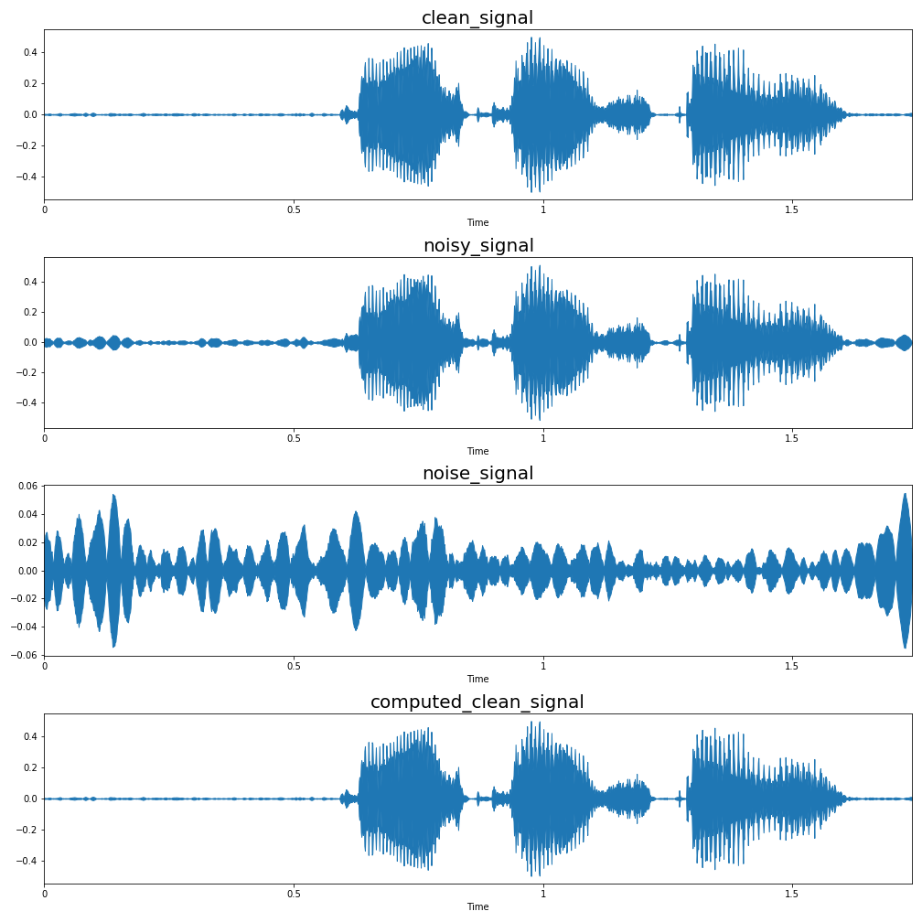
Overview of Data
Published by The University of Edinburgh, UK
54-speaker and 28-speaker datasets and 400 audio files for each speaker.
The clean and noisy audio files correspond to each other as they have same speech with and without background noise.
Total of 26 features were extracted from each of these files.
Notes:
The datasets were downloaded from University of Edinburgh, UK. The datasets have 56-speakers and 28-speakers, and every speaker has 400 audio files each.
These files have been made available to train speech enhancement models, for which they will in-turn be used.

Slide 4
Feature Selection
Zero Crossing Rate
Spectral Centroid
Spectral Rolloff
Chroma Frequencies
Mel-frequency cepstral coefficients

Slide 5
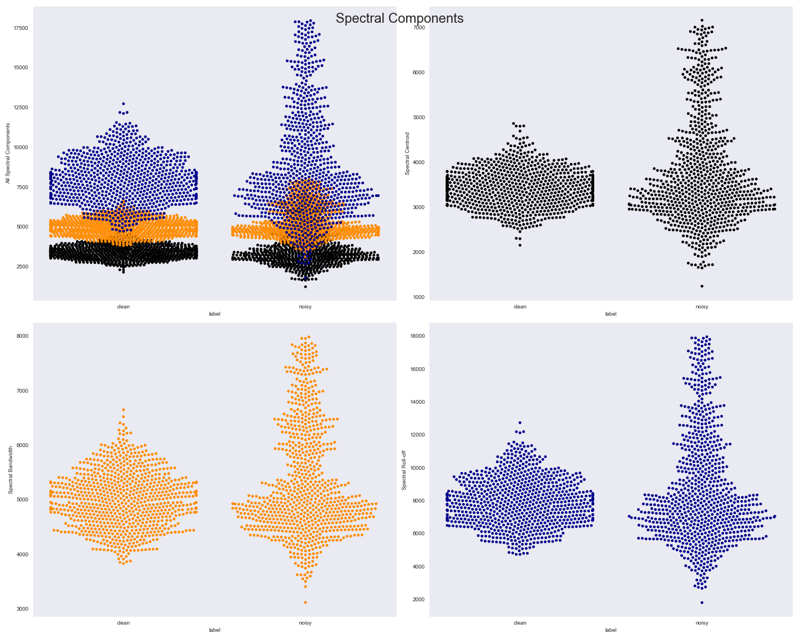
Exploratory Data Analysis
All the three components of the spectral features that were considered showed few differences in clean and noisy audio
But the difference observed visually wasn’t significant enough

Slide 6
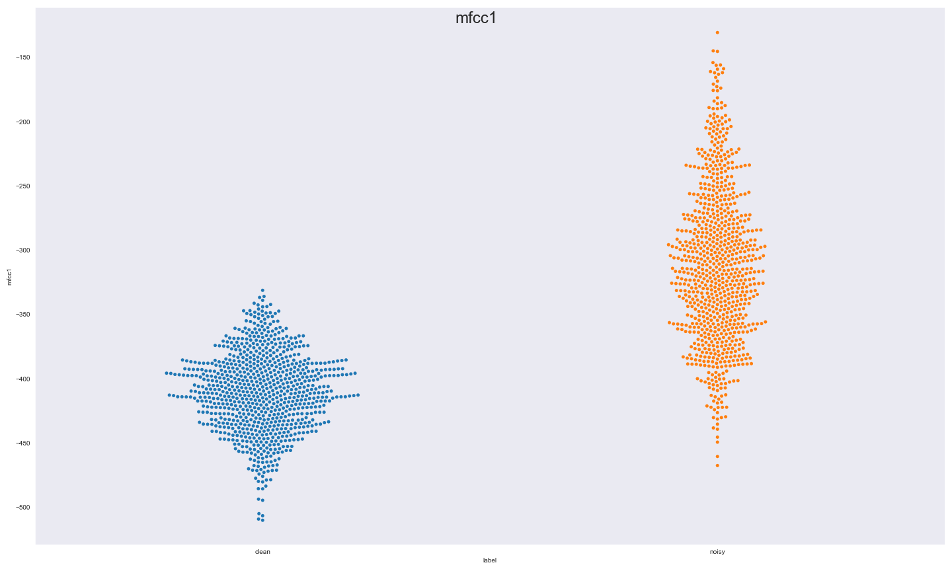
Exploratory Data Analysis
MFCC1 is the first coefficient of the Mel-frequency Cepstrum.
It can be observed visually the differences of MFCC1 in clean and noisy audio
Hence, suggesting that MFCC1 would be a good predictor of the classification

Slide 7
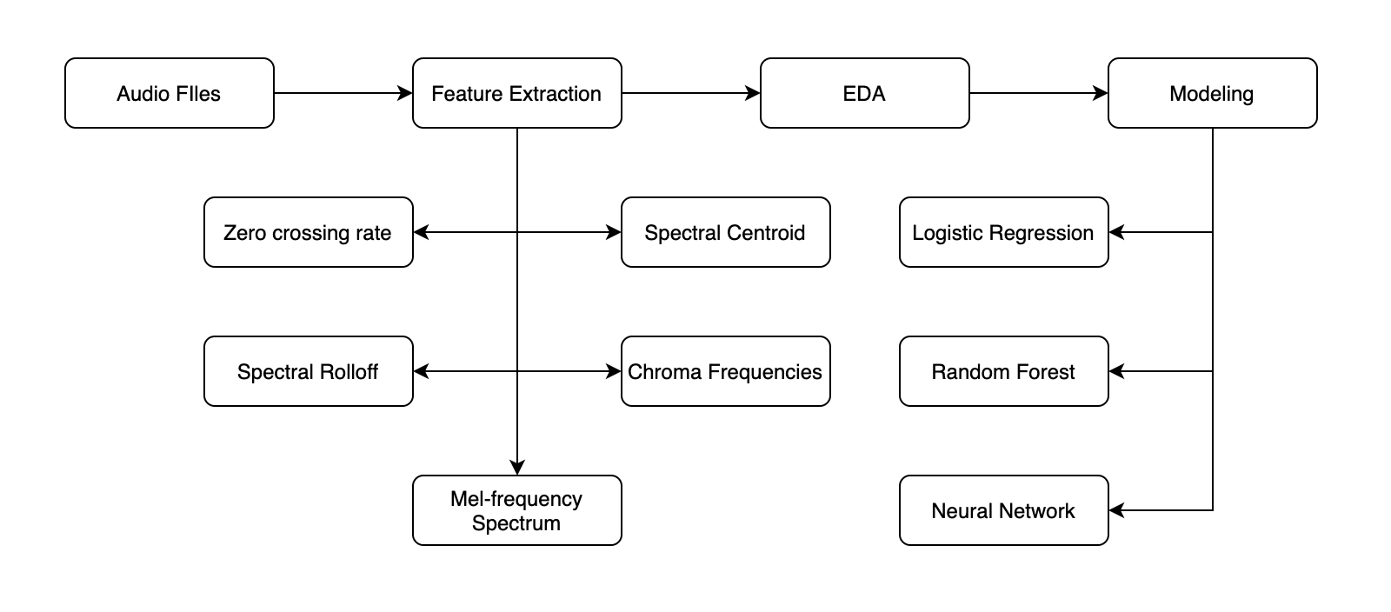
Pipeline

Slide 8
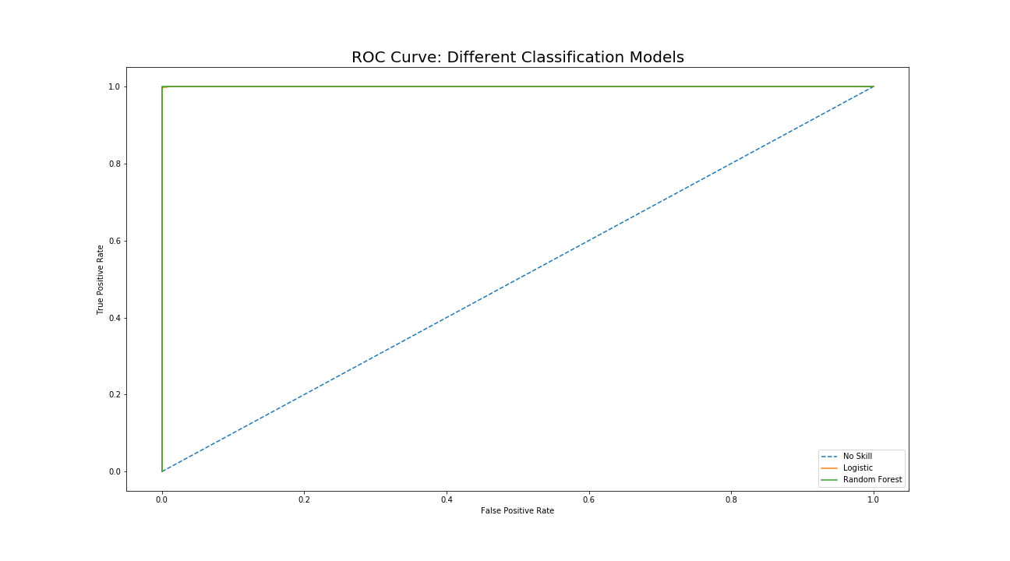
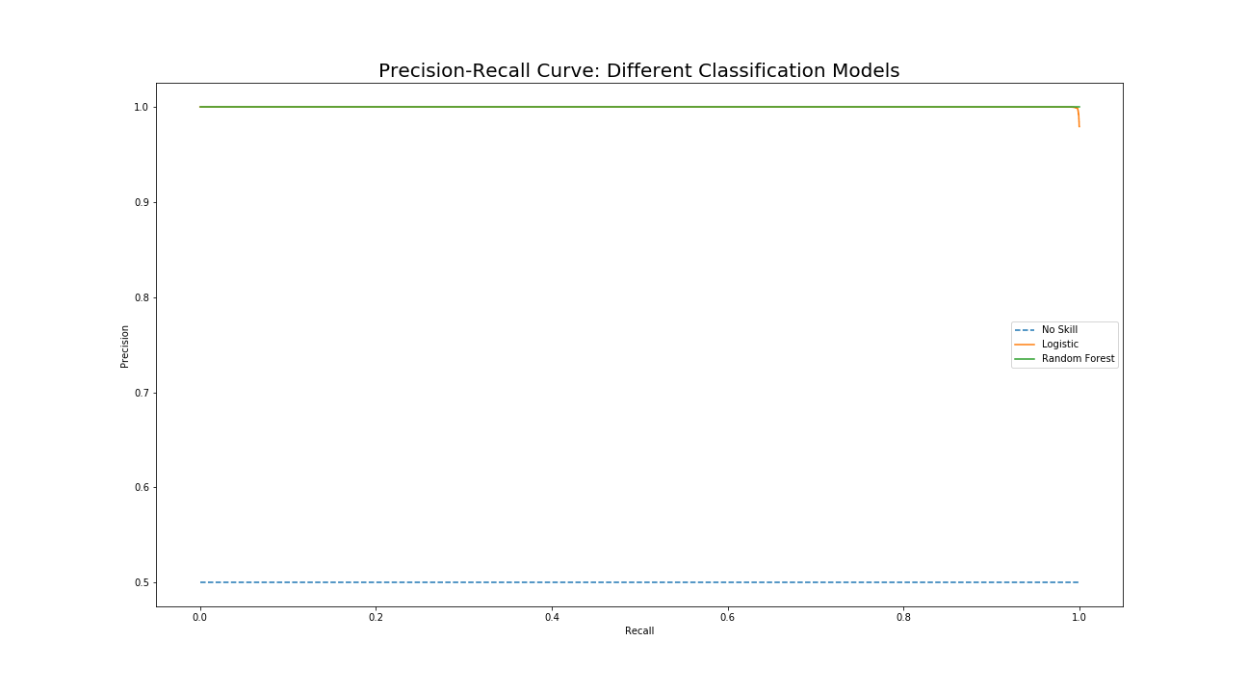
Modeling: Logistic and Random Forest
Train: 56-speaker dataset
Test: 28-speaker dataset

Slide 9

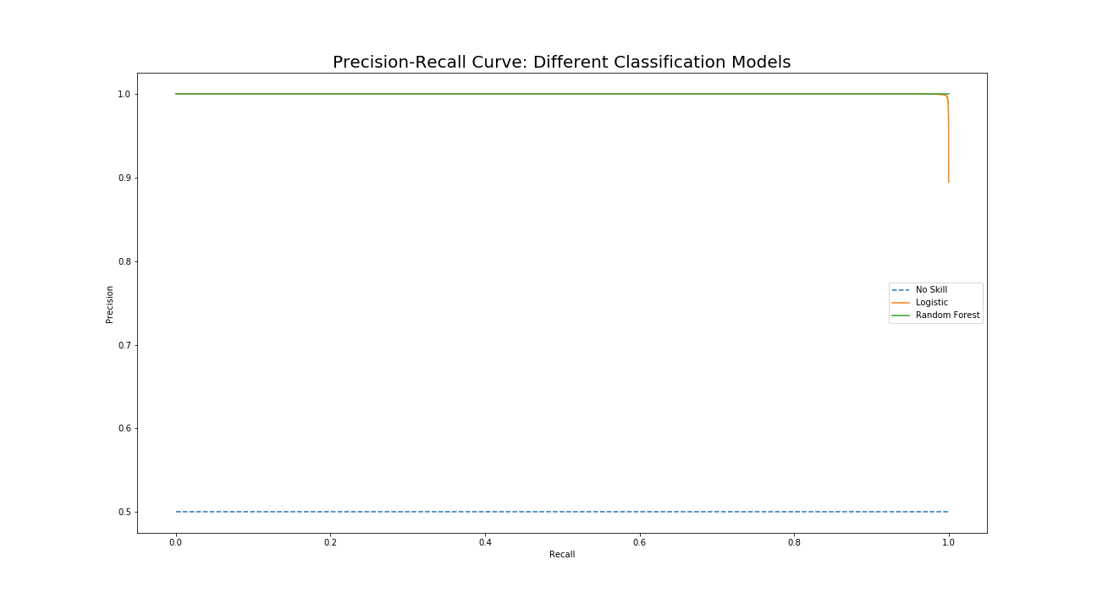
Modeling: Logistic and Random Forest
Train: 28-speaker dataset
Test: 56-speaker dataset

Slide 10
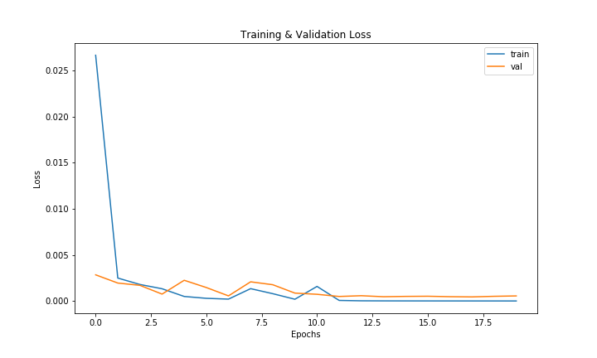
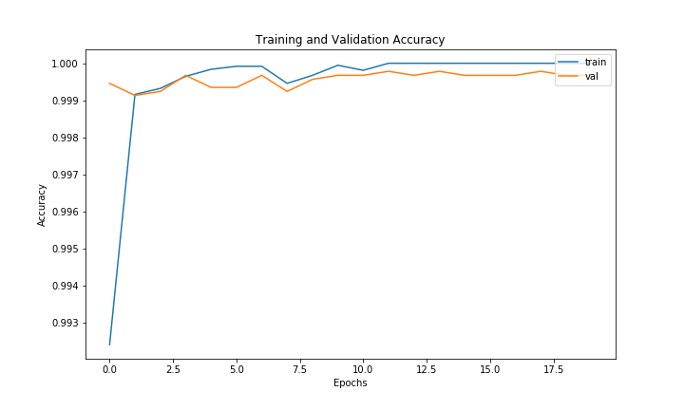
Modeling: Neural Network
Train: 56-speaker dataset
Test: 28-speaker dataset

Slide 11
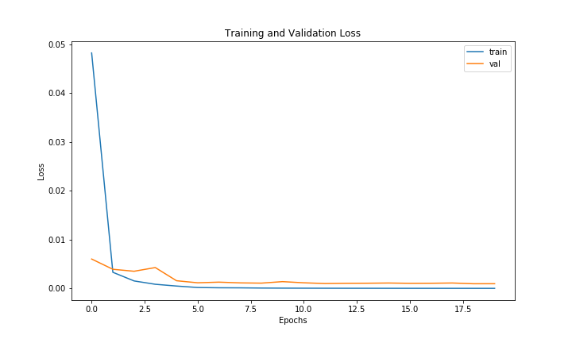
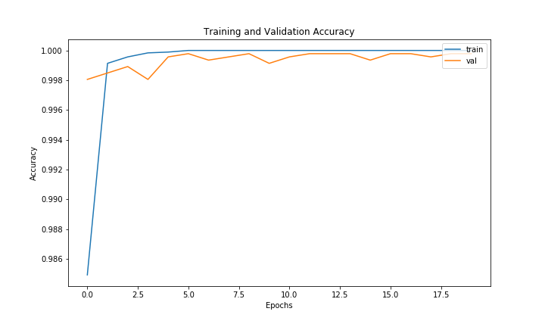
Modeling: Neural Network
Train: 28-speaker dataset
Test: 56-speaker dataset

Slide 12
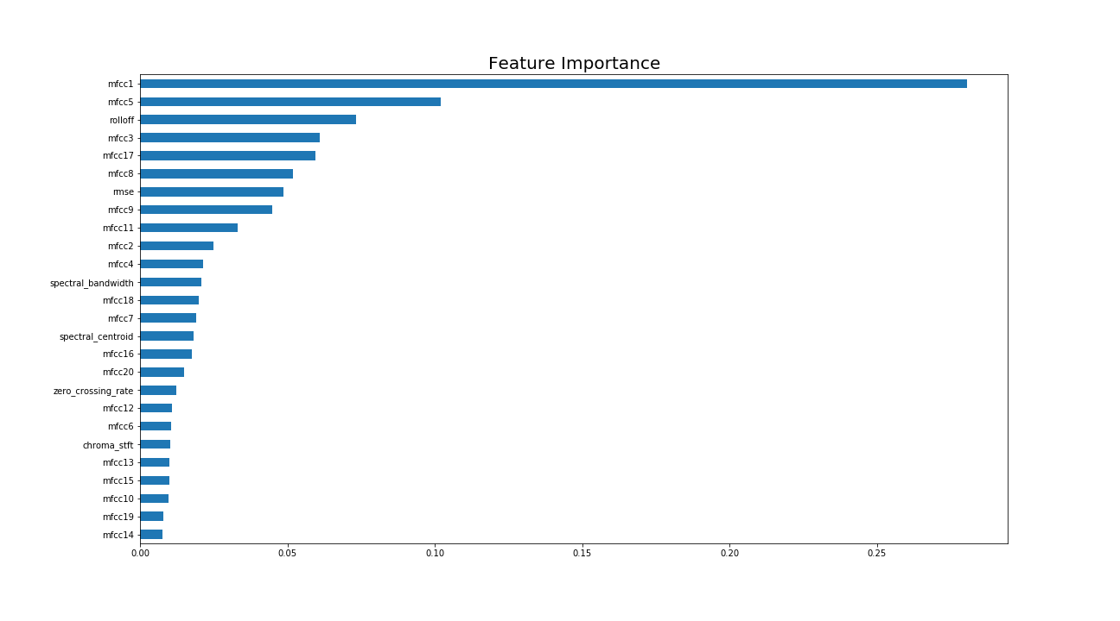
Modeling: Feature Importance
Feature importance were found using Random Forest Classifier
Feature importance was iterated 7 times to find the top 7 features that repeated most in those iterations

Slide 13
Conclusion and Future Work
Even though there is strong correlation between mfcc1 and the classification, it is not strong enough to call it a leakage.
A flask webpage with a Convolutional Encoder-Decoder Network in the backend on AWS is being developed. The 54-speaker Dataset is being used for training the network.
Even though MFCCs were used for classification, STFTs are found to be better for noise reduction.

Slide 14
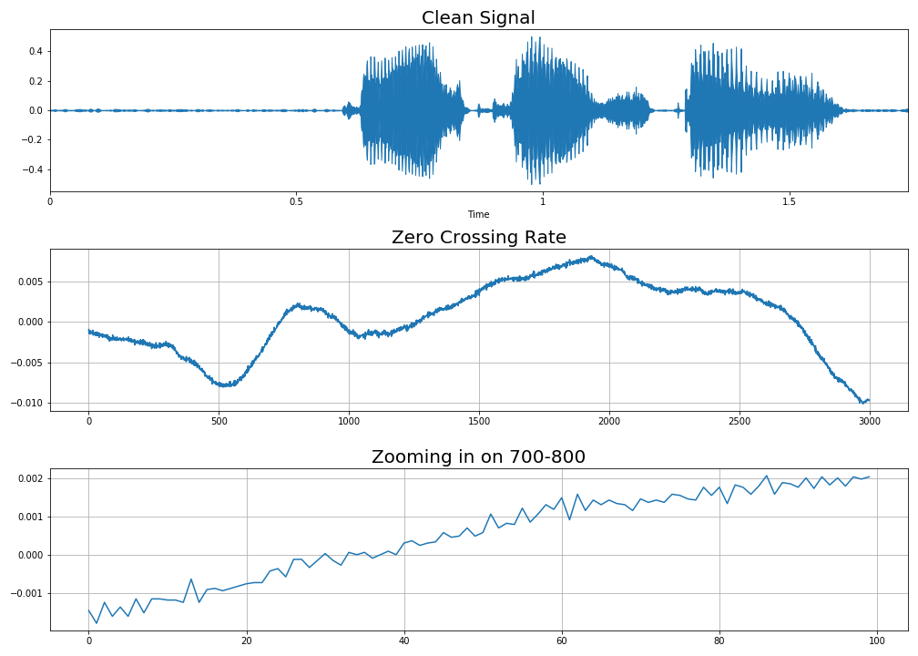
Zero Crossing Rate
ZRC is the rate at which a signal changes the sign
In essence, ZRC measures the dominant frequency of the signal

Slide 15
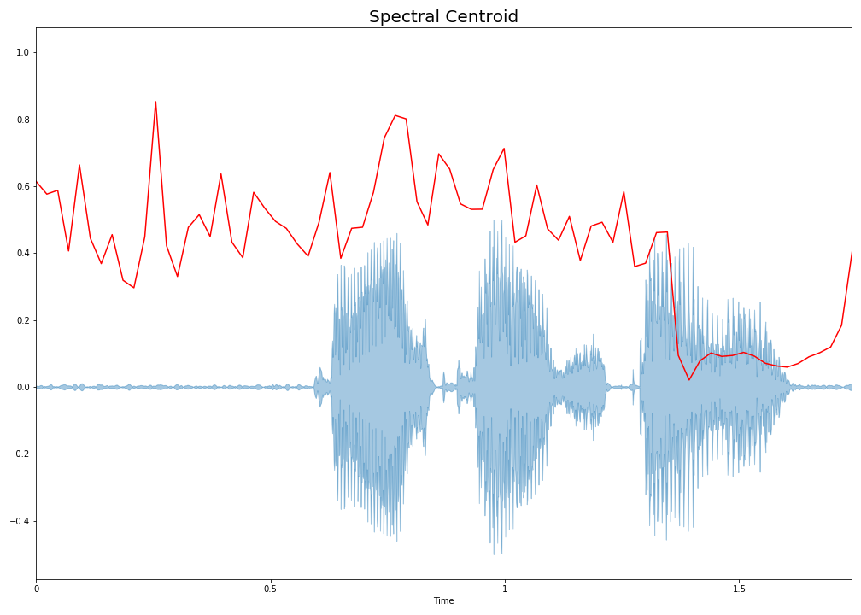
Spectral Centroid
Spectral Centroid indicates the balancing point of the spectral power distribution.
In essence, Spectral Centroid measures the perceived sound quality.

Slide 16
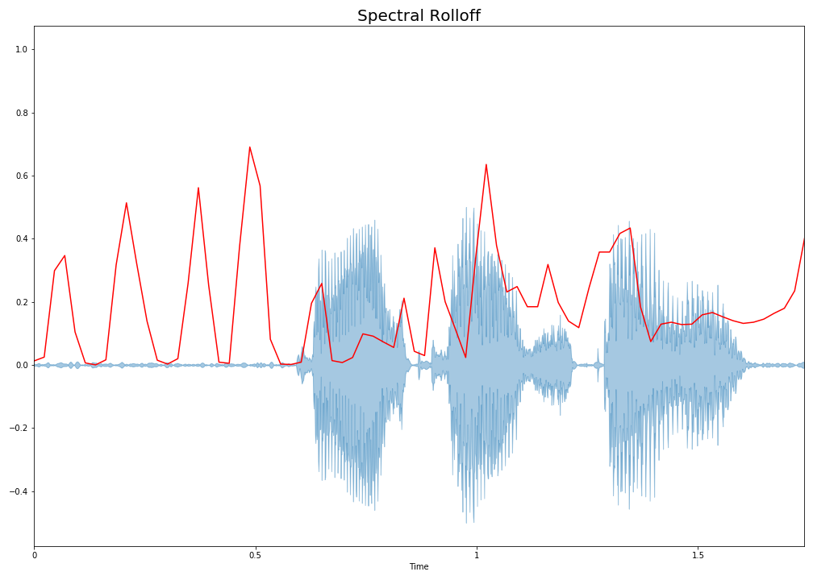
Spectral Rolloff
Spectral Rolloff is the frequency below which a specified percentage of the total spectral energy lies.
The rolloff frequency can be used to distinguish between harmonic (below rolloff) and noisy sounds (above rolloff)
In this project, the rolloff frequency was found at 85% of the total energy spectrum

Slide 17
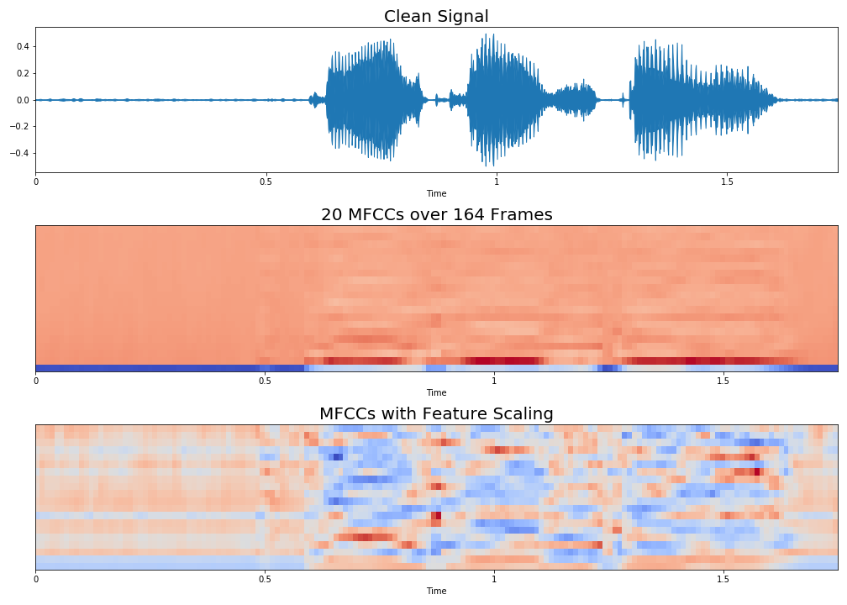
Mel-frequency Cepstrum
Mel-frequency cepstral coefficients (MFCCs) are are coefficients that make up the MFC. A MFC is the short term power spectrum of sound. MFCCs are commonly used in speech recognition.
As MFCCs are sensitive to noise, it is common to normalize them to reduce the influence of noise.
In essence, MFCCs describe the overall shape of the spectral envelope.

Slide 18
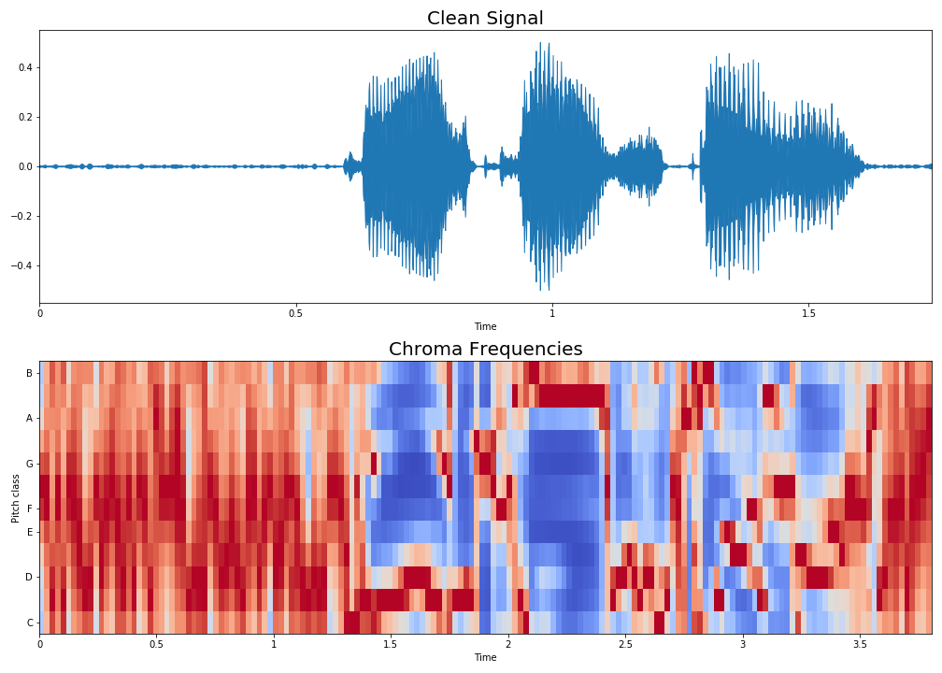
Chroma Frequencies
Chroma features is projecting the entire spectrum into the 12 distinct semitones of the musical octave.

