Slide 1

Interview Assignment
6th October 2021
Appanna MACHIMANDA

Slide 2

Background
Metabolic provides insight to companies on how their material sourcing puts them at risk of negatively affecting nature.
Risk varies by the materials being sourced and the geographies from where they are being sourced.
And also which pressure is being assessed: Land degradation, Bio div.. Etc
Currently the approach has been to compare the company’s facilities (eg factories) with each other so that they have a normalised score from 1 to 5 (highest risk).
An example insight:
A facility has a high_risk for air_pollution relative to the company’s other facilities.
However, this facility might actually still have a relatively low risk for air pollution when compared against global averages (mean of air pollution for all countries).
For a facility, we want to understand the risk of a pressure w.r.t the global risk.

Slide 3
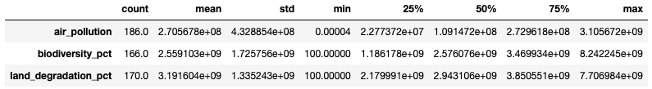
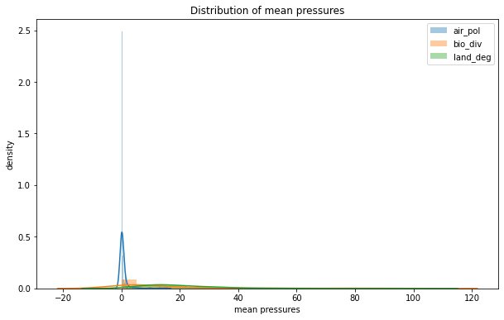
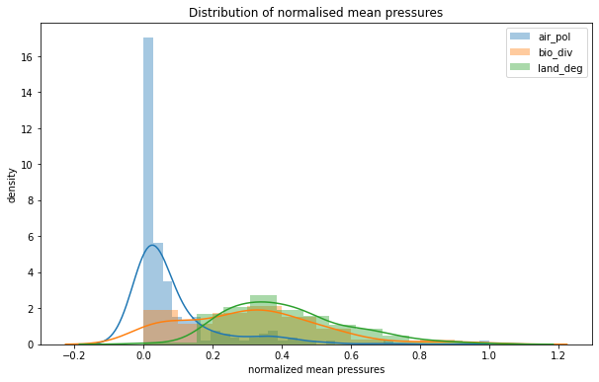
Per country pressure data
There are 198 countries which are being monitored. Not all countries have data for all pressures (refer count)
We have considered mean value from different crops as the value for a particular country.

Slide 4
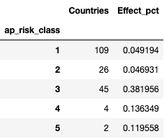
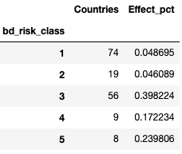
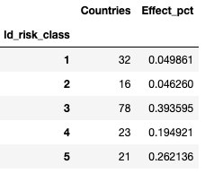
Index for the pressure categories
Air pollution
Let us create cumulative percentage for effect and countries. Next we can rank order the countries from highest to lowest effect. We have not taken population data into account.
Competing concerns for creating index:
Try to distribute countries evenly; try to distribute effect sizes evenly.
Issues:
Too few countries account for maximum effect. Try to have maximum countries in the middle zone of risk.
4 and 5 risk classes should account for the top 40% of the effect.

Slide 5
Aqueduct WRI Water risk Atlas
In the case of the Aqueduct index, several risks have been combined together and it appears that several research papers have been used to develop the index.
Different types of water risks have been included and raw values for each of these have been individually normalised and then weighted on a 1-5 scale based on relevant supporting research, recommendations from subject matter experts, and proprietary indexes.
The index also considers the percentage of the population that will be affected. It appears that consumption across various types of water usage scenarios like agriculture, industry etc have been factored into the calculation for estimating the high risk categories.
This approach seems robust but we cannot simply use the same splits for risk classification. We would need to gather relevant data points for the relevant “pressures” and similar to the Aqueduct model, factor in the affect on the different population groups as well.

Slide 6
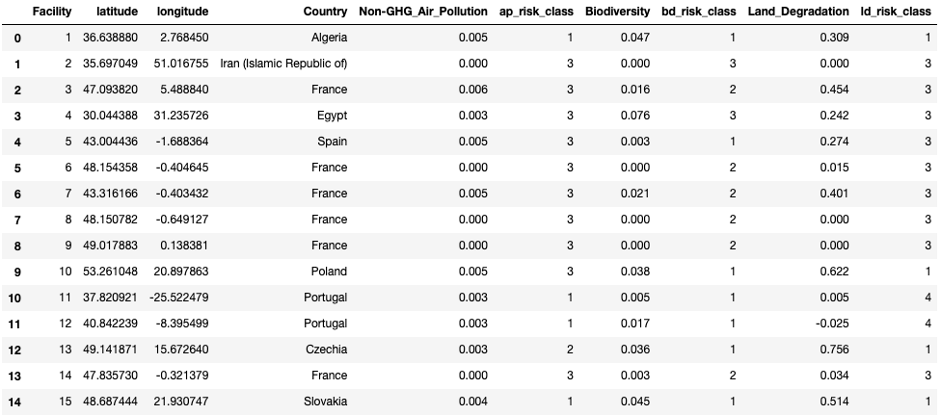
Facility risk scores
It is not clear whether these facilities are from the same company. So I have not used the facility risk index which compares against other facilities of the same company. Ideally we could use that index in combination with the relevant country risk class for the pressure point in question to derive an index which factors both metrics.

Slide 7
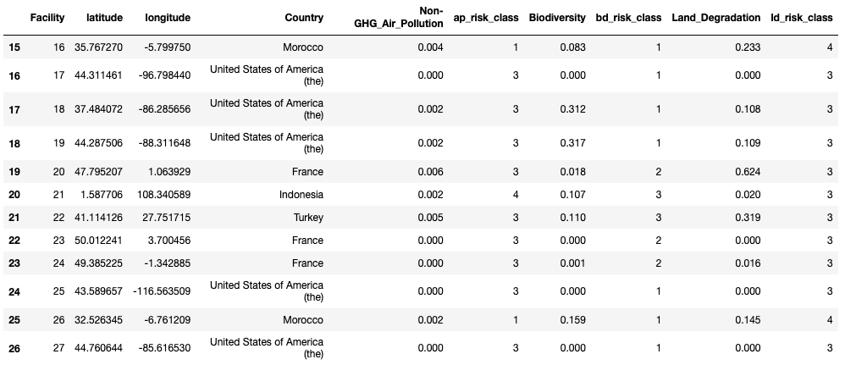
Facility risk scores
These can be potted on an interactive map for flexibly selection pressure, risk class, and other options.

