Slide 1
poison analysis
Assignment carried out using R software.
M.P. Appanna and Hasnaa Latique
(Msc food and agrcultural data management)

Slide 2
Question:
What food did they ate that made them fall sick? Is there a connection with gender or age of the individuals? Is there a connection with age or duration of time they were sick?
Approach:
We started by performing Univariate analysis which gave us min,max and interquartile range for quantitative variables; For qualitative variables this gave us proportion of the categories; Next we performed some Bivariate analysis where for the qualitative variables we compared the variable ‘sick’ with the variables of the individual foods. We also checked correlation between the 2 quantitative variables. Finally we performed Multivariate analysis using MCA and Hierarchical clustering methods.
About the data:
We have a total of 16 columns(variables) and 55 rows(individuals). The qualitative variables in the dataset were converted to factors. There are only 2 quantitative variables (Age and Time) and the remaining 13 are qualitative variables. The ID column has not been considered in the MCA.
The age of the of the individuals range from 4 years old to 88 years old. Most of the individuals are below 10 years old.

Slide 3
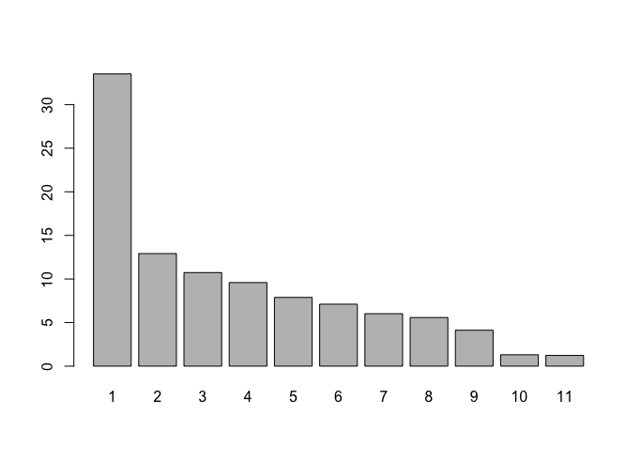
MCA (Multiple Correspondance Analysis)
Approach:
The qualitative variables in the dataset were converted to factors. There are only 2 quantitative variables and 13 qualitative variables. The ID column is not considered.
Age and Time are supplementary quantitative variables; Sick and Sex are supplementary qualitative variables.
As we can see in the bar chart below, the first and second dimension capture about 45% of the variance.
Fig 1

Slide 4
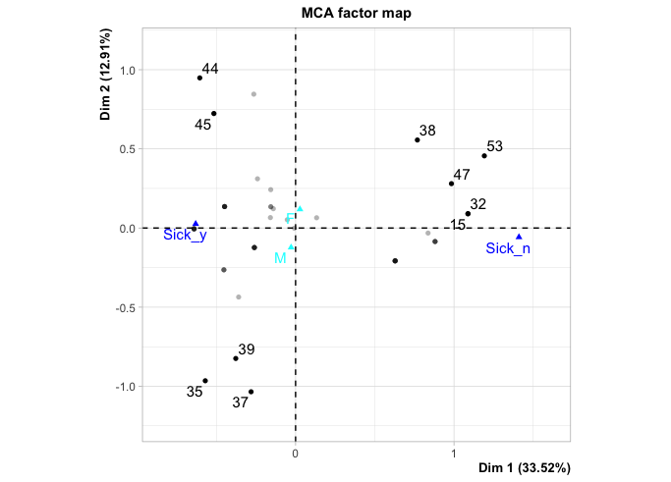
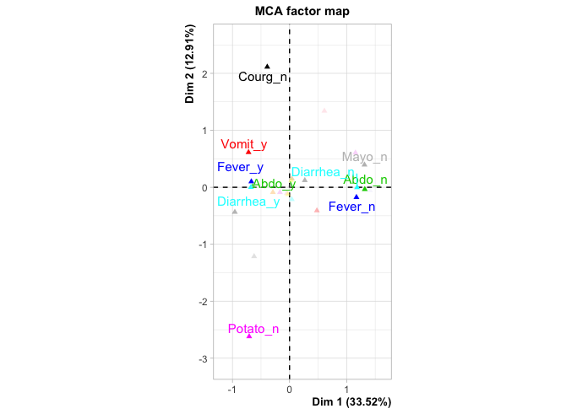
MCA (continued)
All the symptoms and foods eaten are considered as active variables.
10 individuals with the greatest contribution on axes 1 and 2 are: [44, 45], [35,37,39], [15,32,38,47,53]
10 modalities with the greatest contribution on the axes 1 and 2 are Symptoms: Diarrhea yes+no, Fever yes+no, Abdominal yes+no, Vomit yes; Foods: Potato No, Courg No, Mayo No
Fig 2
Fig 3

Slide 5
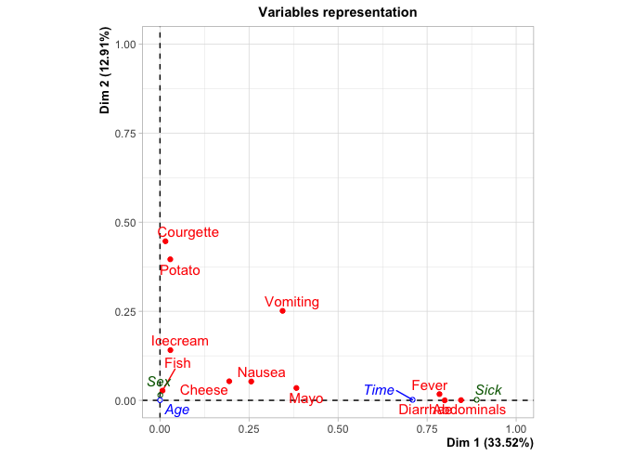
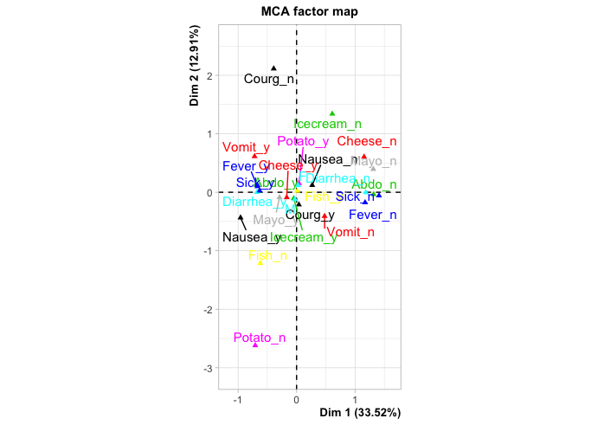
MCA (continued)
The left graph helps to identify variables where the squared correlations between variables and the dimensions are used as coordinates. The further the distance between variable points and the origin, the better is the representation in the factor map. Abdominals, Fever and Diarrhea are most correlated with dimension 1; Courgette and Potato are most correlated with dimension 2
On the right we have the variable categories where similar profiles are grouped together. The food categories closest to Sick_y appears to be: Mayo_y and Cheese_y
Fig 4
Fig 5

Slide 6
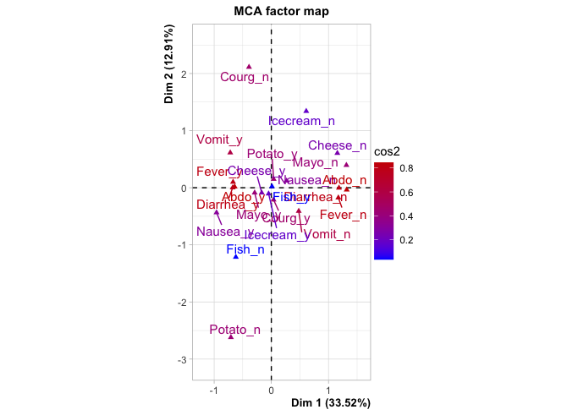
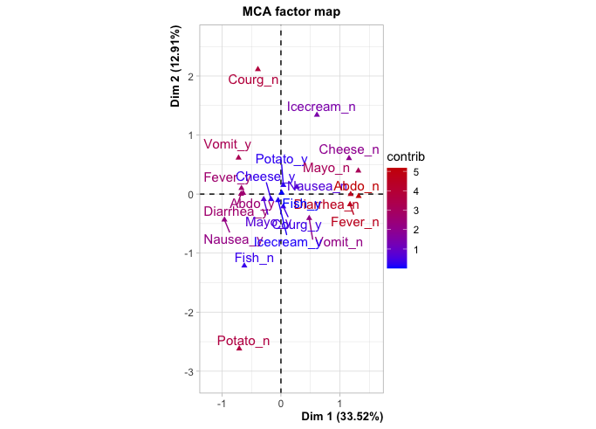
MCA (continued)
The quality of the representation is called the squared cosine (cos2), which measures the degree of association between variable categories and a particular axis. On the left , the variables are colored as a function of the cos2 value. On the right, the variable categories are colored as a function of contribution to the axes.
Fig 6
Fig 7

Slide 7
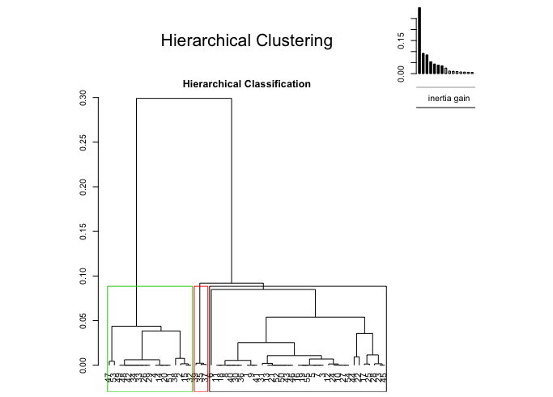
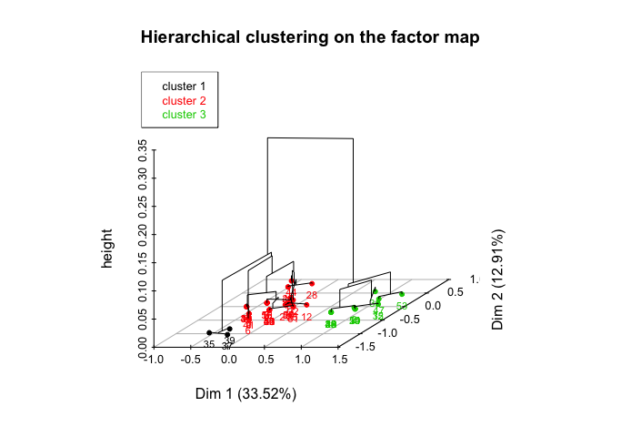
Hierarchical Clustering (HCA)
Approach:
We can use Kaiser criterion to keep axes which have an inertia greater than the inertia mean. From this we know that at least 4 axes should be considered. However, selecting 4 axes and running HCA did not properly separate the 3 groups of individuals which we identified in the prveious MCA. On keeping 5 axes and using ward distance metric for the HCA to cluster into 3 groups, it appears to better represent the 10 highest contributing individuals.

Slide 8
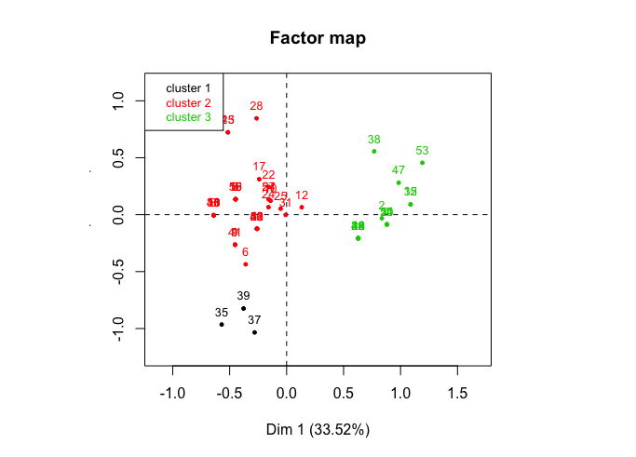
Hierarchical Clustering (continued)
Cluster 1 indicates all individuals who did not eat potatoes. All 3 individuals who did not eat potatoes still became sick.
Cluster 2 seems to indicate the individuals who have become sick. Highest percentage that the class of this cluster refers to a food is for those who ate Mayo. Individuals who ate Potato appear as the second highest possible contributor to falling sick.
Cluster 3 seems to indicate the individuals who did not become sick. Here we confirm that people who did not eat Mayo are the most likely to not fall sick. Since Potato_no does not feature here, it indicates that these individuals do not belong to this class. So we can rule out potato as a contributor to sickness.

Slide 9
MCA Conclusions
Axis 1 and 2 accounts for 45% of the variance (Fig 1). Abdo, Fever, Diarrhea, Mayo are the most important variables for dimension 1. The variables Courg, Potato, Vomit and Icecream contribute the most to the dimension 2(Fig 6). It must be noted that dimension 1 best separates the sick_yes from sick_no.
10 individuals with the greatest contribution on axes 1 and 2 seem to be in 3 groups: [44, 45], [35,37,39], [15,32,38,47,53]
Age is closer to the origin in the plot and hence does not have a significant association with types of foods or symptoms. (Fig 4)
Time of sickness has strongest association with Mayo as indicated by the small angle between the lines from the variables to origin and distance away from origin. Symptoms like Fever, Diarrhea, and Abdominals are associated most with increased time. (Fig 4)
The food categories closest to Sick_y appears to be: Mayo_y and Cheese_y. These foods have the most connection with the sickness of individuals. (Fig 5)
There is no significant difference in males or females being more susceptible to falling sick or eating certain foods. (Fig 5)
HCA Conclusions
All individuals who did not eat potato were in cluster 1 and had fallen sick.
In the 2nd cluster we identified the dominant modality being those who have fallen sick. Here the top foods eaten were Mayo followed by Potato.
In the 3rd cluster the dominant modality is those who are not sick. Mayo_no is the main food feature here and potato_no is not here. So we can rule out potato and identify Mayo as the main cause for sickness.

