Slide 1

INSTITUT POLYTHECHNIQUE UNILASALLE
Master of Science Agricultural and Food Data Management
Survey Methods: Covid_survey and poison data
Project on the LimeSurvey
Appanna MACHIMANDA - Hasnaâ LATIQUE
19 January 2021

Slide 2
Survey objectives
1
1
See if there is an impact of Covid on people's mental health and habits
2
Assess the impact of the problem in case there is an impact
3
Gain an understanding about life under the Covid time
2

Slide 3
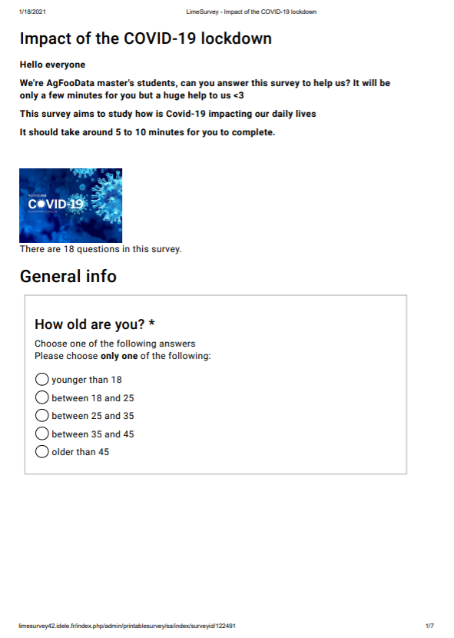
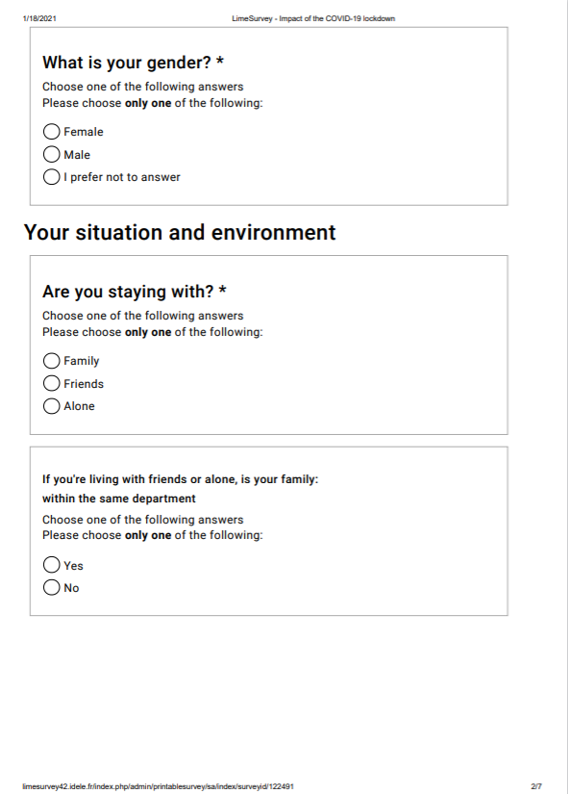
Notes:
Survey questions were divided into three sections: 1) General info, 2) Home Situation and 3) Feelings and habits.

Slide 4
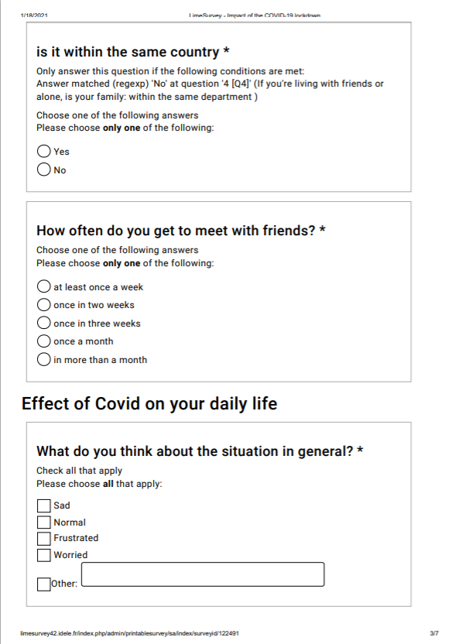
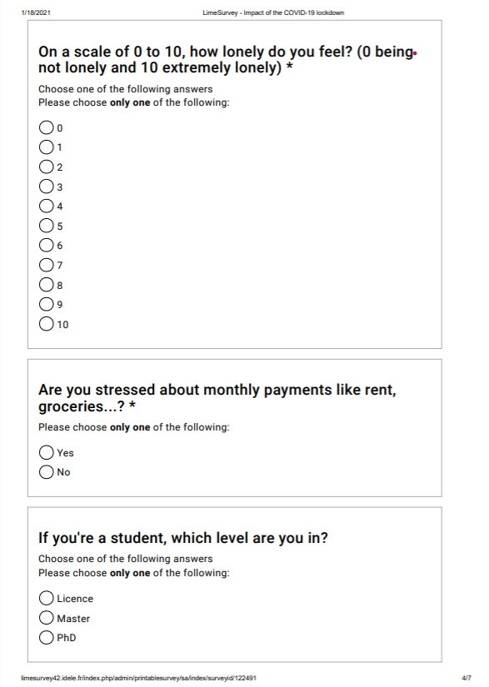

Slide 5
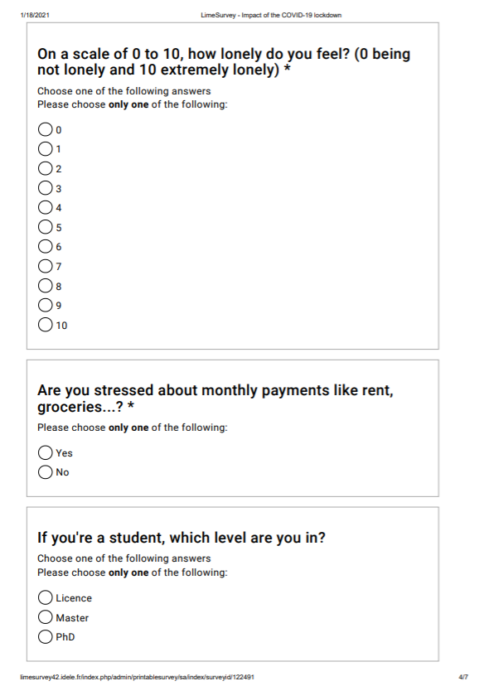
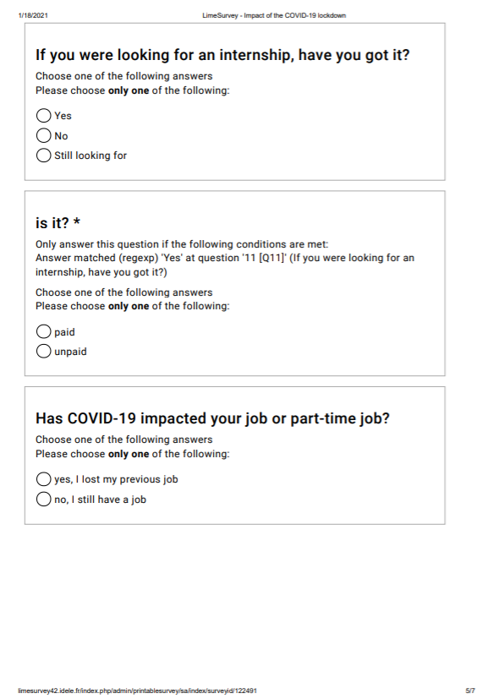

Slide 6
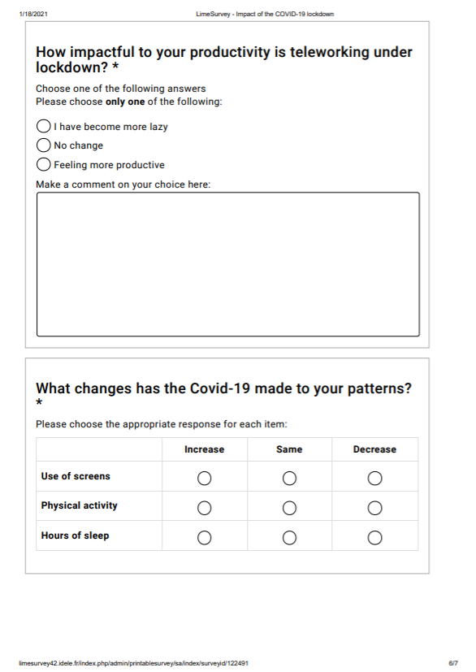
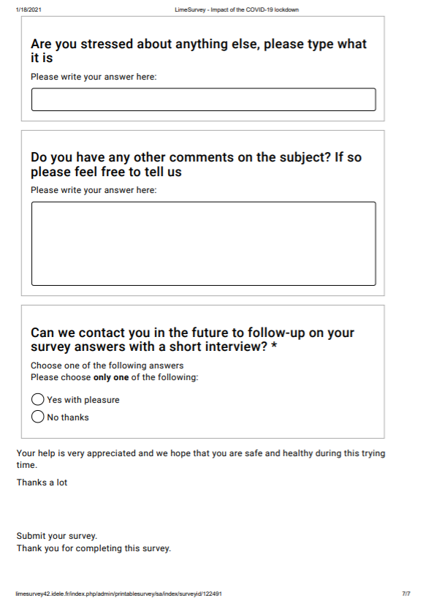

Slide 7
CONTENT OF THE SURVEY
Categories of our data
Personal status
Symptoms
The impact of Covid
Professional status
Habits
Comments

Slide 8
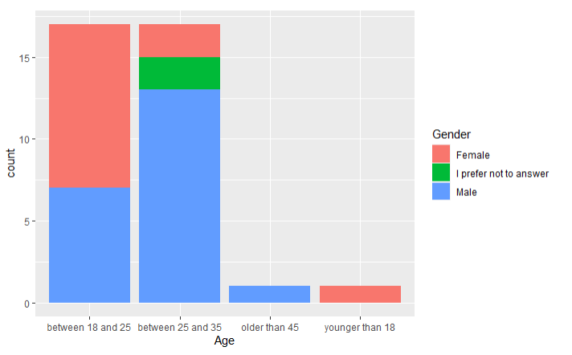
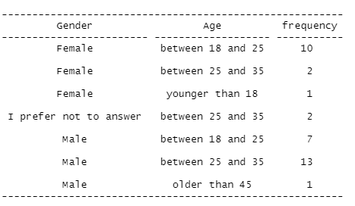
OUR TARGET POPULATION
Notes:
The population is represented by international students, the majorityof participants that has responded to the survey were male
The response rate was most represented:
By 13% male between 25 and 35
And by 10%female between 18 and 25

Slide 9
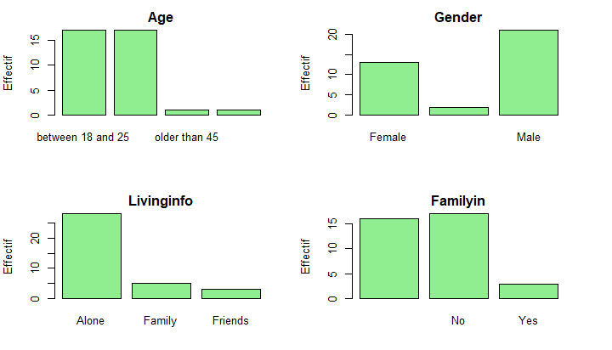
UNIVARIATE ANALYSIS
Part I | PartII
Bar plots

Slide 10
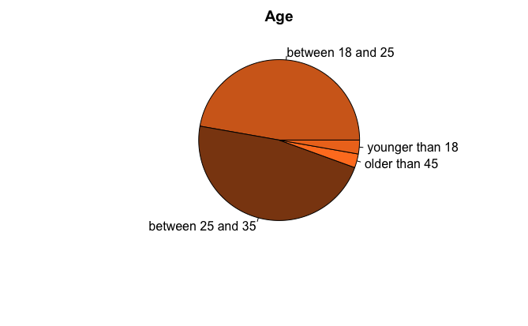
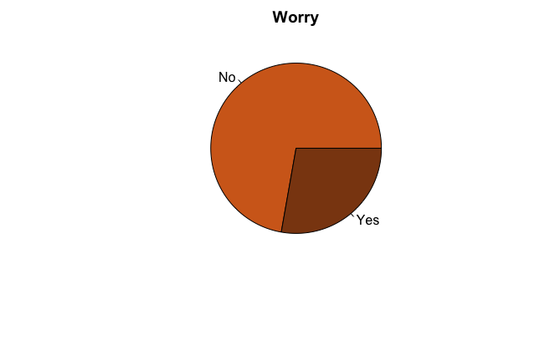
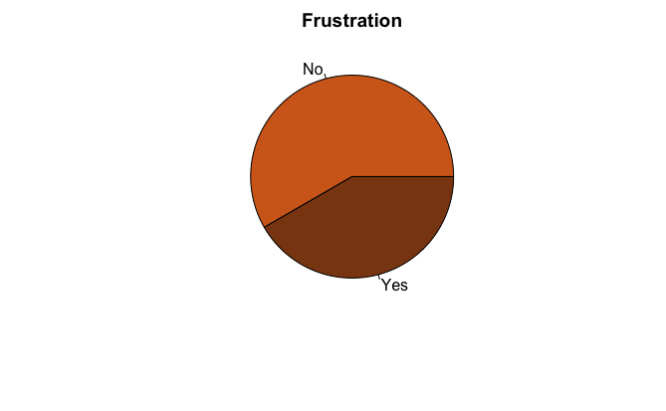

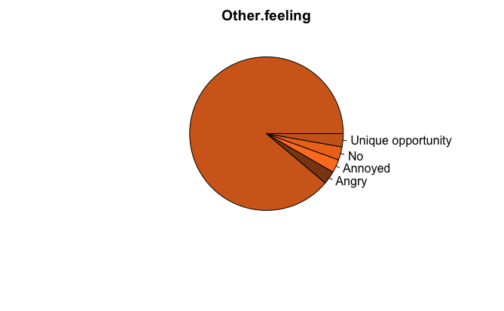
UNIVARIATE ANALYSIS
Part I | PartII
Pie chart

Slide 11
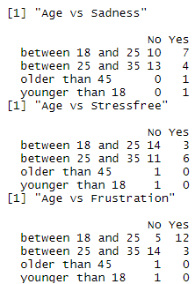
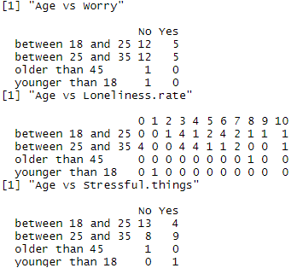
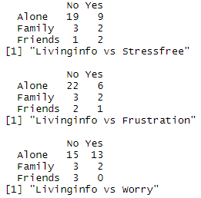
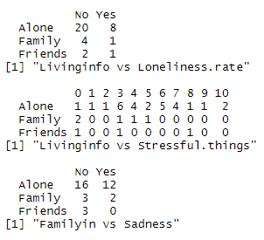
BIVARIATE ANALYSIS
Part I | Part II
FORMULATION GALENIQUE
Contingency tables
The difference of the symptoms based on the age of the participants
the symptoms of negative feelings on each categorie of age
The difference of the symptoms based on the social situation
the symptoms of negative feelings on participants considering within or not they’re living alone or else
Notes:
We got some interesting results here
The following contingency tables show the distribution of the symptoms of negative feelings based on the age of the population.
From the 1st table for example, you can see that 4 people among 13 between the age 25 and 35 feel sad; 7 among 10 of the people between 18 and 25 express this feeling
“Is there a significant relationship between the distribution of the population based on age and the symptoms of negative feelings?”.
A chi-square test could then be run on each table to determine if there is a relationship between the two variables.
We found interesting also to investigate if the social situation is having a role on people’s state of feelings

Slide 12
.
Part I | Part II
Bivariate analysis
professional stats vs symptoms
Level of studies/Internship or job existence vs the symptoms
Personal stats vs habits
Age vs Productivity, Use of screen, Physical activity and hours of sleep
“Stressed about others not feeling ok! i might have been in a decent situation pre covid, but i know others may have not been!”
“ On some days it’s more productive. And on some days it is less productive. Overall I think it takes time to get used to. ”
“ Staying productive and positive and using this opportunity during quarantine, well “
personal stats vs comments
Notes:
1.Concerning professional stats vs symptoms
For example, 10 master students suffer from frustration and 4 licence students experienced this feeling
2. Personal stats vs habits
Productivity, and Physical activity decreases for among all ages
Use of screen, and hours of sleep increase
3. Personal stats vs comments, some students acknowlededged some of the benificial aspects of Covid, others told us they faced several challenges.

Slide 13
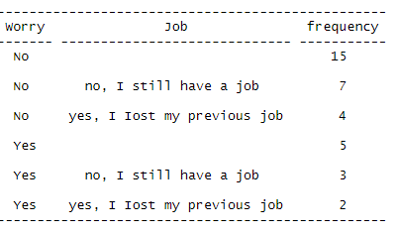
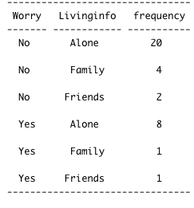
Part I | Part II
Frequency tables

Slide 14
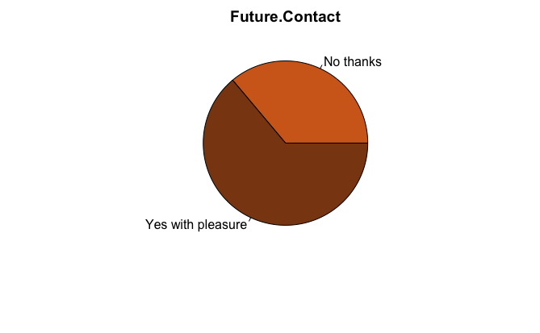
CONCLUSION
A general idea of how our data looks like
Study of the impact of Covid-19 on people’s feelings and patterns
Further analysis of the data
Descriptive statistics on the survey results
UNIVARIATE
BIVARIATE
Notes:
Results can be used To grasp social impacts of this pandemic in the short and long term.
And we can do further analysis with it

