Slide 1
Chapter 4
Vectors: Relationship between two points

Slide 2
Outcomes: you will be able to
Understand that a vector relates two positions to each other,
Recognize that all points in space are position vectors,
Comprehend that a vector encapsulates both a distance and a direction,
Perform basic vector algebra to scale, normalize, add, and subtract vectors,
Apply vectors to control the motions of game objects,
Implement simple game object behaviors like aiming and following,
Design and simulate simple external factors like wind conditions to affect object motion.

Slide 3
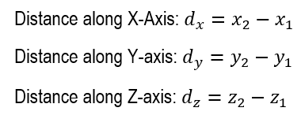
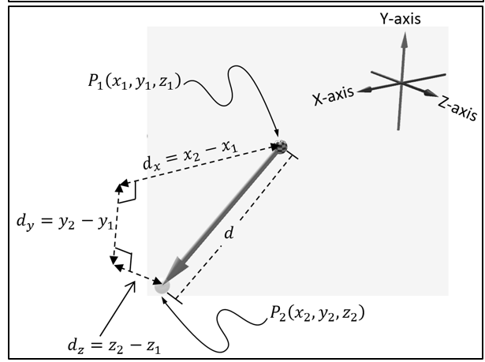
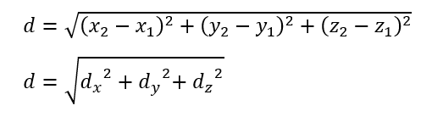
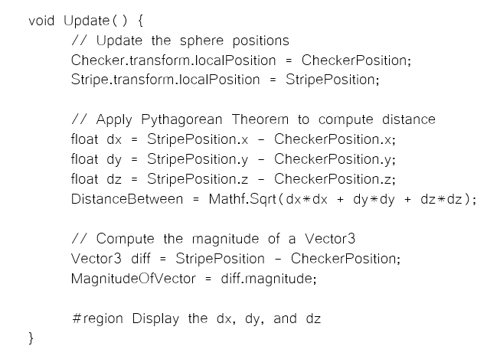
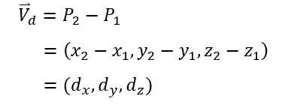
Distance between two points

Slide 4
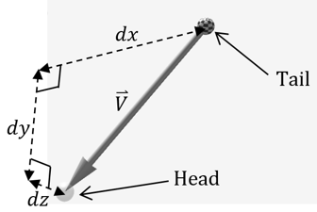
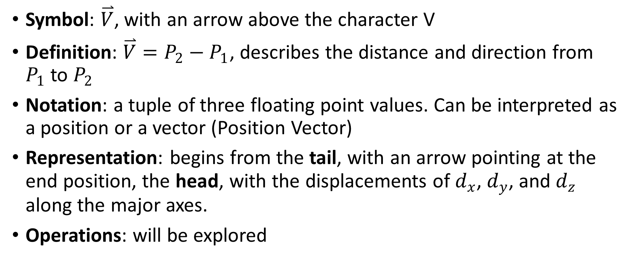
Take note:
Symbol: $\overset{⃑}{V}$, with an arrow above the character V
Definition: $\overset{⃑}{V}=P_{2}−P_{1}$, describes the distance and direction from $P_{1}$to $P_{2}$
Notation: a tuple of three floating point values. Can be interpreted as a position or a vector (Position Vector)
Representation: begins from the tail, with an arrow pointing at the end position, the head, with the displacements of $d_{x}$, $d_{y}$, and $d_{z}$ along the major axes.
Operations: will be explored

Slide 5
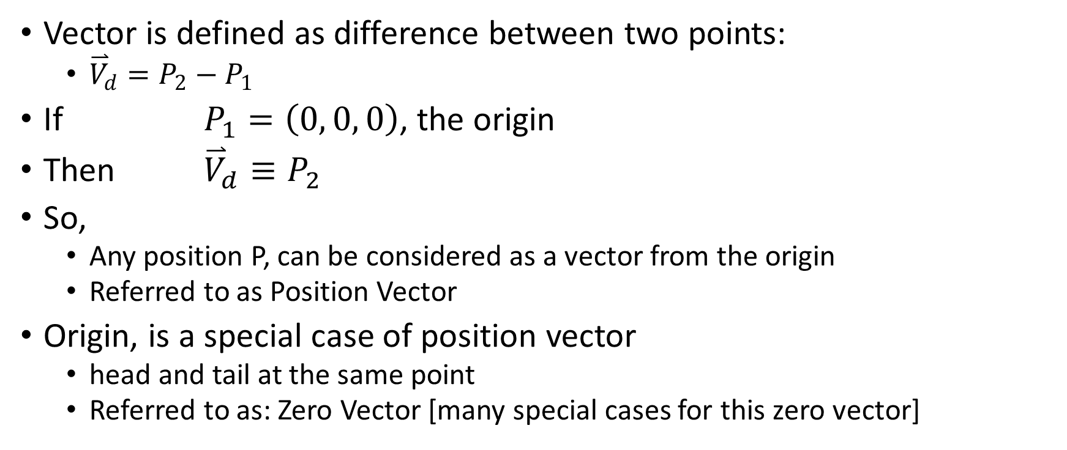
Position Vectors
Vector is defined as difference between two points:
${\overset{⃑}{V}}_{d}=P_{2}−P_{1}$
If $P_{1}=\left(0, 0, 0\right)$, the origin
Then ${\overset{⃑}{V}}_{d}≡P_{2}$
So,
Any position P, can be considered as a vector from the origin
Referred to as Position Vector
Origin, is a special case of position vector
head and tail at the same point
Referred to as: Zero Vector [many special cases for this zero vector]

Slide 6
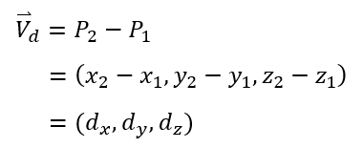
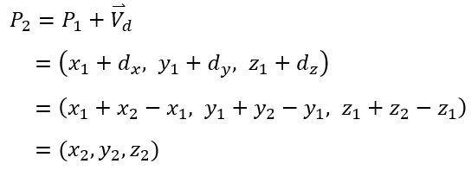

Following a vector
Vector is defined as difference between two points:
${\overset{⃑}{V}}_{d}=P_{2}−P_{1}$
Can also say …
$P_{1}$ followed ${\overset{⃑}{V}}_{d}$ to $P_{2}$ or

Slide 7
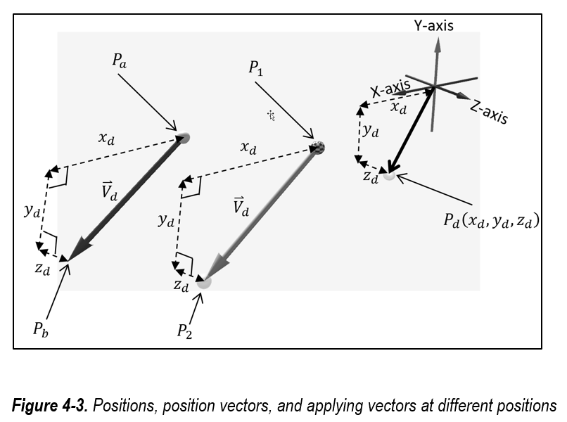
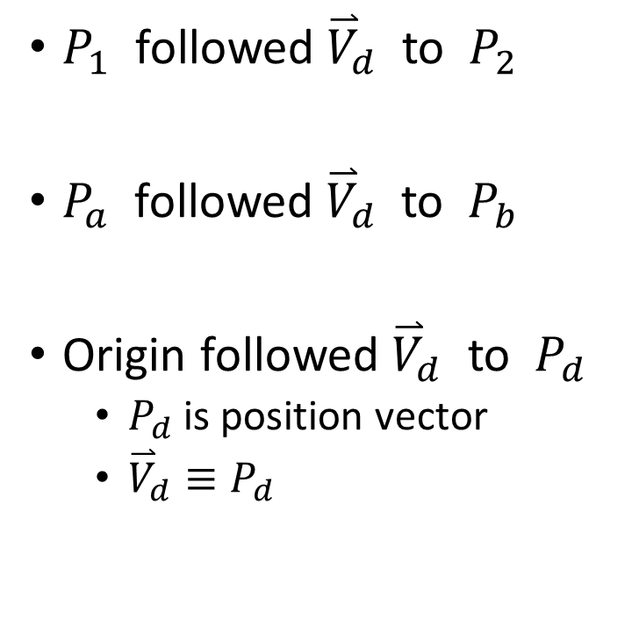
Following Vectors from Different Positions
$P_{1}$ followed ${\overset{⃑}{V}}_{d}$ to $P_{2}$
$P_{a}$ followed ${\overset{⃑}{V}}_{d}$ to $P_{b}$
Origin followed ${\overset{⃑}{V}}_{d}$ to $P_{d}$
$P_{d}$ is position vector
${\overset{⃑}{V}}_{d}≡P_{d}$

Slide 8
Example 4-1: Vectors and Positions
Select the MainCamera (Component (script): EX_4_1_MyScript)
Run and examine/maniupalte in the Scene Window (NOT the Game Window)
Note:
Understand the relationship between positions, position vectors, and applying vectors at positions
Manipulate a position and observe the position vector applied at a different location
Manipulate two positions to define a vector and observe the vector as a position vector from the origin
Examine the implementation and application of vectors
Increase familiarity with the Vector3 class

Slide 9
Example 4-1: Make sure to try/observe
White and Black (position) vectors
Checkered: Pd
Move to change the black vector: position vector of position Pd
White vector:
black vector drawn at position P1 (stripe sphere)
Observe: Gray and black (Position) vectors are identical
P2 (white sphere): cannot be moved, it is Pd-vector offset from P1
Pink and Purple (position) vectors
Pink vector: Move Pi and Pj to
Observe: Pe = Pj – Pi and Purple is identical to Pink vector

Slide 10
Example 4-1: Implementation
Do not be concerned about Start() function
Focuse on Update()
Do not be concern about how the vectors are drawn
Ingore Visualiaiton on/off block
Examine: code in DrawPositionAsVectors
Note: vectorVd: Line 80 is implementation
is Unity Vector3 type, and initialized to the values of position: Pd
Other lines are for visualization
ShowVd (the black vector) : shows vectorVd at origin
ShowVdAtP1 (white vector): shows vectorVd (the Pd position vector) at position P1
Note: P2 is computed in Step2, and thus cannot be changed in the editor
Line 93: is implementation
Other lines are for supporting visualization

Slide 11
Example 4-1: Implementaiton (Cont)
Code in DrawVectorAsPosition
vectorVe: Unity Vector3 from Pi and Pj positions (Line 101)
ShowVeAtPi: The Pink vector from Pi
ShowVe: The Purple vector, same direction and magnitude as vectorVe
Draw at the origin (position vector)
Pe: is simply the value of vectorVe (Line 111)
The position of vectorVe

Slide 12
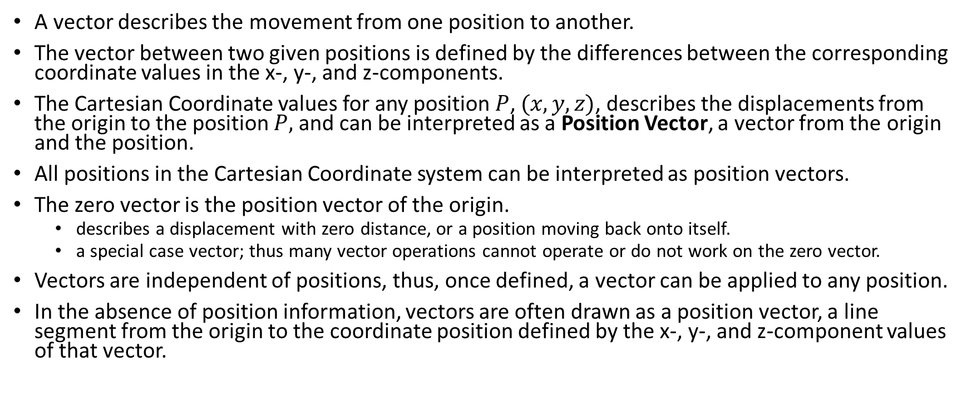
Example 4-1: Take Away
A vector describes the movement from one position to another.
The vector between two given positions is defined by the differences between the corresponding coordinate values in the x-, y-, and z-components.
The Cartesian Coordinate values for any position $P$, $(x, y, z)$, describes the displacements from the origin to the position $P,$and can be interpreted as a Position Vector, a vector from the origin and the position.
All positions in the Cartesian Coordinate system can be interpreted as position vectors.
The zero vector is the position vector of the origin.
describes a displacement with zero distance, or a position moving back onto itself.
a special case vector; thus many vector operations cannot operate or do not work on the zero vector.
Vectors are independent of positions, thus, once defined, a vector can be applied to any position.
In the absence of position information, vectors are often drawn as a position vector, a line segment from the origin to the coordinate position defined by the x-, y-, and z-component values of that vector.

Slide 13
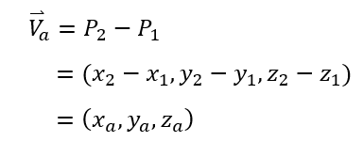


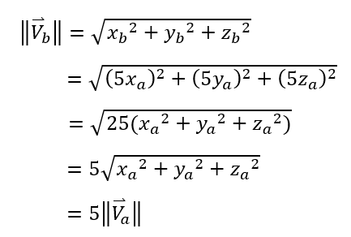
Vector Algebra: Scaling
Given:
If
Then:

Slide 14
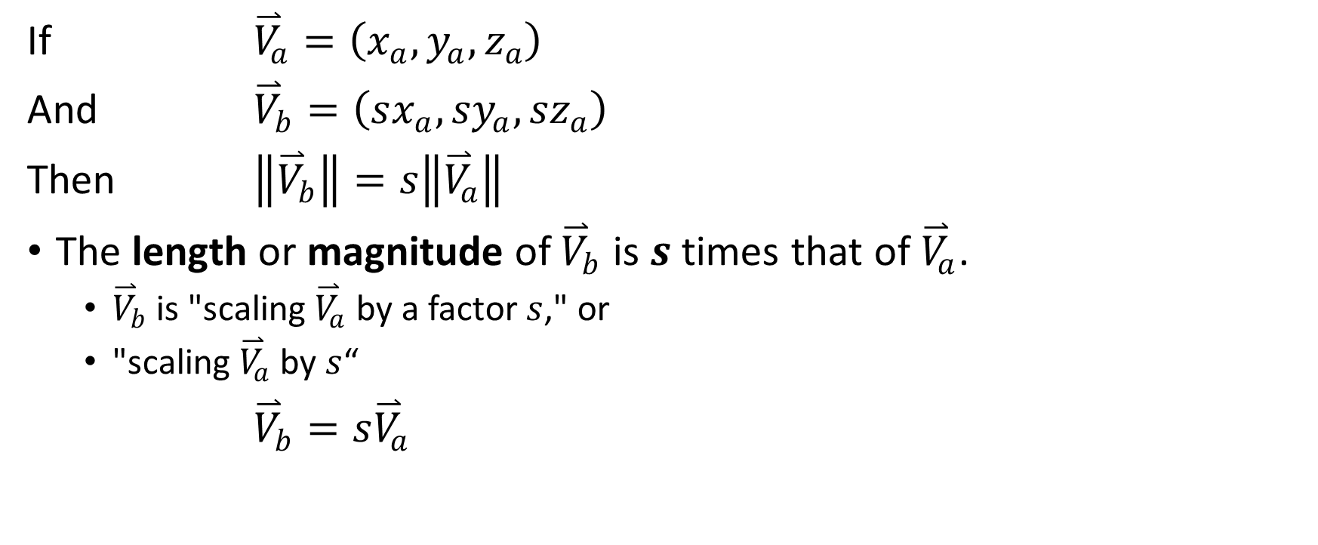
In general
If ${\overset{⃑}{V}}_{a}=\left(x_{a},y_{a},z_{a}\right)$
And ${\overset{⃑}{V}}_{b}=\left(sx_{a},{sy}_{a},{sz}_{a}\right)$
Then $\left\|{\overset{⃑}{V}}_{b}\right\|=s\left\|{\overset{⃑}{V}}_{a}\right\|$
The length or magnitude of ${\overset{⃑}{V}}_{b}$ is $s$ times that of ${\overset{⃑}{V}}_{a}$.
${\overset{⃑}{V}}_{b}$ is "scaling ${\overset{⃑}{V}}_{a}$ by a factor $s$," or
"scaling ${\overset{⃑}{V}}_{a}$ by $s$“
${\overset{⃑}{V}}_{b}=s{\overset{⃑}{V}}_{a}$

Slide 15
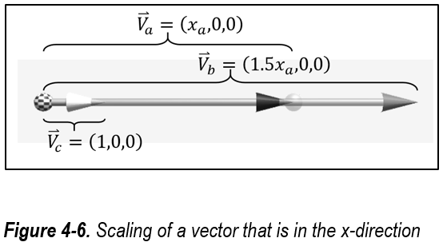
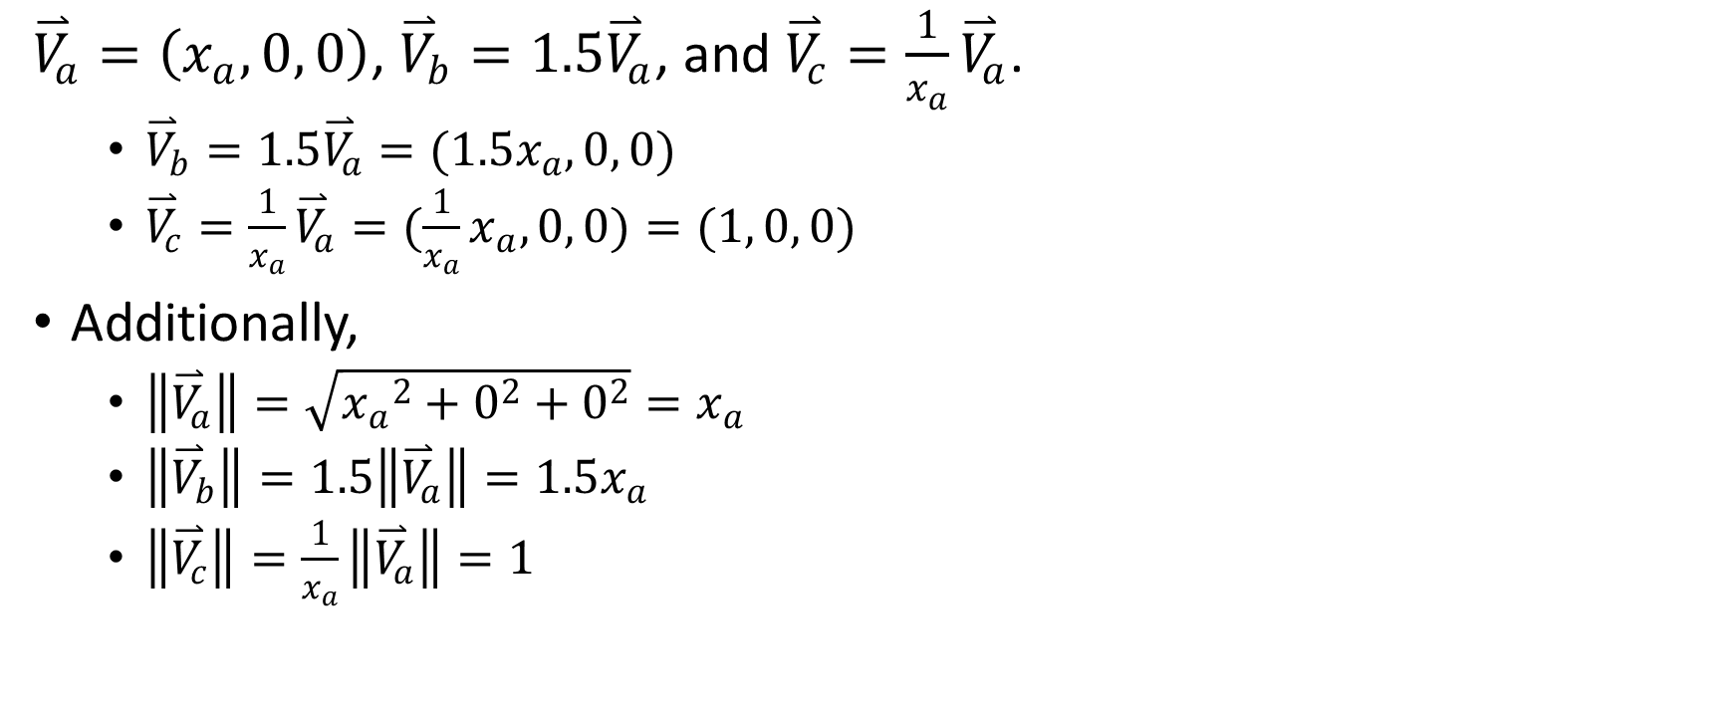
For example
${\overset{⃑}{V}}_{a}=\left(x_{a}, 0, 0\right)$, ${\overset{⃑}{V}}_{b}=1.5{\overset{⃑}{V}}_{a}$, and ${\overset{⃑}{V}}_{c}=\frac{1}{x_{a}}{\overset{⃑}{V}}_{a}$.
${\overset{⃑}{V}}_{b}=1.5{\overset{⃑}{V}}_{a}=(1.5x_{a}, 0, 0)$
${\overset{⃑}{V}}_{c}=\frac{1}{x_{a}}{\overset{⃑}{V}}_{a}=(\frac{1}{x_{a}}x_{a}, 0, 0)=(1, 0, 0)$
Additionally,
$\left\|{\overset{⃑}{V}}_{a}\right\|=\sqrt{{x_{a}}^{2}+0^{2}+0^{2}}=x_{a}$
$\left\|{\overset{⃑}{V}}_{b}\right\|=1.5\left\|{\overset{⃑}{V}}_{a}\right\|=1.5x_{a}$
$\left\|{\overset{⃑}{V}}_{c}\right\|=\frac{1}{x_{a}}\left\|{\overset{⃑}{V}}_{a}\right\|=1$

Slide 16
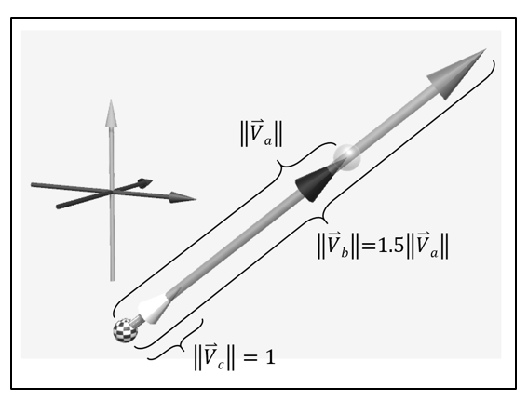

True in general …
Given non-zero vector ${\overset{⃑}{V}}_{a}$, if:
${\overset{⃑}{V}}_{b}=1.5{\overset{⃑}{V}}_{a}$
${\overset{⃑}{V}}_{c}=\frac{1}{\left\|{\overset{⃑}{V}}_{a}\right\|}{\overset{⃑}{V}}_{a}$
Then,
$\left\|{\overset{⃑}{V}}_{b}\right\|=1.5\left\|{\overset{⃑}{V}}_{a}\right\|$
$\left\|{\overset{⃑}{V}}_{c}\right\|=\frac{1}{\left\|{\overset{⃑}{V}}_{a}\right\|}\left\|{\overset{⃑}{V}}_{a}\right\|=1$

Slide 17
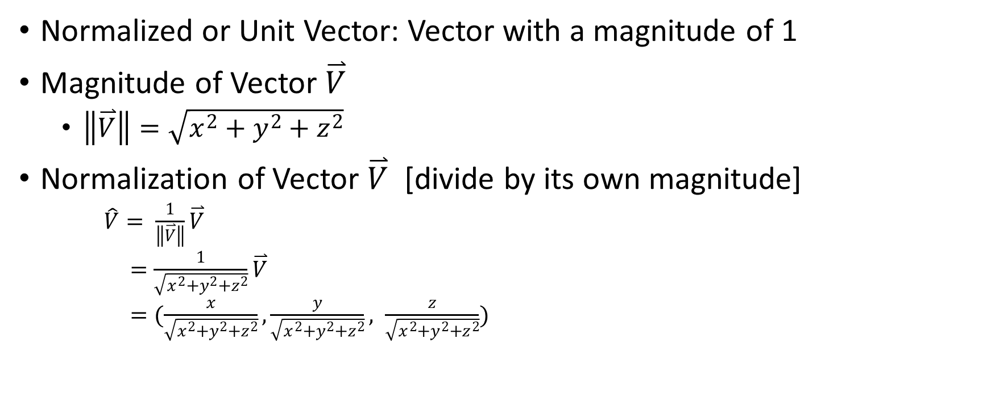
Normalization of Vectors
Normalized or Unit Vector: Vector with a magnitude of 1
Magnitude of Vector $\overset{⃑}{V}$
$\left\|\overset{⃑}{V}\right\|=\sqrt{x^{2}+y^{2}+z^{2}}$
Normalization of Vector $\overset{⃑}{V}$ [divide by its own magnitude]
$\hat{V}= \frac{1}{\left\|\overset{⃑}{V}\right\|}\overset{⃑}{V}$
$=\frac{1}{\sqrt{x^{2}+y^{2}+z^{2}}}\overset{⃑}{V}$
$=(\frac{x}{\sqrt{x^{2}+y^{2}+z^{2}}}, \frac{y}{\sqrt{x^{2}+y^{2}+z^{2}}}, \frac{z}{\sqrt{x^{2}+y^{2}+z^{2}}})$

Slide 18

Directions of Vectors [ this book only ]
Direction of any given vector ${\overset{⃑}{V}}_{c}$
Is its normal vector: $\frac{{\overset{⃑}{V}}_{c}}{\left\|{\overset{⃑}{V}}_{c}\right\|}$
So, in this book, a “direction of a vector” is a vector (normalized)

Slide 19
Example 4-2: Scaling of Vectors
Work in the Scene Window (NOT the game window)
Note:
Interact with and examine the effects of scaling vectors
Experience defining vectors based on specifying their magnitude and direction
Understand the effects of separately changing the magnitude and direction of a vector
Examine the implementation of working with vectors

Slide 20
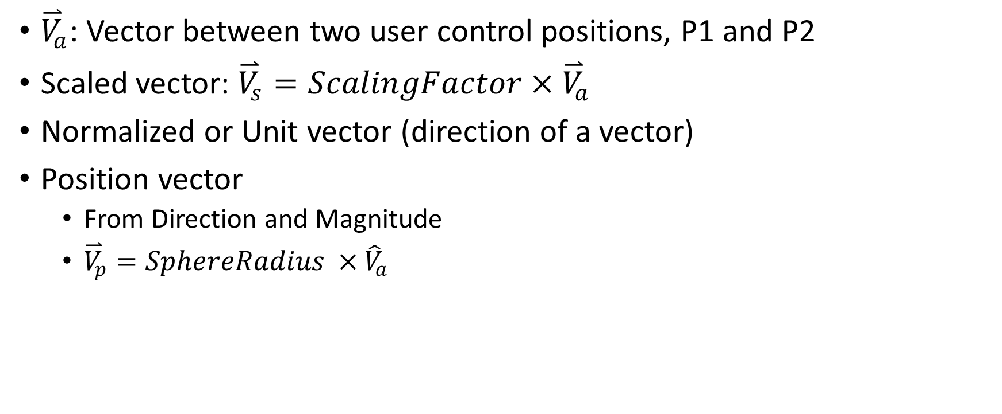
Example 4-2: Make sure to try/observe
${\overset{⃑}{V}}_{a}$: Vector between two user control positions, P1 and P2
Scaled vector: ${\overset{⃑}{V}}_{s}=ScalingFactor×{\overset{⃑}{V}}_{a}$
Normalized or Unit vector (direction of a vector)
Position vector
From Direction and Magnitude
${\overset{⃑}{V}}_{p}=SphereRadius ×{\hat{V}}_{a}$

Slide 21
Example 4-2: Implementation
Again, focus on Update(), ignore visualization on/off
Vector Va (unity Vector3): Line 71
ShowVa (black vector): shows Va at position P1 (checkered sphere)
DrawScaledVector: Line 81
The purple vector, is of length: ScalingFactor * vectorVa
DrawUnitVector: Line 88
The white vector is of size 1
DrawPositionVector: Line 96
The light blue vector: take Va-direction and Sphere-radius as size

Slide 22
Example 4-2: Take Away
All scaled vectors are along exactly the same direction
The unit vector, or normalized vector, is a special case of the scaled vector; it is a vector scaled by the inverse of the size of its reference vector.
The normalized vector, or unit vector, always has a length of one and consistently represent the direction of vectors with different lengths.
The zero vector cannot be normalized. Implementation must check!
A vector can be defined based on a magnitude and a direction.
So, any vector can be decomposed into a unit vector with a scale.

Slide 23
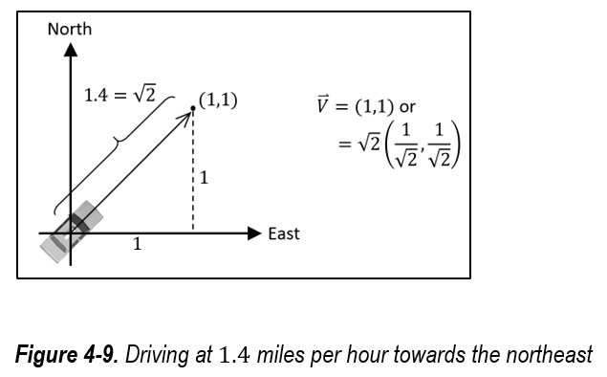
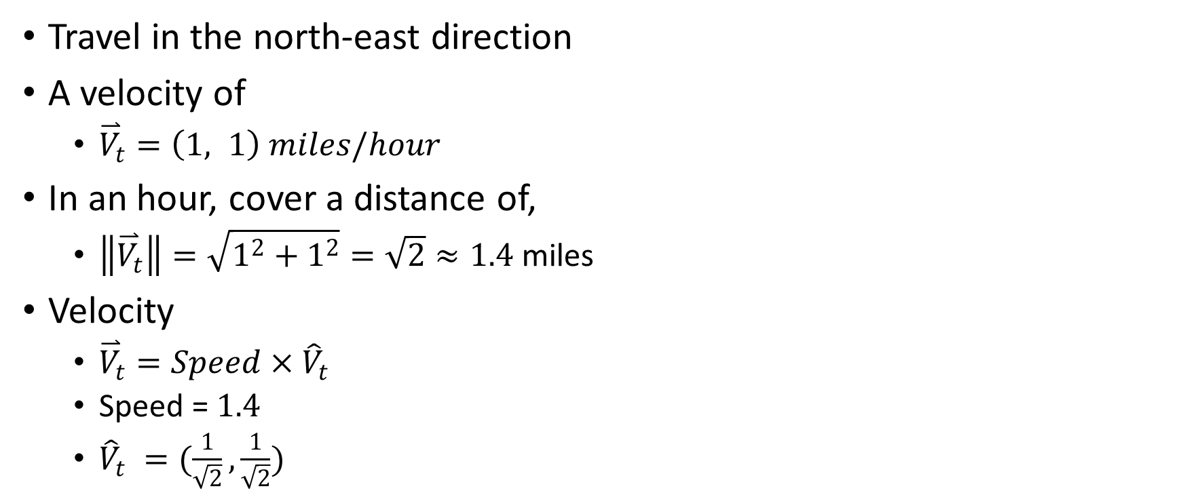
Velocity: Application of Vector
Travel in the north-east direction
A velocity of
${\overset{⃑}{V}}_{t}=\left(1, 1\right) miles/hour$
In an hour, cover a distance of,
$\left\|{\overset{⃑}{V}}_{t}\right\|=\sqrt{1^{2}+1^{2}}=\sqrt{2}≈1.4$ miles
Velocity
${\overset{⃑}{V}}_{t}=Speed$ $×{\hat{V}}_{t}$
Speed = $1.4$
${\hat{V}}_{t} =(\frac{1}{\sqrt{2}},\frac{1}{\sqrt{2}})$

Slide 24
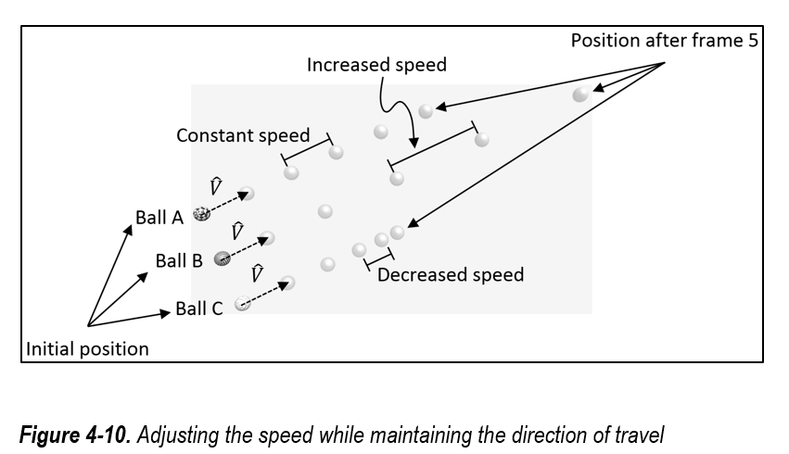
Different Speed, Same direction

Slide 25
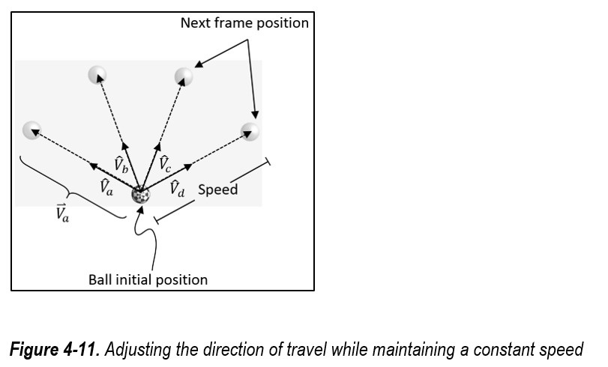
Same Speed, Different Directions

Slide 26
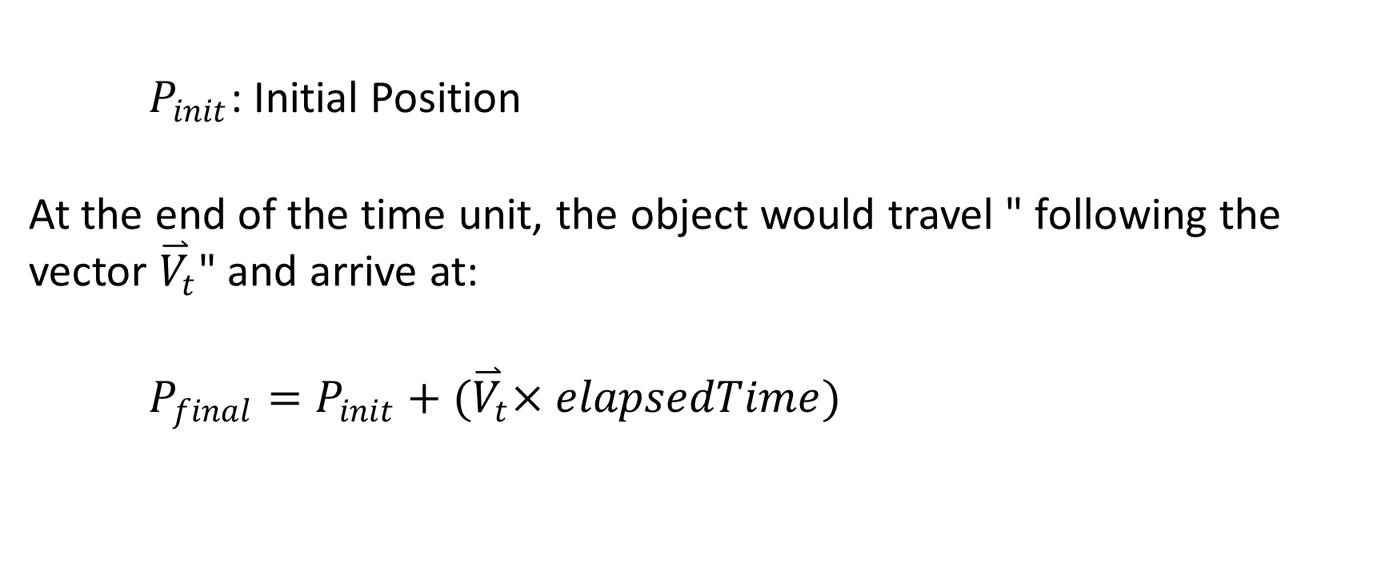
Unity implementation
$P_{init}$: Initial Position
At the end of the time unit, the object would travel " following the vector ${\overset{⃑}{V}}_{t}$" and arrive at:
$P_{final}=P_{init}+{(\overset{⃑}{V}}_{t}×elapsedTime)$

Slide 27
Example 4-3: Velocity and Aiming
Understand the distinction between speed and direction of a velocity
Experience controlling a velocity by manipulating its speed and direction separately
Examine a simple aiming behavior
Examine the implementation of vector-based motion control

Slide 28
Example 4-3: Make sure to observer/try
Scene
Checkered Explorer
Green vector: velocity
Adjust ExplorerSpeed
Red Target
Green Agent
Adjust AgendSpeed
Interactions
Select and manipulate: Checkered, Red
Observe Green follows
Observe Separate
Speed (how fast) and
Velocity Direction (from Checkered to Red)

Slide 29
Example 4-3: Implementation
Vector from Explorer to Target: vET (Line 43)
Distance to target: (Line 51)
Process Explorer (lines 57 and 58)
Process Agent (lines 62 to 66)
Note:
Number of lines of actual code is small!!

Slide 30
Example 4-3: Take Away
The velocity of an object can be represented by a vector
A velocity can be composed by scaling a direction, or unit vector, with speed
The distance between two objects is the magnitude of the vector that is defined by the positions of those two objects

Slide 31
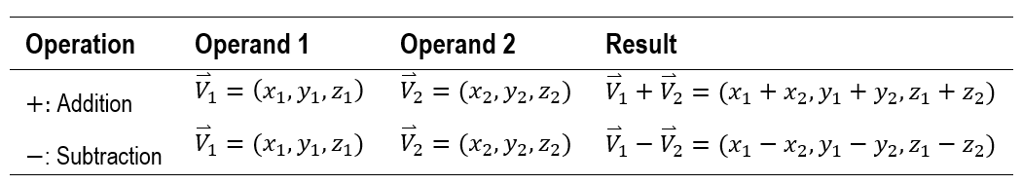
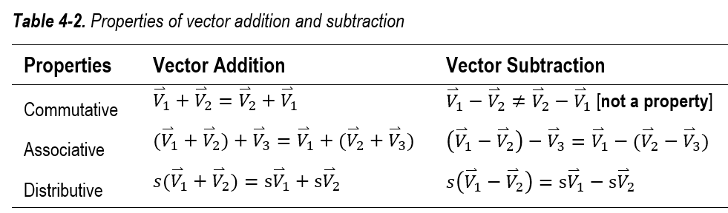

Vector Algebra: Addtion and Substraction
We have seen these
$P_{1}=P_{0}+{\overset{⃑}{V}}_{1}$
${\overset{⃑}{V}}_{1}=P_{1}−P_{0}$
Examples
$\overset{⃑}{V}+\overset{⃑}{V}=2\overset{⃑}{V}$
$\overset{⃑}{V}−\overset{⃑}{V}=ZeroVector$
${\overset{⃑}{V}}_{1}−{\overset{⃑}{V}}_{2}=−1×\left({\overset{⃑}{V}}_{2}−{\overset{⃑}{V}}_{1}\right)$
$=$ $−{\overset{⃑}{V}}_{2}+{\overset{⃑}{V}}_{1}$

Slide 32

Operations with The Zero Vector
${\overset{⃑}{V}}_{1}+ZeroVector=$ $ZeroVector+{\overset{⃑}{V}}_{1}={\overset{⃑}{V}}_{1}$
${\overset{⃑}{V}}_{1}−ZeroVector=$ ${\overset{⃑}{V}}_{1}$
$ZeroVector−{\overset{⃑}{V}}_{1}={−\overset{⃑}{V}}_{1}$

Slide 33

Vectors in an Equation
If ${\overset{⃑}{V}}_{sum}={\overset{⃑}{V}}_{1}+{\overset{⃑}{V}}_{2}$,
then adding a $−{\overset{⃑}{V}}_{2}$ to both sides
${\overset{⃑}{V}}_{sum}+\left(−{\overset{⃑}{V}}_{2}\right)={\overset{⃑}{V}}_{1}+{\overset{⃑}{V}}_{2}+(−{\overset{⃑}{V}}_{2}$)
${\overset{⃑}{V}}_{sum}−{\overset{⃑}{V}}_{2}={\overset{⃑}{V}}_{1}$
${\overset{⃑}{V}}_{1}={\overset{⃑}{V}}_{3}−{\overset{⃑}{V}}_{2}$

Slide 34
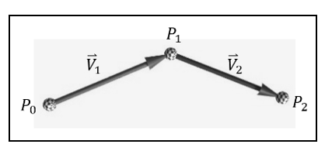
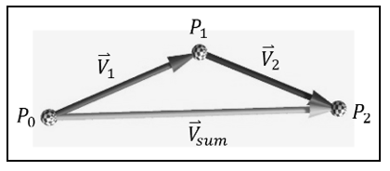
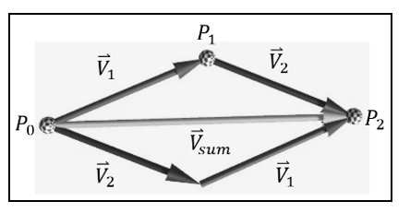

Vectors Addition
If
${\overset{⃑}{V}}_{sum}={\overset{⃑}{V}}_{1}+{\overset{⃑}{V}}_{2}$,
Then, also true that
${\overset{⃑}{V}}_{sum}={\overset{⃑}{V}}_{2}+{\overset{⃑}{V}}_{1}$
Always true:
${\overset{⃑}{V}}_{sum}={\overset{⃑}{V}}_{1}+{\overset{⃑}{V}}_{2}={\overset{⃑}{V}}_{2}+{\overset{⃑}{V}}_{1}$

Slide 35
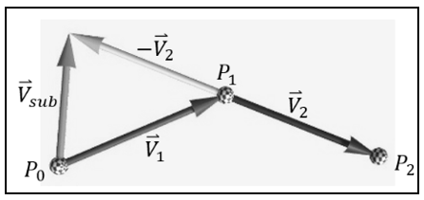

Vector Subtraction
If
${\overset{⃑}{V}}_{sub}={\overset{⃑}{V}}_{1}−{\overset{⃑}{V}}_{2}$
Then,
${\overset{⃑}{V}}_{sub}={\overset{⃑}{V}}_{1}+{\overset{⃑}{V}}_{n2}$
where
${\overset{⃑}{V}}_{n2} =−{\overset{⃑}{V}}_{2}$
or simply
${\overset{⃑}{V}}_{sub}={\overset{⃑}{V}}_{1}−{\overset{⃑}{V}}_{2}={\overset{⃑}{V}}_{1}+(−{\overset{⃑}{V}}_{2})$

Slide 36
Example 4-4: Vector Add and Sub
Examine and gain understanding of vector addition and subtraction
Understand that vector subtraction is simply vector addition with a negative vector as the second operand
Review that all vectors are defined independent of any position

Slide 37
Example 4-4: Make sure to try/observe
Vectors:
V1: in Red V2: in Blue
V12: Draw V1 followed by V2
V21: Draw V2 then V1
Vn2: Negative V2
Select and move P0, P1, and P2 to observe the Sum and Sub
Observe V12 and V21 results in the same Vsum (commutative of addition)
Toggle position vector
Draw all vectors from the origin

Slide 38
Example 4-4: Implementation
All useful code: Update()
Lines 95 to 100
Rests are all visualizing the vectors

Slide 39
Example 4-4: Take Away
Vector addition results in a vector that accumulates the operand vectors
Vector addition is indeed commutative
Vector subtraction is simply an addition with the second operand being negated
Reviewed that vectors are independent of any particular position

Slide 40
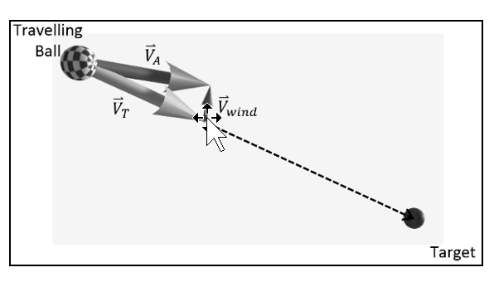
Application of Vector Algebra
An airplane flying or a ship sailing under a constant wind condition

Slide 41
Example 4-5: Windy Condition
Experience a straightforward example of applying vector addition to affect object behavior
Examine and understand the simple implementation of how velocity can be affected under a constant wind condition

Slide 42
Example 4-5: Make sure to try/observe
Checkered: travelling ball Red: Target
Vectors
Green: intended velocity
Red: Wind
Blue: resulting velocity (may or may not take Checkered to Red)
Click on Pause Movement
Adjust:
Speeds (wind speed, traveler speed)
Wind direction

Slide 43
Example 4-5: Implementation
Update() function,
Except the “Display the vectors” block

Slide 44
Example 4-5: Take Away
Model constant wind breeze as a velocity
Changing an object's velocity by the addition of an object's own velocity with that of external velocities

Slide 45
Summary
a vector is a size and a direction that can relate two positions,
the vector definition is independent of any particular position,
all positions in the Cartesian Coordinate System can be considered as position vectors,
scaling a vector by a floating-point number changes its size but not its direction,
a normalized or unit vector has a size of 1 and is convenient for representing the direction of a vector,
vectors are ideal for representing the velocities of objects,
it is convenient to represent a velocity by separately storing its speed and direction of movement,
vector addition and subtraction rules follow closely to those of floating-point algebra.

