Slide 1
Chapter 5
Dot Products: Relationship between 2 vectors

Slide 2
Outcomes: you will be able to
Understand vector dot product: definition, properties, and geometric interpretation
Recognize how the vector dot product relates two vectors by their subtended angle and relative projection sizes,
Comprehend how a vector represents a line segment,
Apply the dot product to allow the interpretation of a line segment as an interval,
Perform the simple inside-outside test for a point and an arbitrary interval,
Apply the vector dot product to determine the shortest distant between a point and a line,
Apply the vector dot product to compute the closest distance between two lines.

Slide 3
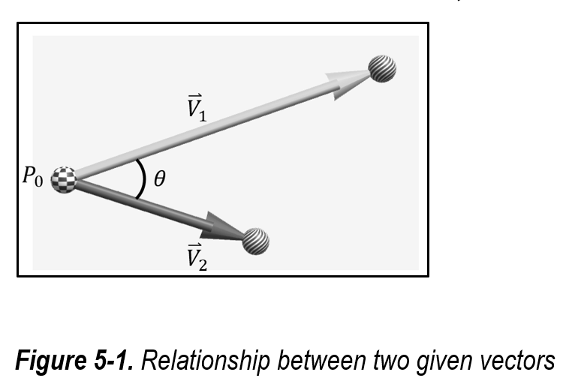
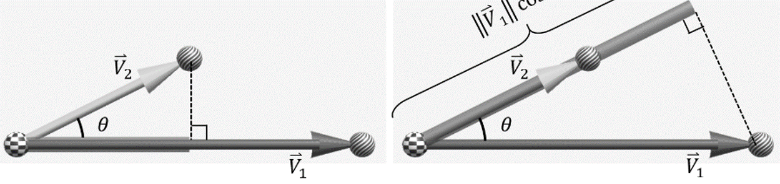
Some sense
Vectors:
Remember, vectors are independent of position
So, can always draw vectors as position vectors (from the origin)
Given two vectors, their relationships
First: angle between the vectors
Second: projected size of a vector from the perspective of the other
That’s all!
Large amount of applications based on something this simple!

Slide 4

Vector Dot Product
Given
${\overset{⃑}{V}}_{1}=\left(x_{1},y_{1},z_{1}\right)$
${\overset{⃑}{V}}_{2}=(x_{2},y_{2},z_{2})$
dot product, or vector dot product
${\overset{⃑}{V}}_{1}∙{\overset{⃑}{V}}_{2}={x_{1}x}_{2}+y_{1}y_{2}+z_{1}z_{2}$
Notice that,
Symbol: "$∙$", is literally a "dot"
Watch out: multiplication and dot are different! …. $s{\overset{⃑}{V}}_{2}$ (scaling of vector)
Will NEVER see: ${\overset{⃑}{V}}_{1}{\overset{⃑}{V}}_{2}$
Operands: the operation expects two vector operands
Result: the result of the operation is a floating-point number.
Also referred to as: inner product, scalar product

Slide 5
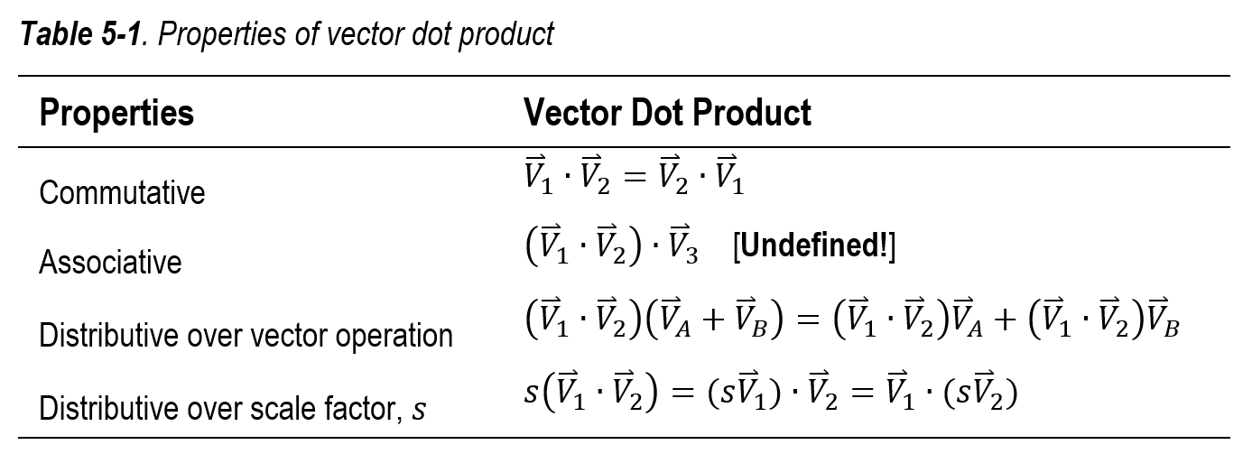

Properties
This is undefined: $\left({\overset{⃑}{V}}_{1}∙{\overset{⃑}{V}}_{2}\right)∙{\overset{⃑}{V}}_{3}$
$\left({\overset{⃑}{V}}_{1}∙{\overset{⃑}{V}}_{2}\right)=f$
$\left({\overset{⃑}{V}}_{1}∙{\overset{⃑}{V}}_{2}\right)∙{\overset{⃑}{V}}_{3}=f∙{\overset{⃑}{V}}_{3}$ f dot ${\overset{⃑}{V}}_{3}$ is illegal
This is perfectly fine: $\left({\overset{⃑}{V}}_{1}∙{\overset{⃑}{V}}_{2}\right){\overset{⃑}{V}}_{3}$
$\left({\overset{⃑}{V}}_{1}∙{\overset{⃑}{V}}_{2}\right){\overset{⃑}{V}}_{3}=f{\overset{⃑}{V}}_{3}$ scaling ${\overset{⃑}{V}}_{3}$ by f is fine

Slide 6
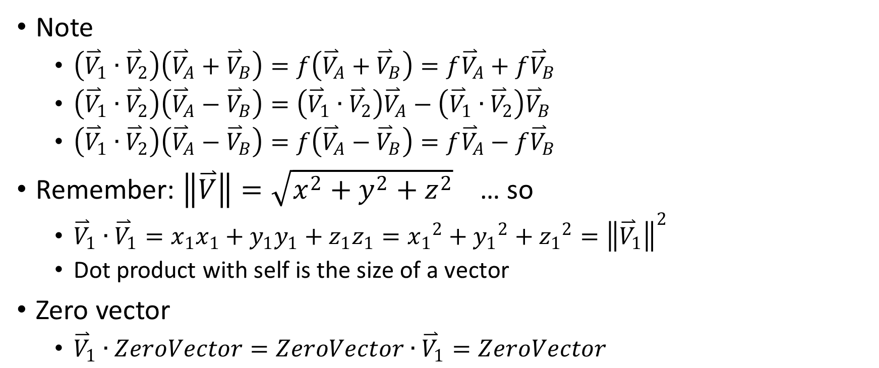
Interesting (or not?)
Note
$\left({\overset{⃑}{V}}_{1}∙{\overset{⃑}{V}}_{2}\right)\left({\overset{⃑}{V}}_{A}+{\overset{⃑}{V}}_{B}\right)=f\left({\overset{⃑}{V}}_{A}+{\overset{⃑}{V}}_{B}\right)=f{\overset{⃑}{V}}_{A}+f{\overset{⃑}{V}}_{B}$
$\left({\overset{⃑}{V}}_{1}∙{\overset{⃑}{V}}_{2}\right)\left({\overset{⃑}{V}}_{A}−{\overset{⃑}{V}}_{B}\right)=\left({\overset{⃑}{V}}_{1}∙{\overset{⃑}{V}}_{2}\right){\overset{⃑}{V}}_{A}−\left({\overset{⃑}{V}}_{1}∙{\overset{⃑}{V}}_{2}\right){\overset{⃑}{V}}_{B}$
$\left({\overset{⃑}{V}}_{1}∙{\overset{⃑}{V}}_{2}\right)\left({\overset{⃑}{V}}_{A}−{\overset{⃑}{V}}_{B}\right)=f\left({\overset{⃑}{V}}_{A}−{\overset{⃑}{V}}_{B}\right)=f{\overset{⃑}{V}}_{A}−f{\overset{⃑}{V}}_{B}$
Remember: $\left\|\overset{⃑}{V}\right\|=\sqrt{x^{2}+y^{2}+z^{2}}$ … so
${\overset{⃑}{V}}_{1}∙{\overset{⃑}{V}}_{1}={x_{1}x}_{1}+y_{1}y_{1}+z_{1}z_{1}={x_{1}}^{2}+{y_{1}}^{2}+{z_{1}}^{2}={\left\|{\overset{⃑}{V}}_{1}\right\|}^{2}$
Dot product with self is the size of a vector
Zero vector
${\overset{⃑}{V}}_{1}∙ZeroVector=ZeroVector∙{\overset{⃑}{V}}_{1}=ZeroVector$

Slide 7
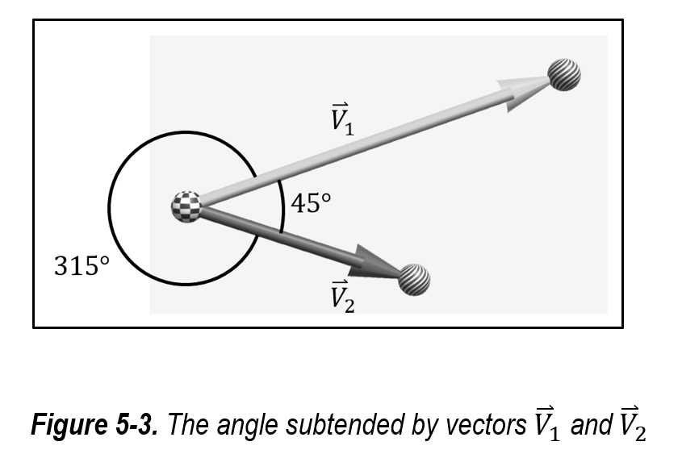
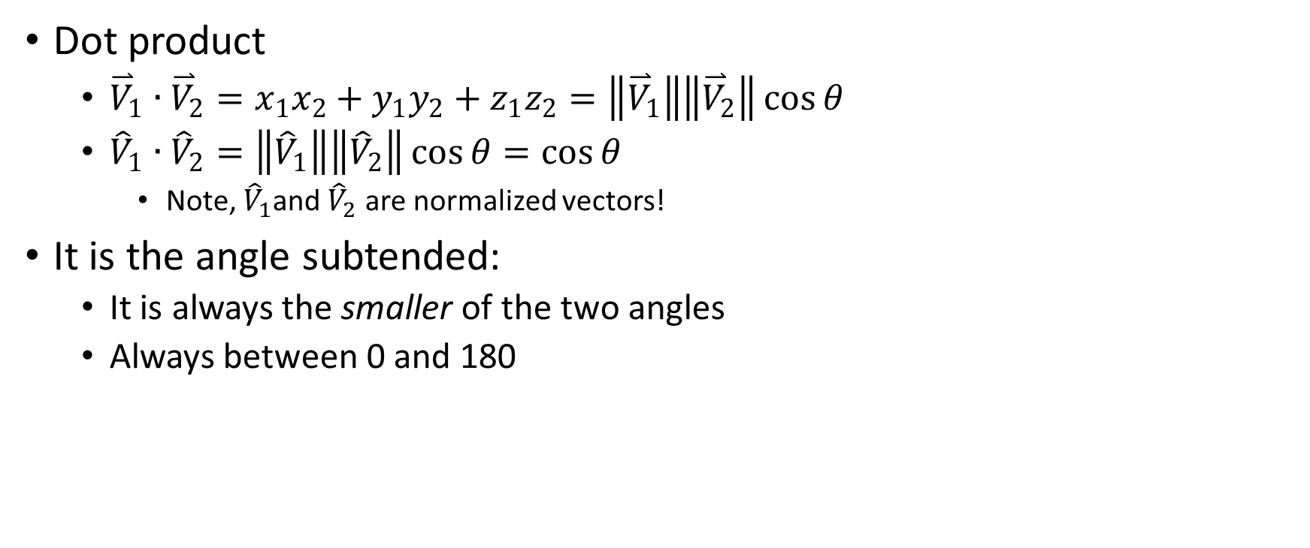
First: Angle between two vectors
Dot product
${\overset{⃑}{V}}_{1}∙{\overset{⃑}{V}}_{2}={x_{1}x}_{2}+y_{1}y_{2}+z_{1}z_{2}=\left\|{\overset{⃑}{V}}_{1}\right\|\left\|{\overset{⃑}{V}}_{2}\right\|\cos{θ}$
${\hat{V}}_{1}∙{\hat{V}}_{2}=\left\|{\hat{V}}_{1}\right\|\left\|{\hat{V}}_{2}\right\|\cos{θ}=\cos{θ}$
Note, ${\hat{V}}_{1}$and ${\hat{V}}_{2}$ are normalized vectors!
It is the angle subtended:
It is always the smaller of the two angles
Always between 0 and 180

Slide 8
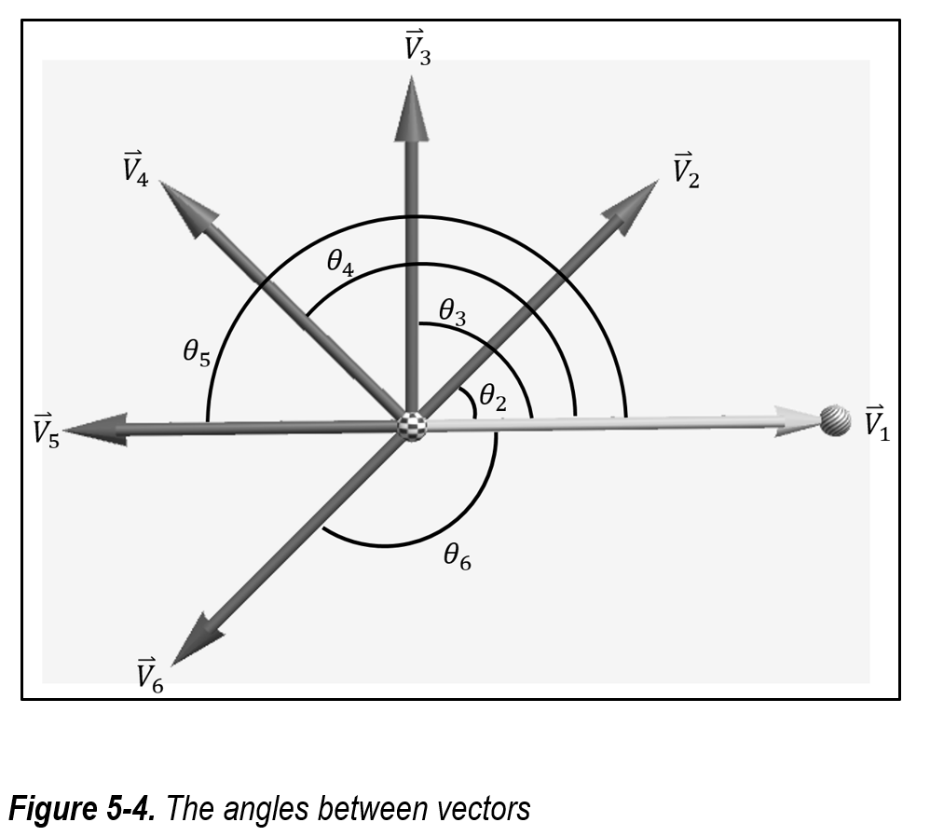
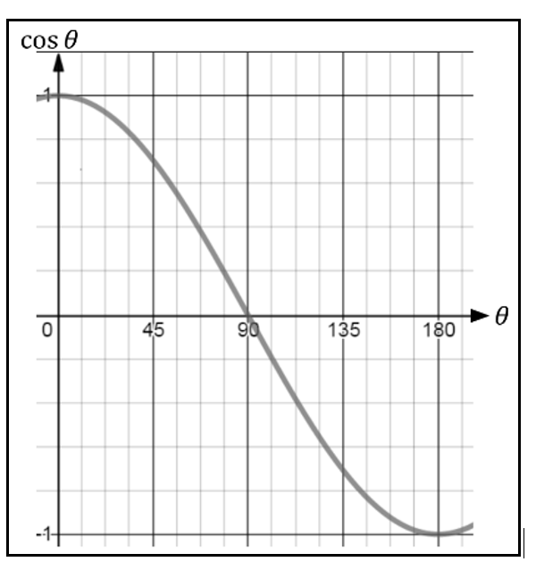

Signs of the angle between two vectors
${\hat{V}}_{1}∙{\hat{V}}_{2}=\cos{θ_{2}}=a positive number; because θ_{2}<90°$
${\hat{V}}_{1}∙{\hat{V}}_{3}=\cos{θ_{3}}=0 because θ_{3}=90°$
${\hat{V}}_{1}∙{\hat{V}}_{4}=\cos{θ_{4}}=a negative number; because θ_{4}>90°$
${\hat{V}}_{1}∙{\hat{V}}_{5}=\cos{θ_{5}}=−1 because θ_{5}=180°$
${\hat{V}}_{1}∙{\hat{V}}_{6}=\cos{θ_{6}}=a negative number because θ_{6}>90°$

Slide 9
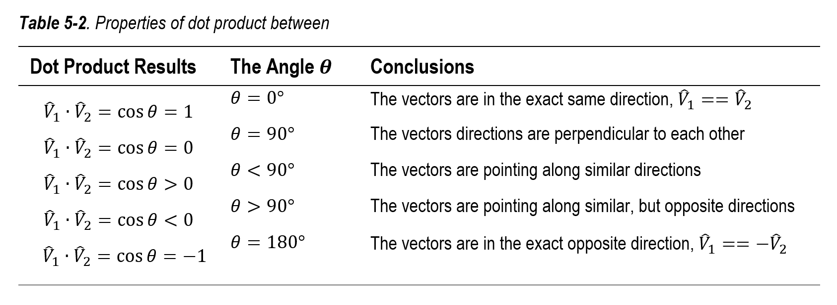
Properties of dot products

Slide 10
Example 5-1: Angle between vectors
Experience manipulating the angle subtended by two vectors and observe the results of the dot product
Verify that a 2D plane can always be found for drawing two non-parallel vectors
Examine the implementation of and appreciate the subtleties of vector normalization when computing dot products

Slide 11
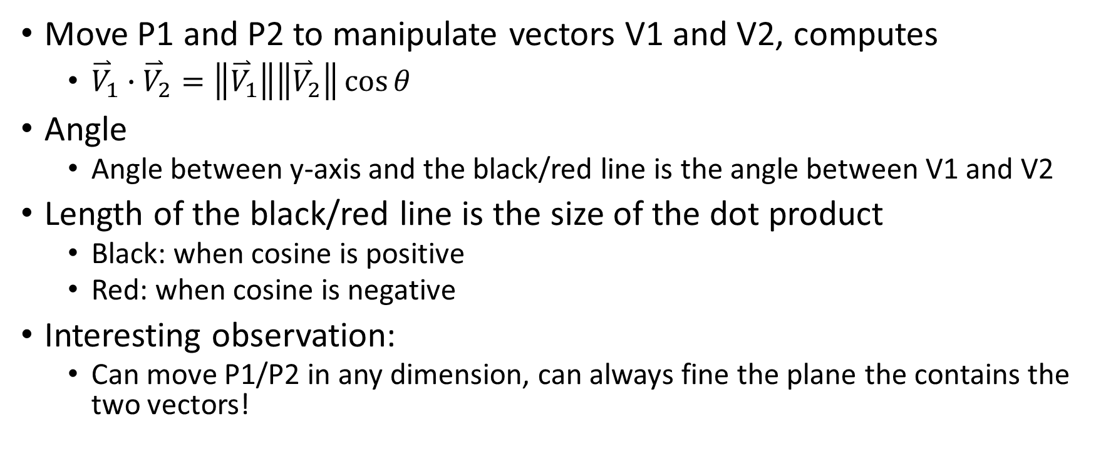
Example 5-1: Make sure to try/observe
Move P1 and P2 to manipulate vectors V1 and V2, computes
${\overset{⃑}{V}}_{1}∙{\overset{⃑}{V}}_{2}=\left\|{\overset{⃑}{V}}_{1}\right\|\left\|{\overset{⃑}{V}}_{2}\right\|\cos{θ}$
Angle
Angle between y-axis and the black/red line is the angle between V1 and V2
Length of the black/red line is the size of the dot product
Black: when cosine is positive
Red: when cosine is negative
Interesting observation:
Can move P1/P2 in any dimension, can always fine the plane the contains the two vectors!

Slide 12
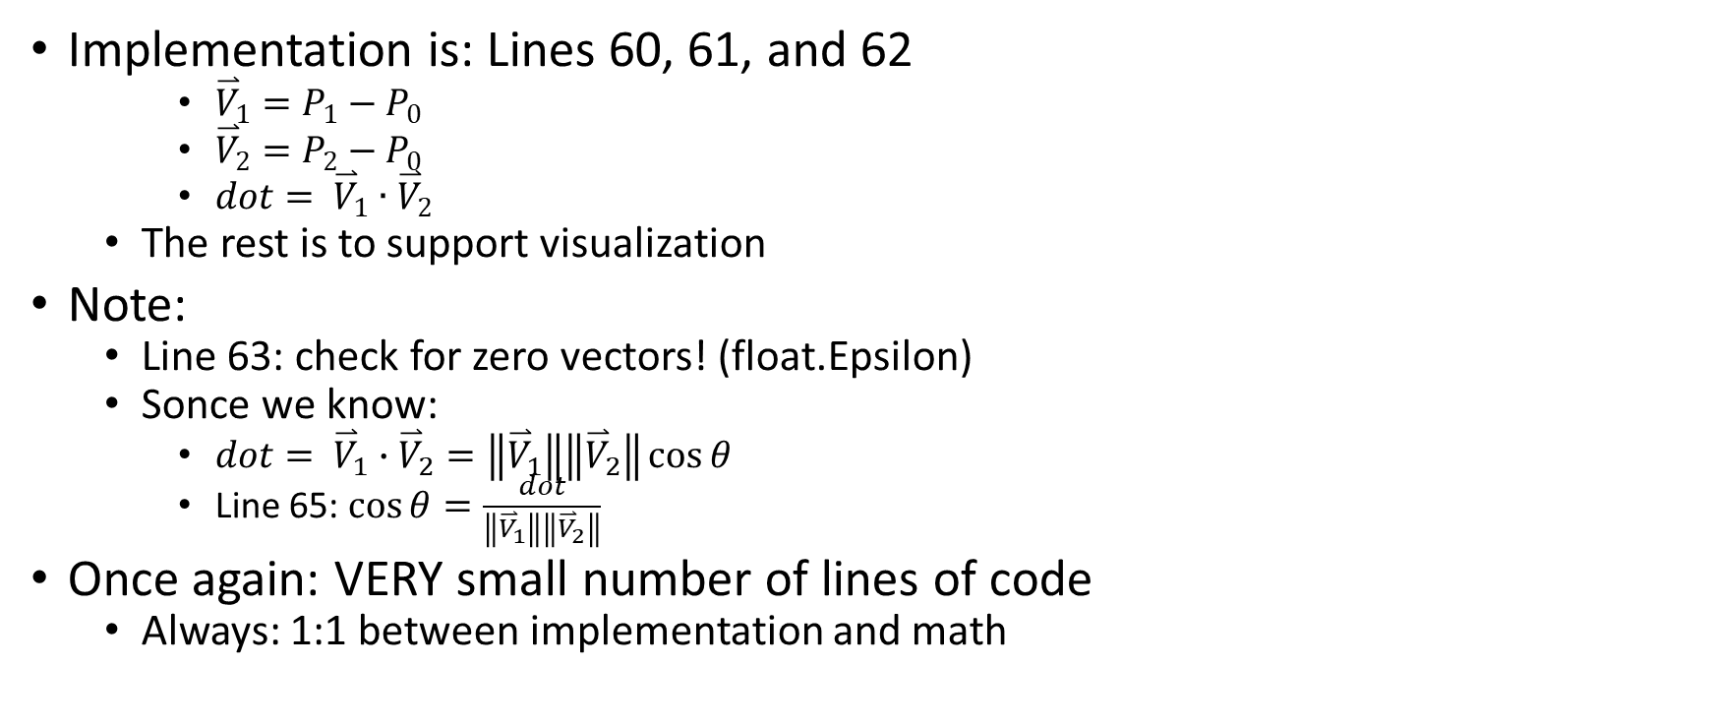
Example 5-1: Implementation
Implementation is: Lines 60, 61, and 62
${\overset{⃑}{V}}_{1}=P_{1}−P_{0}$
${\overset{⃑}{V}}_{2}=P_{2}−P_{0}$
$dot= {\overset{⃑}{V}}_{1}∙{\overset{⃑}{V}}_{2}$
The rest is to support visualization
Note:
Line 63: check for zero vectors! (float.Epsilon)
Sonce we know:
$dot= {\overset{⃑}{V}}_{1}∙{\overset{⃑}{V}}_{2}=\left\|{\overset{⃑}{V}}_{1}\right\|\left\|{\overset{⃑}{V}}_{2}\right\|\cos{θ}$
Line 65: $\cos{θ}=\frac{dot}{\left\|{\overset{⃑}{V}}_{1}\right\|\left\|{\overset{⃑}{V}}_{2}\right\|}$
Once again: VERY small number of lines of code
Always: 1:1 between implementation and math

Slide 13
Example 5-1: Take Away
The dot product of normalized vectors is the cosine of their subtended angle
The value of the dot product provides insights into the relative directions of the operand vectors, (see Table 5-2)
A unique 2D plane can be derived from two non-parallel vectors such that both vectors can be drawn on the plane

Slide 14
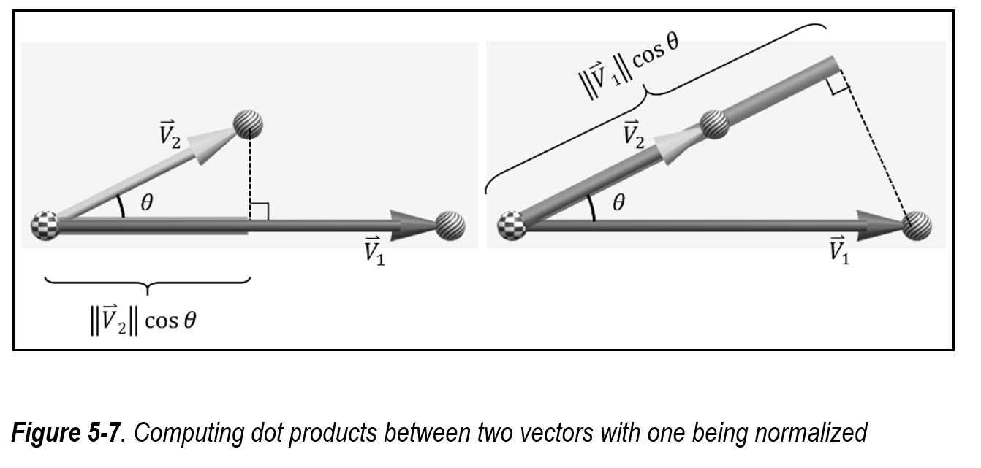
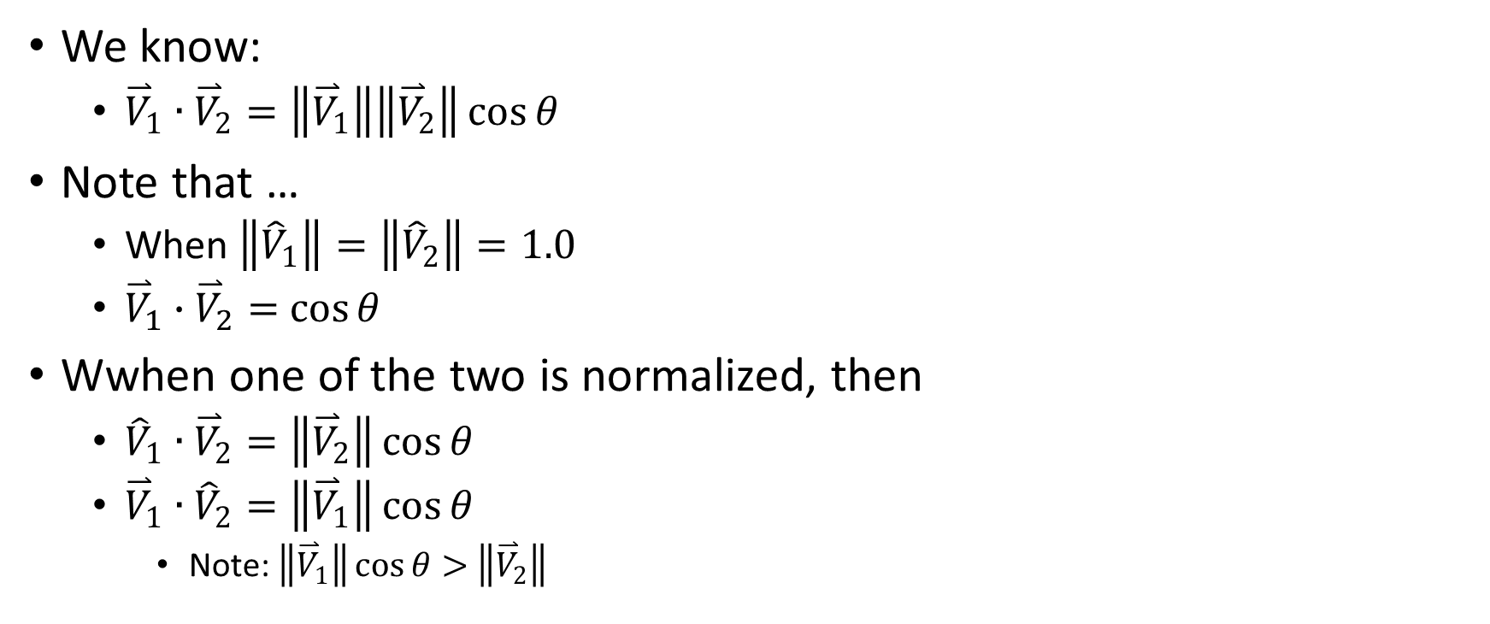
Vector Projections
We know:
${\overset{⃑}{V}}_{1}∙{\overset{⃑}{V}}_{2}=\left\|{\overset{⃑}{V}}_{1}\right\|\left\|{\overset{⃑}{V}}_{2}\right\|\cos{θ}$
Note that …
When $\left\|{\hat{V}}_{1}\right\|=\left\|{\hat{V}}_{2}\right\|=1.0$
${\overset{⃑}{V}}_{1}∙{\overset{⃑}{V}}_{2}=$ $\cos{θ}$
Wwhen one of the two is normalized, then
${\hat{V}}_{1}∙{\overset{⃑}{V}}_{2}=\left\|{\overset{⃑}{V}}_{2}\right\|\cos{θ}$
${\overset{⃑}{V}}_{1}∙{\hat{V}}_{2}=\left\|{\overset{⃑}{V}}_{1}\right\|\cos{θ}$
Note: $\left\|{\overset{⃑}{V}}_{1}\right\|\cos{θ}>$ $\left\|{\overset{⃑}{V}}_{2}\right\|$

Slide 15
Example 5-2: Vector Project Example
Appreciate the results of normalizing one of the vectors in the dot product operation
Experience and understand the results of projecting vectors onto each other
Observe and interact with negative projected distances
Examine the code that performs vector projection

Slide 16
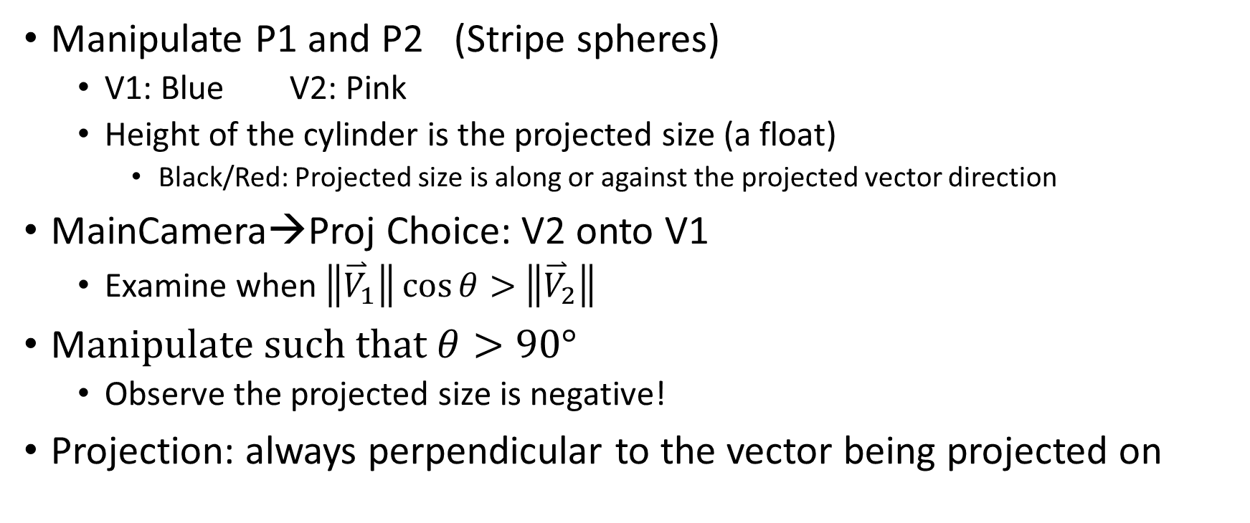
Example 5-2: Make sure to try/observe
Manipulate P1 and P2 (Stripe spheres)
V1: Blue V2: Pink
Height of the cylinder is the projected size (a float)
Black/Red: Projected size is along or against the projected vector direction
MainCamera→Proj Choice: V2 onto V1
Examine when $\left\|{\overset{⃑}{V}}_{1}\right\|\cos{θ}>$ $\left\|{\overset{⃑}{V}}_{2}\right\|$
M$anipulate such that θ>90°$
Observe the projected size is negative!
Projection: always perpendicular to the vector being projected on

Slide 17
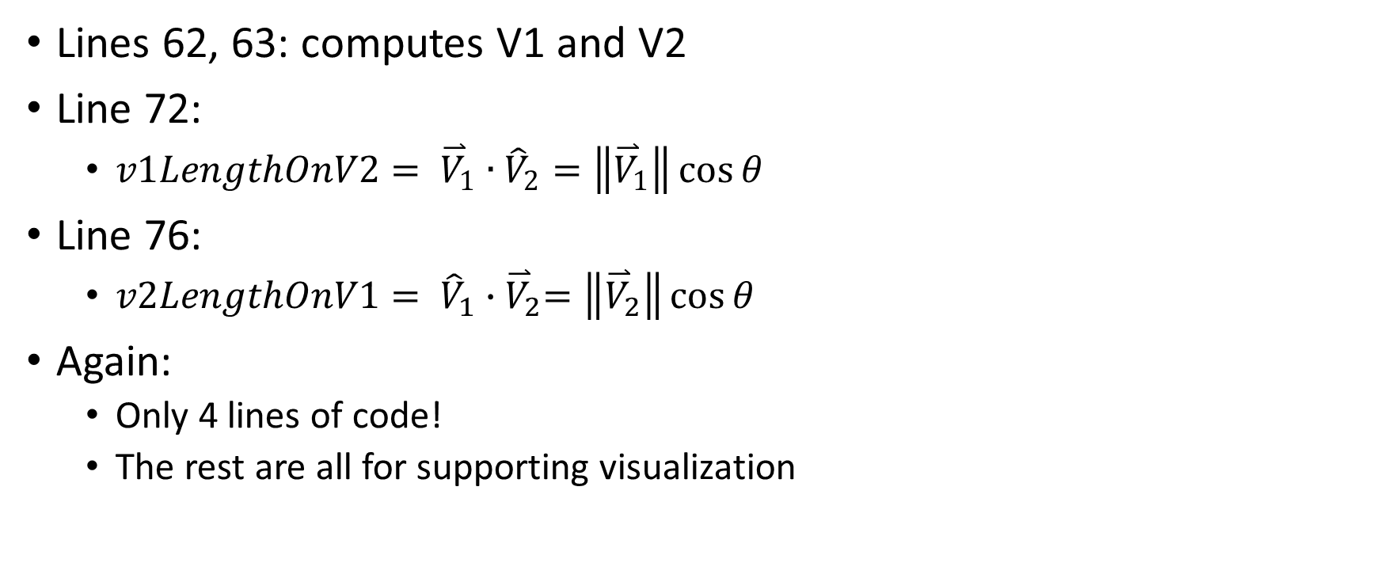
Eaxmple 5-2: Implementation
Lines 62, 63: computes V1 and V2
Line 72:
$v1LengthOnV2= {\overset{⃑}{V}}_{1}∙{\hat{V}}_{2}=\left\|{\overset{⃑}{V}}_{1}\right\|\cos{θ}$
Line 76:
$v2LengthOnV1= {\hat{V}}_{1}{∙\overset{⃑}{V}}_{2}=\left\|{\overset{⃑}{V}}_{2}\right\|\cos{θ}$
Again:
Only 4 lines of code!
The rest are all for supporting visualization

Slide 18
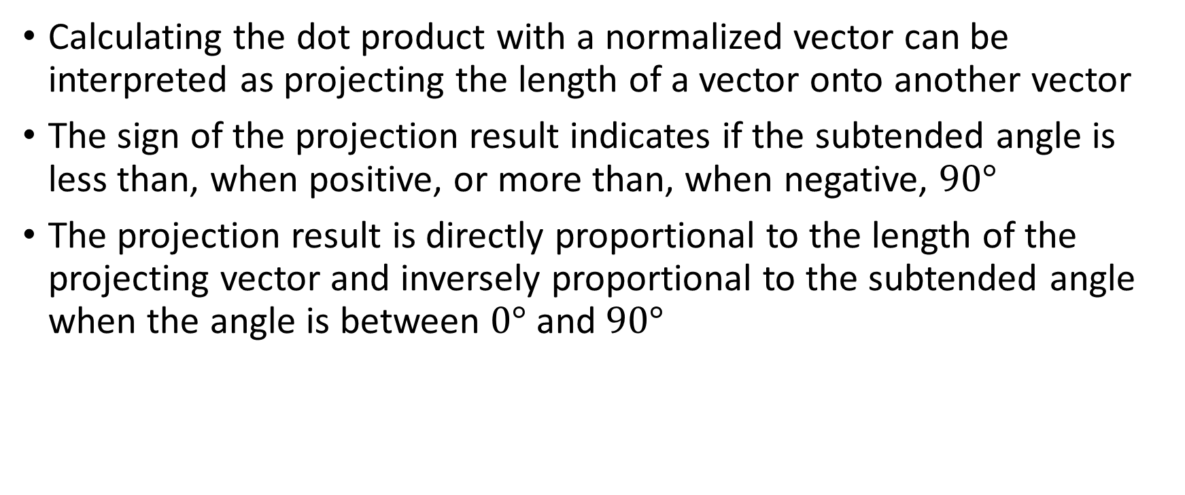
Example 5-2: Take Away
Calculating the dot product with a normalized vector can be interpreted as projecting the length of a vector onto another vector
The sign of the projection result indicates if the subtended angle is less than, when positive, or more than, when negative, $90°$
The projection result is directly proportional to the length of the projecting vector and inversely proportional to the subtended angle when the angle is between $0°$ and $90°$

Slide 19
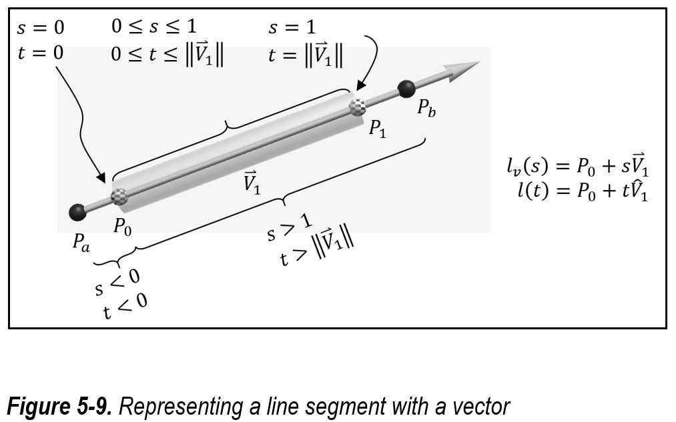

Representation of a Line Segment
Line segment from $P_{0}$ t$o P_{1}$
Direction of line:${\overset{⃑}{V}}_{1}=P_{1}−P_{0}$
Length of line: $\left\|{\overset{⃑}{V}}_{1}\right\|$
Represent as:
$l\left(t\right)=P_{0}+t{\hat{V}}_{1}$
0 ≤ t ≤ $\left\|{\overset{⃑}{V}}_{1}\right\|$
$l_{v}\left(s\right)=P_{0}+s{\overset{⃑}{V}}_{1}$
0 ≤ s ≤ $1$
Note: $l_{v}\left(s\right)$ is convenient
$l_{v}\left(0\right)=P_{0}+0{\overset{⃑}{V}}_{1}=P_{0}$
$l_{v}\left(0.5\right)=P_{0}+0.5{\overset{⃑}{V}}_{1}=midpoint of the line segment$
$l_{v}\left(1\right)=P_{0}+1{\overset{⃑}{V}}_{1}=P_{0}+\left(P_{1}−P_{0}\right)=P_{1}$

Slide 20

Vector line equation (Unity Ray object)
Given a point, $P_{0}$, and a direction $\hat{V}$
The vector line equation
$l\left(t\right)=P_{0}+t\hat{V}$
$t$: distance travelled along the $\hat{V}$ direction
The equation tells us the final destination position

Slide 21
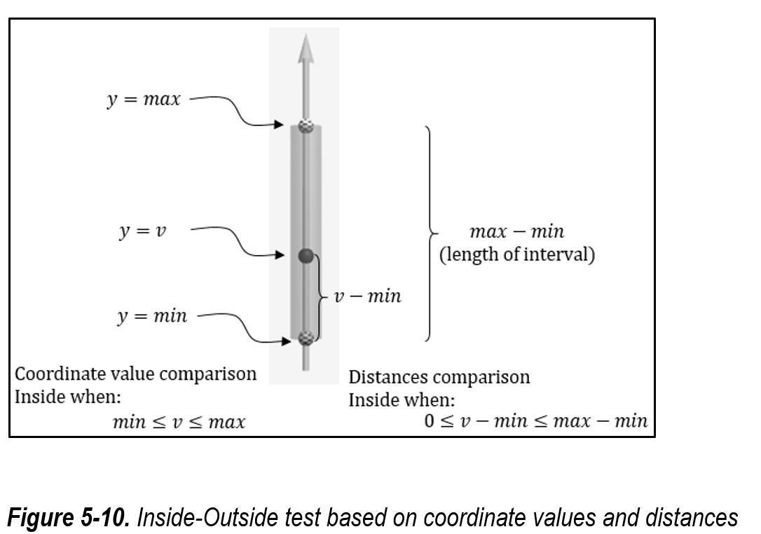

Inside-Outside Test of 1D Interval
Inside y-interval when, the y-value, v
$min≤v≤max$
OR:
$min−min≤v−min≤max−min$
$0≤(v−min)≤(max−min)$

Slide 22
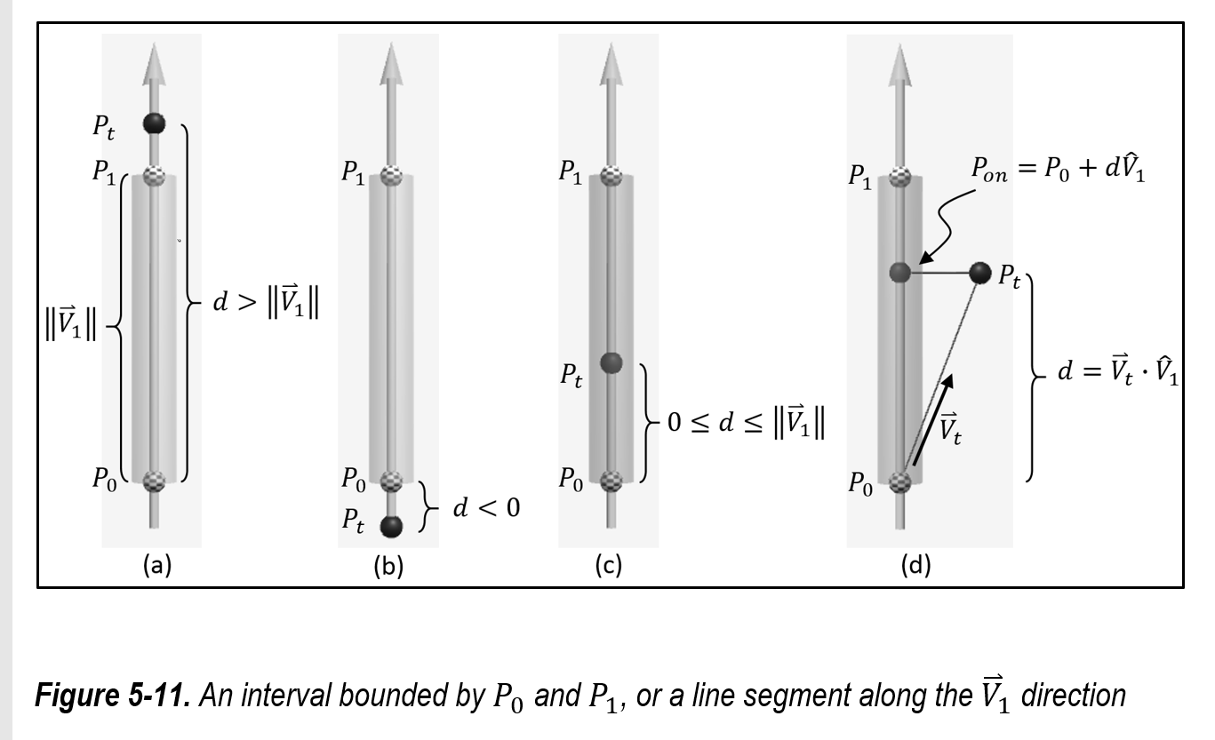

A general case
Line segment from $P_{0}$ to $P_{1}$
Cases (a), (b), and (c), $P_{t}$
On the line segment
Distance from $P_{0}$ is
d = $\left\|P_{t}−P_{0}\right\|$
Inside if
$0≤d≤\left\|{\overset{⃑}{V}}_{1}\right\|$
Similar to the y-axis case
Case (d) … next page

Slide 23
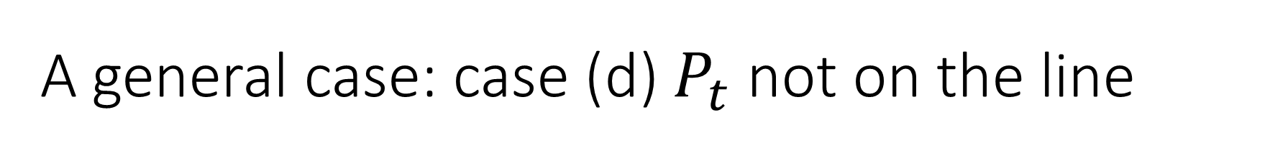

A general case: case (d) $P_{t}$ not on the line
${\overset{⃑}{V}}_{t}=P_{t}−P_{0}$
$d= {\overset{⃑}{V}}_{t}∙{\hat{V}}_{1}$
Note ${\overset{⃑}{V}}_{t}$ projected onto ${\hat{V}}_{1}$
${\overset{⃑}{V}}_{1}$ must be normalized
$P_{on}=l\left(d\right)=P_{0}+d{\hat{V}}_{1}$
$P_{on}$ inside the segment when
$0≤d≤\left\|{\overset{⃑}{V}}_{1}\right\|$
Note: the above actually works for all the 4 cases
$P_{t}$ on the line segment or otherwise, all works!

Slide 24
Example 5-3: Line Interval Bound Example
Experience defining and interacting with a general interval
Examine the projection of a position onto a general interval
Understand the implementation of an inside-outside test for the general interval

Slide 25
Example 5-3: Make sure to try/observe
Manipulate P0 and P1 such that the interval (line-segment) is not along the y-axis
Pon:
Outside: line segment turn white, Pon turn black
Inside: line segment turn red, Pon turn red
Move Pt to
Before P0 on the line segment, Projected size will be negative
After P1 on the line segment, Projected size > line length
Perpendicular distance of Pt to the line segment is not a factor
Pt can be VERY far away (perpendicularly, and still projected to inside)

Slide 26

Example 5-3: Implementation
Line 60: ${\overset{⃑}{V}}_{t}=P_{t}−P_{0}$
Line 61: compute ${\hat{V}}_{1}$
Line 62: $d= {\overset{⃑}{V}}_{t}∙{\hat{V}}_{1}$
Line 63: $P_{on}=l\left(d\right)=P_{0}+d{\hat{V}}_{1}$
Line 65: $0≤d≤\left\|{\overset{⃑}{V}}_{1}\right\|$

Slide 27
Example 5-3: Take Away
An interval along a direction is a line segment and can be represented by the vector line equation
Vector projection can be applied to compute the projected distance of a point along a direction
The projected position along a direction can be determined for any given position

Slide 28
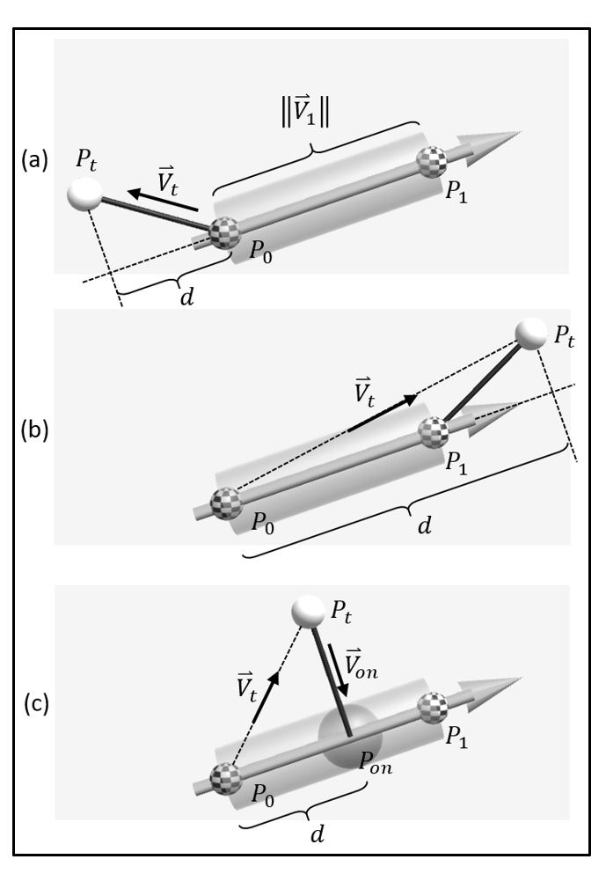

Line to Point Distance
Lines segment P0 to P1
Case (a) before P0
Distance is from Pt to P0
Case (b) after P1
Distance is from Pt to P1
Case (c) inside line segment
Distance is $\left\|{\overset{⃑}{V}}_{on}\right\|$
Use? Try selecting a line in an editor

Slide 29
Example 5-4: Line to Point Distance
Experience working with a straightforward application of the vector dot product concepts
Interact with and understand the results of line to point distance computation
Examine the implementation of line to point distance computation

Slide 30
Example 5-4: Make sure to try/observe
Black line between Pt and line segment is Von
Red sphere: radius is the distance from Pt to line segment
Make sure to try
Move Pt far away (perpendiculy from line)
Move Pt to before/after the end points

Slide 31


Example 5-4: Implementation
Line 50: ${\overset{⃑}{V}}_{1}=P_{1}−P_{0}$
Line 51: v1Len = $\left\|{\overset{⃑}{V}}_{1}\right\|$
Line 55: ${\overset{⃑}{V}}_{t}=P_{t}−P_{0}$
Line 56: ${\hat{V}}_{1}=\frac{\left\|{\overset{⃑}{V}}_{1}\right\|}{v1Len}$
Line 57: $d= {\overset{⃑}{V}}_{t}∙{\hat{V}}_{1}$
Line 58: Case (a) before P0
$P_{on}=P_{0}$
$d=\left\|{\overset{⃑}{V}}_{t}\right\|$
Line 63: Case (b) after P1
$P_{on}=P_{1}$
$d=\left\|P_{t}−P_{1}\right\|$
Line 68: General case
$P_{on}=P_{0}+d{\hat{V}}_{1}$
${\overset{⃑}{V}}_{on}=P_{on}−P_{t}$
$d=\left\|{\overset{⃑}{V}}_{on}\right\|$

Slide 32
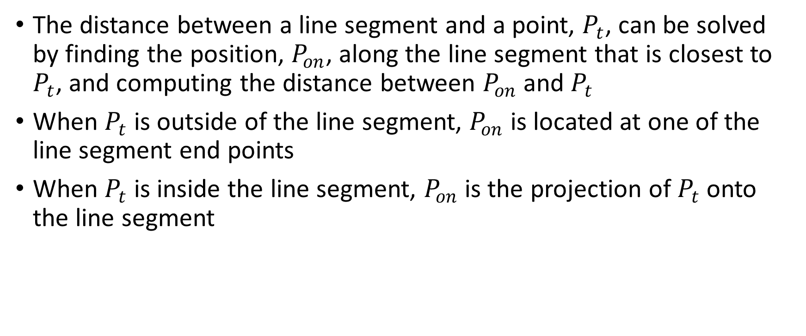
Example 5-4: Take Away
The distance between a line segment and a point, $P_{t}$, can be solved by finding the position, $P_{on}$, along the line segment that is closest to $P_{t}$, and computing the distance between $P_{on}$ and $P_{t}$
When $P_{t}$ is outside of the line segment, $P_{on}$ is located at one of the line segment end points
When $P_{t}$ is inside the line segment, $P_{on}$ is the projection of $P_{t}$ onto the line segment

Slide 33
Line to Line distance
Self-reading if interested

Slide 34
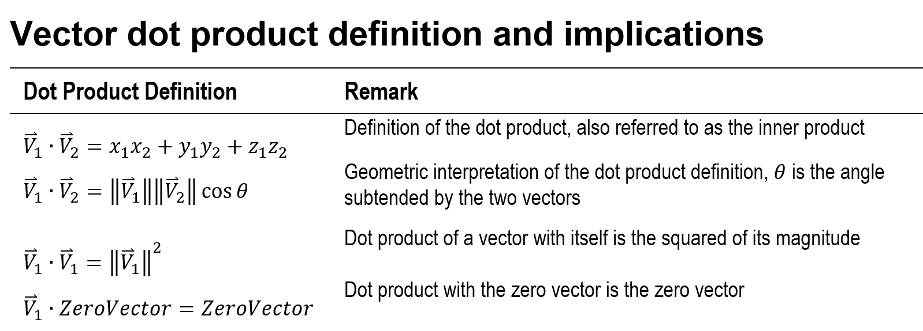
Summary

Slide 35
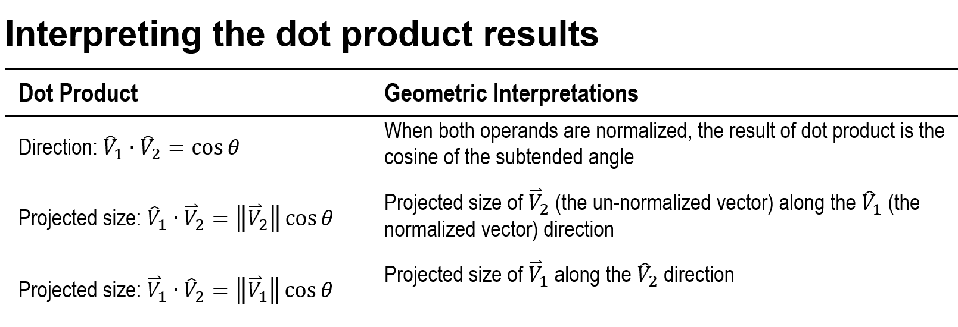
Summary (cont)

Slide 36
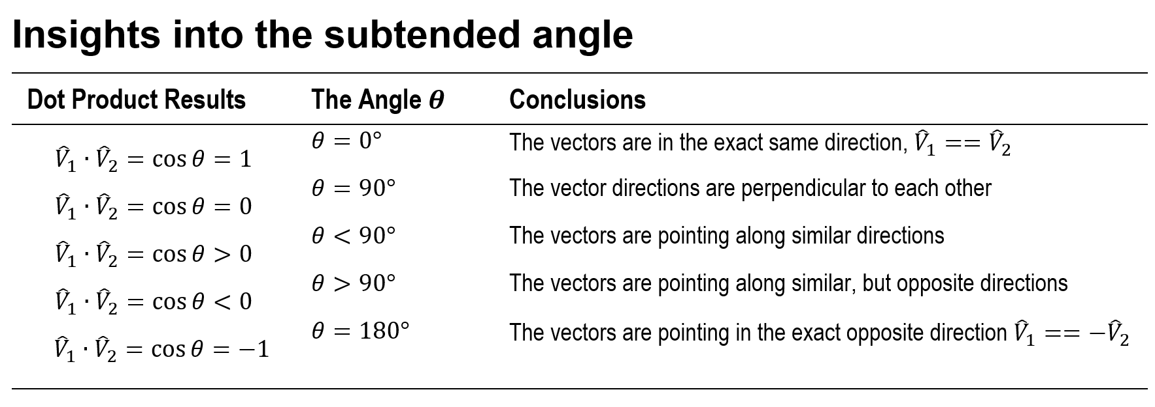
Summary (cont)

Slide 37
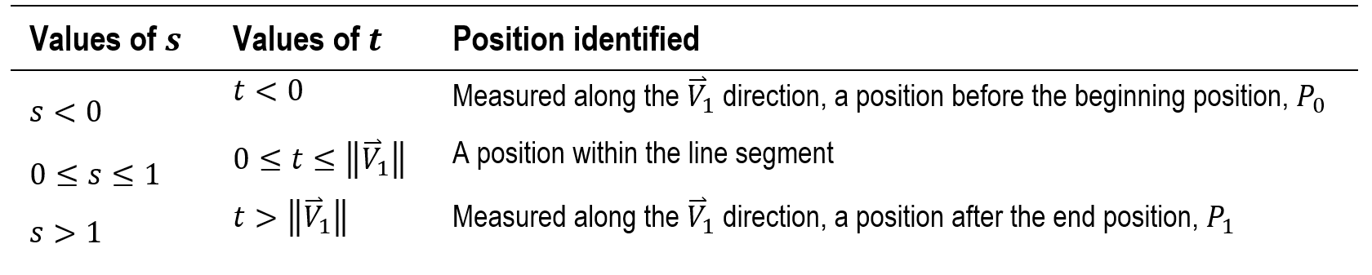

Summary (cont): Line Equations
$l_{v}\left(s\right)=P_{0}+s{\overset{⃑}{V}}_{1}$
$l\left(t\right)=P_{0}+t{\hat{V}}_{1}$
where,
${\overset{⃑}{V}}_{1}=P_{1}−P_{0}$

