Slide 1
Workload Analysis
28-Jul-2018
Auto-Generated by MBPA
A2CA WDLabs (contact jun.xu99@gmail.com for tech support)

Slide 2
Outline
Executive Summary
Analysis Results
Matlab Parser and Analyzer: Methods & Definition

Slide 3
Summary of Trace Properties
Read vs write
Dominiated read requests
R/W: cmd 1:0.28703; blks 1:0.28838
Sequence vs Randomness
Overall- Mode=0 with ratio= 1.5206 and sequence Unknown at QL=1; Higher rate possibly for long length than 128; Strong mixed streams detected
Write- Mode=0 with ratio= 0.20872 and sequence Relatively high at QL=1; Higher rate possibly for long length than 128; Strong mixed streams detected
Read- Mode=0 with ratio= 1.0419 and sequence Unknown at QL=1; Higher rate possibly for long length than 128; Strong mixed streams detected

Slide 4
Summary of Trace Properties (cont)
Write Update
Update blk ratio: freq 0.036797& timed 0.020346
Update cmd ratio: freq 0.026376& timed 0.026376
Idle time
Total effective idle time (>0.1ms)=449.2035; Total idle time=507.5683
Total effective idle frequency (>0.1ms)=7819; Total idle frequency =7819

Slide 5
Basic Information
Trace Information
Maximum time = 610.2407; effective time = 610.2263
Basic Statistics
Metrics | Combined | Read | Write
Cmd number | 7820 | 6076 | 1744
Total blk size | 5284008 | 4101288 | 1182720
Average blk size | 675.7043 | 674.998 | 678.1651
Average IOPS | 12.8149 | 9.957 | 2.858
Average TP (MBps) | 4.2281 | 3.2817 | 0.94637

Slide 6
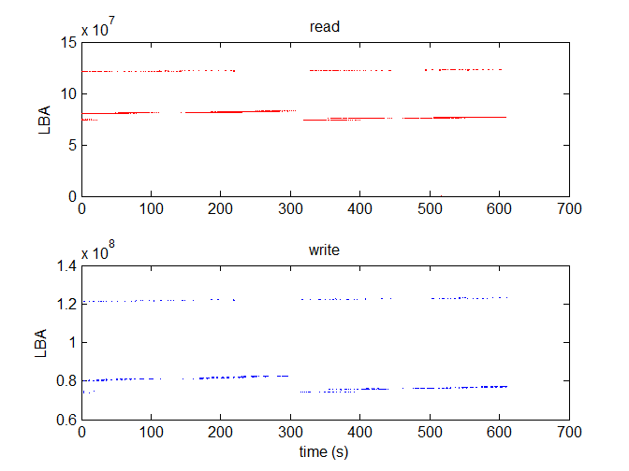
Request LBA Distribution
Basic Properties
LBA vs Time can show the sequence and access range
Visually observe if read and write are in the same/similar range
Use a clustering method to find the access locality range

Slide 7
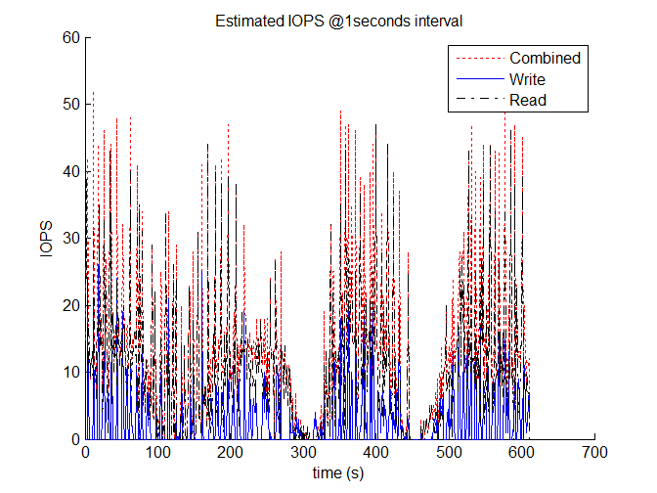
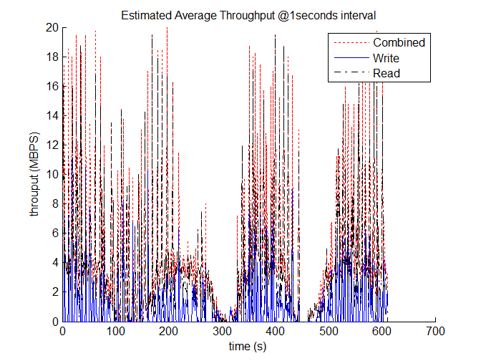
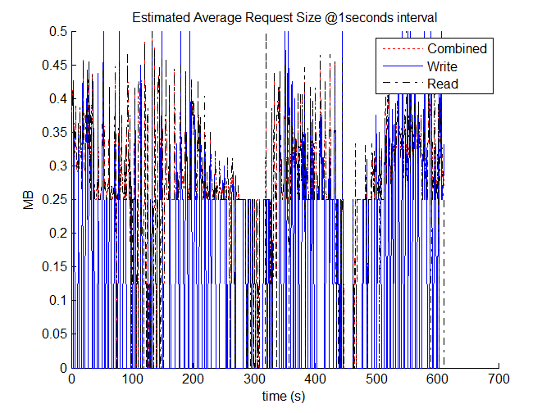
Estimated IOPS and Throughput
Basic Properties
Observe if burst and idleness exist
Bursts exist if there are peaks much higher than the average
Idleness exist if there are troughs much lower than the average

Slide 8
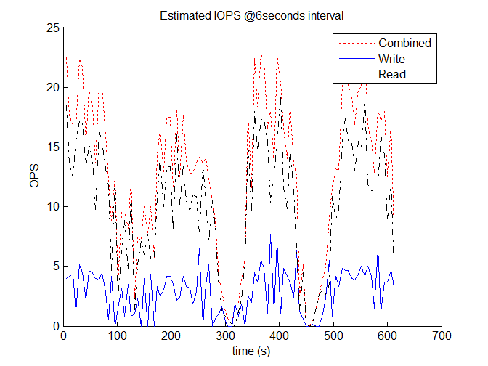
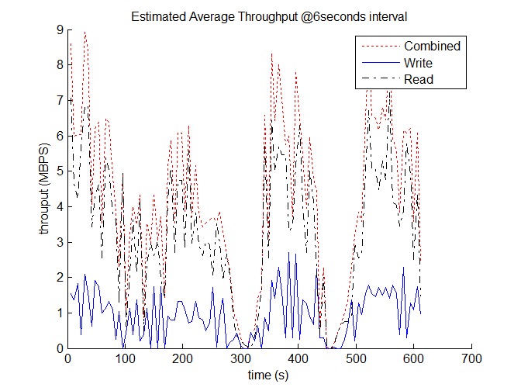
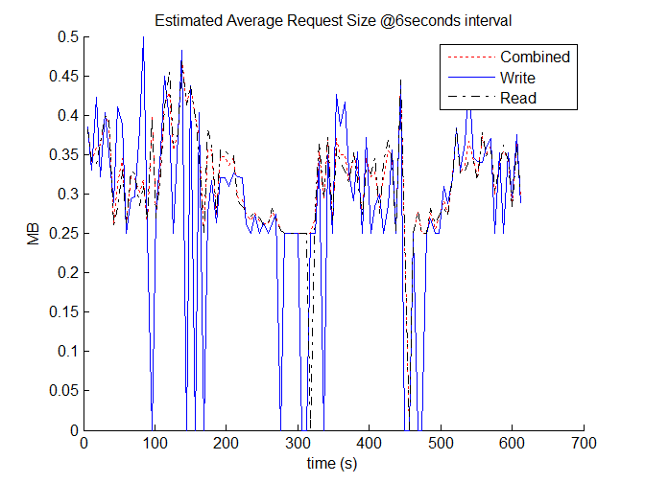
Estimated IOPS and Throughput
Basic Properties
Observe if burst and idleness exist
Bursts exist if there are peaks much higher than the average
Idleness exist if there are troughs much lower than the average

Slide 9
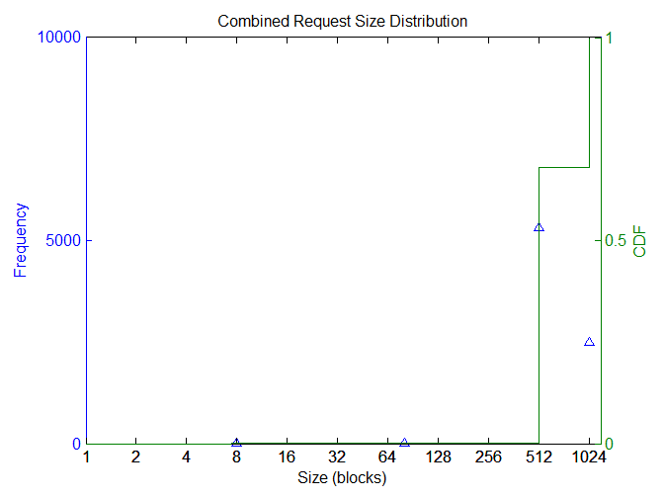
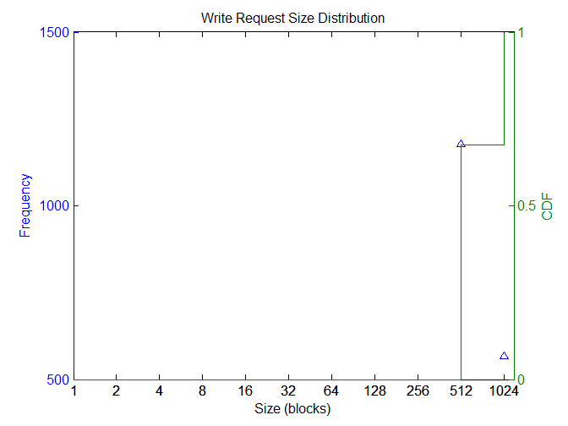
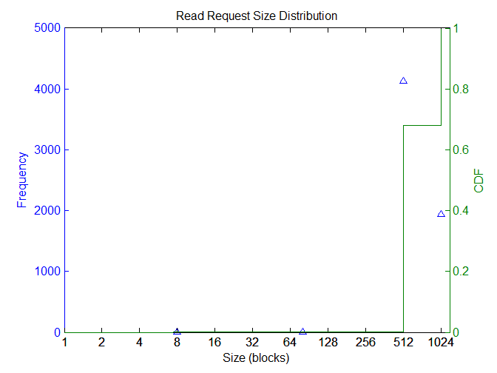
Size Distribution
Basic Properties
Observe the large-size requests for sequence and small-size requests for randomness
The more large-size requests, the more sequetial in a sense

Slide 10
Size Distribution (cont)
Basic Properties
Top 5 Freq | 1 | 2 | 3 | 4 | 5
Comb size | 512 | 1024 | 80 | 8 | 1
Comb freq | 5314 | 2503 | 2 | 1 | 0
Write size | 512 | 1024 | 1 | 2 | 3
Write freq | 1178 | 566 | 0 | 0 | 0
Read size | 512 | 1024 | 80 | 8 | 1
Read freq | 4136 | 1937 | 2 | 1 | 0
Ratio >=size | >=8 | >=16 | >=32 | >=64 | >=128 | >=256 | >=512 | >=1024
Comb | 1.000 | 1.000 | 1.000 | 1.000 | 1.000 | 1.000 | 1.000 | 0.320
Write | 1.000 | 1.000 | 1.000 | 1.000 | 1.000 | 1.000 | 1.000 | 0.325
Read | 1.000 | 1.000 | 1.000 | 1.000 | 1.000 | 1.000 | 1.000 | 0.319
Ratio <=size | <=8 | <=16 | <=32 | <=64 | <=128 | <=256 | <=512 | <=1024
Comb | 0.000 | 0.000 | 0.000 | 0.000 | 0.000 | 0.000 | 0.680 | 1.000
Write | 0.000 | 0.000 | 0.000 | 0.000 | 0.000 | 0.000 | 0.675 | 1.000
Read | 0.000 | 0.000 | 0.000 | 0.000 | 0.000 | 0.000 | 0.681 | 1.000

Slide 11
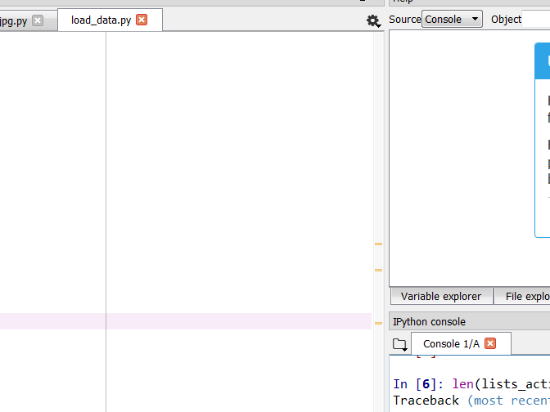


LBA-Size Distribution
Basic Properties
Observe the additional LBA information for sequence/randomness distribition
The more large-size requests and the more narrow LBA range, the more sequetial in a sense
Provide more information than "size vs frequency" curve, but difficult to observe

Slide 12
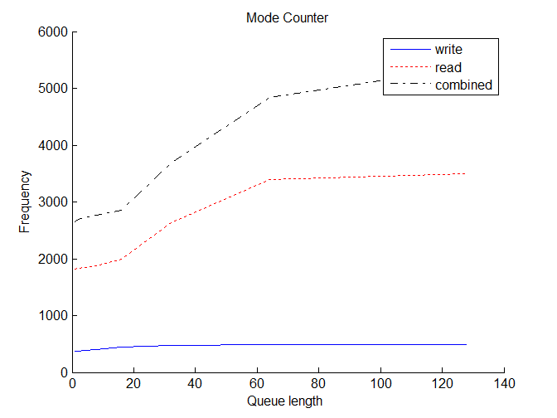
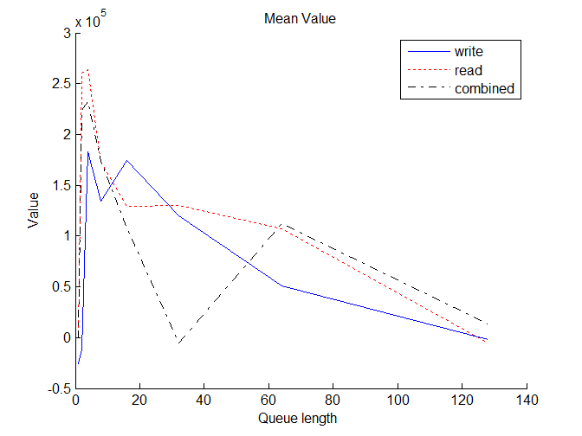
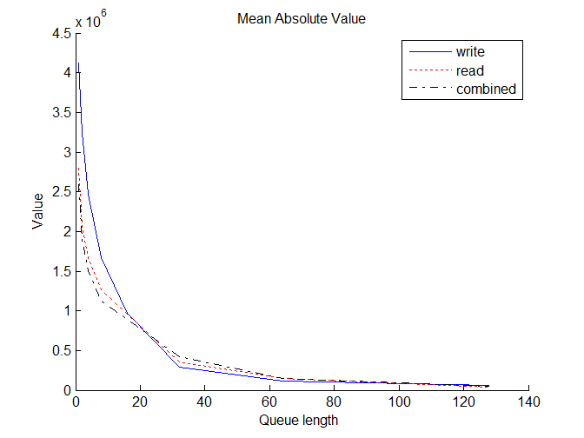
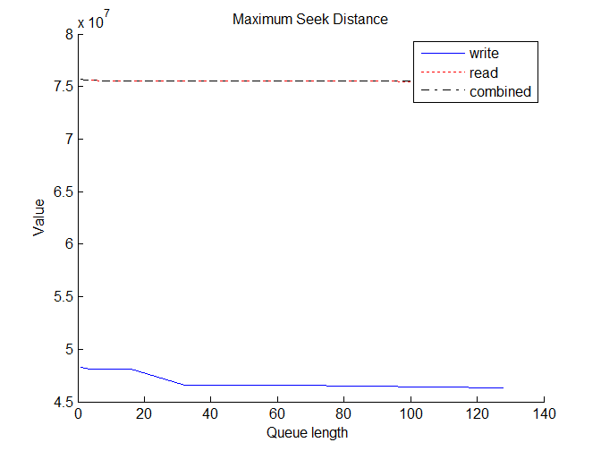
Queued Next Seek Distance
Advanced Properties

Slide 13
Queued Next Seek Distance (cont)
Advanced Properties
Observe the mode value vs ratio; when value is zero, the higher the ratio, the more sequential the workload
Observe if seek distance drop quickly wrt queue length; if so, the stream is mixed and cache plays important role
Sequence vs Randomness
Overall- Mode=0 with ratio= 1.5206 and sequence Unknown at QL=1; Higher rate possibly for long length than 128; Strong mixed streams detected
Write- Mode=0 with ratio= 0.20872 and sequence Relatively high at QL=1; Higher rate possibly for long length than 128; Strong mixed streams detected
Read- Mode=0 with ratio= 1.0419 and sequence Unknown at QL=1; Higher rate possibly for long length than 128; Strong mixed streams detected

Slide 14
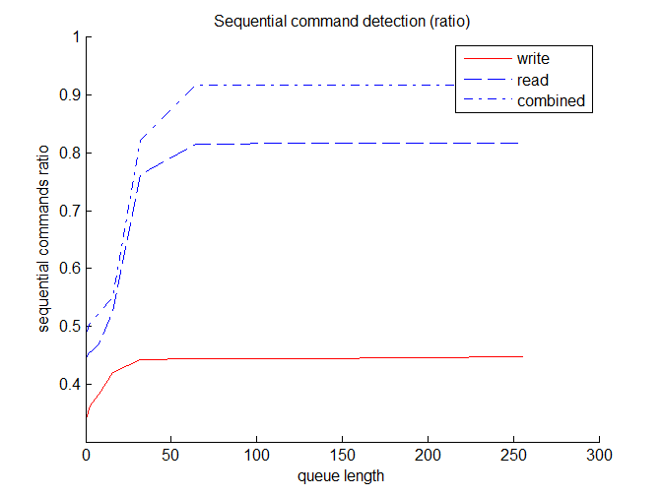
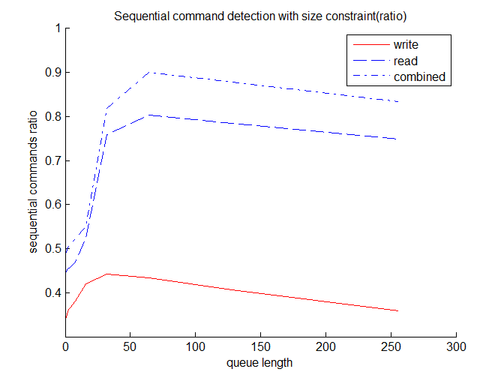
Sequential CMD Ratio
Advanced Properties
Observe sequence ratio with or without size constraint
If the ratio changes sharply wrt queue length, the workload has strong mixed streams, i.e., the cache shall play important role; otherwise, if the curve is flat, there is no or less (mixed) streams
If the ratio with size contraint is much smaller than the one without, the average stream size is small (default 1024 blocks);

Slide 15

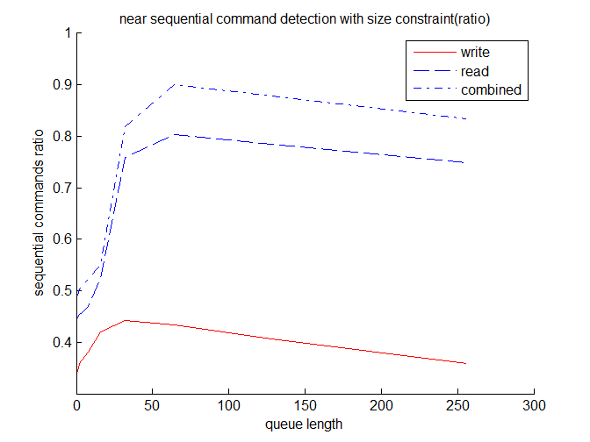
Near Sequential CMD Ratio
Advanced Properties
Observe near sequence ratio with or without size constraint
If the ratio changes sharply wrt queue length, the workload has strong mixed streams, i.e., the cache shall play important role; otherwise, if the curve is flat, there is no or less (mixed) streams
If the ratio with size contraint is much smaller than the one without, the average stream size is small (default 1024 blocks);
Compare the surves with or without gap to check the locality

Slide 16
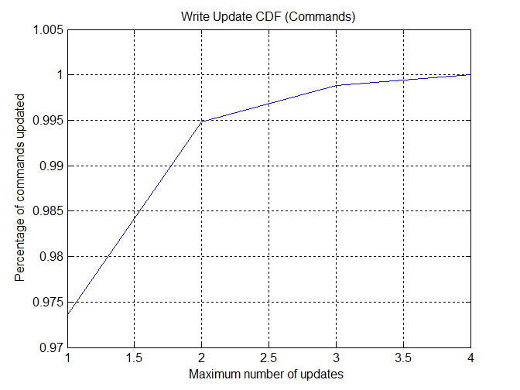
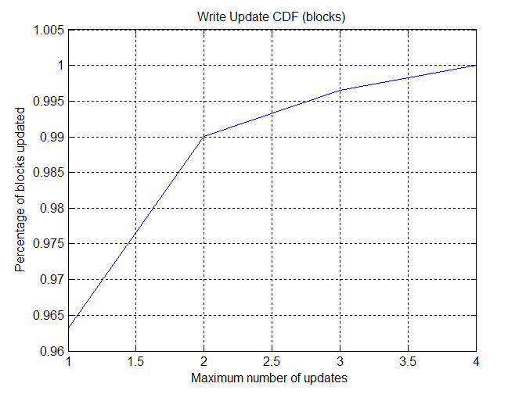
Frequented Write Update
Advanced Properties
Observe frequented write update blk & cmd ratio for write amplifcation (WA) & hit frequency for cache
Higher cmd update ratio than blk ratio usually leads to much higher WA ratio than the mininum ratio; if cmd and blk ratios are close, minimun WA is possible
High hit frequency usually means the necesity of write cache subject to hit recency
Updated blk ratio 0.036797& Updated cmd ratio: freq 0.026376
The minimun amplification ratio is 1.0208, if only the updated blocks in one request are written to the new places

Slide 17
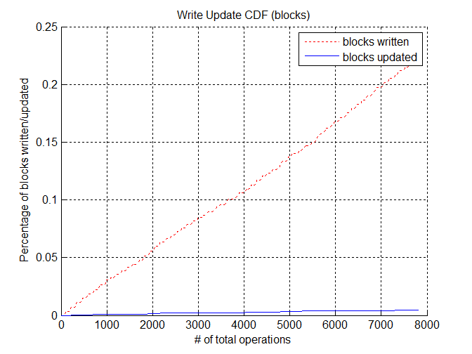
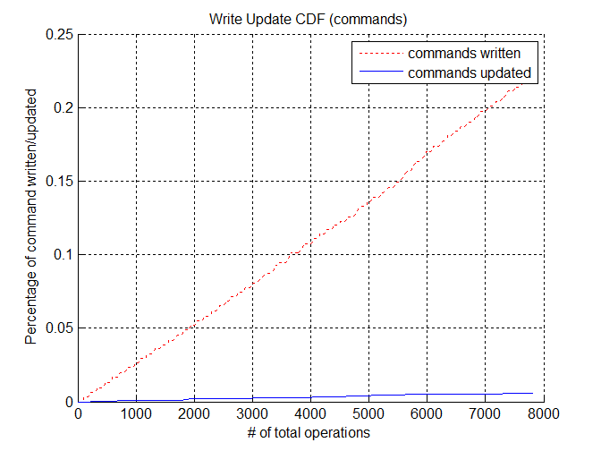
Timed Write Update
Advanced Properties
Observe timed write update blk & cmd ratio for write amplifcation (WA) & update trend vs time
Higher cmd update ratio than blk ratio usually leads to much higher WA ratio than the mininum ratio; if cmd and blk ratios are close, minimun WA is possible
A linear line usually means a relatively steady update trend, i.e., the update is relatively constant for this workload
Updated blk ratio 0.020346& Updated cmd ratio: freq 0.026376
The minimun amplification ratio is 1.0208, if only the updated blocks in one request are written to the new places

Slide 18
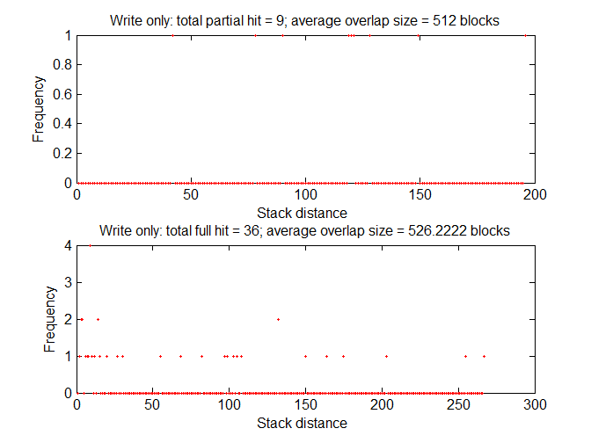
Stack Distance (Write)
Advanced Properties
The top 5 partial hit frequency are 1,1,1,1,1, with stack distance 42,78,90,119,120,
The top 5 full hit frequency are 4,2,2,2,2, with stack distance 9,3,4,14,132,
The stack distances 9 is roughly 3.1491 seconds

Slide 19
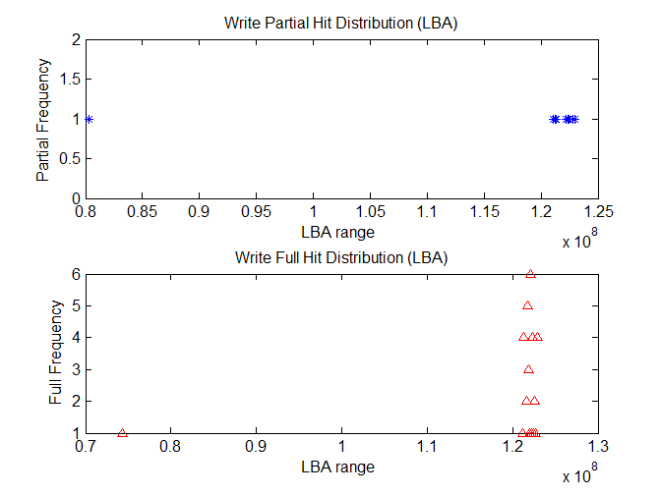
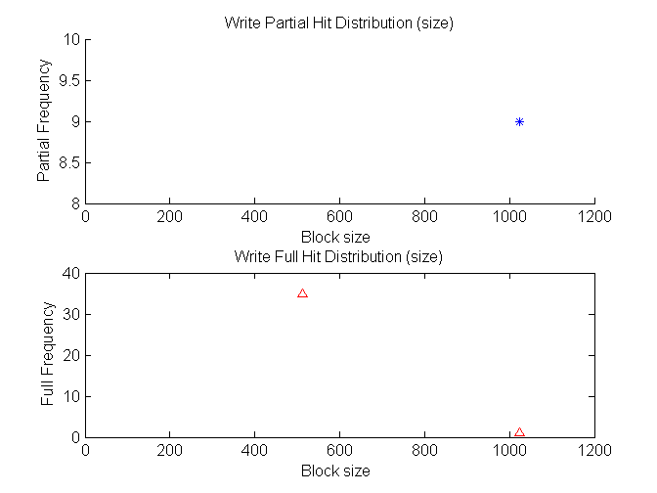
Write Hit LBA & Size Dist
Advanced Properties
Observe hit frequency vs size/LBA distribution
The top 5 partial hit frequency are 1,1,1,1,1, in the LBA range of [80323792,80446988),[121101668,121224864),[121224864,121348060),[121348060,121471256),[122210432,122333628),
The top 5 full hit frequency are 6,5,4,4,4, in the LBA range of [122087236,122210432),[121717648,121840844),[121348060,121471256),[122333628,122456824),[122949608,123072804),
The top 5 partial hit frequency are 9,0,0,0,0, with the block size 35,1,0,0,0,
The top 5 full hit frequency are 1024,1,2,3,4, with the block size 512,1024,1,2,3,

Slide 20
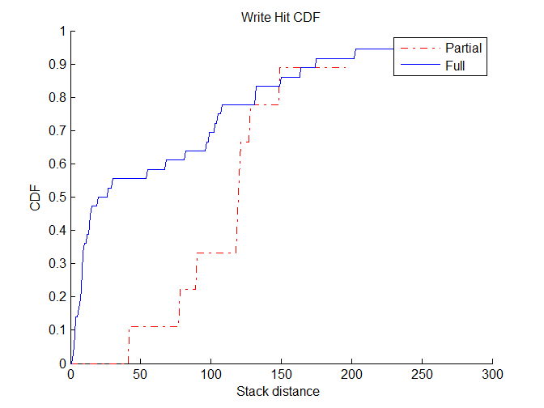
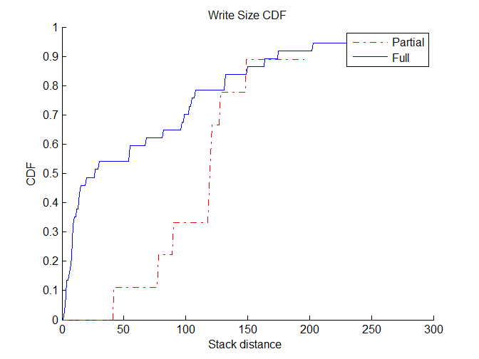
Stacked Write Update
Advanced Properties
Observe reasonable distance range for cache allocation
The CDF rates of 0.2,0.4,0.6,0.8,0.9, are achieved at stack distance of
8,13,56,109,165, for full hit
79,120,121,129,150, for partial hit
10,21,91,129,151,for combined hit
To achieve the combined CDF rates of 0.2,0.4,0.6,0.8,0.9, at least 10,21,91,129,151,102403, blocks of write cache are required in ideal situations, respectively

Slide 21
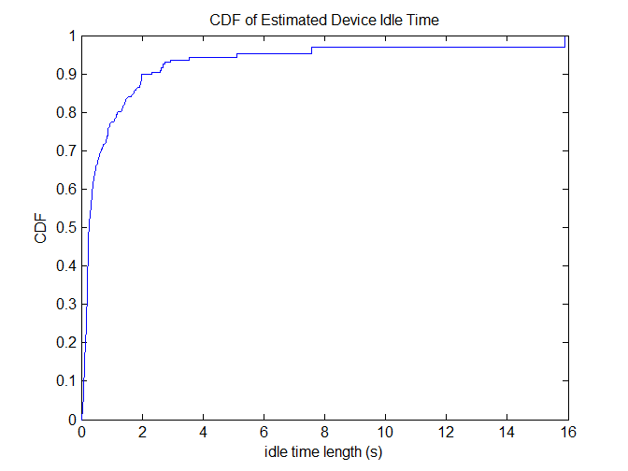
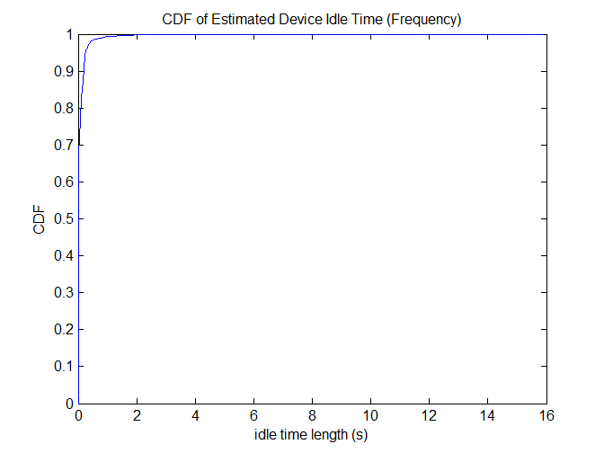
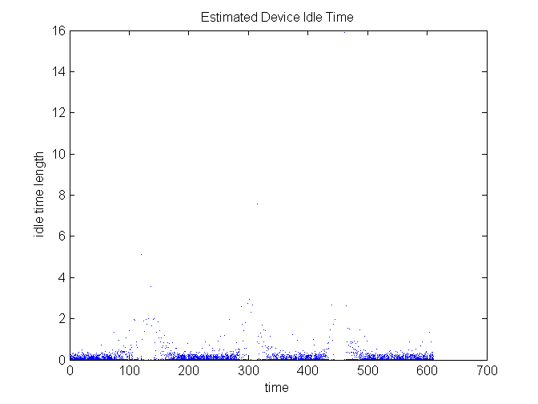
Idle Time
Advanced Properties
Observe whether the (effective)idle time is enough for background activities
Total effective time=610.2285; maximum time=610.2428
Total effective idle time (>0.1ms)=449.2035; Total idle time=507.5683
Total effective idle frequency (>0.1ms)=1526; Total idle frequency =7819

