Slide 1
Chapter 2
The Basics: HTML5, Drawing, and Source Code Organization

Slide 2
This Chapter
Simple drawing with WebGL: constant color square
Variable types: attribute and uniform
Pre-defined variables
Source code files and organization
Approaches to organize:
Appreciation for proper abstraction
Approaches to organize source
Support for growth in complexity
Infrastructure for game engine core
Singleton
User code

Slide 3
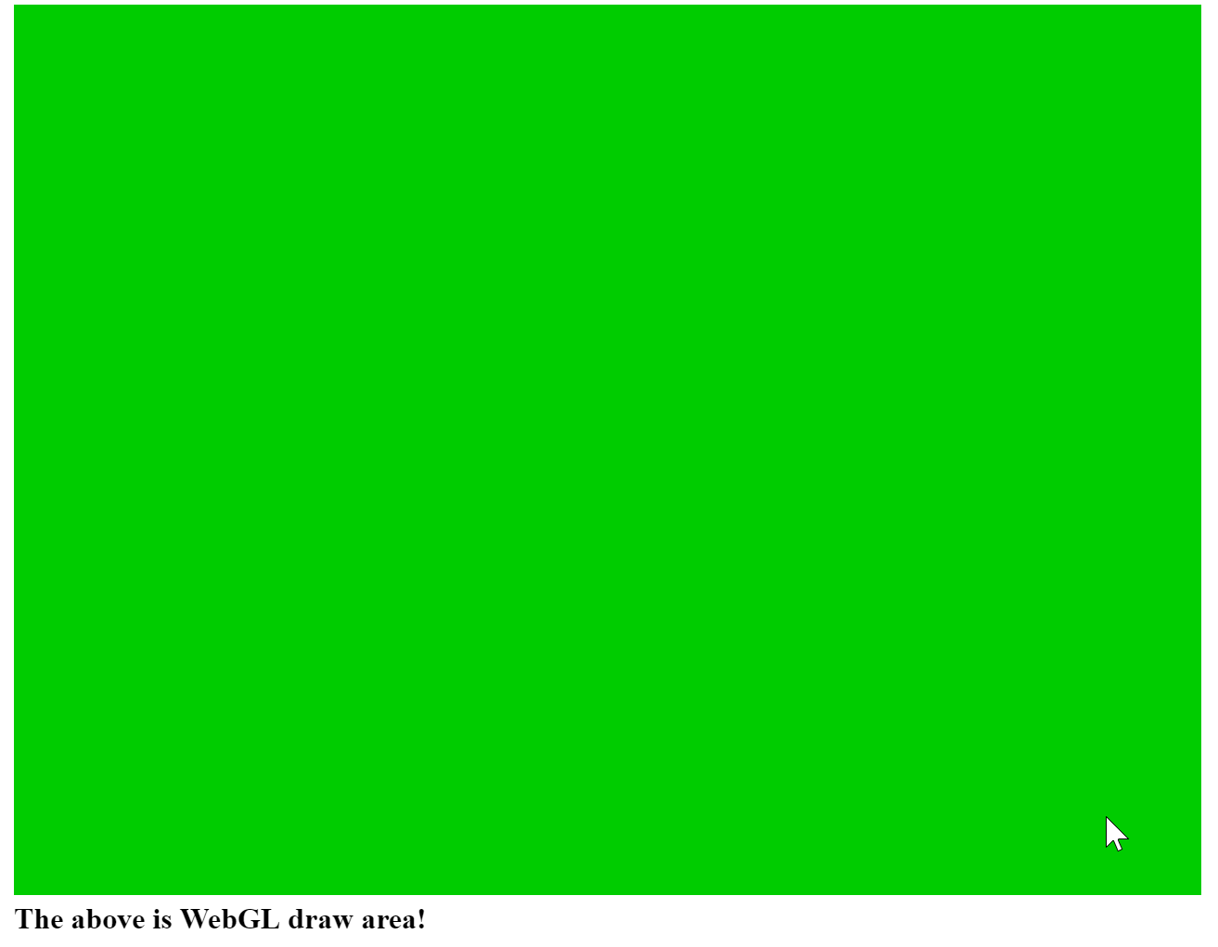
2.1: Canvas for Drawing

Slide 4
2.1: Goals
To learn how to set up the HTML canvas element
To learn how to retrieve the canvas element from an HTML document for use in JavaScript
To learn how to create a reference context to WebGL from the retrieved canvas element and manipulate the canvas from the WebGL context

Slide 5
2.1: Details
Create HTML5 Project and edit the index.html file
Define to a drawing canvas (within the <body> element)
Notice the “id”: name of this canvas
<Javascript> element
WebGL code
To get Canvas element by “id”
to clear the canvas

Slide 6
2.1: Summary
Define a drawing element (with <canvas> tag)
Define scripting element (with <script> tag)
Get a reference to the drawing area
Associate a WebGL context with the drawing area
Draw (in our case) clear with the WeblGL context
Lesson:
Define area
Associate context with area
Draw with context (by using code: gl.Something)

Slide 7

2.2: Source code organization
Observations:
Index.html: contains both
Web page rendering HTML tags
E.g. <body>
Program Logic flow
E.g.
Problem:
One file contains contents for heterogeneous purposes
Does not support growth in complexity!

Slide 8
2.2: Goals
To learn how to separate source code into different files
To organize your code in a logical structure

Slide 9
2.2: Steps
Define source code file(s)
Include source code file in HTML contents
Invoke source code logic

Slide 10
2.2: Details
Create new folder (for organization purpose)
Create new source code file: core.js
“let” to declear variables (within a module [a file])
Definition of functions
window.onload = function() {}
Define what to do after loading for the page is done

Slide 11
Elementary Drawing with WebGL
Drawing with WebGL is non-trivial in general
Involves:
New processor (GPU)
New programming language: GLSL
Steps:
Define geometry
Load geometry (to GPU)
Define drawing program (in GLSL)
Load and compile drawing program (to GLSL)
Invoke drawing from Javascript

Slide 12

2.3: Draw One Square

Slide 13
2.3: Goals
To understand how to load geometric data to the GPU
To learn about simple GLSL shaders for drawing with WebGL
To learn how to compile and load shaders to the GPU
To understand the steps to draw with WebGL

Slide 14
2.3: Steps
Define and load geometry (to GPU)
vertex_buffer.js
NOTE: export statement
Define drawing program (in GLSL)
index.html (for now)
Load, Compile, Link, drawing program (to GLSL)
Bind drawing program with geometry
shader_support.js
Invoke drawing from Javascript
core.js

Slide 15
2.3: Details of CPU and GPU
Refer to
Chap2-EX2.3.pptx

Slide 16
2.3: Observations
NOT a square:
The default Normalized Device Coordinate (NDC)
(-1, -1) to (1, 1)
Square space mapped to non-square drawing area
640x480 canvas area
How to change color of the square?
Problems:
Many global variables scattered in different files (is this a problem?)
Fix in the next example
How to draw more than one square?
Fix in the next chapter!

Slide 17
2.4: JavaScript Objects Project
Draw one square project:
Functional decomposition
Procedural programming
Define procedures/functions to support the logic flow
Well-structured, easy to understand
Does not support hiding of information or increase in complexity
This project:
Object-oriented analysis and programming
Isolates and hides details
Support: manageability and expandability

Slide 18
2.4: Goals
To separate the game engine from the game logic code
To demonstrate the implementation of a Singleton-like object based on the JavaScript Module pattern
To understand how to build abstractions with JavaScript objects

Slide 19
2.4 Steps
Separate folder to organize source code
Separate game engine into
core, vertex_buffer, and simple_shader
Define “user” code
User of GameEngine (in my_game)

Slide 20
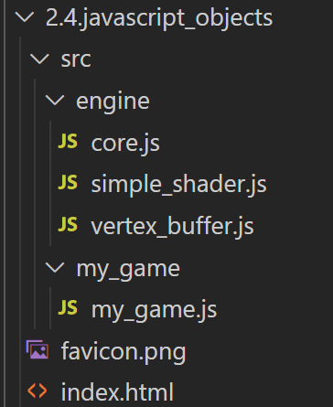
2.4: Folder organization
Source code folders:
engine: source code to the game engine
Javascript module vs class
module: when only one instance is ever needed
class: for many instances and specialization (subclasses)
My_game: user code

Slide 21
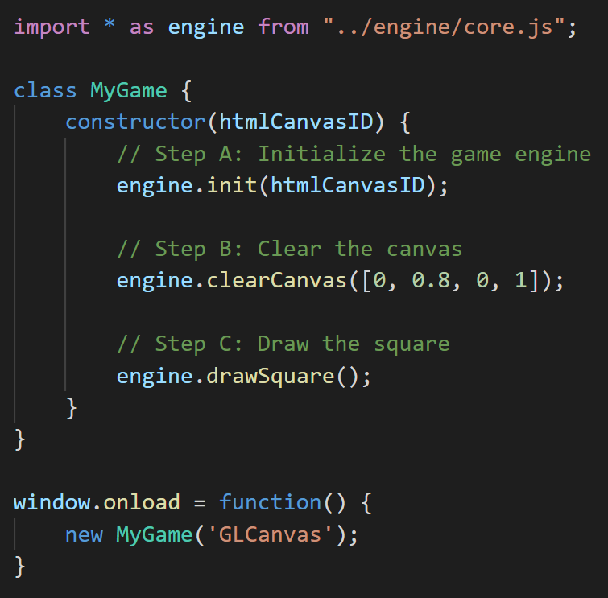
2.4: Observation
Organization:
engine: Source code to game engine
core.js:
core of engine
vertex_buffer.js:
unit square buffer
simple_shader.js:
the shader that supports drawing
my_game: Client code
Invocation from window.onload
Note: statements
export and import

Slide 22
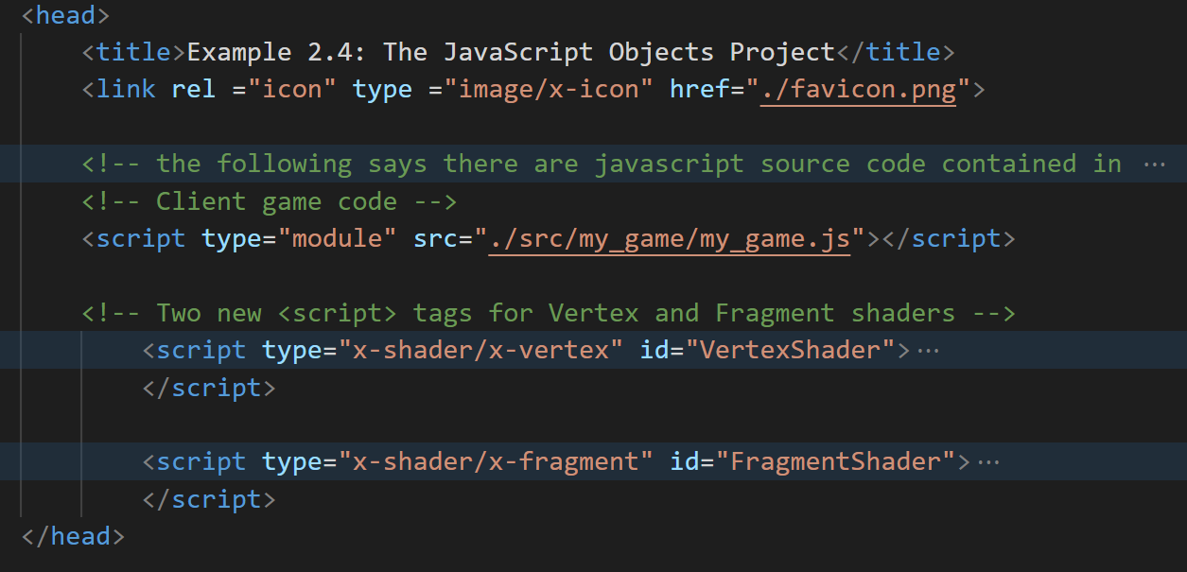
2.5: Separating GLSL shader source code
Recall: GLSL shaders are defined in index.html

Slide 23
2.5: Separating GLSL shader source code
Recall: GLSL shaders are defined in index.html

Slide 24
2.5: Goals
To separate the GLSL shaders from the HTML source code
To demonstrate how to load the shader source files during runtime

Slide 25
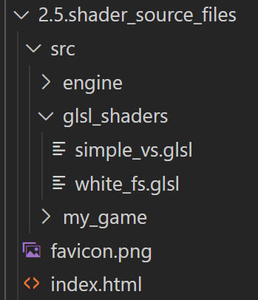
2.5: Organization
Creare a new folder

Slide 26
2.5: Organization
Creare a new folder
GLSLShader
Storing GLSL shaders
Our own convension
simple_vs
white_fs

Slide 27
2.5: Organization
Creare a new folder
GLSLShader
Storing GLSL shaders
Our own convension
simple_vs
white_fs
Convention:
vs: for Vertex Shader: simple_vs
fs: for Fragment Shaders:white_fs

Slide 28
2.5: Details
Shader source code files: in glsl_shaders folder
simple_shader.js
Loading of the source code files during consturction
SimpleShader::loadAndCompileShader()
HTTP.get: synchronous loading
Stop and wait for resuts

Slide 29
2.5: Problem
Synchronous load: performance problem!
Issue load and wait … fix later (when learn about resource management)

Slide 30
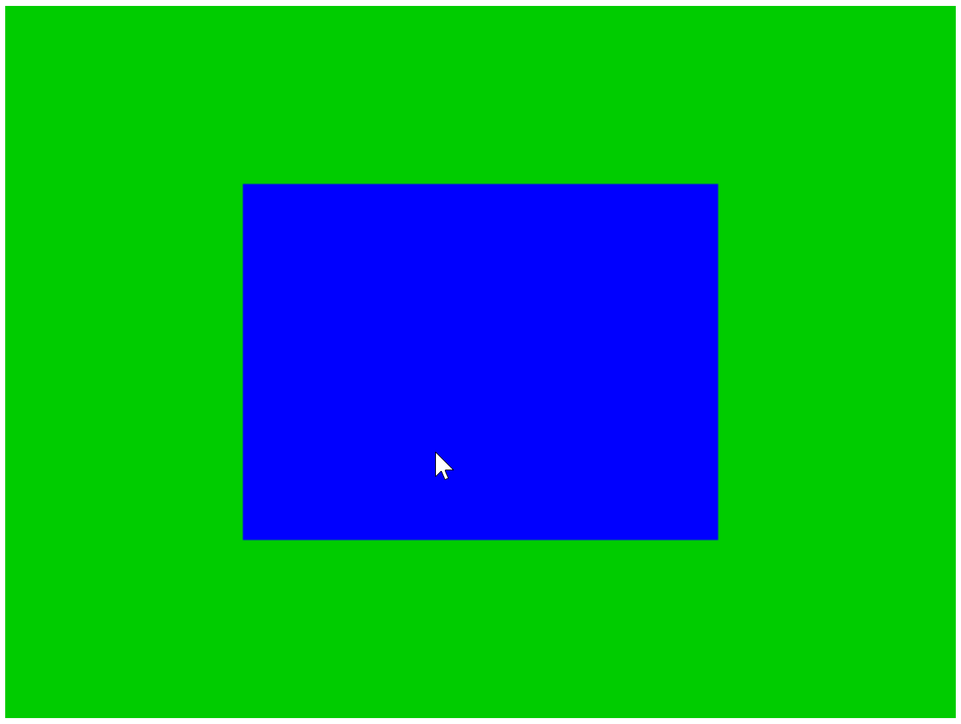
2.6 Parameterize Fragment Shader

Slide 31
2.6: Goals
To gain experience with creating a GLSL shader in the source code structure
To learn about the uniform variable and define a fragment shader with the color parameter

Slide 32
2.6: Details
Recall attribute variable in vertex shader
Binds per vertex (update value per vertex)
uniform: Bind once per loading of the shader …
uniform vec4 uPixelColor (defined in simple_fs.glsl)
simple_shader.js:
Sets a reference (from CPU) to allow value loading per shader invocation
Check out the last lines of: constructor() and activate()

Slide 33
Chapter 2: Learned?
Development with HTML, WebGL, and Javascript
Importance of source code organization
Folders
Source code file types: html, js, glsl
Object-orientation analysis and implementation
GLSL:
Programming model: memory loading, program compiling
attribute and uniform variables
Predefined: gl_Positoin, gl_FragColor

