Slide 1
Chapter 3
Drawing In the World

Slide 2
This Chapter
Create and draw multiple rectangular objects
Control the position, size, rotation, and color of the created rectangular objects
Define a coordinate system to draw from
Define a target subarea on the canvas to draw to
Work with abstract representations of renderable objects, transformation operators, and cameras

Slide 3
Coordinate Space and Pixels
Bad to think pixels:
Same game to run on a phone (low pixel count) and high resolution desk top monitor
Game object reference …
In a chess game
In a soccer game
Need for coordinate system support
Cartesian Coordinate System: origin and axes

Slide 4
Game World and Viewport
What coordinate system the game objects should be defined in?
Idea: need a “Game world coordinate system”
Which of the game objects should be drawn?
Idea: need a “Camera”
Where should the game objects be drawn to?
Idea: need a “Viewport”

Slide 5
Encapsulating Drawing
Drawing with WebGL is messy and non-trivial
Define object to hide the drawing operation
Goal:
No need to worry about drawing
Can focus on thinking and building game-specific support

Slide 6
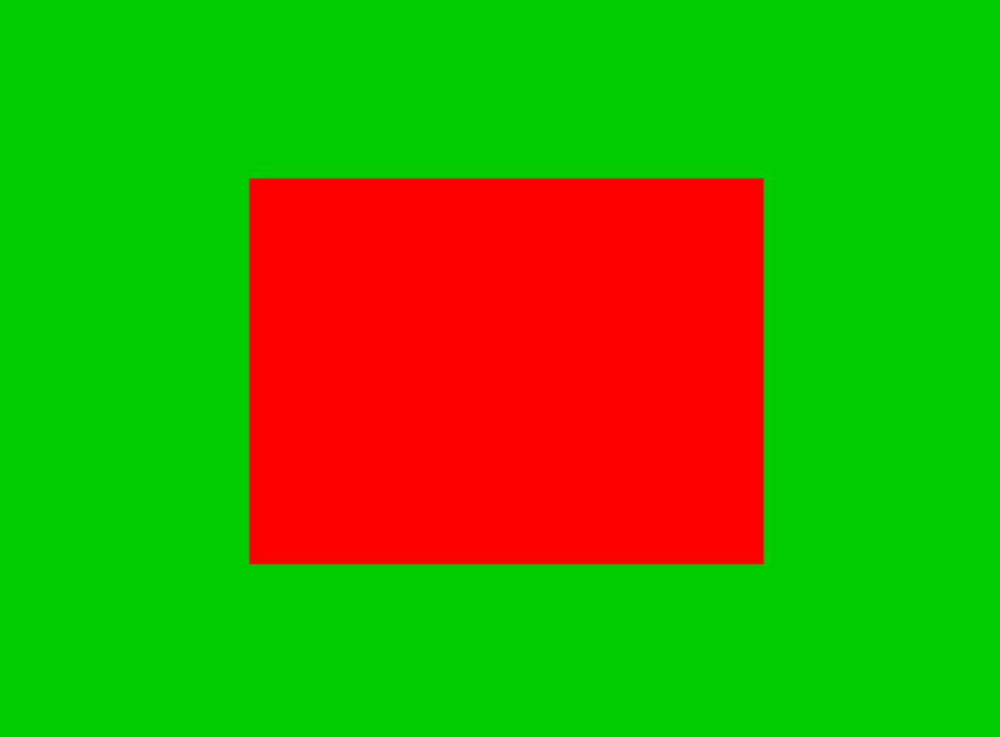
3.1: Renderable Object Project

Slide 7
3.1: Goals
To begin the process of building an object to encapsulate the drawing operations by first abstracting the drawing functionality
To demonstrate the ability to create multiple Renderable objects

Slide 8
3.1: Details
renderable.js
Straightforward wrapping of SimpleShader
Define draw() function to hide WebGL drawArrays() call
Testing: (in my_game folder)
Instance multiple Renderable objects with distinct transform and color settings

Slide 9
3.1: Observations and Problems?
Two squares are drawn, only see one?!
Overlapped
Later drawn overlaps on earlier drawn
What can be done?
Draw to different locations
Approach:
A: Define new square geometries (must transform from CPU to GPU)
B: Define ways of transforming the defined geometry

Slide 10
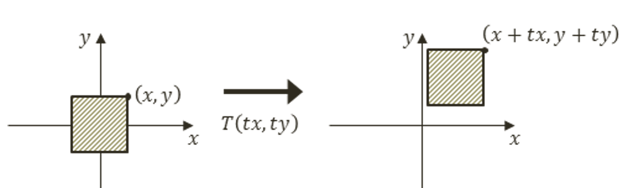
Matrix Transformation: Translate
Matrix: black box operator
Translation:

Slide 11
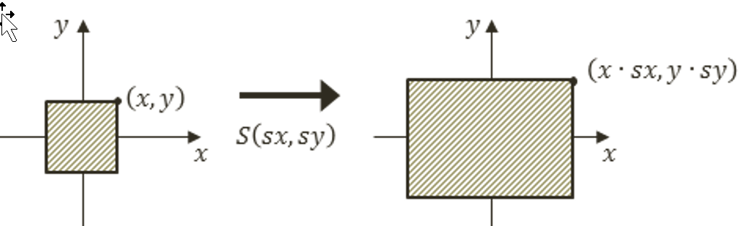
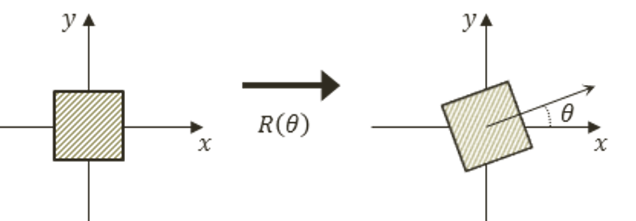
Matrix Transformation: Scale and Rotate
Scaling
Rotation:

Slide 12
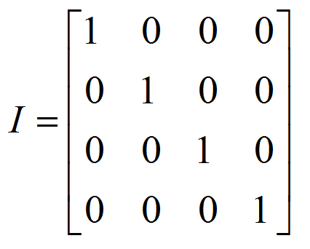
Matrix Transformation: Identity
Identity: no-op
Always transform on vertices:
M: a matrix operator
p: a vertex position
p' is the transform of p by M:
p' = Mp
(Multiple p by M)

Slide 13
Matrix Transformation: Concatenation
If
p is a vertex position
T, R, S: three matrix operators
p‘ = T R S p
vp‘ is the result of S operating on p, followed by R, and lastly by T
Then
Compute new operator: M = T R S
p‘ = M p
M can be applied to any vertex position (same effect as T R S)
More efficient then applying T R S separately!
Order is important!
T S <> S T

Slide 14
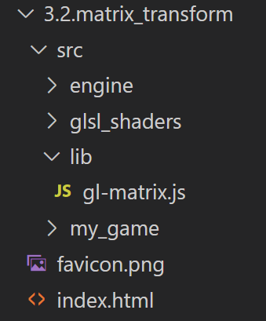
glMatrix.js: Matrix operator library
Download from http://glMarix.net
Load into project:

Slide 15
glMatrix.js: Matrix operator library
Download from http://glMarix.net
Load into project:

Slide 16
glMatrix.js: Matrix operator library
Download from http://glMarix.net
Load into project:
Load glMarix.js in index.html:

Slide 17
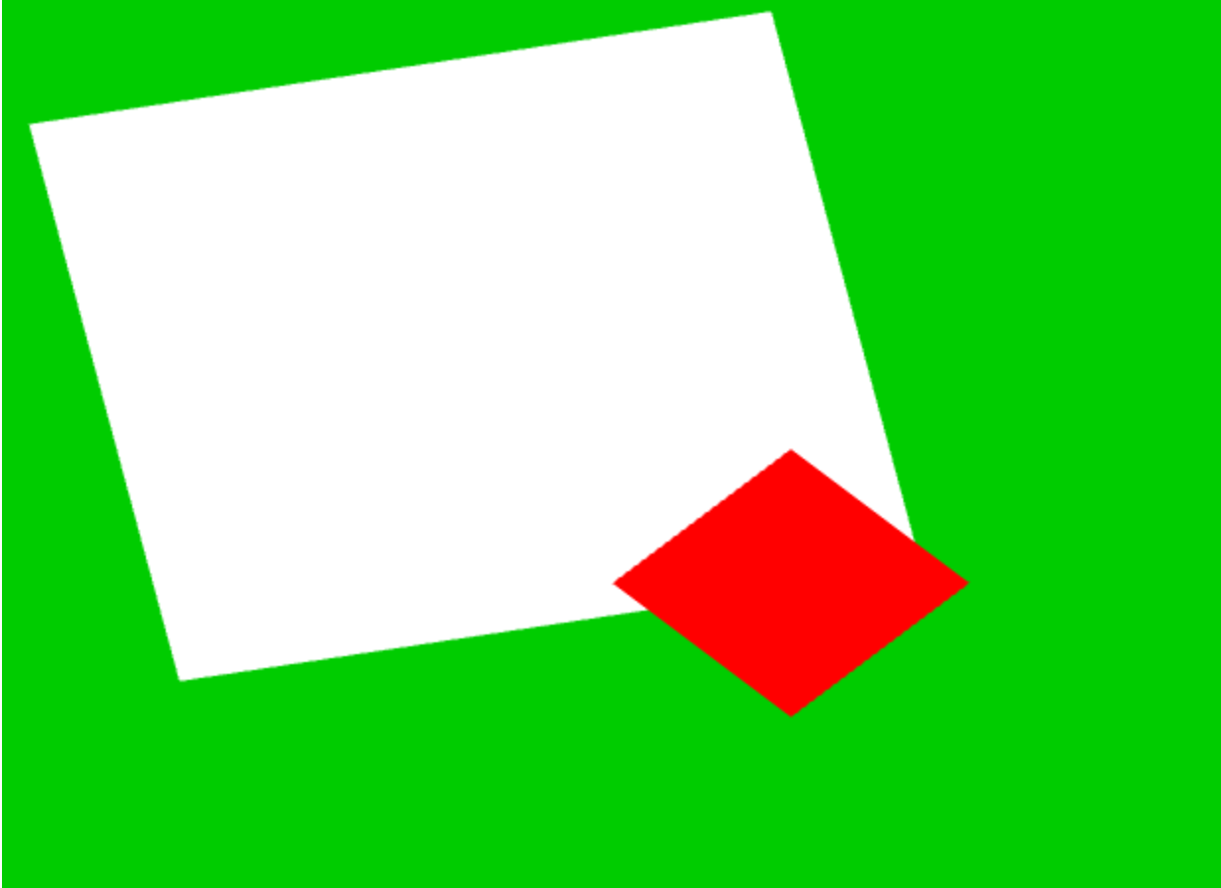
3.2: Matrix Transform Project

Slide 18
3.2: Goals
To introduce transformation matrices as operators for drawing a Renderable
To understand how to work with the transform operators to manipulate a Renderable

Slide 19
3.2: Details
simple_vs.glsl:
Add and use: uModelXformMatrix
simple_shader.js:
Define mModelMatrixRef as reference to uModelXformMatrix
activate(): receive a TRS matrix parameter and loads to the shader
renderable.js:
draw(): receives a TRS matrix and passes to shader when activate
To test: my_game.js
Define and use transformation matrices to draw Renderable objects

Slide 20
Question: What does this do?
// create a new identity transform operator
var xform = mat4.create();
mat4.translate(xform, xform, vec3.fromValues(-0.5, 0.5, 0.0));
mat4.rotateZ(xform, xform, 3.14/4); // rotation is in radian
mat4.scale(xform, xform, vec3.fromValues(0.25, 0.25, 1.0));

Slide 21
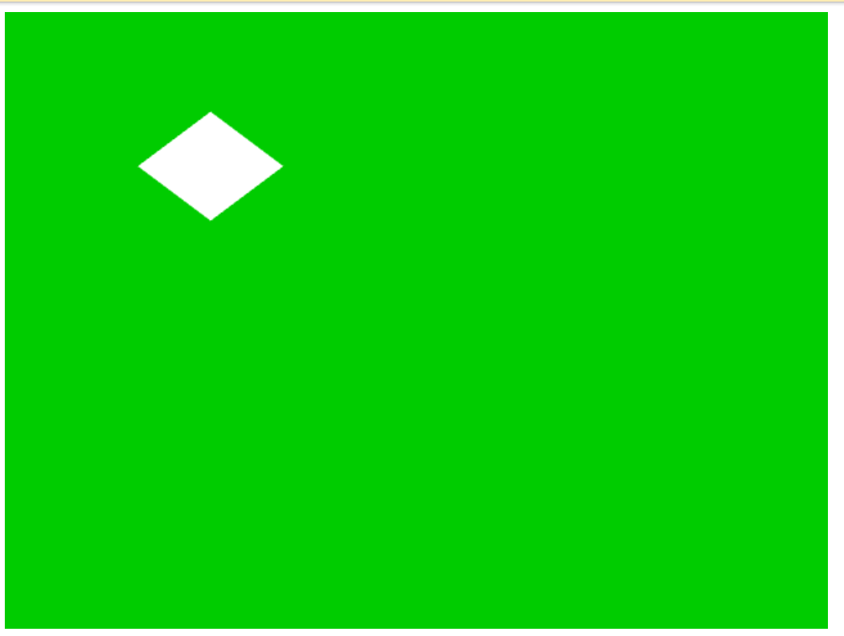

Slide 22
Question: How about this?
// create a new identity transform operator
var xform = mat4.create();
mat4.scale(xform, xform, vec3.fromValues(0.5, 0.5, 1.0));
mat4.rotateZ(xform, xform, 3.14/4); // rotation is in radian
mat4.translate(xform, xform, vec3.fromValues(-0.5, 0.5, 0.0));

Slide 23
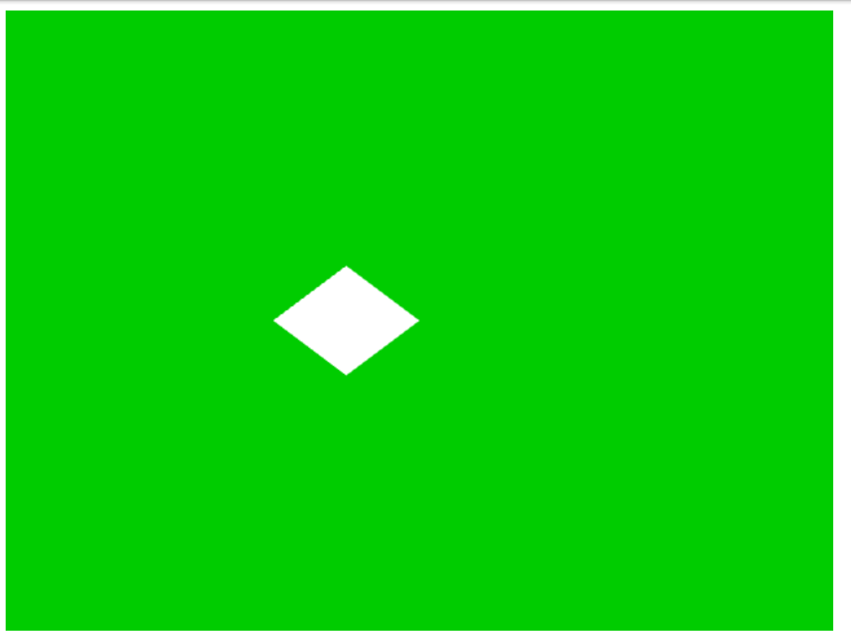

Slide 24
Learned?
Multiplication ordering is IMPORTANT
M = TRS
Is “intuitive”
Rotation after Scaling
Last: translation
No “unexpected” movements!

Slide 25
3.3: Encapsulating Transform

Slide 26
3.3: Goals
To create the Transform object so it can encapsulate the matrix transformation functionality
To integrate the Transform object into the game engine
To demonstrate how to work with the Transform object

Slide 27
3.3: Details
transform.js
Define the Transform class
5 floating points: Position(x, y), Scale(x, y), Rotation(theta)
All the access functions
getTRSMatrix(): Compute and return the TRS matrix
renderable.js
An instance of Transform per Renderable object!
my_game.js
Almost identical test as in the previous project

Slide 28
Question: What happens?
this.mSq.getXform().setPosition(20, 30);
this.mSq.getXform().setRotationInDegree(90); // In Degrees
this.mSq.getXform().setSize(4, 2);
// what is defined?
this.mSq.draw();
// what will I see?

Slide 29
Coordinate Systems and Viewport
Design a soccer game
Where are the center of the field, goal posts? What unit should you use?
You probably want: units in Meters?
Center of field at (0,0) or Left court boundary is X=0?
Design a chess game
Where are the locations of the King, Queen, and Knight?
Probably coordinate in discrete locations (1.5, 1.5) does _NOT_ make sense?!
Display to where in the canvas?
What if you want to reserve part of canvas for UI?

Slide 30
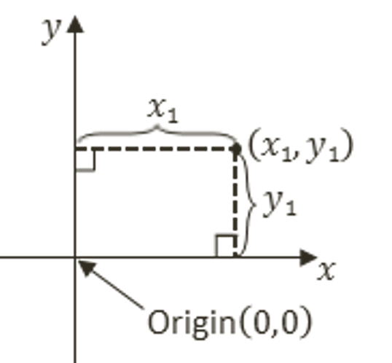
Cartesian Coordinate System
What we want?
Game coordinate system should be user defined!
Origin, Axes (x/y), units are implicit!

Slide 31
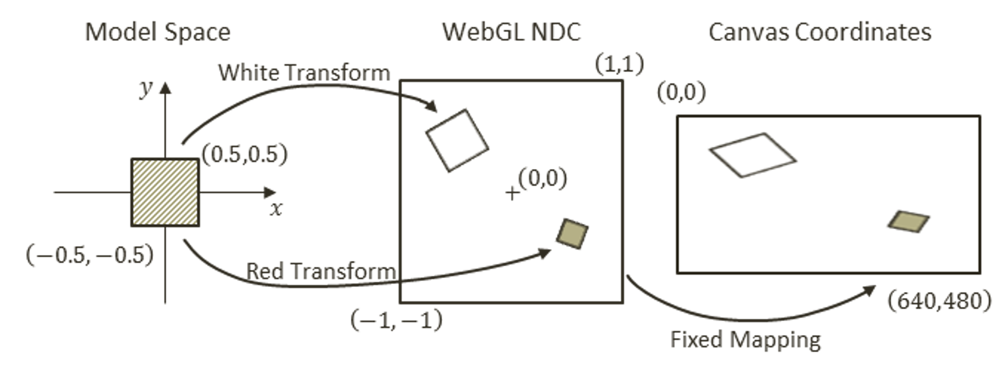
Currently: Drawing
Model space:
Defines the unit square
Vertex Buffer “uModelXformMatrix” transforms into NDC
NDC is drawn on to the canvas automatically!

Slide 32
Currently: Drawing
Model space:
Defines the unit square
Vertex Buffer “uModelXformMatrix” transforms into NDC
NDC is drawn on to the canvas automatically!

Slide 33
Currently: Drawing
Model space:
Defines the unit square
Vertex Buffer “uModelXformMatrix” transforms into NDC
NDC is drawn on to the canvas automatically!

Slide 34
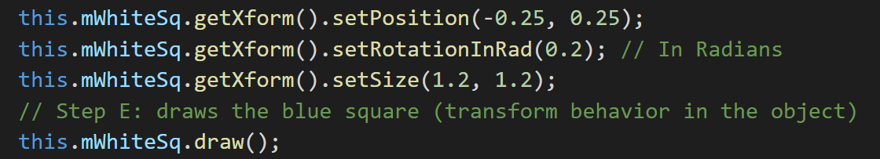
Currently: Drawing
Model space:
Defines the unit square
Vertex Buffer “uModelXformMatrix” transforms into NDC
NDC is drawn on to the canvas automatically!
my_game.js

Slide 35
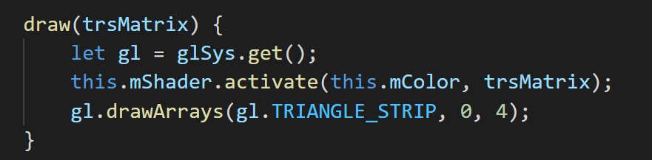
Currently: Drawing
Model space:
Defines the unit square
Vertex Buffer “uModelTransform” transforms into NDC
NDC is drawn on to the canvas automatically!
my_game.js
renderable.js

Slide 36
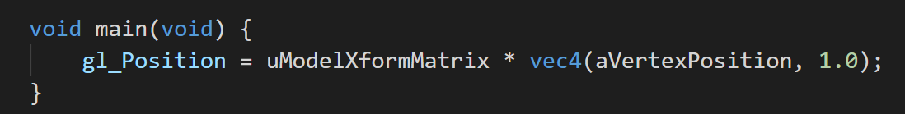
Currently: Drawing
Model space:
Defines the unit square
Vertex Buffer “uModelTransform” transforms into NDC
NDC is drawn on to the canvas automatically!
my_game.js
renderable.js
simple_vs.glsl

Slide 37
All the Coordinate Systems
Modeling Coordinate:
The unit square between (-0.5, -0.5) to (0.5, 0.5)
Normalized Device Coordinate (NDC)
(-1, -1) to (1, 1)
The default drawing space for WebGL
Canvas Coordinate Space (or Device Coordinate Space)
Hardware pixel drawing area, units in pixels
BUT … we need more …

Slide 38
What’s wrong
Our user (MyGame.js) must think in terms of NDC
Everything must be between -1 to 1
Does not work with Soccer or Chess!
Need something in between
Model Coordinate (the unit square)
and
NDC (-1 to 1)
Need: … World Coordinate System

Slide 39
The World Coordinate (WC) System
Let our user define a convenient coordinate system
E.g., (0, 0) to (100, 60) for a soccer field
E.g., (0, 0) to (24, 24) for chess board
Let our user move their objects in their coordinate system
E.g., a play on the soccer field has a size of 1x2, located at (50, 30)
E.g., a chess piece is of size 0.8x0.8, and located at position (3, 5)
Remember:
WebGL only knows how to draw everything within NDC
MUST: transform user defined coordinate system (WC) to NDC

Slide 40
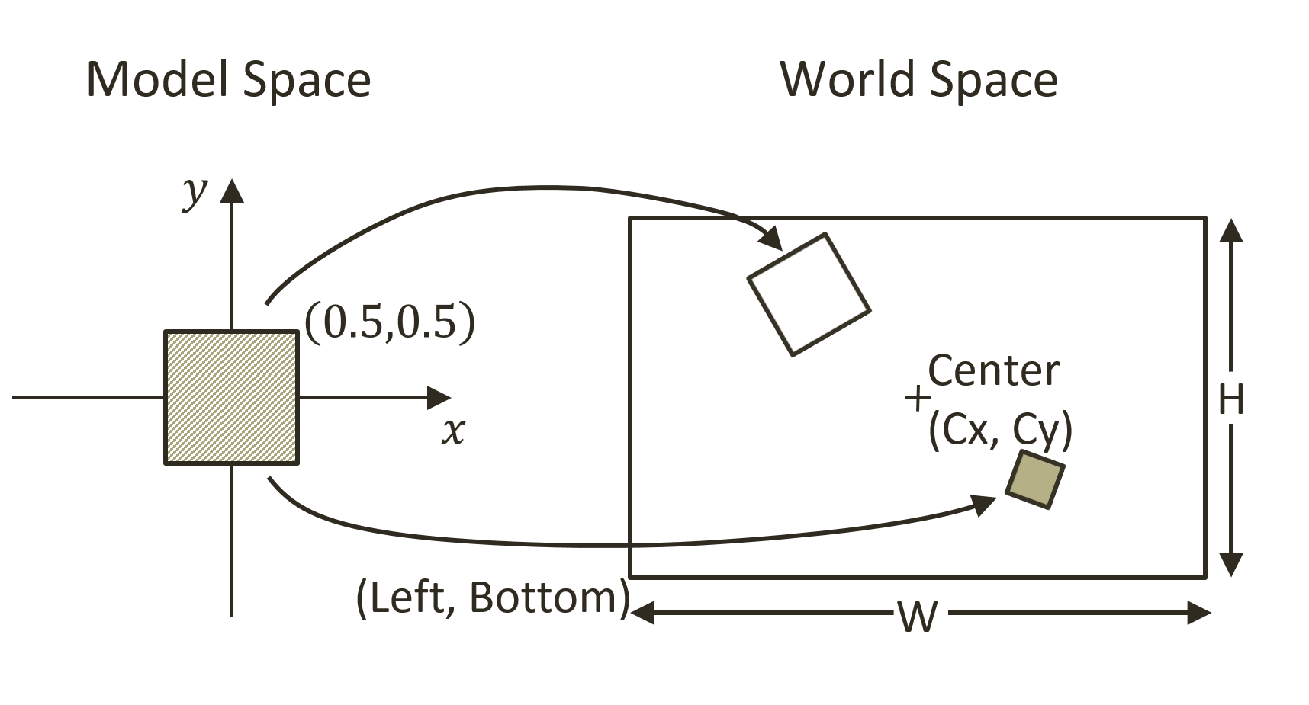
World Coordinate System

Slide 41
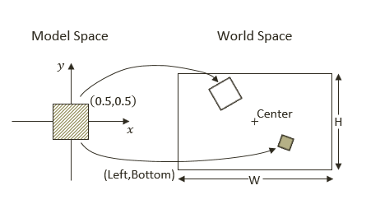
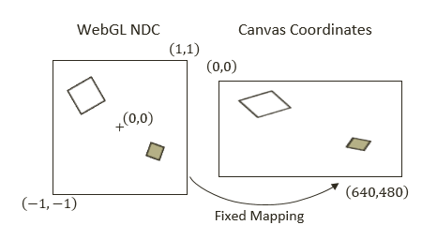
The Camera Transform
Camera Transform

Slide 42
The Camera Transform
Camera Transform

Slide 43
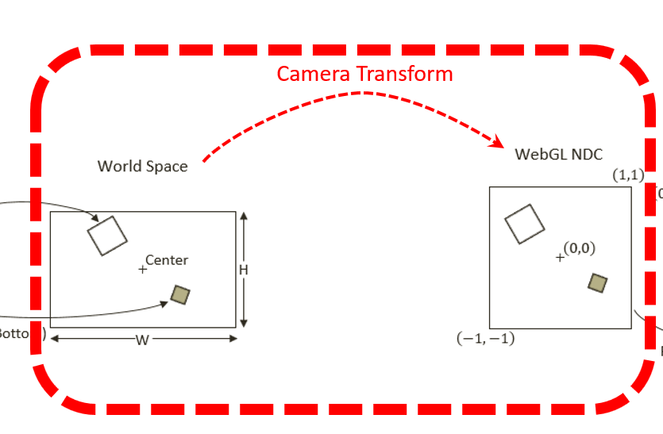
Straightforward: Translation + Scale
Center=(Cx, Cy)
translating (Cx, Cy) to (0, 0)
scaling WxH to 2x2
OR … Matrix = S(2/W, 2/H) T(-Cx, -Cy)
(translation first, then scale)

Slide 44

Question: How to set up … ?
this.mSq.getXform().setPosition(20, 30);
this.mSq.getXform().setRotationInDegree(90); // In Degrees
this.mSq.getXform().setSize(4, 2);
// How to set vpMatrix to see …
// Assume: square canvas! (e.g., 500x500)
// position: in the center of canvas
// size: 50% width and height of canvas

Slide 45
Answer:
Visible width is: 8
Visible Height is: 4
mat = mat4.create(); // identity
mat4.scale(mat, mat, vec3.fromValues(2/8, 2/4, 1.0));
// Z is always 1.0 for scaling
// Translate first, so, scaling operation is specified first
mat4.translate(mat, mat, vec3.fromValues(-20, -30, 0));
// Z is always 0 for translation
// translate opration to be performed first
Center on object

Slide 46

Question: How about this?
this.mSq.getXform().setPosition(20, 30);
this.mSq.getXform().setRotationInDegree(90); // In Degrees
this.mSq.getXform().setSize(4, 2);
// How to set vpMatrix to see …
// Assume: square canvas! (e.g., 500x500)
// position: in the center of canvas
// size: almost covers the entire canvas

Slide 47
Answer:
Visible width is: 4.2
Visible Height is: 2.2
mat = mat4.create(); // identity
mat4.scale(mat, mat, vec3.fromValues(2/4.2, 2/2.2, 1.0));
// Z is always 1.0 for scaling
// Translate first, so, scaling operation is specified first
mat4.translate(mat, mat, vec3.fromValues(-20, -30, 0));
// Z is always 0 for translation
// translate opration to be performed first
Center on object

Slide 48
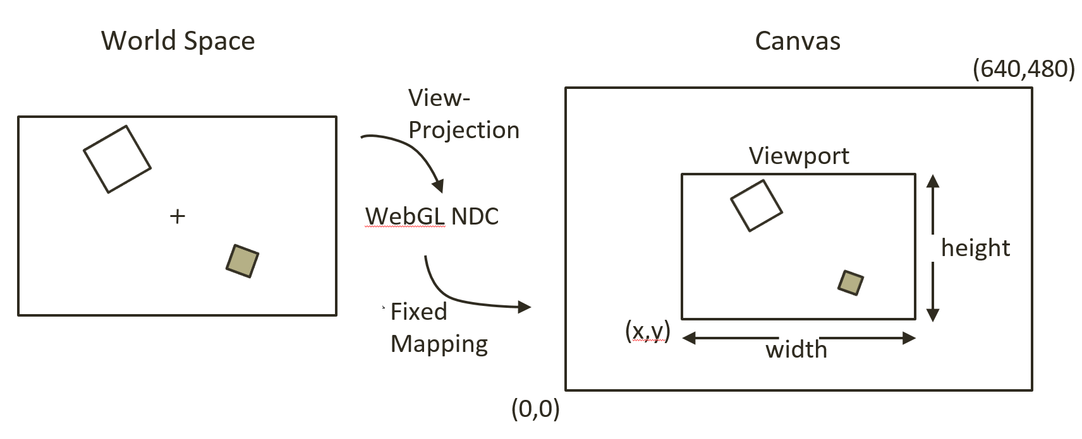
WebGL Viewport
gl.viewport( x, // x position of bottom-left corner of the area to be drawn y, // y position of bottom-left corner of the area to be drawn width, // width of the area to be drawn height // height of the area to be drawn );

Slide 49
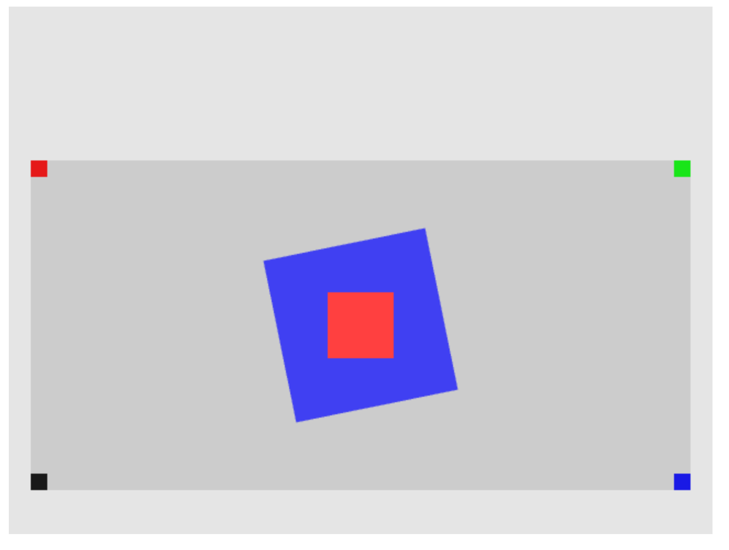
3.4: Camera Transform and Viewport

Slide 50
3.4: Details
simple_vs.glsl:
Define uCameraXformMatrix to transform vertices
simple_shader.js
Constructor: define mCameraMatrixRef to reference uCameraXformMatrix
activate(): receives and passes a cameraMatrix to the shader
renderable.js
draw(): receives a cameraMatrix to pass to SimpleShader::activate()
my_game.js
Define viewport and cameraMatrix to draw all Renderable objects

Slide 51
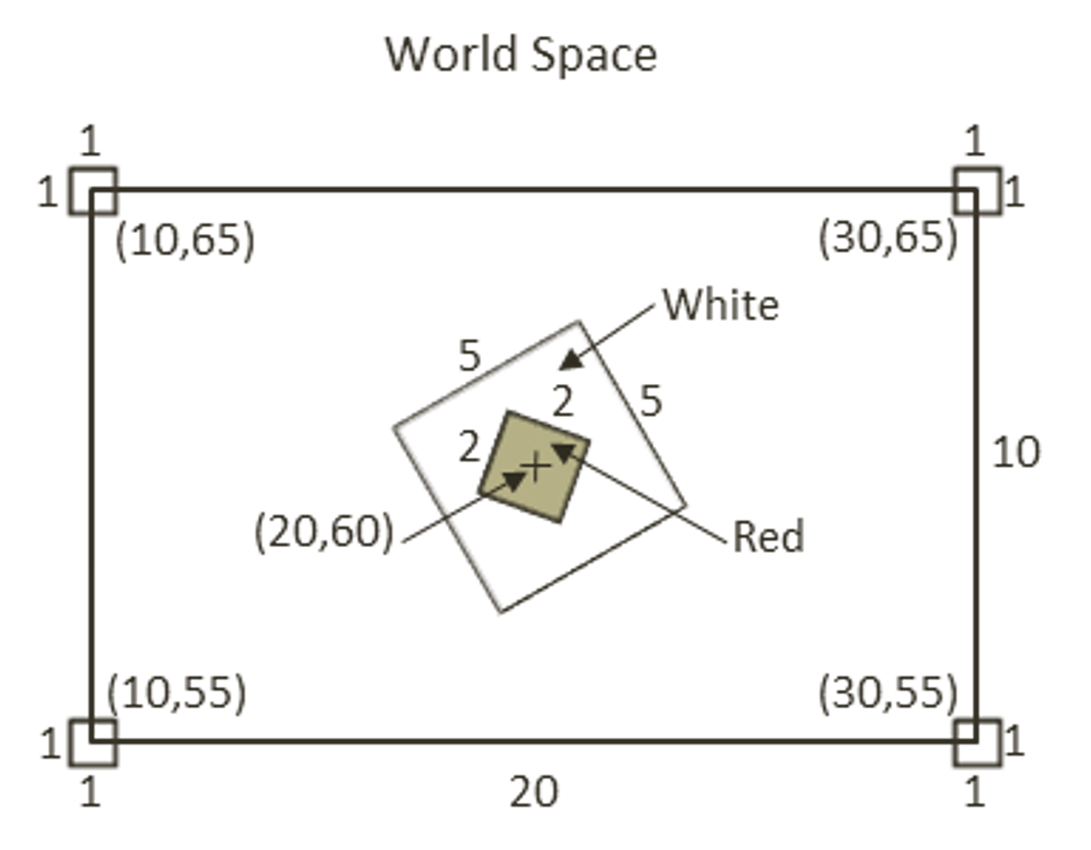
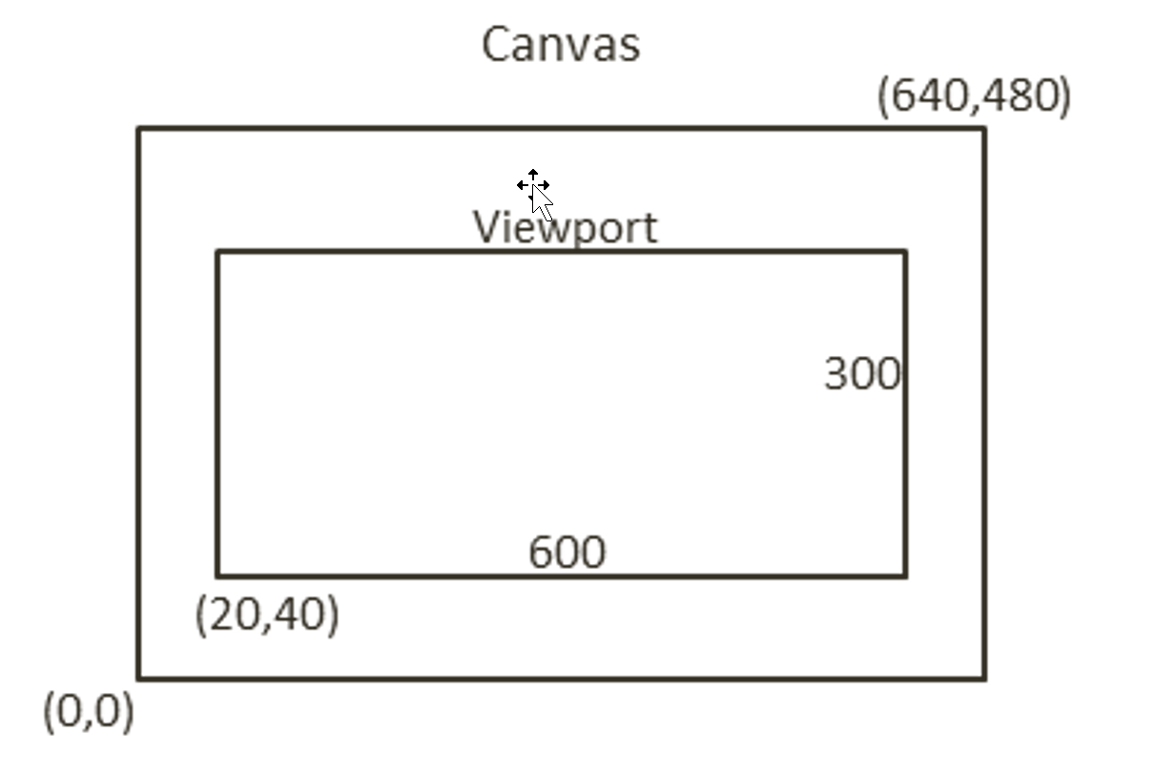
3.4: Testing Camera Transform and Viewport
Design of the test:

Slide 52
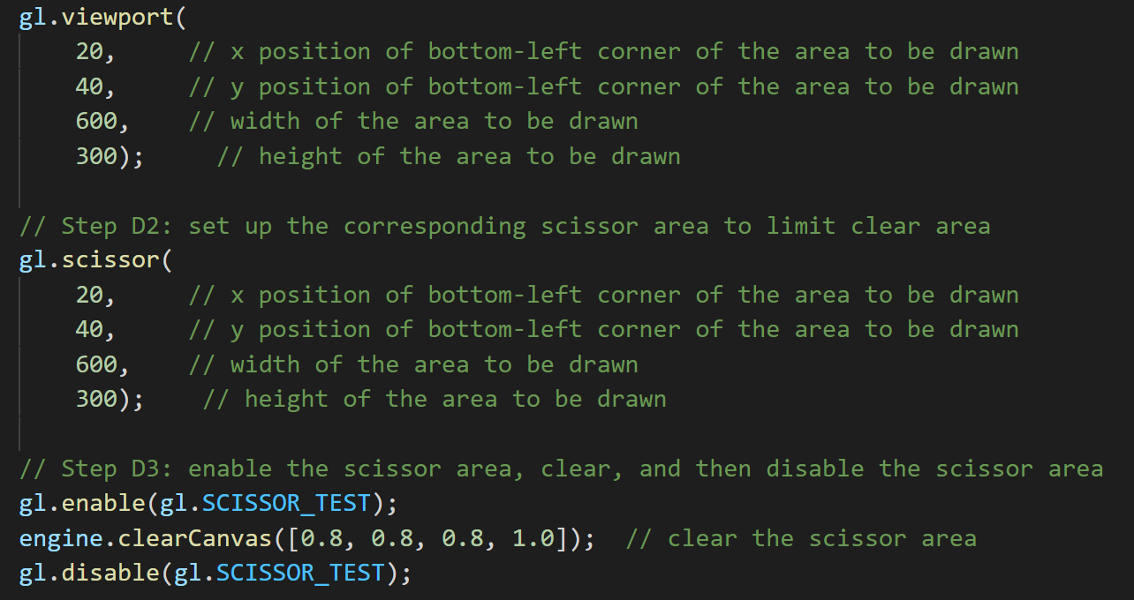
3.4: Note on gl.scissor()

Slide 53
Viewport vs. Scissor
gl.viewport() defines where NDC is mapped to
Implicitly performed by WebGL
gl.scissor() defines area that can be drawn to!
Does not affect anything else
Expensive operation!
That’s why, enable/clear/disable

Slide 54
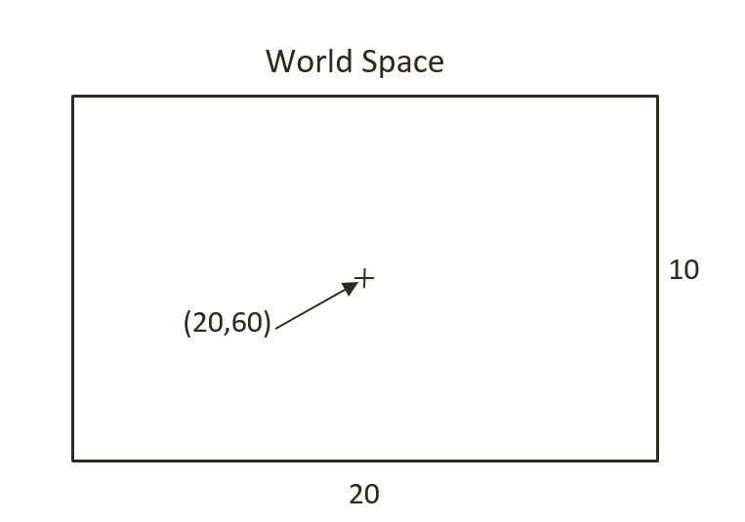
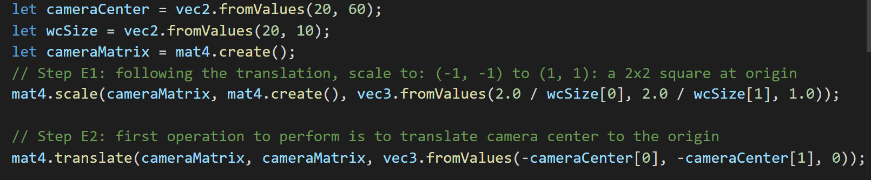
3.4: Setup Camera Matrix (Camera Transform)
MyGame.js

Slide 55
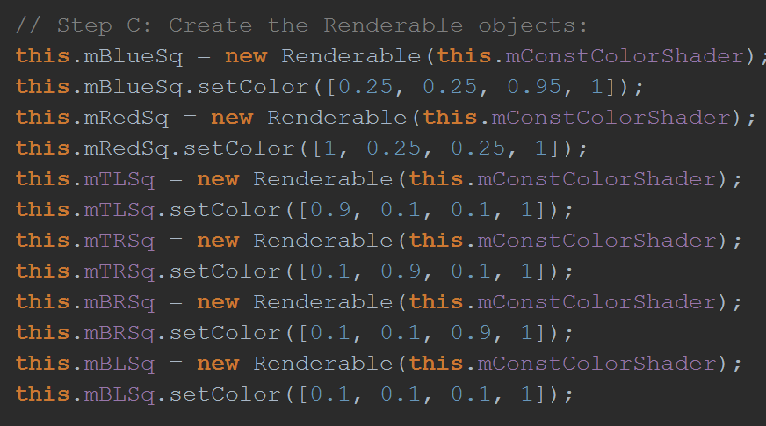
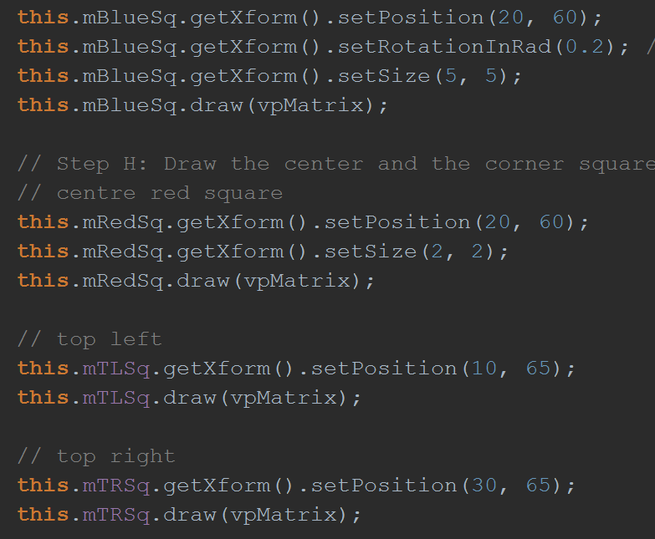
3.4: Implementing the test
MyGame.js

Slide 56
3.5: The Camera
Observation from 3.4
Viewport and Camera Matrix setting
Messy and makes MyGame.js difficult to read
Need an abstraction … the Camera!
Camera:
WC Center: where is the camera viewfinder
WC Width/Height: what can be seen through the camera
Viewport: where to show the WC on the film

Slide 57
3.5: Goals
To define the Camera object to encapsulate the definition of WC and the viewport functionality
To integrate the Camera object into the game engine
To demonstrate how to work with the Camera object

Slide 58
3.5: Details
Define Camera class
3 floats for the camera: position (cx, cy), and width
4 floats (an array) for viewport position
Access functions
setViewAndCameraMatrix():
sets the viewport and computes the camera matrix
getCameraMatrix(): to get the matrix, MUST set (compute) before get!
setViewAndCameraMatrix(): must be called before calling getCameraMatrix()!
Note:
Height of the camera obeys the aspect ratio of the viewport

Slide 59
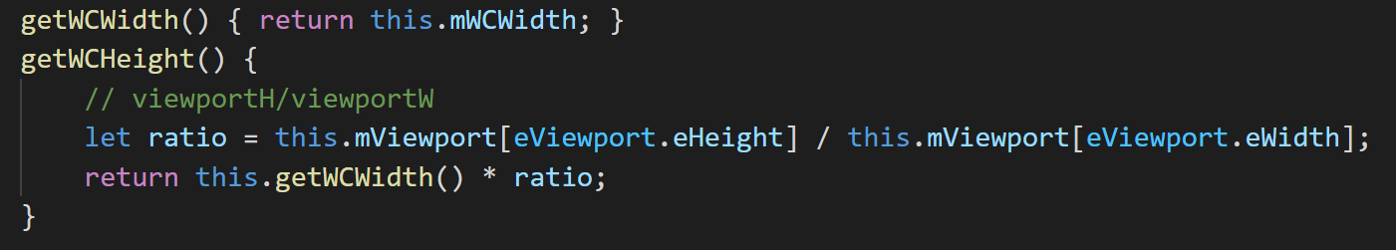
3.5: The Camera –Aspect Ratio

Slide 60
Aspect Ratio of WC and DC must match!
Camera Transform

Slide 61
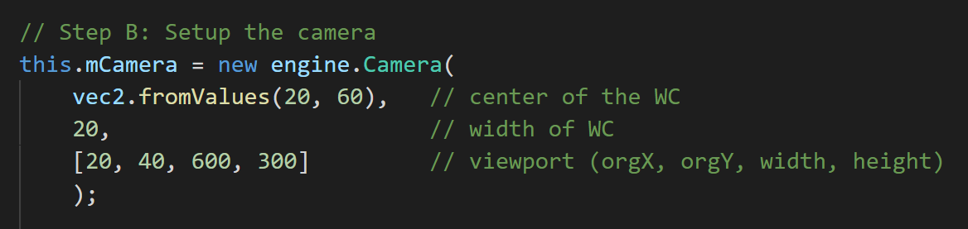
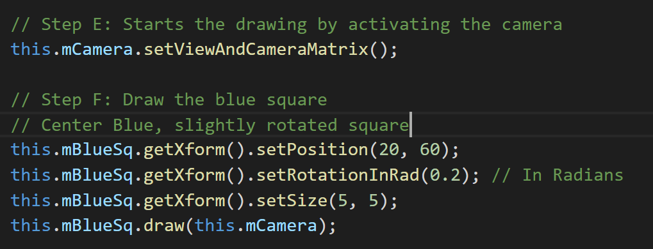
3.5: Testing The Camera
my_game.js
Renderable::darw() receives a Camera now

Slide 62
Chapter 3: Learned?
Transformation and drawing of objects
Coordinate system:
World space
Camera: where to draw from
Viewports: where to draw to

