Slide 1
Chapter 5
Textures, Sprites, and Fonts

Slide 2
This Chapter
What is textures, why textures
How to map and control
Addressing efficiency: loading and memory
Faking animation with textures
Displaying fonts (text) with textures
This is our text solution

Slide 3


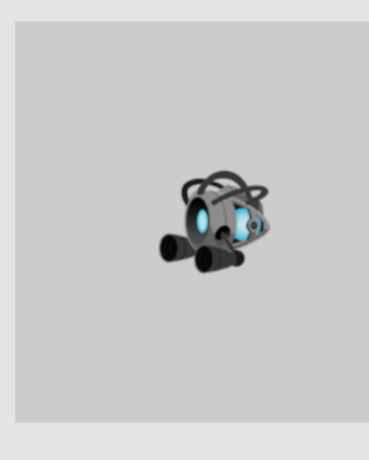
Texture Mapping
A Texture: Fancy word for “an image”
Texture Mapping:
Fancy word for pasting an “image” on a geometry
Texel: pixels of a texture
WARNING: for WebGL (and many hardware)
Texture resolution must be of powers of 2
E.g., 16 x 32, or 2 x 512, or 512x512
1023x1025: is a BAD resolution for WebGL

Slide 4
Why Texture Mapping
Represent “objects”
Cheap, easy, with high quality
Typically: specifically drawn by artists
Ease of control/manipulate
We know how to control a geometry
Control of “objects” can be simply
modifying the corresponding transform (Renderable!)

Slide 5

Texture Mapping Considerations
Texture external to the engine:
Loading must occur
When to load, what happens when done?
Textures with Transparency
The Alpha channel
File format: jpg and png
Memory concerns (lots of textures)
Size of image file (texture)
Sharing of the same texture

Slide 6
A Word about “Transparency” or Alpha
Color = [R, G, B, A] (e.g., [1, 0, 0, 1] for red)
A: the Alpha Channel
Typically for Alpha Blending
Colors C1 = [R1, G1, B1, A1], C2 = [R2, G2, B2, A2]
Blending the colors:
Result = C1 * A1 + C2 * (1 – A1) ←This is the default WebGL blending
Or
Result = C1 * (1 – A1) + C2 * A1

Slide 7
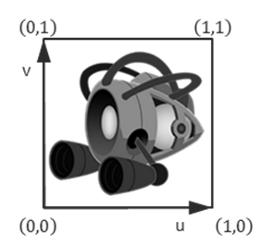
How to texture map?
Map: from one coordinate system to another!
Texture Coordinate System (UV Coordinate)
Just as NDC and WC, independent of pixel (or texel resolution)
Constant range
0 < U < 1
0 < V < 1
Always cover the entire texture

Slide 8
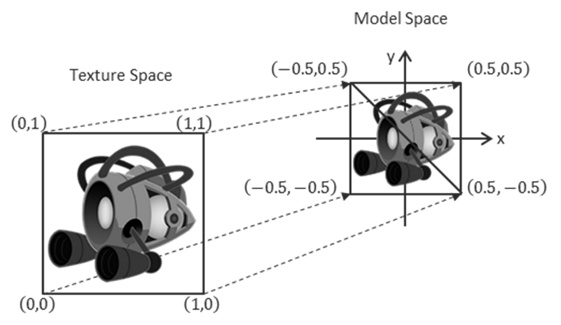
Mapping UV to the Model
Texture mapping:
Associate UV positions with corresponding geometric positions
Define UV values at vertices in Model Space!!
Communicate this association to the WebGL

Slide 9
Question: What will I see
My object:
V1: Position=(-0.5,-0.5) UV=(0, 0)
V2: Position=(-0.5, 0.5) UV=(0, 1)
V3: Position=(0.5,0.5) UV=(1, 1)
V4: Position=(0.5, -0.5) UV=(1, 0)

Slide 10
Answer: What will I see
My object:
V1: Position=(-0.5,-0.5) UV=(0, 0)
V2: Position=(-0.5, 0.5) UV=(0, 1)
V3: Position=(0.5,0.5) UV=(1, 1)
V4: Position=(0.5, -0.5) UV=(1, 0)

Slide 11
Question: What about now?
My object:
V1: Position=(-0.5,-0.5) UV=(0, 0)
V2: Position=(-0.5, 0.5) UV=(0, 0.5)
V3: Position=(0.5,0.5) UV=(0.5, 0.5)
V4: Position=(0.5, -0.5) UV=(0.5, 0)

Slide 12
Answer: What about now?
My object:
V1: Position=(-0.5,-0.5) UV=(0, 0)
V2: Position=(-0.5, 0.5) UV=(0, 0.5)
V3: Position=(0.5,0.5) UV=(0.5, 0.5)
V4: Position=(0.5, -0.5) UV=(0.5, 0)

Slide 13
Answer: What about now?
My object:
V1: Position=(-0.5,-0.5) UV=(0, 0)
V2: Position=(-0.5, 0.5) UV=(0, 0.5)
V3: Position=(0.5,0.5) UV=(0.5, 0.5)
V4: Position=(0.5, -0.5) UV=(0.5, 0)

Slide 14
Question: What about now?
My object:
V1: Position=(-0.5,-0.5) UV=(0, 0.5)
V2: Position=(-0.5, 0.5) UV=(0.5, 0.5)
V3: Position=(0.5,0.5) UV=(0.5, 0)
V4: Position=(0.5, -0.5) UV=(0, 0)

Slide 15
Answer: What about now?
My object:
V1: Position=(-0.5,-0.5) UV=(0, 0.5)
V2: Position=(-0.5, 0.5) UV=(0.5, 0.5)
V3: Position=(0.5,0.5) UV=(0.5, 0)
V4: Position=(0.5, -0.5) UV=(0, 0)

Slide 16
Answer: What about now?
My object:
V1: Position=(-0.5,-0.5) UV=(0, 0.5)
V2: Position=(-0.5, 0.5) UV=(0.5, 0.5)
V3: Position=(0.5,0.5) UV=(0.5, 0)
V4: Position=(0.5, -0.5) UV=(0, 0)

Slide 17
Answer: What about now?
My object:
V1: Position=(-0.5,-0.5) UV=(0, 0.5)
V2: Position=(-0.5, 0.5) UV=(0.5, 0.5)
V3: Position=(0.5,0.5) UV=(0.5, 0)
V4: Position=(0.5, -0.5) UV=(0, 0)

Slide 18
Answer: What about now?
My object:
V1: Position=(-0.5,-0.5) UV=(0, 0.5)
V2: Position=(-0.5, 0.5) UV=(0.5, 0.5)
V3: Position=(0.5,0.5) UV=(0.5, 0)
V4: Position=(0.5, -0.5) UV=(0, 0)

Slide 19
Answer: What about now?
My object:
V1: Position=(-0.5,-0.5) UV=(0, 0.5)
V2: Position=(-0.5, 0.5) UV=(0.5, 0.5)
V3: Position=(0.5,0.5) UV=(0.5, 0)
V4: Position=(0.5, -0.5) UV=(0, 0)

Slide 20
Answer: What about now?
My object:
V1: Position=(-0.5,-0.5) UV=(0, 0.5)
V2: Position=(-0.5, 0.5) UV=(0.5, 0.5)
V3: Position=(0.5,0.5) UV=(0.5, 0)
V4: Position=(0.5, -0.5) UV=(0, 0)

Slide 21
Question: What will I see now?
My object:
V1: Position=(-0.5,-0.5) UV=(-1, -1)
V2: Position=(-0.5, 0.5) UV=(-1, 2)
V3: Position=(0.5,0.5) UV=(2, 2)
V4: Position=(0.5, -0.5) UV=(2 -1)

Slide 22
Answer: What will I see now?
My object:
V1: Position=(-0.5,-0.5) UV=(-1, -1)
V2: Position=(-0.5, 0.5) UV=(-1, 2)
V3: Position=(0.5,0.5) UV=(2, 2)
V4: Position=(0.5, -0.5) UV=(2 -1)

Slide 23

Answer: What will I see now?
My object:
V1: Position=(-0.5,-0.5) UV=(-1, -1)
V2: Position=(-0.5, 0.5) UV=(-1, 2)
V3: Position=(0.5,0.5) UV=(2, 2)
V4: Position=(0.5, -0.5) UV=(2 -1)
But!! … what would be shown outside
Of the 0 to 1 UV range?

Slide 24
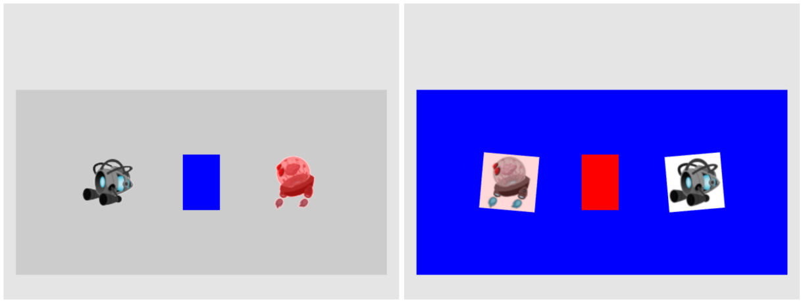
5.1: TextureShader Project

Slide 25
5.1: Goals
define uv coordinates for geometries with WebGL
create a texture coordinate buffer in WebGL
build GLSL shaders to render the textured geometry
define the texture engine component to load and process an image into a texture and to unload a texture
implement simple texture tinting, a modification of all texels with a programmer-specified color

Slide 26
Texture Implementation overview
GLSL Shaders: texture_vs.glsl + texture_fs.glsl
Support UV coordinate at vertex positions
vertex_buffer.js: (in core)
Define UV buffer to load into WebGL
texture_shader.js: (in shaders)
Allow programmer access to the GLSL Shaders
shader_resources: (in core)
New instance of sharable TextureShader object
texture_renderable.js: (in renderables)
Allows multiple TextureShader objects to be drawn (at different locations)
texture.js: (in resources)
Allows loading of texture files

Slide 27
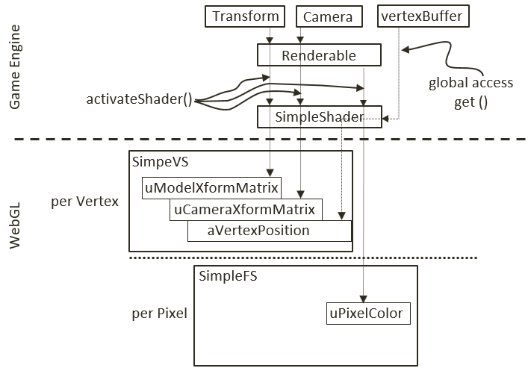
Review: SimpleShader and GLSL Shaders
attribute: aVertexPosition
Per vertex change
Fed via gl.ARRAY_BUFFER
uniform: transforms and pixelColor
Per render update
Stay constant for all vertices
SimpleShader:
Interfaces JavaScript to GLSL variables
Renderable:
Supports our clients to work with SimpleShader

Slide 28
Texture Implementation overview
GLSL Shaders: texture_vs.glsl + texture_fs.glsl
Support UV coordinate at vertex positions
vertex_buffer.js: (in core)
Define UV buffer to load into WebGL
texture_shader.js: (in shaders)
Allow programmer access to the GLSL Shaders
shader_resources: (in core)
New instance of sharable TextureShader object
texture_renderable.js: (in renderables)
Allows multiple TextureShader objects to be drawn (at different locations)
texture.js: (in resources)
Allows loading of texture files

Slide 29
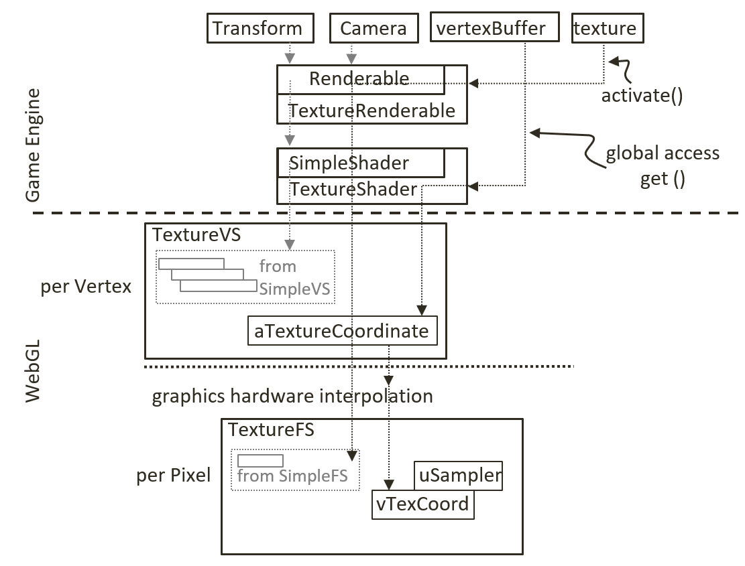
texture_vs (Vertex Shader)
varying: changes per pixel
Feeds into Fragment Shader
aTextureCoordinate:
from core/vertex_buffer.js(later)

Slide 30
Texture_fs (Fragment Shader): Variables
Note the varying (vTexCoord)
Same name as in TextureVS!
sampler2D datatype (uSampler)
Note the texture2D() GLSL function
Using of vTexCoord!
(s, t): interpolated (u, v)
What does r compute?

Slide 31
Texture Implementation overview
GLSL Shaders: texture_vs.glsl + texture_fs.glsl
Support UV coordinate at vertex positions
vertex_buffer.js: (in core)
Define UV buffer to load into WebGL
texture_shader.js: (in shaders)
Allow programmer access to the GLSL Shaders
shader_resources: (in core)
New instance of sharable TextureShader object
texture_renderable.js: (in renderables)
Allows multiple TextureShader objects to be drawn (at different locations)
texture.js: (in resources)
Allows loading of texture files

Slide 32
VertexBuffer support for UV Coordinate
core/vertex_buffer.js
Defines and loads UV coordinate: mTextureCoordinates
Note the ordering correspondence to the mVertexOfSquare
Allocating and loading of GPU buffer is identical to that of vertices

Slide 33
Texture Implementation overview
GLSL Shaders: texture_vs.glsl + texture_fs.glsl
Support UV coordinate at vertex positions
vertex_buffer.js: (in core)
Define UV buffer to load into WebGL
texture_shader.js: (in shaders)
Allow programmer access to the GLSL Shaders
shader_resources: (in core)
New instance of sharable TextureShader object
texture_renderable.js: (in renderables)
Allows multiple TextureShader objects to be drawn (at different locations)
texture.js: (in resources)
Allows loading of texture files

Slide 34
TextureShader
Recall SimpleShader (access to GPU var)
Subclass from SimpleShader
To retain the GPU var access
Define new GPU reference
With new attribute reference
mShaderTextureCoordindateRef to aTextureCoordinate
mSamplerRef to uSampler

Slide 35
Texture Implementation overview
GLSL Shaders: texture_vs.glsl + texture_fs.glsl
Support UV coordinate at vertex positions
vertex_buffer.js: (in core)
Define UV buffer to load into WebGL
texture_shader.js: (in shaders)
Allow programmer access to the GLSL Shaders
shader_resources: (in core)
New instance of sharable TextureShader object
texture_renderable.js: (in renderables)
Allows multiple TextureShader objects to be drawn (at different locations)
texture.js: (in resources)
Allows loading of texture files

Slide 36
shader_resources: Enable sharing
core/shader_resources.js
Creates TextureShader
In addition to loading and creating SimpleShader
Process is identical
Define access methods

Slide 37
Texture Implementation overview
GLSL Shaders: texture_vs.glsl + texture_fs.glsl
Support UV coordinate at vertex positions
vertex_buffer.js: (in core)
Define UV buffer to load into WebGL
texture_shader.js: (in shaders)
Allow programmer access to the GLSL Shaders
shader_resources: (in core)
New instance of sharable TextureShader object
texture_renderable.js: (in renderables)
Allows multiple TextureShader objects to be drawn (at different locations)
texture.js: (in resources)
Allows loading of texture files

Slide 38
TextureRenderable: connection to texture_vs/fs
A Renderable object with references
to TextureShader and
A loaded texture map
textures.activateTexture(): [to come]
Activates and connects
uSampler in TextureFS to current texture image
TextureRenderable.draw():
SimpleShader::activateShader()
Connects and loads square vertex
TextureShader::activateShader()
Connects and loads UV coordinate

Slide 39
Texture Implementation overview
GLSL Shaders: texture_vs.glsl + texture_fs.glsl
Support UV coordinate at vertex positions
vertex_buffer.js: (in core)
Define UV buffer to load into WebGL
texture_shader.js: (in shaders)
Allow programmer access to the GLSL Shaders
shader_resources: (in core)
New instance of sharable TextureShader object
texture_renderable.js: (in renderables)
Allows multiple TextureShader objects to be drawn (at different locations)
texture.js: (in resources)
Allows loading of texture files

Slide 40
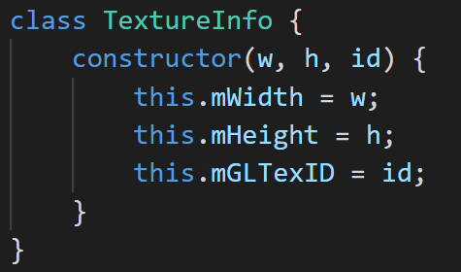
texture module
Use resource_map
TextureInfo object: for resource_map
has/get
Loading: not using loadDecodeParse()
Image loading specific HTML5 function
Simply create a new promise and push to mOutstandingPromises
Process after loaded: processLoadedImage()
To use: activate() and deactivate()

Slide 41
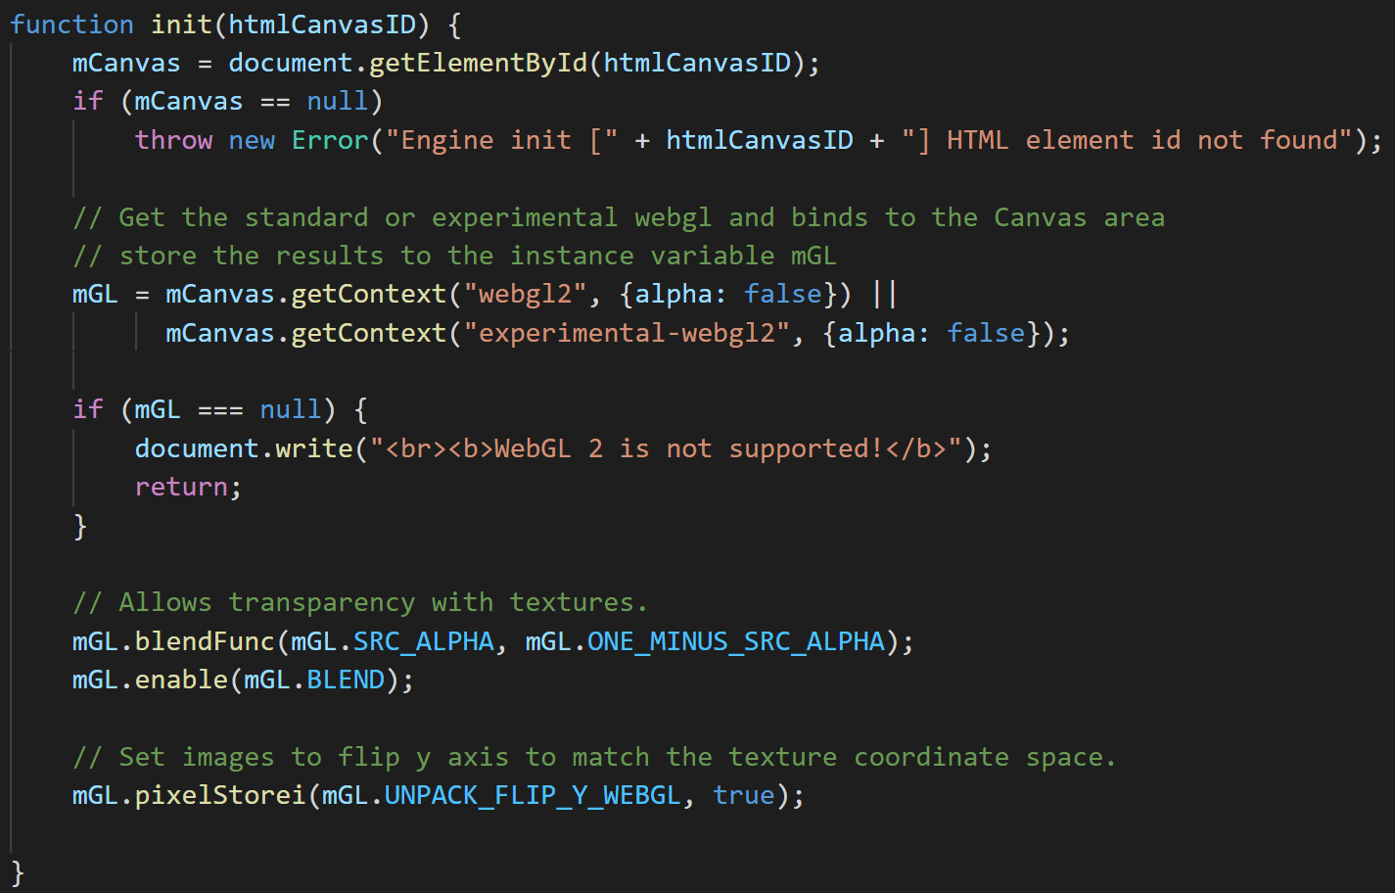
Engine configuration changes
core.js
Canvas: opaque
Blending support in TextureFS.glsl!
C1*A + C2*(1 – A)
Texture Map y increases upwards

Slide 42


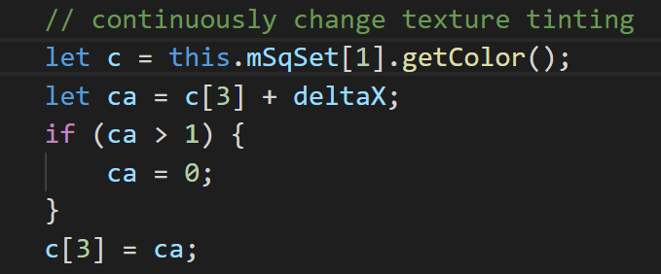
Testing Texture map …
Define file path
Load textures in the load() functions
Texture tinting

Slide 43
Texture Implementation overview
GLSL Shaders: texture_vs.glsl + texture_fs.glsl
Support UV coordinate at vertex positions
vertex_buffer.js: (in core)
Define UV buffer to load into WebGL
texture_shader.js: (in shaders)
Allow programmer access to the GLSL Shaders
shader_resources: (in core)
New instance of sharable TextureShader object
texture_renderable.js: (in renderables)
Allows multiple TextureShader objects to be drawn (at different locations)
texture.js: (in resources)
Allows loading of texture files

Slide 44
Learning from Example 5.1
Texture Mapping: UV to texel mapping
Associate vertex positions and UV coordinates
GLSL varying variable type [compare with attribute and uniform]
Implement: create and associate a second buffer in WebGL
Images are loaded as textures into WebGL
resource_map reference to TextureInfo (defined in textures.js)
CPU only has a textureID
GPU stores the actual texture
Binds TextureID to uSampler in texture_fs
texture::activateTexture()

Slide 45
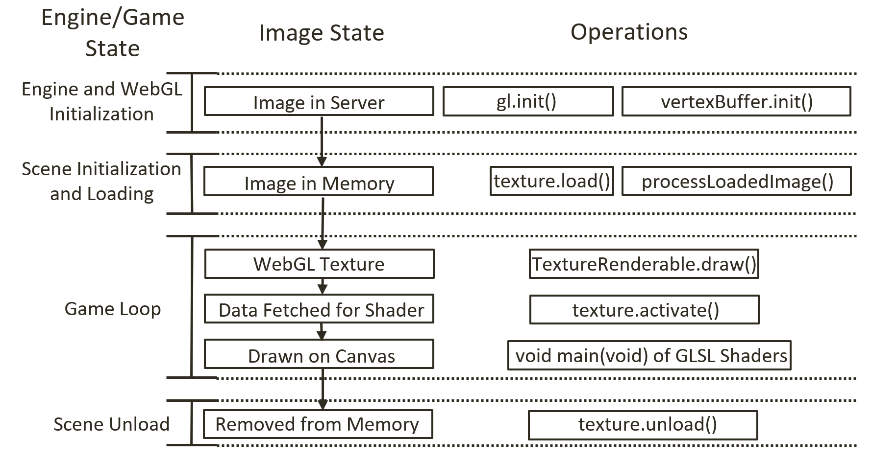
Image File, State, and WebGL

Slide 46
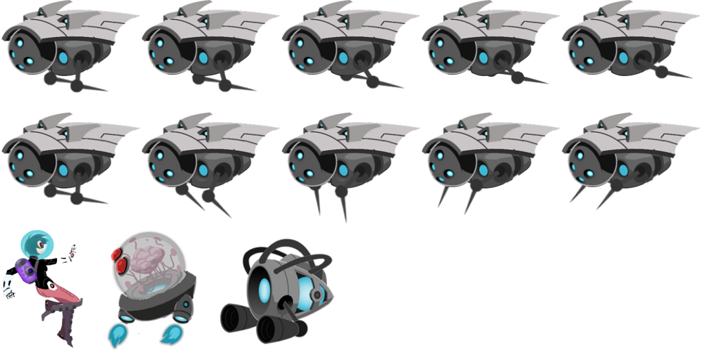

Sprite Sheets: Collection of object images
2^{n} x 2^{m} can be overly restrictive
E.g, 260x130: stored in 512x256!
Optimize load time
Loading many 16x16 images vs
Loading single 128x128 image
Organization: all objects in a level
A single 1Kx1K file
50 files of 128x128

Slide 47
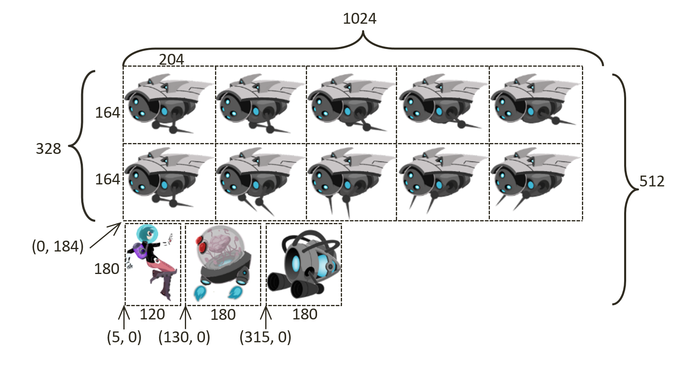
Sprite Sheet:
Artists create, communicate to developers

Slide 48
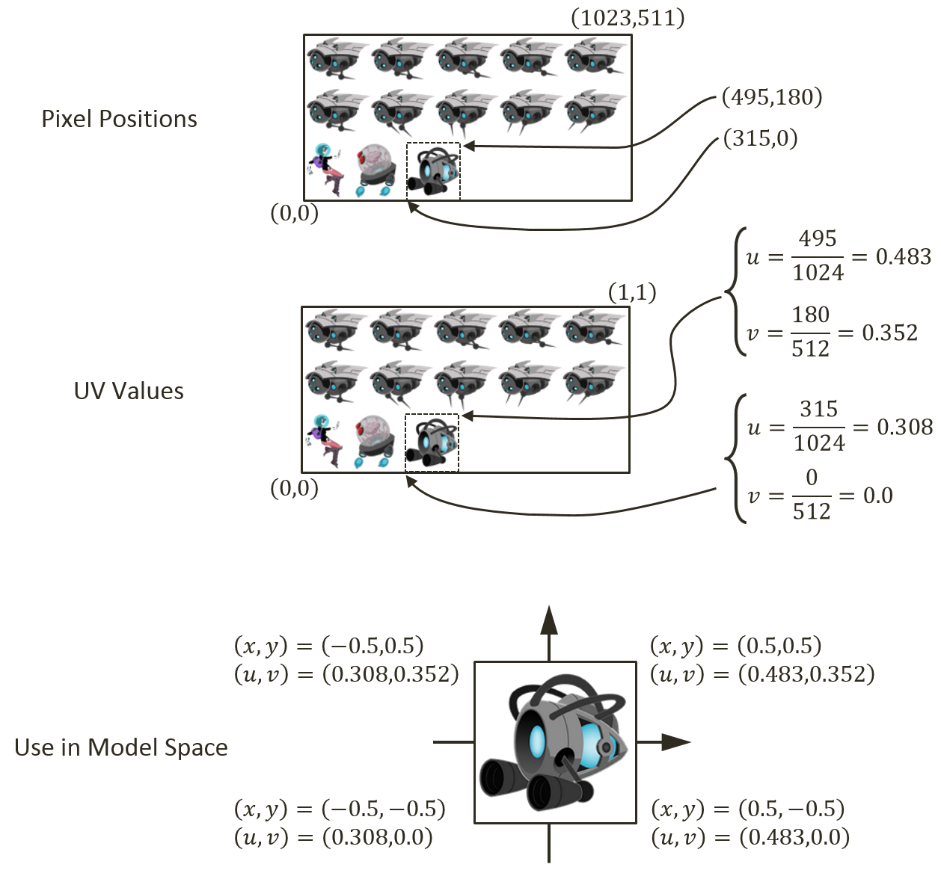
Drawing with Sprite Sheets
Figure out texel positions of an object
Portal as example
Receive info from artists
Compute UV values of the object
Recall 0 to 1 covers the entire image
Map UV values to vertex positions

Slide 49
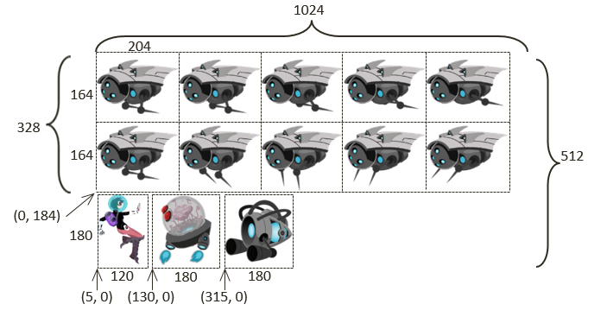
Questions:
What is the bound
[Left, Right, Bottom, Up]
for the element in the RED region
In UV values
In Pixel vales
If the RED region is moved over to the YELLOW region such that the upper-left is located at the center of the element it touches, what is the bound in UV and in pixel?
RED
YELLOW

Slide 50
Answer:
RED:
Pixel:
LEFT = 204+204 = 408
RIGHT = 204+204+204 = 612
BOTTOM = 0 + 180 + 4 = 184
TOP = BOTTOM + 164 = 184 + 164 = 348
UV:
Left = 408/1024
Right = 612/1024
Bottom = 184/512
Top = 348/512
RED
YELLOW

Slide 51
Answer:
YELLOW:
Width = 204 pixels or
(204/1024 in UV)
Height = 164 pixels or
(164/512 in UV)
Left = middle of first element = 204/2 = 102 pixel
Right = Left + 204
Bottom = 184 + (164/2) = 184 + 82 = 266 pixel
Top = Bottom + 164
RED
YELLOW

Slide 52
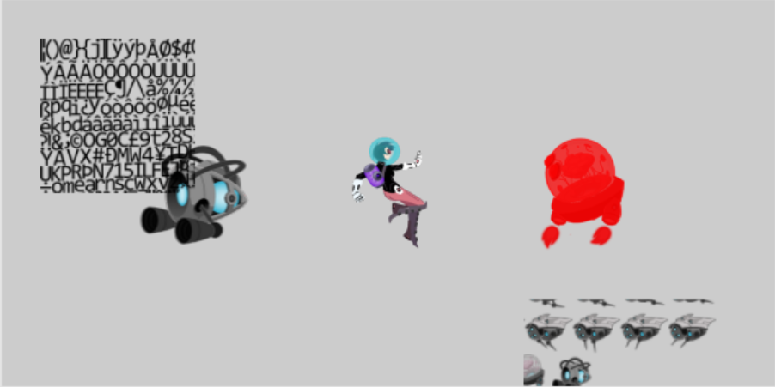
5.2: Sprite Shaders Project

Slide 53
5.2 Goals:
gain understanding for texture coordinate (UV)
experience defining sub-regions within an image for texture mapping
draw squares by mapping from sprite sheet elements
prepare for working with sprite animation and bitmap fonts

Slide 54
Recall: TextureShader …
vertex_buffer::
get ()
Refers to a static WebGL Buffer
Defined once, shared by all TextureShaders!
UV values in the buffer are bounds of UV space and cannot be changed!
Need per-shader Texture coordinate UV buffer for Sprite support

Slide 55
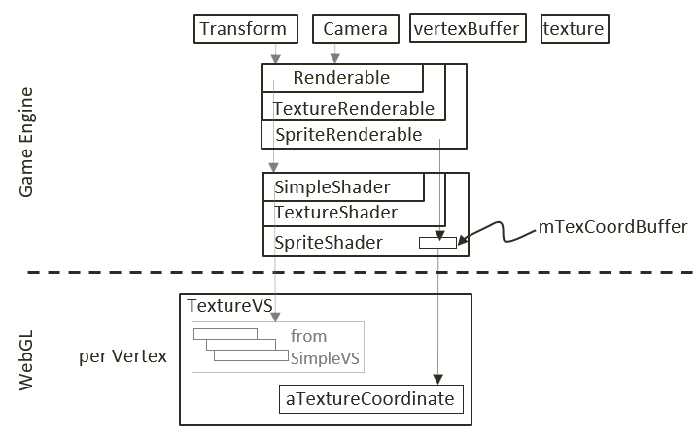
SpriteShader:
A TextureShader which defines its own Texture Coordinate Buffer!

Slide 56
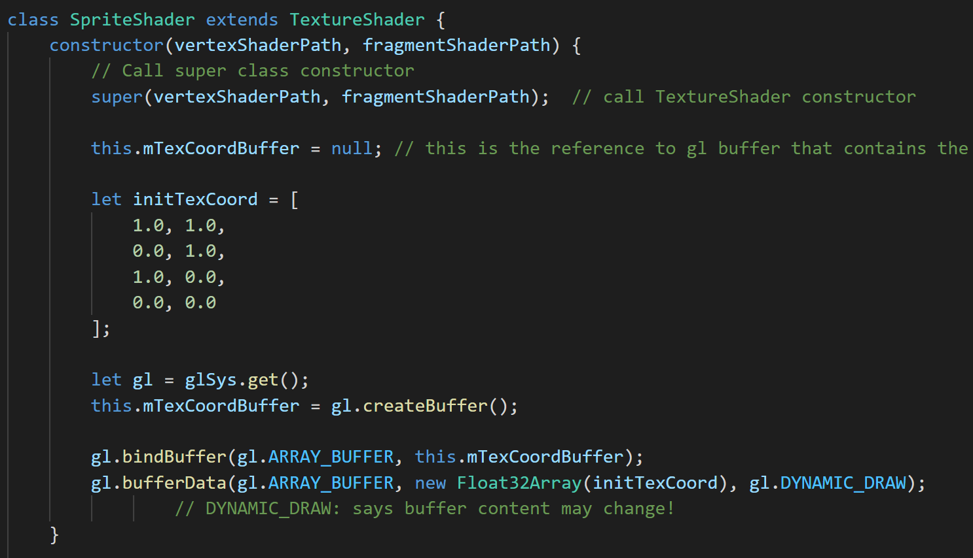
SpriteShader
Defines and loads a Dynamic texture coordinate buffer!

Slide 57
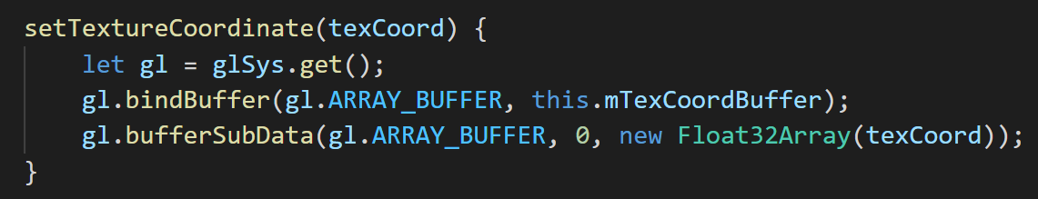
SpriteShader: custom texture coordinate
Set texture coordinate (into WebGL)
To change UV values for a SpriteRenderable object
bufferSubData(): pushes array to WebGL!
Override the _getTexCoordBuffer() function
return the proper address

Slide 58
SpriteRenderable:
A TextureRenderable which remembers UV values for each vertices (instead of the default UV bounds)
DefualtResources: creates a default SpriteShader
eTexCoordArrayIndex constants for array index
Set UV
Based on UV: setElementUVCoordinate()
Based on image pixel: setElementPixelPositions()
Get UV position
Pass to sprite_shader to GPU directly

Slide 59
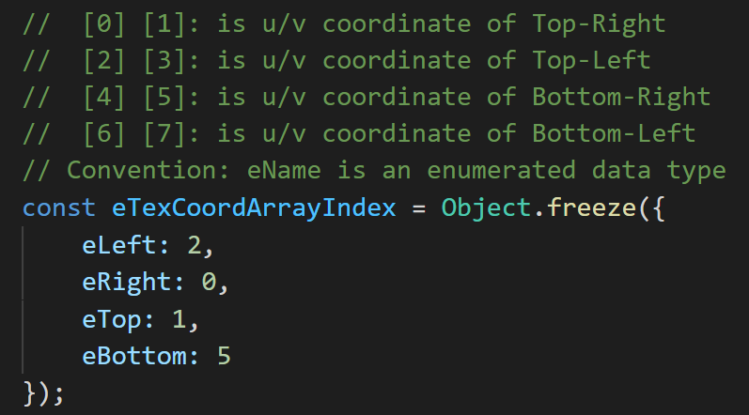
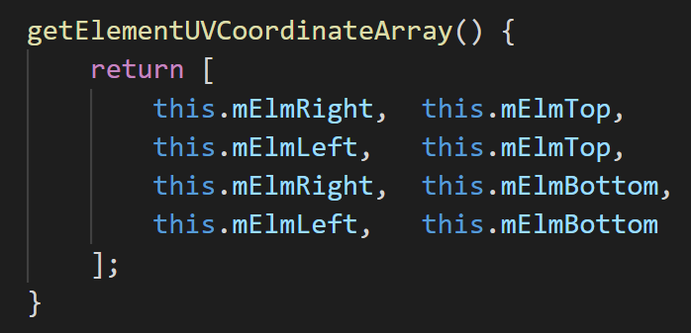
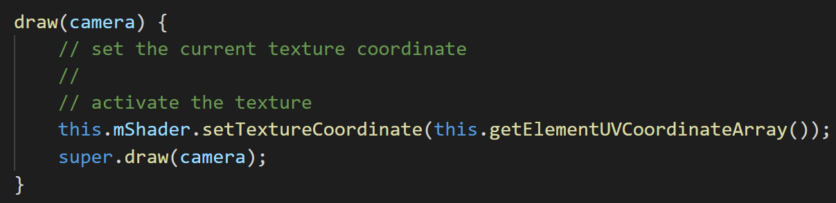
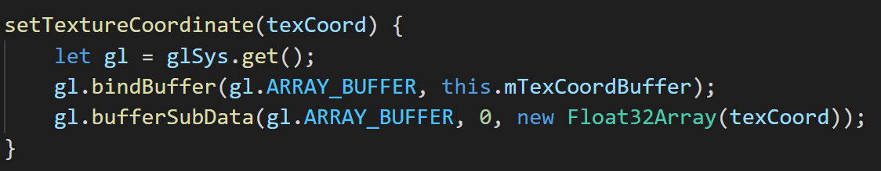
SpriteRenderable: UV to WebGL format
sprite_renderable.js
sprite_shader.js

Slide 60
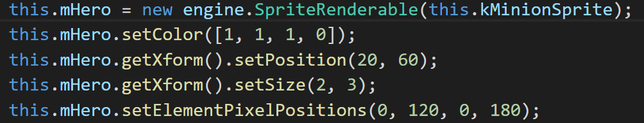
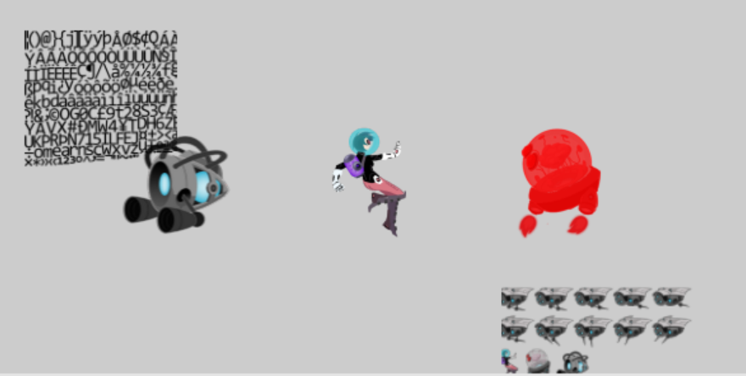
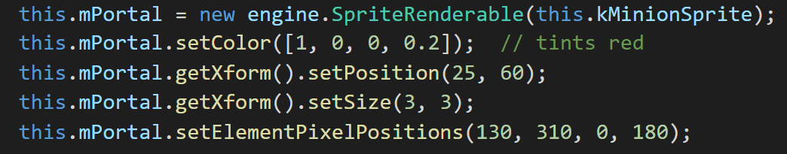
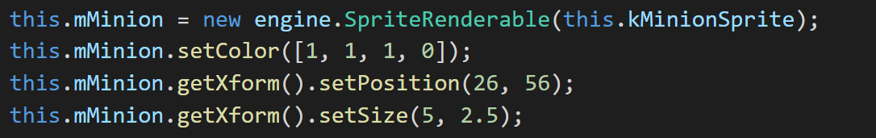
Testing SpriteRenderable
Same sprite sheet (same image)!!
The sprite sheet is shared
SpriteShader is shared
Unique SpriteRenderables!

Slide 61
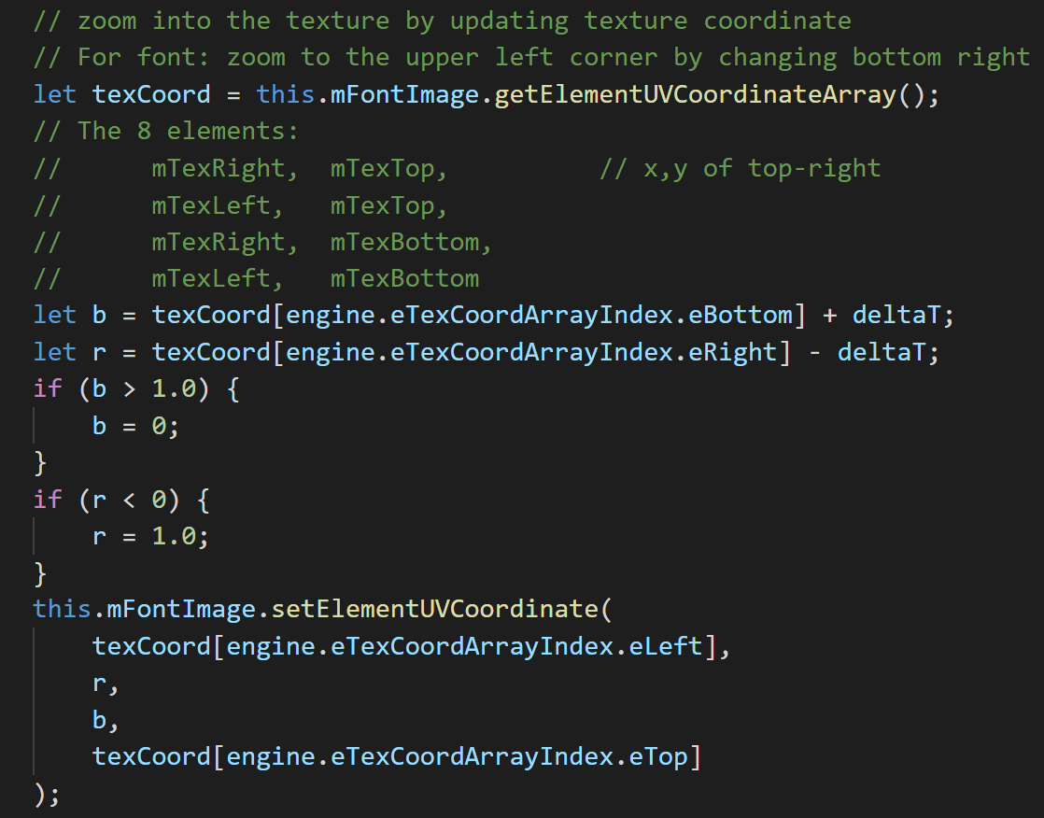
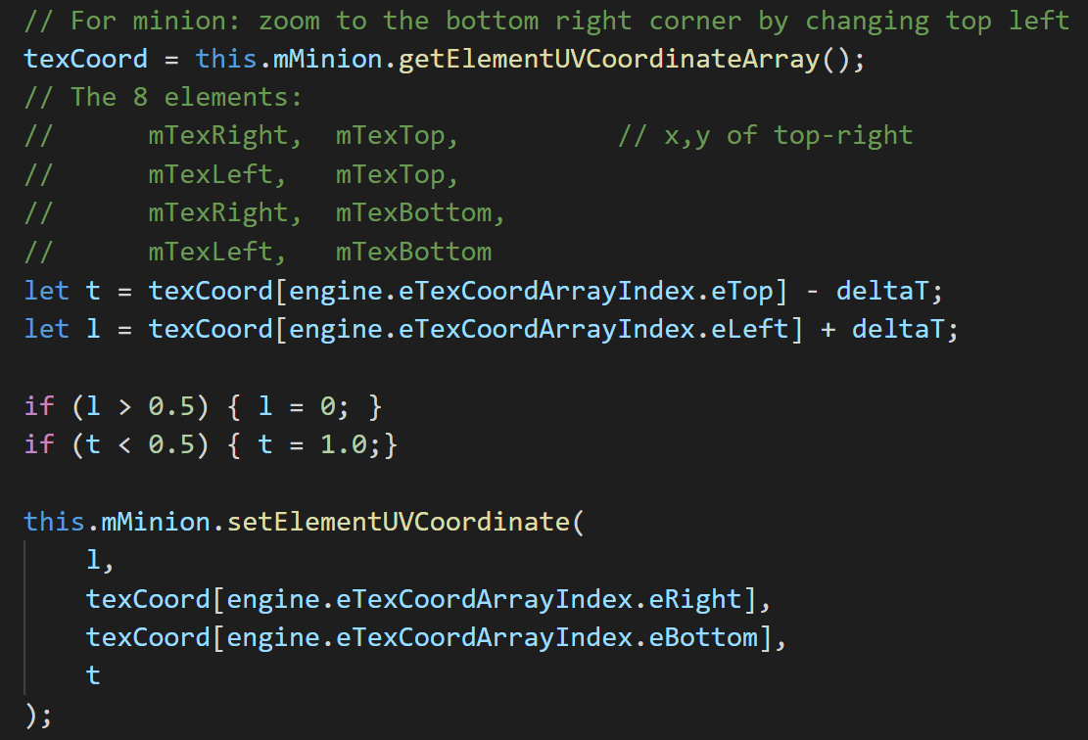
Changing UV in Update

Slide 62


Sprite Animations
Strategically drawn Sprite Sheets
Sequence through elements strategically
Similar to stop-frame animations
Explicit communications with creating artists are required to decode

Slide 63
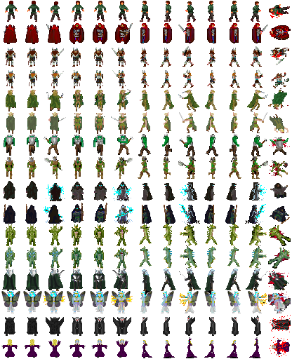
Organization Conventions
Not “laws,” something people seem to follow
Rows x Columns:
Fixed size on a sheet m-pixels by n-pixels
Paddings around each elements
Single row (or part of a row) defines action
Almost never cross rows

Slide 64
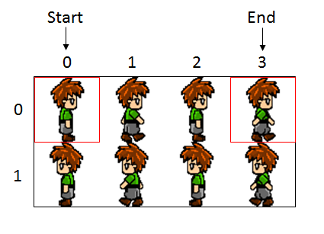
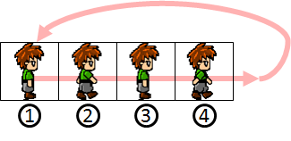
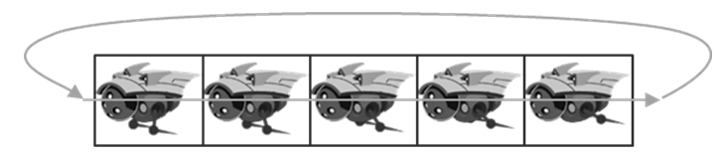
Parameters of Sprite Animation
Direction:
Forward (Left towards right)
Backward (Right towards left)
Swing
Speed: rate at which to change

Slide 65
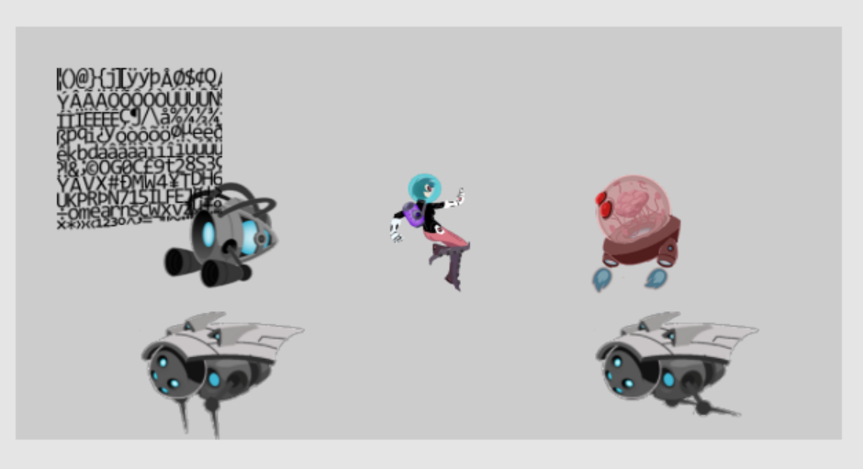
5.3: Sprite Animation Project

Slide 66
5.3: Goals
gain understanding of animated sprite sheets
experience the creation of sprite animations
define abstractions for implementing sprite animations

Slide 67
Implementation consideration
New shader?
NO!!
Access/update SpriteShader’s
mTexCoordBuffer
Change per animation update!

Slide 68
SpriteAnimateRenderable:
Define animation type/speed
Support defining and moving of sprite elements UV-area

Slide 69
SpriteAnimateRenderable: constructor
Three types of variables
Decribe the sprite element:
mFirstElmLeft: UV of the left-most element
Top, Width, Height, padding, num
Per animation setting: Type (left/right/swing), interval
Current state (for implementation): mCurrentAnimAdvance, mCurrentElm
_initAnimation(): set CurrentAnimAdvance and CurrentElm
Animation control:
setSpriteSequence(), setAnimationSpeed(), setAnimationType(), setAnimationSpeed()
updateAnimation(): THIS IS KEY! Must call this in Scene::update()

Slide 70
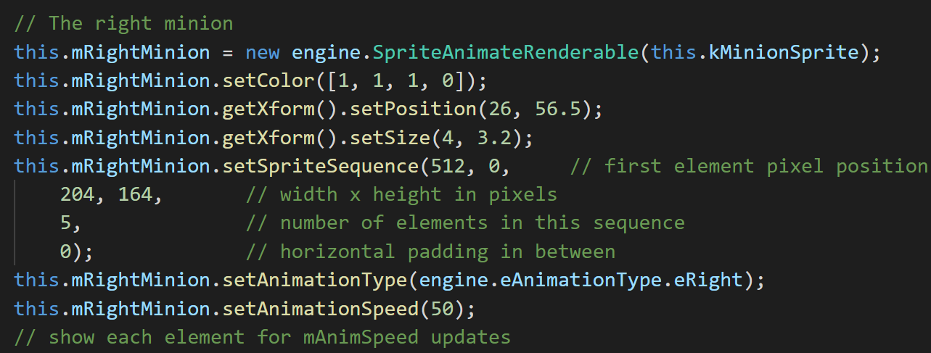
Testing Sprite Animation
To create

Slide 71
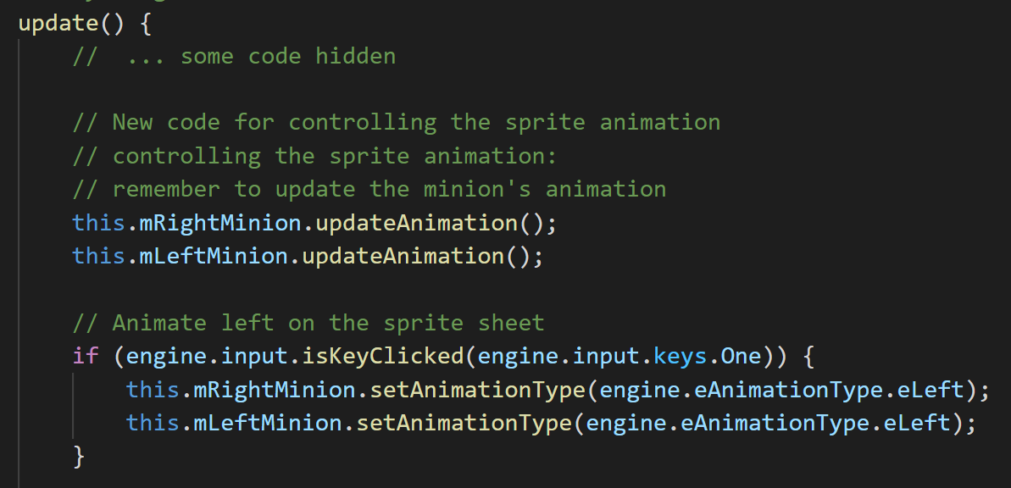
Testing Sprite Animation
To change and update (in MyGame::update())
NOTE: must call obj.updateAnimation() to see animation!

Slide 72
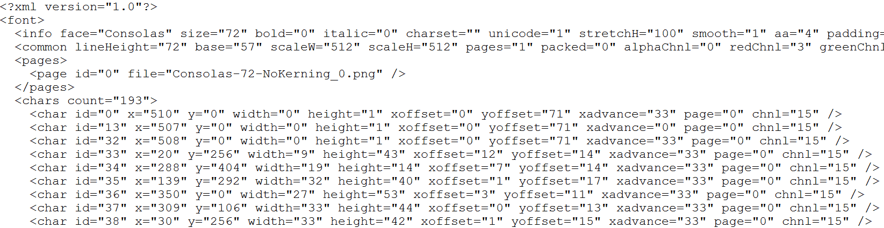
Fonts
Can be important in games
Especially for debug output
Pain to support
Hack: Bitmap fonts
Image + Instruction (to decode)

Slide 73
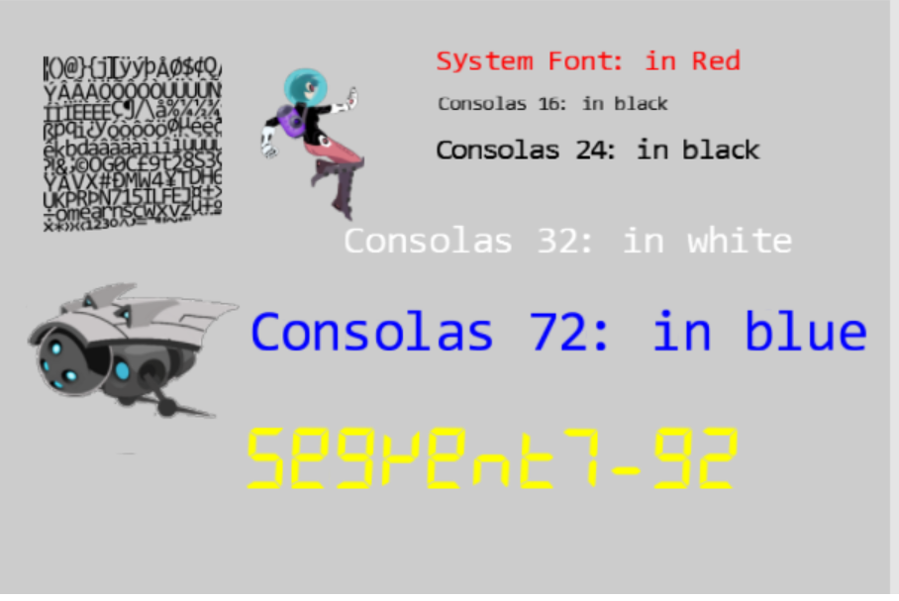
5.4: Font Support

Slide 74
5.4: Goal
Drawing text is not as interesting as the problem at hand
Designing a text solution based on what we have
Given a “string”:
find UV for first character from the bitmap font image
Set the sprite element UV values of a SpriteRenderable
draw the SpriteRenderable: one character
Compute space to skip
Repeat for next character
Abstract the above: FontRenderable

Slide 75
Procedure of working with fonts
Similar to _ALL_ external resources
Load:
DefaultResources: default system font
Per game scene font (if you have any)
Create a Renderable to draw with it
Slightly different …

Slide 76
Chapter 5: learned?
Use resource manager
Texture mapping
UV Coordinate System
Sprite elements in a Texture
Drawing with sprites
Sprite Sheet for animation
Sprite Animation
Bitmap font
Next: Simple behavior (collision)!

