Slide 1
Chapter 4
Implementing Common Components of Video Games

Slide 2
This Chapter
Control the Renderable object’s position, size, and rotation to construct complex movements and animations
Receive keyboard input from the player and animate Renderable objects
Work with asynchronous loading and unloading of external assets
Define, load, and execute a simple game level from a scene file
Change game levels by loading a new scene
Work with sound clips for background music and audio cues

Slide 3
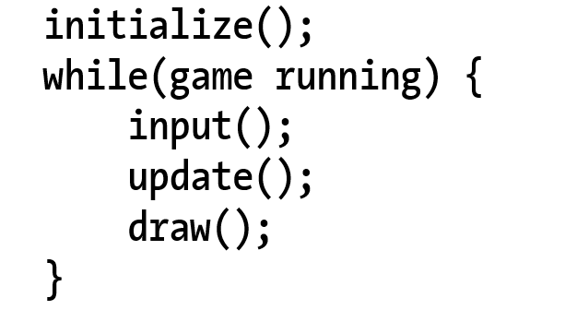
Game Loop
Typical structure
Notice: the input() update!

Slide 4
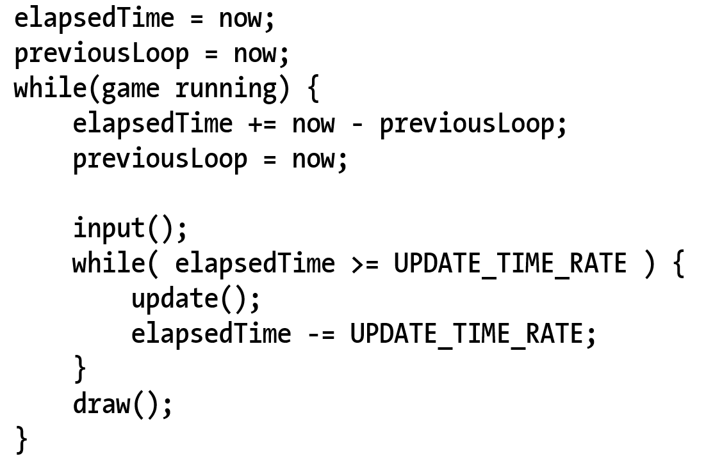
Game Loop: Implementation
Input() inside vs outside of the real-time loop?
Responsiveness when game is lagging
Fixed update rate:
Simple physics implementation (later in Chapter 9)

Slide 5
Questions
What is the Frame/Second?
Is it possible to have the following, and why?
Multiple update() calls per draw()
Multiple input() calls per draw()
Multiple draw() calls per update()
Multiple draw() calls per input()

Slide 6
Questions
What is the Frame/Second? ➔1/elapsedTime-ms or 1000/elapsedTime
Is it possible to have the following, and why?
Multiple update() calls per draw() YES!
When takes too much time to update/draw/input
Multiple input() calls per draw()
No input/draw tied together
Multiple draw() calls per update()
Yes: when running way ahead, no need to update
Multiple draw() calls per input()
NO: input/draw tied!!

Slide 7

4.1: Game Loop Project

Slide 8
4.1: New Module (loop.js)
New Engine component in the core folder
loopOnce()
requestAnimationFrame()
No input() checking yet
update() and draw()
start() / stop()
MyGame: or clients of the engine, must support
init(): called from loop::start()
update() and draw(): called from loop::loopOnce()

Slide 9
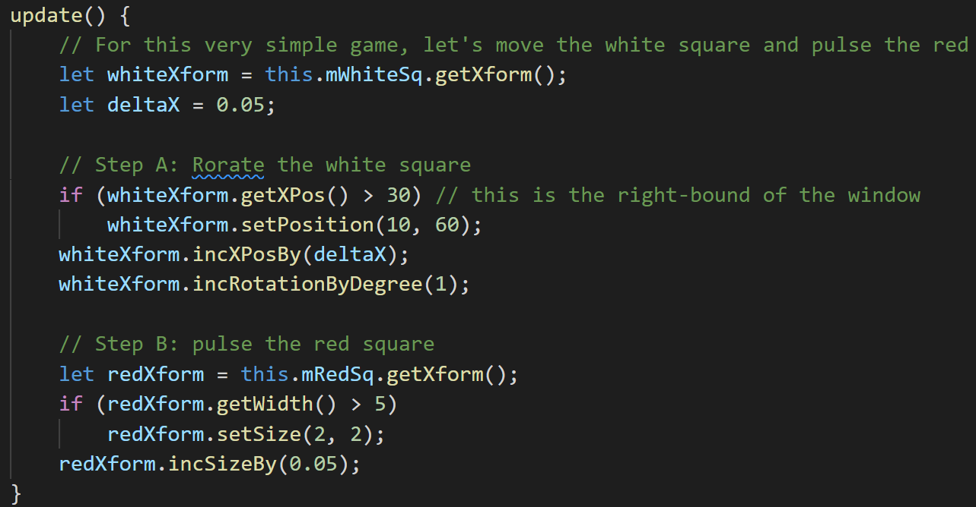
Questions
If there is no lagging …
whiteXform
What is the linear speed of its movement?
What is the angular speed of its rotation?
redXform
What is the speed of its size change?

Slide 10
Questions
whiteXform
What is the linear speed of its movement?
0.05/(1/60) units/sec or
0.05*60 units/sec = 3 unit/sec
In this case, width of world = 20units
Takes about 20/3 to cover the width
A little more than 6 seconds
What is the angular speed of its rotation?
1-degree/(1/60 sec) or 60-degrees/sec
Or exactly 6 seconds for a complete revolution
redXform
What is the speed of its size change?

Slide 11

4.2: Keyboard Input

Slide 12
4.2: Event and Keycodes
Events and event handlers
HTML5 Event registration and handlers
window.addEventListener(“Event”, handler)
Keycodes:
‘A’ = xx
‘B’ = xx+1
…

Slide 13
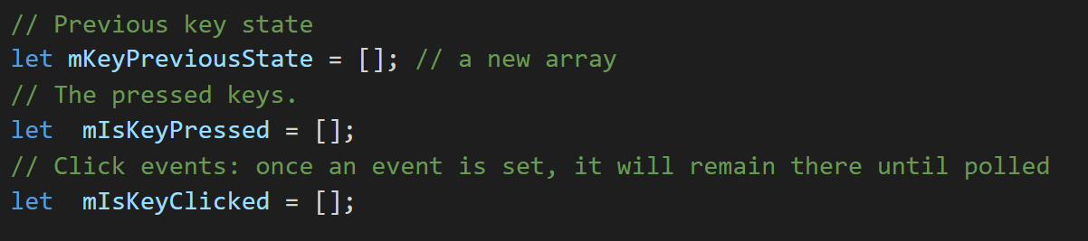
4.2: New module: input.js
States: (must be updated per frame)
Event handler:
onKeyDown() / onKeyUp()
init()
Called from engine::init() (in index.js)
update()
Called from loop::loopOnce()
Queries for client
isKeyPressed() / isKeyClicked()

Slide 14
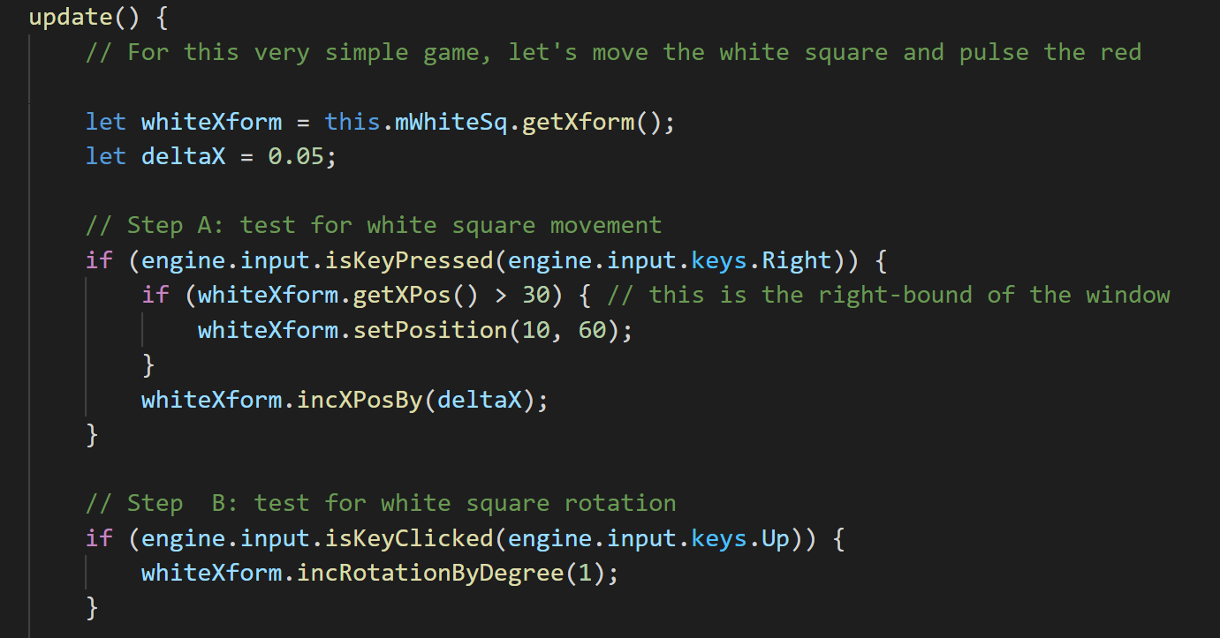
4.2: Testing Keyboard MyGame.update()
Engine initialization:
Called once from Window.onload()
Polling for input state:

Slide 15
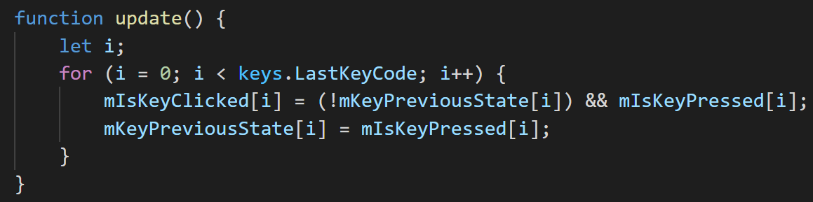
Questions
What is the runtime complexity of Input.update()?
How would you implement a “isKeyUp()” function?
To detect the key-up event
Will the runtime complexity change?

Slide 16
Resource Management
Synchronous load: (SimpleShader._loadAndCompileShader())
Issue load and wait
Stops web browser!!
May seem “hang” to user
Asynchronous load:
Issue load, provide “Callback” and continue
“Callback” is called when load is completed
Pro:
Efficient, support interactivity
Con:
Complex, requires synchronization

Slide 17

4.3: Resource Management Project

Slide 18
4.3: ResourceMap
MayEntry:
Reference to the loaded resource
Referenc Count: how many client requests to load this item
ResourceMap: a simple dictionary of MapEntry
Key-value pair of “string=id” and corresponding MapEntry
E.g., file name and content of file
Utility functions: set/get/has/loadRequested/unload
“Virtual” loadDecodeParse()
Define steps, lets caller define actual behavior details
Uses javascript fetch to send HTTP get request (https://www.w3schools.com/js/js_api_fetch.asp)

Slide 19
Javascript: Promise, async/await
We do not define new Promise, we work with existing Promise
Each Async load request is sent in a Promise: which may or may not complete immediate (Javascript::fetch returns a Promise)
These Promise(s) are pushed into an array of promise
resource_map::mOutstandingPromises
When all load requests are sent
Call a function to stop and wait for all promises to be completed
Stop and wait: await
Must be called from an aysnc function
Ref:
Promise https://www.w3schools.com/js/js_promise.asp
async/await: https://www.w3schools.com/js/js_async.asp

Slide 20
4.3: resource/text module (text.js)
import resource_map as map
Define the loading details
decodeText(): how to decode a loaded file into text
parseText(): there is nothing to do to “parse” a text file
load(): calls map.loadDecideParse() with actual behavior
When call text::load()
HTTP get request is sent (async) via Javascript::fetch
The Promise returned by Javascrip::fetch is pushed into the mOutstandingPromises array

Slide 21
4.3: Async textfile loading
Window.onload() my_game.js
Engine.init() index.js
shaderResource.init() shader_resources.js
Define a Promise to:
Issue two textfile loading
When loadings are done: Calls createShaders()
Push the Promise into ResourceMap
When this Promise is fulfilled ➔SimpleShader is created
loop.start() loop.js
resource_map::waitOnPromises() resource_map.js
Remembers this position in loop::start()
Returns to the caller Window.onload()

Slide 22
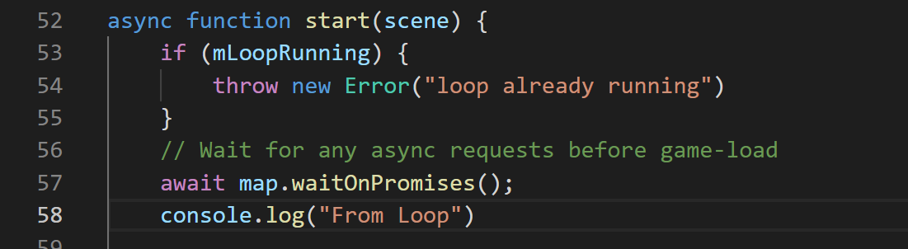
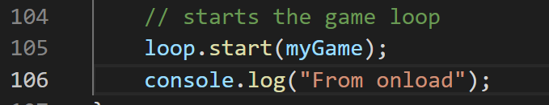
Try this:Example 4.3
Edit: loop.js
In start(): insert output to console after waitOnPromises()
Edit: my_game.js
In onload(): Insert output to console after loop.start()
What is the output you expect?
What is the output you observe?

Slide 23
Try this:Example 4.3
Edit: loop.js
In start(): insert output to console after waitOnPromises()
Edit: my_game.js
In onload(): Insert output to console after loop.start()
What is the output you expect?
“From Loop” appear before “From onload”
What is the output you observe?
“From onload” appear before “From Loop”
What happened?
await: stopped execution at line 57 of loop.js (waiting) and returned to caller (line: 106 of onload())
Sometime later, when all Promises are fulfilled, execution continues from Line 57 of loop.js

Slide 24
4.3: Testing async loading: MyGame
No need to worry about anything!
Identical to as before
Async loading is hiddent completely from the client!

Slide 25
Questions: Assume an empty resource_map
When loop::start() calls map.waitOnPromises()
What is the size of resource_map::mOutstandingPromises?
What are the Promise(s) in the array?
If I issue the following function calls one after the other
engine.text.load("myFile.txt");
engine.text.load("myFile.txt");
What is the size of
resource_map::mOutstandingPromises
How many actual HTTP get are issued?

Slide 26
Questions:
When loop::start() calls map.waitOnPromises()
What is the size of resource_map::mOutstandingPromises? ➔ 3
What are the Promise(s) in the array?
[0]: text file load of simple_fs.glsl (from shader_resources.js)
[1]: text file load of simple_vs.glsl (from shader_resources.js)
[2]: after [0] and [1] the creation of SimpleShader (from shader_resources.js)
If resource_map is empty and I issue the following function calls
engine.text.load("myFile.txt");
engine.text.load("myFile.txt");
What is the size of resource_map::mOutstandingPromises ➔ 1
How many actual HTTP get are issued? ➔ 1

Slide 27

4.4: Scene File Project

Slide 28
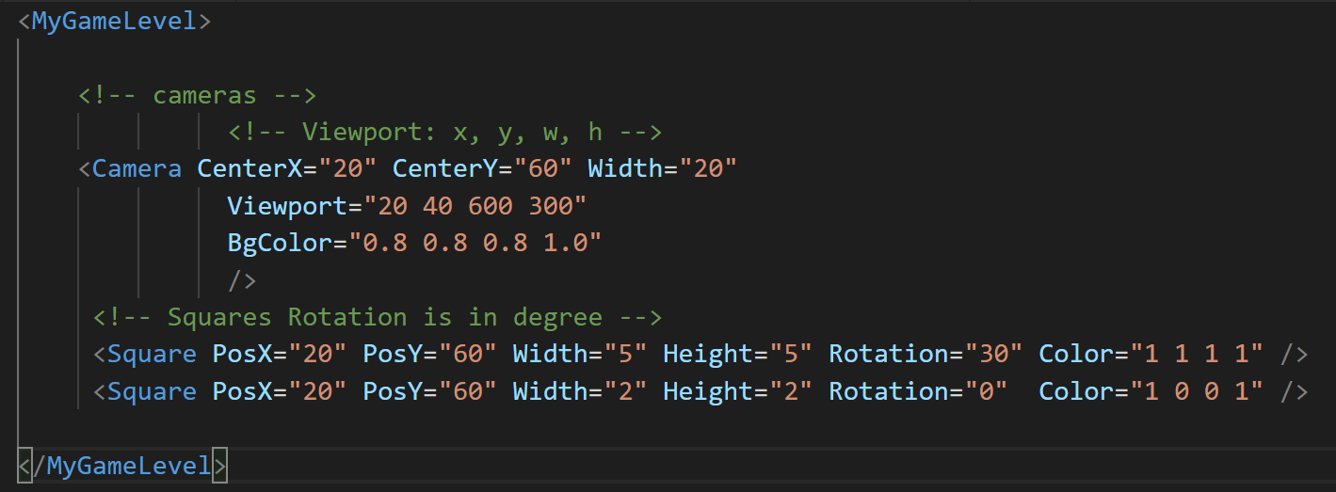
4.4: Scene File
The “assets” folder
A convention for ourselves (NOT defined by anything!!)
XML format and parsing (not cover here)

Slide 29
4.4: MyGame class
Constructor: declaring var and defining constants
Game specific resources (assets) MAY NOT be there!!
Init(): allocate and instantiate, setting up states
Game specific resources are loaded!!
update()/draw(): Seen this before … again:
update(): DO NOT try to draw anything
draw(): DO NOT make any changes to game state!
load()/unload(): loading/unloading of scene specific information!!

Slide 30

4.5: Scene Objects Project

Slide 31
4.5: Scene Objects
Define GameEngine (Core and Loop) interface protocol with game developer (our API user)
Abstract class for subclass by clients
draw() and update(): must be defined by subclass
next(): subclass MUST call this method to stop current loop
By default loop module is not visible by the client (not exported from index.js)

Slide 32
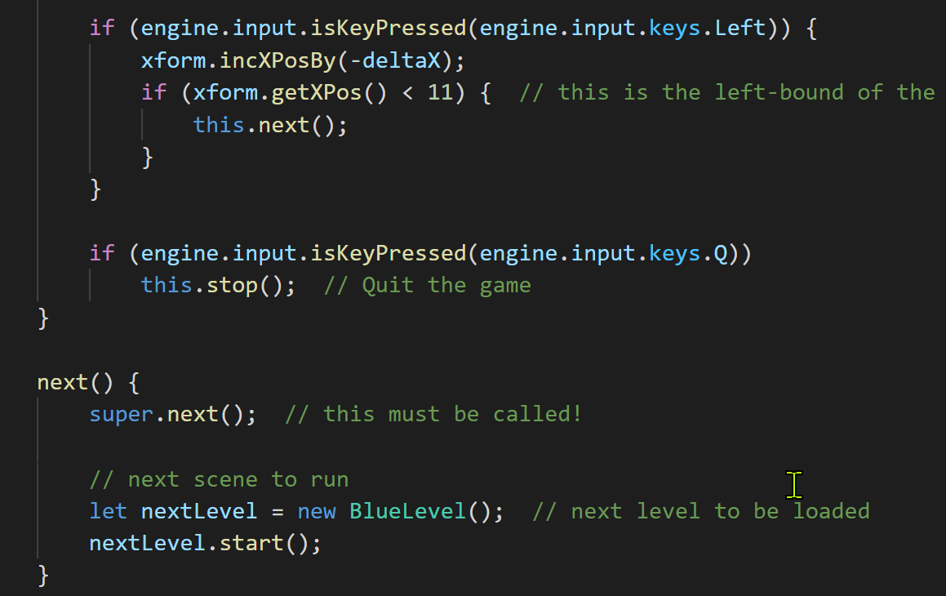
4.5: Loading of next Scene
Calls the next() function
next() implementation
MUST call super.next()
Example showed here
In MyGame
Call this.next()
From update()

Slide 33
Questions
Given MyGame: Constructor(), init(), load(), unload(), draw(), update()
What is the sequence that the above functions are called?
First is:?
Second is:?
Use our engine as an example, explain
why that in addition to Constuctor(), there is the init() function?
Which file include the code that calls the
myGame.init() function?

Slide 34
Questions
Given MyGame: Constructor(), init(), load(), unload(), draw(), update()
Constructor(), load(), init() … loops of draw() + update() … unload()
Note: unload() is called from Scene::next() or Scene::stop()
Use our engine as an example, explain
why that in addition to Constuctor(), there is the init() function?
Constructor: initialize variables/constants
load(): can use the initialized variable/constants for loading
init(): is not called until _AFTER_ load()
Constructor initializes for load(), and init() initialize for update()
Which file include the code that calls the
myGame.init() function? ➔loop::start(), before starting the loop

Slide 35
4.6: Audio support
Audio: files
Just another example of external resource!
Support for mp3 and wav formats
HTML5: AudioContext
Load/Decode audio resources
Play audio resources!!
Two important categories
Audio as music: e.g., background
Continuous playing, need control
Audio as cue:
Short, no need for control

Slide 36
4.6: resources/audio module
Same idea as text/xml loading
Defines decode and parse functions
Calls resource:map::loadDecodeParse() to actually load
Slightly more involved than other resoruces
Background: needs to start/stop, adjust volume
Cue: start (cannot stop)

Slide 37
Chapter 4: Learned?
Game loop
Keyboard input: event and keycodes
Resource management and asynchronous loading
Game level and scene files
How to subclass with JavaScript
Audio support

