Slide 1
Super Meiro Maze
Team ArmTheChildren

Slide 2
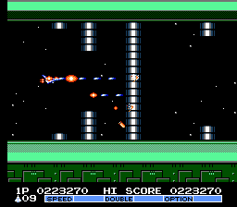
What is it?
Side-scrolling flight simulator with the objective of surviving fast-paced mazes

Slide 3
How do I play it?
Camera pans towards the right - forcing the player to navigate the maze
The speed will increase/decrease depending on situation
Opening/closing doors may appear which require speed adjustments
Movement control by WASD controls
Obstacles will appear which will require clicking to remove
The click will trigger a projectile aimed towards the mouse cursor.

Slide 4
Technical Requirement - Scenes
Tutorial level to introduce game concepts
Multiple levels with increasing difficulty
Load/unload automatically as the player progresses
Victory/defeat splash screen with the option to restart

Slide 5
Technical Requirement - Objects
Main Hero object - per pixel collision to detect crash
Hero will fire a projectile object
Level design will be many interlocked objects
Destructible wall objects and oscillating doors will be throughout the level

Slide 6
Technical Requirement - Camera, Behavior, Physics
Main Camera will pan to the right, forcing the player forward
Secondary camera will provide a minimap to see level progress
Hero’s projectile trajectory will interpolated toward cursor position
Hero collision will cause the camera to shake.
Destructible walls will crumble down as pieces are destroyed.

Slide 7
Technical Requirement - Lights and Particles
Directional light source : Hero’s airship headlights
Point light source: Light objects illuminating the maze
Spotlight source: Destructable objects will have lights pointed at them
Particles: Hero’s projectile will be a missle, upon impact a particle explosion will occur

Slide 8
Production Timeline
Week 1 : Playable demo
Tutorial level with all concepts presented - barebone
Week 2 : Play Test
Lights + Particles + Basic textures/sprites
Playable level 1
Week 3: Final Version
Full playable game - Final textures and sprites

Slide 9
End Title Card
Questions?

