Slide 1
The LLambyrinth
By: GLPeople
Sahjpreet Brar, Connor Browne, Yazel Arce

Slide 2
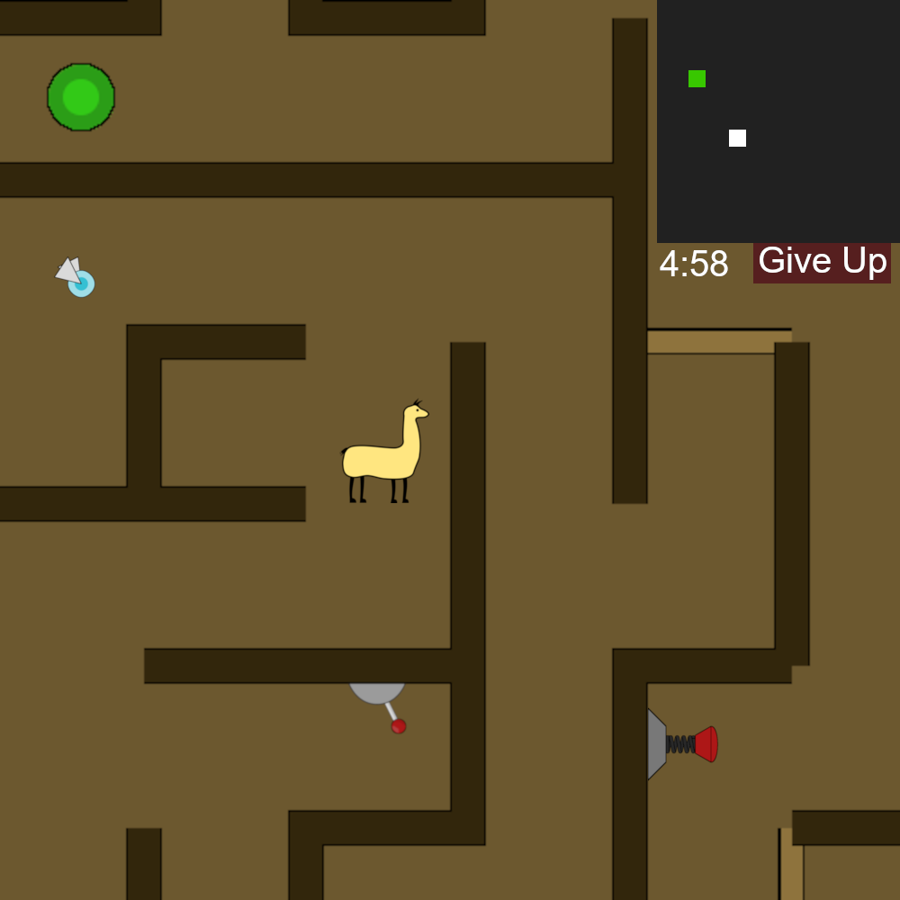
Game Scene:

Slide 3
Scenes
Start scene
Start button
Level button
Darkness button- bright, dim or dark
Win Scene
Lose Scene
Timer runs out
Sprite catches llama

Slide 4
Technical Requirements
Game Objects: hero, sprite, moving walls, levers
Per-pixel collision: sprite and exit
World view-main view and mini map view (upper right corner)
ShakePosition: Lever switching causes world shake
Chase: light source that chases the hero - may interpolate
Physics: hero and button interaction, hero colliding with wall
Light: hero’s light source, sprite, dark maze, exit button
Particle System: sprite

Slide 5
Timeline
Game Pitch: Completed on 2/25/19
Progress Demo: 3/4/19
All objects defined + functionality
Llama collisions
Main camera + mini camera
Particle System
PlayTest: 3/11/19
Scenes-Win/Lose, Start Scene, more Levels
Lights
Physics
Final Game Play: 3/18/19
Rearranging walls

