Slide 1

TEAM TACO - GAME PITCH
By Saiful Salim, Allen Fulmer, Tod Kahler

Slide 2
Our game is inspired by Super Mario Bros, lots of RPG elements, and Kelvin. Yes, Prof Kelvin Sung.
It is a 2D platform single player RPG/platformer game that uses pixelated tiles and objects. The game features our hero character, Kelvin, on his short adventure. A story with some musical elements are incorporated into the game for a surreal experience.
Kelvin will go through two levels (two different scenes) that ends with fighting the last boss, in which Kevlin either defeats and wins, or loses all his lives and… loses. Kelvin will obtain items throughout his way to the boss to make him stronger.
There are a variety of enemies Kelvin will deal with: Ground enemies that Kelvin needs to step on to disable, cannons that shoot standard straight-forward projectile attacks, and flying enemies that shoot homing projectiles that Kelvin needs to deflect. There are multiple difficulty levels, which affect how many lives Kelvin has in total.

Slide 3
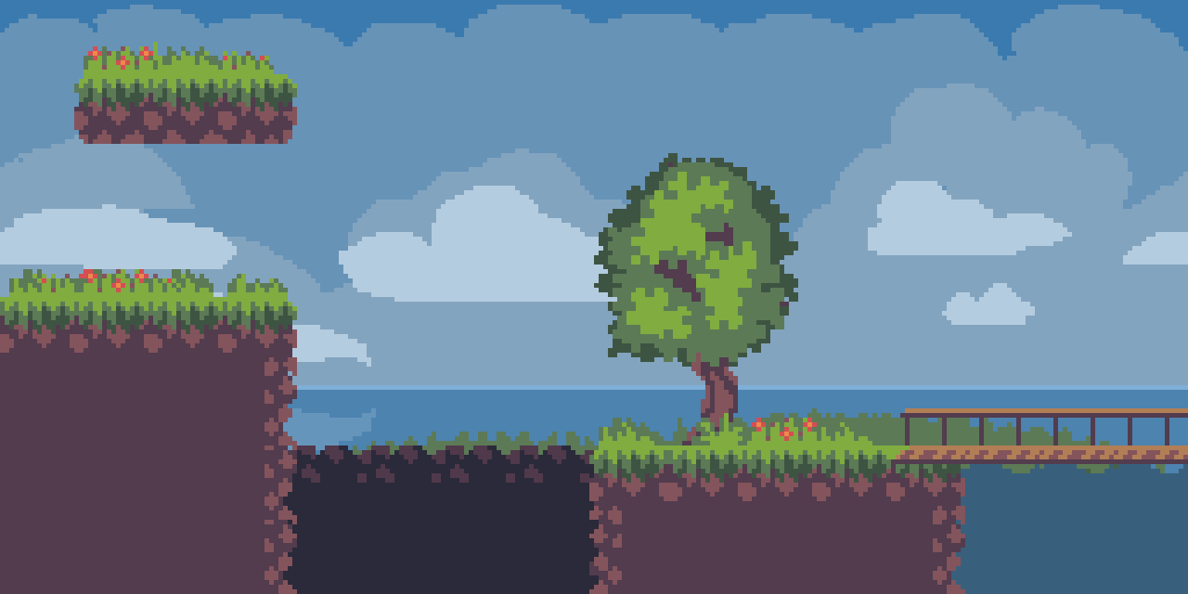


Slide 4
Snippets of the game story element
Kelvin woke up in the middle of nowhere. He’d lost his memory of how, where, and why he was there. The stale air and the gloomy atmosphere didn’t help in reducing his fear of the unknown. He walked around and discovered items on the ground that felt nostalgically familiar to his grasp....
…. *shrkk shrkk* Something was moving towards him. He saw a dwarf-mushroom-ish looking creature scuttling on the ground that said “English is a hard programming language.”
Kelvin: “...I’m like on drugs or something?” The glowing-hot Kelvin asked himself. He didn’t even realize he’d already stripped off his jacket… The heat was unbearable…
*BOOM!!!*
The ground trembled as the giant wooden door slammed open. Kelvin heard an echo that passed through his ear; an echo so soft and mystical, it seemed like it came from a different dimension: “I’m finally here… again...”

Slide 5
Technical Requirements
Scenes - The starting scene, a scene for each level (currently 2), and the ending scene (win/lose).
Game complexity - Kelvin(Hero), 3 different enemy types (Ground, Cannon, Flying), final boss, and items to pick up. Enemies’ traps and projectiles demonstrates per pixel collision.
Camera - Main camera clamped to hero, and a minimap camera that shows the full level at a glance.
Behaviour -
Interpolation: When Kelvin jumps, or when enemy projectiles move.
Shaking: Kelvin shakes when receiving damage, the Camera shakes when the Final boss appears.
Chase: Enemy homing projectiles chase Kelvin.

Slide 6
Technical Requirements.2
Physics: Kelvin and ground enemies stick to the ground, and can’t go through walls/solids.
Game world: One of Kelvin’s powerups causes him to glow (spotlight). Both levels will contain a light source (like the Sun) (point). Red ambient flickers appear on everything during the boss’ appearance (directional). The boss has a destructive attack that causes dust particles to be kicked up.
UI - Selection during the start using both mouse and keyboard, help controls, ability to turn on/off sounds/music.

Slide 7
Approximate Timeline Schedule
First Week - Document the basic skeleton of the game and specify all objects properties, behaviours, and interactions with each other on paper. By the end of the week, user should be able to control the hero and relevant objects should be able to interact with each other in one scene. Make Demo.
Second Week - Finish making all the required assets and story element of game. Add in complex behaviour of hero and enemies, illumination, win/lose scene, second level, final boss fight. Make the UI. Test for bugs and make the game playable.
Third Week - Adds in all the extra game elements such as music, story, and easter egg. Add in particle and all extra effect. Make a thorough testing. Make the game fun!

