Slide 1
Double Blockage
By: Throwing Shaders

Slide 2
Introduction
We wanted to make a game that is a test of reflexes, spatial reasoning, speed, and precision.
Inspired by classic puzzles that are easy to pick up, hard to master.
A game that would be family friendly with a lot of depth.
Tests multitasking ability.
Make a game that can be played in a variety of ways.
A game that doesn’t require professional art, but can be visually pleasing.

Slide 3
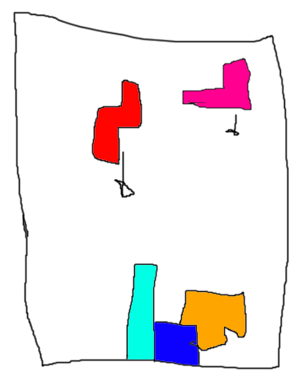
How the game works?
You still get one board.
Instead of one block, you always have two blocks on the screen, and you have to control them both at the same time.
You control one of the tetromino blocks with wasd keys, and the other one with arrow keys.
The moment a block lands, another one spawns immediately in order to ensure you always have two blocks to control at the same time.
Game has a multiplayer component that requires strong cooperation between two people to finish puzzles where each player controls a block.

Slide 4
Technical Requirements
The game can be played entirely with keyboard, the menu will be navigated with either mouse or arrow keys.
Interpolation will be used along with a grid system for the block movement.
Shaking effect will be used when the two blocks collide with each other. It will also create a physics effect where they bounce from each other when that happens.
All the blocks will use point lights and shadows to produce a cool effect against the background. Spotlights will be used to highlight spawned blocks.
A camera view will show up on the top when a line is cleared to display the message “Score unlocked: value of score based on how many lines are cleared”
Particle effect will be created when a line is cleared

Slide 5
Why we think this will work?
It’s an awesome risk vs reward system.
It’s based on a classic game that most people know, so we don’t have to worry too much about user centered design or tutorials.
The formula of this kind of block puzzles is pretty understood at this point, We can have extra time to polish and add extra content within the short period of time we have (maybe more scoring options).
The components logic is relatively simple allowing us to implement machine learning difficulty balancing (similar to games like rocket league and persona games) to ensure a fair balanced difficulty from player to player.
We think the multitasking aspect will add another layer to an already amazing and classic puzzle game.
It would be interesting to see if this also works as a local multiplayer game.

Slide 6
Any Questions?
We're not Google but we try™

