Slide 1
Double Blockage
By: Throwing Shaders
John Ghattas, Luke Smiley, Hossam Basiony

Slide 2
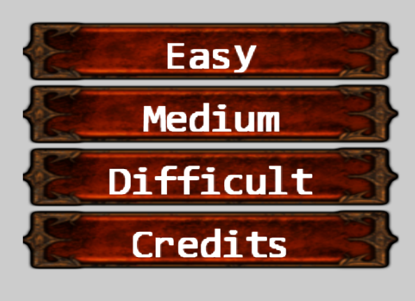
Complete Game Logic
List of instructions appear when you start the game
The game at its current state has a losing concept
If one of the blocks reaches the top grid then it’s game over.
We added a winning scenario in case the player reaches 10,000 (Good luck with that)
We added three difficulty options that change the speed of block movement.
Five Scenes
Start Game Scene
Main Game Scene
Credits Scene
Game Over Scene
Win Scene

Slide 3
Technical Requirements
Interpolation Logic: Every single block in the board now interpolates to destination. This gives it a super smooth feel.
Shaking Logic: If you press down, or S on the keyboard and you place the block quickly. The block will shake on the ground and then snap in place.
Particle System: If you clear a line on the board, you will get a cool fire burning effect.
Lighting System: To distinguish between the two blocks, we made a lighting system that follows one of the blocks. So that you can quickly distinguish between both blocks using light
A main camera view that shows the falling blocks.
A minimap camera view that shows the next two falling blocks.
Another camera is rendered on the bottom right to show the score. This will make it more obvious.
We got an idea based on bingo balls revealing a new result
We decided to implement a similar cool effect for bingo balls revealing the next blocks.

Slide 4
Game Link and Video Demo
Video: https://youtu.be/bt5h7omMUww
Link: http://students.washington.edu/hbasiony/

