Slide 1
Chapter 3
Thinking about Collisions

Slide 2
Goals
Appreciate the significant computational cost of detecting object collisions.
Optimize object collision detection with broad phase collisions to avoid unnecessary computations.
Understand that, in a computer simulation, rigid bodies can interpenetrate during a collision and that this interpenetration must be resolved.
Learn and use the Separating Axis Theorem (SAT) to detect rigid body collisions.
Compute the necessary information to support effective resolution of interpenetration (cover next chapter)
Implement an efficient collision detection algorithm that is based on SAT.
Detect collisions between rigid rectangles and circles accurately.

Slide 3
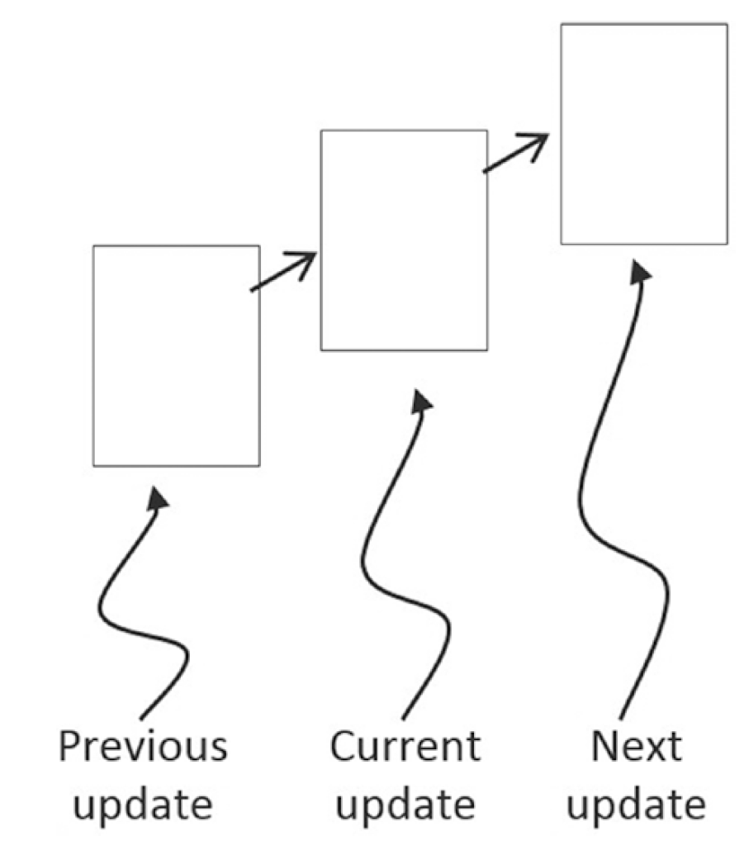
Rigid Body Motion
Discretized positions in the world
You don’t see this in the real world!

Slide 4
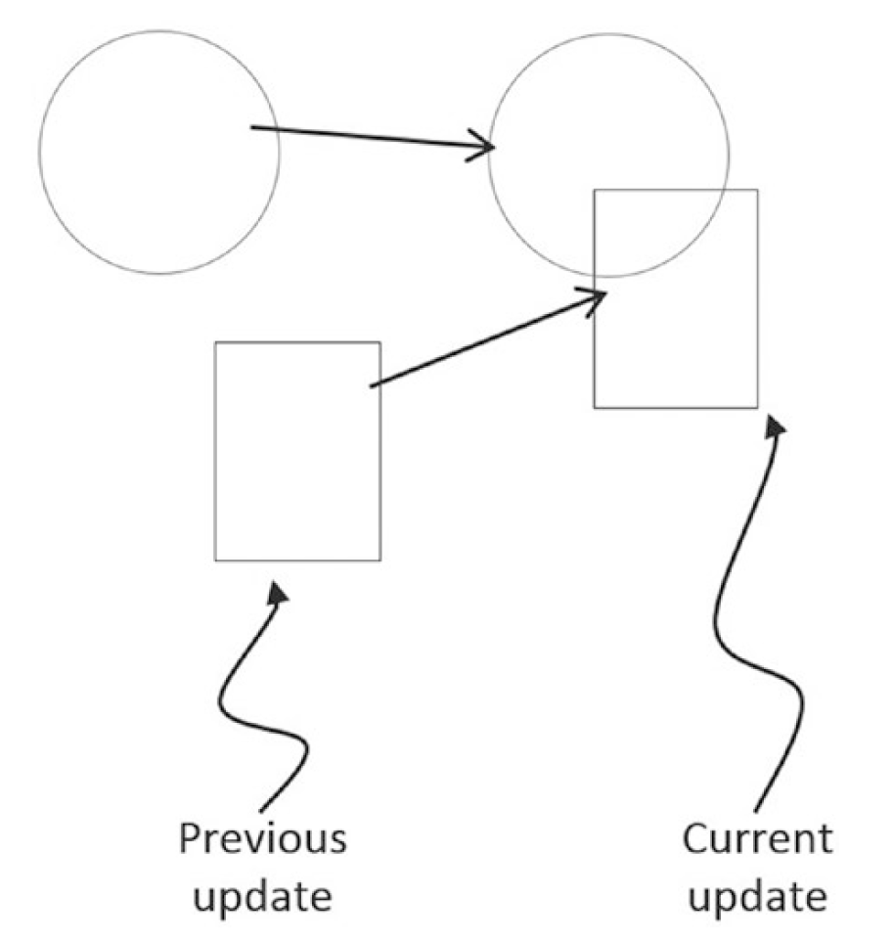
Interpenetration!
Real world rigid bodies cannot do this!
We must resolve this!
How?

Slide 5
Detecting Collision
General cost:
Discussed this last week
Optimization: Broad phase method (acceleration strategies)
Divide the space
Divide the object
Learned BBOX
Now, use circle

Slide 6
Example 3.1
detect collisions between circles/rectangles
Source code:
RigidShape: mBoundRadius + boundTest()
Constructor: mAllObjects.push() ⬅ What does this do?
Subclasses: Rectangle, Circle
Calling sequence
Index.html ➔ initializeEngineCore()
runGameLoop
➔update()/draw()/updateUI()
Inner loop
Physics.collision() ←!!
O(n^2) testings: draw in green if collide!

Slide 7
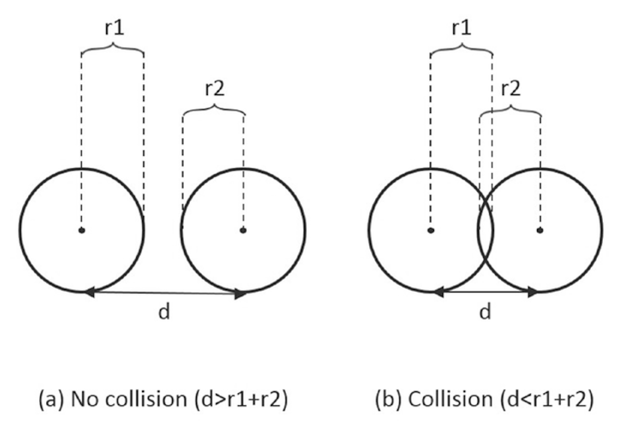
Circle/Circle collision test

Slide 8
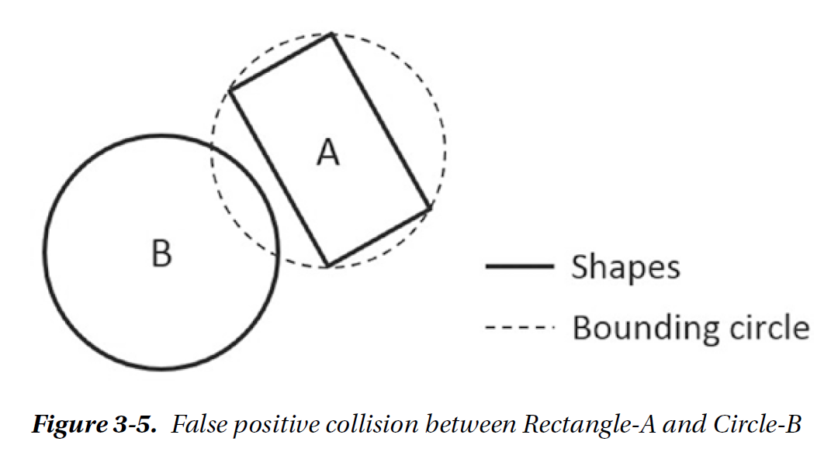
Not very cool because …
Yes/No answer is NOT good enough!
Must resolve the interpenetration
Void space for rectangles!
Will fix this over the next few chapters

Slide 9
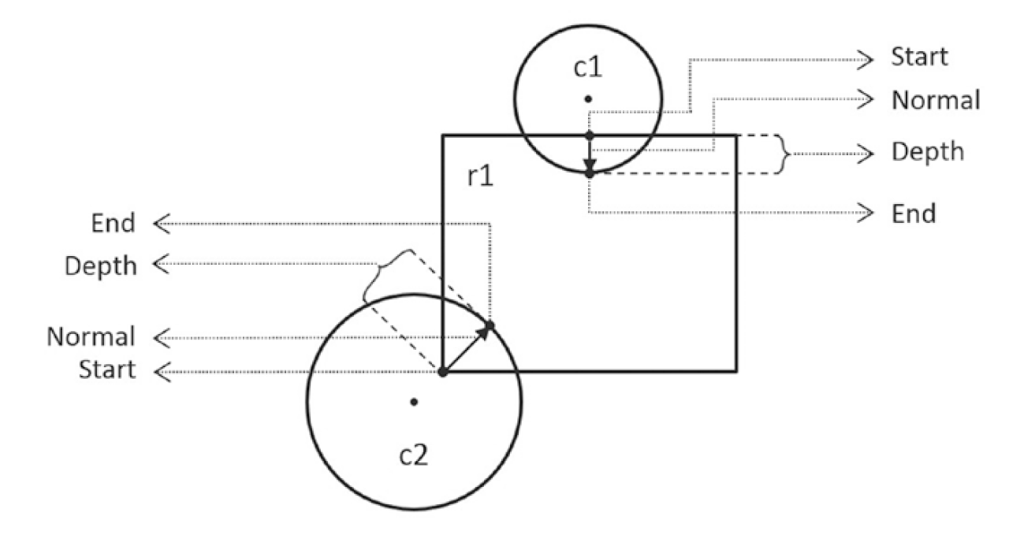
Collision Information
Information kept to resolve interpenetration (next chapter)
Depth: smallest distance to push to resolve
Normal: the direction to push
Start/End: from to positions

Slide 10
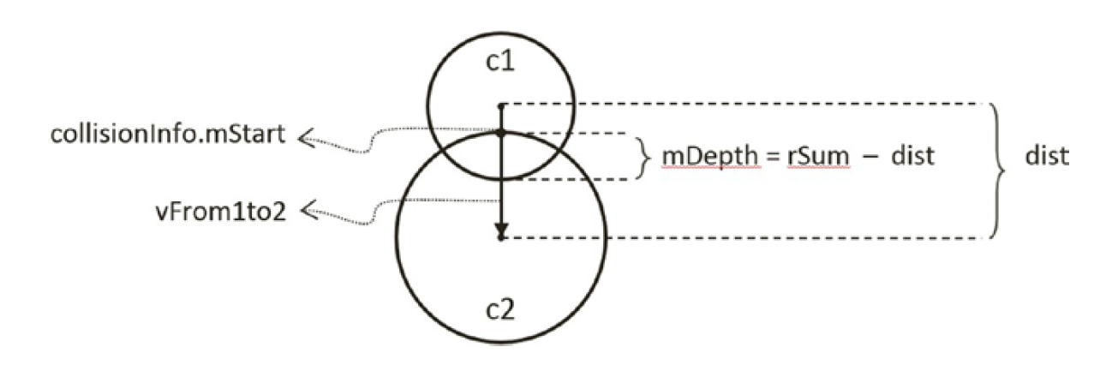
Example 3.2: Record the Collision Information
Basic idea

Slide 11
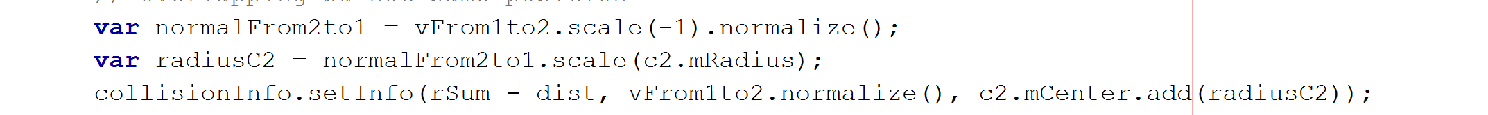
Collision Information: circle/circle
vFrom1to2
radiusC2
C2
C1
Information is meant for C1

Slide 12
Example 3.2: Source code
Physics.collision()
boundTest() before collisionTest()
Not all collisionTest() are implemented
Rectangle: not supported at all
Only Circle works for now

Slide 13
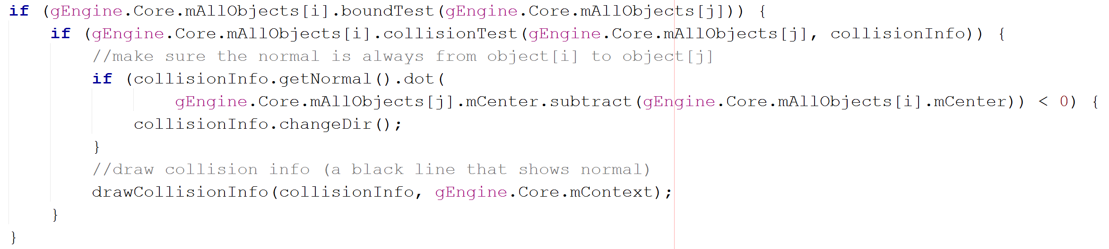
Examine the Physics: collision source code
Ensure always from i towards j
??

Slide 14
Examine the Physics: collision source code
Ensure from i towards j:
Obj-j
Obj-i

