Slide 1
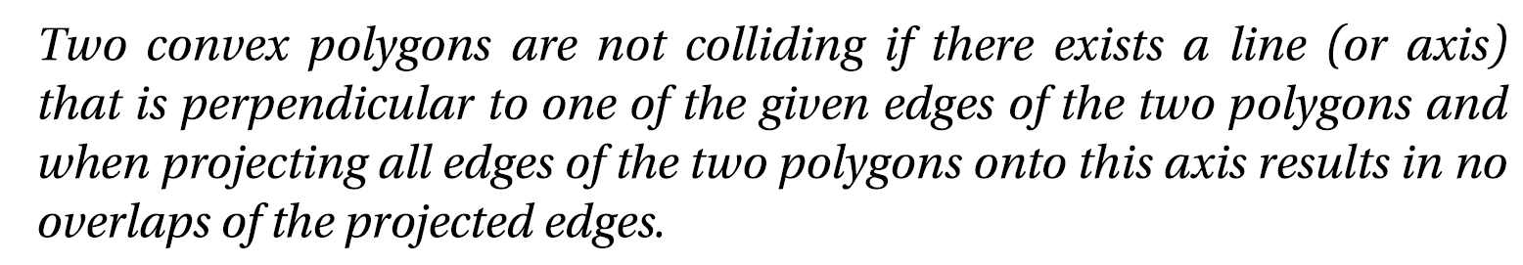
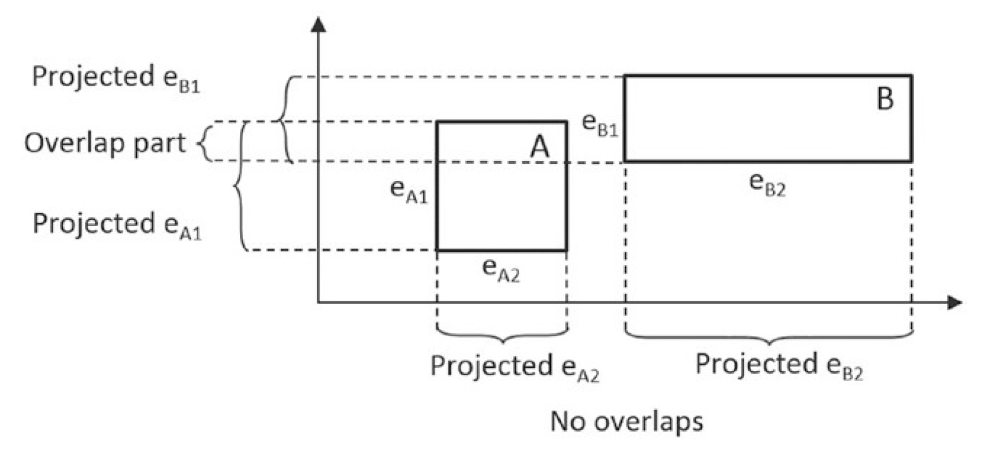
Separating Axis Theorem (SAT)

Slide 2
SAT …
Iterate through ALL face normal
Define a line
Project all edges onto the line
If no overlaps in the projected segements
➔ Conclusion: no collision
Early termination!
If reach the end
Collision

Slide 3
How to resolve overlap?
Pay attention to the overlaps

Slide 4
How to resolve overlap?

Slide 5
“push out” (along Axis direction)

Slide 6
Can we resolve based on other edges/axes?

Slide 7
Can we resolve based on other edges/axes?

Slide 9
Interesting? Does not quite work?
Notice that … Always push “the other”
Resolved polygon no longer collided with the edge!
But pushed too far!
Two observations:
First. Per-edge operation!!
Resolve in the direction of the axis

Slide 10
Support Point: Efficient SAT Implementation
Given two convex polygons: A and B
Support Point
For an edge on A (will use the edge normal) [faceNormal]
For each Vertex on B
Vertex-i on B is a support point for an edge-e on A when
Vertex-i has the MOST NEGATIVE distance from edge-e
Distance measured along the face normal of edge-e
Associated distance: support point distance
Note:
Support point relationship changes for each frame!!

Slide 11
Find all the support points

Slide 12
Find all the support points
Edge-e on A
Vertex-i on B
Distance measured along face normal of Edge-e
Edge-e and face normal

Slide 13
Find all the support points
Edge-e on A
Vertex-i on B
Distance measured along face normal of Edge-e
Edge and face normal
Vertex-i

Slide 14
Find all the support points
Edge-e on A
Vertex-i on B
Distance measured along face normal of Edge-e
Edge and face normal
Vertex-i
Distance measured along face normal
(negative number)

Slide 15
Support point?
Edge-e on A
Vertex-i on B
Distance measured along face normal of Edge-e
Edge and face normal
Vertex-i
Distance measured along face normal
(negative number)

Slide 16
Support point?
Edge-e on A
Vertex-i on B
Distance measured along face normal of Edge-e
Support point is the MOST negative!
Edge and face normal
Vertex-i
Distance measured along face normal
(negative number)

Slide 17
What about this edge?
Edge-e on A
Vertex-i on B
Distance measured along face normal of Edge-e
Support point is the MOST negative!
Edge-e and face normal

Slide 18
What about this edge?
Edge-e on A
Vertex-i on B
Distance measured along face normal of Edge-e
Support point is the MOST negative!
Edge-e and face normal

Slide 19
What about this edge?
This distance is positive?!
Edge-e on A
Vertex-i on B
Distance measured along face normal of Edge-e
Support point is the MOST negative!
Edge-e and face normal

Slide 20
What about this edge?
This distance is positive?!
Edge-e on A
Vertex-i on B
Distance measured along face normal of Edge-e
Support point is the MOST negative!
Edge-e and face normal

Slide 21
Find all the support points

Slide 22
Axis of least penetration

Slide 23
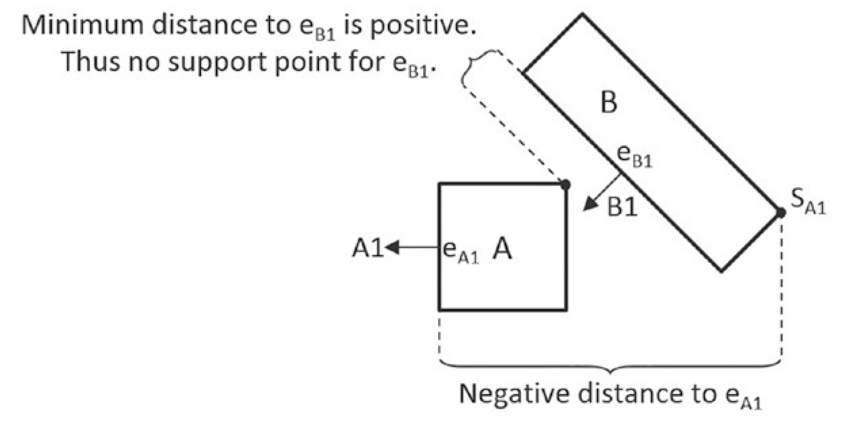
No Support Point:
Vertex-i on B is a support point for an edge-e on A when
Vertex-i has the MOST NEGATIVE distance from edge-e
Distance measured along the normal of edge-e
For edge e_{B1:} no support point
Because A is entirely in front of B
➔ No support points: DO NOT collide
Early termination!
As soon as we find an edge without support points
Implementation note:
Support Distance:
measured along negative normal direction

Slide 24
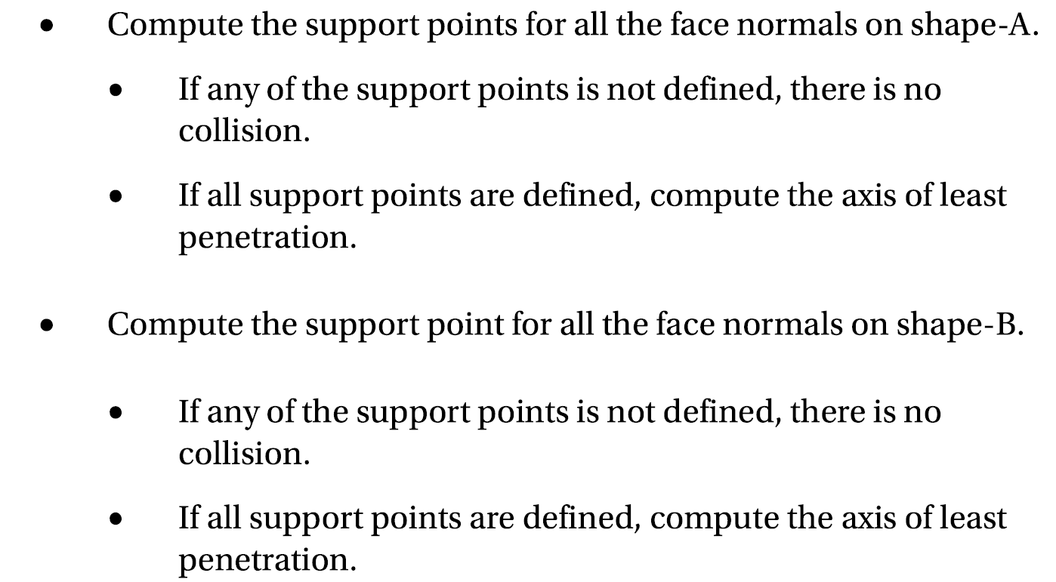
SAT Implementation with Support Point

