Slide 1
Chapter 4

Slide 2
Goals
Approximate integrals
Euler’s Method and Symplectic Euler Integration
Approximate Newtonian motion with Symplectic Euler Integration
Resolve Interpenetration
Respond to collisions that resemble the real world

Slide 3
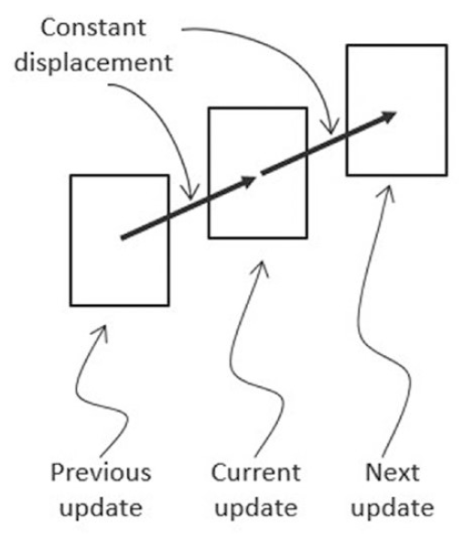

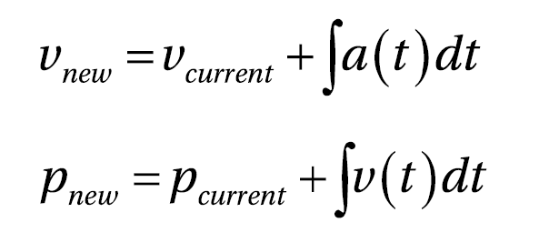
Movement
What we have been doing
What we are approximating

Slide 4
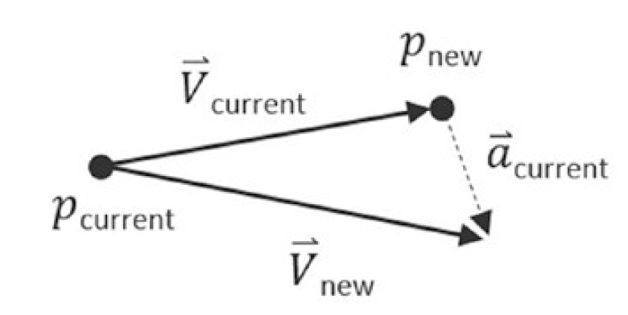
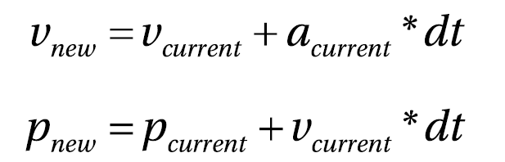
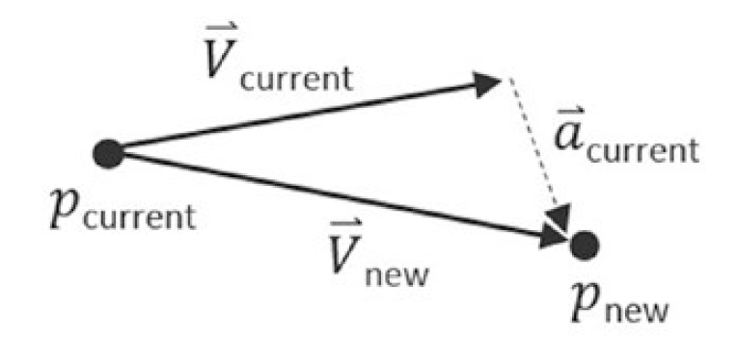
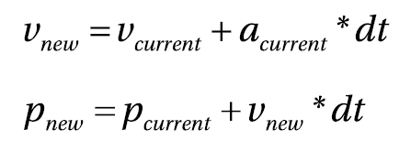
Approximating Integrals
Explicit Euler Integration
Symplectic Euler Integration

Slide 5
Approximating Integrals
Explicit Euler Integration
Symplectic Euler Integration

Slide 6
Newtonian Physical Attributes
Mass: amount of matter in an object, or how dense an object is.
Force: interaction or energy imparted on an object that will change the motion of that object.
Relative Velocity: difference in velocity between two travel shapes.
Coefficient of Restitution: the ratio of relative velocity after and before a collision. This is a measure of how much of the kinetic energy remains for the object to rebound from one another, or, bounciness.
Coefficient of Friction: a number that describes the ratio of the force of friction between two bodies. In your very simplistic implementation, friction is applied directly to slow down linear motion or rotation.
Impulse: accumulated force over time that can cause a change in the velocity. For example, resulting from a collision.

Slide 7
Newtonian Linear vs Rotation Mechanics
Displacement: rotation
Velocity: angular velocity
Force: torque
Mass: rotational inertia
rotational inertia is also known as the angular mass, or rotational inertia
determines the torque needed for a desired angular acceleration about a rotational axis
Derived based on Mass and shape geometry
https://en.wikipedia.org/wiki/List_of_moments_of_inertia

Slide 8
4.1. RigidShape Movement Project
Movement based on Symplectic Euler Integration
Complete RigidShape class with all physical attributes

Slide 9
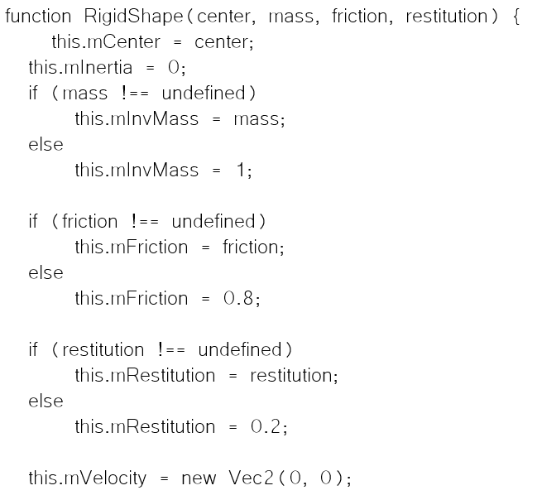
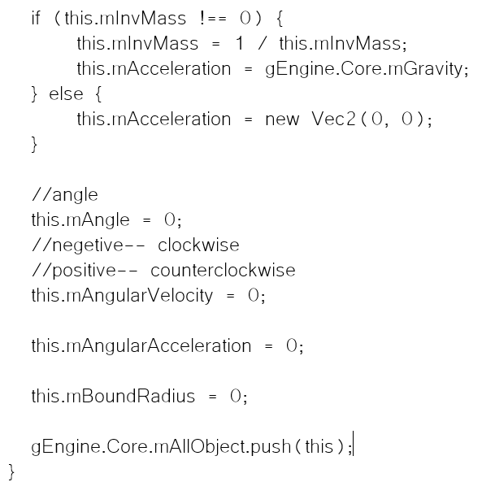
RigidShape class:

Slide 10
RigidShape class:
Keep track of 1/Mass (simpler).
Convention: invMass of zero means shape is stationary

Slide 11
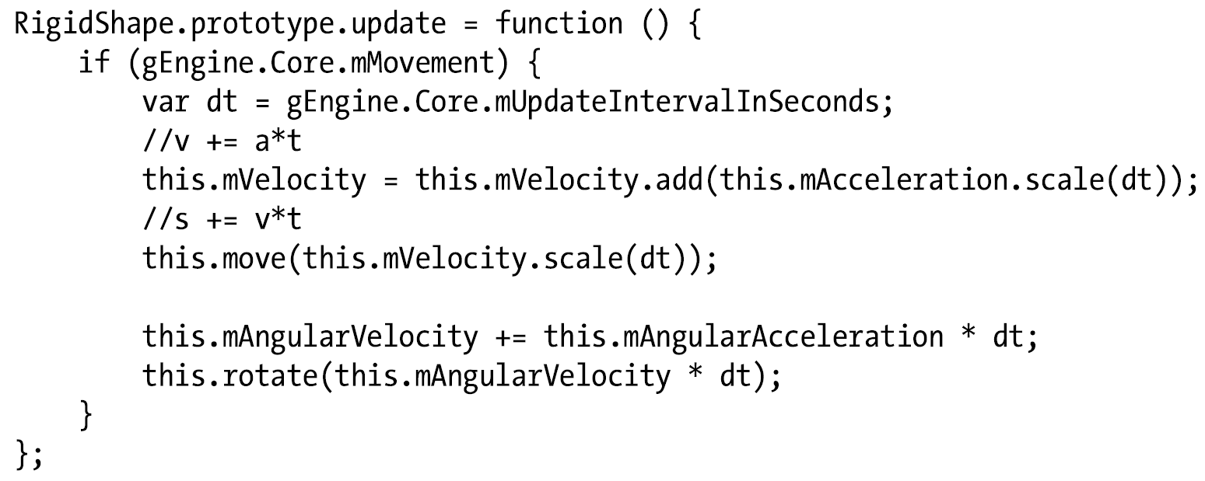
RigidShape Symplectic Euler Integration

Slide 12
RigidShape Symplectic Euler Integration
Use updated velocity to compute displacements
Use updated velocity to compute displacement

Slide 13
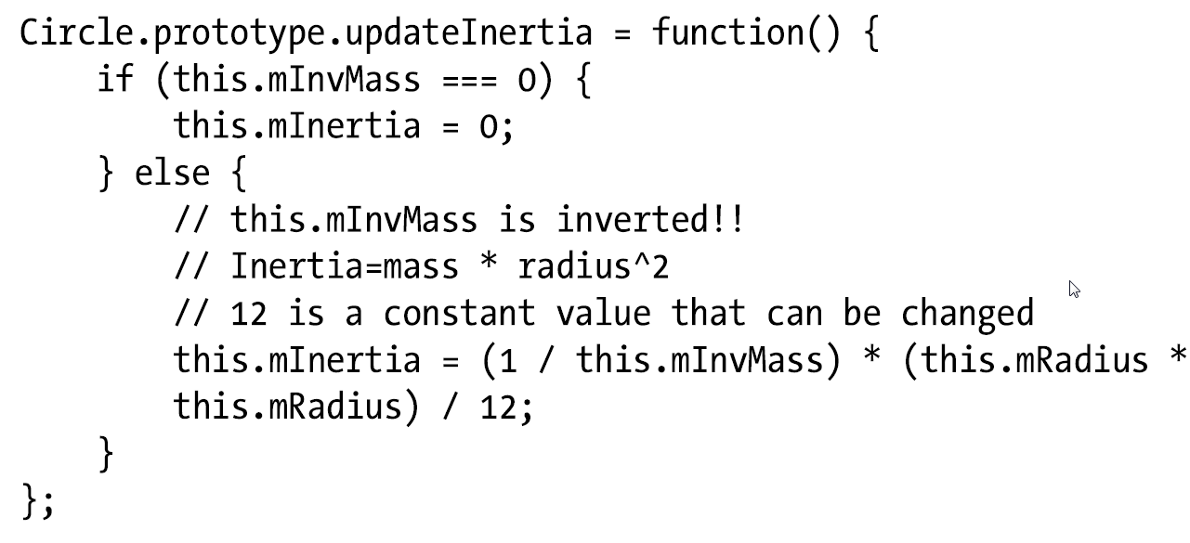
Circle: Update Inertial
Must be called after changing Mass:

Slide 14
Circle: Update Inertial
Must be called after changing Mass:
Assumes:
Mass uniformly distributed over the entire circle
Axis of rotation is at circle center
slows down circle’s rotation (arbitrarily, chose 12, because it looks nice!)

Slide 15
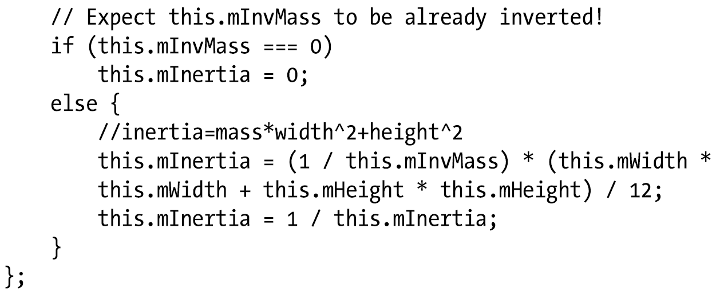
Rectangle: update intertia
Must be called after changing the Mass

Slide 16
Rectangle: update intertia
Must be called after changing the Mass
Assumes:
Mass uniformly distributed over the entire circle
Axis of rotation is at circle center

Slide 17
Run Example 4.1
All shapes now moves
Cool?

Slide 18
Resolving Interpenetrations
Projection Method
Simply displace objects by depth of collision (in the CollisionInfo)
Lack stability, may result in oscillation when there are clustered of shapes
Works well for simple cases: E.g., Pong Game (no cluster of objects can occur)
Impulse Method
Compute repulsive impulses based on object velocities to move in opposite directions
Slows down moving objects rapidly (damping from transfer of momentum)
Penalty Method
Models the compression of a spring based on collision depth

Slide 19
Our implementation
Projection + Impulse
Displace + transfer of momentum
Two step process: makes intuitive sense
Penalty Method: complex
Projection stability
Relaxation Loop: graduate disengalement rather than sudden push!
Relaxation iteration
E.g., Iterates 15 times, resolve 80% of interpenetration at each iteration

Slide 20
4.2: Positional Correction Project
How to work with computed CollisionInfo
Relaxation iteration for Projection Method

Slide 21
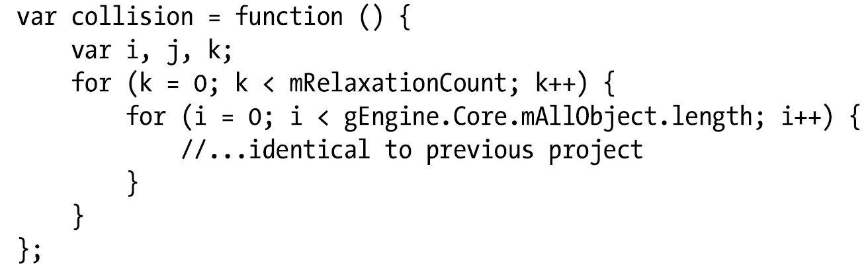
Implementation: Physics.js
Include an outer relaxation loop (index-k)

Slide 22
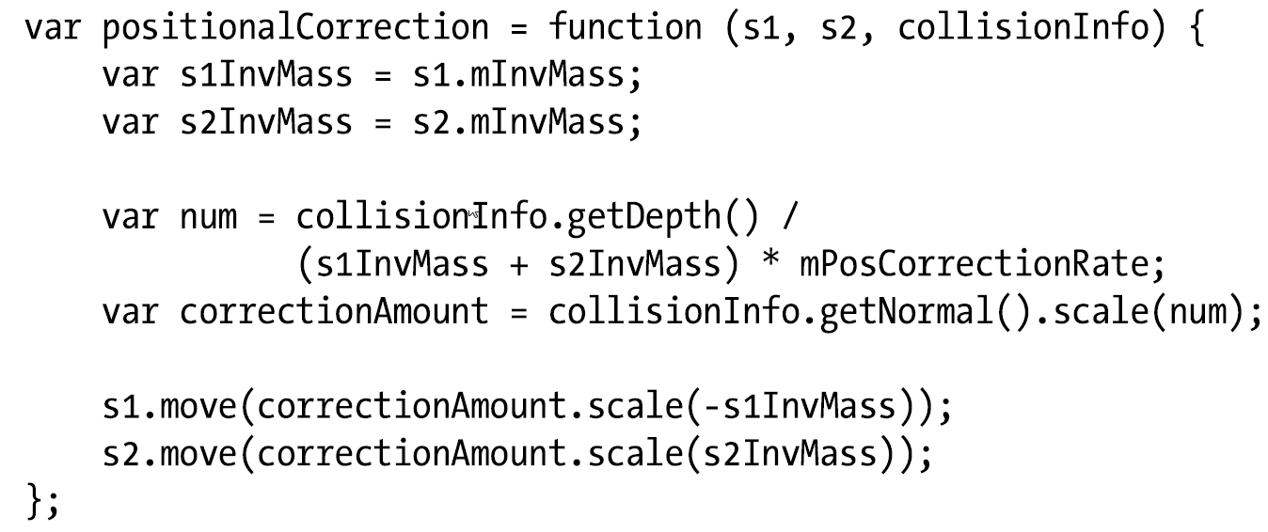
Positional Correction

Slide 23
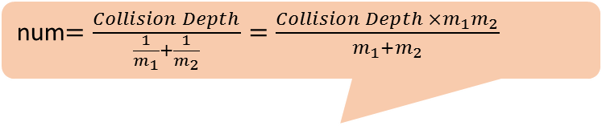
Positional Correction
num$=\frac{Collision Depth}{\frac{1}{m_{1}}+\frac{1}{m_{2}}}=\frac{Collision Depth ×m_{1}m_{2}}{m_{1}+m_{2}}$
80% of the depth
Collision Normal: from s1 towards s2

Slide 24
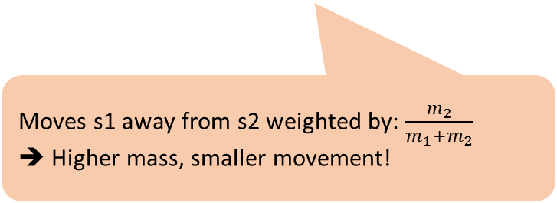
Positional Correction
num$=\frac{Collision Depth}{\frac{1}{m_{1}}+\frac{1}{m_{2}}}=\frac{Collision Depth ×m_{1}m_{2}}{m_{1}+m_{2}}$
80% of the depth
Collision Normal: from s1 towards s2
Moves s1 away from s2 weighted by: $\frac{m_{2}}{m_{1}+m_{2}}$
➔ Higher mass, smaller movement!

Slide 25
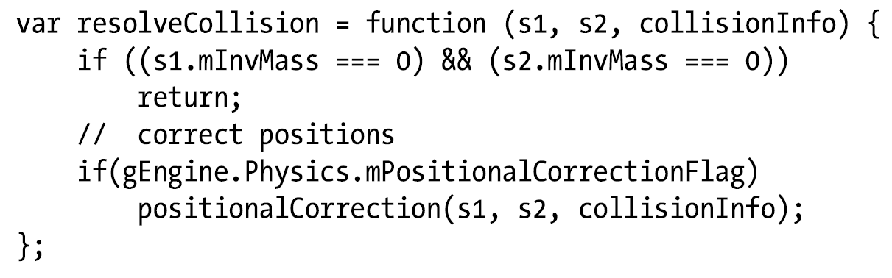
Resolve Collision

Slide 26
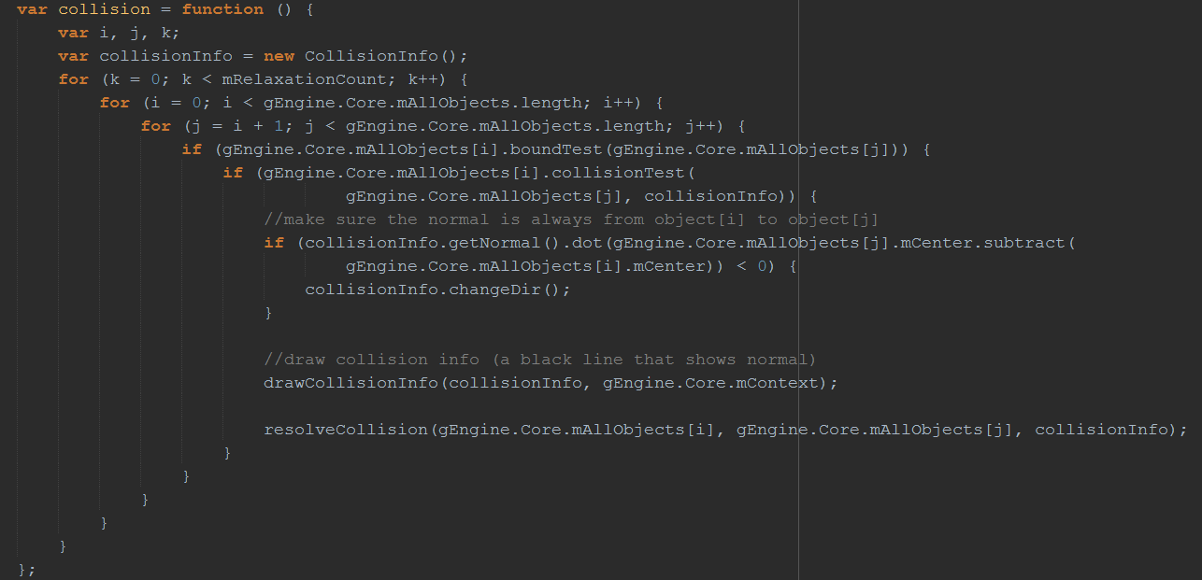
Calling resolve collision …

Slide 27
Calling resolve collision …
Relaxation iteration

Slide 28
Calling resolve collision …
Relaxation iteration
All shape objects

Slide 29
Calling resolve collision …
Relaxation iteration
All shape objects
Broad phase

Slide 30
Calling resolve collision …
Relaxation iteration
All shape objects
Broad phase
Actual collision computation

Slide 31
Calling resolve collision …
Relaxation iteration
All shape objects
Broad phase
Actual collision computation
Ensures collision normal points from s1 towards s2

Slide 32
Calling resolve collision …
Relaxation iteration
All shape objects
Broad phase
Actual collision computation
Ensures collision normal points from s1 towards s2
Draw, that should not be here!

Slide 33
Calling resolve collision …
Relaxation iteration
All shape objects
Broad phase
Actual collision computation
Ensures collision normal points from s1 towards s2
Draw, that should not be here!
Projection Method

Slide 34
Calling resolve collision …
Relaxation iteration
All shape objects
Broad phase
Actual collision computation
Ensures collision normal points from s1 towards s2
Draw, that should not be here!
Loops over 15 times per update!!
Projection Method

Slide 35
Run 4.2
Shapes movement and positional correction is under control
Cool?

Slide 36
Resolving Collision:
Projection Method
Positional Correction
Impulse Method
To repulse the colliding objects!

Slide 37
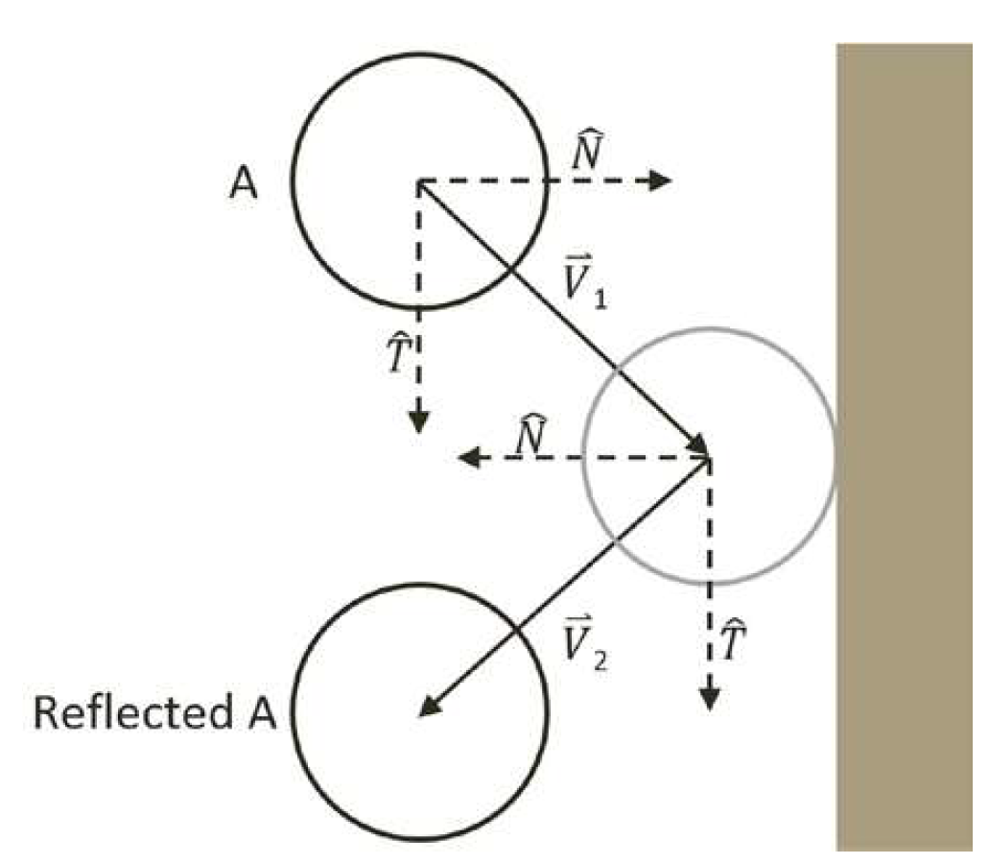

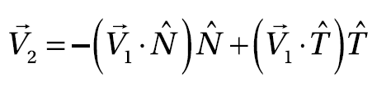
Background: decomposing vectors
True in general:
Decomposed into N/T
Reflection means: flipping N direction and keeping T direction

Slide 38
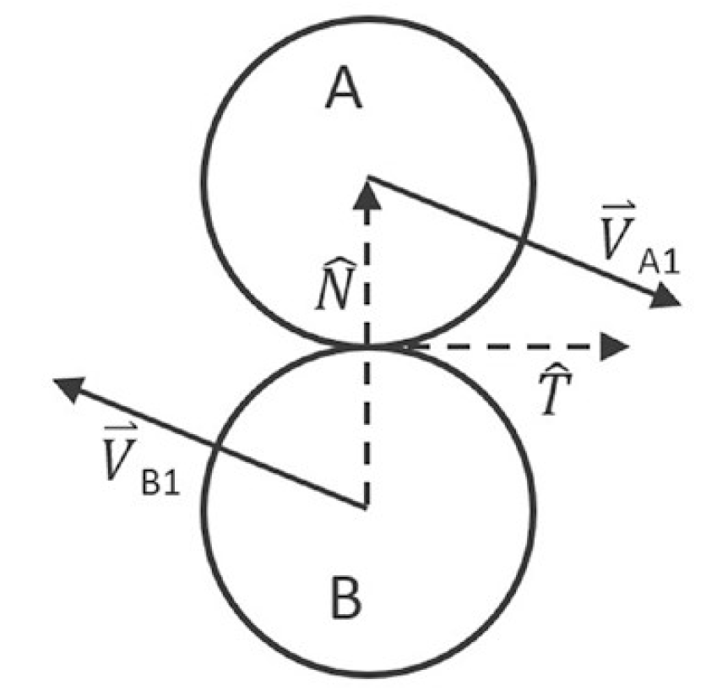

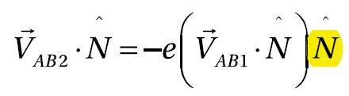
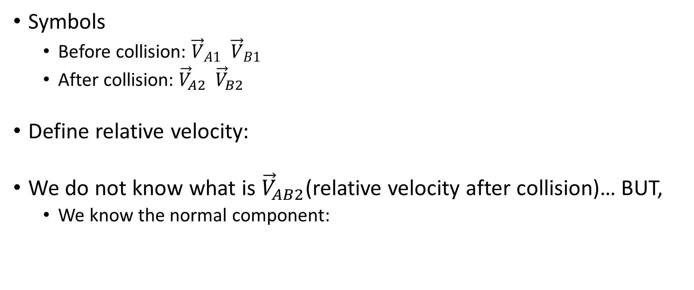
Relative Velocity
Symbols
Before collision: ${\vec{V}}_{A1} {\vec{V}}_{B1}$
After collision: ${\vec{V}}_{A2} {\vec{V}}_{B2}$
Define relative velocity:
We do not know what is ${\vec{V}}_{AB2}$(relative velocity after collision)… BUT,
We know the normal component:

Slide 39

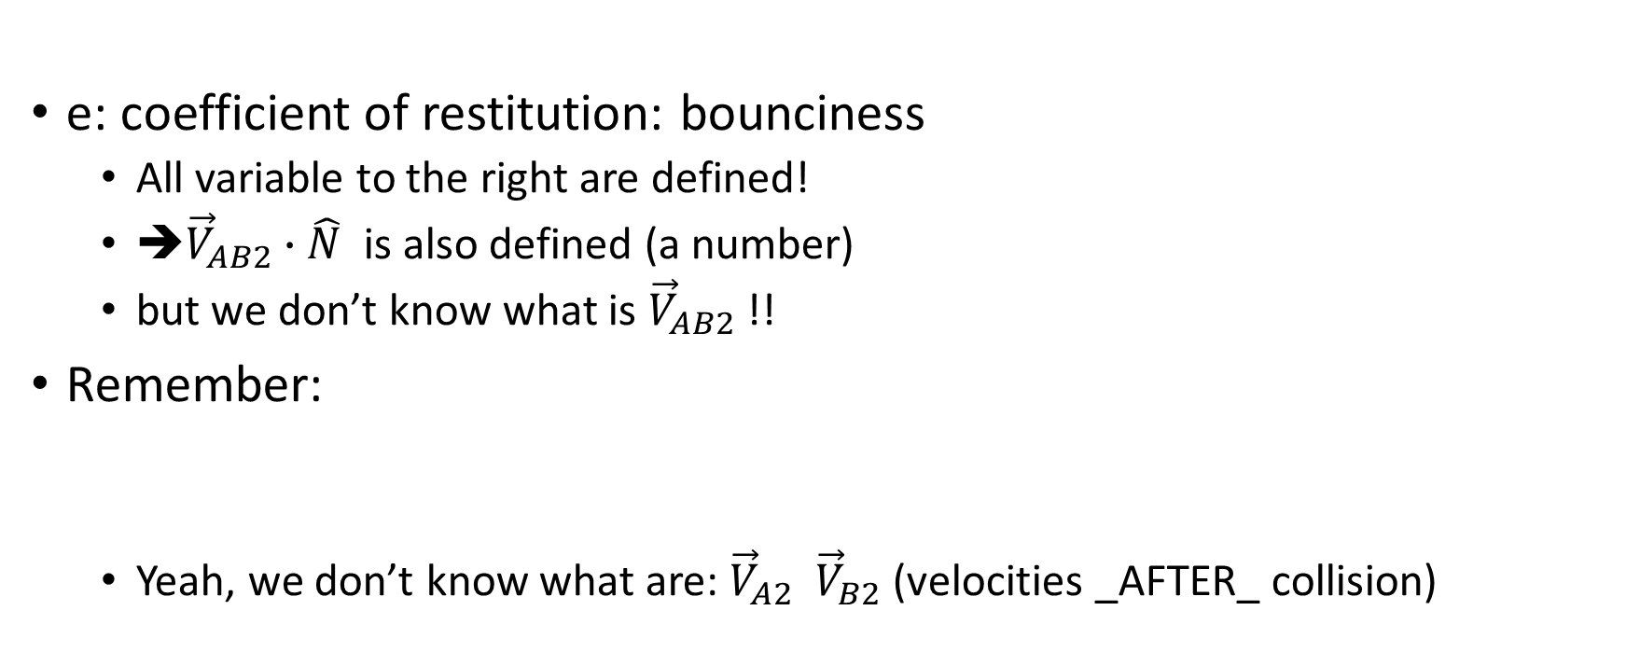
Relative Velocity after collision
e: coefficient of restitution: bounciness
All variable to the right are defined!
➔${\vec{V}}_{AB2}∙\hat{N}$ is also defined (a number)
but we don’t know what is ${\vec{V}}_{AB2}$ !!
Remember:
Yeah, we don’t know what are: ${\vec{V}}_{A2} {\vec{V}}_{B2}$ (velocities _AFTER_ collision)

Slide 40

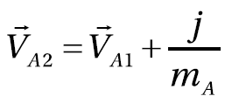

Impulse: change in momentum
Object-A with
Mass, $m_{A}$,
Traveling with velocity ${\vec{V}}_{A1}$
After collision traveling with velocity ${\vec{V}}_{A2}$
Define momentum change as impulse, j
Or,

Slide 41
Impulse: change in momentum
Object-A with
Mass, $m_{A}$,
Traveling with velocity ${\vec{V}}_{A1}$
After collision traveling with velocity ${\vec{V}}_{A2}$
Define momentum change as impulse, j
Or,
Says, change in velocity is inversely proportional to mass. The heavier, the less change!

Slide 42
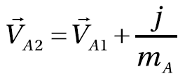
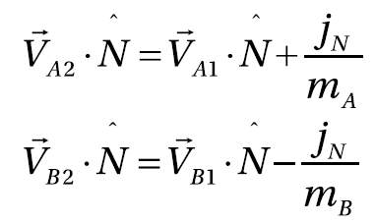
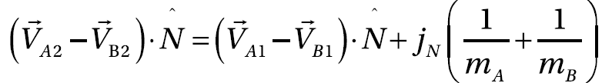
Work with impulse …
We know:
In the normal direction and
Relative velocity after collision (in the normal direction)
But, we know:

Slide 43
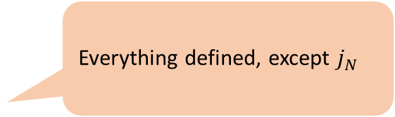
Work with impulse …
We know:
In the normal direction and
Relative velocity after collision (in the normal direction)
But, we know:
Everything defined, except $j_{N}$

Slide 44
Work with impulse …
We know:
In the normal direction and
Relative velocity after collision (in the normal direction)
But, we know:
Everything defined, except $j_{N}$
Everything is defined

Slide 45
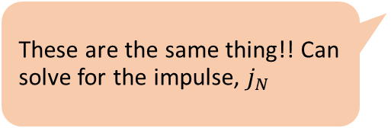
Work with impulse …
We know:
In the normal direction and
Relative velocity after collision (in the normal direction)
But, we know:
Everything defined, except $j_{N}$
These are the same thing!! Can solve for the impulse, $j_{N}$
Everything is defined
Everything is defined

Slide 46
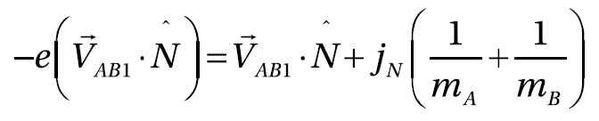
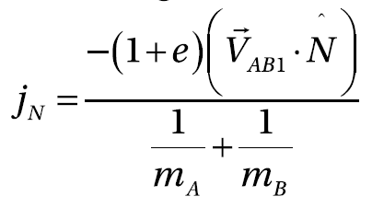
Solving for the impulse
Relative velocity derived from impulse equations
Relative velocity based on arbitrary bounciness
Says:
OR

Slide 47
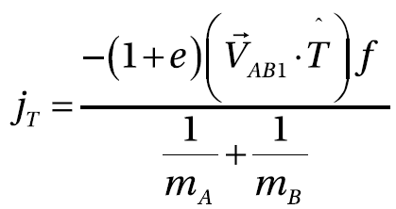
Impulse in Normal and Tangent directions
Normal:
Tangent:
Assuming f is friction coefficient

Slide 48
Implementation
Step A: make sure at least one of the colliding shapes is not static
an inverse mass that is not equal to 0
Step B: positional correction with relaxation iterations
Step C: compute relative velocity
Step D: compute the Normal and Tangent components of the relative velocity
Normal component indicates how rapidly the two shapes are moving toward or away
Positive value: the shapes are moving away from each and impulse response will not be necessary.
Remember, the two are already not interpenetrating at this point (taken care of in Step B)
Step E/F: compute the impulse in the normal and tangent directions
Step G: apply impulses

Slide 49
4.3: Collision Impulse Project
To understand the details of Impulse Method computations
To build a system that resolves the collision between colliding shapes

Slide 50
All in Physics.js
Relaxation iteration
All shape objects
Broad phase
Actual collision computation
Ensures collision normal points from s1 towards s2
Draw, that should not be here!
Projection Method

Slide 51
All in Physics.js
Projection Method + Impulse

Slide 52
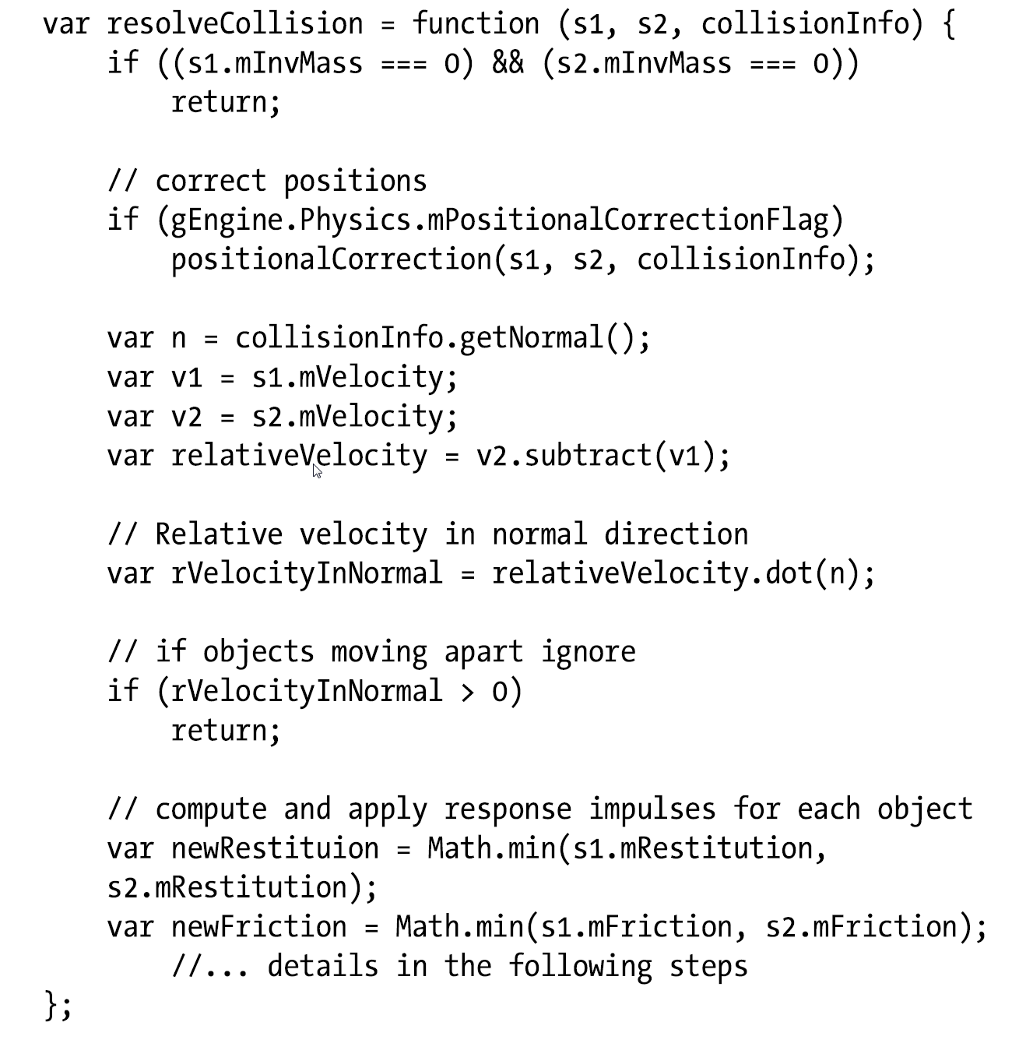
resolveCollision

Slide 53
resolveCollision
Only if both are non-static

Slide 54
resolveCollision
Only if both are non-static
Projection Method

Slide 55
resolveCollision
Only if both are non-static
Projection Method
Relative velocity

Slide 56
resolveCollision
Only if both are non-static
Projection Method
Relative velocity
Normal component of relative velocity!

Slide 57
resolveCollision
Only if both are non-static
Projection Method
Relative velocity
Normal component of relative velocity!
Use min of the two, a choice

Slide 58
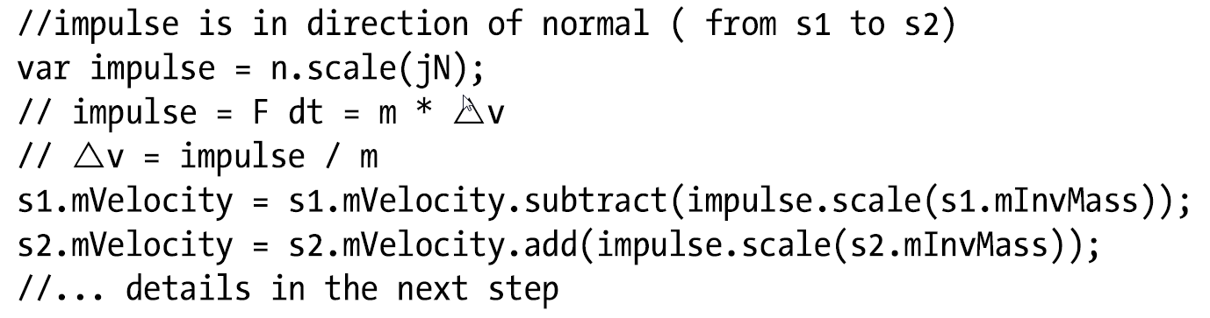
Computing and using impulse

Slide 59
Computing and using impulse
Remember: n is collision normal (point fom S1 to S2)
Velocity change is inversely proportional to mass, the heavier, the less change ☺!

Slide 60
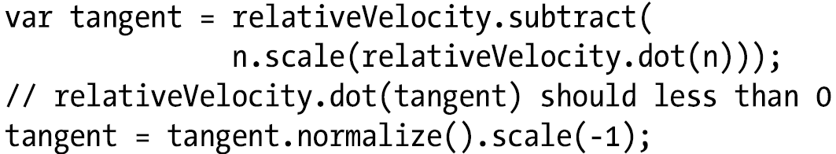
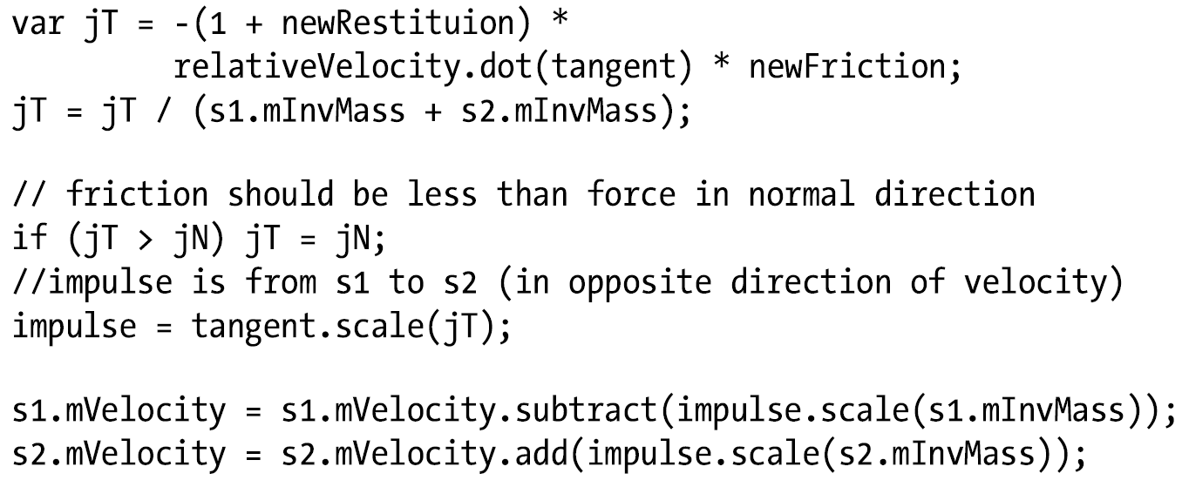
Work on the tangent direction

Slide 61


Work on the tangent direction
B
$$\hat{n}$$
Complete the diagram based on the above code
$\overset{⃑}{V}$_{AB1}
A

Slide 62

Work on the tangent direction
tangent
B
$$\hat{n}$$
$\overset{⃑}{V}$_{AB1}
relativeVelocity.dot(n)
A

Slide 63
Work on the tangent direction

Slide 64
Run 4.3
Collision and linear responses …
Need the shapes to rotate!

Slide 65
Newtonian Linear vs Rotation Mechanics
Displacement: rotation
Velocity: angular velocity (a vector perpendicular to Velocity!)
Force: torque
Mass: rotational inertia
rotational inertia is also known as the angular mass, or rotational inertia
determines the torque needed for a desired angular acceleration about a rotational axis
Derived based on Mass and shape geometry
https://en.wikipedia.org/wiki/List_of_moments_of_inertia

Slide 66
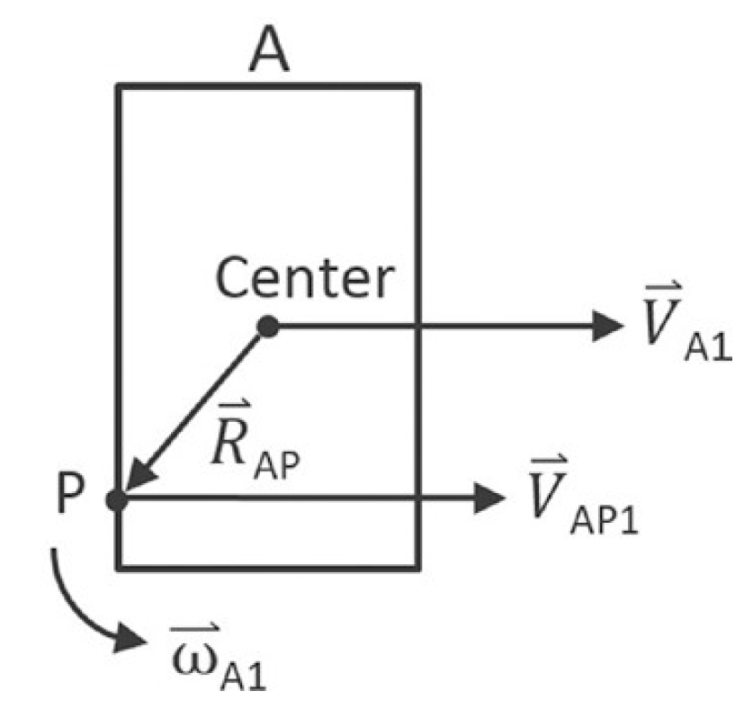
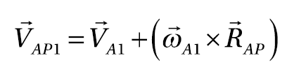

Support for rotation …
Velocity on the shape is positional dependent!
Angular velocity is a vector that is perpendicular to the linear velocity.
$\vec{ω}$ is a vector in the z direction since objects rotate around their center of mass

Slide 67
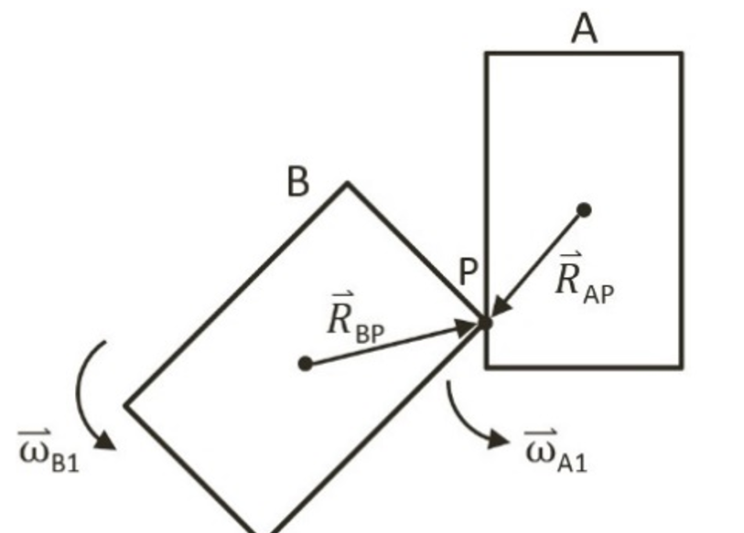

Angular velocity before and after collision
Linear velocity: ${\vec{V}}_{A2}={\vec{V}}_{A1}$+$\frac{j}{m_{A}}={\vec{V}}_{A1}$+$\frac{j_{N}}{m_{A}}\hat{N}$+$\frac{j_{T}}{m_{A}}\hat{T}$
Angular velocity: I is inertia
${\vec{ω}}_{A2}={\vec{ω}}_{A1}+\left({\vec{R}}_{AP}×\hat{N}\right)\frac{j_{N}}{I_{A}}+\left({\vec{R}}_{AP}×\hat{T}\right)\frac{j_{T}}{I_{A}}$
${\vec{ω}}_{B2}={\vec{ω}}_{B1}+\left({\vec{R}}_{AP}×\hat{N}\right)\frac{j_{N}}{I_{B}}+\left({\vec{R}}_{AP}×\hat{T}\right)\frac{j_{T}}{I_{B}}$

Slide 68
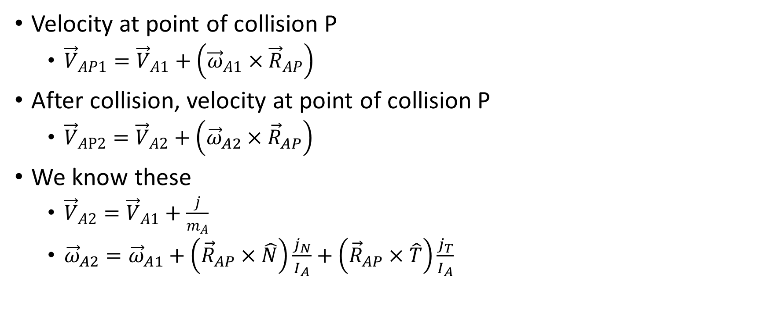
Listing out everything we know so far
Velocity at point of collision P
${\vec{V}}_{AP1}={\vec{V}}_{A1}+\left({\vec{ω}}_{A1}×{\vec{R}}_{AP}\right)$
After collision, velocity at point of collision P
${\vec{V}}_{AP2}={\vec{V}}_{A2}+\left({\vec{ω}}_{A2}×{\vec{R}}_{AP}\right)$
We know these
${\vec{V}}_{A2}={\vec{V}}_{A1}+\frac{j}{m_{A}}$
${\vec{ω}}_{A2}={\vec{ω}}_{A1}+\left({\vec{R}}_{AP}×\hat{N}\right)\frac{j_{N}}{I_{A}}+\left({\vec{R}}_{AP}×\hat{T}\right)\frac{j_{T}}{I_{A}}$

Slide 69
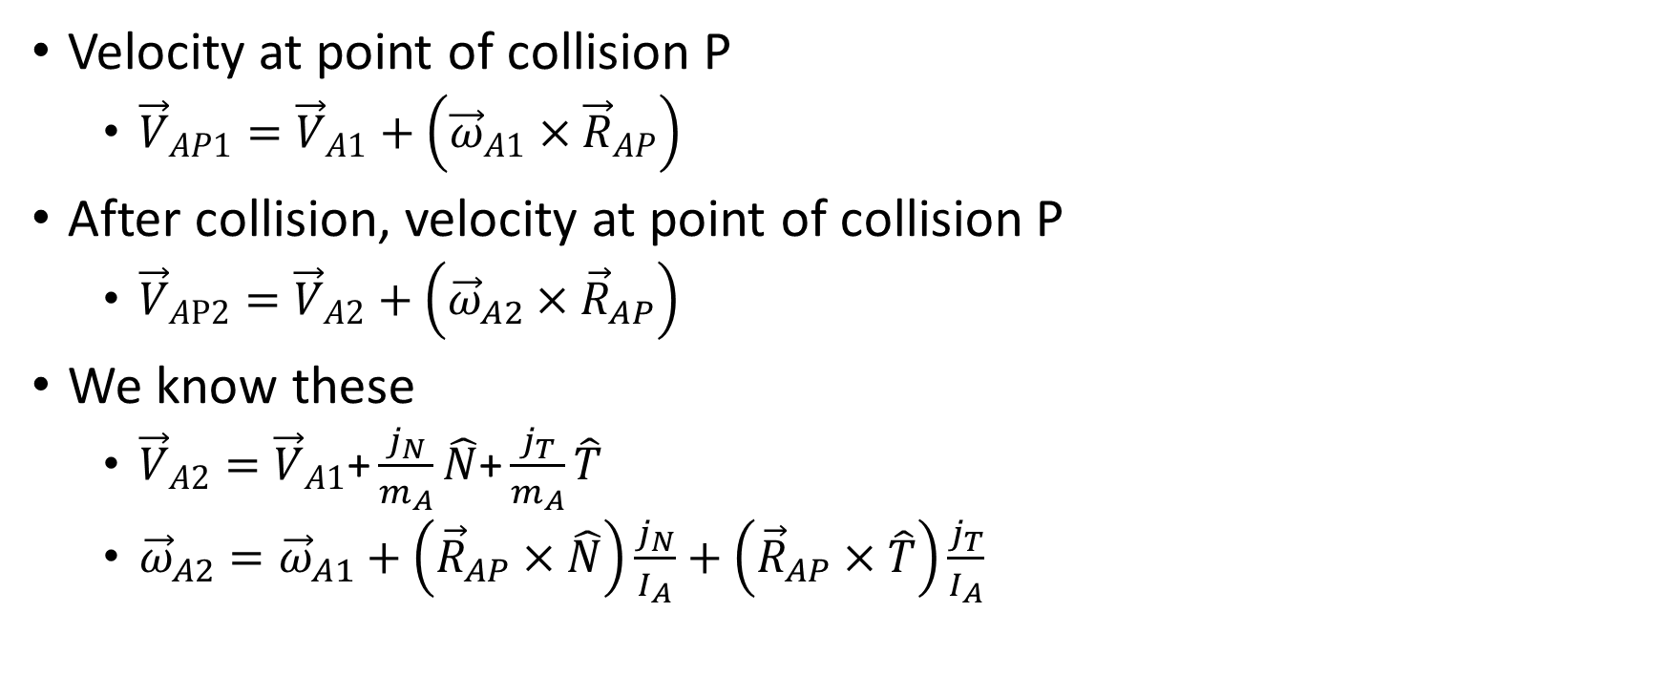
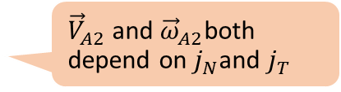
Listing out everything we know so far
Velocity at point of collision P
${\vec{V}}_{AP1}={\vec{V}}_{A1}+\left({\vec{ω}}_{A1}×{\vec{R}}_{AP}\right)$
After collision, velocity at point of collision P
${\vec{V}}_{AP2}={\vec{V}}_{A2}+\left({\vec{ω}}_{A2}×{\vec{R}}_{AP}\right)$
We know these
${\vec{V}}_{A2}={\vec{V}}_{A1}\text{+}\frac{j_{N}}{m_{A}}\hat{N}\text{+}\frac{j_{T}}{m_{A}}\hat{T}$
${\vec{ω}}_{A2}={\vec{ω}}_{A1}+\left({\vec{R}}_{AP}×\hat{N}\right)\frac{j_{N}}{I_{A}}+\left({\vec{R}}_{AP}×\hat{T}\right)\frac{j_{T}}{I_{A}}$
All given
${\vec{V}}_{A2}$ and ${\vec{ω}}_{A2}$both depend on $j_{N}$and $j_{T}$

Slide 70
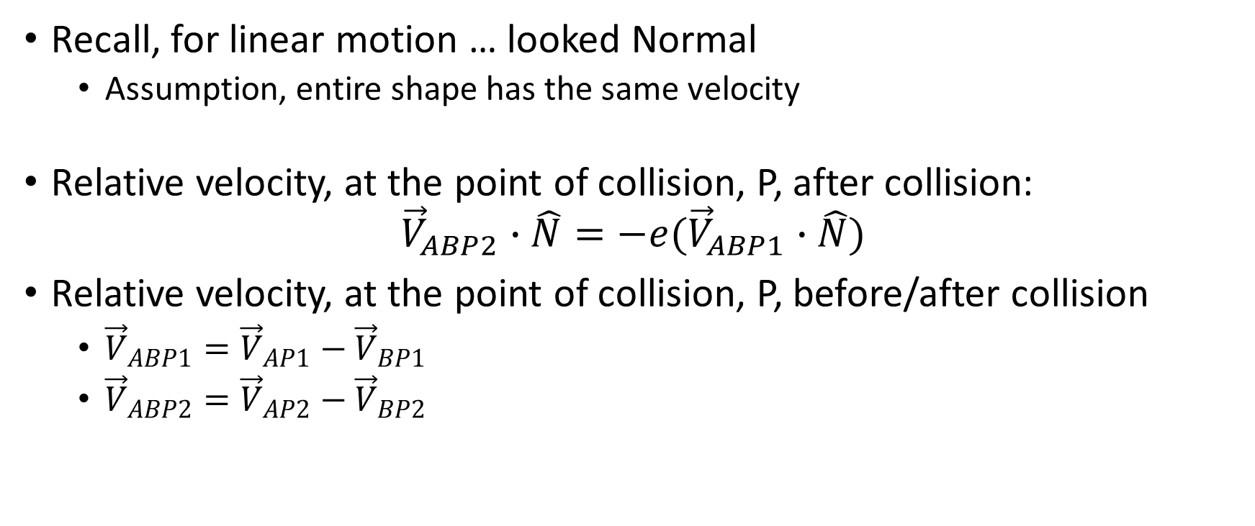
Normal component … again!
Recall, for linear motion … looked Normal
Assumption, entire shape has the same velocity
Relative velocity, at the point of collision, P, after collision: ${\vec{V}}_{ABP2}∙\hat{N}=−e({\vec{V}}_{ABP1}∙\hat{N})$
Relative velocity, at the point of collision, P, before/after collision
${\vec{V}}_{ABP1}={\vec{V}}_{AP1}−{\vec{V}}_{BP1}$
${\vec{V}}_{ABP2}={\vec{V}}_{AP2}−{\vec{V}}_{BP2}$

Slide 71
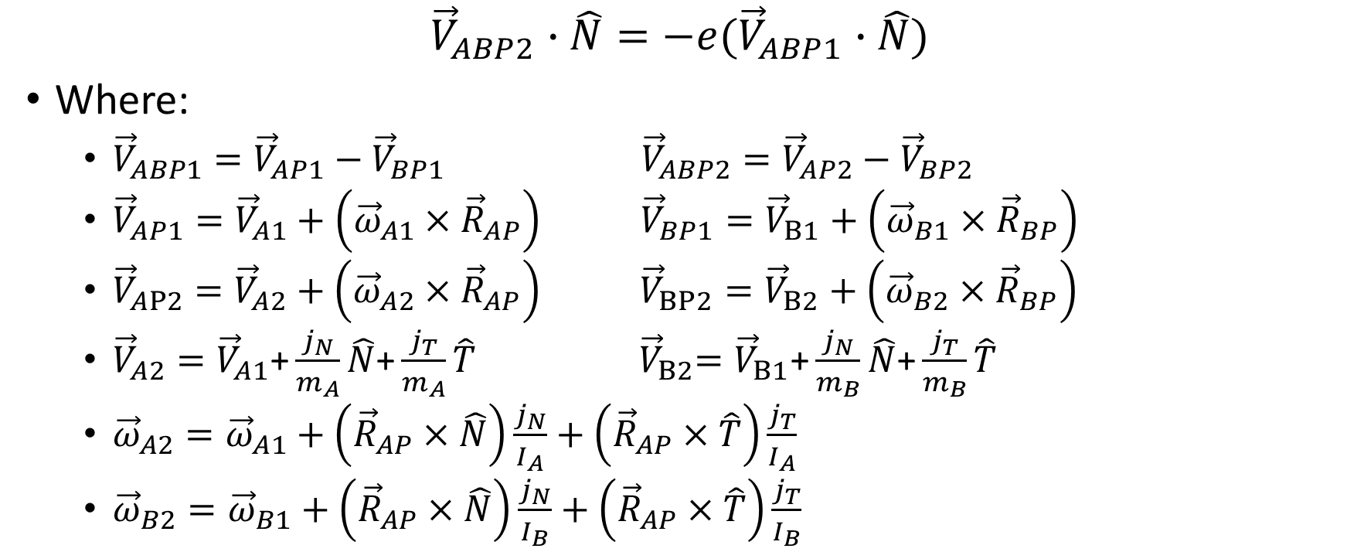
Compute for impulse …
$${\vec{V}}_{ABP2}∙\hat{N}=−e({\vec{V}}_{ABP1}∙\hat{N})$$
Where:
${\vec{V}}_{ABP1}={\vec{V}}_{AP1}−{\vec{V}}_{BP1} {\vec{V}}_{ABP2}={\vec{V}}_{AP2}−{\vec{V}}_{BP2}$
${\vec{V}}_{AP1}={\vec{V}}_{A1}+\left({\vec{ω}}_{A1}×{\vec{R}}_{AP}\right) {\vec{V}}_{BP1}={\vec{V}}_{B1}+\left({\vec{ω}}_{B1}×{\vec{R}}_{BP}\right)$
${\vec{V}}_{AP2}={\vec{V}}_{A2}+\left({\vec{ω}}_{A2}×{\vec{R}}_{AP}\right) {\vec{V}}_{BP2}={\vec{V}}_{B2}+\left({\vec{ω}}_{B2}×{\vec{R}}_{BP}\right)$
${\vec{V}}_{A2}={\vec{V}}_{A1}\text{+}\frac{j_{N}}{m_{A}}\hat{N}\text{+}\frac{j_{T}}{m_{A}}\hat{T}$ ${ \vec{V}}_{B2}={\vec{V}}_{B1}\text{+}\frac{j_{N}}{m_{B}}\hat{N}\text{+}\frac{j_{T}}{m_{B}}\hat{T}$
${\vec{ω}}_{A2}={\vec{ω}}_{A1}+\left({\vec{R}}_{AP}×\hat{N}\right)\frac{j_{N}}{I_{A}}+\left({\vec{R}}_{AP}×\hat{T}\right)\frac{j_{T}}{I_{A}}$
${\vec{ω}}_{B2}={\vec{ω}}_{B1}+\left({\vec{R}}_{AP}×\hat{N}\right)\frac{j_{N}}{I_{B}}+\left({\vec{R}}_{AP}×\hat{T}\right)\frac{j_{T}}{I_{B}}$

Slide 72
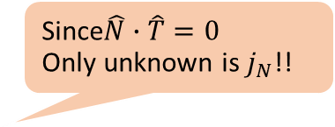
Compute for impulse …
$${\vec{V}}_{ABP2}∙\hat{N}=−e({\vec{V}}_{ABP1}∙\hat{N})$$
Where:
${\vec{V}}_{ABP1}={\vec{V}}_{AP1}−{\vec{V}}_{BP1} {\vec{V}}_{ABP2}={\vec{V}}_{AP2}−{\vec{V}}_{BP2}$
${\vec{V}}_{AP1}={\vec{V}}_{A1}+\left({\vec{ω}}_{A1}×{\vec{R}}_{AP}\right) {\vec{V}}_{BP1}={\vec{V}}_{B1}+\left({\vec{ω}}_{B1}×{\vec{R}}_{BP}\right)$
${\vec{V}}_{AP2}={\vec{V}}_{A2}+\left({\vec{ω}}_{A2}×{\vec{R}}_{AP}\right) {\vec{V}}_{BP2}={\vec{V}}_{B2}+\left({\vec{ω}}_{B2}×{\vec{R}}_{BP}\right)$
${\vec{V}}_{A2}={\vec{V}}_{A1}\text{+}\frac{j_{N}}{m_{A}}\hat{N}\text{+}\frac{j_{T}}{m_{A}}\hat{T}$ ${ \vec{V}}_{B2}={\vec{V}}_{B1}\text{+}\frac{j_{N}}{m_{B}}\hat{N}\text{+}\frac{j_{T}}{m_{B}}\hat{T}$
${\vec{ω}}_{A2}={\vec{ω}}_{A1}+\left({\vec{R}}_{AP}×\hat{N}\right)\frac{j_{N}}{I_{A}}+\left({\vec{R}}_{AP}×\hat{T}\right)\frac{j_{T}}{I_{A}}$
${\vec{ω}}_{B2}={\vec{ω}}_{B1}+\left({\vec{R}}_{AP}×\hat{N}\right)\frac{j_{N}}{I_{B}}+\left({\vec{R}}_{AP}×\hat{T}\right)\frac{j_{T}}{I_{B}}$
Since$\hat{N}∙\hat{T}=0$
Only unknown is $j_{N}$!!

Slide 73

Impulses that supporting rotation
$j_{N}=\frac{−(1+e)\left({\vec{V}}_{AB1}∙\hat{N}\right)}{\frac{1}{m_{A}}+\frac{1}{m_{B}}+\frac{{({\vec{R}}_{AP}×\hat{N})}^{2}}{I_{A}}+\frac{{({\vec{R}}_{BP}×\hat{N})}^{2}}{I_{B}}}$
$j_{T}=\frac{−(1+e)\left({\vec{V}}_{AB1}∙\hat{T}\right)f}{\frac{1}{m_{A}}+\frac{1}{m_{B}}+\frac{{({\vec{R}}_{AP}×\hat{T})}^{2}}{I_{A}}+\frac{{({\vec{R}}_{BP}×\hat{T})}^{2}}{I_{B}}}$

Slide 74
4-4: Angular Impulse Project
To understand the details of angular impulse
To integration rotation into your collision resolution
To complete the physics component

Slide 75
Implementation: all Physics.js!!
var resolveCollision = function (s1, s2, collisionInfo) {
//.. Check for stationary object + Positional Correction
var n = collisionInfo.getNormal();
//the direction of collisionInfo is always from s1 to s2
//but the Mass is inversed, so start scale with s2 and end scale with s1
var start = collisionInfo.mStart.scale(s2.mInvMass / (s1.mInvMass + s2.mInvMass));
var end = collisionInfo.mEnd.scale(s1.mInvMass / (s1.mInvMass + s2.mInvMass));
var p = start.add(end);
//r is vector from center of shape to collision point
var r1 = p.subtract(s1.mCenter);
var r2 = p.subtract(s2.mCenter);
// newV = V + mAngularVelocity cross R
var v1 = s1.mVelocity.add(new Vec2(-1 * s1.mAngularVelocity * r1.y,
s1.mAngularVelocity * r1.x));
var v2 = s2.mVelocity.add(new Vec2(-1 * s2.mAngularVelocity * r2.y,
s2.mAngularVelocity * r2.x));
var relativeVelocity = v2.subtract(v1);
// Relative velocity in normal direction
var rVelocityInNormal = relativeVelocity.dot(n);
…
};

Slide 76
Implementation: all Physics.js!!
var resolveCollision = function (s1, s2, collisionInfo) {
//.. Check for stationary object + Positional Correction
var n = collisionInfo.getNormal();
//the direction of collisionInfo is always from s1 to s2
//but the Mass is inversed, so start scale with s2 and end scale with s1
var start = collisionInfo.mStart.scale(s2.mInvMass / (s1.mInvMass + s2.mInvMass));
var end = collisionInfo.mEnd.scale(s1.mInvMass / (s1.mInvMass + s2.mInvMass));
var p = start.add(end);
//r is vector from center of shape to collision point
var r1 = p.subtract(s1.mCenter);
var r2 = p.subtract(s2.mCenter);
// newV = V + mAngularVelocity cross R
var v1 = s1.mVelocity.add(new Vec2(-1 * s1.mAngularVelocity * r1.y,
s1.mAngularVelocity * r1.x));
var v2 = s2.mVelocity.add(new Vec2(-1 * s2.mAngularVelocity * r2.y,
s2.mAngularVelocity * r2.x));
var relativeVelocity = v2.subtract(v1);
// Relative velocity in normal direction
var rVelocityInNormal = relativeVelocity.dot(n);
…
};

Slide 77
Implementation: all Physics.js!!
var resolveCollision = function (s1, s2, collisionInfo) {
//.. Check for stationary object + Positional Correction
var n = collisionInfo.getNormal();
//the direction of collisionInfo is always from s1 to s2
//but the Mass is inversed, so start scale with s2 and end scale with s1
var start = collisionInfo.mStart.scale(s2.mInvMass / (s1.mInvMass + s2.mInvMass));
var end = collisionInfo.mEnd.scale(s1.mInvMass / (s1.mInvMass + s2.mInvMass));
var p = start.add(end);
S2
Start
End
S1
P: a weighted Avg of Start/End
based on relative Mass of S1 and S2

Slide 78
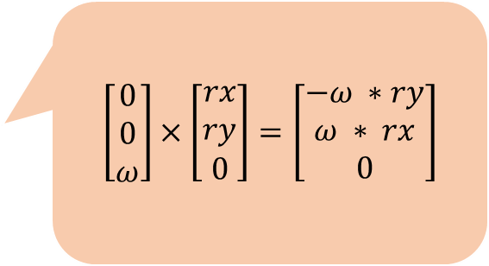
Implementation: all Physics.js!!
var resolveCollision = function (s1, s2, collisionInfo) {
//.. Check for stationary object + Positional Correction
var n = collisionInfo.getNormal();
//the direction of collisionInfo is always from s1 to s2
//but the Mass is inversed, so start scale with s2 and end scale with s1
var start = collisionInfo.mStart.scale(s2.mInvMass / (s1.mInvMass + s2.mInvMass));
var end = collisionInfo.mEnd.scale(s1.mInvMass / (s1.mInvMass + s2.mInvMass));
var p = start.add(end);
//r is vector from center of shape to collision point
var r1 = p.subtract(s1.mCenter);
var r2 = p.subtract(s2.mCenter);
// newV = V + mAngularVelocity cross R
var v1 = s1.mVelocity.add(new Vec2(-1 * s1.mAngularVelocity * r1.y,
s1.mAngularVelocity * r1.x));
var v2 = s2.mVelocity.add(new Vec2(-1 * s2.mAngularVelocity * r2.y,
s2.mAngularVelocity * r2.x));
var relativeVelocity = v2.subtract(v1);
// Relative velocity in normal direction
var rVelocityInNormal = relativeVelocity.dot(n);
…
};
$$\left[\begin{matrix}0 \\ 0 \\ ω\end{matrix}\right]×\left[\begin{matrix}rx \\ ry \\ 0\end{matrix}\right]=\left[\begin{matrix}−ω ∗ry \\ ω ∗ rx \\ 0\end{matrix}\right]$$

Slide 79
The impulse: Normal component
var newFriction = Math.min(s1.mFriction, s2.mFriction);
//R cross N var R1crossN = r1.cross(n); var R2crossN = r2.cross(n);
// Calc impulse scalar // the formula of jN can be found in http://www.myphysicslab.com/collision.html var jN = -(1 + newRestituion) * rVelocityInNormal; jN = jN / (s1.mInvMass + s2.mInvMass + R1crossN * R1crossN * s1.mInertia + R2crossN * R2crossN * s2.mInertia);
s1.mAngularVelocity -= R1crossN * jN * s1.mInertia; s2.mAngularVelocity += R2crossN * jN * s2.mInertia;

Slide 80

The impulse: Normal component
var newFriction = Math.min(s1.mFriction, s2.mFriction);
//R cross N var R1crossN = r1.cross(n); var R2crossN = r2.cross(n);
// Calc impulse scalar // the formula of jN can be found in http://www.myphysicslab.com/collision.html var jN = -(1 + newRestituion) * rVelocityInNormal; jN = jN / (s1.mInvMass + s2.mInvMass + R1crossN * R1crossN * s1.mInertia + R2crossN * R2crossN * s2.mInertia);
s1.mAngularVelocity -= R1crossN * jN * s1.mInertia; s2.mAngularVelocity += R2crossN * jN * s2.mInertia;
$$\left[\begin{matrix}rx \\ ry \\ 0\end{matrix}\right]×\left[\begin{matrix}nx \\ ny \\ 0\end{matrix}\right]=\left[\begin{matrix}0 \\ 0 \\ rx ∗ny −ry ∗nx\end{matrix}\right]$$

Slide 81

The impulse: Normal component
var newFriction = Math.min(s1.mFriction, s2.mFriction);
//R cross N var R1crossN = r1.cross(n); var R2crossN = r2.cross(n);
// Calc impulse scalar // the formula of jN can be found in http://www.myphysicslab.com/collision.html var jN = -(1 + newRestituion) * rVelocityInNormal; jN = jN / (s1.mInvMass + s2.mInvMass + R1crossN * R1crossN * s1.mInertia + R2crossN * R2crossN * s2.mInertia);
s1.mAngularVelocity -= R1crossN * jN * s1.mInertia; s2.mAngularVelocity += R2crossN * jN * s2.mInertia;
$$\left[\begin{matrix}rx \\ ry \\ 0\end{matrix}\right]×\left[\begin{matrix}nx \\ ny \\ 0\end{matrix}\right]=\left[\begin{matrix}0 \\ 0 \\ rx ∗ny −ry ∗nx\end{matrix}\right]$$

Slide 82

The impulse: Normal component
var newFriction = Math.min(s1.mFriction, s2.mFriction);
//R cross N var R1crossN = r1.cross(n); var R2crossN = r2.cross(n);
// Calc impulse scalar // the formula of jN can be found in http://www.myphysicslab.com/collision.html var jN = -(1 + newRestituion) * rVelocityInNormal; jN = jN / (s1.mInvMass + s2.mInvMass + R1crossN * R1crossN * s1.mInertia + R2crossN * R2crossN * s2.mInertia);
s1.mAngularVelocity -= R1crossN * jN * s1.mInertia; s2.mAngularVelocity += R2crossN * jN * s2.mInertia;
$$\left[\begin{matrix}rx \\ ry \\ 0\end{matrix}\right]×\left[\begin{matrix}nx \\ ny \\ 0\end{matrix}\right]=\left[\begin{matrix}0 \\ 0 \\ rx ∗ny −ry ∗nx\end{matrix}\right]$$

Slide 83

Continue with the Tangent
tangent = tangent.normalize().scale(-1);
var R1crossT = r1.cross(tangent); var R2crossT = r2.cross(tangent);
var jT = -(1 + newRestituion) * relativeVelocity.dot(tangent) * newFriction; jT = jT / (s1.mInvMass + s2.mInvMass +
R1crossT * R1crossT * s1.mInertia +
R2crossT * R2crossT * s2.mInertia);
s1.mAngularVelocity -= R1crossT * jT * s1.mInertia;
s2.mAngularVelocity += R2crossT * jT * s2.mInertia;

Slide 84
Test run 4.4
Cool eh?

