Slide 1
Nuclear waste
first version

Slide 2
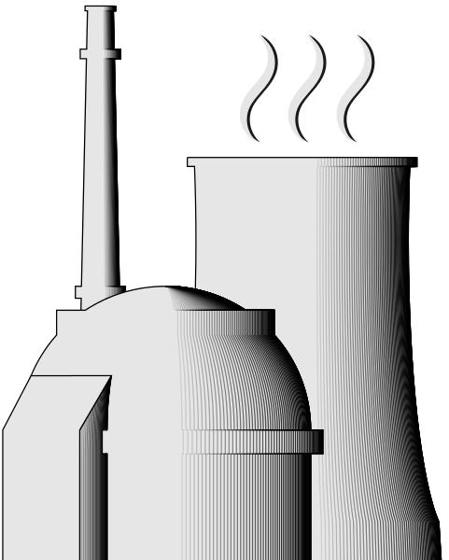
Uranium
Mining
Fuel
Production
New
Fuel
Power reactors

Slide 3
Uranium
Mining
Fuel
Production
New
Fuel
Power reactors
Mill tailings

Slide 4
Uranium
Mining
Fuel
Production
New
Fuel
Power reactors
Liquid and gaseous radioactive waste
Mill tailings
Low level waste
Waste from dismantling

Slide 5
Spent
Fuel
Uranium
Mining
Fuel
Production
New
Fuel
Power reactors
Liquid and gaseous radioactive waste
Mill tailings
Low level waste
Waste from dismantling

Slide 6
Reprocessing
Spent
Fuel
Uranium
Mining
Fuel
Production
New
Fuel
Unreprocessed fuel
Power reactors
Liquid and gaseous radioactive waste
Mill tailings
Low level waste
Waste from dismantling

Slide 7
Separated fissiles
Waste from reprocessing
Reprocessing
Spent
Fuel
Uranium
Mining
Fuel
Production
New
Fuel
Unreprocessed fuel
Power reactors
Liquid and gaseous radioactive waste
Mill tailings
Low level waste
Waste from dismantling

Slide 8
Production
of MOX/Ure fuel
Separated fissiles
Waste from reprocessing
Reprocessing
Spent
Fuel
Uranium
Mining
Fuel
Production
New
Fuel
Unreprocessed fuel
Power reactors
Liquid and gaseous radioactive waste
Mill tailings
Low level waste
Waste from dismantling

Slide 9
Production
of MOX/Ure fuel
Separated fissiles
Waste from reprocessing
Reprocessing
Depleted uranium
Spent
Fuel
Uranium
Mining
Fuel
Production
New
Fuel
Unreprocessed fuel
Power reactors
Liquid and gaseous radioactive waste
Mill tailings
Low level waste
Waste from dismantling

Slide 10
Production
of MOX/Ure fuel
Separated fissiles
Waste from reprocessing
Reprocessing
Depleted uranium
Spent
Fuel
Uranium
Mining
Fuel
Production
New
Fuel
Unreprocessed fuel
Power reactors
Used MOX
Liquid and gaseous radioactive waste
Mill tailings
Low level waste
Waste from dismantling

Slide 11
PowerPoint
in PowerPoint
(with a few animations)

Slide 12



Slide 13


Slide 14
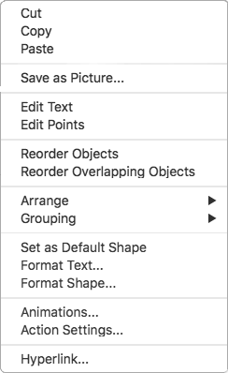



Slide 16
Variable assignment
(with animation)

Slide 17
42
my_variable

