Slide 1
Elephant
across a pipe

Slide 2


Slide 4
Coffee break

Slide 5
END
OF PART 1

Slide 6

INTERMISSION

Slide 7
BEGINNING
OF PART 2

Slide 8
Change of Topic,
no break

Slide 9
END
OF PART 1

Slide 11
BEGINNING
OF PART 2

Slide 12
Prerequisites

Slide 13
We want to do this.

Slide 14
This is a prerequisite.

Slide 15
Prerequisite
of the prerequisite.

Slide 16
This is a prerequisite.

Slide 17
We want to do this.

Slide 18
Too much code,
the classical way

Slide 19
List Roles
select u.rolname as username,
case u.rolsuper
when true then 'Y'
else ' '
end as superuser,
case u.rolcreatedb
when true then 'Y'
else ' '
end as db_creator,
string_agg(q.rolname, ',') as roles

Slide 20
List Roles (Cont'd)
from pg_roles u
left outer join pg_auth_members am
on am.member = u.oid
left outer join pg_roles q
on am.roleid = q.oid
where u.rolcanlogin = true
group by u.rolname, u.rolsuper,
u.rolcreatedb
order by roles, username;

Slide 21
Too much code,
using "push"

Slide 22
List Roles
select u.rolname as username,
case u.rolsuper
when true then 'Y'
else ' '
end as superuser,
case u.rolcreatedb
when true then 'Y'
else ' '
end as db_creator,
string_agg(q.rolname, ',') as roles

Slide 23
from pg_roles u
left outer join pg_auth_members am
on am.member = u.oid
left outer join pg_roles q
on am.roleid = q.oid
where u.rolcanlogin = true
group by u.rolname, u.rolsuper,
u.rolcreatedb
order by roles, username;

Slide 24
Too much code,
using "push" and a gradient

Slide 25
List Roles
select u.rolname as username,
case u.rolsuper
when true then 'Y'
else ' '
end as superuser,
case u.rolcreatedb
when true then 'Y'
else ' '
end as db_creator,
string_agg(q.rolname, ',') as roles

Slide 26
from pg_roles u
left outer join pg_auth_members am
on am.member = u.oid
left outer join pg_roles q
on am.roleid = q.oid
where u.rolcanlogin = true
group by u.rolname, u.rolsuper,
u.rolcreatedb
order by roles, username;

Slide 27
Too much code,
using "pan" and a gradient

Slide 28
List Roles
select u.rolname as username,
case u.rolsuper
when true then 'Y'
else ' '
end as superuser,
case u.rolcreatedb
when true then 'Y'
else ' '
end as db_creator,
string_agg(q.rolname, ',') as roles

Slide 29
from pg_roles u
left outer join pg_auth_members am
on am.member = u.oid
left outer join pg_roles q
on am.roleid = q.oid
where u.rolcanlogin = true
group by u.rolname, u.rolsuper,
u.rolcreatedb
order by roles, username;

Slide 30
Too much code,
using "pan" and a special background

Slide 31
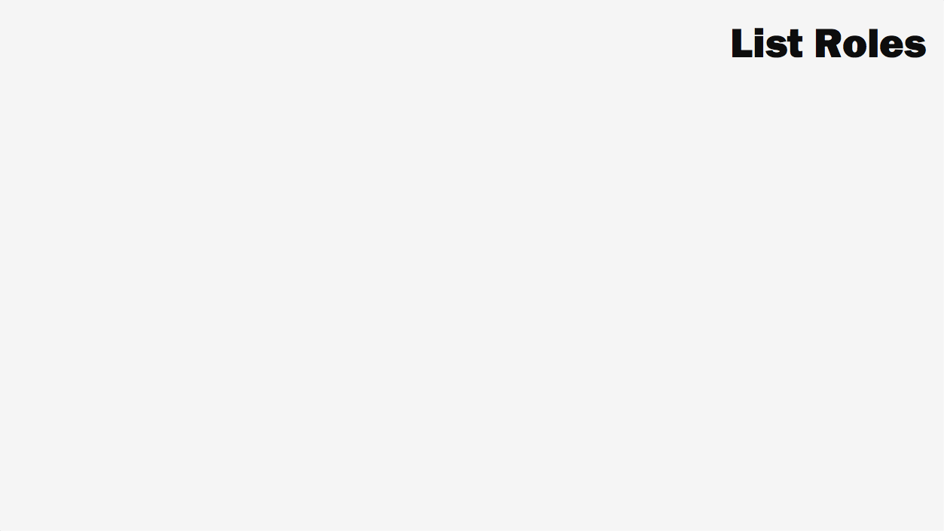
select u.rolname as username,
case u.rolsuper
when true then 'Y'
else ' '
end as superuser,
case u.rolcreatedb
when true then 'Y'
else ' '
end as db_creator,
string_agg(q.rolname, ',') as roles

Slide 32
from pg_roles u
left outer join pg_auth_members am
on am.member = u.oid
left outer join pg_roles q
on am.roleid = q.oid
where u.rolcanlogin = true
group by u.rolname, u.rolsuper,
u.rolcreatedb
order by roles, username;

Slide 33
Nuclear waste
second version

Slide 34
Uranium
Mining

Slide 35
Uranium
Mining
Mill tailings

Slide 36
Uranium
Mining
Fuel
Production
Mill tailings

Slide 37
Uranium
Mining
Fuel
Production
Mill tailings

Slide 38
Depleted uranium

Slide 39
Uranium
Mining
Fuel
Production
Mill tailings

Slide 40
Uranium
Mining
Fuel
Production
Mill tailings

Slide 41
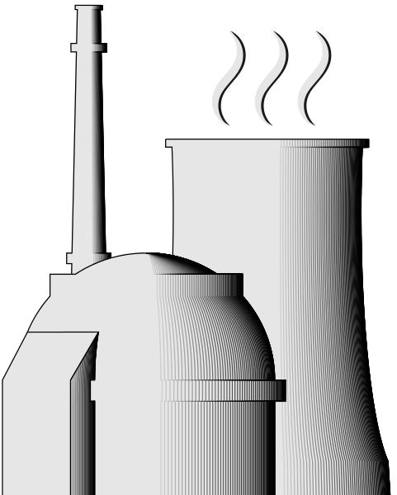
New
Fuel
Power reactors

Slide 42
New
Fuel
Power reactors
Liquid and gaseous radioactive waste

Slide 43
New
Fuel
Power reactors
Liquid and gaseous radioactive waste
Low level waste

Slide 44
New
Fuel
Power reactors
Waste from dismantling
Liquid and gaseous radioactive waste
Low level waste

Slide 45

New
Fuel
Power reactors
Waste from dismantling
Liquid and gaseous radioactive waste
Low level waste

Slide 46
Unreprocessed fuel
Spent
Fuel

Slide 47
Reprocessing
Unreprocessed fuel
Spent
Fuel

Slide 48
Waste from reprocessing
Reprocessing
Unreprocessed fuel
Spent
Fuel

Slide 49
Separated fissiles
Waste from reprocessing
Reprocessing
Unreprocessed fuel
Spent
Fuel

Slide 50
Separated fissiles
Waste from reprocessing
Production
of MOX/Ure fuel
Reprocessing
Unreprocessed fuel
Spent
Fuel

Slide 51
Depleted uranium

Slide 52
Depleted uranium

Slide 53
Separated fissiles
Waste from reprocessing
Production
of MOX/Ure fuel
Reprocessing
Unreprocessed fuel
Spent
Fuel

Slide 54
Separated fissiles
Waste from reprocessing
Production
of MOX/Ure fuel
Reprocessing
Unreprocessed fuel
Spent
Fuel

Slide 55
New
Fuel
Power reactors
Used MOX
Waste from dismantling
Liquid and gaseous radioactive waste
Low level waste

