Slide 1
Wipe vs Peek In

Slide 2
A
B
A
B

Slide 3
Travel-sized Elephant

Slide 4

The difficulty is in switching from slide 1 to slide 2
SLIDE 1

Slide 5
The difficulty is in switching from slide 1 to slide 2
SLIDE 2

Slide 6
Dial & Needle

Slide 8
Mock Web search

Slide 9

Tallyho
Search

Slide 10
Slanted zoom

Slide 11




Slide 12
Nuclear waste
final version

Slide 13
Uranium
Mining

Slide 14
Uranium
Mining
Mill tailings

Slide 15
Uranium
Mining
Fuel
Production
Mill tailings

Slide 16
Uranium
Mining
Fuel
Production
Mill tailings

Slide 17
Depleted uranium

Slide 18
Uranium
Mining
Fuel
Production
Mill tailings

Slide 19
Uranium
Mining
Fuel
Production
Mill tailings

Slide 20
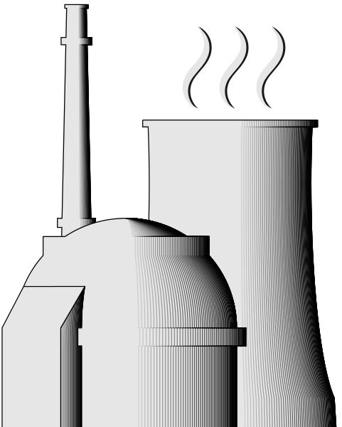
New
Fuel
Power reactors

Slide 21
New
Fuel
Power reactors
Liquid and gaseous radioactive waste

Slide 22
New
Fuel
Power reactors
Liquid and gaseous radioactive waste
Low level waste

Slide 23
New
Fuel
Power reactors
Waste from dismantling
Liquid and gaseous radioactive waste
Low level waste

Slide 24

New
Fuel
Power reactors
Waste from dismantling
Liquid and gaseous radioactive waste
Low level waste

Slide 25
Unreprocessed fuel
Spent
Fuel

Slide 26
Reprocessing
Unreprocessed fuel
Spent
Fuel

Slide 27
Waste from reprocessing
Reprocessing
Unreprocessed fuel
Spent
Fuel

Slide 28
Separated fissiles
Waste from reprocessing
Reprocessing
Unreprocessed fuel
Spent
Fuel

Slide 29
Separated fissiles
Waste from reprocessing
Production
of MOX/Ure fuel
Reprocessing
Unreprocessed fuel
Spent
Fuel

Slide 30
Depleted uranium

Slide 31
Depleted uranium

Slide 32
Separated fissiles
Waste from reprocessing
Production
of MOX/Ure fuel
Reprocessing
Unreprocessed fuel
Spent
Fuel

Slide 33
Separated fissiles
Waste from reprocessing
Production
of MOX/Ure fuel
Reprocessing
Unreprocessed fuel
Spent
Fuel

Slide 34
New
Fuel
Power reactors
Used MOX
Waste from dismantling
Liquid and gaseous radioactive waste
Low level waste

Slide 35
