Slide 1
Geant4 in production: status and developments
John Apostolakis (CERN)
Makoto Asai (SLAC)
for the Geant4 collaboration
Notes:
V 0.5 JA, 19:20 IST
V 0.4 JA, Sun 12 Feb 2006, 18:30 Mumbai (GMT+4:30)
Revisions merged: JA
Modified : Makoto Fr 10 Feb 2006, 13:00 PST
V 0.3 JA Fr 10 Feb 2006, 19:00 CET

Slide 2
Outline
Geant4 is heavily used
  HEP, imaging, radiotherapy, satellite applications
Improvements in Geant4 capabilities
  Improved stability of EM energy deposition, resolution
  Extensions to geometry modeler
  New, improved hadronic models
Strengths seen in use, production
  Users create applications and extend the toolkit
    Validate for and utilise in new application areas
    Customise/extend toolkit, profiting from open source
  Robustness shown in large scale productions

Slide 3
1. Geant4’s in HEP, production
HEP Experiments in large scale production
  BaBar (2001)
  CMS (2003)
  ATLAS (2004)
  LHCb (2004)
Used in many existing experiments
  KamLAND, Borexino, HARP, …
Used to study future experiments
  ILC, NA48/3 (PA326), …
Notes:
- TODO:
add detector size
add number of events simulated

Slide 4
Geant4’s widespread use
Imaging, radiotherapy, dosimetry
  PET and SPECT imaging (GATE),
  brachytherapy, hadrontherapy,
Space: satelites and planetary missions
  XMM, INTEGRAL, Bepe Colombo, LISA, …
Radiation assessment, dosimetry
  LHCb, Electronics (TCAD), …

Slide 5
2. Geant4 improvements
Improved stability of EM energy deposition, resolution
  From revision of electron transport (Multiple scattering)
  Enables better accuracy at higher cuts - with less CPU
Extensions to geometry modeler
Ability to revise many particle properties
Refinements, improvements in hadronics
Physics Lists

Slide 6
Energy deposition and cuts: issues
Electron transport is key to accurate energy deposition, resolution
  in setups with materials with very different Z
Users reported results strongly dependent on cut value (or step limits)
  Sampling calorimeters: Atlas (Cu–lAr), ILC (W-Si), LHCb (Pb-Sci)
  In water phantoms with perturbing layer (Poon & Verhaegen)
Cut dependence verified in HEP sampling calorimeters (eg Cu-lAr, Pb-Sci)
  Energy deposited varied 10%-30% when production cuts are changed from 1 μm to 1 mm
    Effect existed in previous Geant4 releases (5.x, 6.x and 7.x)
An extensive investigation concluded that the Multiple Scattering process could be improved
  Revisions provided in Geant4 8.0 address these issue
M. Maire, L. Urban
Notes:
Simulating energy deposition with high precision could require very small cuts
Speed penalty for medical applications, fine granular calorimeters, …

Slide 7
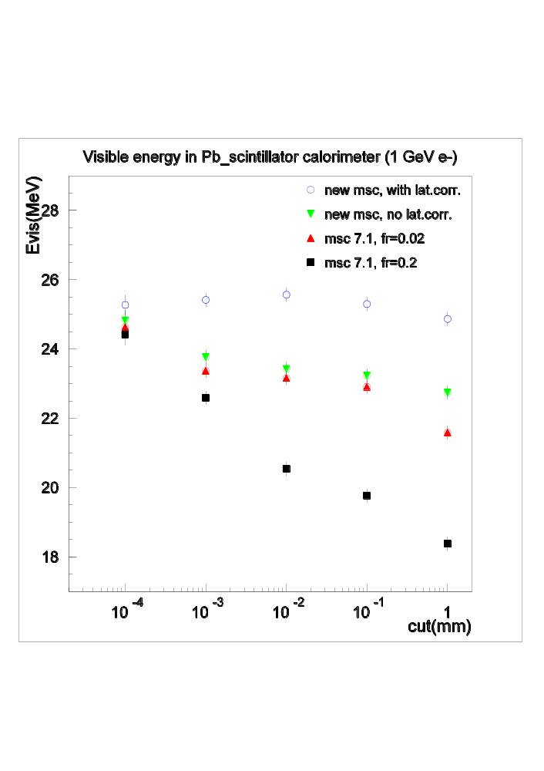
First results
Visible Energy (MeV)
Geant4 8.0
Visible Energy
In Pb scintilator
Calorimeter
1 GeV electrons
Geant4 7.1
varied 20%
M. Maire, L. Urban
Z
Production cut (mm)

Slide 8
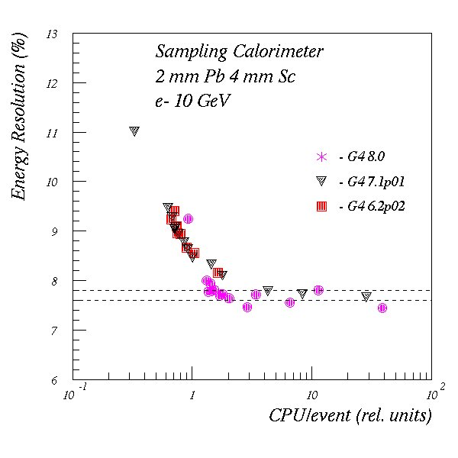
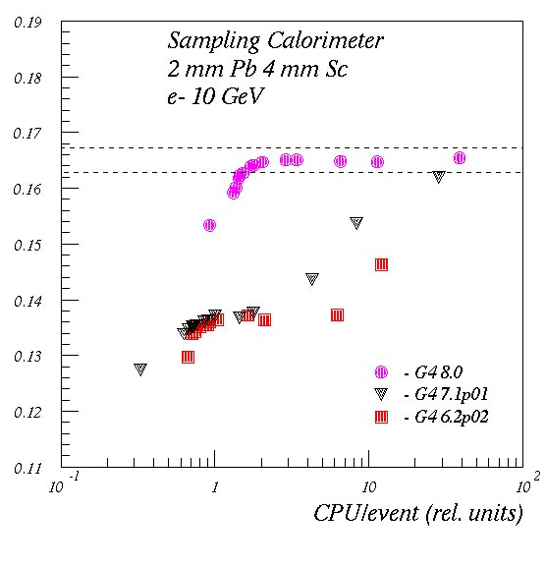
CPU versus physics performance
Simple calorimeter similar to LHCb setup
Visible Energy fraction = Evis/E
G4 8.0
Geant4 8.0
More stable E_{visible}, resolution and less CPU

Slide 9
Energy deposition and cuts: resolution
Revisions of Multiple Scattering (available in release 8.0)
Improvements to physical model – calculating displacement and applying it
  Introduced correlation between scattering angle and lateral displacement
  Ensure recalculation of geometry ‘safety’ before sampling the displacement
    Since the safety value limits the displacement allowed
Improvements in restricting step:
  Stricter step restriction
    using smaller fraction (0.02 vs old 0.02) of particle’s range
    in all volumes, including the starting volume of track
  Restrict step size using geometrical information
    Ensures more than one step in each volume
Note: User can switch off the extra new step limitation (for comparisons)
For more information please see upcoming talk “The recent Upgrades in the Geant4 Standard Electromagnetic Physics Package”
M. Maire, L. Urban
Notes:
New method SetMscStepLimitation(false) overrides changs
Restores values/results of 7.1 in G4VMultipleScattering

Slide 10
Geometry improvements
New solids for unusual shapes
  Twisted trapezoid, ellipsoid, tetrahedron
Ability to measure volume (mm³)
  Use it to measure also the mass of a setup
Refinement to support better dynamic geometries
  Option to only re-optimise parts that change with run
New ability to detect overlap problems
  when user creates his/her geometry setup
Tool for large regular (‘voxel’) geometries
  When only material varies in regular structure
More in presentation on “The Geant4 Geometry Modeler”

Slide 11
Verification / validation
Additional thin-target comparisons
  For verifying models
Validation
  New comparisons (eg CMS TB2004, ATLAS CTB)
  Revisiting test-beam comparisons
    Eg Atlas HEC
  EM calibration below per-cent level
  Open challenges for hadronic calorimetry
    Shower shape, energy density (at low values)

Slide 12
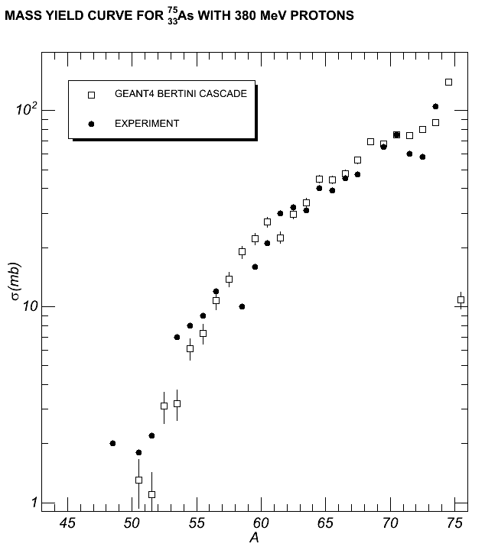
Mass yield curve
Geant4 Bertini
vs Experiment

Slide 13

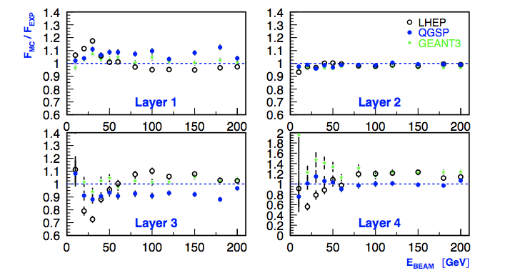
ATLAS HEC:
G4 7.0p01 PRELIMINARY, Oct 2005
Updated comparisons from 5.2
Thanks to A. Kiryunin, ATLAS-HEC

Slide 14
Additional capabilities
Fast simulation (shower parameterisation)
  Originally a framework for users’ parameterisations
  New GFLASH concrete implementation
      See presentation in EPA-3 (Tues)
  Extending use of ‘Regions’ to fast simulation
Handle ‘unknown’ particles (with no G4 physics)
  Accept from Event Generator, transport, decay
Now allow change in particles’ properties
  In initialisation phase the user can change unstable particles’ mass, width, ..
Notes:
User can change unstable particles’ properties
Eg modifying width, decay modes
To be consistent with Event Generator’s particle properties
Enabled handling of ‘unknown’ particles
Accept these from Event Generator
G4ParticleTransformer creates tracks of ‘Unknown particle’
Processes: transport and decay (as pre-assigned)
Extending use of ‘Regions’
To fast simulation
For user step limits

Slide 15
3. Users apply and extend G4
Tools using Geant4 for class of related applications
  GATE tool
    “Geant4 Application for Tomographic Emission”
  BDSIM for beam-line simulations
Users extend Geant4
  Special solids for own geometry (many -> G4)
    Atlas endcap solid (fan), twisted tube (KEK), Tet (vanderbilt)
  GFLASH shower parameterisation (Atlas, CMS -> G4)
  ‘Regular’ navigation (10-100 mil volumes at one level)
  Use of 2,500 materials
Key strengths exploited: architecture, open source
Notes:
Plethora of specialized applications
Hadron therapy

Slide 16

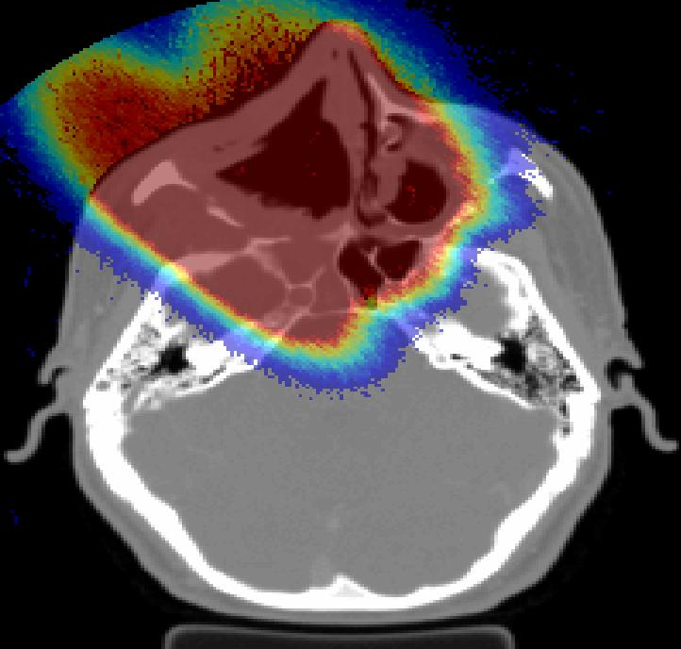
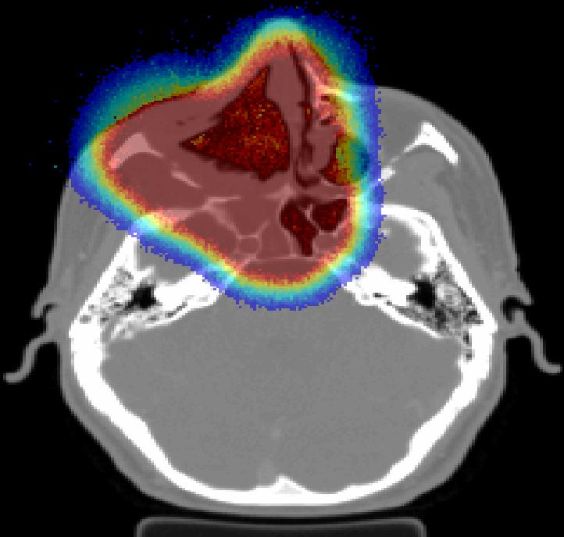
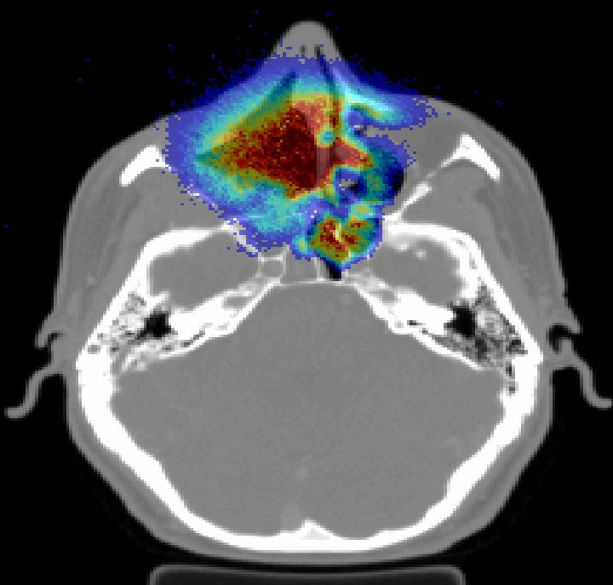
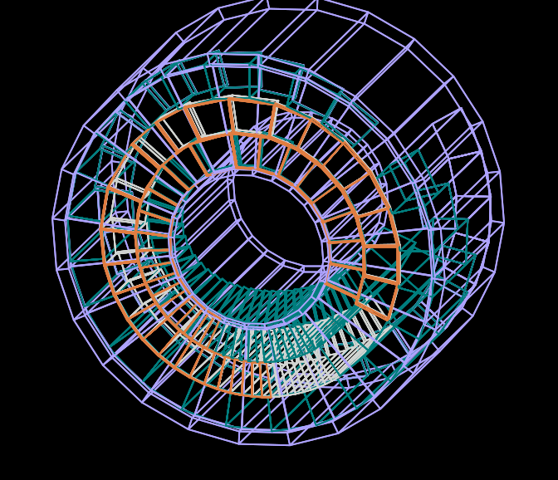
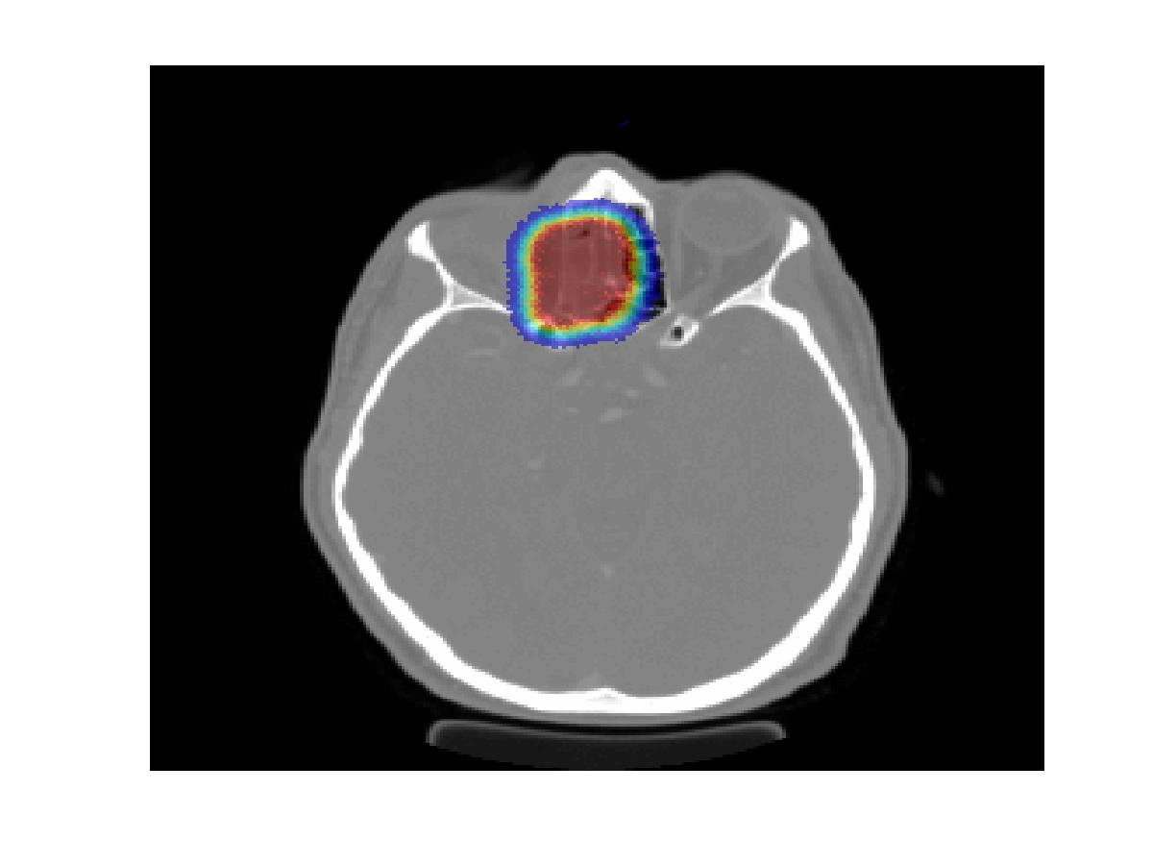
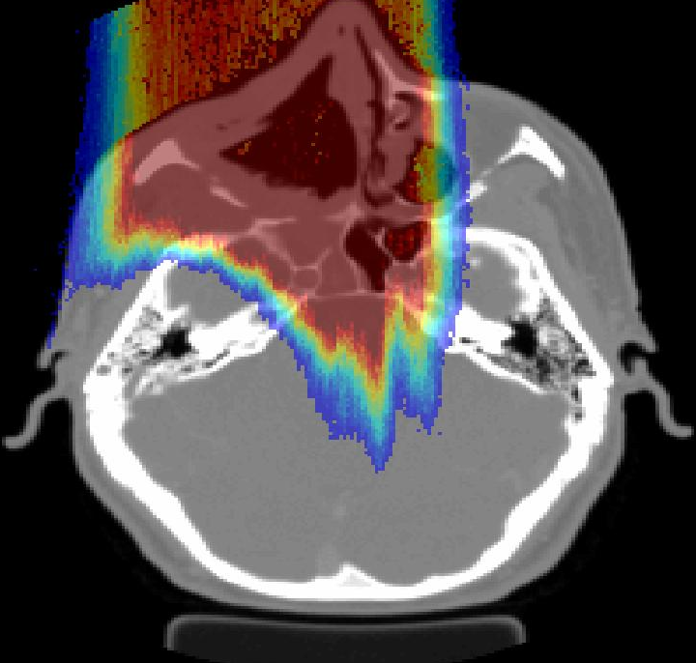
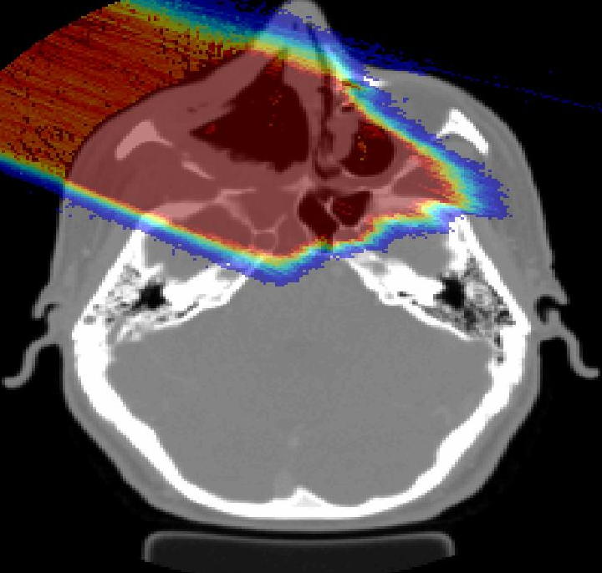
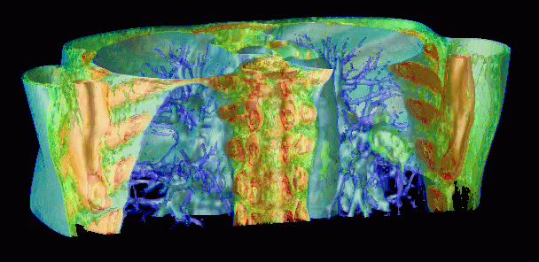


GEANT4 based proton dose calculation in a clinical environment: technical aspects, strategies and challenges
Harald Paganetti
Notes:
H. Paganetti’s conclusions (Bordeaux, Nov 2005):
Routine use of (proton) Monte Carlo dose calculation (using GEANT4)
requires work in many different areas
of treatment head and patient modeling
requires establishing a link between
treatment planning and Monte Carlo
is being done at MGH

Slide 17
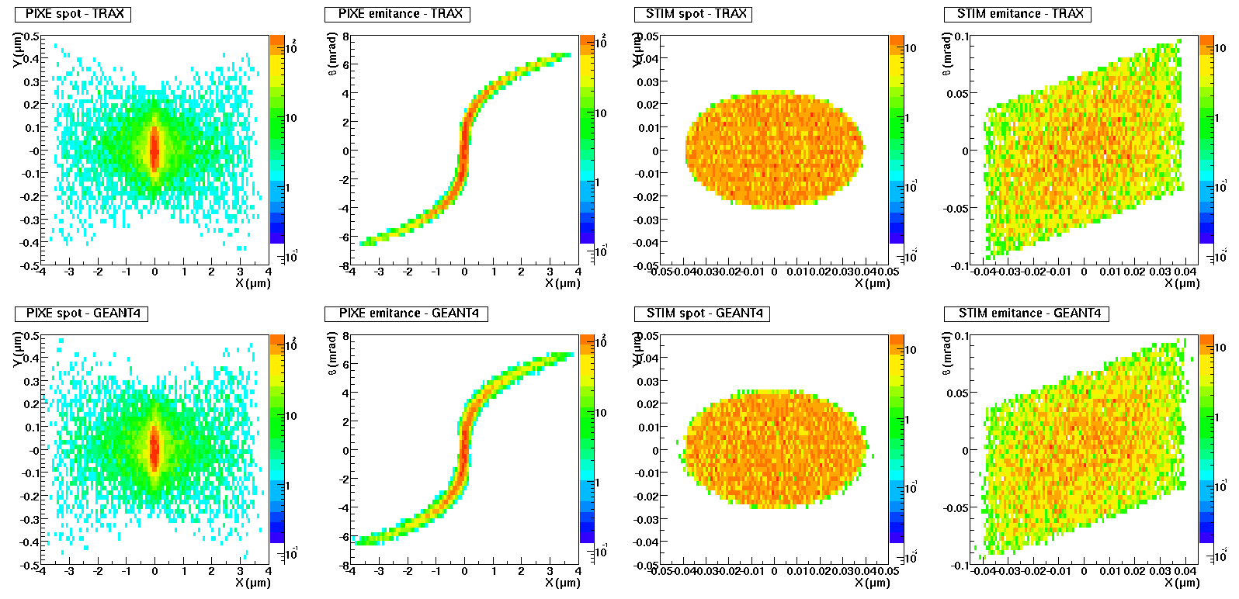
Microbeam simulation:
Comparison in high (PIXE) and low flux (STIM) modes
Geant4 versus TRAX (reference)
300 nm x 200 nm
90 nm x 50 nm
Nice agreement between TRAX and Geant4 (square field model, no map)
Sharp STIM image, distorted PIXE image (chromatic and spherical aberrations)
Compatible with probe size requirements
Pure vacuum, no collimators
Thanks to S. Incerti

Slide 18
Users extend Geant4
For regular voxel phantom geometries
  Tens of millions of volumes at one level!
  Revising one/two navigation class(es)
    K. Sutherland, H. Jiang
To simulate thousands of materials
  Varying in density
  storing physics tables for tens/hundreds
    H. Jiang / H. Paganetti
Utilise toolkit and open source
  And customise for own application requirements / constraints
Notes:
Publications
Paganetti “Nuclear Interactions in Proton Therapy …“
Phys Med Biol 2002: 47, 747-764
Paganetti,Gottschalk “Test of Geant3 and Geant4 nuclear models …“
Med Phys 2003: 30, 1926-1931
Flanz,Paganetti “Monte Carlo calculations in support of commissioning …“
Austral Phys Eng Sc Med 2003: 26. 156-161
Paganetti,Jiang,Lee,Kooy “Accurate Monte Carlo simulations for nozzle …“
Med Phys 2004: 31, 2107-2118
Jiang,Paganetti “Adaptation of GEANT4 to Monte Carlo dose …”
Med Phys 2004: 31, 2811-2818

Slide 19
Robustness, testing
Low rate of problems in production
  Was <~ 10⁻⁴ per LHC event with G4 5.x
  CMS reports 10⁻⁶ per event (G4-related) with G4 6.2
New, large-scale, regressions testing
  Finds rare problems
  Used LCG/EGEE Grid
    Need and got > 150 CPU-weeks in 10 days
      G4 VO: thanks to LCG team, CERN, Imperial C., Nikhef, CIEMAT
  Identifies physics revisions, finds new software issues
    See A. Ribon’s talk

Slide 20
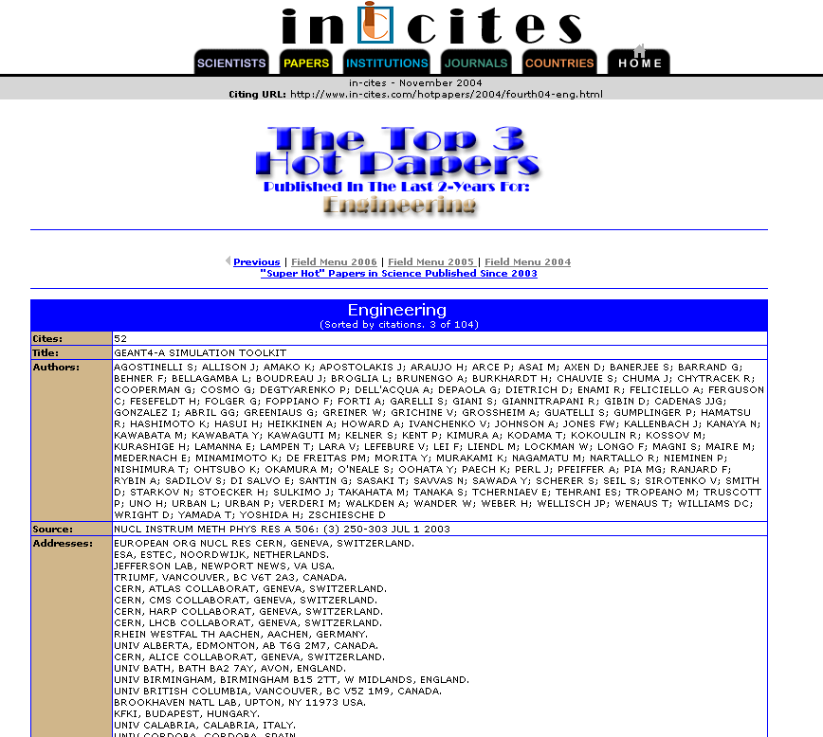
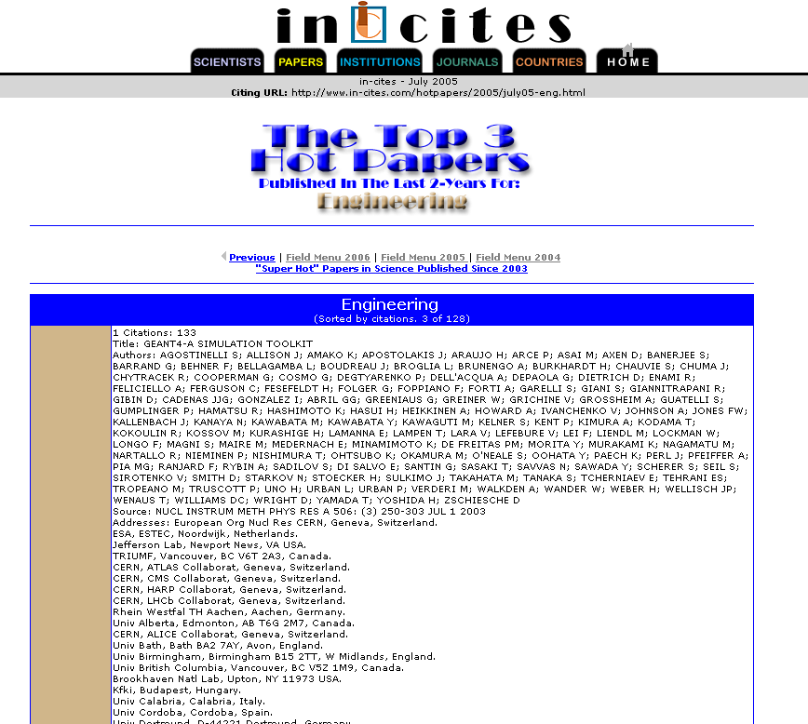
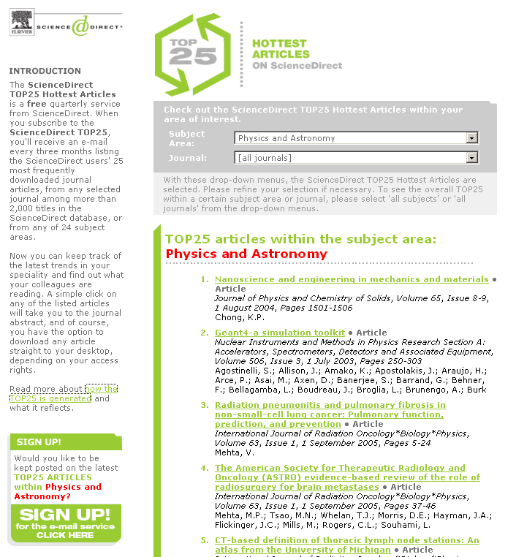
http://www.in-cites.com/hotpapers/2004/november04-eng.html
http://www.in-cites.com/hotpapers/2005/july05-eng.html

Slide 21
Summary
Improvements in multiple scattering process
  Addressing issues with ‘electron transport’
Speedups for initialisation/navigation
  Option to only re-optimise parts that change with run
  New voxelisation options being studied for regular geometries
Overlap checks at geometry construction
Revised implementation of particles
  Impacting advanced users, customizing
Refinements in hadronic physics

Slide 22
More slides on EM revisions, performance

Slide 23
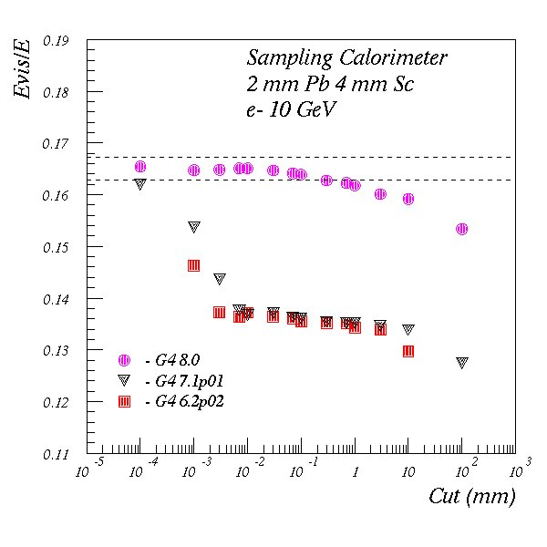
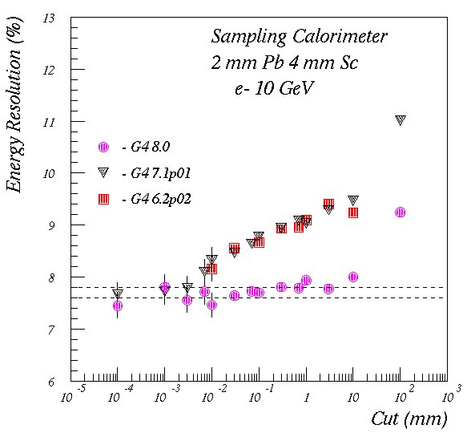
Multiple Scattering model upgrade LHCb type calorimeter
V. Ivantchenko

Slide 24
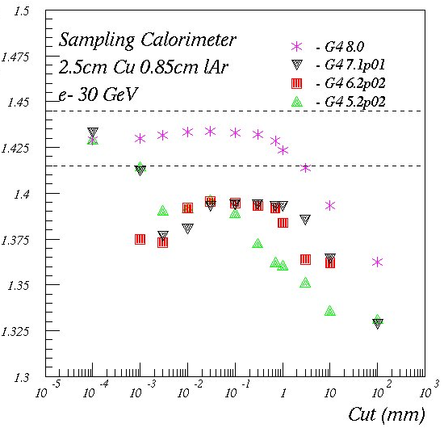
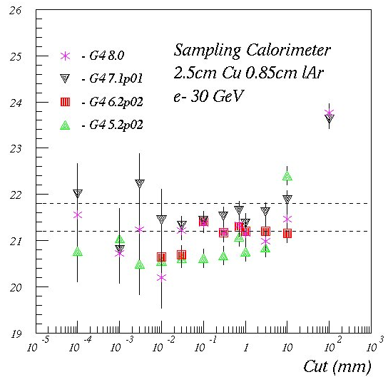
Atlas HEC : Cu(25mm)-lAr(8.5mm)
Energy Deposited (GeV)
RMS/ (E * sqrt(E₀/GeV) (%)

Slide 25
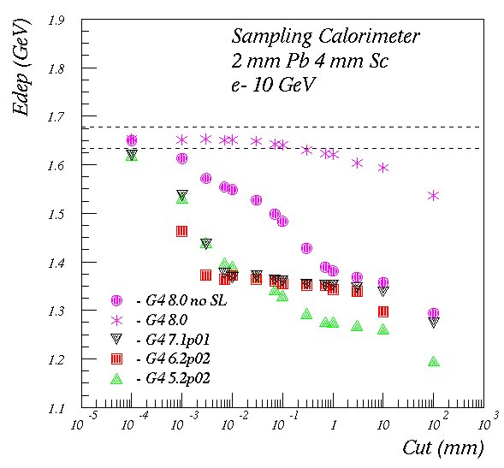
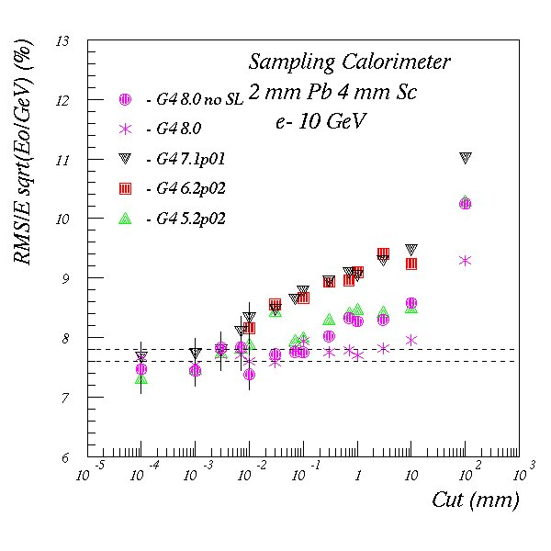
LHCb : Pb(2mm)-Sc(4mm)

Slide 26
Energy deposition and cuts (more)
Electron transport is key to accurate energy deposition, resolution
  in setups with materials with very different Z
Users reported results strongly dependent on cut value and step limits
  Atlas sampling calorimeter (Cu – lAr )
  In water phantoms with perturbing layer (Poon & Verhaegen)
  In other hadronic calorimeters (W-Si ILC, Pb-Sci LHCb)
Cut dependence verified in HEP sampling calorimeters (eg Cu-lAr, Pb-Sci)
  Energy deposition varied 10%-30% in changing production cuts from 1 μm to 1 mm
    Effect existed in recent Geant4 releases (5.x, 6.x and 7.x)
An extensive investigation of cut/step limit effects concluded that the Multiple Scattering process could be improved
  Revisions provided in Geant4 8.0 address this issue
M. Maire, L. Urban
Notes:
Simulating energy deposition with high precision could require very small cuts
Speed penalty for medical applications, fine granular calorimeters, …

Slide 27
Revisions of Multiple Scattering (8.0)
Improvements to physical model – calculating displacement and applying it
  Introduced correlation between scattering angle and lateral displacement
  Ensure recalculation of geometry ‘safety’ before sampling the displacement
    Since the safety value limits the displacement allowed
  step restriction not only after boundary with parameter facrange but also from the start of the track and from geometry (facgeom)
Improvements in restricting step:
  Stricter step restriction in all volumes using fraction (0.02) of particle range
    Including the starting volume of track (new)
      Previously only applied after first boundary
  Step restriction using geometrical information to guarantee at least
    2 steps in the start volume
    4 steps in other volumes a track crosses
User can switch off this step limitation (for comparisons)
For further information please see upcoming talk “The recent Upgrades in the Geant4 Standard Electromagnetic Physics Package”
M. Maire, L. Urban
Notes:
New method overrides changs
Restores values/results of 7.1
SetMscStepLimitation(false)
In G4VMultipleScattering

Slide 28
More on applications

Slide 29

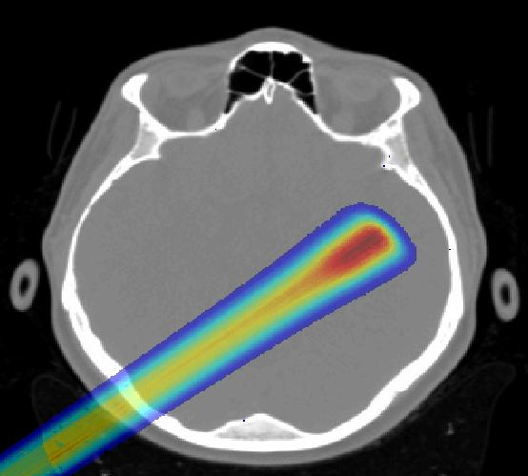
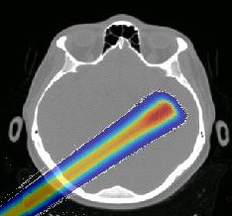
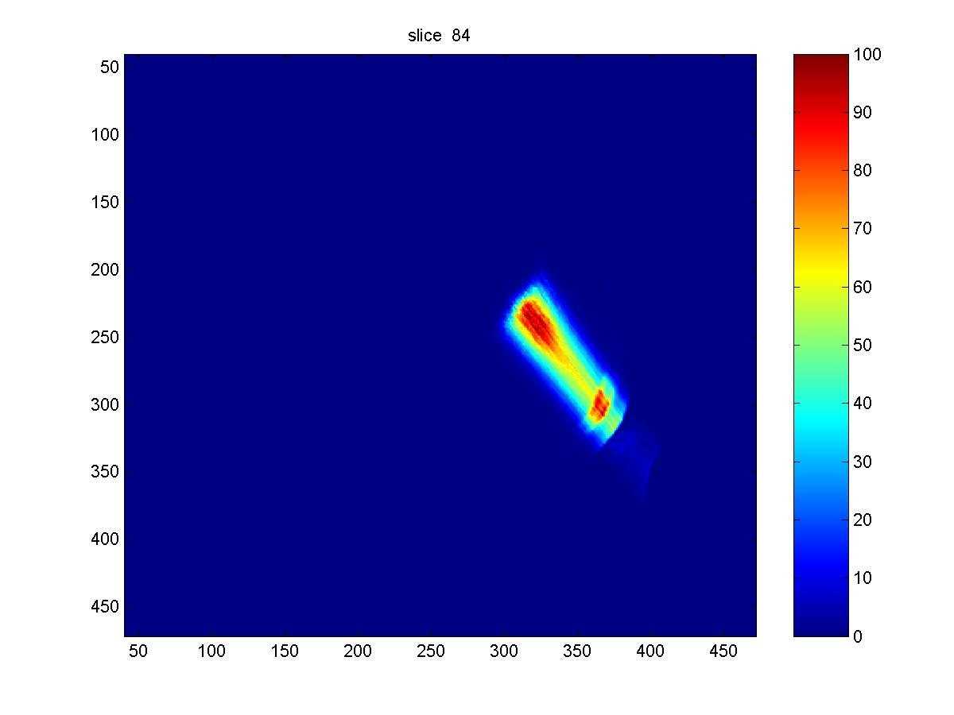
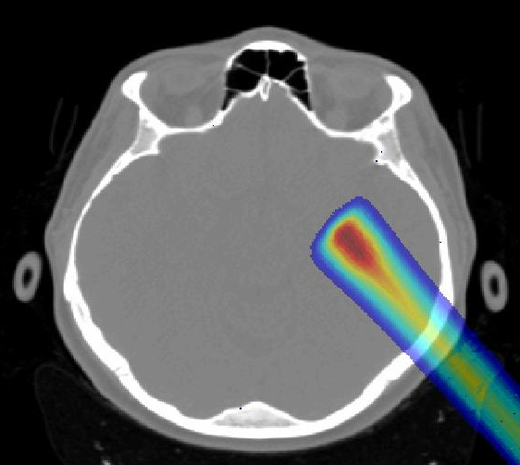
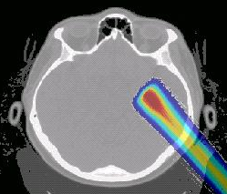
Monte Carlo dose calculation, Example 2:
Radiosurgery (4 fields)
Thanks to H. Paganetti, MGH
BORDEAUX 2005
FOCUS
Monte Carlo
FOCUS
Monte Carlo
Notes:
Publications
Paganetti “Nuclear Interactions in Proton Therapy …“
Phys Med Biol 2002: 47, 747-764
Paganetti,Gottschalk “Test of Geant3 and Geant4 nuclear models …“
Med Phys 2003: 30, 1926-1931
Flanz,Paganetti “Monte Carlo calculations in support of commissioning …“
Austral Phys Eng Sc Med 2003: 26. 156-161
Paganetti,Jiang,Lee,Kooy “Accurate Monte Carlo simulations for nozzle …“
Med Phys 2004: 31, 2107-2118
Jiang,Paganetti “Adaptation of GEANT4 to Monte Carlo dose …”
Med Phys 2004: 31, 2811-2818
H.P.’s Acknowledgements
Hongyu Jiang (GEANT4 / CT)
Shashi Kollipara (patient database)
NIH/NCI grant # P01 CA 21239

Slide 30
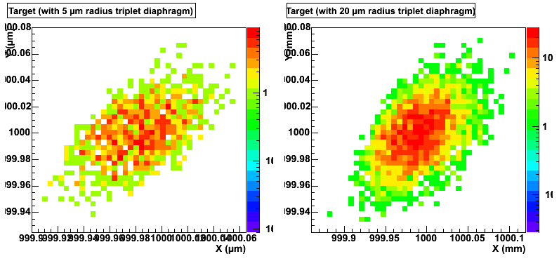
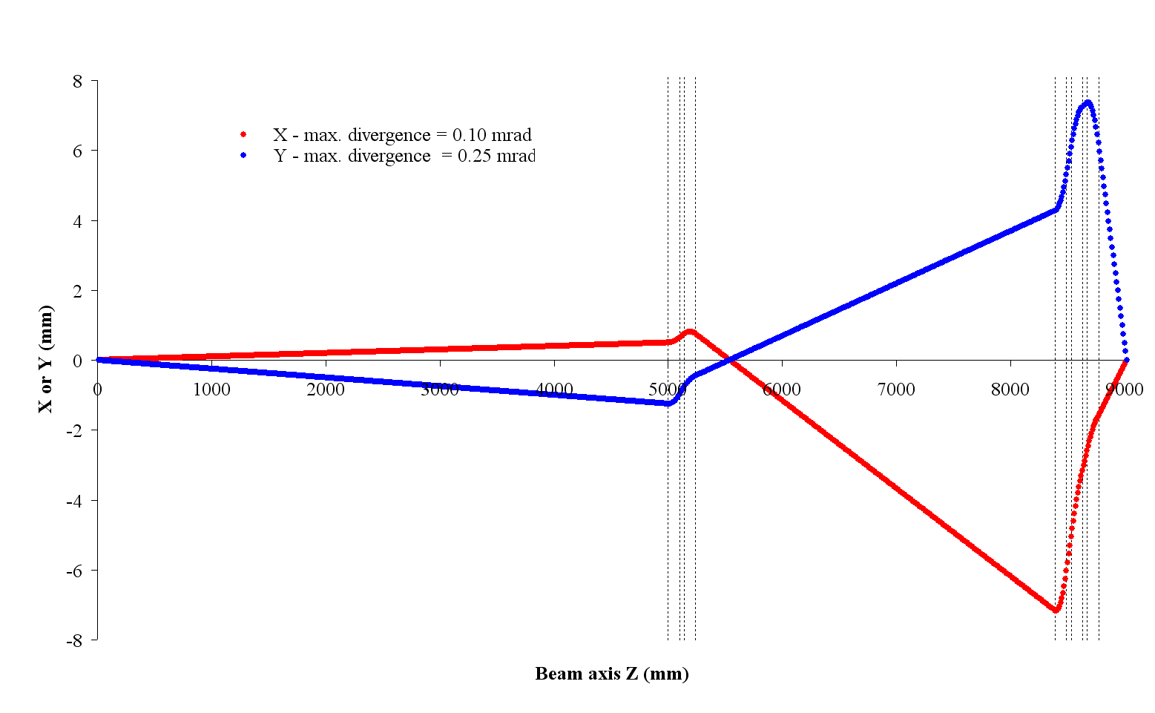
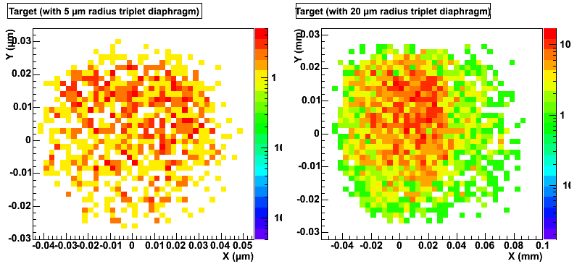
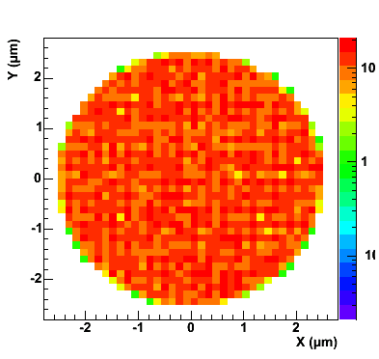
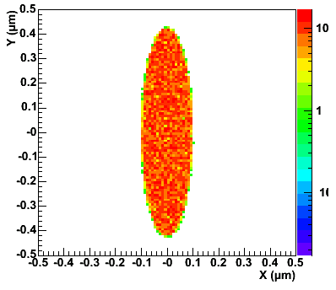
Nanobeam line ray-tracing
With electrostatic deflection
Beam maximum
external envelope
4565
5000
DOUBLET
TRIPLET
Object collimator
Diaphragm
3150
Diaphragm
40
40
400
400
250
Switching
magnet
X
Image plan
90° analysis
magnet
300
1727 V & 2916 V
100
11°
100
90°
Electrostatic plates
60 nm x 80 nm
Singletron incident beam
5 µm diameter
object collimator
Intermediate image size
200 nm x 900 nm
Thanks to S. Incerti
Without electrostatic deflection
Notes:
“Why Monte Carlo simulation ?“
Looking for a simulation tool able to perform…
True ray-tracing
ion transport in focusing quadrupoles to characterize the microbeam line performances and predict / adjust the nanobeam line focusing capabilities
understand and reduce scattering along the line :
collimator edges, diaphragms, pipe residual air…
understand and reduce scattering inside the cellular irradiation chamber :
ion detector, extraction window, culture foil where cells attach…
Microdosimetry and cell damage
estimate the absorbed dose in single ion irradiation mode
model DNA damage and survival at the cell level
compare with other irradiation techniques (alpha emitters, macro beam)

Slide 31
Geant4 8.0 developments
Additional information

Slide 32
Geometry: solids and dynamical geometries
Additional solids
  Generic twisted trapezoid shape with different endcaps - (O. Link)
  New ellipsoid (G.Guerrieri, INFN/Genova) and elliptical cone (D. Anninos, CERN/Cornell)
  Tetrahedron (M. Mendelhall, Vanderbilt Univ.)
Testing and Improvements (O. Link, CERN)
  Solid accuracy tests identified problems in torus, sphere (theta)
  Fix in sphere and improvement of torus (new polynomial solver)
Localized re-optimization for dynamic geometries
  Change and re-optimize only part of a large geometry (G. Cosmo)
    Enables lightweight initialisation for changes in dynamic geometries

Slide 33
Other new features in geometry
Overlap detection at construction time
  When a volume is placed it is checked optionally for ‘overlaps’
    If it overlaps sister volumes or protrudes from its mother
    Points on its surface are sampled
    An exception is generated if a point is outside the mother or inside a sister volume
  Applicable for placement and parameterised volumes
Extended use of G4Region:
  Was used for G4ProductionCuts and G4VUserRegionInformation,
  Can now create User Limits for Regions (7.1)
  Now enabled its use with parameterisation / Fast Simulation
    All these data members are optional

Slide 34
Nested parameterization
In the past G4VPVParameterization::ComputeMaterial() method used to take only the copy number of the immediate physical volume
  There was no way to get a copy number of its (grand)mother volume
To implement boxes in 3-Dimensional alignment with varying material (e.g. DICOM), one parameterization has to take care of three dimensions.
  One big mother volume filled by one tiny cell with 3-dimensional parameterization
With newly introducing nested parameterization, a touchable instead of naïve copy number is provided to ComputeMaterial() method.
  Material of a box can be indexed not only with the copy number of the immediate volume but also with copy numbers of its (grand)mother volumes
  The big mother box can be replicated twice in first and second axes, and then parameterized only along the third axis.
  Performance improvement in both voxelization and navigation/tracking

Slide 35
Non-static particle definition
In Geant4 8.0, all particle definition class objects are instantiated when GenerateParticle() method of physics list is invoked
  Until now, most particle definition objects were static and the GenerateParticle() method ensured they were linked in the executable
A side effect is foreseen if your physics list has physics processes/models as data members of your physics lists.
  such processes or models may not been instantiated properly.
Released revised physics lists to address this
What to do
  In case processes/models are defined as data members, they are actually instantiated at the moment your physics list itself is instantiated, i.e. before GenerateParticle() method is invoked.
  If you use your own copy/customized physics list you will need to migrate
    For example if you derived from one of the “educated guess” physics list,
    How to do this
      define pointers for such processes/models as the data members, and make sure all processes/models are actually instantiated in your GenerateProcess() method.

Slide 36
Concrete sensitivity classes
Until 7.1 Geant4 provided only an abstract class (G4VSensitiveDetector) for the user to define his/her detector sensitivity.
  Various example detector classes are provided.
    Good to store hits in their detectors (HEP experiments).
  But is not convenient for radiation applications (Space/medical/HEP)
    Where the main interest is scoring dose/flux.
G4 8.0 introduces G4MultiFunctionalDetector
  In it you can register concrete ‘scorers’ to build a custom scoring detector.
  Now provide scorers for EnergyDeposition, Surface Flux, Dose, Track Length
    additional concrete classes are under development.
  Note: G4MultiFunctionalDetector is a G4VSensitiveDetector.
Notes:
M. Asai for Run-Event WG

Slide 37
Concrete sensitivity classes
Each G4VPrimitiveSensitivity class generates one hits collection per event. By registering more than one classes of G4VPrimitiveSensitivity, G4MultiFunctionalDetector generates more than one collections.
G4THitsMap template class (an alternative to G4THitsCollection) introduced. It is also a derived class of G4VHitsCollection.
  It is more convenient for scoring purposes, and simpler
New class G4VSDFilter introduced. Can be attached to G4VSensitiveDetector and/or G4VPrimitiveSensitivity to define which kinds of tracks are to be scored.
  E.g., surface flux of protons of more than 1 GeV/c can be scored by G4PSSurfaceFluxScorer with a filter.
Current G4Scorer and its related classes are kept, for the time being
  Expect these to be declared obsolete.

Slide 38
Bertini Cascade
Isotope production
  Proton and neutron induced
Elastic scattering interface (release 7.1)
  G4CascadeElasticInterface (for < 1 GeV)
Kaon extensions
Validation
Optimization for speed, model tuning
A. Heikkinen, D. Wright

Slide 39
Bertini Cascade
Isotope production
  Proton and neutron induced
Elastic scattering interface for release 7.2
  G4CascadeElasticInterface (for < 1 GeV)
Kaon extensions
Validation
Optimization for speed, model tuning
Ion-ion interactions (future)

Slide 40
Bertini hadronic models in Geant4 7.1
Submodels implemented for proton, neutron, pion bullets:
  G4ElementaryParticleCollider
  G4IntraNucleiCascader
  G4NonEquilibriumEvaporator (pre-equilibrium)
  G4EquilibriumEvaporator
  G4Fissioner
  G4BigBanger
Latest Bertini extension (June, 2005)
  First partial release providing elastic part of intra-cascade treatment for kaon, lambda, sigma, and xi by Dennis Wright (SLAC)
    Now stable and available at CVS (use KAON-flag)
    This SLAC-tag is to be released fully in Geant4 7.2 release

Slide 41
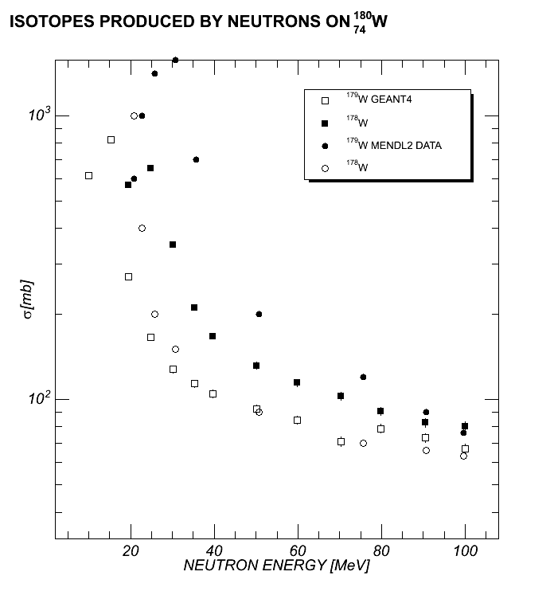
Low-energy neutron induced isotope production is usually treated with Geant4 isotope production model using of evaluated data libraries
Yet in some cases Bertini model performs quite well and might be useful

Slide 42
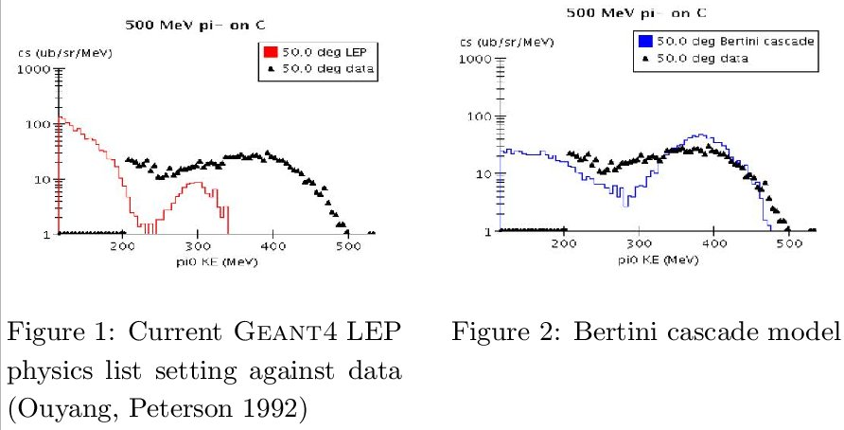

Slide 43
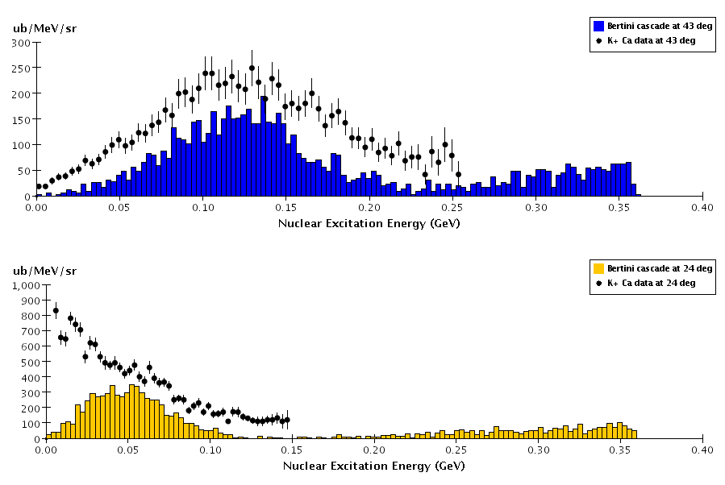
705 MeV/c K+ quasi-elastic scattering from Ca

Slide 44
New Developments in CHIPS
G4QCaptureAtRest for nuclear capture of negative hadrons, muons, and low energy neutrons/antineutrons.
Process level tests for comparison of simulated parameters with experimental data
  Validation tests for at rest and in-flight (test19/test29).
G4QCollision for photo- and lepto-nuclear reactions
  with DIS simulation of neutrino-nuclear reactions.
New fixed version of CHIPS for QGSC and FTFC.
M. Kosov

Slide 45
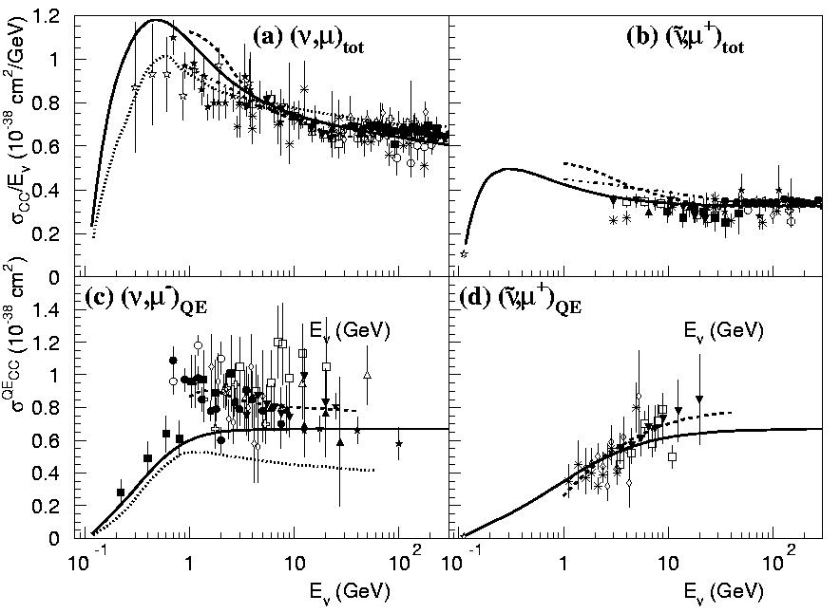
Neutrino-nuclear interactions for CNGS

Slide 46
Physics Lists
Revised to work with Geant4 8.0
  Co-work with particles revision
Utilise EM(std) physics builders
  Tested by EM(std) WG on HEP calorimeter setups
Now γ-A interactions is default in all PLs
  QGSP_GN is now QGSP, includes γ−nuclear
  A few ‘engines’ suppressed
    LHEP_GN, ..
New variant with ‘old’ EM physics
  QGSP_EMV uses multiple scattering with 7.1 parameters

Slide 47
Migrations
Migrations:
  Use of <sstream> instead of <strstream>
  Support for CLHEP-2.0.X (compatible with 1.9.X series)
Changes required in User Code
  Fast parameterisation
    Region replaces ‘envelope’.
  Creating and instantiating physics lists : impact of the revised, "non-static", particle definitions
  G4VProcess base class
    StartTracking() now has argument const G4Track*

Slide 48
http://top25.sciencedirect.com/index.php?subject_area_id=21

Slide 49
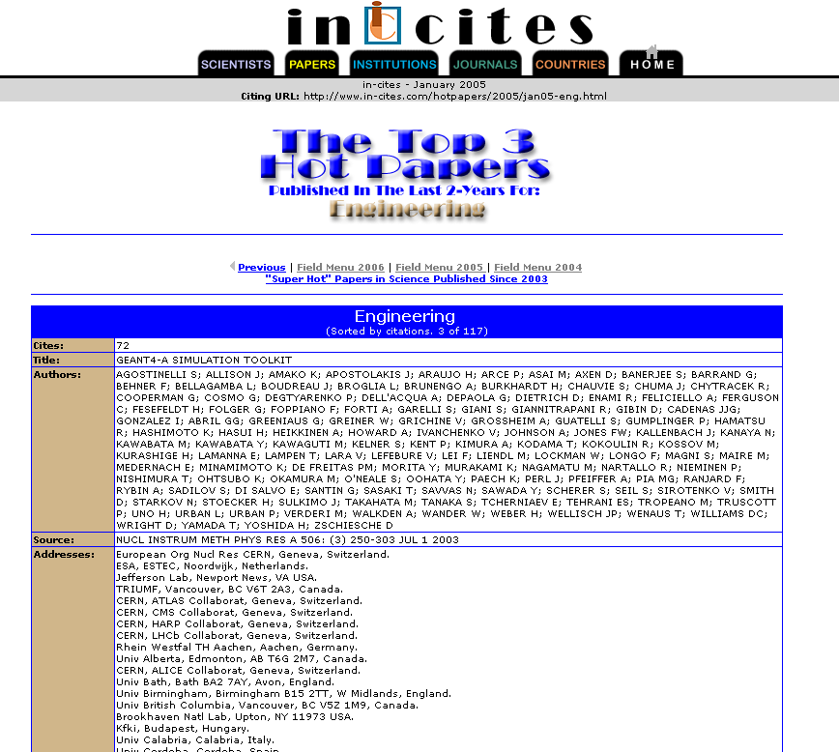
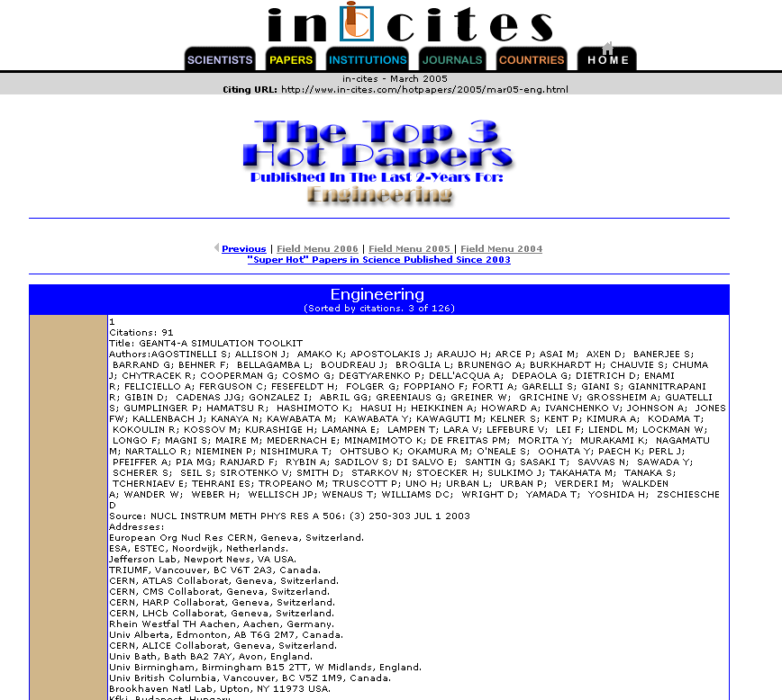
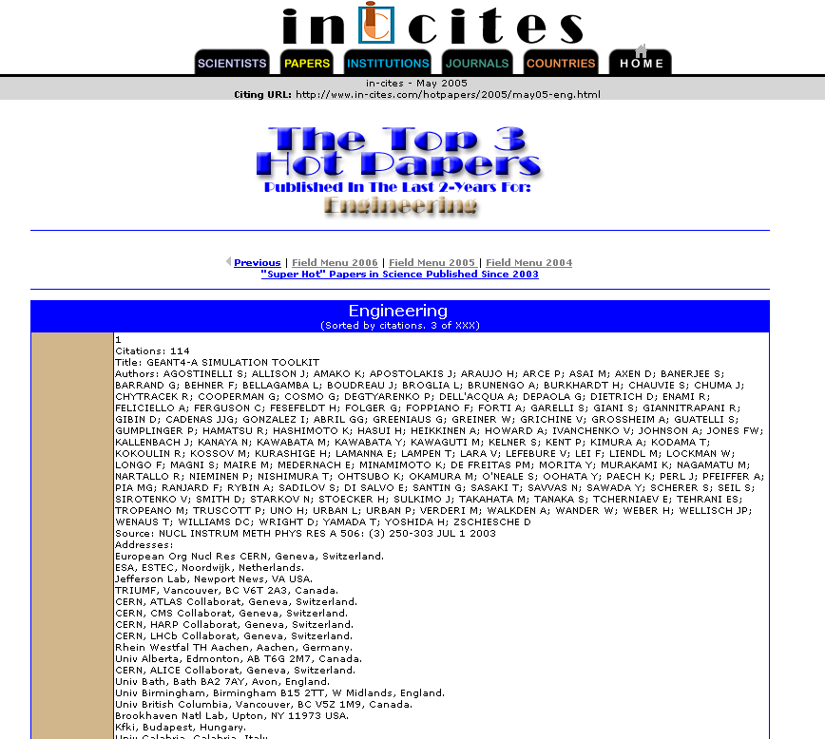
http://www.in-cites.com/hotpapers/2004/november04-eng.html
http://www.in-cites.com/hotpapers/2005/jan05-eng.html
http://www.in-cites.com/hotpapers/2005/mar05-eng.html
http://www.in-cites.com/hotpapers/2005/may05-eng.html
http://www.in-cites.com/hotpapers/2005/july05-eng.html

