Slide 1

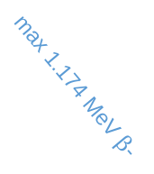
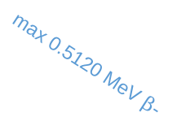
55Cs137
7/2+
30.17a
max 0.5120 MeV $β$-
94.6%
56Ba137m
0.6617
11/2-
max 1.174 MeV $β$-
2.55m
0.6617 MeV $γ$
5.4%
85.1%
56Ba137
0
3/2+
stable

