Slide 1

Econometrics Forecasting Model for Blueberry
Notes:
Timing (overlap or off-season)

Slide 2

OBJECTIVE
To better estimate future price and production of BC agriculture commodities
To assist BC blueberry farmers make more accurate financial budget
Blueberry is selected as the representative commodity for model construction

Slide 3
DATA AND METHODOLOGY
Methodology: interview; literature review and statistical analysis
Data (for blueberry model): 1982-2018
Exchange rate index
U.S. production
Household spending
Population (BC and Canada)
GDP per capita
Consumption Trend
Trading Information
Temperature (April, July, previous November)
Production Condition

Slide 4

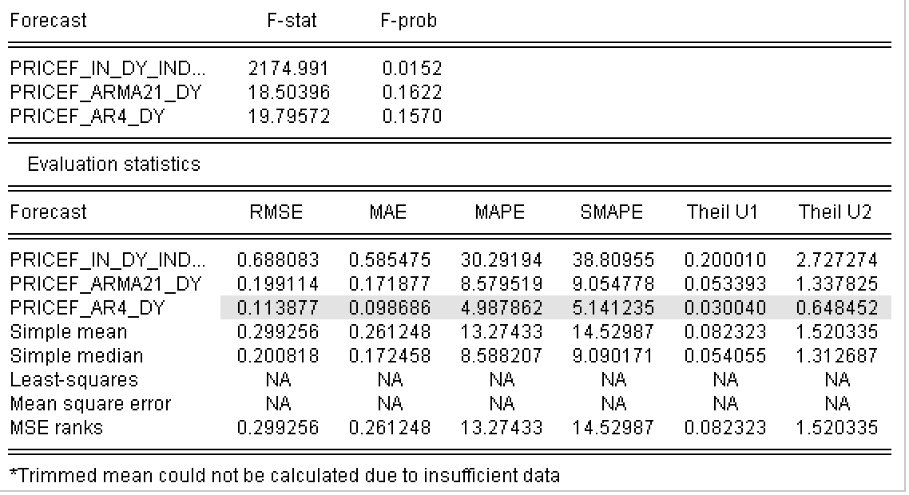
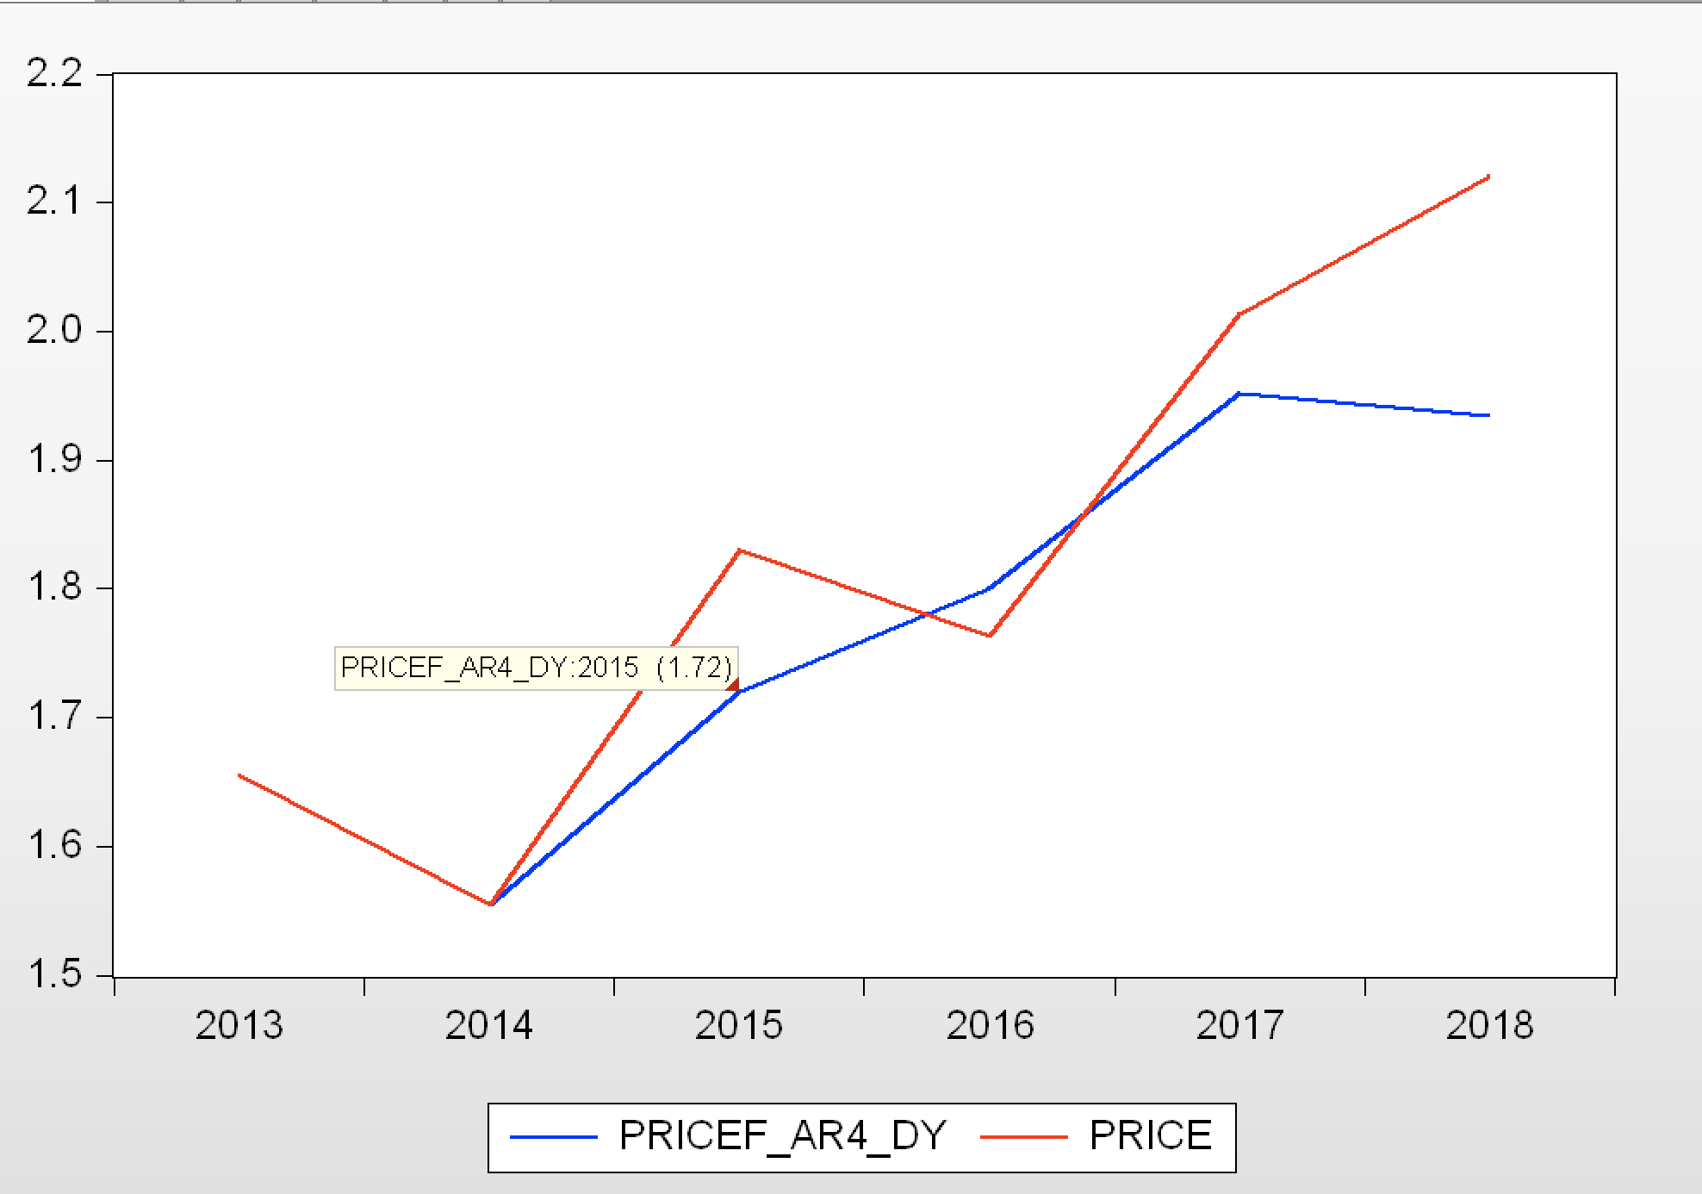
RESULTS – PRICE FORECAST

Slide 5
CHALLENGES
Time Constraint
Low data availability
Some influencers are hard to quantify
(relative harvest time, pollination, etc.)

Slide 6

Thank You!

