Slide 1
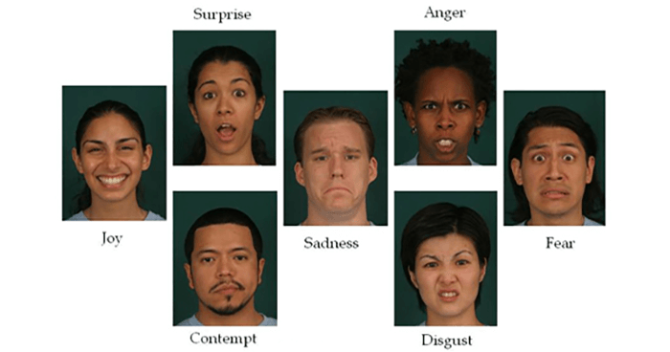


Speech Emotion Analyzer
By:-
Dave Burgman
April Holmes
Neil Lawren
Ipsita Pattanaik

Slide 2

What is Speech Emotion Analyzer?
Human speech contains several features that the listener interprets to unpack the rich information transmitted by the speaker. The speaker also inadvertently shares tone, energy, speed, and other acoustic properties, which helps capture the subtext or intention and literal words.

Slide 3
How does Speech Emotion Analyzer Work?
Scientists apply various audio processing techniques to capture this hidden layer of information that can amplify and extract tonal and acoustic features from speech.
Converting audio signals into numeric or vector format is not as straightforward as images. The transformation method will determine how much pivotal information is retained when we abandon the “audio” format.

Slide 4
Open Source Dataset
Toronto emotional speech set (TESS) Collection https://tspace.library.utoronto.ca/handle/1807/24487
The Ryerson Audio-Visual Database of Emotional Speech and Song (RAVDESS) https://zenodo.org/record/1188976

Slide 5

Methodology
Processing: The removal of unwanted noise signal from speech
Feature extraction: Extract the feature from the audio files which then used to identify how we speak
Classification: Match the feature with corresponding emotions

Slide 6
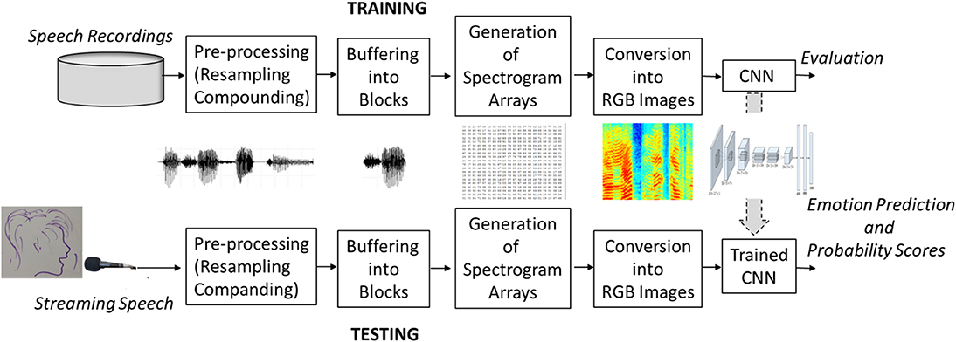
Training and Testing Process flow diagram

Slide 7

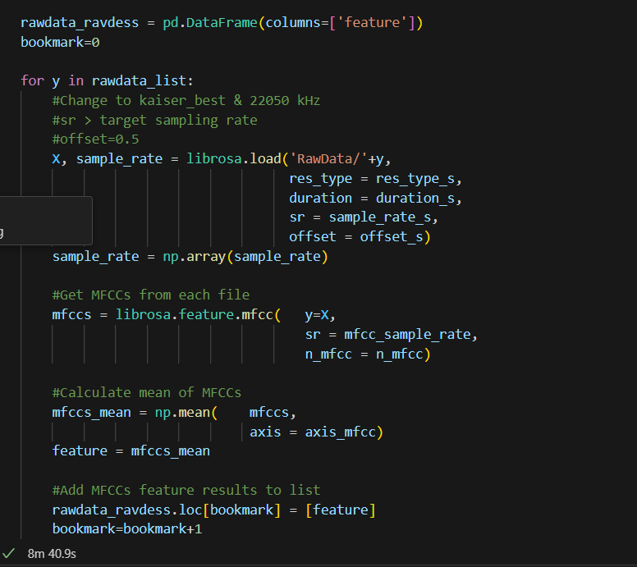
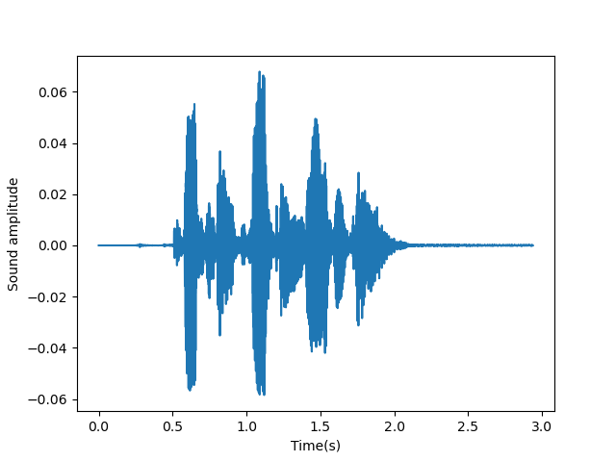
Process
Turn sounds into bits and numbers: The first step in working with audio files is how to turn an audio wave into numbers so that you can feed this into your machine learning algorithm.
Build a spectrogram of the audio file
Play audio file sample:

Slide 8
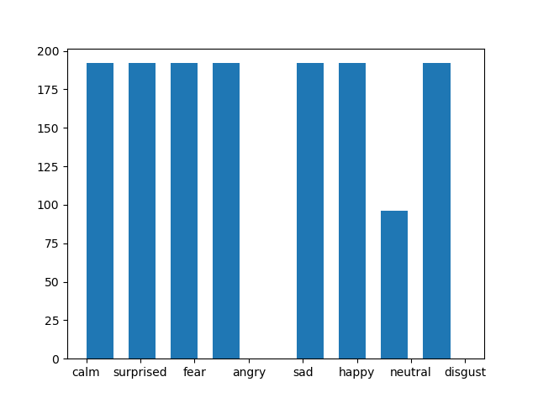
Histogram of emotions in samples

Slide 9

Process
Divide and train test data
Divided the data into test and train with a 20% split in order to start preparing dataframe for our model.
Label encoding
Encode emotion labels into numbers: Since you are using strings for your emotions, it is important that you use label encoding to transform these emotions into numbers; otherwise, your model just won’t run!
Scaling data
This step is very important as it will prevent your model to fit the volume level of your audio recordings.

Slide 10
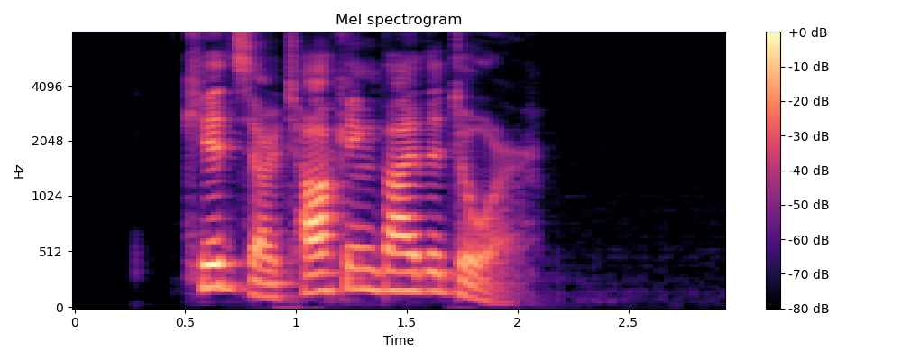
Even though a spectrogram is a great way to visually see an audio wave, you need to still need to use the Mel Frequency Cepstral Coefficient in order to extract the features from your audio files. MFCCs is the best way to capture audio features and similar to how the human auditory system processes sound and frequencies. The Mel scale will basically transform linear frequencies to a log scale.
Mel Frequency Cepstral Coefficient

Slide 11
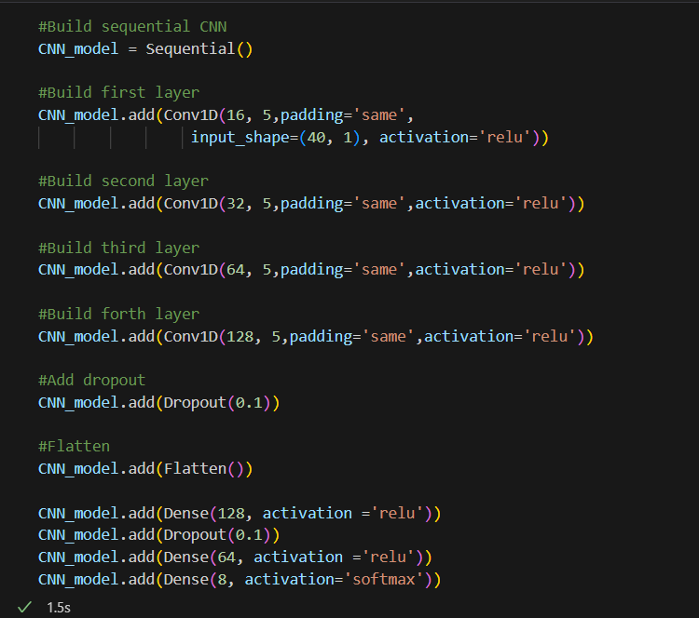
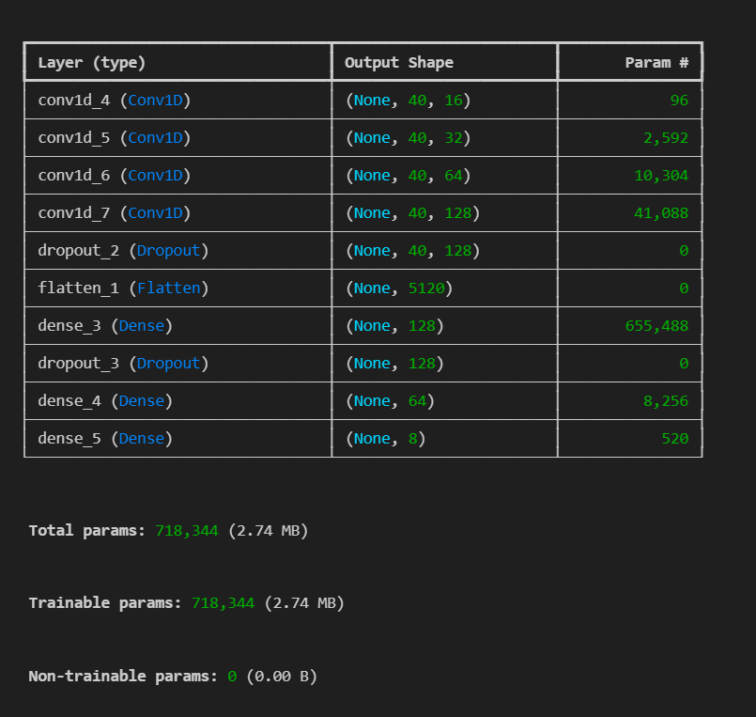
Building the CNN model

Slide 12
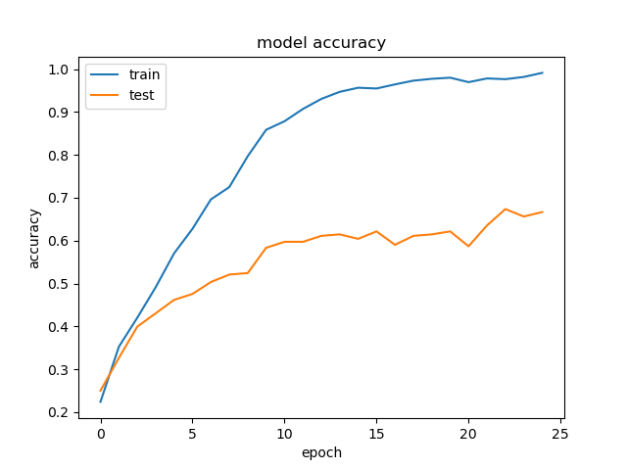
CNN model accuracy
Compile the model with the desired loss function, optimizer, and metric to optimize
CNN_model.compile(loss = 'categorical_crossentropy',
optimizer = 'Adam',
metrics = ['accuracy’])
Pre-training accuracy: 66.6667%
The model went through 25 epochs and maxes out at 10–12 epochs with a 67% accuracy
Training Accuracy: 0.9982638955116272
Testing Accuracy: 0.6666666865348816

Slide 13
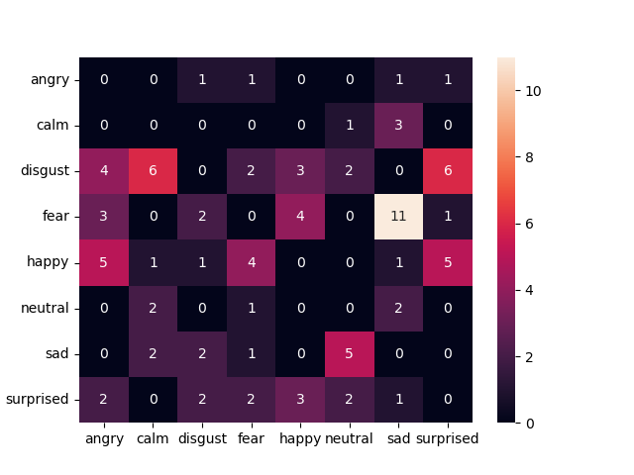
A confusion matrix in order to visualize what audio files are being misclassified

Slide 14

Potential Uses
Business Marketing
Voice Assistance
Mental health Assessment
Human Computer interaction

Slide 15

Challenges
Handling the class imbalance in the dataset, which we addressed using oversampling techniques.
Optimizing hyperparameters to prevent overfitting.
Need to reduce the number of audio files used to test and train due to processing limitations on our computers

Slide 16

Future Work
The system could take into consideration multiple speakers from different geographic locations speaking with different accents
Study shows people suffering from autism have difficulty expressing their emotions explicitly. Image based speech processing in real time can prove to be a great assistance.
Though standard feed forward MLP is powerful tool for classification problems, we can use CNN, RNN models with larger dataset and high computation power machine and compare between them.

Slide 17


