Slide 1
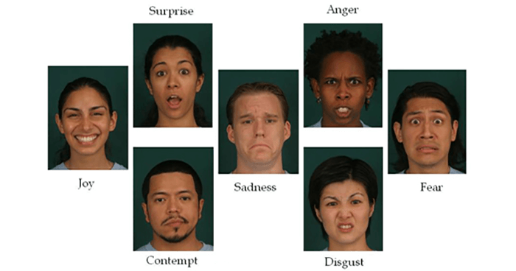


Speech Emotion Analyser

Slide 2
Open Source Dataset
Toronto emotional speech set (TESS) Collection https://tspace.library.utoronto.ca/handle/1807/24487
The Ryerson Audio-Visual Database of Emotional Speech and Song (RAVDESS) https://zenodo.org/record/1188976

Slide 3

What is Speech Emotion Recognition?
Human speech contains several features that the listener interprets to unpack the rich information transmitted by the speaker. The speaker also inadvertently shares tone, energy, speed, and other acoustic properties, which helps capture the subtext or intention and literal words.

Slide 4
How does Speech Emotion Recognition Work?
Scientists apply various audio processing techniques to capture this hidden layer of information that can amplify and extract tonal and acoustic features from speech.
Converting audio signals into numeric or vector format is not as straightforward as images. The transformation method will determine how much pivotal information is retained when we abandon the “audio” format.

Slide 5

Methodology
Processing: The removal of unwanted noise signal from speech
1
Feature extraction: Extract the feature from the audio files which then used to identify how we speak
2
Classification: Match the feature with corresponding emotions
3

Slide 6
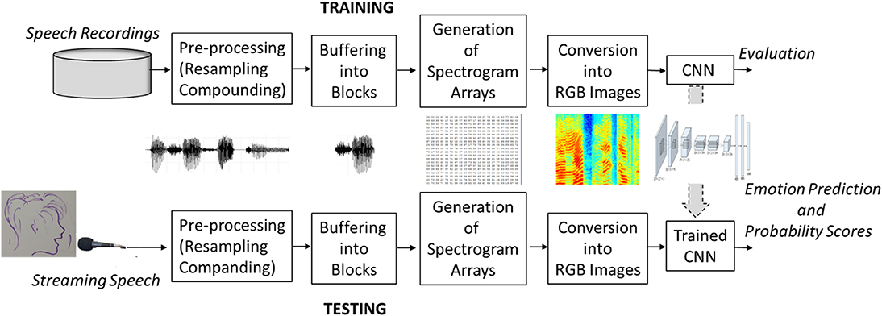
Training and Testing Process flow diagram

Slide 7
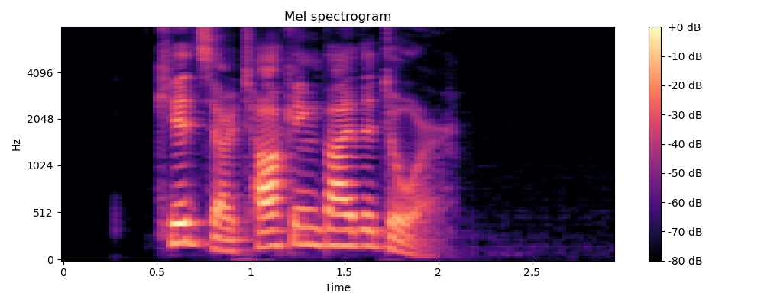

Slide 8
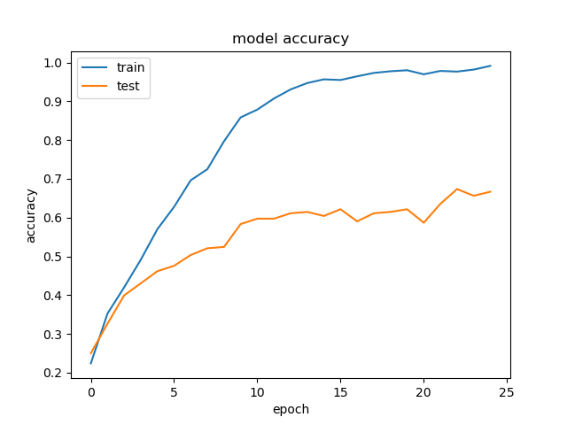

Slide 9
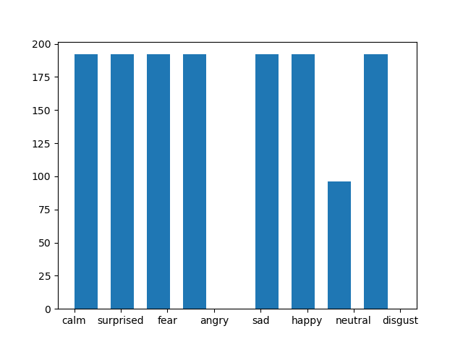

Slide 10
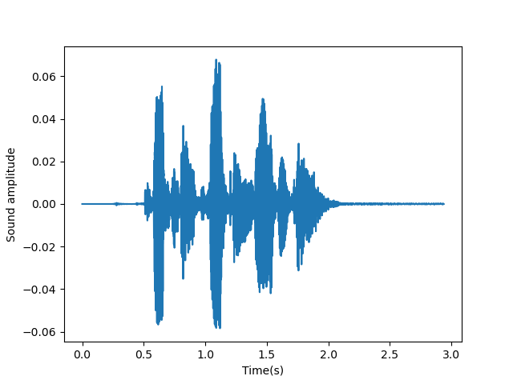

Slide 11
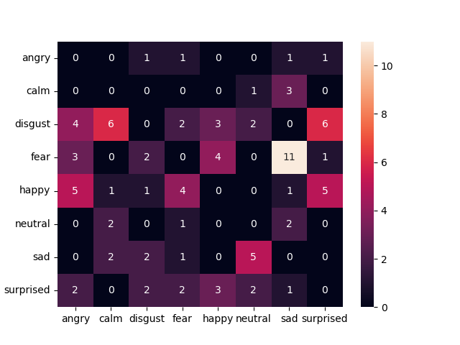

Slide 12
Applications
Business Marketing
Voice Assistance
Suicide Prevention

Slide 13

Future Work
The system could take into consideration multiple speakers from different geographic locations speaking with different accents
Study shows people suffering from autism have difficulty expressing their emotions explicitly. Image based speech processing in real time can prove to be a great assistance.
Though standard feed forward MLP is powerful tool for classification problems, we can use CNN, RNN models with larger dataset and high computation power machine and compare between them.

Slide 14


