Slide 1
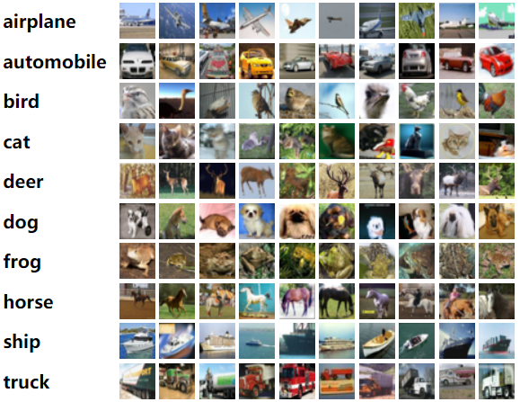
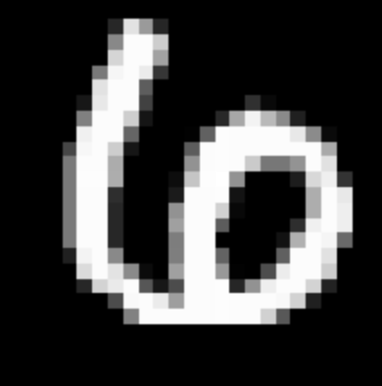
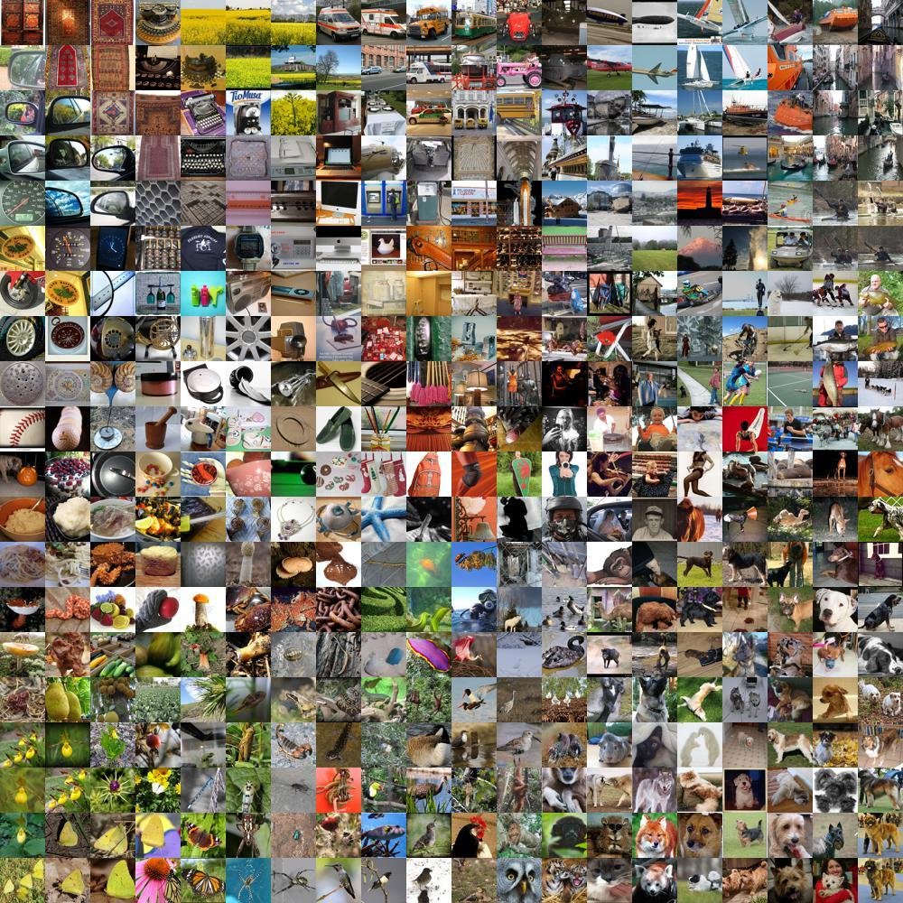
Cifar10
Conv1
1 channel
Resnet18
L
512 ➡️ encoding size
Quantum Layer
L
Boson sampler ➡️ 10
‘6’
ImageNet
Conv1
1 channel
Resnet18
L
512 ➡️ encoding size
Quantum Layer
L
Boson sampler ➡️ 10
‘6’

Slide 2
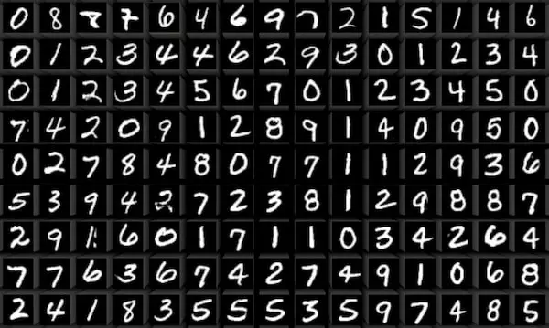
MNIST
Resnet18
L
512 ➡️ encoding size
Quantum Layer
L
Boson sampler ➡️ 10
‘6’
Cifar10
Vanilla
L
512 ➡️ encoding size
Quantum Layer
L
Boson sampler ➡️ 10
‘6’

Slide 3
MNIST
Classical data
Quant data
Resnet18
L
512 ➡️ encoding size
Quantum Layer
L
Boson sampler ➡️ 10
‘6’

