Slide 1
Homework 7
Ding Jieqiong
https://github.com/Aprillll-7/Creative-Computing-2023-FALL/tree/main

Slide 2
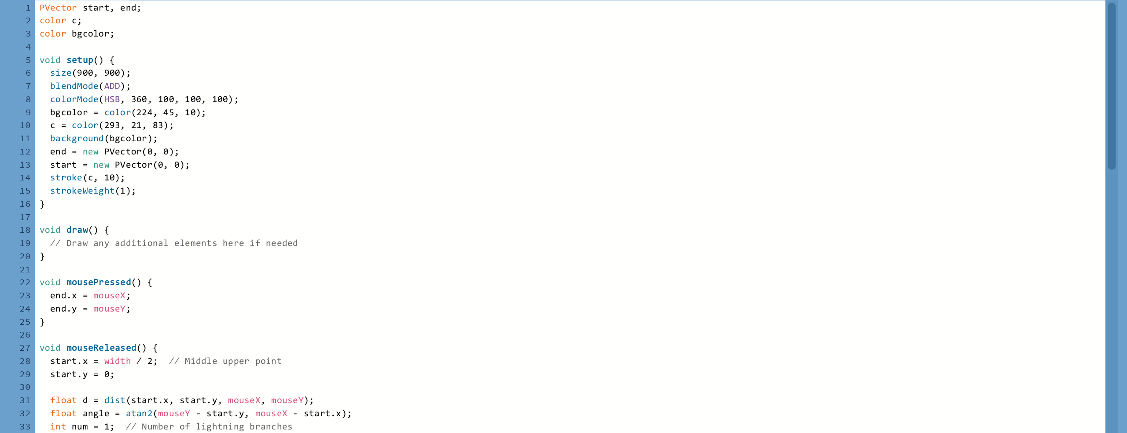
Code

Slide 3
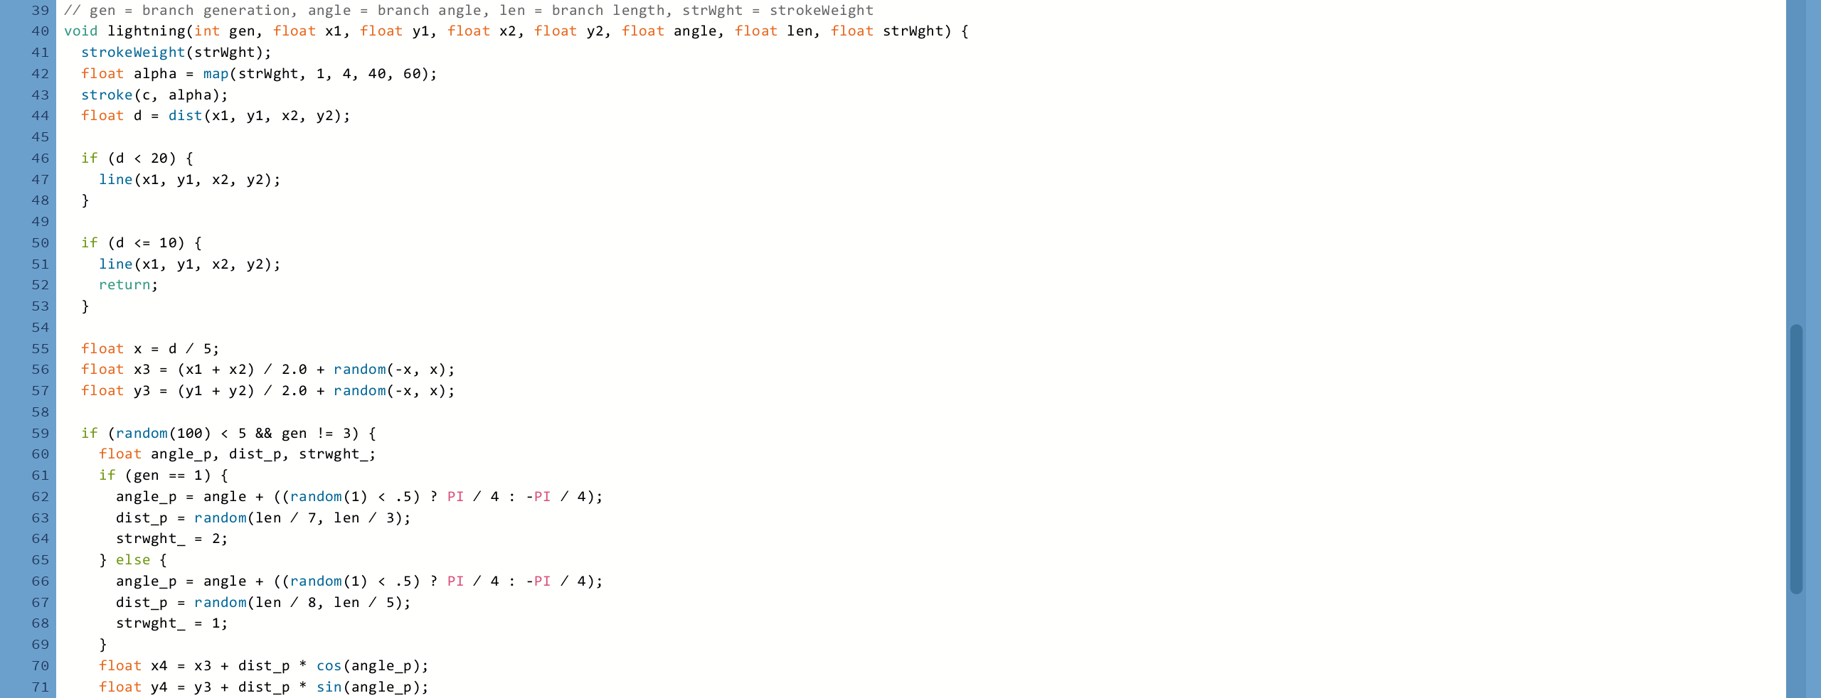


Slide 4

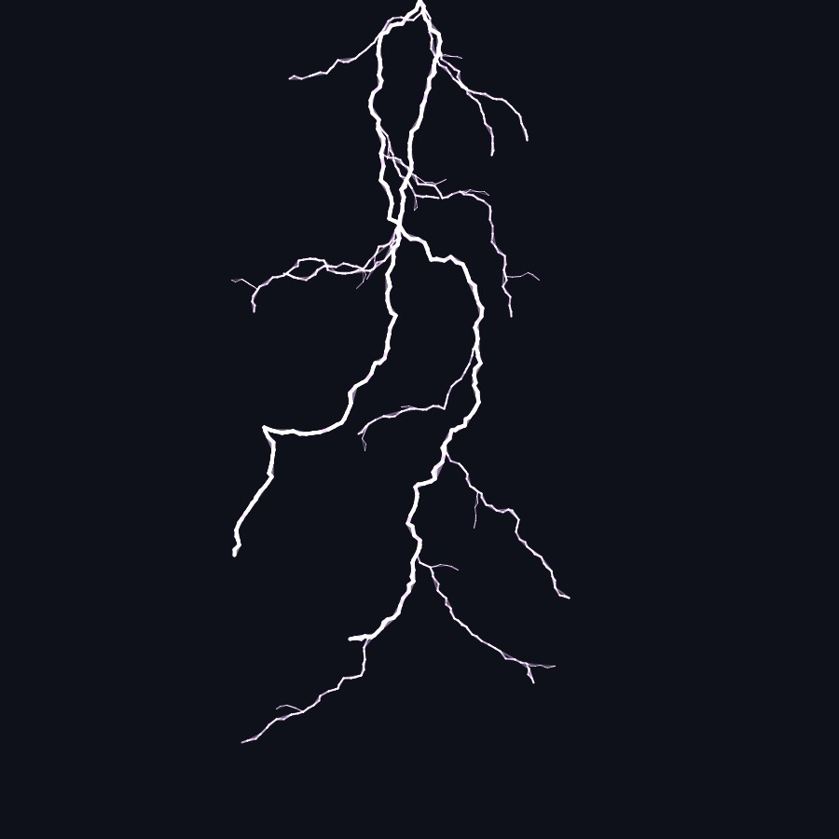
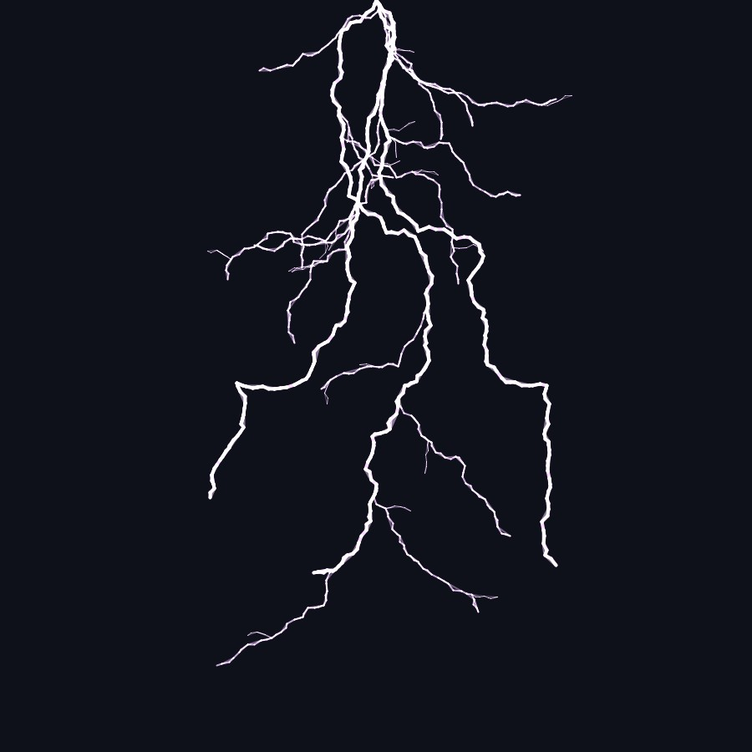

Slide 5
