Slide 1
Homework 7
Ding Jieqiong | Creative Coding
https://github.com/Aprillll-7/Creative-Computing-2023-FALL/tree/main

Slide 2



Code (CylinderMesh)

Slide 3


Code (Triangle)

Slide 4

Code (Triangle)

Slide 5


Code (UI)

Slide 6
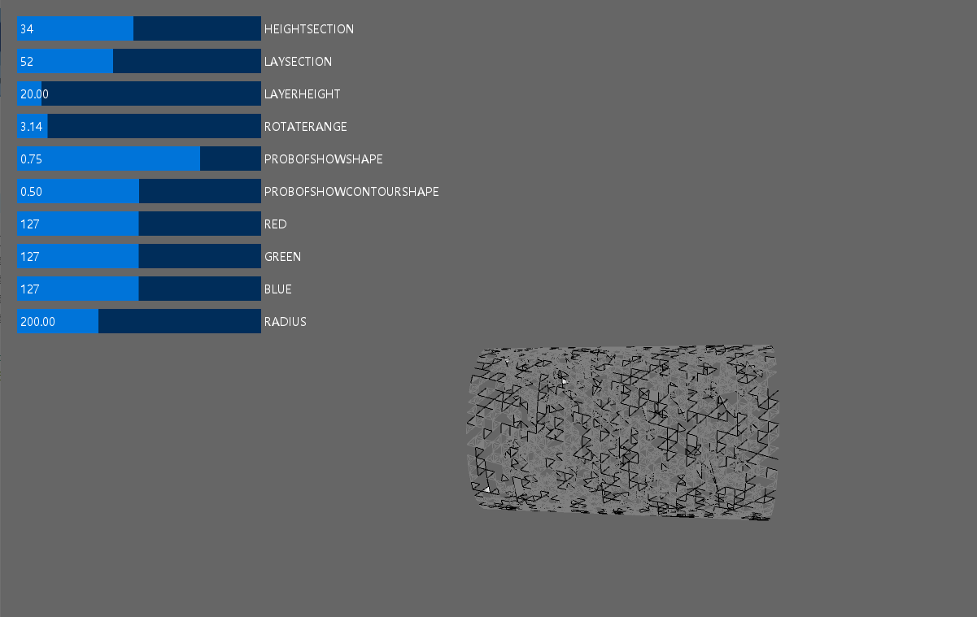
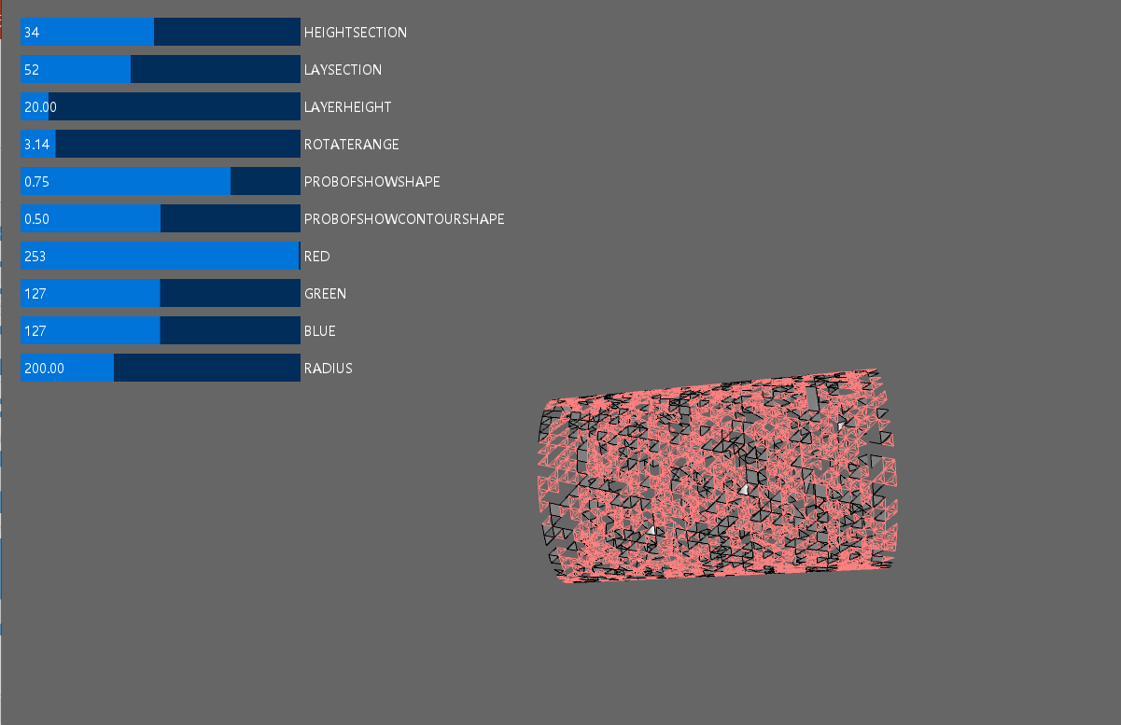
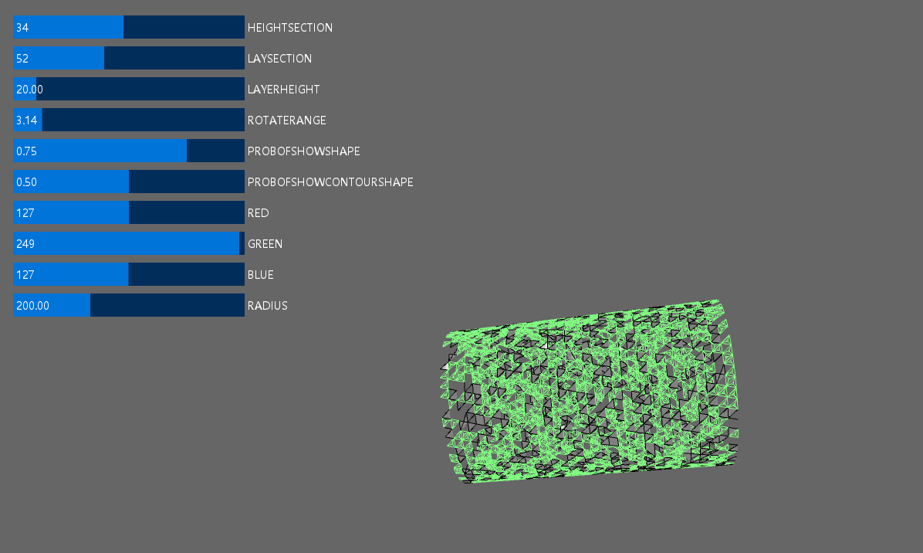
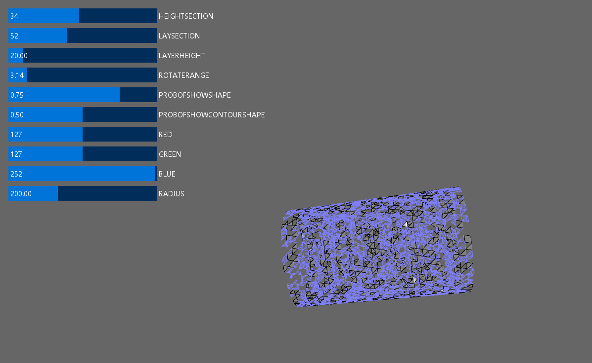

Slide 7
