Slide 1
Valhacks hackathon 2024
Lucas Vilsen & Alexander Wittrup

Slide 2
Problems
Data quality
Data quantity
Data distribution

Slide 3
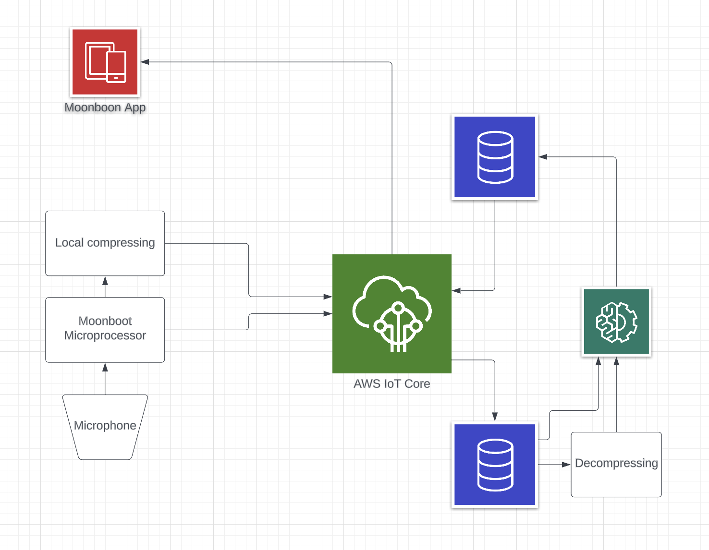
Cloud structure

Slide 4
Compression
Lossy Compresion methods (MP3)
Lossless compression (FLAC, Wav)
MPEG-4-SLS (Scalable, lossless)

Slide 5
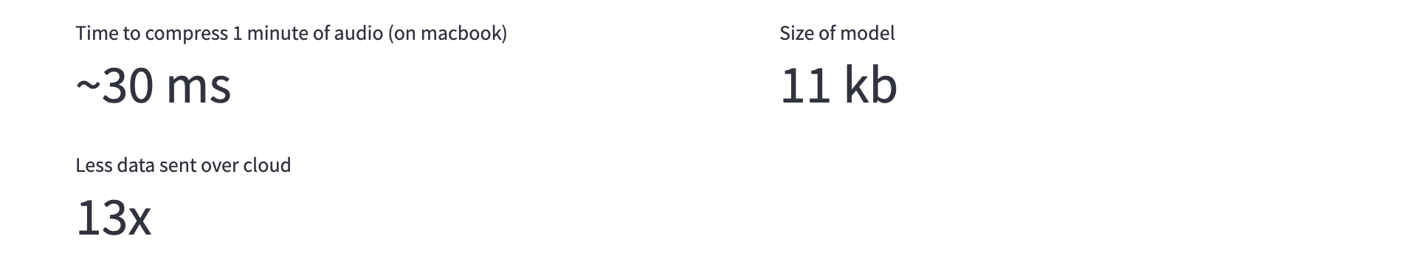
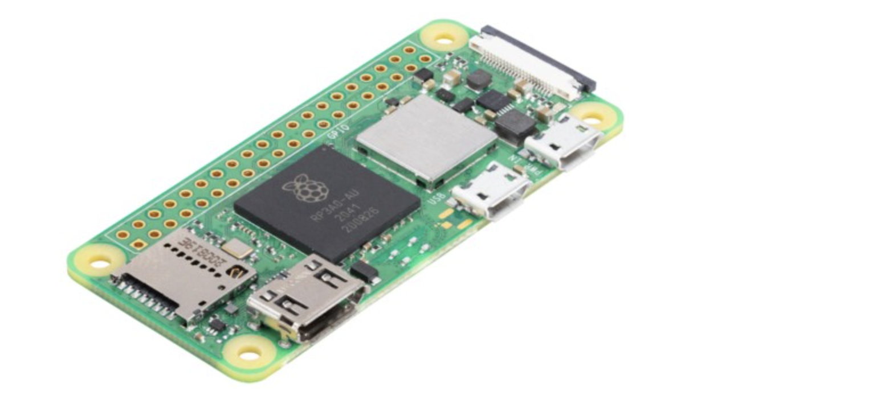
Compression

Slide 6
Classification
Crying
Breathing
Nothing

Slide 7
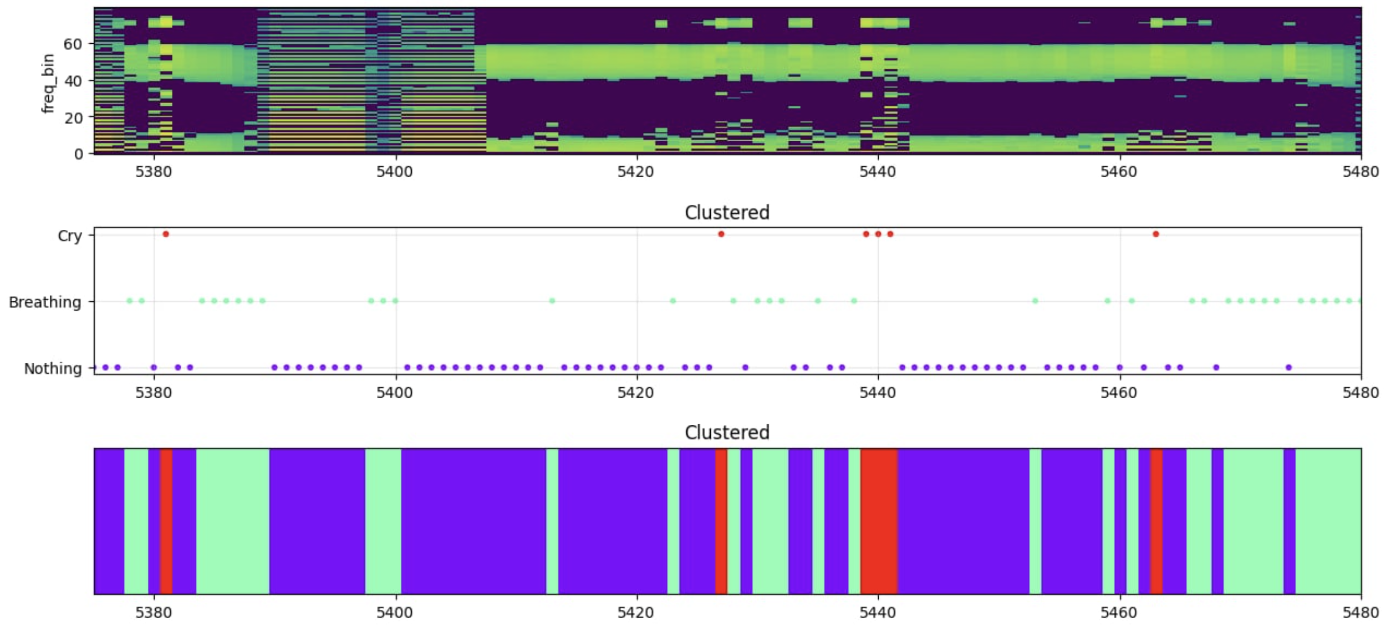
Classification

Slide 8
Classification

Slide 9
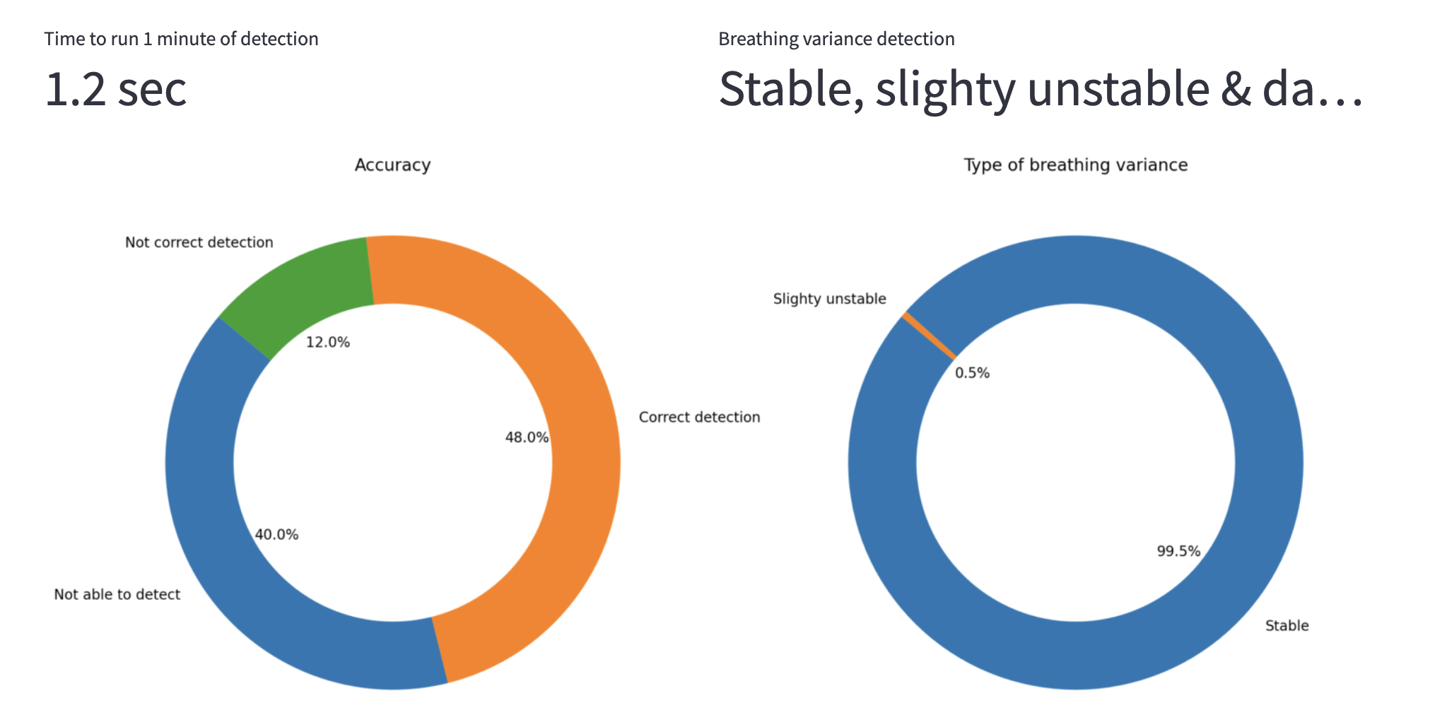
Breathing Cadence

Slide 10

Examples
Succesful: 20.17 Breaths per minute, Stable
Unsuccesful: 27 Breaths per minute, Stable

Slide 11
Improvements
Manual data labelling
More extensive testing
Stabilize models with more training

Slide 12
Code
https://github.com/Apros7/Hackathons/tree/main/Valhacks2024

