Slide 1
数据结构基础
Fundamentals of Data Structures
主讲教师： 朱建科
Instructor: ZHU, JIANKE
E-mail: jkzhu@zju.edu.cn
Courseware and homework sets can be downloaded from http://www.cs.zju.edu.cn/ds/

Slide 2



 教材 (Text Book)
Data Structures and
Algorithm Analysis in C
(2nd Edition)
Mark Allen Weiss
陈 越 改编
Email: weiss@fiu.edu

Slide 3
 参考书目 (Reference)
➢ 数据结构与算法分析（C语言版）
魏宝刚、陈越、王申康 编著 浙江大学出版社
➢ Data Structures, Algorithms, and Applications in C++
数据结构算法与应用——C++语言描述 （英文版）
Sartaj Sahni McGraw-Hill & 机械工业出版社
➢ 数据结构课程设计
何钦铭、冯雁、陈越 著 浙江大学出版社

Slide 4

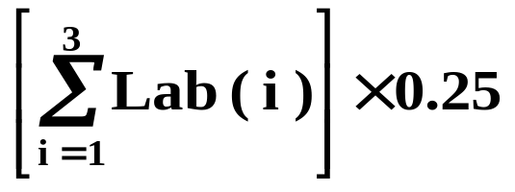
课程评分方法 (Grading Policies)
 Lecture Grade (75) = Homework Exercises (10)
+ Quizzes (10)
+ Mid-Term Exam (15*)
+ Final Exam (40*)
 Laboratory Grade (25) =

Slide 5
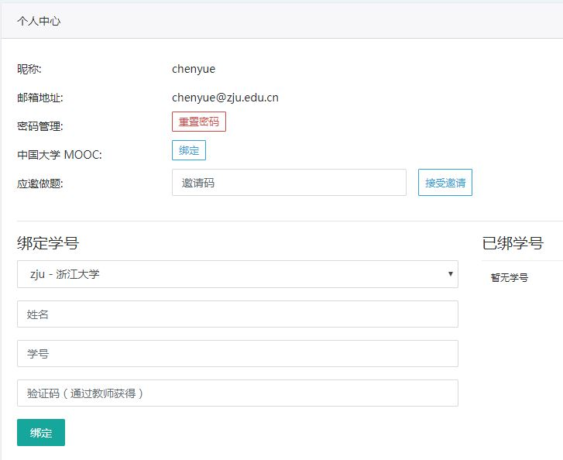

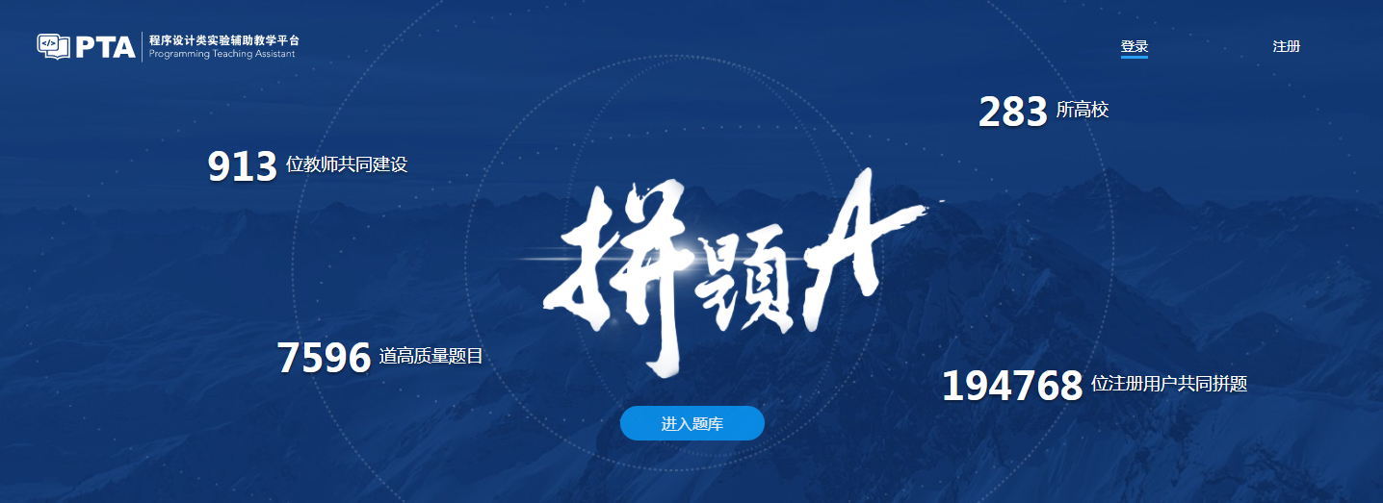
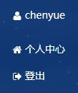
作业 (Homework Assignments)
Register and login at https://pintia.cn/
Bind your student ID with bind key
Enter

Slide 6
测验 (Quizzes)
 Random Quizzes
 10 minutes and 10 points each
 Problems will be chosen from HW

Slide 7
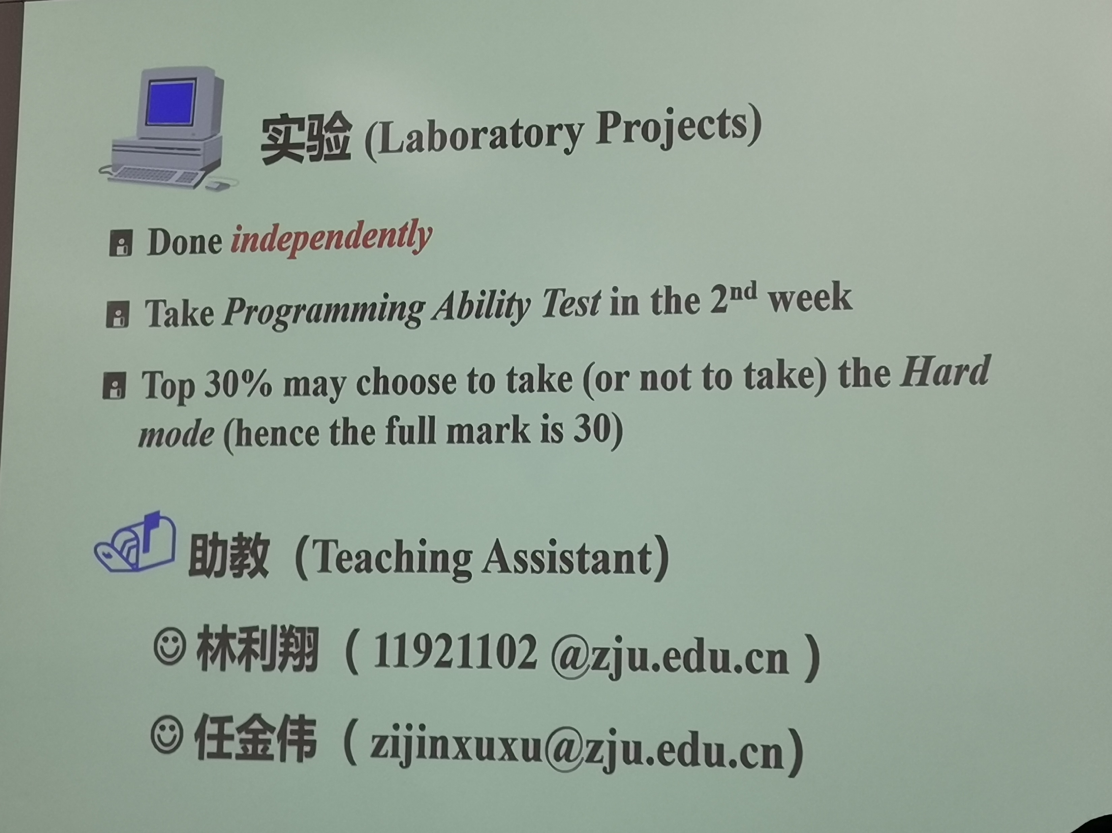

Slide 8


实验 (Laboratory Projects)
Peer Review
Grade= G_{TA} × 50% + G_{PR} × 50%

Slide 9
Peer review is for the reviewer
Editing someone else’s work is one of the best ways to learn how to edit your own
  It’s much easier to see what’s working and what isn’t in someone else’s paper than in your own.
Writing is revision
  The more you practice reading and critiquing someone else’s work, the stronger your editing skills will be when it’s time to apply them to your own work.
Any skill level works
  You can learn a great deal about the fundamentals of good writing from carefully reading and reviewing poor writing, figuring out why it’s not succeeding and what it needs to succeed.

Slide 10
Process
Submit initial version for peer review (1 week) at http://zjuhw.rqnoj.cn
Participate in peer review (2 days)
Revise paper and submit to TA (2 days) at http://www.cs.zju.edu.cn/ds/
Receive final grading from TA

Slide 11
诚信守则
（Code of Academic Honesty）
One must get a full mark to be eligible to take the final exam.
As long as there is one action of academic dishonesty in this semester, one will not be eligible to take the final exam and one’s course score will be zero.

