Slide 1
Processing Data with Kafka Streams through Confluent Cloud
Developers: Ryan Apsche, John Wilson, Jake Weidokal
Project Manager: Brian Krebs
Sponsored by: Jeff Hassler and David Mooter
Special thanks: John Roberts

Slide 2
Our goal
Find and read multiple real time data streams
Use Kafka to process the data
Use a streams processor to enrich the data
Set up the system with Confluent Cloud
Notes:
Image Creds
https://www.confluent.io/blog/the-future-of-etl-isnt-what-it-used-to-be/

Slide 3
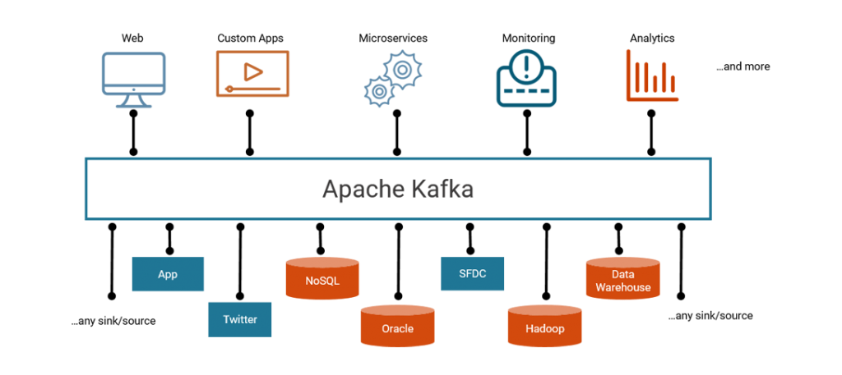
What is kafka
Open source streaming platform
Publish and Subscribe model

Slide 4

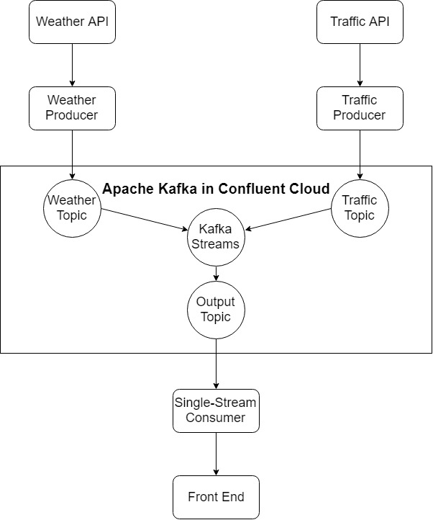
Architecture

Slide 5
Confluent cloud
Apache Kafka as a service
Removes need for managing clusters and brokers
High scalability, designed with mission-critical enterprise applications in mind

