Slide 1

Department of Information Technology
NBA Accredited A.P. Shah Institute of Technology G.B.Road,Kasarvadavli, Thane(W), Mumbai-400615 UNIVERSITY OF MUMBAI Academic Year 2022-2023

Slide 2
A Project Report on A.R based App For College Campus Navigation Submitted in partial fulfillment of the degree of Bachelor of Engineering(Sem-8) in INFORMATION TECHNOLOGY By Sameer Sawant (19104054) Raj Shisode(19104070) Prathmesh Shrirao(19104016) Under the Guidance of Prof. Mandar Ganjapurkar
Prof. Shweta Mahajan

Slide 3
1.Project Conception and Initiation

Slide 4
1.1 Abstract
Indoor positioning has gained popularity recently due to its potential to be used in the increasing complexity of indoor environments.
Although GPS is widely used for navigation purposes, GPS uses satellite links for pinpointing the location, GPS is not recommended for indoor navigation because satellite signals may be difficult to penetrate tall buildings.
The Augmented Reality (AR) navigation systems can provide a new experience compared to conventional navigation on 2D maps.
Nowadays AR finds its involvement in various fields along with its smart application software which can be used in different fields including education, entertainment, navigation, and many more.

Slide 5
1.2 Objectives
Enhance user experience: The use of AR technology in indoor navigation systems can significantly enhance the user experience by providing real-time, interactive and immersive visual aids.
Using OCR: Implementing OCR to identify classroom numbers, can improve the efficiency and accuracy of navigation systems and help individuals find their destination more easily.
Increase efficiency: AR-based indoor navigation systems can help users navigate through complex indoor environments more efficiently by providing the shortest and most optimized route to their destination.
Render directions: Once the route has been calculated, the navigation system then renders directions on the screen in a clear and user-friendly way. This may include turn-by-turn directions, visual cues such as arrows and landmarks.

Slide 6
1.3 Literature Review
Title: Indoor Navigation system using visual position system with augmented reality.
Author: Ravinder Yadav, Vandit Jain, Himanika Chugh
Summary:
This study suggests a development strategy for an augmented reality and image processing-based interactive indoor navigation system.
In this project, computer produced 3D graphics are superimposed on user's mobile screen using the AR Toolkit (open source AR software).
Two crucial tasks are performed by the AR toolkit: perspective tracking and virtual object interaction. The camera angle and location can be determined in real time using the AR toolkit.
After determining the position of the actual camera, ARtoolkit lines up the virtual camera with the actual camera before drawing 3D computer graphics precisely over the actual marker.

Slide 7
1.3 Literature Review
Title: AR-based Navigation Using Hybrid Map.
Author: Yanlei Gu Woranipit and Chidsin Igor Goncharenko
Summary:
This research suggests a marker-free indoor navigation system based on augmented reality. The suggested system uses SLAM (Simultaneous Localization and Mapping)to create a point cloud map.
It executes positioning and navigation using a cutting-edge hybrid map that combines 3D point cloud data and an indoor environment floor map. Positioning and navigation are controlled by the data in the floor maps and point cloud, respectively.
In order to demonstrate the viability of the suggested navigation system, tests are conducted in the hallway of a substantial construction.

Slide 8
1.3 Literature Review
Title: Design of a Mobile Augmented Reality-based Indoor Navigation System.
Author: Xin Hui Ng, Woan Ning Lim
Summary:
In order to give users with an immersive navigation experience, the suggested system merges AR technology with the built-in sensors that are already present in the majority of mobile devices to determine the user's location.
In this project, a smartphone app for indoor navigation was created and put to the test.
The research paper shows how to use IndoorAtlas, a tool that enables indoor positioning through technology fusion to determine a user's location and calculate a path to a destination, in conjunction with ARCore to display augmented reality guidance using the computed route

Slide 9
1.4 Problem Definition
Problems Identified:
The current navigation system requires the user to continuously map their own position in the navigation application with the real-world environment.
The identification of nearby places of unknown locality is difficult as one has to ask for information and reviews which can be often can be misleading.
Users can’t keep looking for help desks or navigation billboards inside a large organizational building to reach their destination.

Slide 10
1.5 Scope
Can assist people who are lost huge in indoor spaces.
Can help large organizations to conduct events like examinations , admission process, concert or any other big scale event.
Can provide relief to people who are not familiar with the surroundings of a building.

Slide 11
1.6 Technology stack
Android Studio
Google ML Kit
SceneView library
Optical Character recognition.

Slide 12
1.7 Benefits for environment & Society
Can fully digitalise the navigation system as there is no need of huge boards which depict indoor maps.
Can save a lot of time for anyone who often gets confused while using 2d navigation system like google maps.
Will help people to navigate faster within closed surroundings without any external help.

Slide 13
2. Project Design

Slide 14
2.1 Proposed System
Feature 1:
User will be able to locate his own position in real time with the help of camera as he wouldn’t have to remap their own location simultaneously as is the case with 2d map application.
Feature 2:
User will be able to find his directions without any assistance from external sources as the direction pointers will be directly shown on the user’s mobile screen.
Feature 3:
User will be suggested with the shortest path between user’s current location and user’s preferred destination.

Slide 15
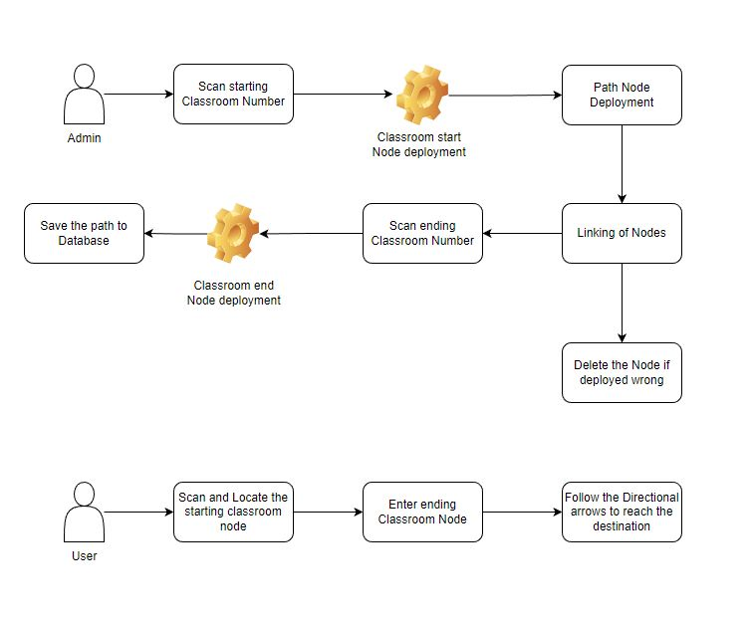
2.2 Design(Flow Of Modules)
Fig 1. System Architecture

Slide 16
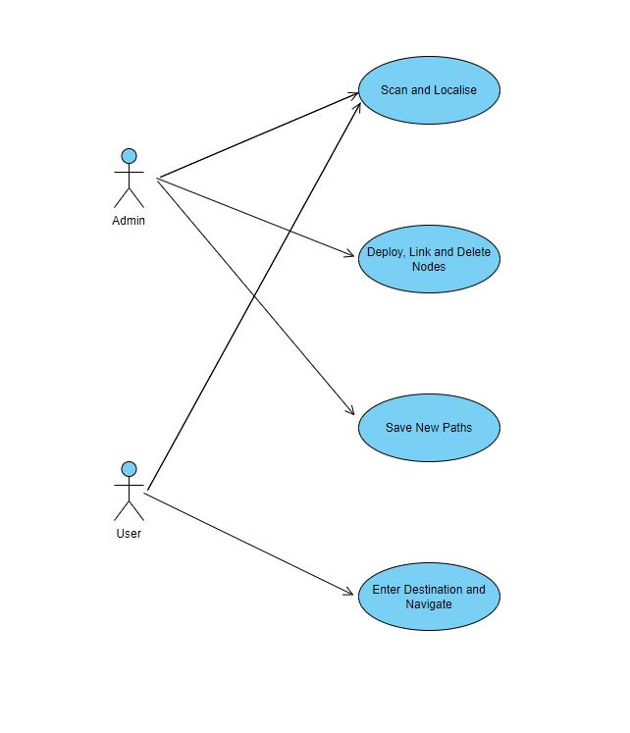
2.3 Description Of Use Case
Fig 2. Use Case Diagram

Slide 17
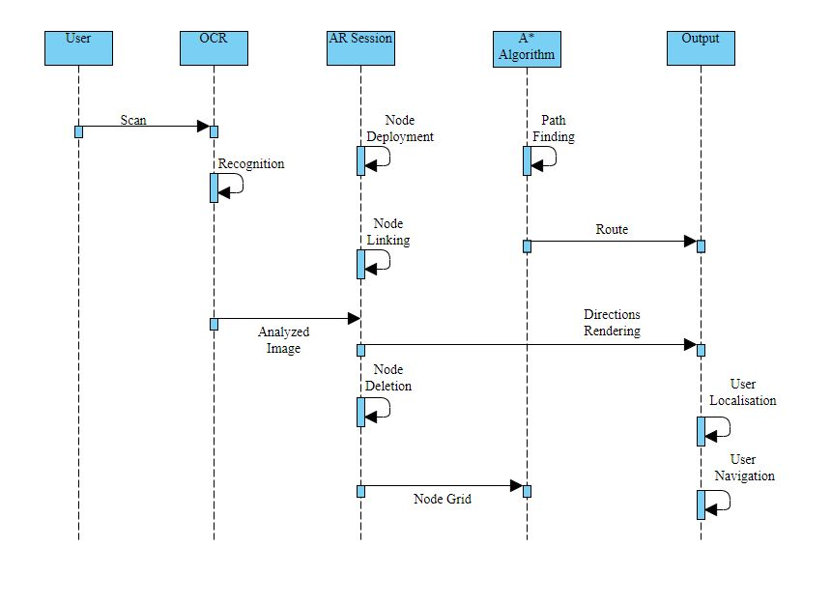
2.4 Activity diagram
Fig 3. Sequence Diagram

Slide 18
3. Implementation

Slide 19
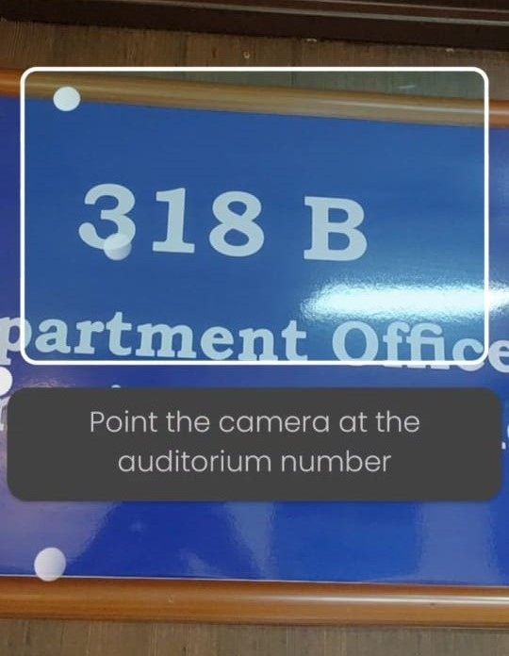
3.1 Implementation:
The method described in this research paper uses optical character recognition (OCR) to identify classroom numbers and generates nodes for augmented reality (AR) navigation.
The system takes pictures of classroom doors with a smartphone camera, which are then analyzed with OCR to identify the classroom number.
An AR navigation system can then be used to direct students to their classrooms by using the recognized number to construct a node in the system.
Fig 4.Scanning the Room Number

Slide 20
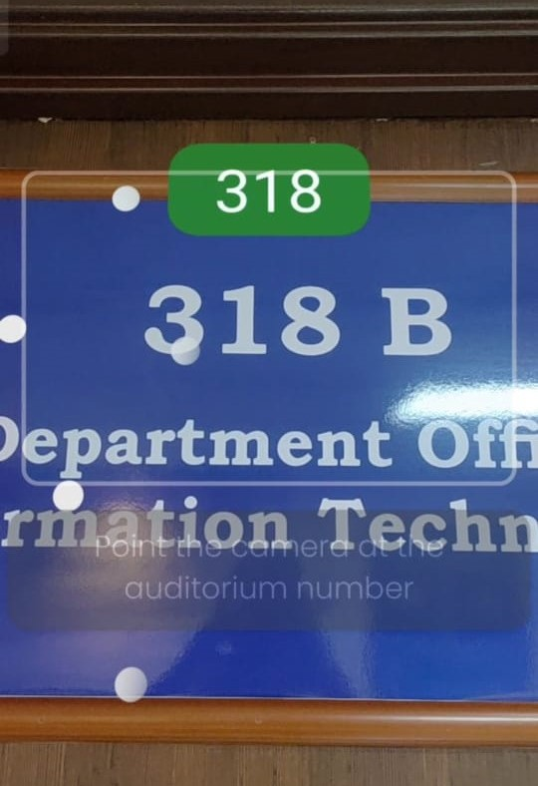
The two primary parts of the proposed system are OCR and AR navigation. The collected image is sent into an OCR engine during the OCR stage in order to identify the classroom number.
The identified classroom number is then utilized to generate a node in an AR navigation system, which can be used to navigate students to their classrooms, in the stage of AR navigation.
Fig 5.OCR helps to Scan the Room Number

Slide 21
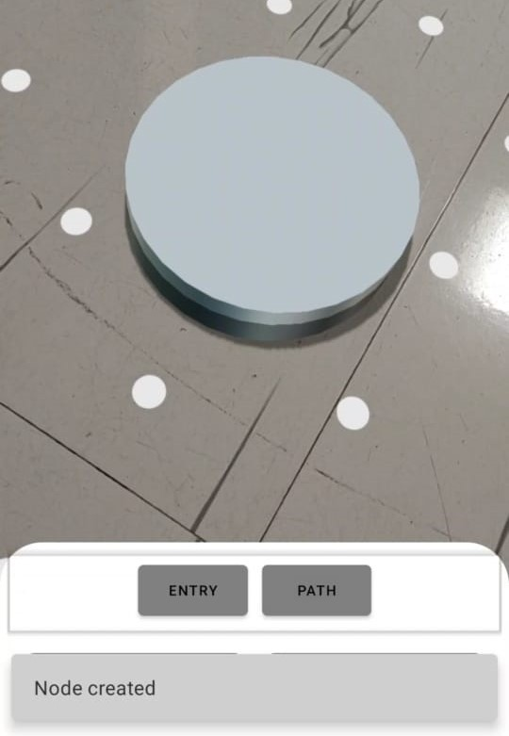
The adjacent image shows a node has been created and stored.
Node Deployment: To start, you would need to deploy nodes throughout the indoor space.
Base Node: Once the nodes are deployed, you would need to select a base node as the starting point for the navigation system. This base node would serve as the origin for the coordinate system used to navigate through the indoor space.
Fig 6. Node Deployed

Slide 22
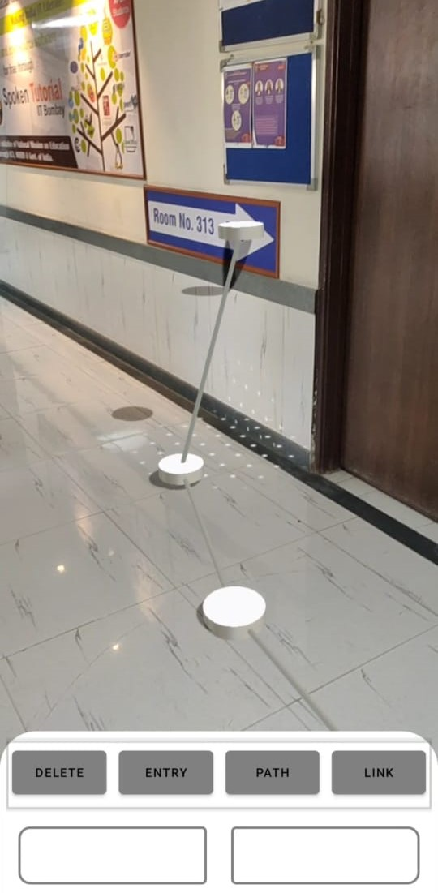
Node Layout: Next, you would lay out additional nodes throughout the indoor space, starting from the base node and placing each node at equal distances from each other.
Network Creation: Once all the nodes are laid out, you can connect them to create a network of interconnected nodes throughout the indoor space. This network can be used to track the user's location in real-time and provide turn-by-turn navigation guidance.
Fig 7. Node Grid

Slide 23
4. Testing

Slide 24
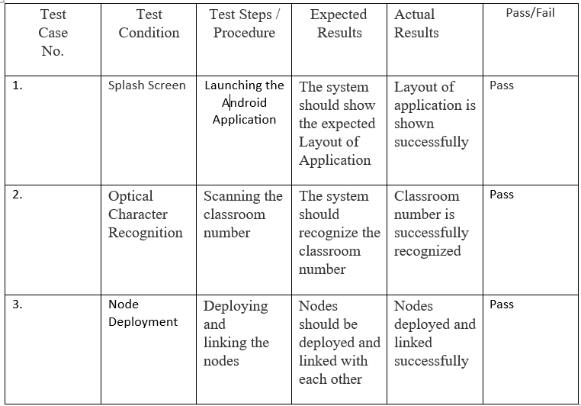

Slide 25
5. Result

Slide 26
5.1 Result:
The whole system describes the process of displaying a built route in 3D space using
SceneView AR library.
The shortest route is determined using the A* algorithm, which is an efficient pathfinding algorithm commonly used in navigation systems.
Once the route is established, path smoothing is performed using Bezier curves, which help to create a smoother and more visually appealing path for the user.
Overall, this approach allows for accurate and efficient navigation in augmented reality environments

Slide 27
6. Conclusion and Future Scope

Slide 28
5.1 Conclusion:
The primary goal of this project is to give a simple and unhindered way to move inside enormous, complex buildings without the need for outside assistance. Prior to deploying nodes on the college map to start the entire indoor navigation, we first scan and localize the indoor area(in this example, the classroom number).
It asks for the user's present position and the final destination location before using the A* algorithm to map the quickest route between the two spots.
The accuracy of path finding was increased by recursively scanning the grid nodes with the A* algorithm.
The application guides the user by using graphically created directing Arrows that are then superimposed on the user's mobile screen.

Slide 29
References
“Indoor Navigation system using visual position system with augmented reality”, 2018 International Conference on Automation and Computational Engineering (ICACE - 2018).
Yanlei Gu, Woranipit Chidsin ,Igor Goncharenko “AR-based Navigation Using HybridMap”, 2021 IEEE 3rd Global Conference on LifeSciences.
Xin Hui Ng, Woan Ning Lim “Design of a mobile Augmented Reality – based indoor navigation system.”, 2020 4th International Symposium on Multidisciplinary Studies.

Slide 30
Paper Publication:
Paper entitled “AR App for College Campus Navigation” is presented at “International Conference on Contemporary Challenges in Science and its Engineering Applications (IC3SEA 2023)” by ”Sameer Sawant, Raj Shisode, Prathmesh Shrirao, Prof. Mandar Ganjapurkar, Prof. Shweta Mahajan”.

Slide 31
Thank You

