Slide 1

Department of Information Technology NBA Accredited
A.P. Shah Institute of Technology
G. B. Road, Kasarvadavli, Thane(W), Mumbai-400615
UNIVERSITY OF MUMBAI
Academic Year 2022-2023

Slide 2
Eshop: Comprehensive Blockchain based Web Framework
for E-commerce
A Project Report on
Submitted in partial fulfillment of the degree of
INFORMATION TECHNOLOGY
By
Sakshi Shinde(19104055) Anurag Singh(19104003) Shubhangi Lanke(19104064)
Under the Guidance of
Prof. Manjusha Kashilkar

Slide 3
1. Project Conception and Initiation

Slide 4
1.1 Abstract
Counterfeit products play an important role in product manufacturing industries. This affects the companies name, sales, and profit of the companies.
Blockchain technology can used for identification of real products and detect fake products.
To ensure the identification of real products throughout the supply chain, a functional
blockchain technology is used for preventing product counterfeiting.

Slide 5
1.2 Objectives
To ensure everyone's access to original and safe products on portal.
To improve the product supply chain ecosystem's trust and transparency from manufacturer to consumers.
To secure product details using a QR code.
To prevent consumer from receiving counterfeit products.

Slide 6
1.3 Literature Review
Sr. No. | Title | Key Findings | Year
1. | A Survey of Counterfeit Product Detection | Counterfeit products are growing exponentially with the enormous amount of online and black market. This paper discusses various techniques for identifying counterfeit products. | 2019
2. | A Blockchain-Based Supply Chain Quality Management Framework | The proposed framework provides a theoretical basis for intelligent quality management of the supply chain based on blockchain technology. It provides a foundation to develop theories about information resource management in distributed, virtual organizations. | 2019
3. | A Blockchain-Based Application System for Product Anti- Counterfeiting | A decentralized Blockchain system with products anti- counterfeiting, in that way manufacturers can use this system to provide genuine products without having to manage direct-operated stores, which can significantly reduce the cost of product quality assurance. | 2020

Slide 7
1.4 Problem Definition
To ensure the identification of real products throughout the supply chain on E-commerce platform by using a functional blockchain technology for preventing product counterfeiting.

Slide 8
1.5 Scope
Can be useful for building transparency throughout the supply chain.
Can be managed and controlled by different admins.
Can be used by any new user because of the adoptability of the process.

Slide 9
1.6 Technology stack
Frontend :- Html , CSS, JavaScript
Blockchain:- Ethereum, Solidity, Ganache
Platform :- Visual Studio Code

Slide 10
1.7 Benefits for environment & Society
Enhanced security: Your data is sensitive and crucial, significantly change how your critical information is viewed.
and blockchain can
Greater transparency: Without blockchain, each organization has to keep a separate database.
Instant traceability: Blockchain creates an audit trail that documents the provenance
of an asset at every step on its journey.
Automation: Transactions can even be automated with “smart contracts,” which
increase your efficiency and speed the process even further.

Slide 11
2. Project Design

Slide 12
2.1 Proposed System
1. Product Traceability:
A product can be added to the platform with all the necessary details and can trace
their owner at any time.
2. Security:
Blockchain will be used to store all the data also QR code will prevent the data
breaches.
3. Product Verification:
Customer can verify the products using generated QR by just scanning it.

Slide 13
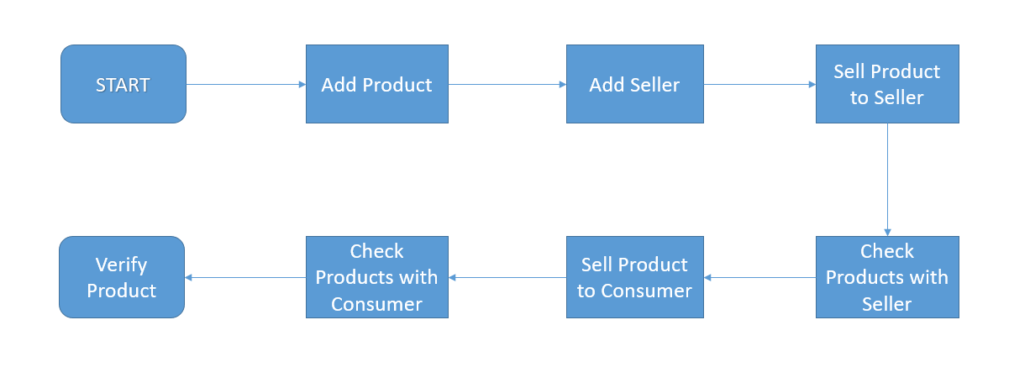
2.2 Design(Flow Of Modules)
Our product anti-counterfeiting system based on Blockchain is composed of three roles, The Manufacturer Role, The Seller Role, and The Consumer role.
Fig. Workflow

Slide 14
Manufacturer: Manufacturer logs into the manufacturer account and adds other required details of the product to add catalogue in the website. Manufacturer is the main entity who creates the blockchain and push the starting values into it. Functions like,
i] Add Products, ii] Add Seller, iii] Sell Product to Seller, iv] Query Seller
Seller: Supplier logs into supplier account and Seller is the intermediate identity who takes the authority from Manufacturer and sells the product to the consumer. Functions like,
i] Show Products for sale, ii] Can sell products to consumer and generate QR code.
Consumer: Customers can check the integrity of the product by scanning QR code which will list the history of transactions and thus verifying the genuinity of the product. Consumer is the end user here who will check the genuineness of product. Functions like,
i] Consumer purchase history, ii] Product Verification.

Slide 15
2.3 Description Of Use Case
Manufacturer will be the admin of the website. They can control the supply chain.
The supplier will be the middle man who is providing that product their name and
handling over to Consumer.
End Consumer then gets the genuine product which follows this cycle.

Slide 16
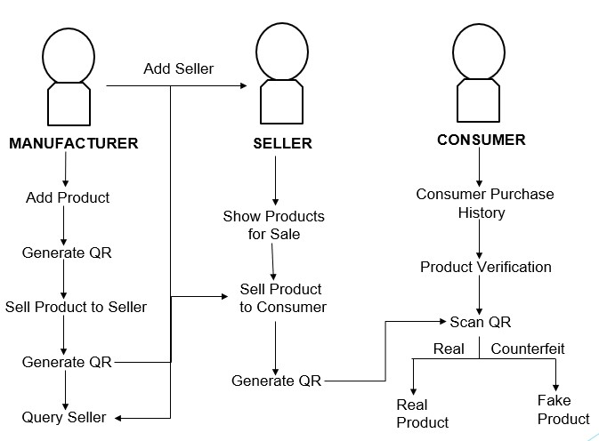
2.4 Activity diagram
The figure shown is the complete activity diagram of the proposed system. First the user will be assigned with the roles like Manufacture, Seller and Consumer. The home page would be displayed. By selecting the roles we can perform the different actions respective to the roles. Every module is connected with each other.

Slide 17
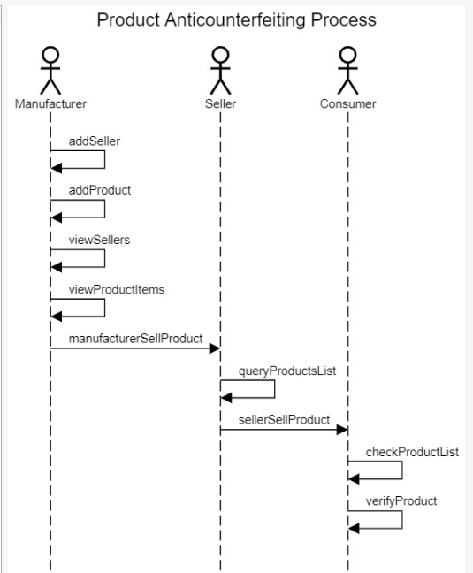
2.5 Sequence Diagram
The sequence diagram shows the entire sequence of flow of the data in the system. In the initial step the Manufacturer will add product and sellers with their details. Then only Manufacture can sell that added product to any particular Seller with the allotted seller code. Manufacturer can also check the added Seller details. Next, Seller can check Products for Sale and he can also sell that product to the Consumer. Finally, Consumer can check the products with him and can verify any product using QR code.

Slide 18
3. Implementation

Slide 19
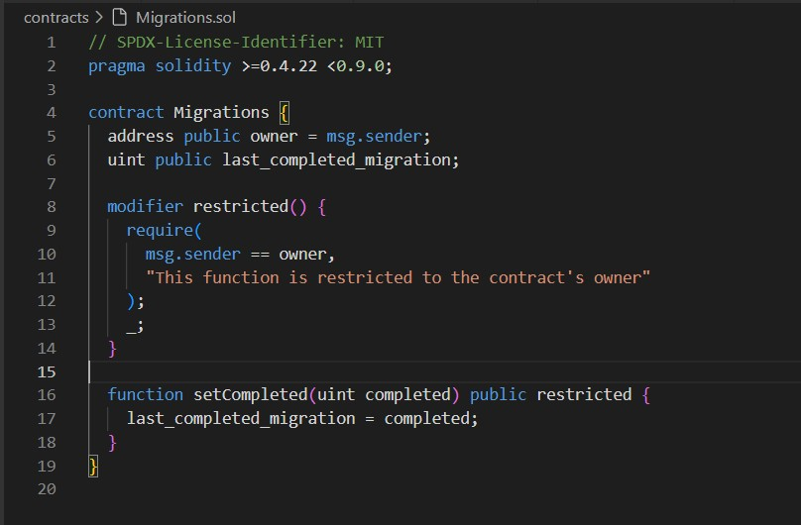
3. Implementation
Project implementation consists of visions and plans with which we are supposed to build the end product. This includes the logical conclusion, after evaluating, deciding, visioning, planning and finding the other resources for the project. Technical implementation is one of the major aspects of executing a project.
In fig. 3.1 code is implementing a smart contract in the Solidity programming language. The smart contract is called "Migrations".
Figure 3.1 Migration Code

Slide 20
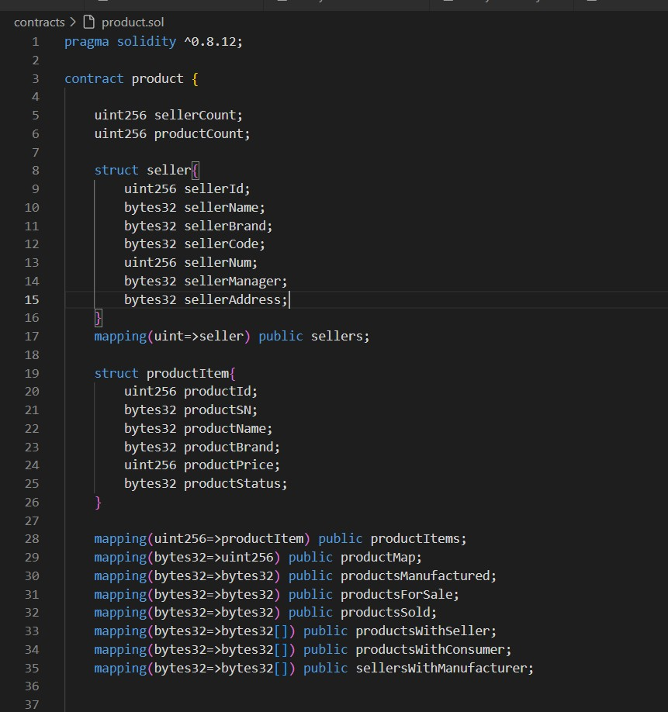
This code declares multiple mappings that are used to manage a product inventory system in Solidity.
Figure 3.2 Smart Contract to manage Product

Slide 21
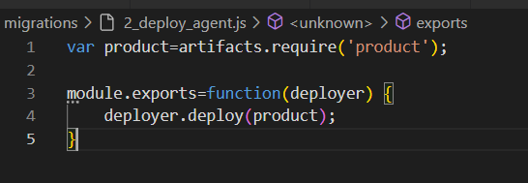
This code deploys the "Migrations" contract to the blockchain network using the Truffle framework, which allows developers to easily deploy, test, and interact with smart contracts.
Figure 3.3 Deploying Smart Contracts
Code that uses the Truffle framework to deploy a smart contract called "product" to a blockchain network.
Figure 3.4 Deploying Product Smart Contract on Blockchain

Slide 22
This code deploys the "Migrations" contract to the blockchain network using the Truffle framework, which allows developers to easily deploy, test, and interact with smart contracts.
Figure 3.3 Deploying Smart Contracts
Code that uses the Truffle framework to deploy a smart contract called "product" to a blockchain network.
Figure 3.4 Deploying Product Smart Contract on Blockchain

Slide 23
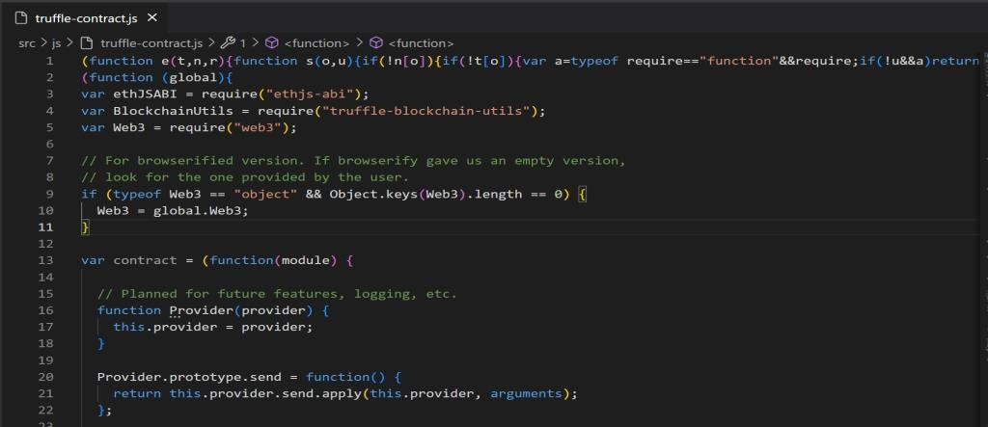
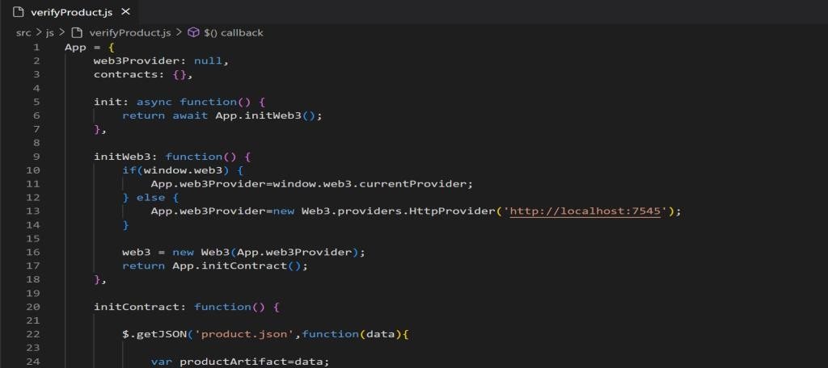
JavaScript code that defines a module for interacting with Ethereum smart contracts.
Figure 3.5 Interacting with Smart Contracts
A JavaScript code that defines an object App with properties and methods for interacting with a smart
contract.
Figure 3.6 Properties and Methods for Interacting with a Smart Contract

Slide 24
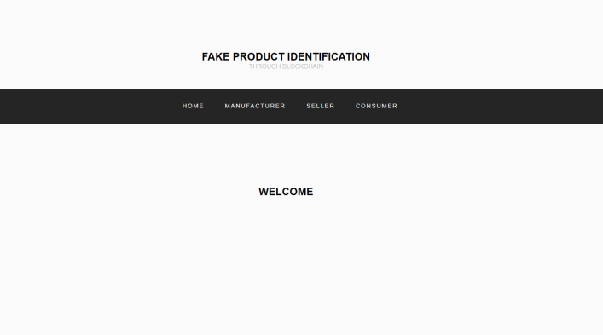
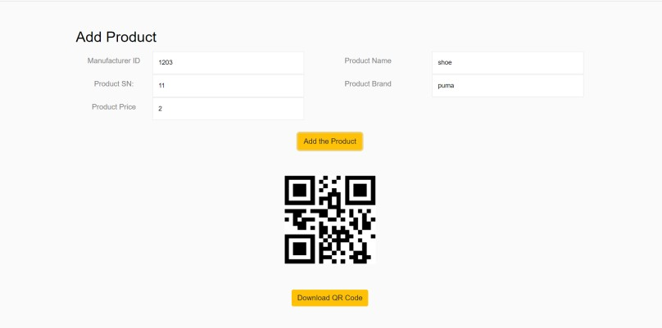
Here, is the home page of the E-commerce website as shown in Fig 3.7
Figure 3.7 Home page
This is the add product page where Manufacturer can add products to the database with all the required details and it will generate a QR code as shown in fig. 3.8
Figure 3.8 Add Product Page

Slide 25
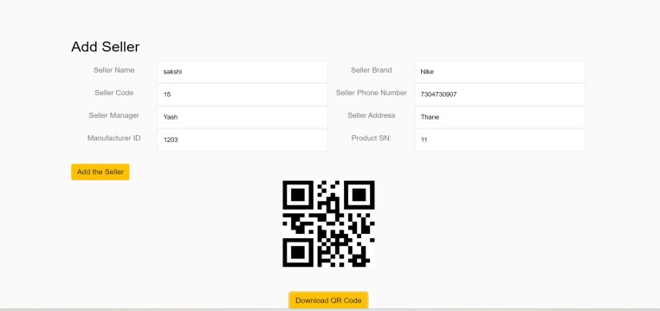
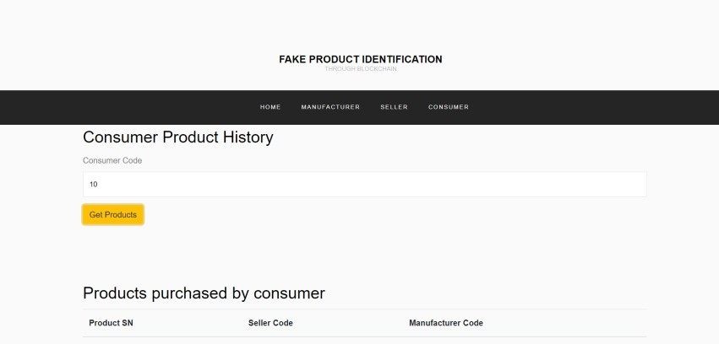
This is the add seller page where Manufacturer can add seller to the database with all the required
details and it will generate a QR code as shown in fig. 3.9
Figure 3.9 Add Seller Page
This is the consumer product history page, where consumer can submit their code and get the list of
products bought by them.
Figure 3.10 Consumer Product History Page

Slide 26
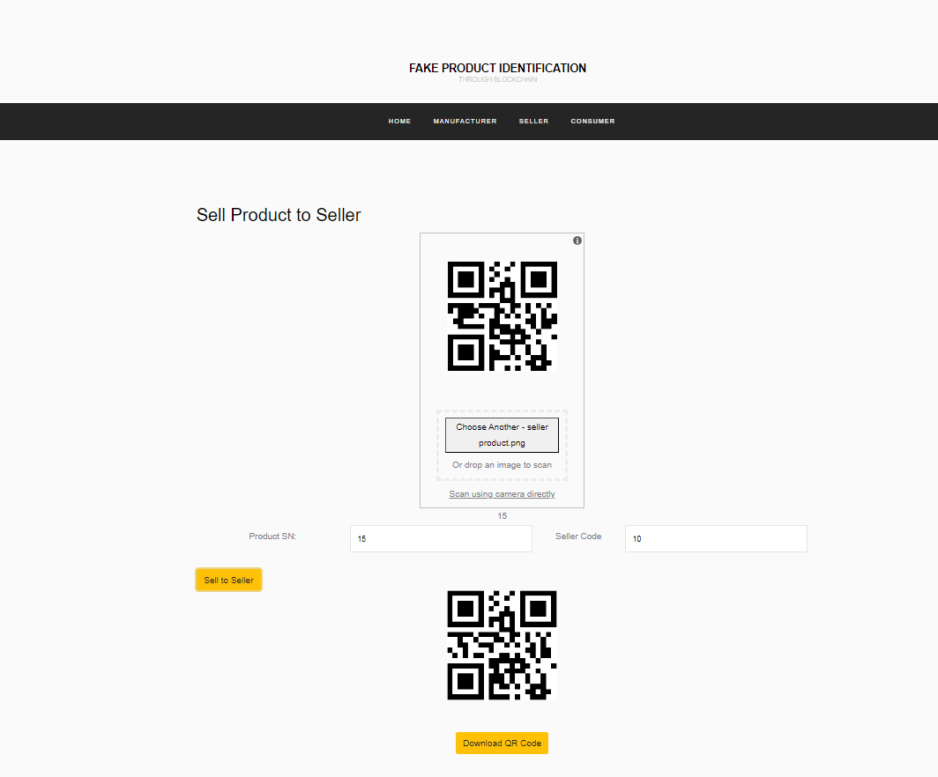
This is the sell product to seller page, where Manufacturer can add step and seller code to whom the product authority should be given.
QR code generated in previous
Figure 3.11 Sell Product to Seller Page

Slide 27
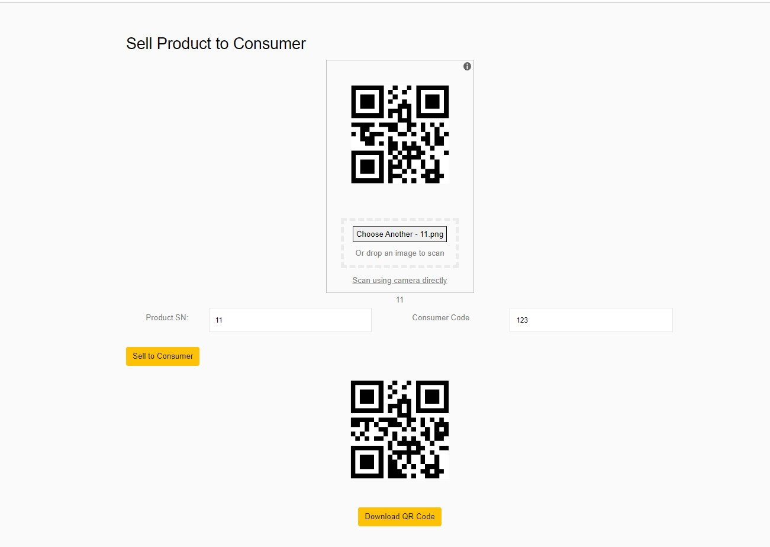
This is the sell product to consumer page, where Seller can add QR code generated in previous step and consumer code to whom the product authority should be given.
Figure 3.12 Sell Product to Consumer Page

Slide 28
4. Testing

Slide 29
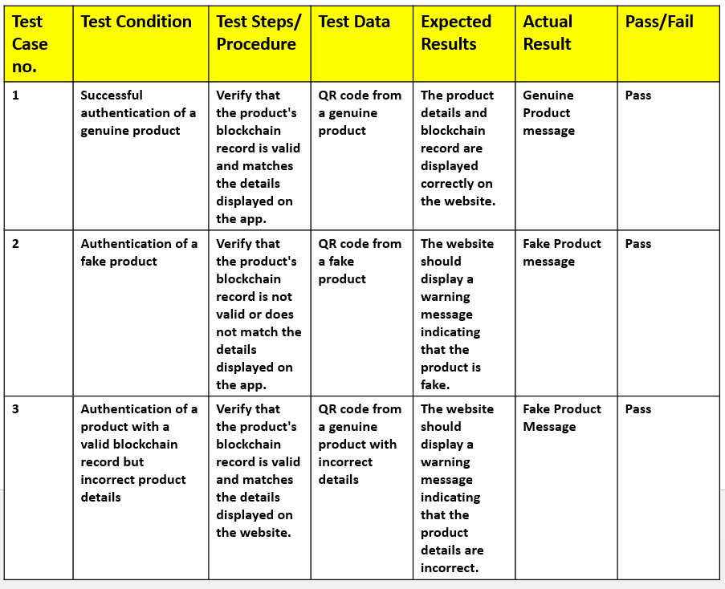
4.1 Unit Testing
Fig. Testcases

Slide 30
5. Result

Slide 31
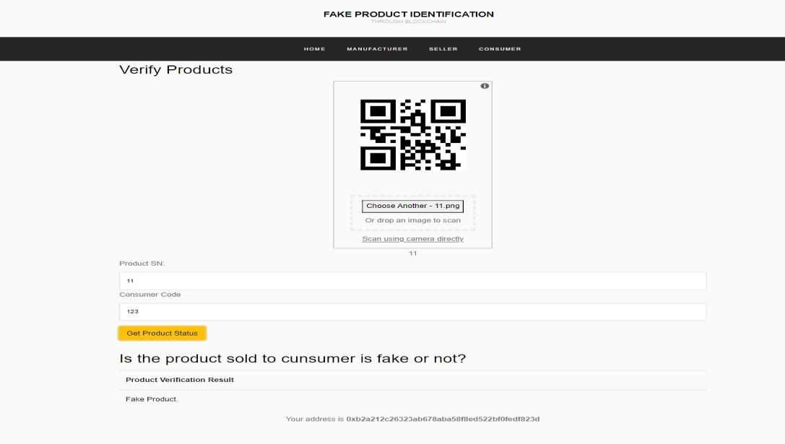
5.1 Verify Product
QR codes plays a very important role in determining Genuine and Fake products. QR code generated in the last step should be submitted to fetch the product id and the by providing Consumer code we can check that is the product sold to consumer is fake or not.
Fig. Verify Product Page

Slide 32
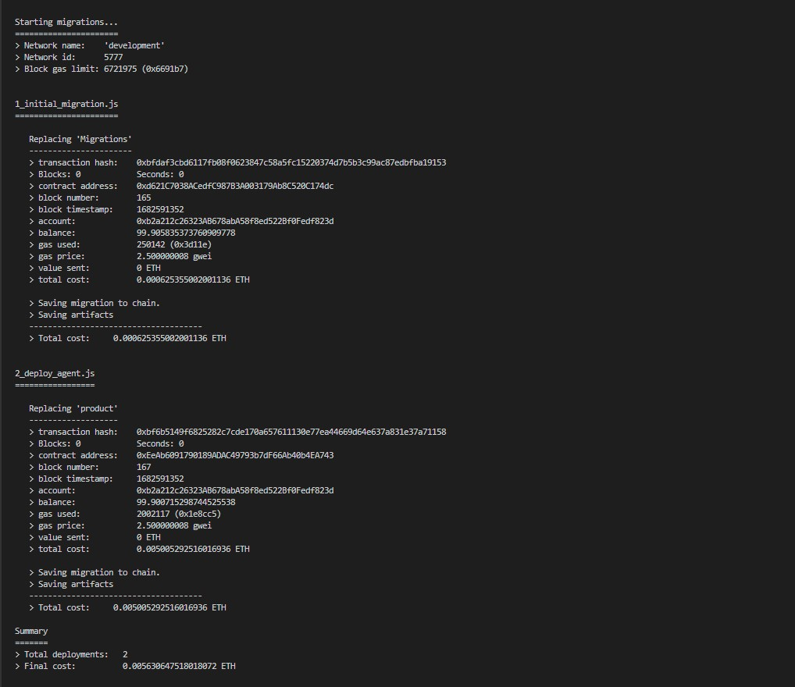
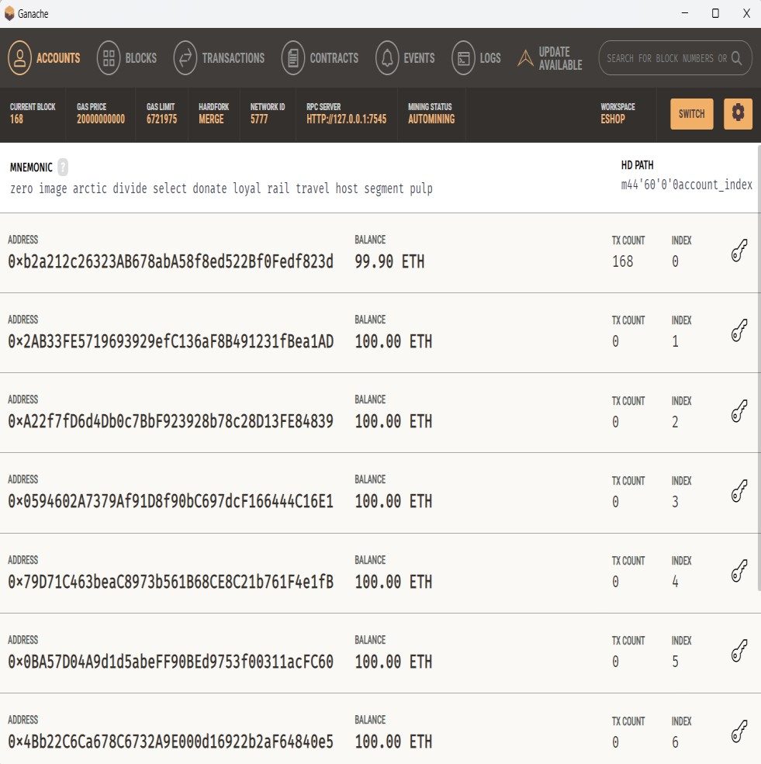
5.2 Smart Contracts and Blocks
Fig. Deploying Smart Contract on the Blockchain Network
Fig. Records Uploaded on local Blockchain

Slide 33
6. Conclusion and Future Scope

Slide 34
6.1 Conclusion and Future Scope
The system provides a secure and efficient framework for product authentification.
Useful for the Seller as well as Consumer to maintain a transparent and secure cycle
of transaction.
Promising future with the potential to revolutionize the way we verify the
authenticity of products in online transactions.
It will be useful to make a change in the society by adopting a new trend on E-
commerce shopping platforms.

Slide 35
References
[1] B.Prabhu Shankar, Dr. R.Jayavadivel, "A Survey Of Counterfeit Product Detection", International Journal of Scientific and Technology Research Volume 8, 12, December 2019.
[2] Si Chen; Rui Shi; Zhuangyu Ren; Jiaqi Yan; Yani Shi; Jinyu Zhang, "A Blockchain-Based Supply Chain Quality Management Framework", 2017 IEEE 14th International Conference on E-Business Engineering (ICEBE), 04-06 November 2019.
[3] Jinhua Ma; Shih-Ya Lin; Xin Chen; Hung-Min Sun; Yeh-Cheng Chen; Huaxiong
Wang, "A Blockchain-Based Application System for Product Anti-Counterfeiting", IEEE Access ( Volume: 8), 06 February 2020.

Slide 36
Paper Publication
Paper entitled “Eshop: Comprehensive Blockchain based Web Framework for E- Commerce” is submitted at “7th Edition Of ITC (IEEE International Test Conference of India 2023)” by “Sakshi Shinde, Anurag Singh, Shubhangi Lanke and Prof. Manjusha Kashilkar.”

Slide 37
Thank You

