Slide 1

Department of Information Technology
NBA Accredited A.P. Shah Institute of Technology G.B.Road,Kasarvadavli, Thane(W), Mumbai-400615 UNIVERSITY OF MUMBAI Academic Year 2022-2023

Slide 2
A Project Report on Content Sanitization using CV & NLP Submitted in partial fulfilment of the degree of Bachelor of Engineering(Sem-8) in INFORMATION TECHNOLOGY By Parth Bhoir(19104050) Pranav Mayekar(19104040)
Anjali Singh(20204006) Under the Guidance of Ms. Rujata Chaudhari
Mrs. Shital Agrawal

Slide 3
1.Project Conception and Initiation

Slide 4
1.1 Abstract
This platform named coinplanet is useful for new projects and businesses to give a head start to their projects with the help of surveys with support for multimedia data.
However with increasing number of people using the internet they might find toxic content on platform.
To deal with this, our platform comes into picture. It handles toxic data and prevent them from spreading further to keep the online space safe.

Slide 5
1.2 Objectives
To manage toxic text using Machine Learning.
To detect and manage inappropriate images and videos using OpenCV by making use of CNN to detect features necessary for inappropriate image detection.
To detect inappropriate audio by converting language to text using Natural Language Processing.

Slide 6
1.3 Literature Review
Sr. No. | Title | Key Findings | Year
1. | Nudity detection based on image zoning. | They used image zoning and skin filtering for nudity detection in their architecture. | 2021
2. | Transfer learning based object detection. | Comparison of different pretrained CNN models. | 2020
3. | Audio based toxic language detection and classification. | Proposed 2 models, first will process the words and calculate relevance toxicity and second will summarize meaning of audio. | 2021

Slide 7
1.4 Problem Definition
In our platform a user can create these survey forms and add contents like text, image, video and audio in those survey forms.
The only issue is that if a user adds some inappropriate contents like obscene images and toxic language in the survey forms and then publishes the survey.
Users of varying age and from different backgrounds visit the platform everyday, it is our duty to make sure that the content on our platform is safe for everyone.

Slide 8
1.5 Scope
Can be used for censorship of videos.
Can be used for audio censorship.
Can be used by organization to reduce toxicity.
Can be used by companies to automatically sanitize the data.

Slide 9
1.6 Technology stack
ReactJS 18.2.0
Node v14.1.0
Flask 1.9.1
RabbitMQ v3.9.0
OpenCV 4.6.0
Python v3.0
CNN Algorithm
Natural Language Processing

Slide 10
1.7 Benefits for environment & Society

Slide 11
2. Project Design

Slide 12
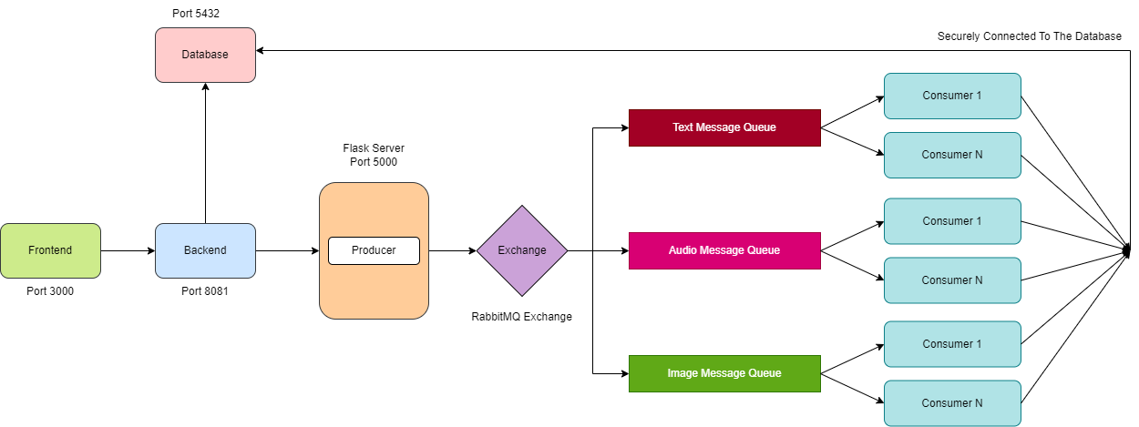
2.1 Proposed System

Slide 13
2.2 Design(Flow Of Modules)

Slide 14
2.3 Description Of Use Case

Slide 15
2.4 Activity diagram

Slide 16
3. Implementation

Slide 17
4. Testing

Slide 18
5. Result

Slide 19
6. Conclusion and Future Scope

Slide 20
We achieved text, image, audio and video sanitization and exclude inappropriate multimedia for our website environment.
We also achieved requests processing in bulk without dropping the requests in a Competing Consumer Pattern .
This can be applied to large applications as well but the number of Consumers needs to be increased in accordance with the average number of request.
In future, we are planning to develop an ecosystem on our platform so that functionalities implemented on platform can be integrated with other platforms in real time.

Slide 21
References
Clayton Santos, Eulanda M. dos Santos, Eduardo Souto, "NUDITY DETECTION BASED ON IMAGE ZONING", "https://sci-hub.se/10.1109/ISSPA.2012.6310454" The 11th International Conference on Information Sciences, Signal Processing and their Applications: Special Sessions,2020
Rahat Shahriar Islam, Raisa Siddiqui, Dipta Roy,"Blurring of Inappropriate Scenes in a Video Using Image Processing".
Shoji Kido, Yasusi Hirano, Noriaki Hashimoto "Detection and Classification of Lung Abnormalities by Use of Convolutional Neural Network (CNN) and Regions with CNN Features (R-CNN)"

Slide 22
Thank You

