Slide 1
GTM – GA4

Slide 2
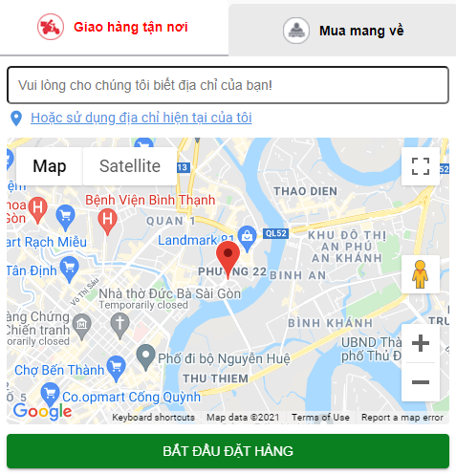
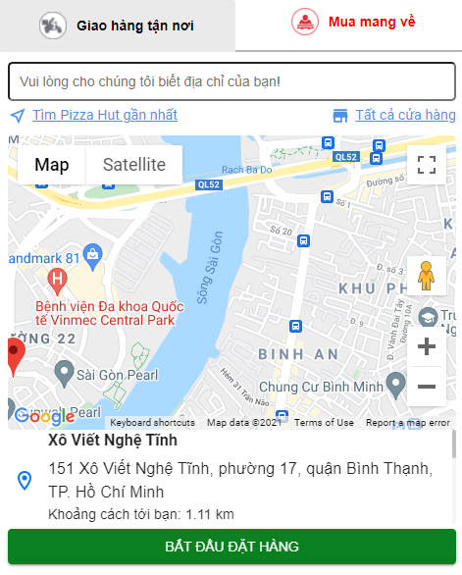
I. HOME PAGE
Event: LocalisationAttempt
Event & ID: LocalisationAttempt_delivery
Event & ID: LocalisationAttempt_Carryout
Event & ID: DeliveryMyLocation
Event & ID: CarryoutNearStores
Event & ID: CarryoutAllStores
Event & ID: LocalisationSuccess
Note: Back to Homepage -> Menu: repeat event LocalisationSuccess

Slide 3
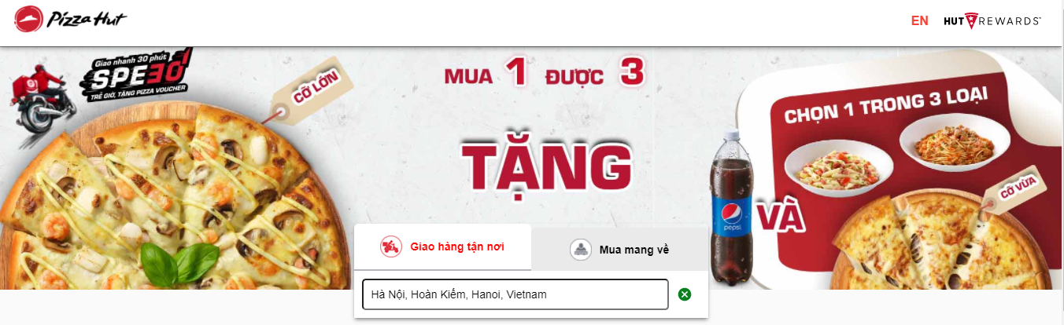
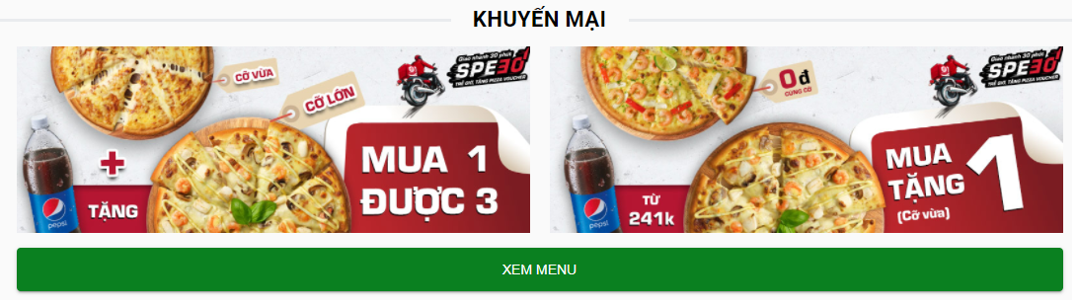
I. HOME PAGE
Event & ID: TopBanner
Event & ID: FooterBanner1
Event & ID: FooterBanner2
Event & ID: FooterCheckMenu

Slide 4
II. CATEGORY
Event - Link: MixedBoxListView
Event - Link: ItemListView
Event - Link: MyBoxListView
Event - Link: BOGOListView
Event - Link: ComBoListView
Event - Link: PizzaItemListView
Event - Link: PastaRiceItemListView
Event - Link: StarterItemListView
Event - Link: DrinkItemListView

Slide 5
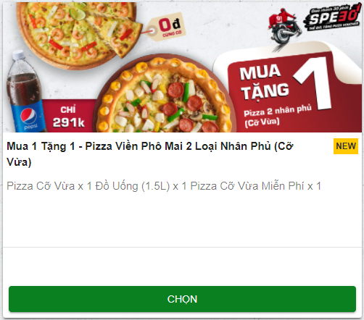
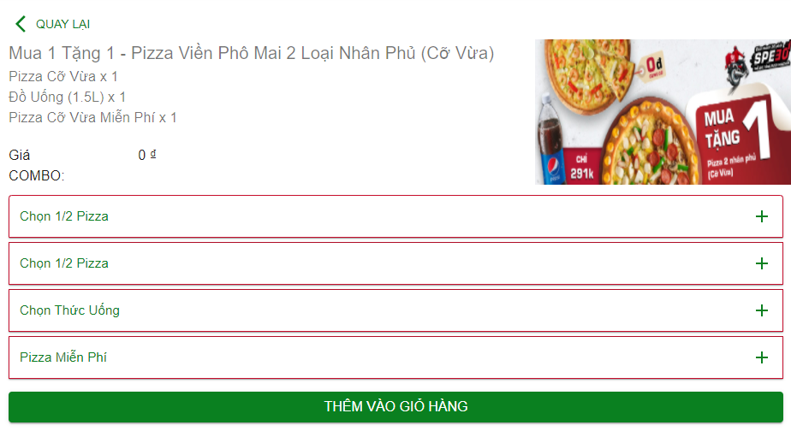
II. CATEGORY
BOGO & COMBO (Giá - Custom)
Event & ID: DetailComboListView
Event & ID: DetailItemComboListView

Slide 6
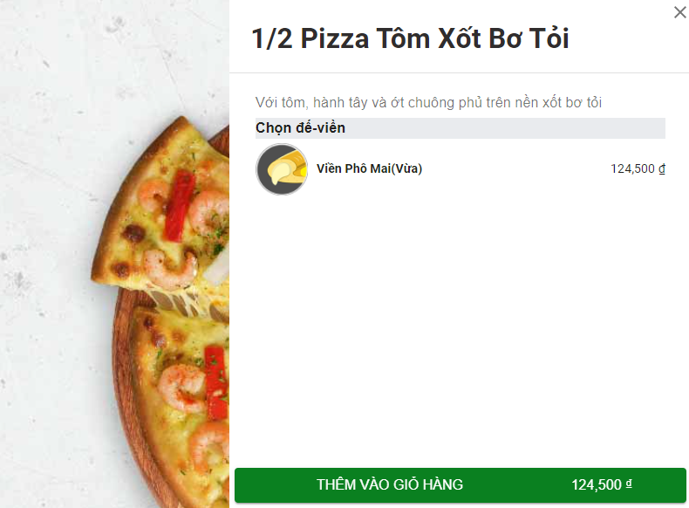
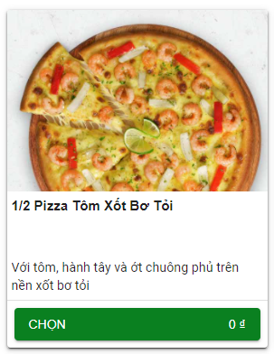
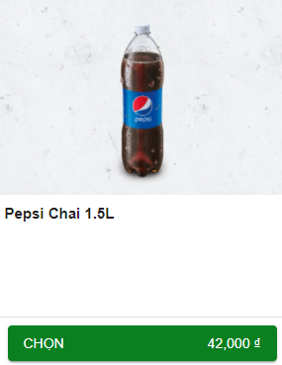
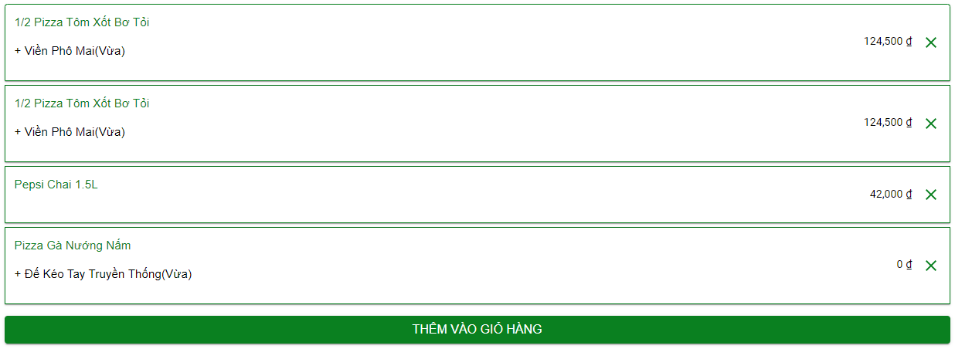
II. CATEGORY
Event & ID: DetailItemComboView
Event & ID: AddToCombo
BOGO & COMBO (Giá - Custom)
Flow 1
Flow 2
Event & ID: AddToCombo
Event & ID: AddToBasket

Slide 7
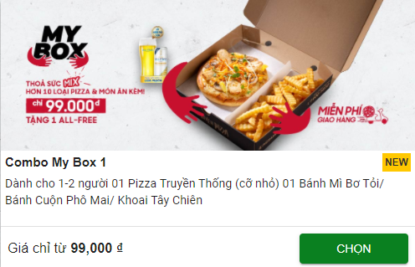
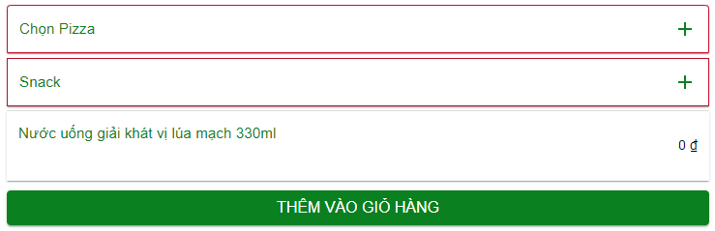
II. CATEGORY
My Box (Giá - Fix)
Event & ID: ComboDetailListView
Event & ID: ComboDetailItemListView

Slide 8
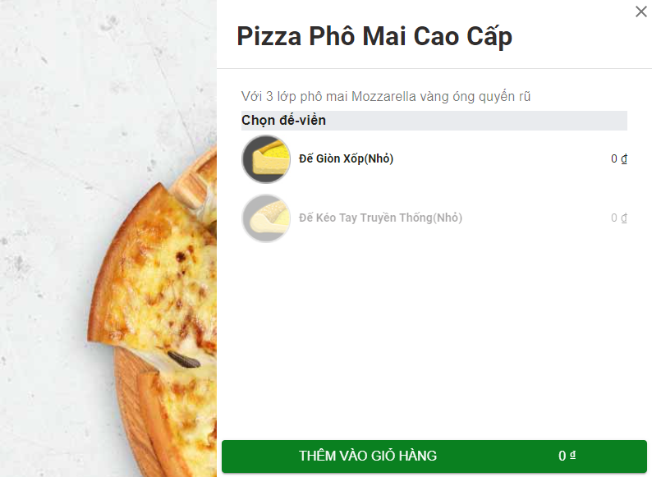
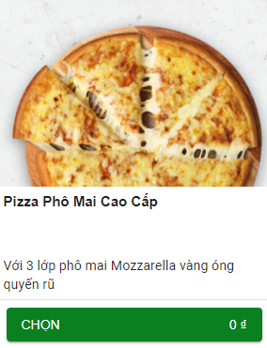
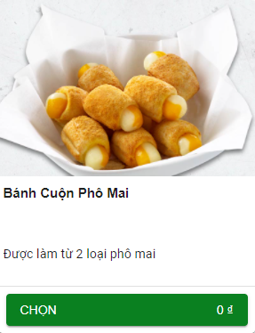
II. CATEGORY
Event & ID: ComboDetailItemView
My Box (Giá - Fix)
Flow 1
Flow 2
Event & ID: AddToCombo
Event & ID: AddToCombo
Event & ID: AddToBasket

Slide 9
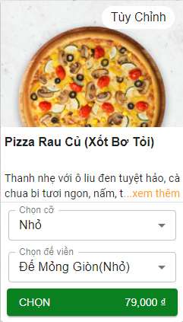
II. CATEGORY
Items
Lỗi Datalayer
Datalayer cần có các thông tin:
Kích cỡ
Loại đế
Event & ID: AddToBasket

Slide 10
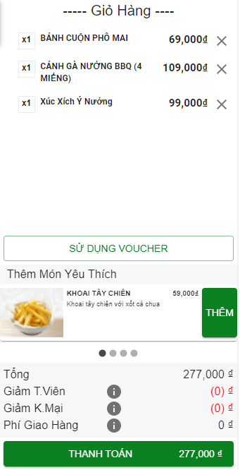
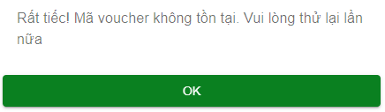
II. CATEGORY
Event & ID: RemoveFromCart
Event & ID: Usevoucher
Event & ID: UsevoucherFailure
Event & ID: UsevoucherSuccess
Event & ID: Checkout (Note: Truyền thông tin item trong Basket)

Slide 11
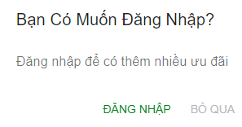
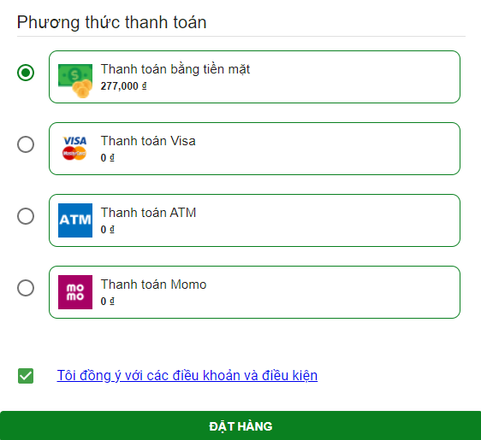
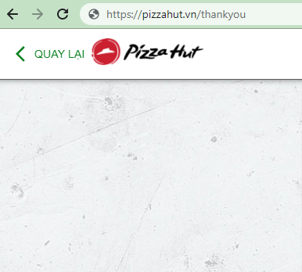
III. ORDER
Event & ID: Login
Event & ID: Nologin
Event - ID: Paynow (Note: Truyền thông tin item trong Basket)
Event & Link: OrderSuccess

