Slide 1
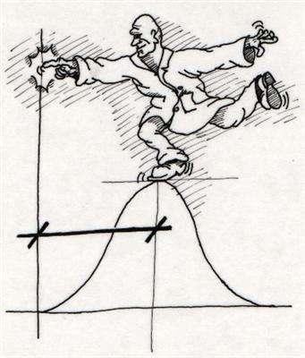
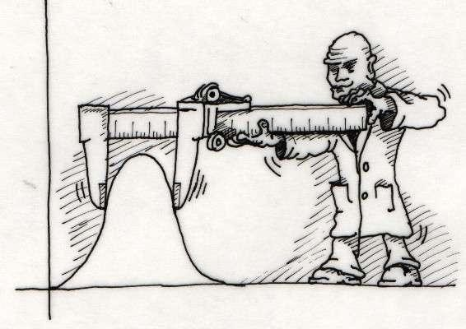
Introduction
to
Statistics
1

Slide 2
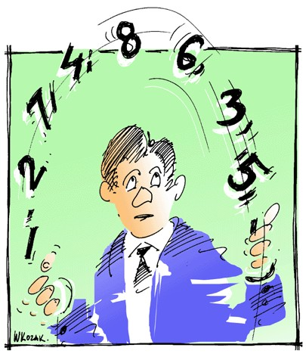
Contents
▪
Introduction
▪
Measures
of
Central
Tendency
▪
Measures
of
Dispersion
2

Slide 3
Statistics is divided into two broad areas
▪
The subject of statistics is divided into two broad areas that incorporate the
collecting,
data
organizing,
summarizing, analyzing, and
making
inferences
from
Statistics
Descriptive
Statistics
Inferential
Statistics
Descriptive
statistics utilizes numerical
Inferential statistics utilizes sample
data to make estimates, decisions, predictions, or other generalizations about a larger set of data.
E.g.: Age, time, product consumption
and graphical methods to look for patterns
in a data set, to summarize the information revealed in a data set, and to present the information in a convenient form.
E.g.: Number of houses, cars, surveys
4

Slide 4
Data are the values or measurements
describing an event can assume.
that
variables
•
Types of Data
•
•
Qualitative
Quantitative
•
Measurement is the assignment of numbers to objects
or events in a
systematic fashion. It is used to categorize
and/or
quantify
variables
•
Three levels of
measurement scales
–
–
–
Nominal
Ordinal Numeric
5

Slide 5
Nominal Variable
▪
Nominal variables allow for only qualitative classification. That is, they
can be measured only in terms of whether the individual items belong to certain distinct categories or not as per the presence or absence of certain attributes.
But we cannot quantify or even rank order the categories. Because
▪
these variable values are completely qualitative, arithmetic (+, -, /,
or logical operations (>, <, =) can’t be applicable to nominal data
*)
Examples for Nominal Scale:
•
•
•
Gender: Male / Female
Marital Status: Unmarried / Married / Divorcee / Widower
Shop type: Hypermarket / Supermarket / Kiosk / Traditional trade
6

Slide 6
Ordinal Variable
▪
A discrete ordinal variable is a nominal variable, but its different states are
ordered in a meaningful sequence. So Ordinal data can be ranked in either ascending or descending order, but the intervals between scale points may be uneven.
These variables are non-quantifiable in magnitude, so arithmetic operations
are impossible
Logical operations can be performed on the ordinal data.
Mostly used in Market Research surveys while designing the questionnaires specifically or in any other social and behavioral research. It helps to frame the questions.
▪
▪
▪
Example of Ordinal scale: Consider a questionnaire about studying the consumer behavior pattern for
any FMCG product. Question to identify the various income groups in the society would be:
What is the annual income of the respondent (tick on any of the below options applicable):
1 = less than 60000 (Lower class income group)
2 = 60000 - 1,20,000 (Middle Class income group)
3 = 1,20,001 – 5,00,000 (Upper middle class income group)
4 = More than 5,00,000 (Higher income group)
Here, the variable ‘Annual Income' is an ordinal variable with 4 states.
7

Slide 7
Numeric Variable
Numeric variables are those whom we can quantify and perform all arithmetic and logical operations.
Example: Age, Income, height, time
7

Slide 8
Measures of central tendency
A single expression representing the whole group, is selected which may convey a
fairly adequate idea about the whole group.
This single expression is an average. Averages are central part
of distribution
and
therefore, they are also called
measures
of central
tendency.
Types of Central Tendency
1.
2.
3.
Arithmetic mean(A.M)
Median
Mode
Features:
•It should
•It should
•It should
•It should
be
be be be
rigidly defined
easy to understand and easy to calculate based on all observations of data
least affected by the fluctuations of sampling
10

Slide 9
Merits and Limitations
Merits:
1.
2.
3.
4.
Its easy to understand and easy to calculate
It
It
It
is
is is
based on all items of the sample
capable for further algebraic treatment so least affected by sampling fluctuations
that its utility is enhanced
Limitations:
1.
Extreme values in the data unduly effect the mean because
on all items
it
is
based
2.
Mean is not
useful for studying the qualitative phenomenon
14

Slide 10
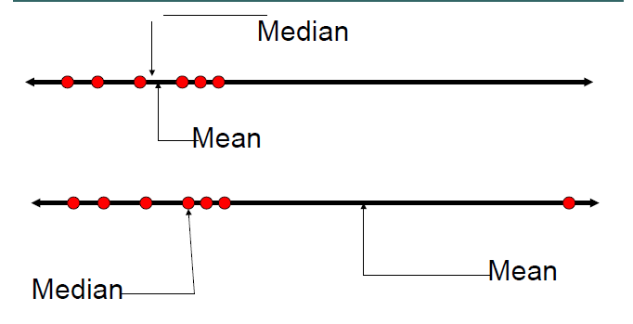
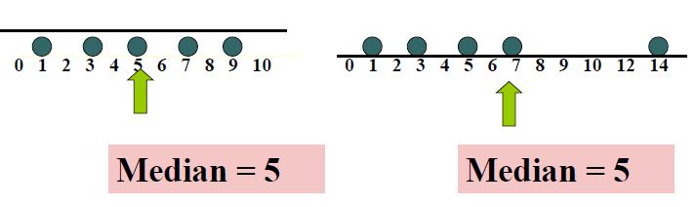
Median is the middle score of the distribution
when all the scores have been ranked
In
▪
▪
an ordered array,
If n or N is
If n or N is numbers
odd, the median is middle number
even,
the
median
is
average
of
the
two
middle
15

Slide 11

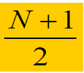
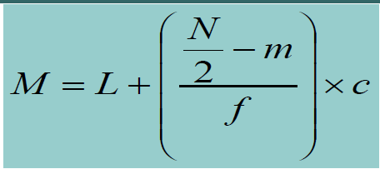
Median for raw data
When
observations
Median=
are
even, arrange the items in ascending order
When
observations
Median=
are
odd, arrange
the
items
in
ascending
order
For
Continuous
series:
where
M=median,
L=Lower limit of median
class
m=cumulative frequency of median class
f=frequency of median class
N=sum of frequencies
16

Slide 12
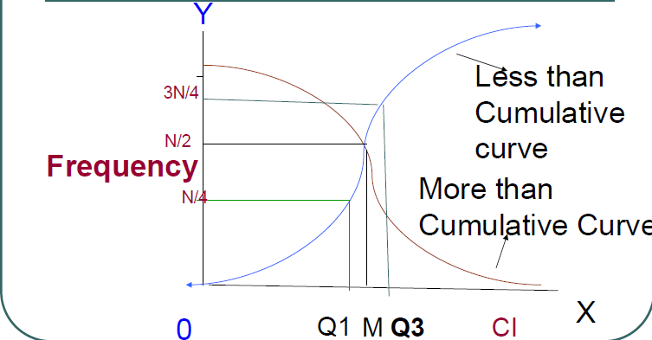
Merits and Limitations of Median
Merits
•
•
•
Median is not affected by extreme values
It
It
is more suitable average for dealing
with
qualitative
data
can be determined
by
graphically
Limitations
•
•
•
It is not based all the
items of the series
It is not capable of algebraic treatment. Its
formula cannot be
extended to calculate combined median of two or more related
groups
17

Slide 13
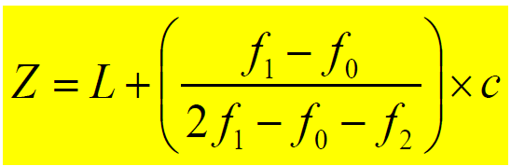
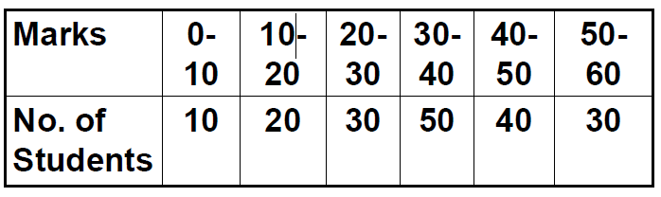
Mode, the most frequent score in the
distribution
A distribution where a single score is most frequent has one mode and is called
unimodal,
when there are ties for the most frequent score, the distribution is bimodal,
more than two scores tie, multimodal.
if
Mode for
Continuous series
where z=mode
L=lower limit of modal class
f0=frequency of
f1=frequency of f2=frequency of c=class interval
the pre modal class
the modal class
the post modal
of modal class
class
Calculate
mode for the following
series
18

Slide 14
Merits and Limitations of Mode
Merits of Mode
•
Mode is the only suitable average e.g., modal
shoes.,etc
It is not effected by extreme values
Its value can be determined graphically
size
of
garments,
•
•
Limitations
•
In case of bimodal/multimodal series, mode
determined.
cannot be
•
It is not capable for further algebraic treatment, combined
of two or more series cannot be determined.
mode
19

Slide 15
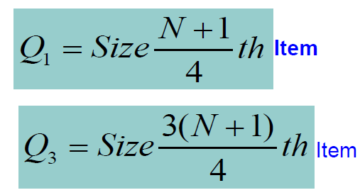
Quartiles
The values of variate that divides the series or the distribution into
four equal parts are known as Quartiles.
•
The first quartile(Q₁) known as lower quartile is value of the variate which is
below 25% of the observations
The second quartile(Q2) known as median, value of the variate which is 50%
of the observations
•
•
The third quartile(Q₃) known as
above 75% of the observations
upper
quartile
is
value
of
the variate
which
is
20

Slide 16
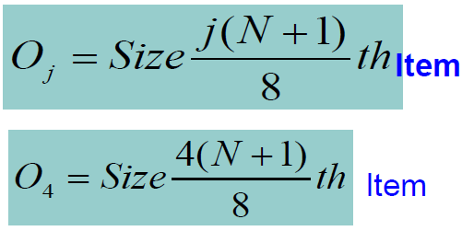
Octiles and Deciles
Octiles
The values of variate that divides series or distribution into eight equal parts are known as Octiles
Each octile contains 12.5% of total number of
observations
Deciles
The values of variate that divides parts are known as Deciles
series
or
distribution
into
ten equal
Percentiles
The values of variate that divides
parts are known as Percentiles
series
or
distribution
into
100 equal
21

Slide 17
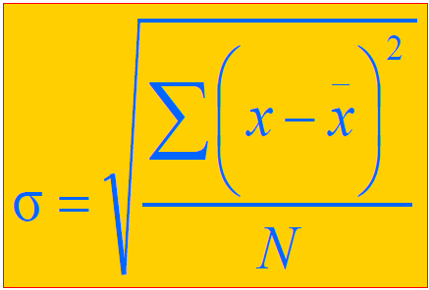
Standard Deviation
▪
Standard Deviation is the most commonly used measure of
dispersion
▪
Similar to the mean deviation the standard deviation takes
account the value of every observation
into
▪
The values of the mean deviation and standard
should be relatively similar
deviation
27

Slide 18
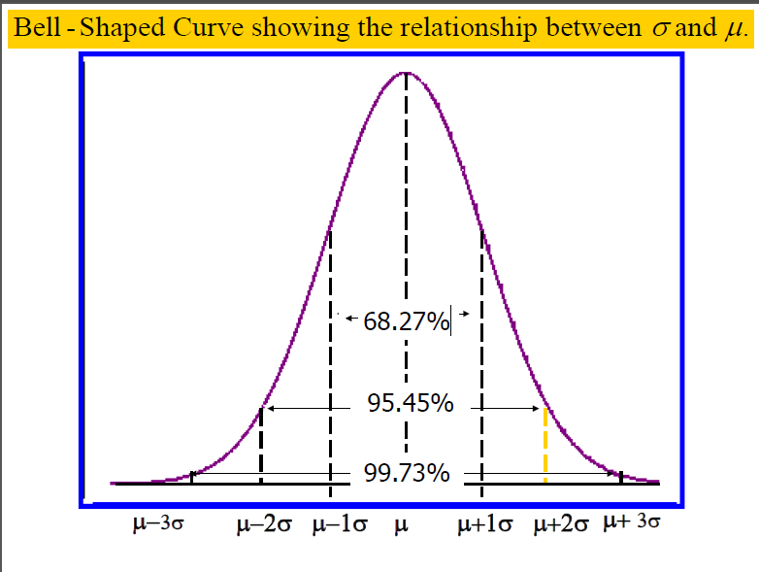
Relationship
between
SD
and
Mean
28

Slide 19

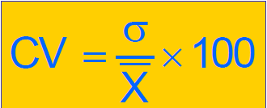
Variance is the square of the Standard
Deviation
Interpretation of Variance
Smaller the variance, greater the uniformity in population
Larger the variance, greater the variability
The coefficient of variation
The coefficient of variation is a measure of relative variability
It is used to measure the changes that have taken place in a population over time
To compare the variability of two populations that are expressed different units of measurement
in
30

Slide 20
MEASURES OF DISPERSION / VARIABILITY
While the Measures of central tendency give insight into the central values of your data, Measures of Dispersion tell you how much they are deviated from the Central Values.
In reality, data is mostly not very consistent and always data is varied.
There is a need to calculate the differences to get more relevance in the data and not just talk about middle / central values in our analysis.
3 main measures of Dispersion are - RANGE, Standard Deviation and Variance.

Slide 21
RANGE
Is the highest and the lowest value in the data values.
Range does not take any other values, especially the central values into account, hence not so popularly used for statistical analysis.
Range is affected by outliers.
Mostly used to find out what band the values of the data fall under.
Ex: salary, range, age group, - mostly used as intervals too.

Slide 22
MEAN ABSOLUTE DEVIATION
Deviations from the MEAN value is first calculated, but the negative signs are ignored and absolute numbers are taken and then they are summed up.
MAD =
, here the MAD is 16.33/12 = 1.36

Slide 23
VARIANCE
Since MAD neglects all the –ves and treats them as positive, Variance uses a different calculation.
Variance is just the square of all negative and positive deviations’ from the mean, divided by the total number of obs.
Variance is the sum of all the square deviations from the mean by N

Slide 24
STANDARD DEVIATION
SD is the most popular measure of variability.
Used mostly in computing confidence intervals and Hypothesis Testing.
Since Variance takes both negative and Positive Square of deviations, it may not be the accurate measure.
SD is the square root of the sum of all variances.
Denoted by SIGMA σ, is also the Square root of Variance.

Slide 25
MEASURES OF SHAPE
we have calculated the central tendency measure, we also know how each value in the data series varies from the central value.
We now need to see a graphical representation of the data and analyze the shape which describes the rough distribution of data from its central value.
Two Measures of Shape are:
SKEWNESS
KURTOSIS

Slide 26
MEASURES OF SHAPE
Skewness and Kurtosis help you find out the pattern of your data distribution
help find extreme or outlier values and also tell you about the symmetry of your data distribution
When we find out the central tendency value for a data series, we expect that the MEAN/MEDIAN/MODE would divide the values into halves and expect to see the right half and left half of the graph almost similar.
This distribution of data in which the right half is a mirror image of the left half is said to be SYMMETRICAL.

Slide 27
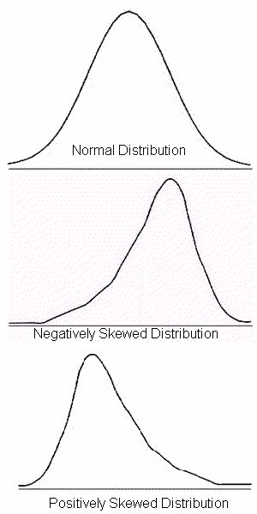
SKEWNESS
Skewness is when a distribution is asymmetrical or lacks symmetry
the data is said to be skewed either right ways or left ways.
When you draw a curve graph of the data, if the bell shaped curve is either to the left or right, it is said to be skewed.
The skewed portion is the long thin part of the curve.
If the bell curve is to the right and the skew tail is to
the left , then it is NEGATIVELY SKEWED.
If the skewed portion is to the right and the curve
is to the left, it is POSITIVELY SKEWED.
Skewness shows that more number of data values lie in a particular side of the central value.

Slide 28
The concept of skewness helps understand the relationship of the mean, median or mode.
The mean tends to be located towards the tail of the curve, because the mean is affected by all values including the extremes.
A bell shaped or normal distribution with the mean, median and mode all at the center of the distribution has no skewness.

Slide 29
KURTOSIS
Explains the amount of peakedness of the distribution curve. Distributions that are high and thin are referred as Leptokurtic, distributions that are flat and spread out are called Platykurtic and the distributions which are almost normal bell shaped are Mesokurtic .
If a distribution is Leptokurtic, then there are frequently occurring values and the mode will be the peak. K>3, then leptokurtic.
If a distribution is Mesokurtic (k is appx =3), the mode is the highest peak, but there are other values around the Mean/Median – ideally should all lie closer to central point.
If a distribution is platykurtic (K<3), then data is distributed or spread out and not too centered.
In R we could see Kurtosis is derived as Kurtosis score-3, hence look for close to 0 (for a normal distribution), this is done to align with skewness scores

Slide 30
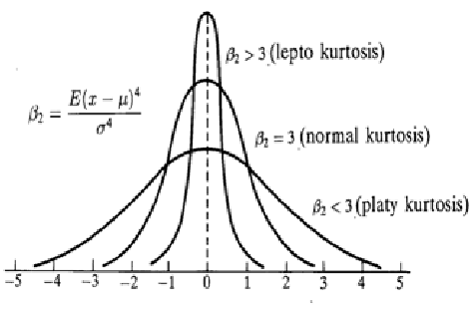

Slide 31
HYPOTHESIS TESTING
Business researchers often need to provide insight and information to decision makers to assist them in answering questions like,
What container shape is most economical and reliable for shipping a product?
Which management approach best motivates employees in the retail industry?
What is the most effective means of advertising in a business setting?
How can the company’s retirement investment financial portfolio be diversified for optimum performance?

Slide 32
For these purposes, researches develop “Hypotheses” to be studied and explored.
THESIS is something already proven and established.
HYPOTHESIS is
Something that needs to be proven or disproved.
It is an educated guess
A claimed fact
Is a tentative explanation of a principle operating in nature.
Is an assumption about population or unknown value/parameter

Slide 33
We explore all types of hypotheses, how to test them, how to interpret the results of such tests to help decision making.

Slide 34
Research hypothesis is a statement of what the researcher believes will be the outcome of an experiment or a study.
Business researchers have some idea or theory based on previous experience and data as to how the study will turn out

Slide 35
Statistical hypothesis is required in order to scientifically test the research hypothesis.
All Statistical hypothesis consist of 2 parts,
NULL HYPOTHESIS & ALTERNATIVE HYPOTHESIS.

Slide 36
NULL HYPOTHESIS – usually states that “Null” condition exists, that there is nothing new happening, the old theory is still true, the old standards / quality are correct, and the system is under control. It is represented by H0.
ALTERNATIVE HYPOTHESIS - on the other hand usually states that the new theory is true, there are new standards, the system is out of control or something different is happening all the time. Represented as H1.

Slide 37
Use appropriate statistical test
Hypothesis Testing
One Variable
N ≤ 30 One Sample T.Test
N ≥ 30 Z.Test
Two Variables
Independent T / Z Test
Dependent T/Z Test
N≤ 30 Ind T.Test
N ≥ 30 Ind Z.Test
Paired T.Test
2 > Variables ANOVA (F Test)
One Way ANOVA
Two Way ANOVA
One Dep& One Ind Variable
One Dep &Two Ind variables

Slide 38
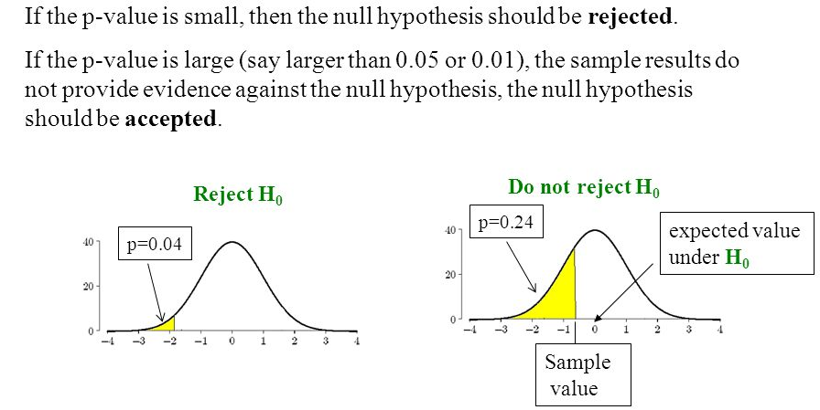
Hypothesis
A hypothesis is a speculation or theory, based on insufficient evidence that lends itself to further testing and experimentation. With further testing, a hypothesis can usually be proven true or false. A null hypothesis is a hypothesis that says there is no statistical significance between the two variables

Slide 39
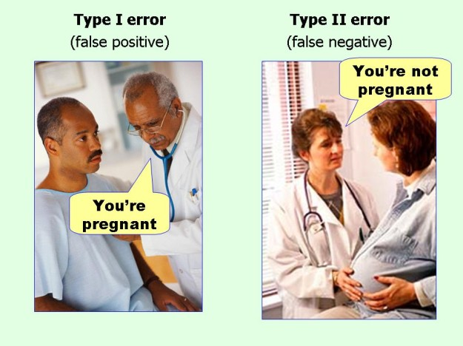
Type 1 and Type 2 Errors
When do you reject null hypothesis?
Calculated value should be greater than critical value
P value should be less than alpha
Null Hypothesis
Objective: We want to see whether a person is pregnant or not
null hypothesis is: Person is not pregnant; we will find evidence to reject this.
Type 1 error: (False positive) Rejecting H0 when H0 is true:
So you picked a man and concluded he is pregnant
Type 2: (False negative) Fail to Rejecting H0 when H0 is false:
So you picked a pregnant woman and concluded she is not pregnant

Slide 40
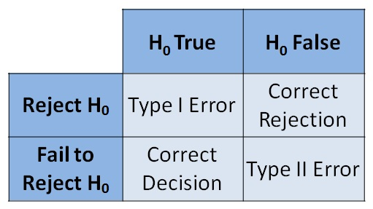

Type 1 and Type 2 Errors
Power of test

Slide 41

Degrees of Freedom
In statistics, the number of degrees of freedom is the number of values in the final calculation of a statistic that are free to vary. The number of independent ways by which a dynamic system can move, without violating any constraint imposed on it, is called number of degrees of freedom.

Slide 42
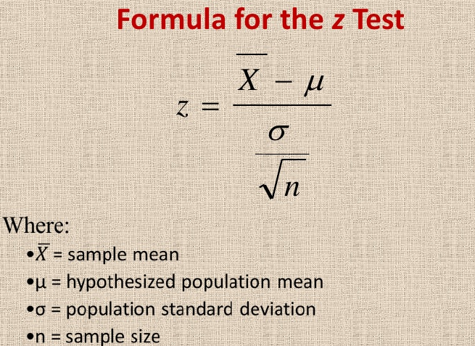
Z-Test
Z-test fails as :
In real life scenarios we never know what is population standard deviation
Sample size’s never be less than 30.

Slide 43
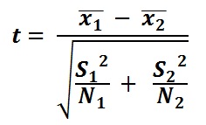
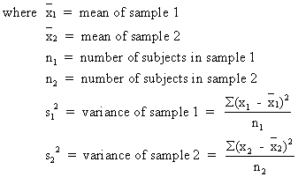

T-Test
Paired sample T-test:
When your sample observations are same.
Checking BP of same person morning and evening
Two sample – equal variance
When sample are different but their variance is same.
Comparing BP of two apartment people of same age
Two sample – Unequal variance
When sample are different and their variance is NOT same.
Comparing BP of two apartment people.

Slide 44
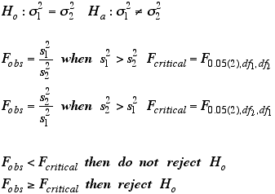
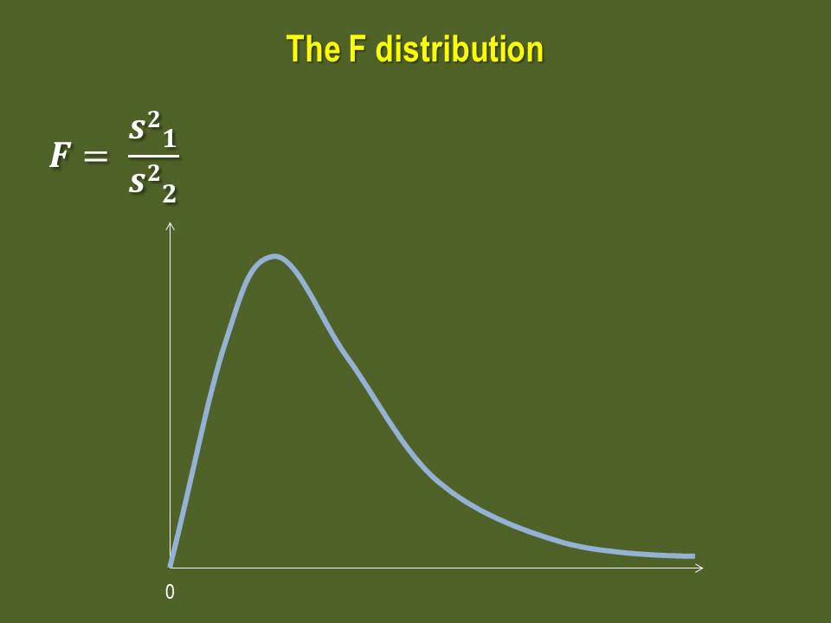
F test for Equality of Variances
So when do we go for F-test?
when we want to test variance of two samples.
Why F test is one tail distribution?
Because it uses squared terms

Slide 45
Chi-Square Test
Chi-Square?
When you have categorical data and you want to compare the proportions
H0: There is no difference of agreement level at different income level
H1: There is difference
Good ness of fit?
Now our table value is less than critical value then we FAIL reject null hypothesis.

