Slide 1

Historical Development of Cloud Computing
Dr. Risala Tasin Khan
Professor
Institute of Information Technology

Slide 2
A Brief History: Open Platform
The good old days
Octopus-like mainframes
Only a few venders to choose from
Farms of disks where required
Applications were specific for each machine
Open platform
New client/server architecture
Open system allowed mix-and-match
Different application technologies could be purchased from different venders
Examples: server platform, client platform, network protocols, middleware software, etc.

Slide 3

What is Client/Server (C/S) Computing
It started as PCs became more powerful
PCs were no longer dumb terminals
Provided an open and flexible environment
C/S is considered as a form of distributed software
Any application can run on any machine
From anywhere files can be accessed

Slide 4
Distinct characteristics of C/S
Client-server is a computing architecture which separates a client from a server
It is almost always implemented over a computer network
This type of architecture is sometimes referred to as two-tier.
It allows devices to share files and resources.
Clients must request or initiate the service
The location of the server in the network is transparent to clients
Transaction between C/S is message-passing based
C/S architecture is scalable
The server is centrally maintained where as clients are independent of each other

Slide 5
Systems with C/S Architecture
File servers
File sharing and file processing
Data base servers
Passing file results
Example: Query in DBMS server
Typically one single request/reply
Transaction servers
Transaction server includes DBMS and transaction monitoring
Server has remote procedures run online by the client
web servers
Super-fat servers and thin clients
Uses HTTP protocol
Java was first to introduce interactive C/S forms
Client
Server
Client
Internet
Application
Client
HTML
Server
Client
JAVA

Slide 6
Client/Server Models
Fat clients
The bulk of the application is running on the client
The client knows how the data is organized and where it is
Different clients access the same applications different ways
Fat servers
The server more complicated
The clients are less complex
More of the code runs on the server
The network interaction is minimized
Application
Client
Server
Notes:
A fat client (also called heavy, rich or thick client) is a computer (clients), in client–server architecture or networks, that typically provides rich functionality independent of the central server. Originally known as just a "client" or "thick client,“
A fat client still requires at least periodic connection to a network or central server, but is often characterised by the ability to perform many functions without that connection.

Slide 7
Two-Tier vs. Three-Tier Architecture
Same basic idea as fat-client versus fat-server
Depends on how the application is divided between the server and the client
Two-tier servers
Examples: file servers and database server
In this case the process (application logic) is buried within the client or server (or both)
Three-tier servers
Examples: Web and distributed objects
In this case the process is run on the middle-tier – separated from the user and data interface
They can integrate the data from multiple sources
More robust and more scalable

Slide 8
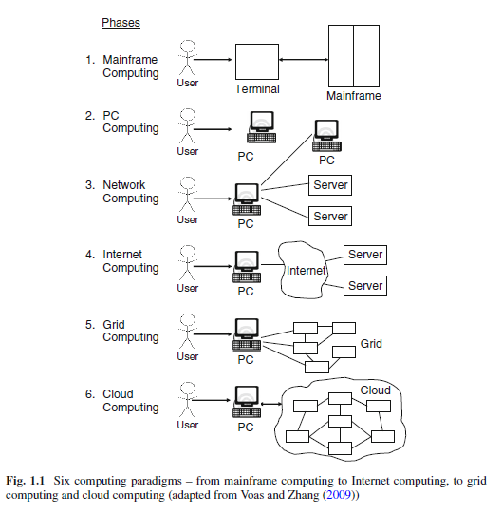
Computing Paradigms
In phase 1, many users shared powerful mainframes using dummy terminals.
In phase 2, stand-alone PCs became powerful enough to meet the majority of users’ needs.
In phase 3, PCs, laptops, and servers were connected together through local networks to share resources and increase performance.
In phase 4, local networks were connected to other local networks forming a global network such as the Internet to utilize remote applications and resources.
In phase 5, grid computing provided shared computing power and storage through a distributed computing system.
In phase 6, cloud computing further provides shared resources on the Internet in a scalable and simple way.

Slide 9
What is Distributed System
A distributed system is a collection of independent computers that appears to its users as a single coherent system.
This definition has two aspects:
The first one deals with hardware: the machines are autonomous
The second one deals with software: the users think they are dealing with a single system.
One important characteristic of a distributed system is that the differences between the various computers and the way in which they communicate are hidden from the users
Another important characteristic is that users and applications can interact with a distributed system in a consistent and uniform way, regardless of where and when interaction takes place.

Slide 10
Continue…
Distributed systems are often organized by means of a layer of software that is logically placed between a higher level layer consisting of users and applications and a layer underneath consisting of operating system.
For example, consider a network of workstations in a university. In addition to each user’s PC there might be a pool of processors in the machine room that are not assigned to specific users but are allocated dynamically as needed. Such a system might have a single file system, with all files accessible from all machines using the same path name.
If the system as a whole looks and acts like a classical single-processor timesharing system, it qualifies as a distributed system

Slide 11
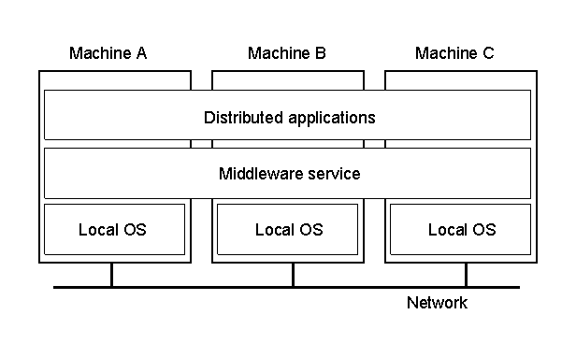
Continue…
1.1
A distributed system organized as middleware
Note that the middleware layer extends over multiple machines

Slide 12
Properties of Distributed Systems
CHARACTERIZATION OF DISTRIBUTED SYSTEMS
Our definition of distributed systems has the following significant properties: Concurrency Tasks carry out independently No global clock Tasks coordinate their actions by exchanging messages
Couloris,Dollimore and Kindberg Distributed Systems: Concepts & Design Edn. 4 , Pearson Education 2005

Slide 13
Properties Distributed Systems
CHARACTERIZATION OF DISTRIBUTED SYSTEMS
Independent Failures Faults in the network result in the isolation of the computers that are connected to it. Each component of the system can fail independently, leaving the others still running.
Couloris,Dollimore and Kindberg Distributed Systems: Concepts & Design Edn. 4 , Pearson Education 2005

Slide 14

Mobile and Ubiquitous Computing
Mobile computing (also known as nomadic computing) is the performance of computing tasks while the user is on move, or visiting places other than their usual environment.
In mobile computing, users who are away from their “home” intranet are still provided with access to resources via the devices they carry with them.
They can continue to access the Internet; and there is increasing provision for users to utilize resources such as printers that are conveniently nearby as they move around. This is known as location aware or context-aware computing.

Slide 15
Ubiquitous Computing
Also known as “pervasive computing”
Means “to be found everywhere”
Ubiquitous computing is the harnessing of many small, cheap computational devices that are present in users’ physical environments, including the home, office and even natural setting.
The term “ubiquitous” is intended to suggest that small computing devices will eventually become so pervasive in everyday objects that they are scarcely noticed. That is, the computational behavior will be transparently and intimately tied up with their physical function.
The presence of computers everywhere only becomes useful when they can communicate with one another.

Slide 16

Ubiquitous Computing Characteristics
Physical Integration:
Integration between computing nodes and the physical world
Instantaneous Interoperation:
Devices interoperate spontaneously in changing environment.

Slide 17
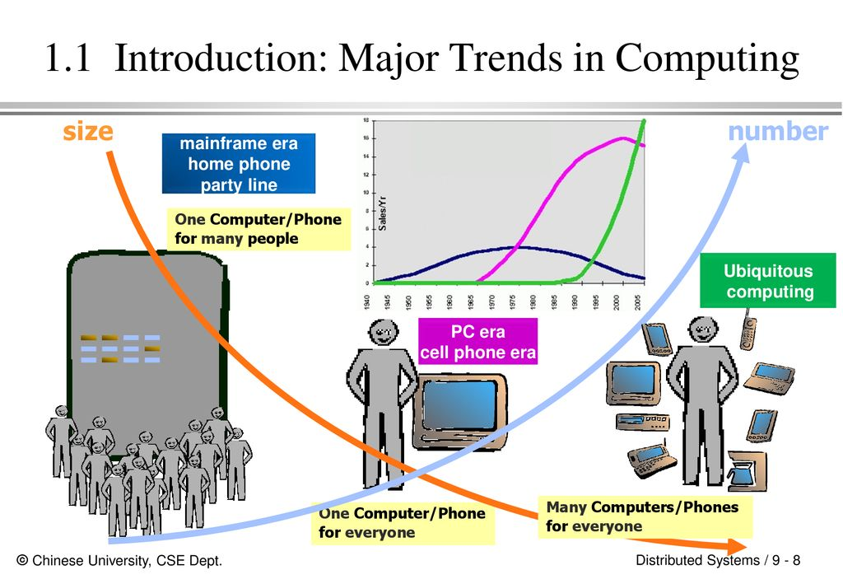

Slide 18
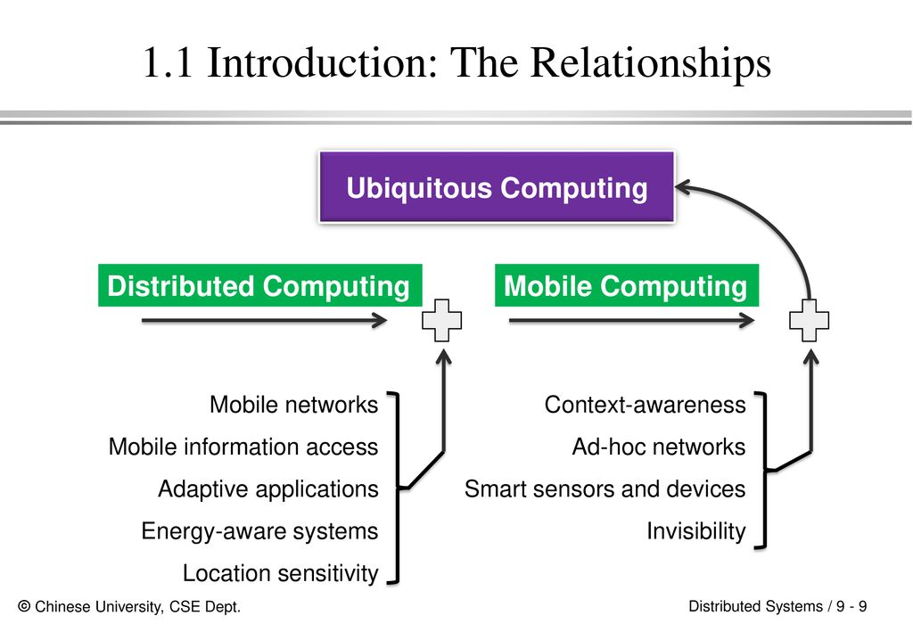

Slide 19

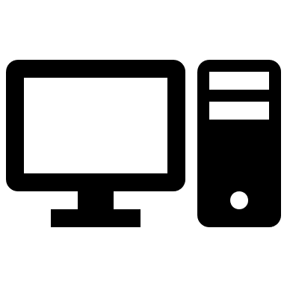
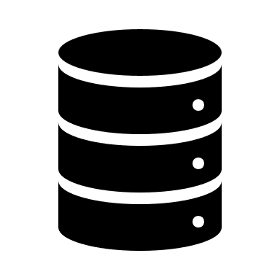
Centralized vs Parallel Computing
Centralized
Mainframe Computer
Parallel
Computer resources are centralized in one physical system. All resources (processors , memory, and storage) are fully shared and tightly coupled within one integrated OS. Example: Data center and super computers.
Processors are tightly coupled with centralized shared memory/loosely coupled with distributed memory. Computer system capable of parallel computing is called parallel computer. Programs running in such computer are called parallel programs .

Slide 20
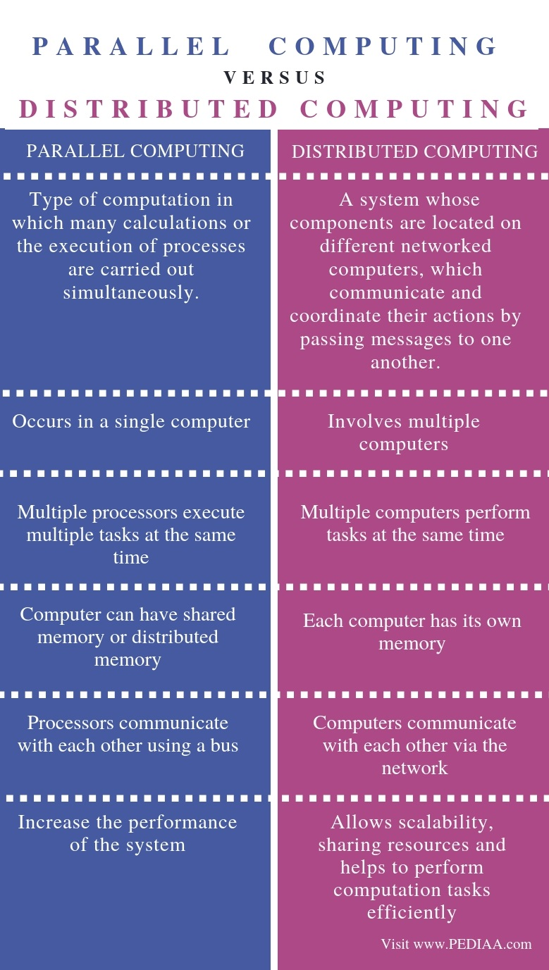
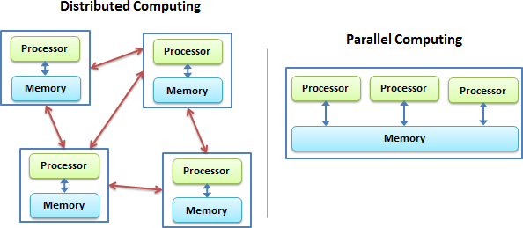
Parallel vs Distributed Computing
https://pediaa.com/

Slide 21

System Models for Distributed System
Minicomputer model
Workstation model
Workstation-server model
Processor-pool model
Cluster model
Grid Model

Slide 22
Minicomputer Model
A mini-computer distributed system refers to a distributed computing setup where mini-computers (mid-range systems between mainframes and microcomputers) act as interconnected nodes.
These systems were historically used in business, scientific, and industrial applications due to their balance of power and affordability.

Slide 23
Minicomputer Model
Mini-
computer
ARPA
net
Mini-
computer
Mini-
computer
Extension of Time sharing system
User must log on his/her home minicomputer.
Thereafter, he/she can log on a remote machine by telnet.
Resource sharing
Database
High-performance devices

Slide 24
Key Features of Minicomputer System
Multiple Mini-Computers as Nodes
Each mini-computer has its own processor, memory, and storage.
They communicate over a network to share tasks and resources.
Client-Server or Peer-to-Peer Architecture
Can follow a client-server model, where one mini-computer acts as a central server, while others function as clients. Alternatively, it can be peer-to-peer, where all mini-computers share processing workloads.
Multi-User and Multi-Tasking
Supports multiple users accessing the system simultaneously. Capable of handling multiple processes efficiently.
Reliability and Fault Tolerance
Distributed nature ensures that failure of one mini-computer doesn’t shut down the entire system. Load balancing improves overall system efficiency.

Slide 25
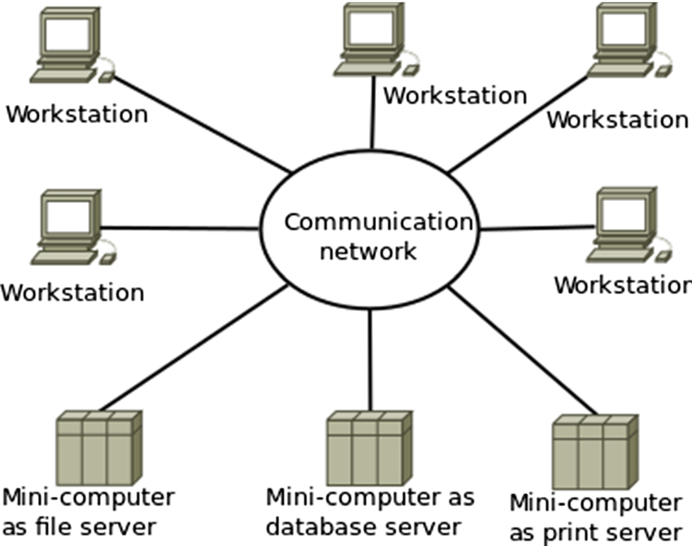
Workstation Model
A workstation distributed system model is a type of distributed system where multiple workstations (powerful personal computers) are interconnected over a network to share computing resources, processing power, and data.

Slide 26
Key Features of Minicomputer System
1.Multiple Interconnected Workstations
Each workstation has its own CPU, memory, and storage.
They communicate over a high-speed LAN (Local Area Network) or WAN (Wide Area Network).
2. Idle Workstation Utilization
Workstations are often used during working hours but remain idle at other times.
Distributed systems can leverage idle processing power to run background tasks, scientific computations, or large-scale data processing.
3. Decentralized Computing
No single point of failure—if one workstation fails, others continue running.
Resources and computing power are distributed among all nodes.
Load Sharing & Balancing
Some systems use load balancing algorithms to distribute tasks among workstations.
Ensures efficient resource utilization and prevents bottlenecks.

Slide 27
Types of Workstation Distributed System Models
Workstation-Server Model
Each workstation acts as a client, while powerful servers handle file storage, processing, and authentication.
Common in corporate networks and academic institutions.
Workstation-on-Demand Model
Workstations are dynamically allocated processing power based on demand.
Useful for computational tasks where processing is offloaded to idle workstations.
Peer-to-Peer (P2P) Workstation Model
All workstations share computing resources without a central server.
Suitable for environments with distributed computing needs (e.g., research labs).

Slide 28
Workstation-Server Model
Client workstations
Graphic/interactive applications processed in local
All file, print, http and even cycle computation requests are sent to servers.
Server minicomputers
Each minicomputer is dedicated to one or more different types of services.
Client-Server model of communication
RPC (Remote Procedure Call)
RMI (Remote Method Invocation)
A Client process calls a server process’ function.
No process migration invoked
Example: NSF
Workstation
Workstation
Workstation
100Gbps
LAN
Mini-
Computer
file server
Mini-
Computer
http server
Mini-
Computer
cycle server

Slide 29
Processor-Pool Model
Clients:
They log in one of terminals.
All services are dispatched to servers.
Servers:
Necessary number of processors are allocated to each user from the pool.
Better utilization but less interactivity
100Gbps
LAN
Server 1
Server N

Slide 30
Cluster Model
Workstation
Client
Takes a client-server model
Server
Consists of many PC/workstations connected to a high-speed network.
Puts more focus on performance: serves for requests in parallel.
Workstation
Workstation
100Gbps
LAN
http server2
http server1
http server N
Master
node
Slave
1
Slave
2
Slave
N
1Gbps SAN

Slide 31
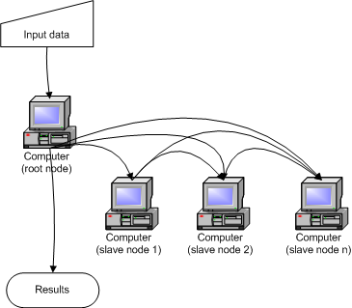
Cluster Computing
CHARACTERIZATION OF DISTRIBUTED SYSTEMS
A type of parallel or distributed processing system, which consists of a collection of interconnected stand-alone computers cooperatively working together as a single, integrated computing resource. The computers may be standard per uniprocessor or multiprocessor.
Couloris,Dollimore and Kindberg Distributed Systems: Concepts & Design Edn. 4 , Pearson Education 2005

Slide 32
Cont…
Cluster computing acted as a low-cost alternative to the use of mainframes and supercomputers.
The low cost machines could be clustered together and then be connected by a high-bandwidth network and controlled by specific software tools that manage them as a single system.
Starting in the 1980s, clusters become the standard technology for parallel and high-performance computing.
One of the attractive features of clusters was that the computational power of commodity machines could be leveraged to solve problems that were previously manageable only on expensive supercomputers.
Moreover, clusters could be easily extended if more computational power was required

Slide 33
Grid Computing
CHARACTERIZATION OF DISTRIBUTED SYSTEMS
Grid computing appeared in the early 1990s as an evolution of cluster computing. In an analogy to the power grid, grid computing proposed a new approach to access large computational power, huge storage facilities, and a variety of services. Users can “consume” resources in the same way as they use other utilities such as power, gas, and water. Grids initially developed as aggregations of geographically dispersed clusters by means of Internet connections. These clusters belonged to different organizations, and arrangements were made among them to share the computational power. Different from a “large cluster,” a computing grid was a dynamic aggregation of heterogeneous computing nodes, and its scale was nationwide or even worldwide. rld.

Slide 34
Reasons behind Grid Computing
The reason behind grid computing were:
clusters became quite common resources;
they were often underutilized;
new problems were requiring computational power that went beyond the capability of single clusters; and
the improvements in networking and the diffusion of the Internet made possible long-distance, high-bandwidth connectivity.
All these elements led to the development of grids, which now serve a multitude of users across the world.

Slide 35
Difference between Cluster and Grid Computing
Cluster Computing | Grid Computing
Nodes must be homogeneous i.e. they should have same type of hardware and operating system. | Nodes may have different Operating systems and hardwares. Machines can be homogeneous or heterogeneous.
Computers in a cluster are dedicated to the same work and perform no other task. | Computers in a grid contribute their unused processing resources to the grid computing network.
Computers are located close to each other. | Computers may be located at a huge distance from one another.
Computers are connected by a high speed local area network bus. | Computers are connected using a low speed bus or the internet.
Computers are connected in a centralized network topology. | Computers are connected in a distributed or de-centralized network topology.
Scheduling is controlled by a central server. | It may have servers, but mostly each node behaves independently.
Whole system has a centralized resource manager. | Every node manages it’s resources independently.

Slide 36

Goal of a Distributed System
A distributed system should easily connect users to resources;
It should hide the fact that resources are distributed across a network
It should be open
It should be scalable
Notes:
---y-----------------_

Slide 37
Design Challenges of Distributed Systems
CHARACTERIZATION OF DISTRIBUTED SYSTEMS
Designers of distributed systems need to take the following challenges into account: Heterogeneity Heterogeneous components must be able to interoperate. Openness Interfaces should allow components to be added or replaced. Security The system should only be used in the way intended.
Couloris,Dollimore and Kindberg Distributed Systems: Concepts & Design Edn. 4 , Pearson Education 2005

Slide 38
Design Challenges of Distributed Systems
CHARACTERIZATION OF DISTRIBUTED SYSTEMS
Scalability System should work efficiently with an increasing number of users. System performance should increase with inclusion of additional resources. Failure handling Failure of a component (partial failure) should not result in failure of the whole system.
Couloris,Dollimore and Kindberg Distributed Systems: Concepts & Design Edn. 4 , Pearson Education 2005

Slide 39
Design Challenges of Distributed Systems
CHARACTERIZATION OF DISTRIBUTED SYSTEMS
Transparency Distribution should be hidden from the user as much as possible.
Couloris,Dollimore and Kindberg Distributed Systems: Concepts & Design Edn. 4 , Pearson Education 2005

Slide 40
Heterogeneity
CHARACTERIZATION OF DISTRIBUTED SYSTEMS
The Internet enables users to access services and run applications over a heterogeneous collection of computers and networks. Heterogeneity applies to all of the following: Networks Hardware architectures Operating systems Programming languages
Couloris,Dollimore and Kindberg Distributed Systems: Concepts & Design Edn. 4 , Pearson Education 2005

Slide 41
Heterogeneity
CHARACTERIZATION OF DISTRIBUTED SYSTEMS
Although the Internet consists of many different sorts of networks, their differences are masked by the fact that all of the computers attached to them use the same Internet protocols to communicate with one another. Data type such as integers may be represented in different ways on different sorts of hardware, these differences in representation must be dealt with if messages are to be exchanged between programs running on different hardware. Although the operating systems of all computers on the Internet need to include an implementation of the Internet protocols, they do not necessarily all provide the same application programming interface to these protocols. For example, the calls for exchanging message in UNIX are different form the calls in Windows. Different programming languages use different representations for characters and data structures such as array and records. These differences must be addressed if programs written in different languages are to be able to communicate with one another.

Slide 42
Heterogeneity
Middleware:
Middleware is a software layer that sits between the operating system and applications, enabling communication, interoperability, and resource management in distributed systems. It acts as a bridge, allowing different applications, services, or devices to communicate seamlessly, even if they run on different platforms or architectures.
Middleware masks the heterogeneity of the underlying networks, hardware, operating systems and programming languages.
The Common Object Request Broker (CORBA) is a middleware example.
Some middleware such as Java Remote Method Invocation (RMI) supports only a single programming language.
Most middleware is implemented over the Internet protocols, which themselves mask the differences of the underlying networks.

Slide 43
Openness
CHARACTERIZATION OF DISTRIBUTED SYSTEMS
The openness of a computer system is the characteristic that determines whether the system can be extended and reimplemented in various ways. Openness in a distributed system refers to its ability to be extensible, interoperable, and scalable by supporting standard interfaces, protocols, and components that allow different systems to work together seamlessly. It ensures that new components, services, and technologies can be integrated without significant modifications to the existing system. The openness of distributed systems is determined primarily by the degree to which new resource-sharing services can be added and be made available for use by a variety of client programs. Openness cannot be achieved unless the specification and documentation of the key software interfaces of the components of a system are made available to software developers. In a word, the key interfaces are published. For example, AWS, Google Cloud, and Azure provide open APIs and SDKs.

Slide 44
Transparency
A distributed system that is able to present itself to users and applications as if it were only a single computer system is said to be transparent.
The ANSA Reference Manual [ANSA 1989] and the International Organization for Standardization’s Reference Model for Open Distributed Processing (RM-ODP) [ISO 1992] identify eight forms of transparency.

Slide 45
Transparency in a Distributed System
Transparency | Description
Access | Hide differences in data representation and how a resource is accessed
Location | Hide where a resource is located
Migration | Hide that a resource may move to another location
Relocation | Hide that a resource may be moved to another location while in use
Replication | Hide that a resource may be replicated
Concurrency | Hide that a resource may be shared by several competitive users
Failure | Hide the failure and recovery of a resource
Persistence | Hide whether a (software) resource is in memory or on disk
Different forms of transparency in a distributed system

Slide 46
Transparency
The two most important transparencies are access and location transparency; their presence or absence most strongly affects the utilization of distributed resources. They are sometimes referred to together as network transparency.
As an illustration of access transparency, consider a graphical user interface with folders, which is the same whether the files are inside the folder are local or remote.
URLs are location transparent because the part of URL that identifies a web server domain name refers to a computer name in a domain, rather than to a Internet address.

Slide 47
Security
CHARACTERIZATION OF DISTRIBUTED SYSTEMS
Security of a computer system is the characteristic that the resources are accessible to authorized users and used in the way they are intended. Security for information resources has three components: Confidentiality Protection against disclosure to unauthorized individual.

Slide 48
Security
CHARACTERIZATION OF DISTRIBUTED SYSTEMS
Integrity Protection against alteration or corruption. Availability Protection against interference with the means to access the resources.

Slide 49
Security
CHARACTERIZATION OF DISTRIBUTED SYSTEMS
Security Mechanisms are: Encryption Authentication Authorization
Couloris,Dollimore and Kindberg Distributed Systems: Concepts & Design Edn. 4 , Pearson Education 2005

Slide 50
Security challenges
CHARACTERIZATION OF DISTRIBUTED SYSTEMS
1. Unauthorized Access (Authentication & Authorization Issues) Challenge: Ensuring that only authorized users and systems access resources. Example: An attacker trying to log in to a remote server using stolen credentials. Solution: Implement multi-factor authentication (MFA), role-based access control (RBAC), OAuth, and LDAP.
Couloris,Dollimore and Kindberg Distributed Systems: Concepts & Design Edn. 4 , Pearson Education 2005

Slide 51
Security challenges (Cont…)
2.Data Confidentiality (Eavesdropping & Data Leakage)
Challenge: Protecting sensitive data from unauthorized access during transmission and storage.
Example: A hacker intercepts unencrypted communication between two servers (Man-in-the-Middle attack).
Solution: Use end-to-end encryption (TLS, SSL), VPNs, and secure storage methods (AES encryption).

Slide 52
Security challenges (Cont…)
3. Data Integrity (Tampering & Corruption)
Challenge: Ensuring that data is not altered or corrupted during transmission or storage.
Example: A cybercriminal intercepts and modifies financial transactions in an online banking system.
Solution: Implement cryptographic hash functions (SHA-256), digital signatures, and checksums.
4. Availability (Denial of Service Attacks - DoS/DDoS)
Challenge: Preventing attacks that disrupt system availability.
Example: A DDoS attack floods a cloud-based service with traffic, making it inaccessible to users.
Solution: Use firewalls, rate limiting, intrusion detection systems (IDS), and load balancing.

Slide 53
Security challenges (Cont…)
5. Secure Communication (Network Security Threats)
Challenge: Ensuring secure data transmission across multiple distributed nodes.
Example: Attackers exploiting unsecured API calls in a microservices-based application.
Solution: Implement end-to-end encryption (TLS, SSH), VPNs, and secure API gateways.
6. Trust Management (Compromised Nodes & Insider Threats)
Challenge: Trusting remote nodes and users in a distributed environment.
Example: A compromised employee or insider gains unauthorized access and leaks sensitive data.
Solution: Enforce zero-trust architecture, user behavior analytics (UBA), and access monitoring.

Slide 54
Security challenges (Cont…)
7. Secure Software & Patch Management
Challenge: Ensuring that all distributed nodes run updated and secure software.
Example: An outdated server in a distributed system is exploited via an unpatched vulnerability.
Solution: Enforce regular security updates, vulnerability scanning, and automated patch management.

Slide 55

Scalability
Scalability of a system can be measured along at least three different dimensions:
First, a system can be scalable with respect to its size, meaning that we can easily add more users and resources to the system
Second, a geographically scalable system is one in which the users and resources may lie far apart.
Third, a system can be administratively scalable, meaning that it can still be easy to manage even if it spans many independent administrative organizations.

Slide 56
Scalability
CHARACTERIZATION OF DISTRIBUTED SYSTEMS
Challenges of designing scalable distributed systems are: Controlling the cost of physical resources Cost should linearly increase with the system size. For example, the frequency with which files are accessed in an intranet is likely to grow as the number of users and computer increases. It must be possible to add server computers to avoid performance bottleneck that would arise if a single file server had to handle all file access requests.

Slide 57
Scalability
Controlling the performance loss
Consider a table with the correspondence between the domain names of computers and their IP address held by the DNS, which is used mainly to look up DNS names.
Algorithm that use hierarchic structures scale better than those that use linear structures.
But even in hierarchic structures an increase in size will result in some loss in performance.
For example, in hierarchically structured data, search performance loss due to data growth should not be beyond O(log n), where n is the size of data.
For a system to be scalable, the maximum performance loss should not be more than that

Slide 58
Scalability
CHARACTERIZATION OF DISTRIBUTED SYSTEMS
Preventing software resources running out An example is the numbers used as Internet addresses (IP)(32 bit->128-bit) Y2K like problem. Caching and replication in Web are examples of providing scalability.
Couloris,Dollimore and Kindberg Distributed Systems: Concepts & Design Edn. 4 , Pearson Education 2005

Slide 59
Failure handling
CHARACTERIZATION OF DISTRIBUTED SYSTEMS
Failures in distributed systems are partial, that is some components fail while others continue to function. Techniques for dealing with failures: Detecting failures E.g. Checksums Masking failures E.g. Retransmission of corrupt messages E.g. File redundancy
Couloris,Dollimore and Kindberg Distributed Systems: Concepts & Design Edn. 4 , Pearson Education 2005

Slide 60
Failure handling
CHARACTERIZATION OF DISTRIBUTED SYSTEMS
Tolerating failures E.g. Exception handling E.g. Timeouts Recovery from Failure E.g. Rollback mechanisms Redundancy E.g. Redundant components
Couloris,Dollimore and Kindberg Distributed Systems: Concepts & Design Edn. 4 , Pearson Education 2005

Slide 61
Concurrency
CHARACTERIZATION OF DISTRIBUTED SYSTEMS
With concurrency, services and applications can be shared by clients in a distributed system. For an object to be safe in a concurrent environment, its operations must be synchronized in such a way that its data remains consistent.
Couloris,Dollimore and Kindberg Distributed Systems: Concepts & Design Edn. 4 , Pearson Education 2005

Slide 62
Concurrency
CHARACTERIZATION OF DISTRIBUTED SYSTEMS
Concurrency can be achieved by standard techniques such as semaphores, which are used in most operating systems.
Couloris,Dollimore and Kindberg Distributed Systems: Concepts & Design Edn. 4 , Pearson Education 2005

Slide 63

Problems of designing distributed system
Some of the problems that the designers of distributed systems face:
Widely varying modes of use:
In a website some web pages are accessed by millions of users at a time.
Again some parts of the system may be disconnected or poorly connected some of the time----for example when mobile computers are included in the system.
Some applications have special requirements for high communication bandwidth and low latency.

Slide 64

(Cont…)
Wide range of system environments:
A distributed system must accommodate heterogenous hardware, operating systems and networks.
The network may differ widely in performance-----a wirelss networks operate at a fraction of the speed of locan networks.
Internal Problems:
Non-synchronized clocks, conflicting data update, many modes of hardware and software failure involving the individual components of the system
External Threats:
Attacks on data integrity and secrecy, denial of service etc.

