Slide 1
Computer Project
Submitted by: Apurba Debnath
NCC -ID:00155430
Submitted to: Mr.Mohammad Azizur Rahman

Slide 2
DIA Library System
A Library Management System

Slide 3
Contents
Introduction
Background of the project
Aims and objectives
Functional and non-functional requirements
Use case diagram
class diagram
Entity relationship diagram(ERD)
Activity Diagram
Testing
Technical Architecture
Strength and weakness
Future work

Slide 4
Introduction
Now day’s proficient computerized library management system will improve the adequacy of the library. A decent library management system should empower librarian to manage library resources in a more effective way to save time and effort. So that, I am interested to make such computerized library management system in order to enhance the presentation of a library and reduces the chance of all kind of human mistakes and reduce the cost of managing a library and also saves time and all kind of effort belongs with it.

Slide 5
Project background
Today an integrated and computerized Library system is essential for schools, colleges and universities library. It helps to increase the efficiency of the library and reduces the cost of managing a library and also reduces the all kind human mistake for managing a library. It also saves time and effort. So I want to make such system which include many useful features for managing a library and which is also important for students and teacher for their learning purpose. The System will help librarian to manage a library in an easy way and it will avoid all types of human mistakes. Students can easily borrow and return book according to their requirement from librarian and librarian can easily store those information. Librarian can add book’s information and also can add student’s Information. According to that information, librarian can also store all the information about Issued and Return details of book and also provide book for each student in an effective way. It will enhance the presentation of the library. It also saves time and cost of managing library.

Slide 6
Project aims and objectives-1
Aims
Objectives
To create such system, this can receive input and generate output automatically in a short time and an easy way.
To create such monitoring system that is capable to monitor and manage all library operation efficiently.
Provide an opportunity to librarian to reduce mistake that always happen during manual operation.
To store properly all library items in order to maintain their security.
To handle easily for types of daily activities of the library:
Manage account module.
Search record module.
Book borrowing system module.
Report generate module
Make efficient computerized library management system.
Make a secure application for authorized user only.
Make a user friendly GUI.
Make a system which will help library manager to manage the whole library system in an easy and efficient computerized way.
Make a registration system for all book and student in order to checking a student is authorized for this service or not.
Make a computerized borrow and return book system in order to reduce the chance of human mistakes.
Make a statistics of that borrow and return details in order to make a report.

Slide 7
Functional and Non-functional requirements-1
Following are the basic Functional requirements of this system
User registration.
User login system.
Retrieve password system.
User friendly GUI.
User can manage book’s information.
User can manage student’s information.
User can search a specific book.
User can search a specific student.
User can add borrow book details.
User can add return book details.
User can print borrow books details
User can print return books details.
User can take screenshot of the statistic.

Slide 8
Functional and Non-functional requirements-2
Following are the basic Non-Functional requirements:
This system is accessible form any portable device
Efficient performance.
Recoverability
Maintainability
Manageability
Better usability
Data Integrity
Environmental
Highly secure.
Testability

Slide 9
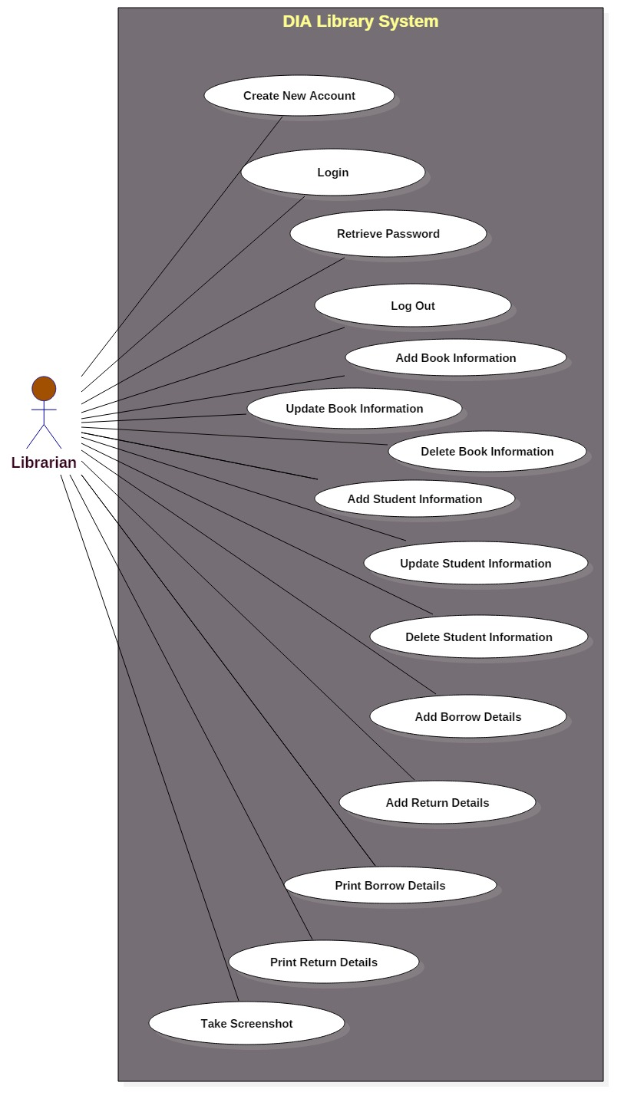
Use case diagram for user
Notes:
Figure above showing Use case diagram of the system

Slide 10
Explanation of the use case diagram of the system:
In this use case diagram the actor is only librarian. A librarian means the man who actually administrates the library. Only librarian will use this application. So, I have mentioned one actor as librarian. At first, user or librarian has to create his or her personal account for login to this system. Here, librarian can also add, delete, update books and student’s information and can also add borrow and return details and also can print or take screenshot of those details. I have mentioned these functionalities as use cases. The system name is “DIA library system”. So, I have also mentioned “DIA library system” as system boundary.

Slide 11
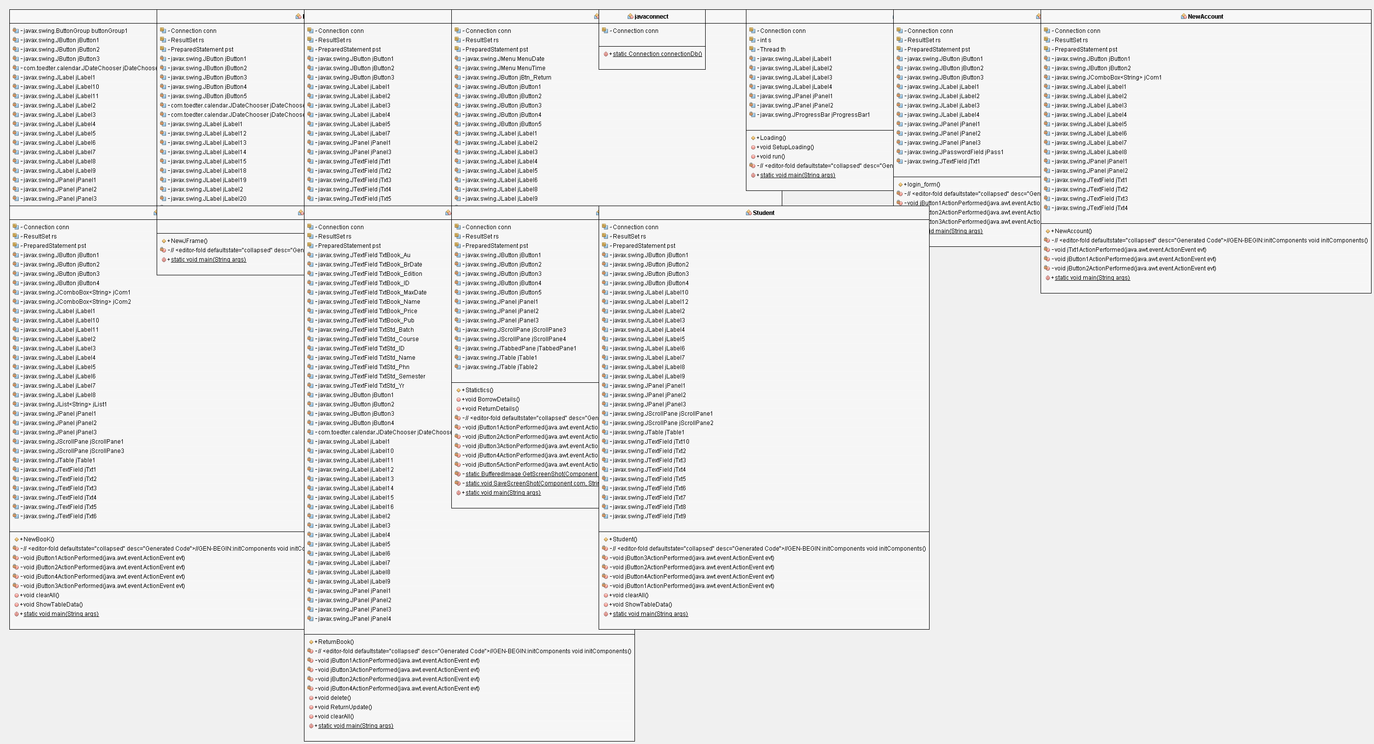
class diagram with dependency
Notes:
Figure above showing initial class diagram of this project

Slide 12
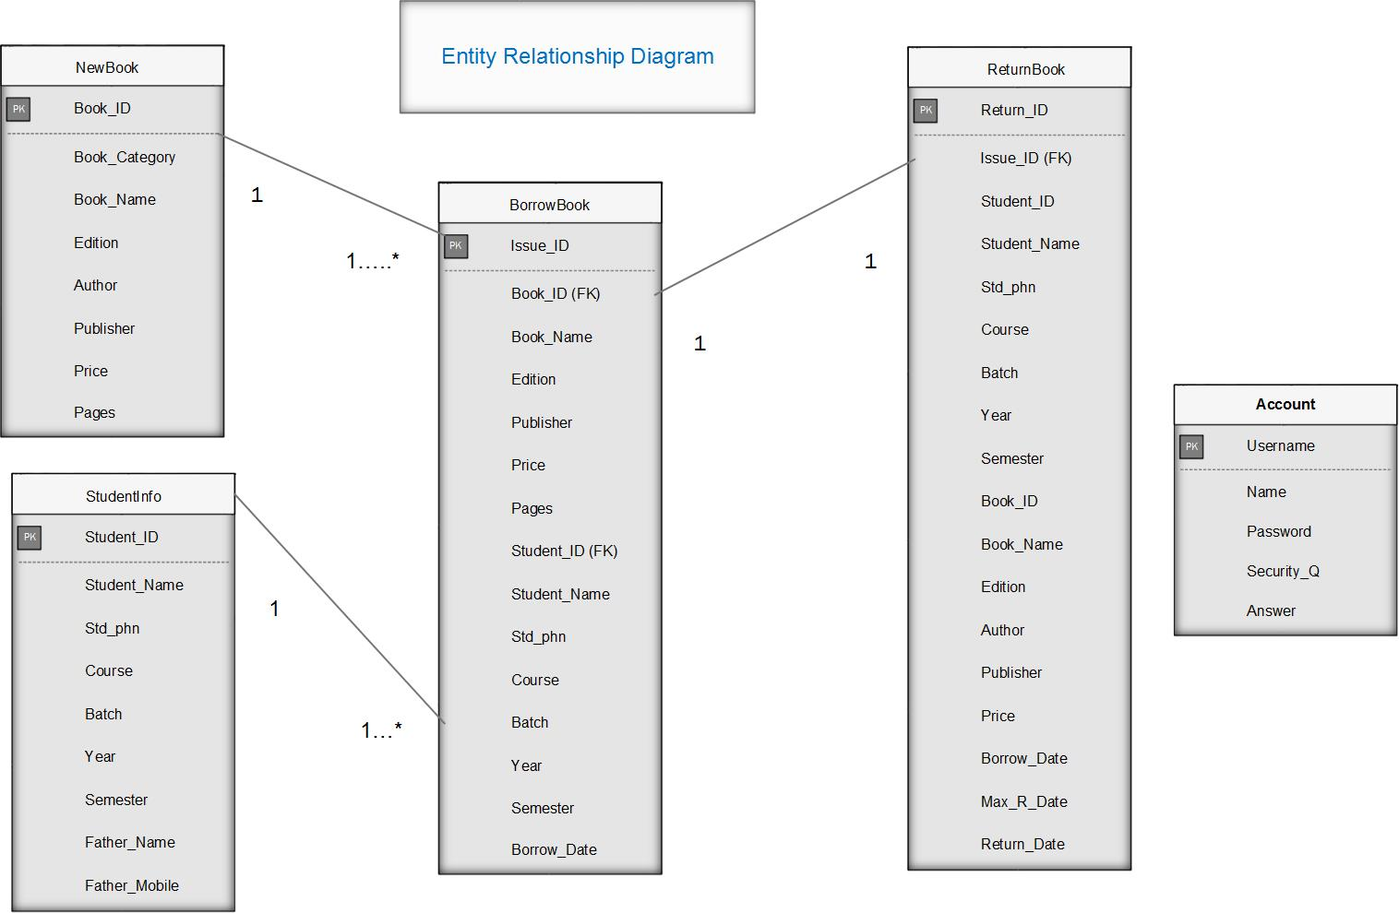
Entity Relationship Diagram(ERD)
Notes:
Figure above showing ERD diagram of this system

Slide 13
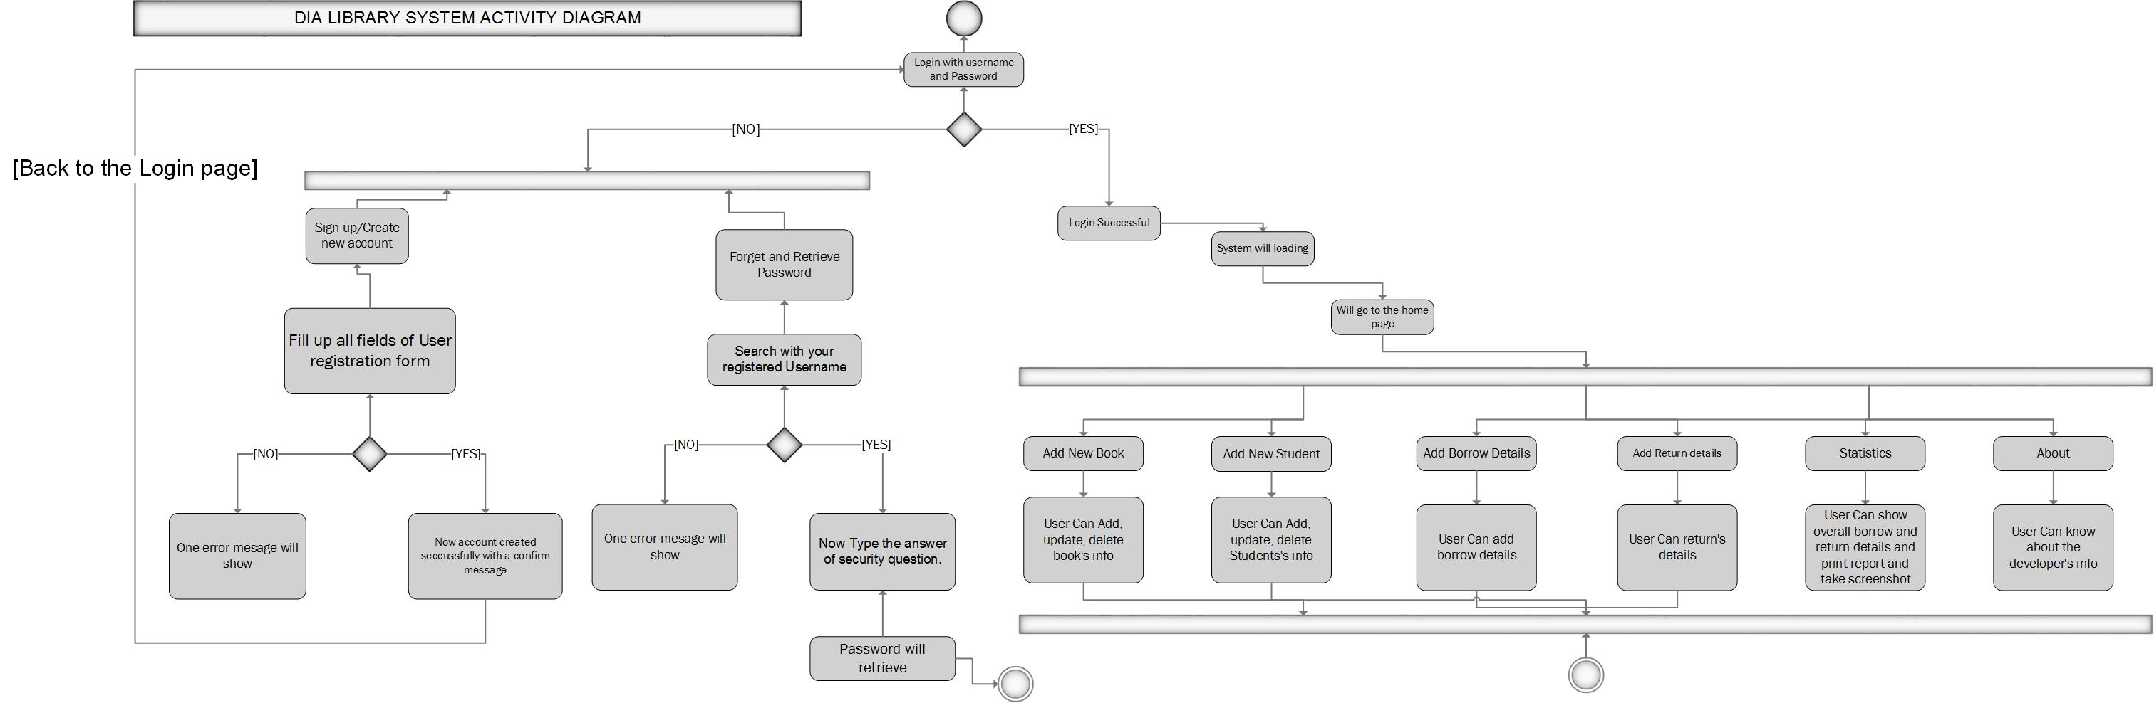
Activity Diagram of overall system

Slide 14
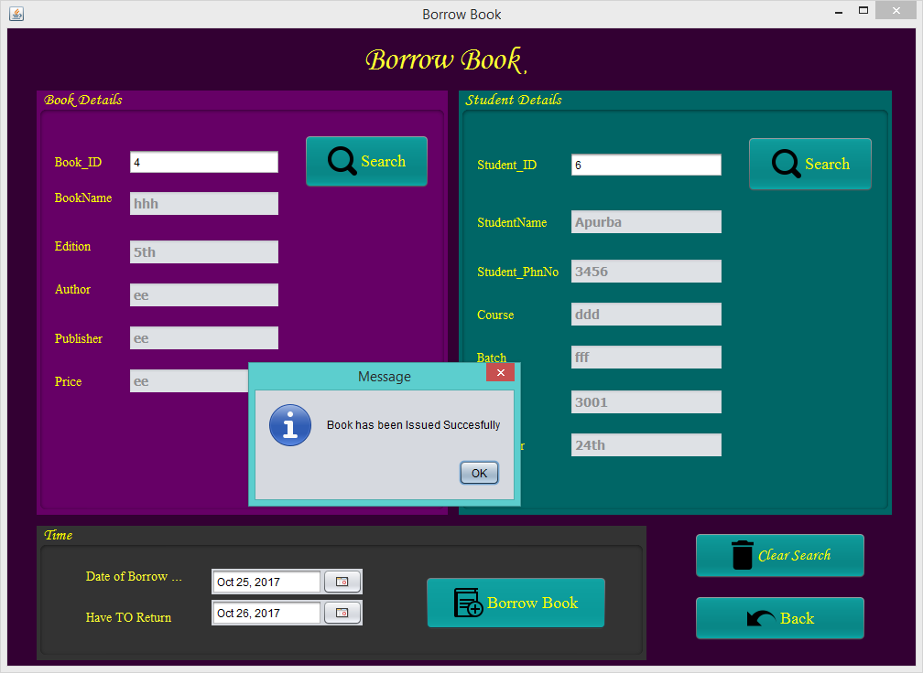
Unit Testing of “Borrow Book” functions.
Unit Testing-8
Test class- User | Designed by: Apurba Debnath
Data source: User Entry | Objectives: Unit-8 (The main functionalities) |  | Tested by: Apurba debnath
Test case | Description | Task | Expected result | Actual Result
1. | “Borrow Book” portion testing. | If user want to add borrow information then Required to search with valid book id or will get error. Required to select 2 dates. | If user do this task perfectly then user can add borrow book for a specific student id otherwise system will give error message. | User can add borrow information for a valid student and book id successfully.

Slide 15
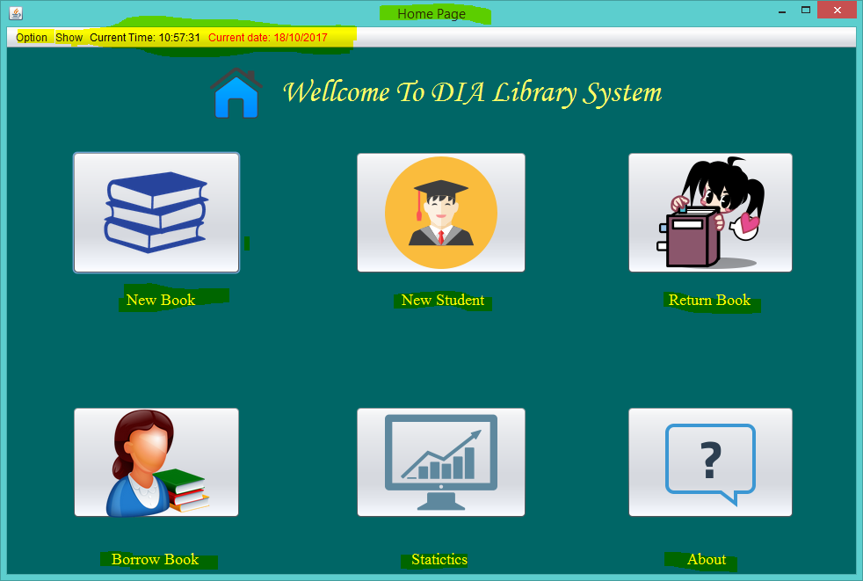

Integration Testing of “Home Page”
Integration Testing-5
Test class- User | Designed by: Apurba Debnath
Data source: User Entry | Objectives: Module-2 (The main functionalities) |  | Tested by: Apurba debnath
Test case | Description | Task | Expected result | Actual Result
1. | Home Page testing | After showing progress bar, user will show a home page. Here, user will get many buttons and will show a menu bar and current date and time. | If user comes to the home page then user will show many button for essential works as his requirements and also show current date and time and an option menu bar. Everything will work correctly. | Everything of the home page is working perfectly as the user requirements.
After clicking this button user will able to add, delete and update the book’s information.

Slide 16
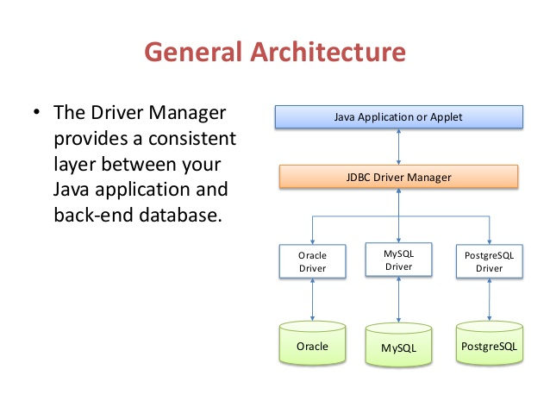
Technical architecture of the system

Slide 17
Explanation of the technical architecture: Here, I have used java as programming language and sqllite as database. I have also used JDBC driver manager for connection build up between them. How it actually work shown in the above image. The java application mainly connected with database with the help of JDBC driver manager. The JDBC driver manager builds a route between the java application and back-end database. .

Slide 18
Strength and weakness of this project
Strength
Efficient computerized system that reduces the human mistakes.
Easy to use
User friendly GUI.
Highly secured.
More efficient for managing a library.
More efficient for librarian or library manager.
No internet connection required to manage and run it.
Reduces time and effort.
Easy to manage.
Weakness
Platform specific as it is a desktop based application only.
Can be added some additional features.
Only requirement specific.
Can be added extra security features.

Slide 19
Future work
Can be added a late fine functions for late return.
Can be added a super admin for giving the permission to access and manage this application.
Can be made this application more users friendly.
Can be added a student section for their use.
Can be made this application more dynamic.

Slide 20
End

