Slide 1
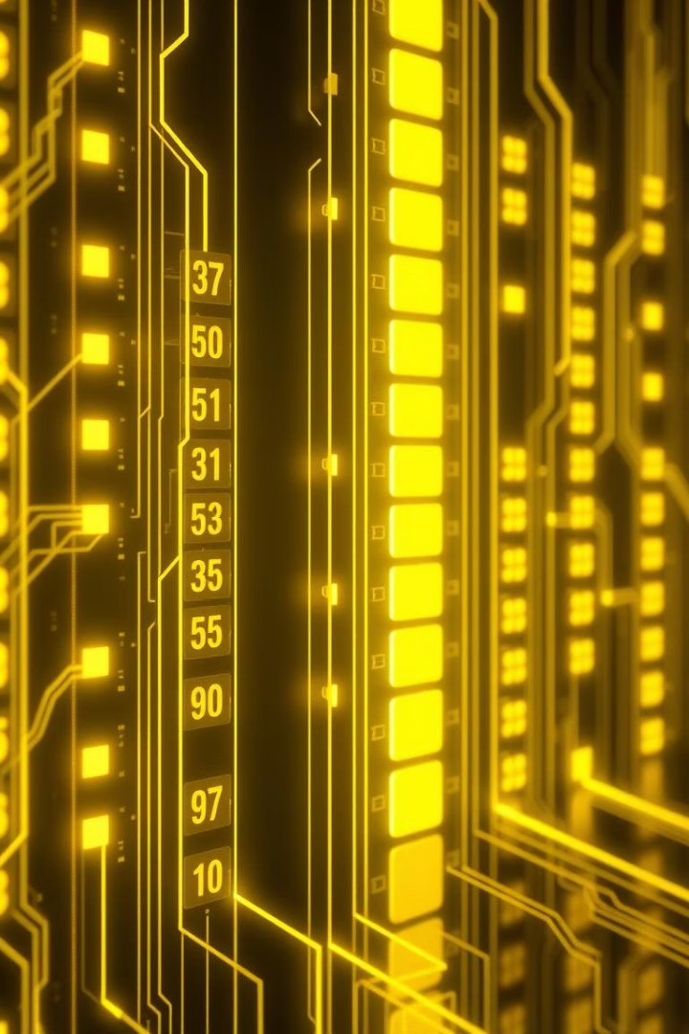
Segmentation and Paging: Memory Management Techniques
This presentation explains segmentation and paging, two key memory management methods. They ensure efficient, secure use of memory in today's operating systems.

Slide 2

Segmentation: Dividing Memory into Logical Units
Definition
Segments
Segment Table
Memory is divided into variable-sized logical segments.
Examples: code, data, and stack represent logical units.
Maps segment names to physical addresses in memory.

Slide 3

Segmentation: Address Translation
Example
Physical Address Calculation
Segment 2, Base 2000, Limit 500; Logical (2,300) → Physical 2300.
Segment Table Entry
Logical Address
Stores segment base address and segment size limit.
Physical address = base address + offset if offset is valid.
Consists of segment number and offset within that segment.

Slide 4
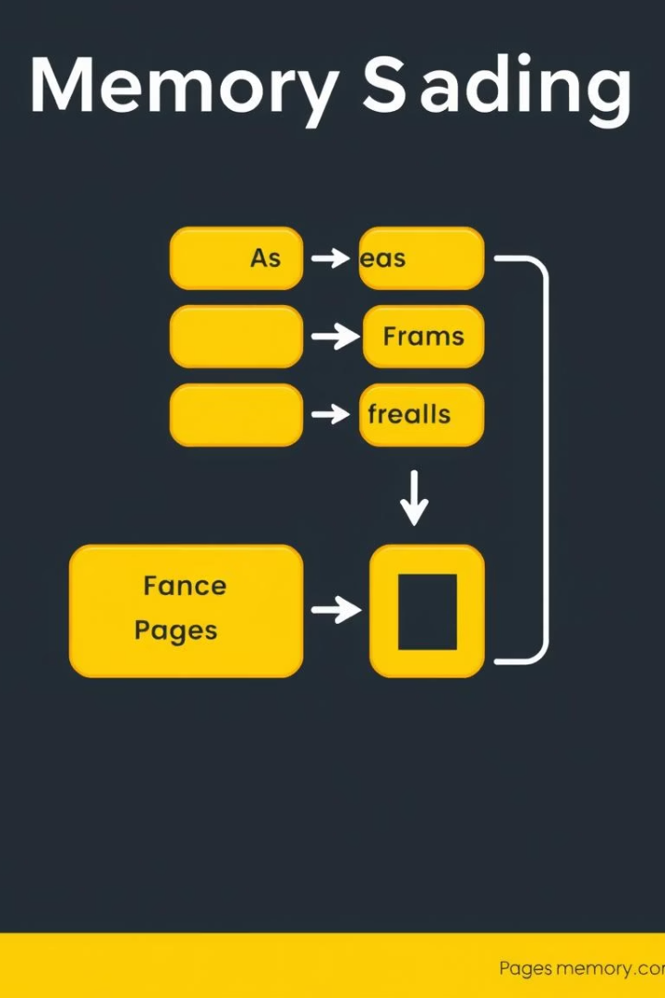
Paging: Dividing Memory into Fixed-Size Pages
Definition
Page Table
Memory split into fixed-size pages and frames.
Maps logical pages to physical frames.
Internal Fragmentation
Unused space inside pages due to fixed size.

Slide 5
Paging: Address Translation
Logical Address
Page Table Entry
Physical Address
Combination of page number and offset.
Contains frame number and validity bit.
Computed as frame number × page size + offset.
Example size: 4KB pages.
Example: page 3 maps to frame 6.
Example: (3, 100) → (6 × 4096 + 100) = physical address.

Slide 6


Segmentation vs. Paging: Advantages and Disadvantages
Segmentation
Paging
Logical organization
No external fragmentation
Supports protection
Simple management
External fragmentation
Internal fragmentation
Complex management
Page table overhead

Slide 7
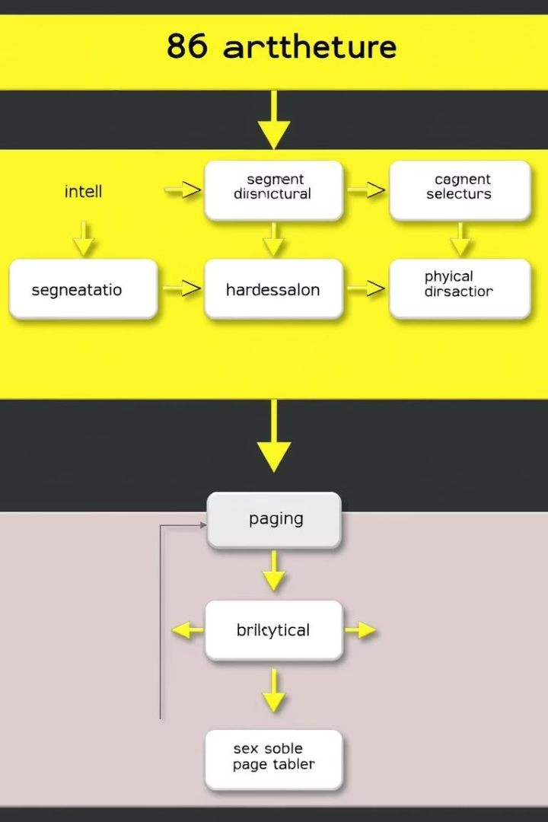
Segmentation and Paging: Combined Approach
The Intel x86 architecture uses segmentation for logical division and paging for physical memory efficiency. Combining both allows flexible, secure, and efficient memory management.

Slide 8
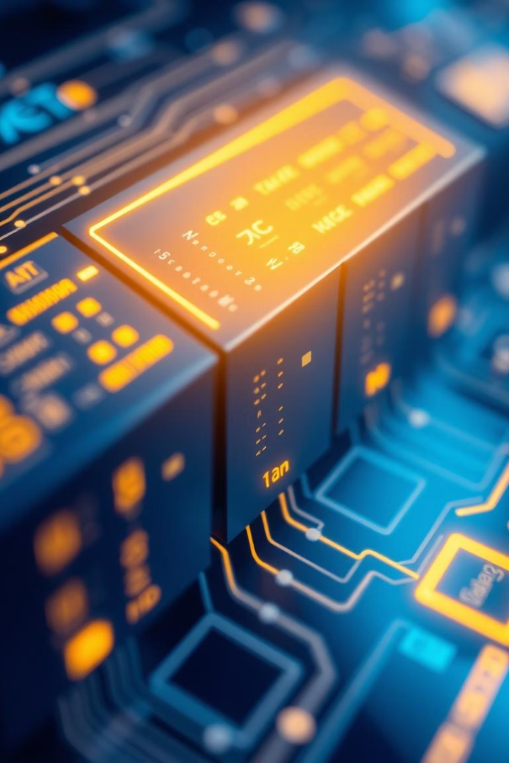
Conclusion: Choosing the Right Technique
Segmentation
Best for logical memory organization.
Paging
Optimizes physical memory use.
Hybrid Approach
Balances the strengths of both techniques.
Future Trends
Advances in memory management focus on efficiency and security enhancements.

