Slide 1

LevelUp An e-learning platform
By-
Apurv Henakare
Chaitanya Kardile
Muskan Jain

Slide 2
Technology Stack
Spring boot
Spring Data JPA
MySQL Database
Eclipse IDE
Postman Client
React JS 18+
CSS
JavaScript
NPM
Visual Studio Code IDE
Axios

Slide 3
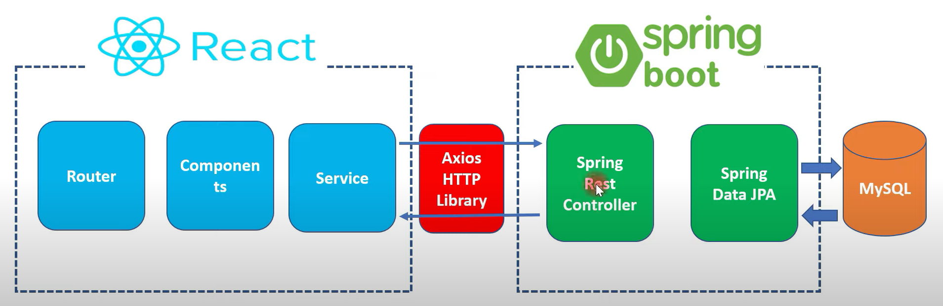
Architecture

Slide 4
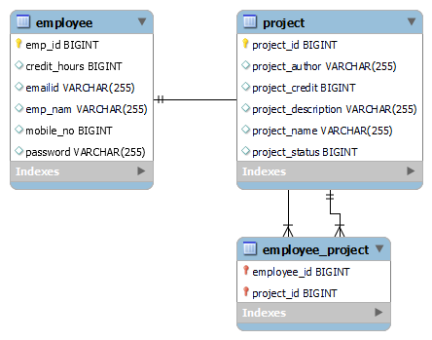
ER Diagram

Slide 5
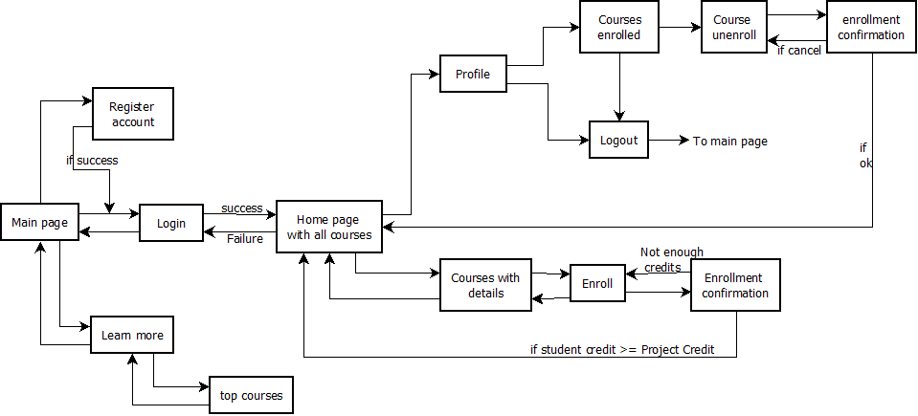
Work flow-Employee

Slide 6
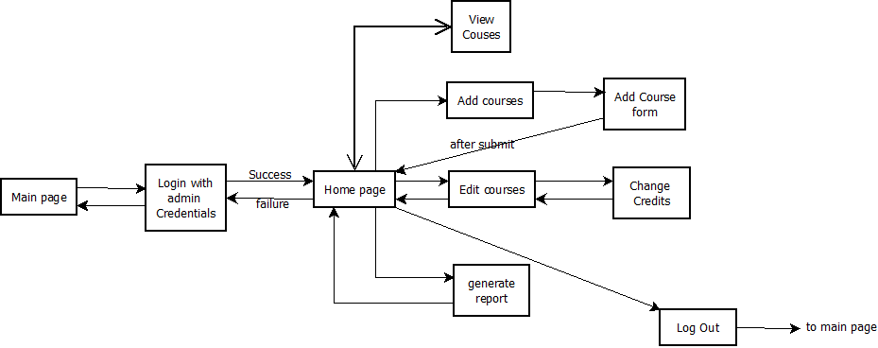
Work flow-Admin

